Slide 1
DAG Diagnosis & the u-score Do-Operator
Why the DAG collapsed to its initialization, why the threshold-mutilation
pipeline is biased, and a principled replacement.
CausalBioRL | Phase-1 deep-dive | Goodarzi Lab, Arc Institute

Slide 2
Phase-1 Diagnostic — checkpoints/phase1_best_no_dag.pt
DAG structure
Mutilation (threshold scheme, 137 test perts, N=8 DAGs)
• mean edge prob: 0.0071
• median edge prob: 0.0064
• max edge prob: 0.0465
• θ mean / std: −5.056 / 0.491
• edges (p > 0.1): 0 / 4032
• edges (p > 0.3, 0.5, 0.7): 0
• mean n_affected: 48.6 ± 2.3 (max d = 64)
• median n_affected: 49
• frac > 10 affected: 100%
• frac > 30 affected: 100%
• frac ≤ 5 affected: 0%
• mean max |dε|: 0.292
• dε L1/L2 : 6.25 (1=sparse, √64=8=dense)
• dz L1/L2 : 6.17
Orthogonality (decoder D)
• off-diag mean(|·|): 0.0006
• off-diag max(|·|): 0.0036
• col-norm CV: 0.0007 (highly uniform)
Verdict (printed by dag_diagnostics.py):
⚠ Most programs mutilated per pert (49/64) — dε is dense, not sparse
✓ D is nearly orthogonal (off-diag mean = 0.001)

Slide 3
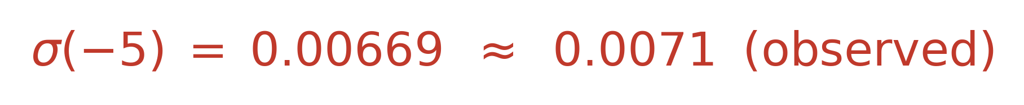
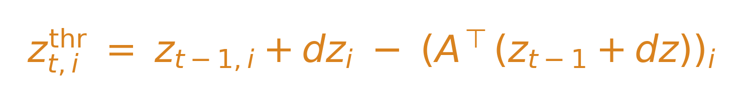
Two Distinct Problems Behind That Output
Problem A — the DAG never left initialization
Problem B — threshold scheme is dense by construction
• θ ~ N(−5.0, 0.5²) → edge prob ≈ σ(−5) ≈ 0.0067
• Observed mean: 0.0071 → literally still the init.
• λ_sparse = 1.0 actively pulls θ down.
• λ_prior = 0.1, margin = 0.1 → margin-ranking too weak.
• no_dag checkpoint sets ρ_dagma = 0 → no force pushing up.
• Pipeline: dz = D⁺·dx, dε = (I − A^T) dz, mutilate where |dε|>τ·max.
• When A ≈ 0 (Problem A!), dε ≈ dz.
• dz = D⁺ dx for a single gene is dense — orthogonality controls D columns, not rows.
• So threshold catches half the latent dim regardless of biology.
• Fix #1: u-score (slides 5–8). Fix #2: add L1 on D entries (gene-level sparsity).
Smoking gun:
Math says:
Fix: grid-search (λ_sparse, λ_prior, margin) on a 5k-cell Replogle subset.
Residual only vanishes when A→0. Fix: u-score do-operator (slides 5–8).
These problems compound: Problem A hides Problem B at training time, and Problem B prevents the gradient signal that would fix Problem A.

Slide 4
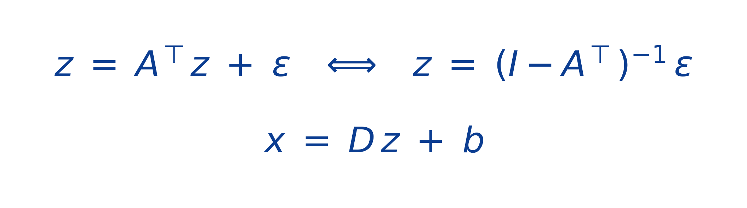
Setup — the Linear Latent SCM and the Decoder
Causal VAE generative model
What we want to intervene on
• A gene-level action delivers dx ∈ R^G (supported on one row in the gene axis).
• World model must lift dx → a latent intervention on z under the SCM.
• Two candidate liftings: (i) argmax|D[g,:]| (ii) D⁺ + threshold mutilation.
• (i) ignores the long tail; (ii) is biased when A is small (Theorem 3, slide 7).
Notation we will keep using

Slide 5
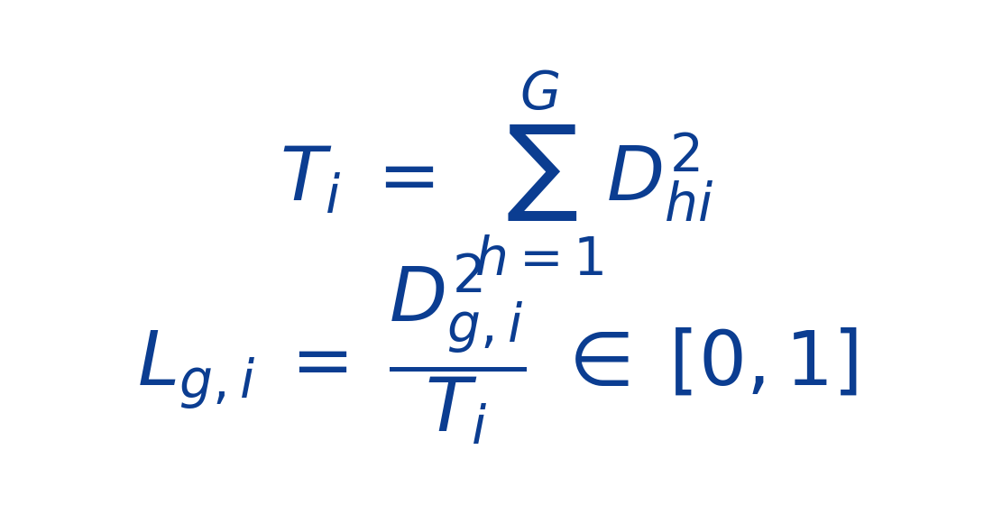
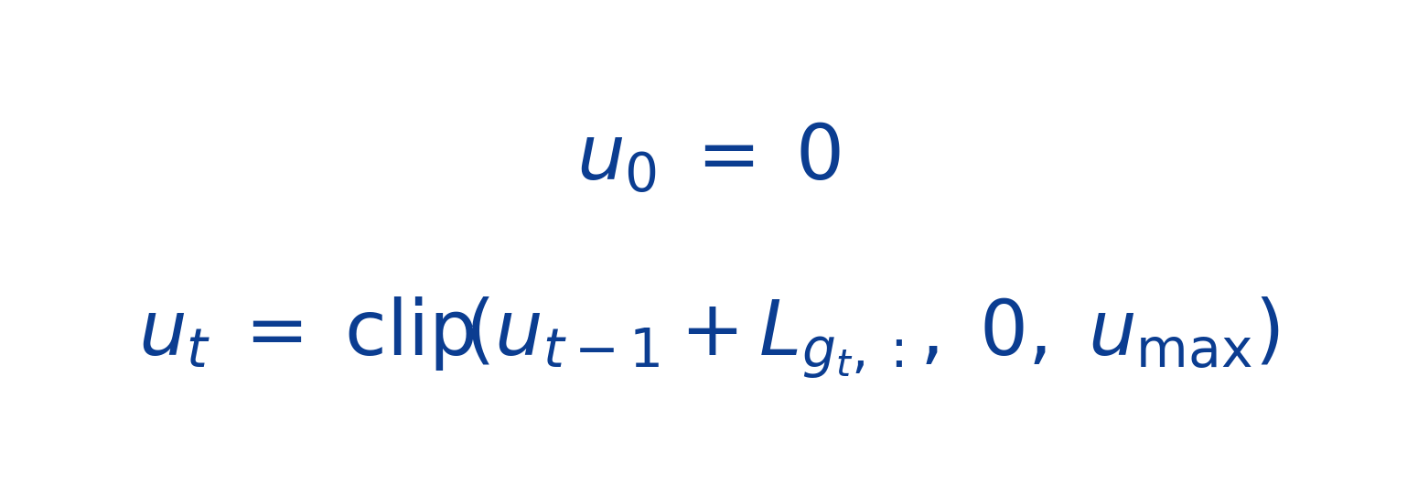
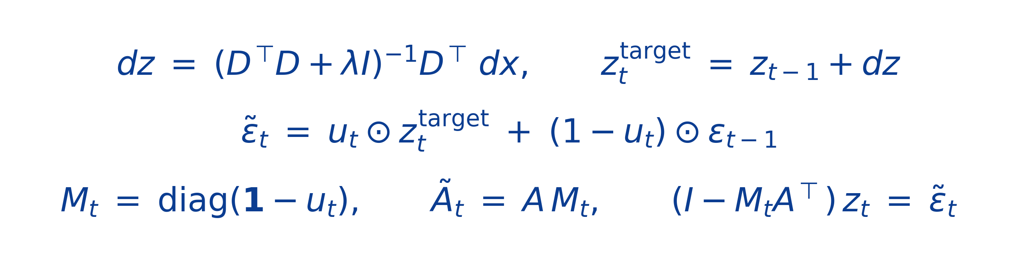
The u-score Do-Operator — Definition
Decoder loadings L
Strength vector u (per episode)
• L_{g,i} = fraction of program-i decoder energy from gene g.
• Σ_g L_{g,i} = 1 (each column of L is a distribution over genes).
• L ≥ 0, computed once per training epoch (cheap).
• u_t monotone non-decreasing → persistence is automatic.
• Sparse for single-gene actions (only programs g loads on get mass).
• No threshold to tune.
Transition step (knockout / overexpress action)

Slide 6
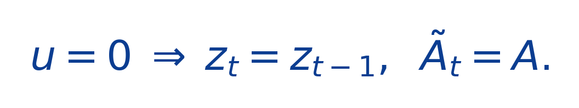
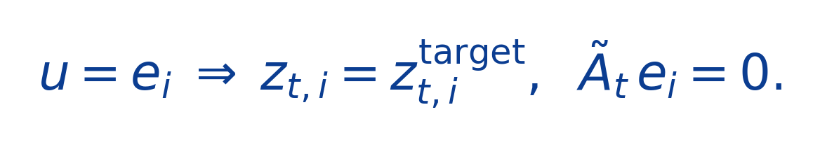
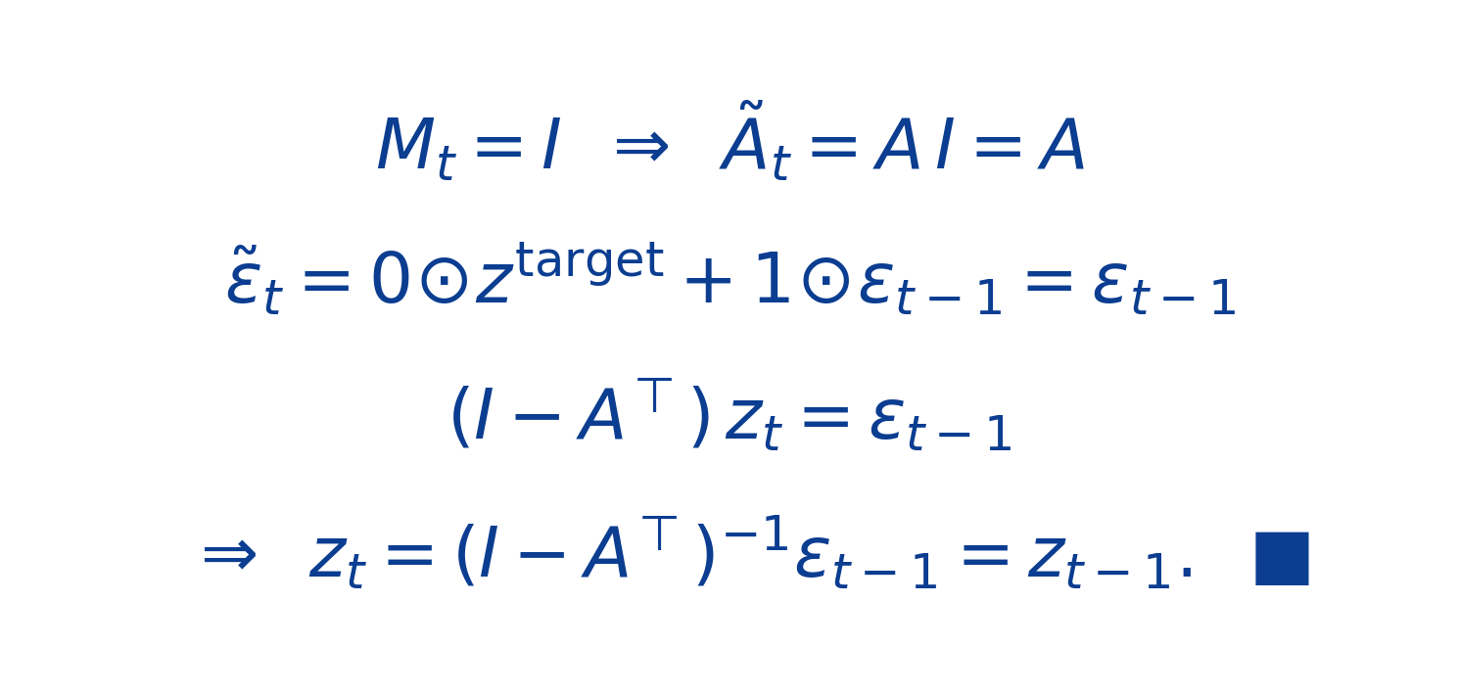
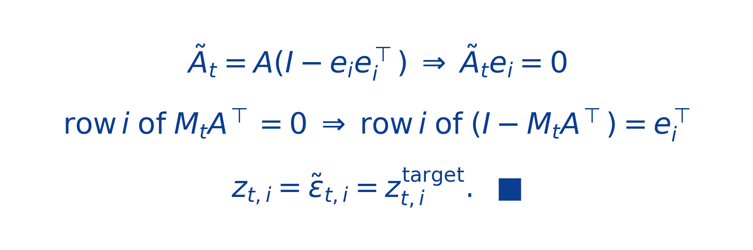
Endpoint Lemmas — u = 0 is identity, u = e_i is classical do
Lemma 1 (u = 0 ⇒ identity)
Lemma 2 (u_i = 1 ⇒ classical do)
Claim:
Claim:
Proof:
Proof:
Verified to numerical zero in test_u_zero_identity.
Verified to numerical zero in test_u_one_pins_target.

Slide 7
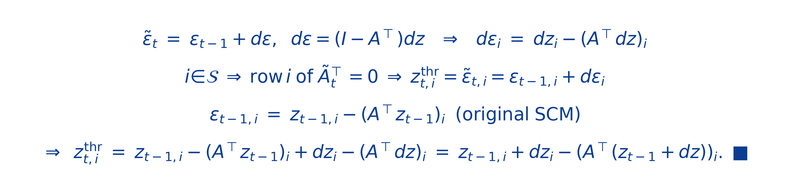
Theorem 3 — the Threshold Scheme is Biased Away from do
Claim
Proof
Interpretation:
dε was calibrated to the un-mutilated graph, then A was mutilated → the parental term is double-counted.
The bias vanishes only when A ≈ 0 — exactly the regime that hid the bug throughout training.

Slide 8
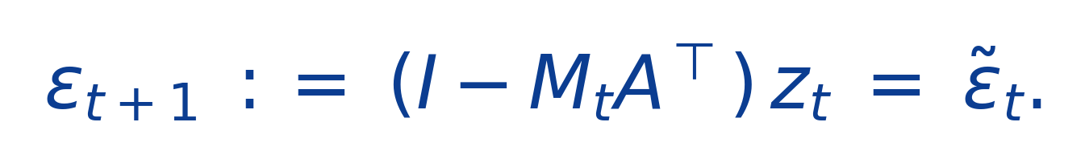
Persistence — ε Recovery in the Mutilated Regime
Lemma 4 (ε recovery inverts the do)
• Direct from the SCM equation at step t in the mutilated regime.
• Verified to numerical zero in test_recover_epsilon_u_inverts.
Why use the mutilated graph for recovery?
• The intervention persists into step t+1 (CRISPR knockout is not transient).
• A^T would mis-attribute the new value of program i to its old parents — the parents have been detached.
• Knockout clamp: x[g] = 0 for every g in knockout_set before computing the next dx.
env.reset() clears the persistence state:
current_u ← 0 · knockout_set ← ∅ · step_count ← 0
(see CausalWorldModelEnv.reset, rl/env.py)

Slide 9
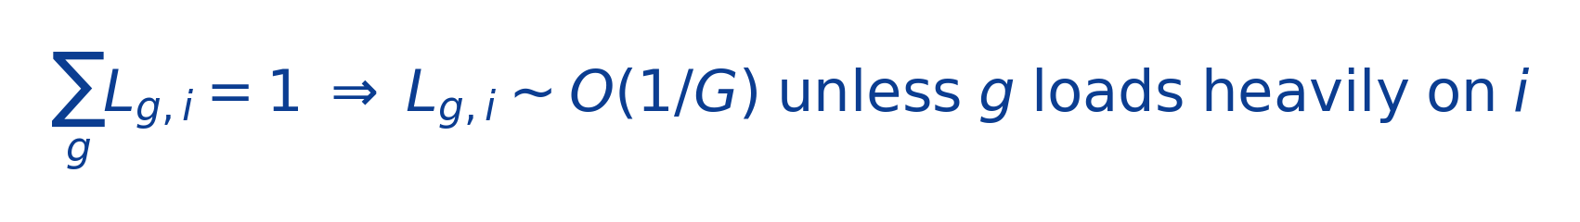
Why This Fixes the Diagnostic + Code Layout
u is sparse by construction
Code: both schemes coexist behind a flag
configs/*.yaml
intervention:
scheme: u_score # or "threshold"
u_clip_max: 1.0
u_accumulate: true
knockout_clamp: true
phase1:
lambda_D_sparse: 0.001 # L1 on entries of D
• Single-gene action u = L[g,:] is sparse with no threshold.
• Two-gene combo u = L[g₁,:] + L[g₂,:] may saturate when both load on the same program.
• L inherits sparsity of D — adding L1 on D makes u even sharper.
• Diagnostic prints ‖u‖₀ at thresholds {0, 0.1, 0.5} + L1/L2 + programs_per_gene.
• rl/env.py — episode persistence (current_u, knockout_set).
• evaluation/eval_combinatorial.py — sequential combo with u carry.
• evaluation/run_perturbation_eval.py — single-pert eval.
• lambda_D_sparse = 0.001 — new L1 on D entries (gene-level sparsity).
Validation — tests/test_u_intervention.py:
7 / 7 invariants pass to numerical zero on a controlled toy model:
u=0 identity · u_i=1 pins target · monotonicity · Σ_g L_{g,i}=1 · ε recovery inverts · knockout-clamp idempotent · legacy threshold path unchanged

Slide 10
Running the Grid Search + u-score Training
1. Diagnose first — grid sweep on a 5 k-cell Replogle K562 subset
# from the repo root (CausalBioRL/)
sbatch scripts/train_phase1_grid.sbatch
• 4 × 2 = 8 runs, 40 epochs each, ~30 min/run → total ≈ 4 h.
• Outputs: results/grid_search/<run_id>/{checkpoint, edge_prob_histogram.png, summary.json}.
• Aggregate row per run in results/grid_search/summary.csv.
2. Promote winner + run full Phase-1 with the u-score scheme
# pick winning row, edit configs/replogle_u_score.yaml lambda_sparse / lambda_prior / prior_margin
sbatch scripts/train_phase1_replogle_u_score.sbatch
# verify the DAG escaped init and u is sparse
python evaluation/dag_diagnostics.py --checkpoint checkpoints/phase1_best.pt --output_dir results/dag_diagnostics_u
3. Unit tests (quick sanity)
pip install pytest && pytest tests/test_u_intervention.py -v

Slide 11
Quick Reference
Files added / modified
models/dag.py + scm_intervene_u
models/causal_vae.py + compute_loadings, intervene_gene_u, recover_epsilon_u
rl/env.py dispatch + current_u + knockout_set
training/train_vae.py compute_loadings each epoch; prior_margin plumb
training/train_joint.py plumb intervention config into env
evaluation/dag_diagnostics.py + analyze_u_sparsity (importable)
evaluation/eval_combinatorial.py scheme dispatch (threshold | u_score)
evaluation/run_perturbation_eval.py scheme dispatch
configs/{default,replogle,combined}.yaml + intervention: block
configs/replogle_u_score.yaml NEW — u-score full Phase-1 config
scripts/run_phase1_grid.py NEW — grid sweep driver
scripts/train_phase1_grid.sbatch NEW — Slurm wrapper for grid sweep
scripts/train_phase1_replogle_u_score.sbatch NEW — Slurm wrapper for u-score training
tests/test_u_intervention.py NEW — 7 invariant unit tests
docs/architecture_u_score.md NEW — full math write-up
Doc with full proofs
docs/architecture_u_score.md — Lemmas 1, 2, 4 + Theorem 3 + Proposition 5 with full derivations.

