Slide 1
2024 PHYSICAL DESIGN FINAL PROJECT PROPOSAL “ CHIP LEVEL GLOBAL ROUTER “
Group11
R12943097 孫定洋 R12943117 隋中彧
R12943094 劉建亨 R12921090 温千懿
Notes:
大家好，我們是第11組，那我們這組做的主題是Chip Level Global Router

Slide 2
OUTLINE
Introduction
Our program flow
Proposed method
Results
Notes:
那這邊是我們的outline，一開始我們會簡單介紹這次Project在做什麼，接著我們介紹我們的Program流程，再來講解一下我們是怎麼實踐的，最後會Demo我們的實驗數據。

Slide 3
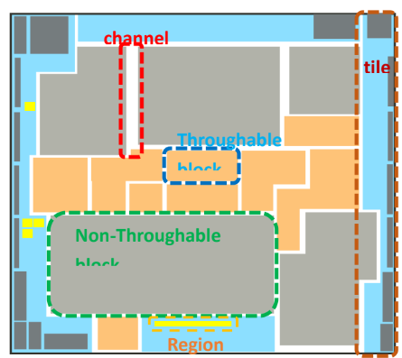
INTRODUCTION
Our main goal is to optimize these elements and output our routing layout.
In this problem, there are four elements that should be considered :
1) Channel overflow
2) Wirelength
3) Edge pin density
4) Net turn cost
Notes:
那這次Project我們做的是ICCAD的第四題， 這個Project題目簡單來說就是，在chip level 上做最佳化的繞線處理，那chip由5種元件構成，在題目規定的4個成本考量之下，有
overflow
wL
Edge pin density
4. Net turn cost

Slide 4
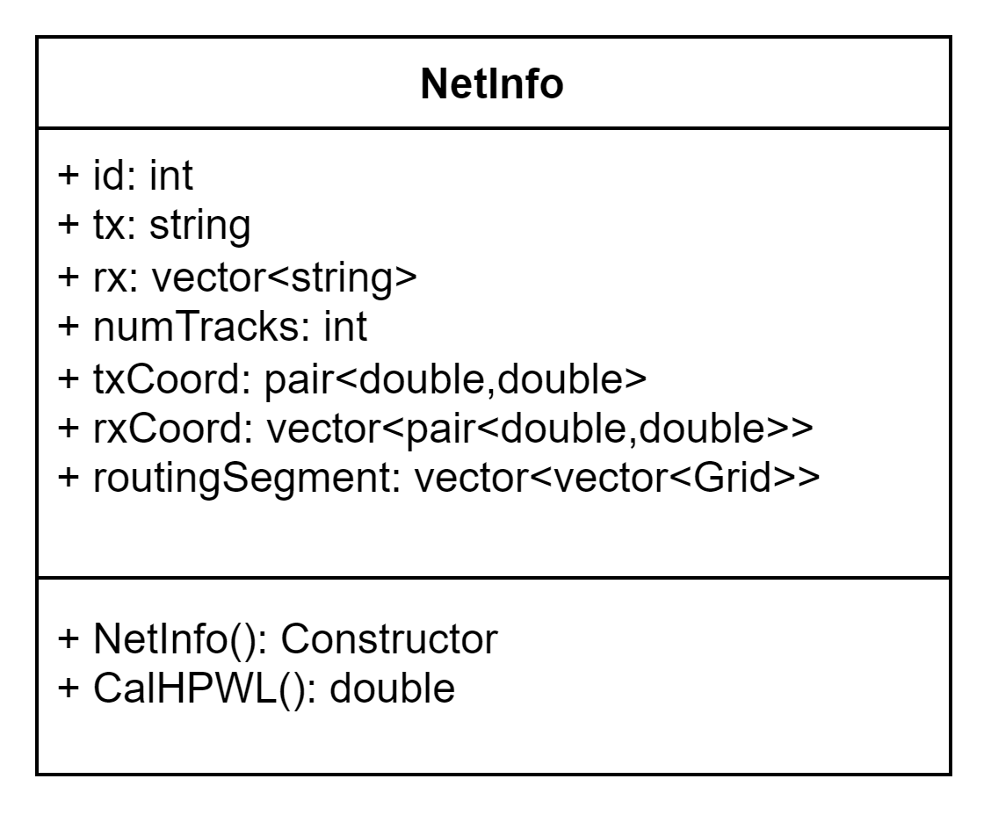
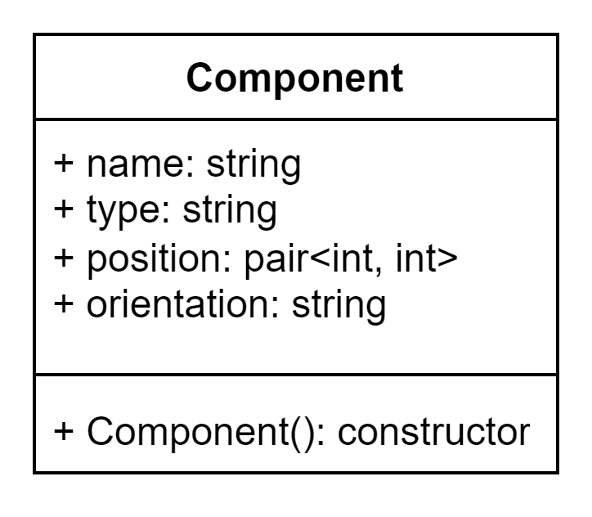
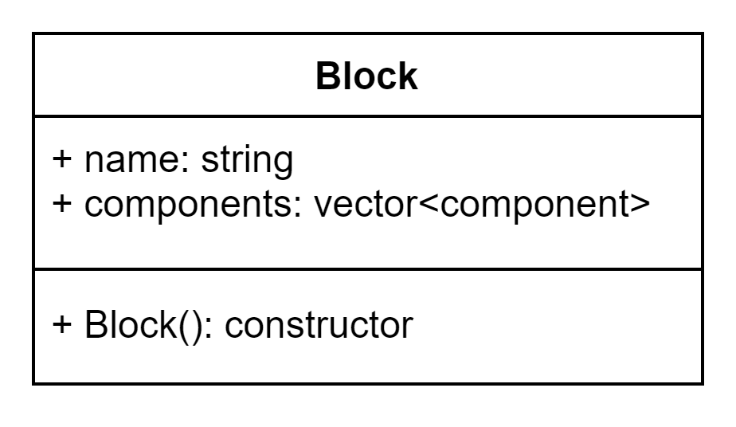
DATA STRUCTURE
Notes:
以上是我們使用的資料結構

Slide 5
OUR PROGRAM FLOW
Global Routing
Minimum Spanning Tree/Dijkstra
Detail Routing
A*-search
Result
Visualization of case
Notes:
那這邊是我們的Program Flow，一開始我們會用Minimum Spanning Tree和Dijkstra去實作global routing，接著使用A star tree實踐detail routing，接著視覺化呈現結果

Slide 6
GLOBAL ROUTING
MST
Simply do MST on each net
“vertice” for MST : all the TX, RX of the net
“edge” for MST : E = V X V
“edge weight” for MST : simply use the Manhattan distance between the TX, RX coordinate of block given by problem
Problem : how to consider wire density ? how to avoid huge obstacle ? Also, the vertice is still to far for A* search

Slide 7
GLOBAL ROUTING
Modified Dijkstra :
from a TX node, do Dijkstra till a shortest path to some RX node.
view the path as a supernode, relax the nodes that connect to this supernode.
While relaxation, if we found a node that is already popped out of heap but not in a path of TX, RX node. We still relax it and push it back to heap if it’s key value decrease.
from supernode, repeat previous steps till all RX is connected

Slide 8
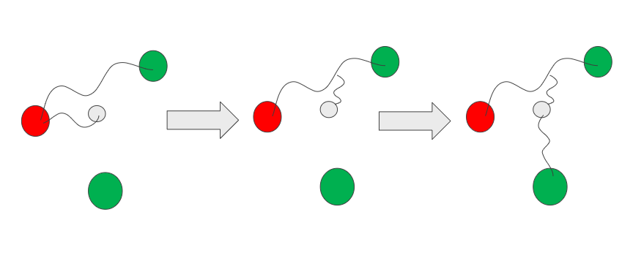
GLOBAL ROUTING

Slide 9
GLOBAL ROUTING
Modified Dijkstra (following part is still on the road):
“node” : blocks + region + cut channels
thus, all the grid available belongs to some node
“edge” : (u, v) exists if u is beside v on grid map.
“edge weight” : function of the
wire density and capacity of u and v
“distance” between u and v

Slide 10
DETAIL ROUTING
Apply A*-search way to route the block.
Utilize the Manhattan Distance to calculate the cost.
The following is an example :
Original A*-search
Block C
 |  | 6 | 6 | 6 | 6 | 6
 | 7 |  | 6 | 6 | 6 | 6 | 6
 | 7 | 7 | 9
 | 7 | 7 | 9
 | 7 | 7 | 9
 | 7 | 7 | 9
 | 7 | 7 | 9
Block B
Target : Do A*-search detail routing to connect block A, block B and block C.
Block A
Notes:
經過global routing的處理後，會產生grid圖，我們使用A star search來做繞線，並利用曼哈頓距離來算出最短路徑，這邊舉簡單的小例子說明我們核心的演算法，首先經過global繞線處理後，我們知道block A會需要先經過block b，再到block c，所以綠線為計算後的最佳路徑

Slide 11
DETAIL ROUTING
A*-search considering overflow and non-throughable grids
Considering Overflow and Non-throughable grids in the grid graph.
If the cost of two routes are the same, we choose the one with smaller net turns.
The following is an example :
 | 8 | 8
 | 8 | 8 | 8
 | 8 |  | 8
 | 8 | 8 | 8
 | 8 | 8
 | 8 | 8
Route A
Net turn: 2
Net turn of Route A is smaller than Route B
Thus, Route A is better than Route B
Route B
Net turn: 3
Overflow or Non-throughable grid
Notes:
接下來我們可能會遇到需要考慮Overflow and Non-throughable的區域，我們不會嘗試去繞的區域。以右圖為例，即灰色部分，演算法計算完後如果有兩條繞線路徑的成本相同，那我們就選擇轉彎數比較小的那條作為最佳路徑，我們會選A這條路徑

Slide 12
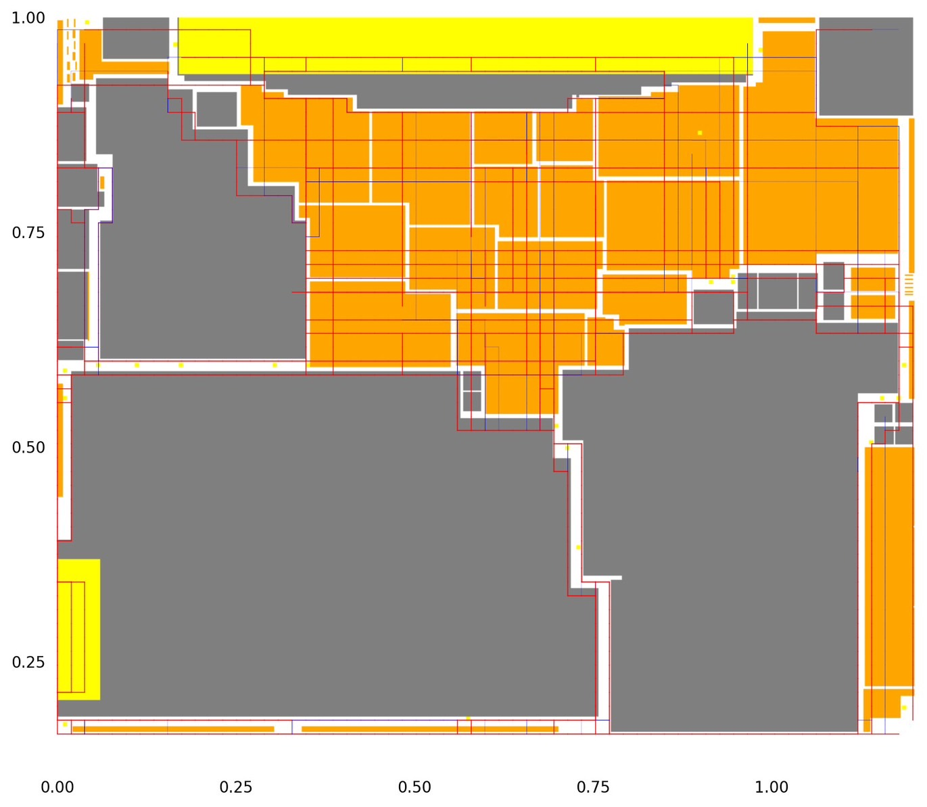
VISUALIZATION OF CASE
Case 1
the density exceeds a certain value , it will turn red.
Notes:
而這是我們Case4執行完routing的結果，相近的線我就疊在一起 越密線越粗 密度超過一定值變紅線

Slide 13
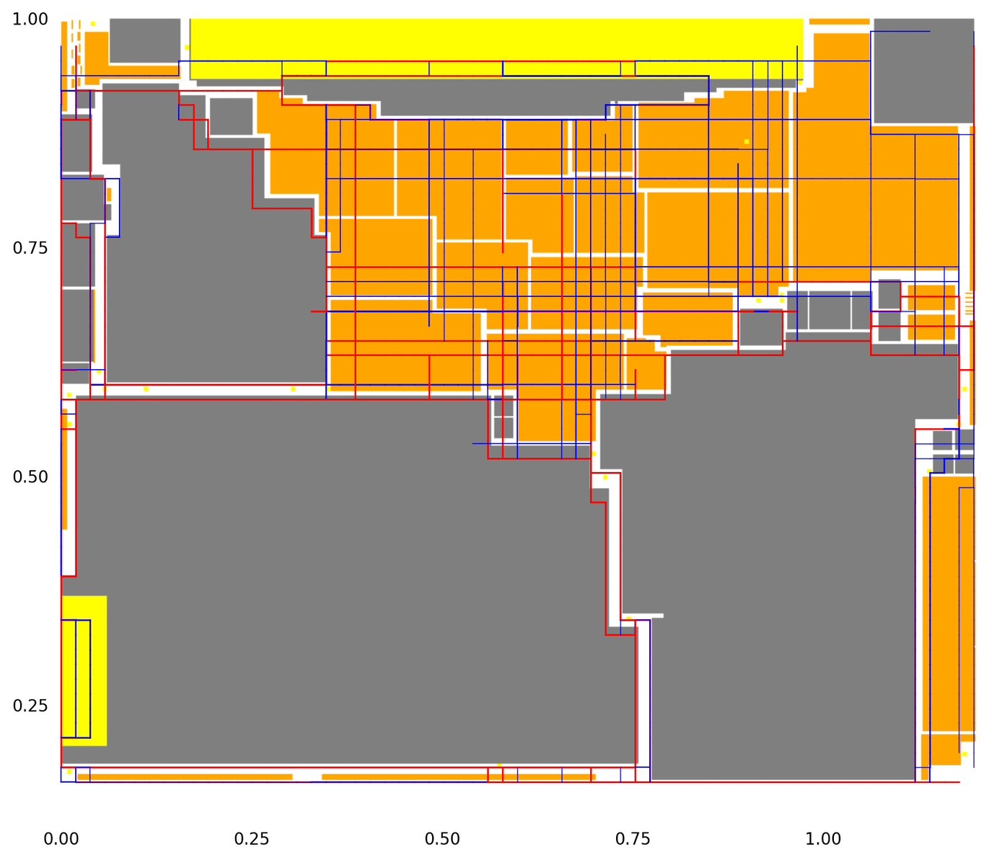
VISUALIZATION OF CASE
Case 2
Lines that are close together will overlap. The denser the line segments, the thicker they will be.
Notes:
而這是我們Case5執行完routing的結果

Slide 14
Thanks for Listening
Notes:
那以上是我們的報告，謝謝大家

