Slide 1


Project Title - Seasonal Agriculture Performance Analysis
Student Name: CHAITANYA ROHIT KAWLE
College Name- KJ SOMAIYA INSTITUTE OF TECHNOLOGY
AICTE STU ID : STU6a6b68883e2041785424008
9/3/2026
Annual Review
‹#›

Slide 2

PROBLEM STATEMENT
Seasonal & Regional Variation
Agricultural output varies significantly across seasons, regions, and crop types, making consistent planning difficult.
Productivity & Profitability Patterns
Hidden trends in resource use, irrigation, and environmental factors limit understanding of key productivity and profit drivers.
Crop-Level Performance Gaps
Lack of structured analysis leads to unidentified underperforming crops and missed opportunities for yield optimisation.
Evidence-Based Improvement
The goal is to provide data-driven insights that support better agricultural practices and informed decision-making.
9/3/2026
Annual Review
‹#›

Slide 3
Project Description
This project conducts an end-to-end data analytics study on 4,000 agricultural farm records across 28 distinct features to evaluate the impact of seasonal variations on farming performance.
Using a Python data science pipeline (Pandas, Matplotlib, Seaborn), the analysis processes environmental variables, soil chemistry , irrigation techniques, pest risks, and farm economics across the Kharif, Rabi, and Zaid seasons.
By performing structured data cleaning, missing value imputation, and multi-variable analysis, the project identifies seasonal yield bottlenecks, compares water productivity, and evaluates profit dynamics to provide actionable, evidence-based recommendations for strategic agricultural planning.
9/3/2026
Annual Review
‹#›

Slide 4

WHO ARE THE END USERS?
  Farmers & Planners
Farmers and agricultural planners seeking seasonal performance insights to optimize crop selection and resource use.
  Policy Makers
Policy makers aiming to enhance regional agricultural productivity through evidence-based decisions.
  Research Institutions
Academic and research institutions leveraging dataset insights for agricultural studies and innovation.
  Agribusiness Analysts
Agribusiness analysts studying economic trends, revenue distribution, and profitability across crops and states.
9/3/2026
Annual Review
‹#›

Slide 5
Technology Used
The project leverages industry-standard data science tools to process and analyze 4,000 farm records. Python serves as the core programming language, with Pandas enabling efficient data manipulation and preparation. Visualization libraries provide clear graphical representations of complex agricultural patterns. Code screenshots and exploratory analysis outputs are included as placeholders to demonstrate the analytical workflow applied throughout the project.
Python & Pandas:Data cleaning, missing value handling, outlier detection, and exploratory data analysis using Python and Pandas library.
Matplotlib & Seaborn:Interactive and publication-quality visualizations of seasonal trends, crop distributions, and regional performance using Matplotlib and Seaborn.
Statistical Analysis:Comparative and statistical analysis across seasons, crops, and regions to identify key performance drivers and economic patterns.
9/3/2026
Annual Review
‹#›
Notes:
5

Slide 6
RESULTS
Dataset Scale
Revenue & Profit
4,000 farm records across 8 states and 8 crop types, providing a comprehensive basis for seasonal performance analysis.
Total Revenue: ¤2,551,440,192.00
Total Profit: ¤446,225,860.00 across all farms and seasons.
Seasonal & Irrigation
Efficiency & Top Farm
Kharif season: 44.5% of farms. Flood irrigation used on 32.8% of all farms surveyed.
Avg. water efficiency: 5.39 t/1000 m³. Highest individual farm profit: ¤4,345,421.00.
9/3/2026
Annual Review
‹#›

Slide 7
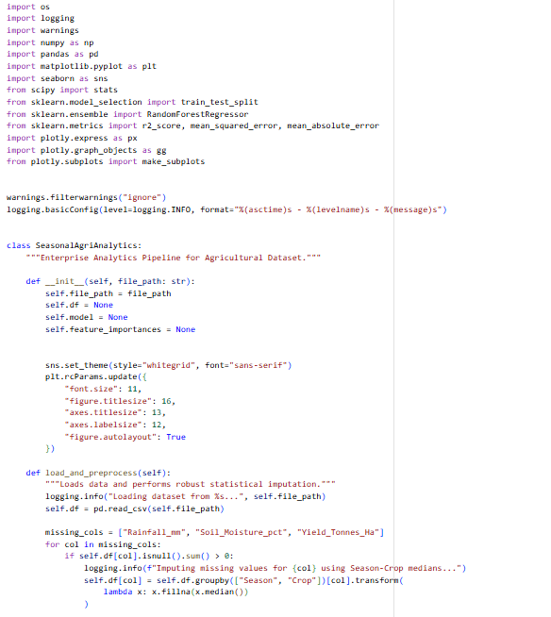
RESULTS
9/3/2026
Annual Review
‹#›

Slide 8
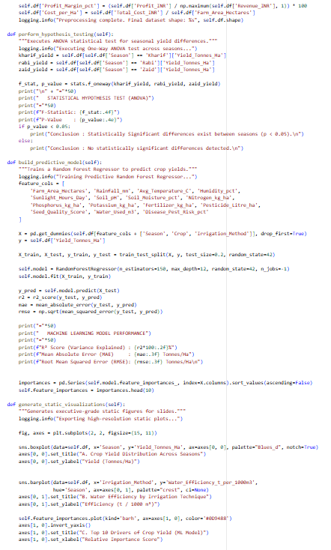
RESULTS
9/3/2026
Annual Review
‹#›

Slide 9
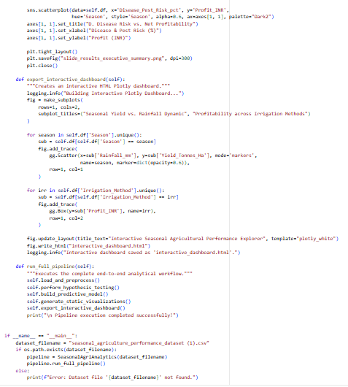
RESULTS
9/3/2026
Annual Review
‹#›

Slide 10
Future scope
  Predictive Machine Learning: Develop XGBoost and LightGBM regression models to forecast seasonal crop yields and profit margins prior to planting using weather forecasts.
  Real-Time IoT Integration: Connect live soil moisture and micro-climate IoT sensor feeds to enable dynamic, automated irrigation scheduling.
  GIS Spatial Dashboards: Build interactive district-level maps to provide localized crop advisories and precision farming recommendations for strategic agricultural planning.
9/3/2026
Annual Review
‹#›

Slide 11
GitHub Link
https://github.com/goodboyaz/Data-Analysis-project
9/3/2026
Annual Review
‹#›

Slide 12


Chaitanya Kawle
Data Visualization
September 9, 2026
VFLMS26_163777

Slide 13
Thank you
.
.
9/3/2026
Annual Review
‹#›

