Slide 1

Project: Loan eligibility prediction
By: Madhupreet singh
Radhakrishna nelapatla

Slide 2

Machine Learning in Finance: A Revolution Tech Evolution in Finance: Highlight the rapid integration of cutting-edge technology in financial sectors. Machine Learning: Focus on Machine Learning as a transformative force, enabling deeper data insights and smarter decision-making.
Project Overview: Enhancing Loan Decisions
Aim: Introduce the project's goal to predict loan eligibility using Machine Learning, showcasing a blend of technology and finance.
Impact: Emphasize the potential to modernize and streamline loan approval processes.
Scope and Relevance Today
Modern Financial Needs: Briefly note the shift towards automated, data-driven decision-making in finance.
Loan Processing Revolution: Highlight the project's potential in improving the efficiency, accuracy, and fairness of loan decisions.

Slide 3
Defining the Goal Primary Objective: Clearly state that the main goal is to develop a machine learning model capable of accurately predicting loan eligibility based on various applicant factors. Focus on Predictive Power: Emphasize the model's aim to harness historical data to predict future outcomes – specifically, the likelihood of loan repayment.
Why Loan Eligibility Prediction?
Predicting loan eligibility is a cornerstone of financial services, integral to balancing the scales of credit distribution and risk management. By leveraging advanced analytics, we seek to refine the evaluation process, ensuring that loans are granted to those with a higher likelihood of timely repayment.
Risk Management: The ability to forecast loan repayment success with higher precision is a game-changer in risk mitigation. Our model meticulously analyzes borrower data, identifying patterns that flag potential risks.
Operational Efficiency: Through the automation of loan eligibility assessments, we usher in a new era of operational excellence. The model significantly truncates the time traditionally required for loan processing, liberating resources from the tedium of manual vetting. This efficiency not only accelerates the loan approval cycle but also allocates human expertise to more strategic tasks, optimizing the workforce.
Enhancing Decision Accuracy: At the heart of this project lies the commitment to decision-making precision. The predictive model distills complex applicant data into actionable insights, ensuring that loan approvals are grounded in data-driven rationality.

Slide 4
Dataset Description
Comprehensive Applicant Profiles:
Our dataset encapsulates a broad spectrum of applicant attributes essential for determining loan eligibility, ensuring a multifaceted assessment.
Key Features at a Glance:
Income Details: Applicant and co-applicant incomes provide insight into repayment capacity.
Loan Characteristics: Loan amount and term inform on the feasibility of the loan structure.
Credit History: A critical predictor, reflecting the applicant's financial reliability.
Target Variable – Loan Status:
The focal point of our prediction, 'Loan Status', indicates the approval outcome, guiding the model's learning path.

Slide 5
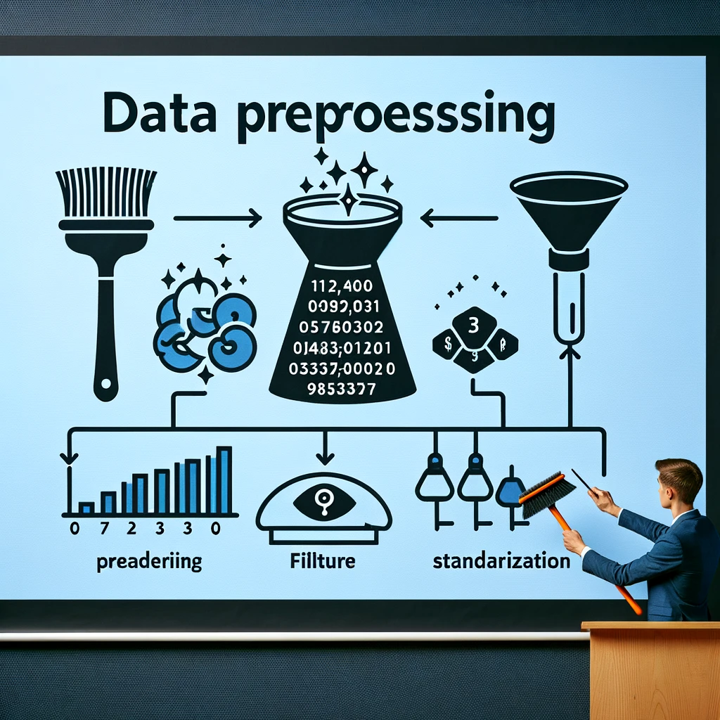
Ensuring Model Readiness: Data preprocessing is a critical step, fine-tuning the raw input into a refined format that our model can interpret effectively. Strategies Implemented: Missing Data: Tackled missing entries to maintain data integrity, ensuring no applicant is overlooked due to incomplete information. Categorical to Numerical: Translated categorical variables into a numerical code, facilitating the model's understanding of non-quantitative attributes. Feature Standardization: Applied standard scaling to numerical features, harmonizing data variance and bolstering the model's ability to learn unbiased by scale differences. Ready for Training: With preprocessing complete, the dataset is primed for the next phase – building a predictive model that encapsulates our analytical rigor.

Slide 6
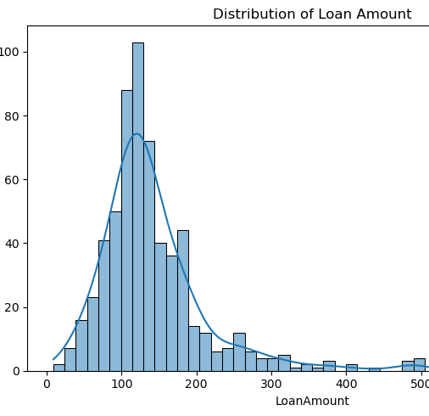
Model Development and Evaluation
We initiated our project by constructing a Logistic Regression model, a quintessential tool for binary classification problems like ours. This model was chosen for its simplicity, interpretability, and robust performance in scenarios similar to loan eligibility prediction.
Model Training:
The model was trained on a dataset comprising various applicant features, learning to discern patterns and correlations that contribute to the outcome of loan approvals. This phase is crucial, as it sets the stage for the model's ability to make accurate predictions.
Hyperparameter Tuning:
To fine-tune our model, we employed GridSearchCV for hyperparameter optimization. This step involved systematically varying parameters such as the regularization strength and solver type to find the combination that maximizes model performance.
The evaluation phase yielded valuable insights, confirming the model's strong predictive capabilities, especially in recognizing eligible loan applications. It also revealed areas where the model could improve, guiding future iterations and enhancements.

Slide 7
Feature Importance Analysis
Unveiling Influential Factors:
Feature importance analysis sheds light on the attributes that most significantly sway the model's predictions. By examining the weight of each feature, we can understand their impact on the likelihood of loan approval.
Top Predictors:Credit History stood out as the most influential factor, affirming conventional lending wisdom. Applicant and Coapplicant Income followed, highlighting the model's emphasis on an applicant's financial strength.
Influence on Decisions:Grasping which features are most impactful aids lenders in tailoring their assessment criteria and provides transparency in the decision-making process, ensuring that crucial factors are not overlooked.
Data-Driven Lending:The insights gained from this analysis underscore the importance of a data-driven lending process that is more objective, consistent, and fair. This approach ensures that lending decisions are based on quantifiable and relevant applicant characteristics.

Slide 8
Hyperparameter Tuning and Model Training
Hyperparameter Tuning:Delve into the process of refining the model through hyperparameter tuning, which fine-tunes the algorithm to perform optimally on our dataset. The search for the ideal parameters, like regularization strength and solver choice, was exhaustive and systematic, ensuring the model's robustness.
Training the Optimized Model:Post-tuning, the model was retrained with the best-found parameters, solidifying its predictive accuracy. This step was crucial to harness the full potential of the Logistic Regression algorithm.
Impact of Tuning:Highlight the tangible benefits observed post-tuning, such as an improved accuracy score and a better balance between precision and recall, indicating a more reliable model.
Ensuring Generalization:Emphasize the importance of a model that not only fits the training data well but also performs consistently across various sets of unseen data, demonstrating its ability to generalize well.

Slide 9
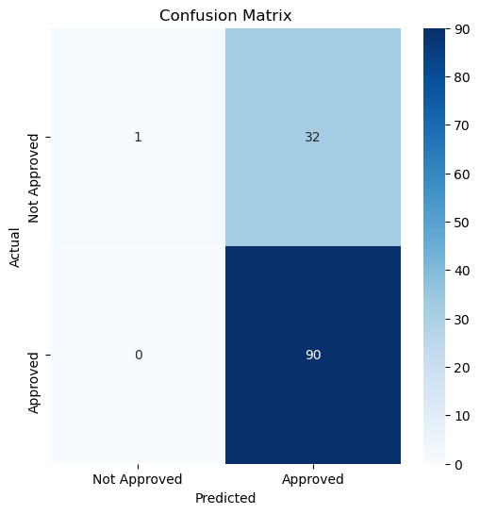
Model Evaluation and Validation
Our evaluation process involved rigorously testing the model against a validation dataset. This phase is essential to confirm that the model accurately predicts loan eligibility, reflecting its real-world applicability and reliability.
Key Metrics Used:To gauge the model's effectiveness, we employed several metrics:
Accuracy: This metric showed us the percentage of total predictions our model got right.
Precision and Recall: These metrics gave us insight into the model's ability to correctly predict loan approvals and identify actual loan rejections.
F1-Score: A balance between precision and recall, the F1-score provided a holistic view of the model's performance, especially important in scenarios with an imbalanced dataset.
Confusion Matrix Insights:The confusion matrix offered a detailed breakdown of the model's predictions, categorizing them into true positives, false positives, true negatives, and false negatives. This breakdown was instrumental in understanding the model's decision-making process, particularly in differentiating between approved and declined loans.
Model's Predictive Power:In summary, the model exhibited robust predictive capabilities, showcasing its potential as a reliable tool for financial institutions. The evaluation results underscored the model's efficiency in predicting loan eligibility, an attribute that could significantly enhance decision-making in loan processing

Slide 10
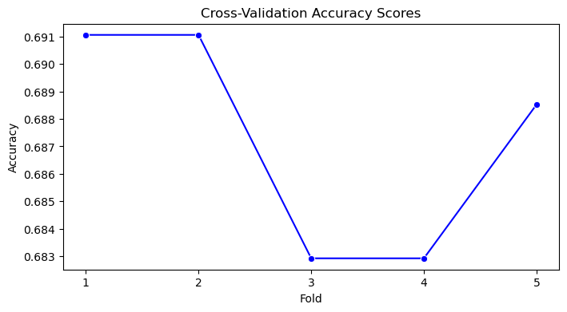
Insights from Feature Importance
The feature importance analysis provided valuable insights into which factors most significantly impact loan eligibility decisions. By examining the weight assigned to each feature, we could discern their relative influence on the model's predictions.
Credit History as a Prime Indicator:Credit history emerged as the most influential factor, aligning with traditional lending norms. Its prominent weight in the model underlines its critical role in assessing borrower reliability and predicting loan repayment likelihood.
Income Levels and Loan Details:Applicant and co-applicant income levels also played a significant role, reflecting the practical aspect of an applicant's ability to repay. Additionally, loan amount and term were important but secondary to credit history, underscoring the multifaceted nature of loan approval processes.
Impact on Lending Decisions:These insights are pivotal for lenders, as they provide a data-backed rationale for focusing on specific borrower attributes. Understanding feature importance helps in fine-tuning lending criteria and policies, leading to more informed, fair, and effective lending decisions.

Slide 11
Conclusions and Future Directions
Project Summary:
Our journey in creating a machine learning model for loan eligibility prediction has culminated in a tool that not only streamlines the approval process but also infuses it with greater accuracy and fairness. This project stands as a testament to the power of data-driven decision-making in the financial domain.
Key Achievements:The heart of our success lies in thorough data analysis, meticulous preprocessing, and strategic model training. These efforts have materialized into a model that robustly predicts loan eligibility, ensuring that financial institutions can make more informed lending decisions.
Looking Ahead:The road ahead beckons further exploration and innovation. We envision delving into more sophisticated machine learning algorithms to capture complex data patterns more effectively. Additionally, enriching our model with a wider array of data sources, like detailed employment history or more comprehensive credit records, could further fine-tune its accuracy.
Envisioning the Future:As we look to the horizon, we see machine learning not just as a tool for automation, but as a catalyst for transformative change in the finance sector. It holds the promise of making lending more inclusive and fair, aligning with both the needs of financial institutions and the aspirations of borrowers.

Slide 12
Github profile hyperlink
https://github.com/Madhupreet
https://github.com/goodboyradha

