Slide 1
Appendix A. ATOMS AND ATOMIC BONDING
A.1 Electronic configuration of atoms
Consider hydrogen like atoms (Z protons with one electron only). The electron is moving in the orbit around the proton. The classical picture is shown schematically in Fig. A.1.
It should be noted that in reality, the orbit is not a circular orbit as in Fig. A.1. The orbit is well described using the quantum mechanics.
electron
– q
protons
+Zq
Fig. A.1

Slide 2
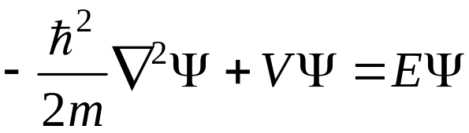
The behavior of the electron can be obtained using the quantum mechanic treatment. We apply the Schrödinger equation to the problem
(A.1)
Kinetic Energy term
Potential Energy term
Total Energy term
Ψ : electron wave function. Describe the behavior of the electron in the atom
V : electron potential energy of electron
E : total energy of electron

Slide 3
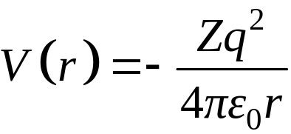
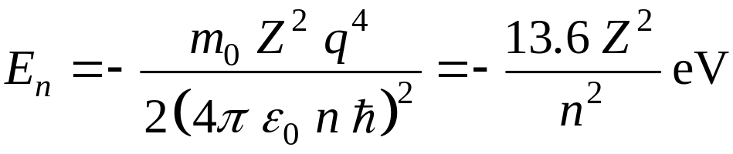
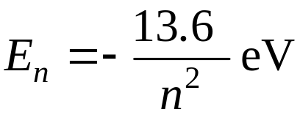
For hydrogen like atom (Z protons and one electron system), the potential energy is
(A.2)
r : the radial distance between the electron and the nucleus
Substitute eqn. (A.2) into eqn. (A.1) and use polar coordinate and the method of separation of variable to solve eqn. (A.1).
The solution is
  Energy Eigenvalue:
(A.3.a)
For hydrogen atom (Z = 1),
(A.3.b)

Slide 4
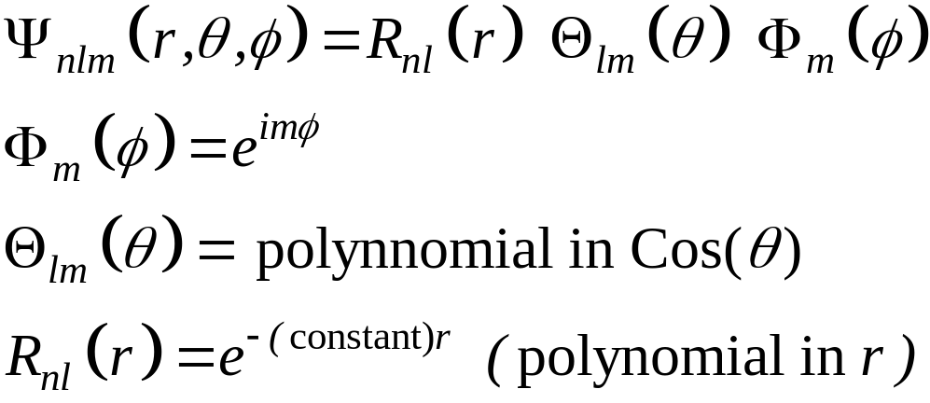
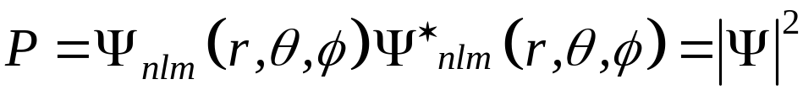
  Wave function
  The wave function Ψ_{nlm}(r, θ, φ) gives the probability density P which is the probability of finding the electron per unit volume at (r,θ,φ). Mathematically P is given by
(A.4)

Slide 5

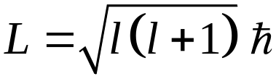
  n : the principal quantum number
  n = 1, 2………. (A.5)
  K, L, M…………
  This is associated with the radial part of the wave function. In the hydrogen like atoms n solely determines the energy of the electron (see eqn. A.3)
  l : the orbital quantum number.
  For a given value of n
  l = 0, 1, 2 ……..(n – 1) (A.6)
  s, p, d………….(spectroscopic notation)
  l characterizes the orbital angular momentum of the electron. The magnitude of the orbital angular momentum L is given by
(A.7)

Slide 6

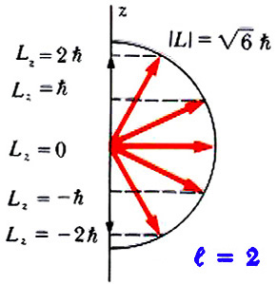
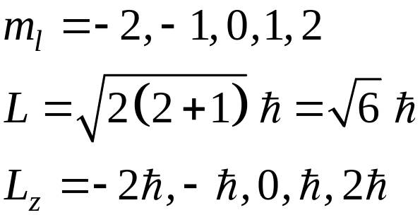
  m_{l} : the orbital magnetic quantum number.
  For a given value of l
  m_{l} = −l, −l+1, …..0……, l−1, l. (A.8)
  m_{l} describes the component of L along a particular direction, say in z-direction, L_{z}
(A.9)
Example for l = 2
Fig. A.2

Slide 7
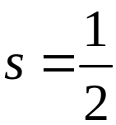
The solution of the Schrődinger equation gives three quantum number n, l and m_{l}.
It was found experimentally (see, for example, the Stern-Gerlach experiments) that the electron has an intrinsic angular momentum called the electron spin.
The electron spin can be conveniently visualized (although strictly speaking is incorrect) as angular momentum of the electron spinning on its own axis.
Again, the electron spin is quantized and is described by the spin quantum number s. It is analogous with the orbital quantum number l but always has a magnitude of 1/2
  s : the spin quantum number

Slide 8
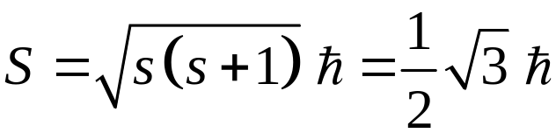
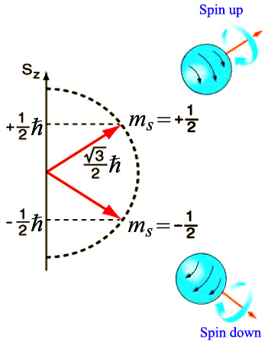
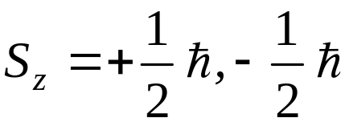
The magnitude of the spin angular momentum S is
  The component of S along a particular direction, say in z-direction, is described by
  m_{s} : the spin magnetic quantum number.
  The value is
  m_{s} = +1/2, –1/2 (spin up , spin down )
  The component of S along z-direction is
(spin up , spin down )
Fig. A.3

Slide 9

Each electron quantum state in an atom can be completely described by a set of the four quantum number namely
We can now construct the available electron quantum states in atoms
  States with the same value of n form a shell.
  Shells are identified as K,L,M … corresponding to n = 1,2,3 …
  States with the same value of n and  form a sub-shell.
  Subshells are identified as s,p,d,f,g,h …corresponding to  = 0,1,2 ...

Slide 10
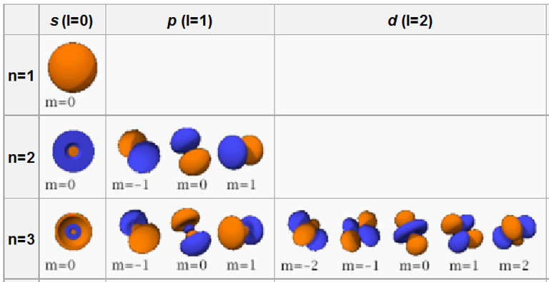
  Atomic Orbitals

Slide 11
Table A.1 Available quantum states in atoms
Shell | n | l | m_{l} | m_{s} | Subshell | No. of states | Max. No. of electrons
K | 1 | 0 | 0 | ±1/2 | s | 2 | 2
L | 2 | 0 | 0 | ±1/2 | s | 2 | 2
 |  | 1 | –1 | ±1/2 | p | 6 | 6
 |  |  | 0 | ±1/2
 |  |  | 1 | ±1/2
M | 3 | 0 | 0 | ±1/2 | s | 2 | 2
 |  | 1 | –1 | ±1/2 | p | 6 | 6
 |  |  | 0 | ±1/2
 |  |  | 1 | ±1/2
 |  | 2 | –2 | ±1/2 | d | 10 | 10
 |  |  | –1 | ±1/2
 |  |  | 0 | ±1/2
 |  |  | 1 | ±1/2
 |  |  | 2 | ±1/2

Slide 12
The electronic configuration in atoms is determined by the following:
  Electrons will occupy energy levels in the order of increasing energy starting from the ground state
  For a given principal quantum number n, the order of increasing energy of the subshells corresponds to the order of increasing  (see Fig. A.4)
  For the same value of , the electrons will occupy state such that the number of unpaired spins are maximised (Hund’s rule), see Fig. A.5

Slide 13
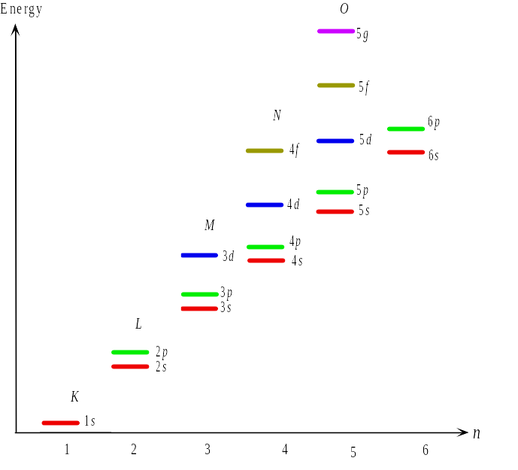
Fig. A.4 Energy of various electron states. The energy depends on both n and l

Slide 14
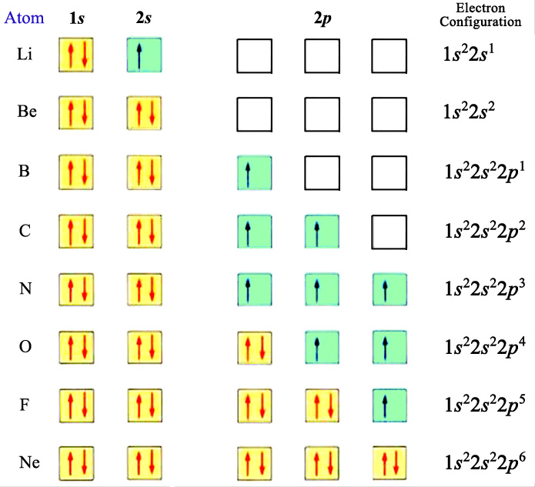
Fig. A.5

Slide 15
Table A.2 Electronic configuration of some common elements in semiconductors
Element | Symbol | Atomic number | Electronic configuration
Boron Silicon Phosphorus Gallium Germanium Arsenic | B Si P Ga Ge As | 5 14 15 31 32 33 | 1s² 2s² 2p¹ 1s² 2s² 2p⁶ 3s² 3p² 1s² 2s² 2p⁶ 3s² 3p³ 1s² 2s² 2p⁶ 3s² 3p⁶ 3d¹⁰ 4s² 4p¹ 1s² 2s² 2p⁶ 3s² 3p⁶ 3d¹⁰ 4s² 4p² 1s² 2s² 2p⁶ 3s² 3p⁶ 3d¹⁰ 4s² 4p³

Slide 16
A.2 Atomic bonding
Whether a solid is a metal or dielectric depends on the types of bonds, or interaction, between atoms, which then depends on the particular atom or atoms in the crystal
Solids are mostly formed by ionic, covalent and metallic bonds
Ionic bond
  Found in compounds composed of both metallic and non-metallic
  Atoms of metallic elements give up their electrons to the non-metallic elements so that all atoms have complete subshells
  Consequently, the metallic atoms become positively charged and the non-metallic atoms become negatively charged.
  The bond is a result of the coulomb attraction

Slide 17
  The classic example is sodium chloride NaCl
  Electron configuration of Na: 1s² 2s² 2p⁶ 3s¹
  Electron configuration of Cl: 1s² 2s² 2p⁶ 3s² 3p⁵
  By giving up the electron in the outershell, the Na atom has a complete subshell and becomes Na⁺. By accepting an electron, the Cl atom has also a complete subshell and become Cl⁻
Covalent bond
  This bond is formed by sharing the electrons between atoms so that the atoms achieve a stable electron configuration or in other words the atoms have complete subshells
  The example is hydrogen molecule (H₂).

Slide 18
  Electron configuration of H: 1s¹
  If two H atoms share their electrons, each of H atom will in effect have two electrons, so that the 1s shell of each H atom is full
  Semiconductor materials (e.g. Si, Ge, GaAs….etc.) have covalent bonds.
  Consider Si. Electron configuration of Si: 1s² 2s² 2p⁶ 3s² 3p²
  To have complete subshells each Si atoms needs four more electrons. This is achieved by making bonds with four nearest neighbors Si atoms, with each Si atom contribute one electron. This is conveniently illustrated in 2-dimensional representation in Fig. A.6. Note that, since this is a 2-dimensional diagram, it could not show the angle of the bonds. The angle of the bonds is shown in 3-dimensional representation given, for examples, in Chapters 2 and 3 (see Fig.2.7, Fig.2.8 and Fig.3.3).

Slide 19
Si
Si
Si
Si
Si
Si
Si
Si
Si
Si
(b)
(a)
Fig. A.6 Illustration of (a) silicon valence electrons (b) covalent bonding in the silicon crystal

Slide 20
Metallic bonding
  Found in metals and their alloys. The valence electrons interact in a way similar to that in covalent bonding. We may regard the positive metallic ions as being surrounded by a “sea” or “gas” of electrons which are free to move throughout the entire solids.
  The solid is held together by the electrostatic force (the attractive force between the positive ions and the electron gas. This is illustrated in Fig. A.7
  In metal, the free electron concentration is about 10²²/cm³
sea electrons
ion cores
+
+
+
+
–
–
–
+
+
+
+
–
–
–
+
+
+
+
–
–
–
+
+
+
+
Fig. A.7

Slide 21
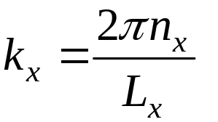
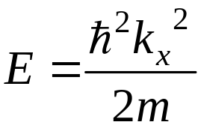
Appendix B DENSITY OF STATES
Consider a free particle in one dimensional (1-D) system.
Using the periodic boundary condition in eqn. (D.13) in Appendix D, the wave vector k_{x} is given by eqn. (D.14):
where n_{x} is integer.
the energy of the particle is given by:

Slide 22
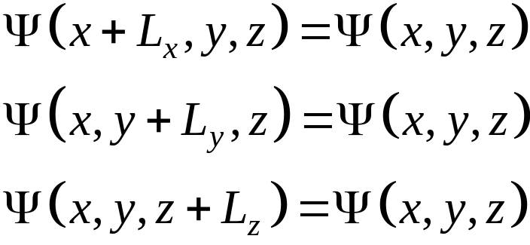
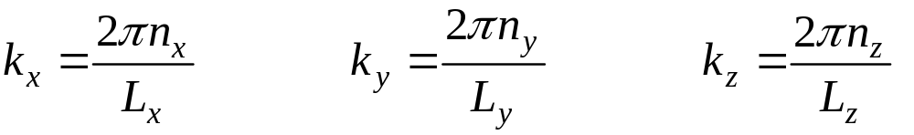
Consider now a free particle in 3 dimensional (3-D) system.
Similar to the 1-D case, the periodic boundary condition is
(B.1)
where L_{x}, L_{y} and L_{z} are periodicity in x, y & z direction respectively.
The wave vector is then given by
(B.2)
where n_{x}, n_{y} and n_{z} are integers.

Slide 23
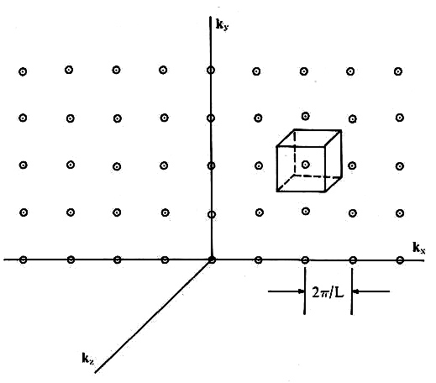
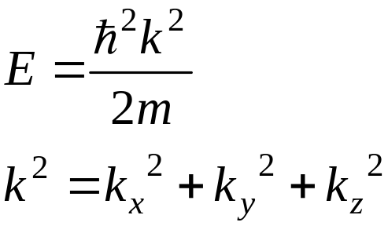
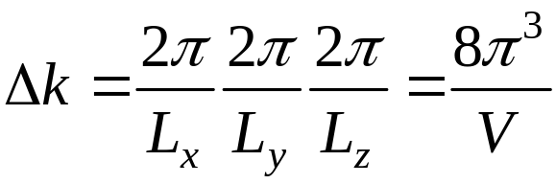

The energy is given by
(B.3)
where
(B.4)
In k-space (Fig. B.1), one k state occupy a volume of
Fig. B.1 Allowed quantum states in k-space.
(B.5)
where
is the volume of the crystal.

Slide 24

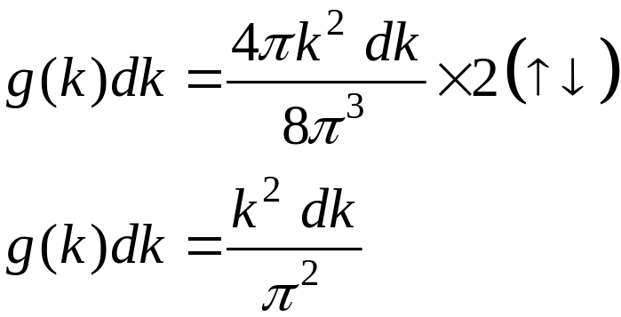
For a unit volume of the crystal, eqn. (B.5) becomes
(B.6)
Therefore, the number of states between k & k+dk per unit volume of the crystal is (see Fig. B.2):
volume
element
4πk² dk
k
(B.7)
where g(k) in eqn. (B.7) is number of states per unit volume of the crystal per unit k.
Note that the factor of 2 is to take into account the electron spins.
k+dk
Fig. B.2 Volume element in k-space

Slide 25
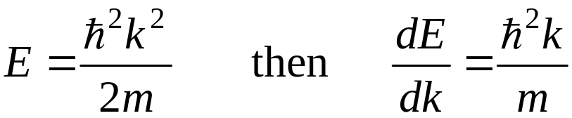
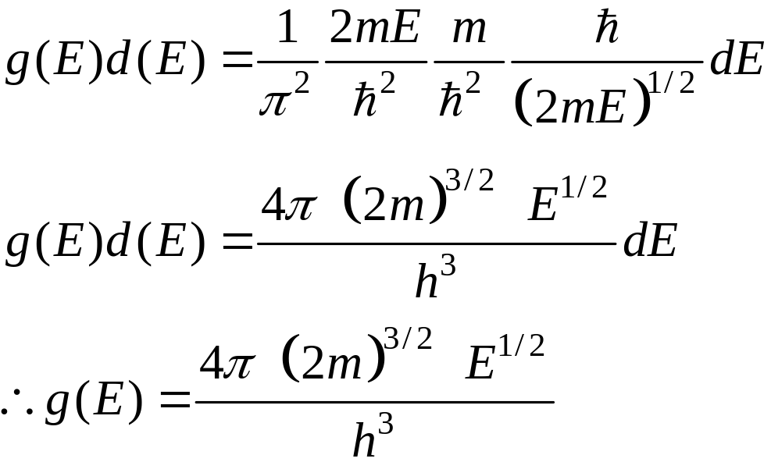
Recall eqn. (B.3):
(B.8)
Using eqns. (B.3) & (B.8) in the right hand side of eqn. (B.7), we obtain the number of states between energy E & E+dE per unit volume of the crystal:
(B.9)
g(Ε ) is the number of states per unit volume of the crystal per unit energy & referred to as the density of states.

Slide 26
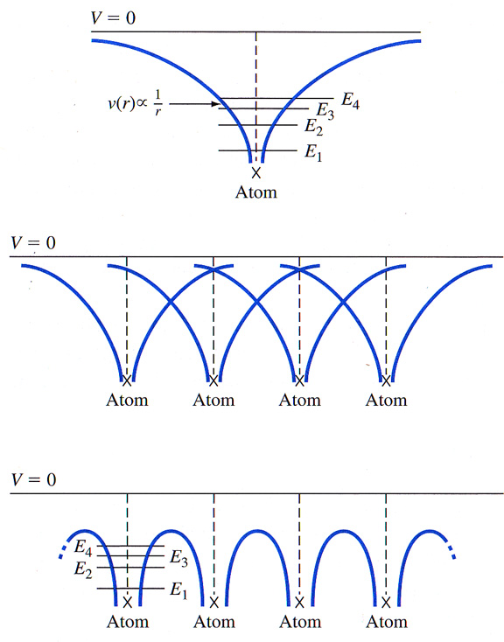
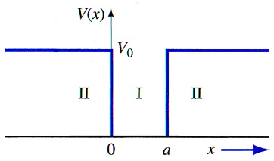
Appendix D E – k relation
Here, we will consider the relation between the electron energy E with its momentum p (or in crystals, more precisely, it is called crystal momentum).
Single Atom

Slide 27
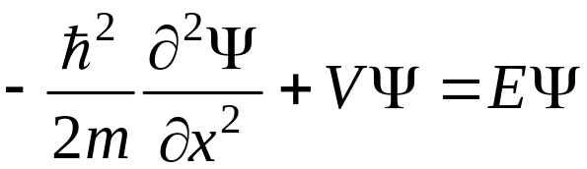
D.1 Free electrons
∞
∞
Let us first of all consider the relation of E with p for a free electron confined in a 1-D box of side L_{x} as shown in Fig. D.1.
Fig. D.1
0
L_{x}
The time independent Schrödinger equation for this 1-D system is
(D.1)

Slide 28
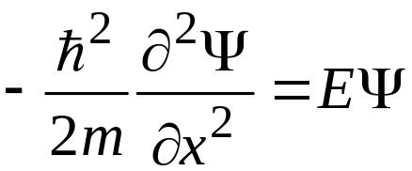

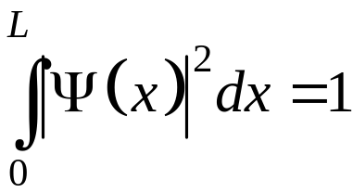
In the box the electron is free, the potential energy V = 0. Equation (D.1) reduces to
(D.2)
We look for a solution of eqn. (D.2) with the following condition:
  the wave function Ψ must be continuous inside and outside the box at x = 0 and x = L_{x}. Therefore, the only allowable value of Ψ at x = 0 and x = L_{x} is zero. This is called boundary conditions and we simply write:
(D.3)
  the probability of finding the electron in the box = 1
(D.4)

Slide 29
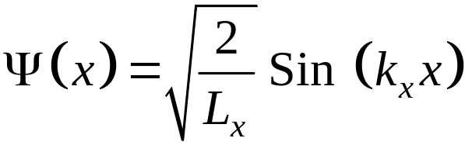
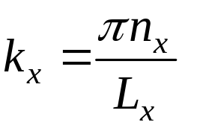
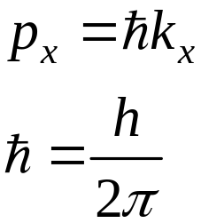
With condition in (D.3) and (D.4), the solution of eqn. (D.2) gives us the following
  The wave function:
(D.5)
  where k_{x} is the wave-vector and given by :
(D.6)
n_{x} is integer
    The momentum:
(D.7)
where

Slide 30
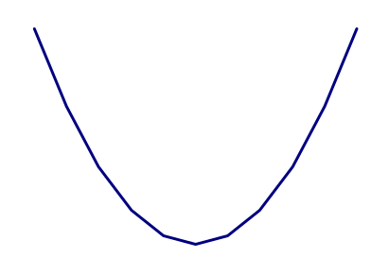
    The electron energy E as a function of k_{x} is parabolic and given by :
(D.8)
    where k_{x} is quantized and given in eqn. (D.6)
E
E versus k_{x} is shown in Fig. D2.
0
p_{x} or k_{x}
Fig D.2

Slide 31
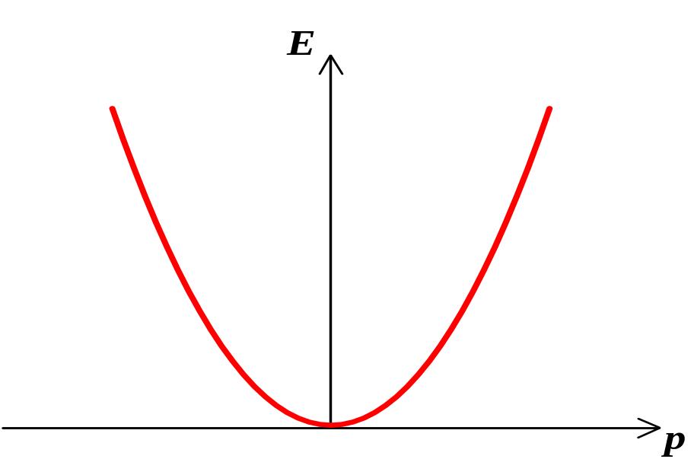

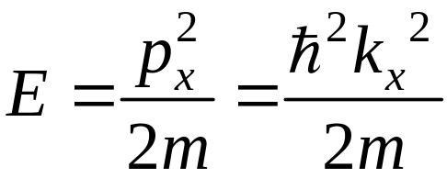
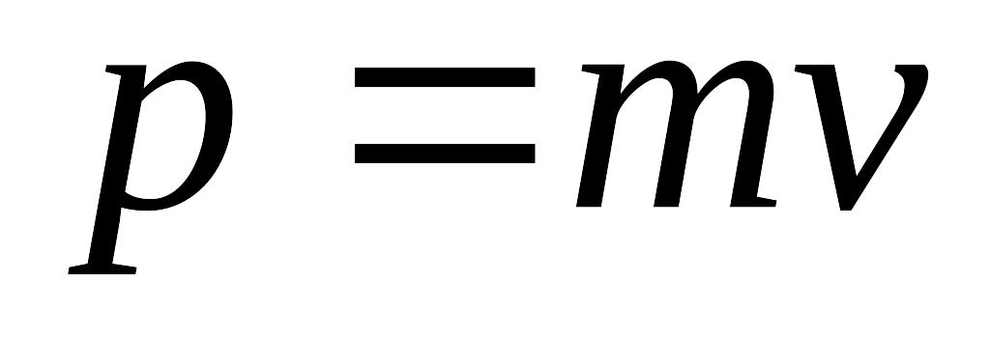
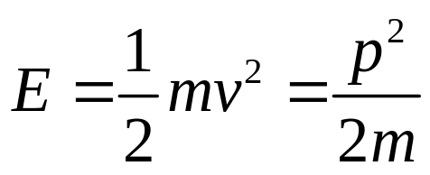
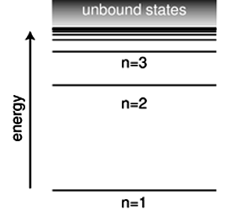
Free Particle
Quantum Mechanics
Classical Mechanics
v
m
Discrete spectral lines of an atom

Slide 32
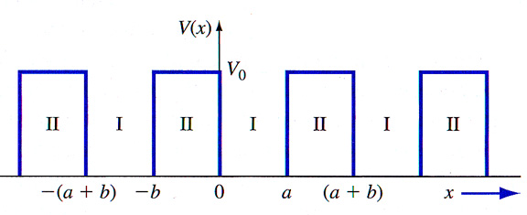
D.2 Electrons in crystals
Single Atom
Periodic atoms in a semiconductor
Kronig-Penney Model

Slide 33
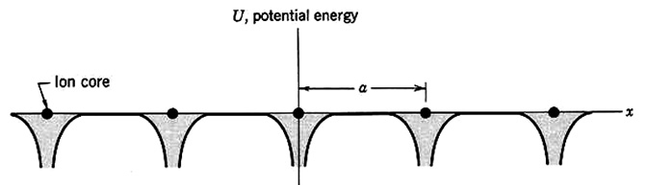

In a crystal, electrons are subjected to periodic potential formed by the atoms/ions arranged periodically in the crystal. The behavior of the electrons can be obtained by putting the periodic potential energy in eqn. (D.1) & solve the equation.
Fig. D.3
Consider 1-D monoatomic lattice (in x-direction) where there are
N_{x} unit cells with lattice constant a.
periodic potential energy U(x). The potential energy is illustrated in Fig. D.3 & can be expressed as
(D.9)
n_{x} is integer

Slide 34
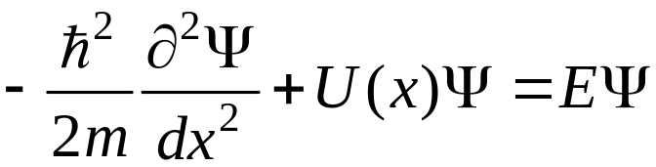
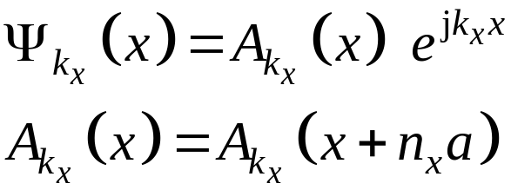
The Schrödinger equation:
(D.15)
periodic potential energy
The solution is in the form:
(D.16)
(D.17)
  This function is called Bloch functions

Slide 35

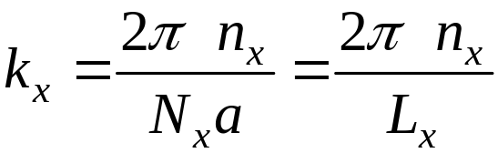

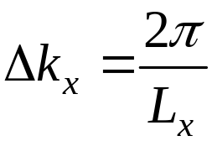
Imposing the periodic boundary condition
(D.18)
  we obtain the wave vector k_{x}:
(D.19)
  n_{x} is integer
  L_{x} is the crystal dimension
  In k-space, each k_{x} value occupies
  or in other words
(D.20)

Slide 36



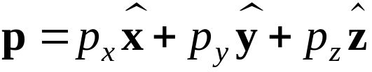

The momentum in x-direction is
  In three dimensions (3-D) there are also momentum in y and z directions
(D.21)
(D.22)
(D.23)
  The total momentum
(D.24)
are the the unit vector in x, y and z directions respectively
  It is important to note that the momentum here is called the crystal momentum, it is not the actual momentum of the electron in the crystal, but it describes the motion of the electron that includes the interaction between the electron and the crystal.

Slide 37
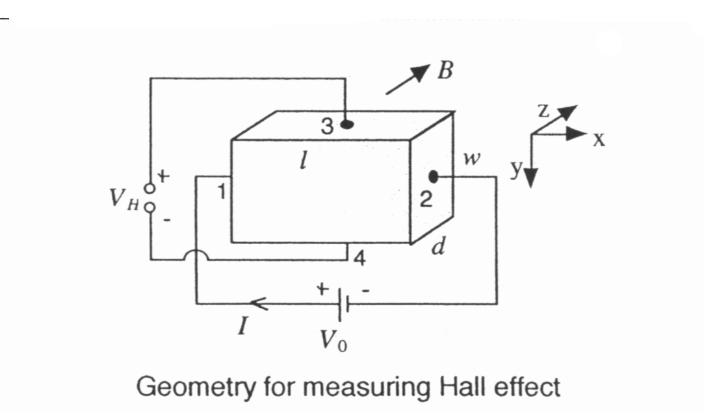
Characterizations
The Hall Effect
The Hall effect was discovered in 1879 by American physicist Edwin Hall.
Consider a rectangular piece of semiconductor with contacts 1 & 2 at ends of specimen and contacts 3 & 4 in the middle of the lateral surface. This is shown in Fig. Z.1.
The current flow through the specimen from contact 1 to 2
Measure voltage between contacts 3 & 4
  any reading?
  No, it will show no reading
Fig. Z.1

Slide 38
How about between contacts 1 & 3 and contacts 1 & 4?
  Yes, there is a voltage drop between contacts 1 & 3 and also between contacts 1 & 4. In this case the value is the same since both points 3 and 4 have the same distance to point 1.
  Consequently, the potential difference between contacts 3 & 4 is zero.
Now, place sample into a magnetic field directed perpendicular to it and measure voltage between contacts 3 & 4
  this time we will get a potential difference between points 3 & 4
  potential difference obtained is proportional to current flowing through and strength of the magnetic field

Slide 39


What is the reason ?
  The reason is that a charge particle moving with velocity v in a magnetic field B will experience a force called the Lorentz force F_{L}
  The Lorentz force experienced by an electron is
(Z.1.a)
  The Lorentz force experienced by a hole is
(Z.1.b)
Note that eqns. (Z.1.a ) and (Z.1.b) are the vector cross product. F_{L} is perpendicular to both v and B.
We note here that, as in Chapter 6, the presence of electric and magnetic fields do not generate extra or excess carriers (electrons and/or holes).

Slide 40
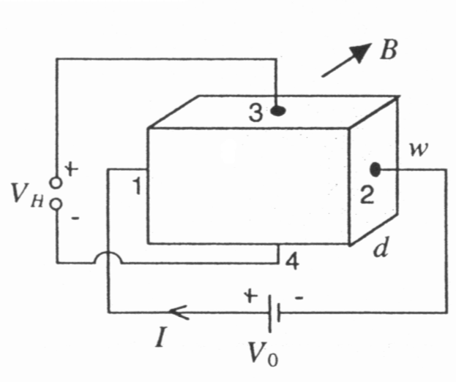
Let us now consider a p-type semiconductor, in which p>>n, shown schematically in Fig. Z.2. The geometry is the same as that in Fig. Z.1.
From eqn. (Z.1.b), the Lorentz force F_{L} acting on the hole majority carriers is upwards
  F_{L} will deflect the holes to the top surface.
  Consequently, there will be a buildup of positive charge on the top surface, which induces an electric field opposing F_{L}. This electric field is called the Hall field ξ_{H} and the corresponding voltage is called the Hall voltage V_{H}
ξ_{H}
l
+ + + + + +
F_{L}
v_{dp}
– – – – – –
F_{H}
Fig. Z.2 A voltage is applied between contacts 1 & 2. The Hall voltage is measured between points 3 & 4

Slide 41



  The force acting on the holes, F_{H}, due to the Hall field ξ_{H} is just
(Z.2)
  The force F_{H} is downwards opposing F_{L}
  In steady state, F_{L} is exactly balanced by F_{H}, in other words the total force is zero. We can write
(Z.3.a)
(Z.3.b)
downwards
upwards
v_{dp} is the hole drift velocity.

Slide 42

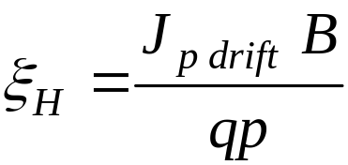

  Since F_{H} and F_{L} are the same in magnitude and v_{dp} is perpendicular to B (see Fig. Z.2) we can write
(Z.4)
  Combining eqn. (6.17 in Chapter 6), the expression for the hole drift current density, and eqn. (Z.4), we get
(Z.5)
  We can then define a Hall coefficient R_{H} given by
(Z.6)

Slide 43

  The parameters in eqn. (Z.6), namely ξ_{H}, J_{p drift} and B, can be obtained experimentally
  From Fig. Z.2,
(Z.7)
(Z.8)
The Hall voltage V_{H}, the current I and the magnetic field B can be experimentally measured. The measured current I has only drift current component, the diffusion current component is zero.
Hence, by performing the Hall effect measurement and calculating the Hall coefficient, we could obtain the majority hole concentration p, or the acceptor concentration (assuming complete ionization and for doping concentration much larger than the intrinsic carrier concentration).

Slide 44
Consider now an n-type semiconductor, in which n>>p, with the same geometry as Fig. Z.1. The schematic diagram is shown in Fig. Z.3.
From eqn. (Z.1.a), the Lorentz force F_{L} acting on the electron majority carriers is upwards
  F_{L} will deflect the electrons to the top surface.
  There will be a buildup of negative charge on the top surface, which induces the Hall field ξ_{H}.
F_{H}
l
– – – – – –
F_{L}
v_{dn}
+ + + + + +
ξ_{H}
Fig. Z.3 A voltage is applied between contacts 1 & 2. The Hall voltage is measured between points 3 & 4

Slide 45

  The force acting on the electrons, F_{H}, due to the Hall field is
(Z.9)
  As in the case of p-type semiconductor discussed earlier, F_{H} is downwards opposing the Lorentz force.
  Note, however, here the Hall field ξ_{H} is directed upwards, where as for the p-type sample discussed earlier the Hall field is directed downwards.
  Consequently, for the configuration in Fig. Z.2 and Fig. Z.3, the measured Hall voltage V_{H} for the p-type sample is positive and for the n-type sample is negative.
  This implies that the type of a semiconductor, p-type or n-type, can be determined by measuring the Hall voltage

Slide 46



If we perform the same analysis as we did for the p-type sample, we obtain the Hall coefficient for the n-type semiconductor
(Z.10)
the minus sign is because the Hall field ξ_{H} or the Hall voltage V_{H} is negative.
We can relate the mobility and the conductivity using the Hall coefficient R_{H}. For a p-type semiconductor where p >> n, the resistivity is given in eqn. (6.24.a)
Using R_{H} in eqn. (Z.6), we obtain
(Z.11.a)

Slide 47


In the same way, for n-type semiconductors
(Z.11.b)
Remember for n-type semiconductors R_{H} is negative, μ_{n} will then become positive.
For the geometry in Fig. Z.1 (Fig. Z.2 or Fig. Z.3), the conductivity σ in eqn. (Z.11) is given by
(Z.12)

Slide 48
The mobility obtained from eqn. (Z.11), i.e. from the Hall measurement, is called Hall mobility
  it may differ from the mobility determined by conductivity type measurements because of nonlinear effects of mobility on magnetic field
We see that the Hall effect measurement allows us to determine
  the type of the sample (n-type or p-type),
  the majority carrier concentration
  and the majority carrier mobility

Slide 49
For materials where electron and hole concentrations are comparable, e.g for intrinsic materials, both types of carriers must be considered
Hall voltage will partially or fully cancelled out and will be a function of both concentrations and mobilities of electrons and holes
As an example, the Hall effect is utilized in devices to measure magnetic field (gaussmeter).

Slide 50
Example Z.1
A piece of a semiconductor has dimensions of l = 0.1 cm, w = 0.01 cm and d = 10⁻³ cm. Hall effect measurement was performed in the geometry shown in Fig. Z.1. It is given that I = 1.0 mA, V₀ = 12.5 V, B = 500 gauss = 5 × 10⁻² tesla and V_{H} = – 6.25 mV. Determine the type of the sample, the majority carrier concentration and mobility
A negative V_{H} for the geometry in Fig Z.1 implies that the sample is n-type (see Fig.Z.3)
l
– – – – – –
F_{L}
v_{dn}
+ + + + + +
Fig. Z.1
Fig. Z.3

Slide 51


From eqn. (Z.10), the Hall coefficient is
Majority carrier electron concentration is

Slide 52


The conductivity is calculated from eqn. (Z.12)
Hence, from eqn. (Z.11.b), the majority carrier electron mobility is

Slide 53

Four Point Probe Measurement
Most commonly used technique in the semiconductor industry for measuring resistivity is the four point probe method
method is non-destructive
can be used to measure resistivity of ingots, as well as wafers
Fig. Z.4 shows the schematic of a four point probe and a two point probe measurement
Fig. Z.4

Slide 54
The arrangement of the four point probe measurement shown in Fig. Z.4 is as follows
Four collinear metal probes with sharpened tips are placed on semiconductor sample
A constant current I is passed through the two outer probes
Measure the potential difference V developed across the inner two probes with a high-input impedance voltmeter
In this way, the metal-semiconductor contact resistance does not affect results
In addition, in this configuration the spreading resistance component at the probes can also be neglected
In the two point probe measurement (see Fig. Z.4), the contact and spreading resistance cannot be neglected.

Slide 55


For collinear probes with separation s₀ placed on a semi-infinite medium, the resistivity is given by
(Z.13)
Eqn. (Z.13) is valid for a sample with the thickness d is larger than 5s₀, and all edges of sample are away from probes by a distance larger than 10s₀
If sample is in the form of a wafer and its thickness is less than 5s₀, then a multiplicative correction factor F is necessary. Eqn. (Z.13) becomes
(Z.14)

Slide 56


For the case where the wafer thickness d is small compared to s₀, and it is semi-infinite in the other two dimensions, we get
(Z.15)
  this relation is also used to measure resistivity of thin diffused layers in semiconductors for transistor fabrication
We can also consider the sheet resistance of a thin film layer defined by
(Z.16)
ρ_{s} represents the resistance of an arbitrary-size square of the thin film layer and is expressed in ohm per square (Ω/)

Slide 57
Electrical circuitry for four point probe measurement is simple,
requires only a probe head, ammeter, voltmeter and constant current source
a number of metals with high Young’s modulus are suitable for making the probes, but silicon carbide and tungsten are favoured because of their hardness
Direct conversion from resistivity to doping concentration can be obtained from curves in Fig. Z.5, which is a compilation of a large amount of empirical data. Note that in using the data in Fig. Z.5, we must ensure that the majority carrier concentration of the sample is approximately equal to the doping concentration, that is
the impurity atoms are fully ionized and
the doping concentration is much larger than the intrinsic carrier concentration (see section 5.5)

Slide 58

Fig. Z.5

Slide 60

Problems
Q1: Consider silicon at T = 300K. A Hall effect device is fabricated with the following geometry: d = 50 µm, W = 500 µm, and L = 0.50 cm. The electrical parameters are: I_{x} = 0.50 mA, V_{x} = 1.25V, and B_{z} = 650 gauss. The Hall field is E_{H} = -16.5 mV/cm. Determine (a) the Hall voltage, (b) the conductivity type, (c) the majority carrier concentration, and (d) the majority carrier mobility. (5.49)

Slide 61


1 Gauss = 0.0001 Tesla

