Slide 1
Support Vector Machine for Sentiment Analysis on Twitter Data
5th Semester Mini Project
IPRJ505P (P)
Presented by,
Nilotpal Pramanik (IRM 2016501)
Rahul Chanderiya (IIM2016002)
Ankit Kumar Gupta (IHM2016004)
Ashutosh Yelgulwar (IIM2016006)
Neil Leeson Syiemlieh (IIT2016125)
Under Supervision: Dr. K.P.Singh
Associated TAs: Mr. Upendra P. Singh
Ms. Daisy Lal

Slide 2


PROJECT
“Support Vector Machine (SVM) for Sentiment Analysis on Twitter Data”
This is the 5th Semester Mini-Project under the course IPRJ505(P)
Project Supervisor- Dr. K.P.Singh

Slide 3
Abstract of the Project
Let’s start with the Abstract...

Slide 4
Sentiment analysis is a very popular technique for social network analysis. One of the most popular social networks for micro-blogging that has a great growth is Twitter, which allows people to express their opinions using short, simple sentences. These texts are generated daily, and for this reason it is common for people to want to know which are the trending topics and their drifts. In this project we will propose to deploy a machine learning based implementation that provides information focusing on areas, such as, Politics, Social, Tourism, and Marketing using algorithmic approach under Natural Language Processing. The application shows the polarity of each theme as positive, negative, or neutral.
4

Slide 5
1.
Introduction of the Project
This is the Introduction...

Slide 6
Popularity : About 300 million active users per month. 3 billion tweets and 15 billion API calls generated daily.
User Experience : Tweet,like,comment and retweet.
Analysis : Different organization use the twitter data to do Market analysis and get user feedback.
Classification : User data is broadly classified into three sections positive,negative and neutral.

Slide 7
2.
Motivation of the Project
Here’s all about the Motivation!!

Slide 8
It is a better approximation of public sentiment as opposed to conventional Internet articles and web blogs.
The reason is that the amount of relevant data is much larger for twitter, as compared to traditional blogging sites.
Moreover the response on twitter is more prompt and also more general.
Since twitter allows us to download stream of geo-tagged tweets for particular locations.
"Twitter is a good reflection of off-line sentiment.”--Tumasjan et al. in Germany
8

Slide 9
3.
Problem Formulation of the Project
Going to the Problem Formulation!!

Slide 10
To perform sentiment analysis
on Twitter data and classify each tweet into one of three polarities:
positive, negative and neutral.
To provide a machine learning implementation that focuses on politics, social, tourism and marketing

Slide 11
4.
Objectives of the Project
The Objectives are here...

Slide 12
Twitter data processing(Data Collection: Tweepy)
Training the algorithm on the labeled data i.e Training dataset
Sentiment classification of out of sample data using SVM
Calculating the accuracy of the algorithm
Categorization of the Tweets on the basis of positive, negative and neutral sentiments
Identify the misinterpretations, violation and redundancy of the tweets

Slide 13
5.
Solution Methodologies
Several Methods to achieve the Solution...

Slide 14
5.1. Sentiment Analysis
Sentiment analysis can be considered a classification process. The class labels constitute the polarity of each text, which can be positive, negative or neutral. Additionally, sentiment analysis can identify the emotional state of a word, such as anger, sadness, happiness, etc.
14

Slide 15
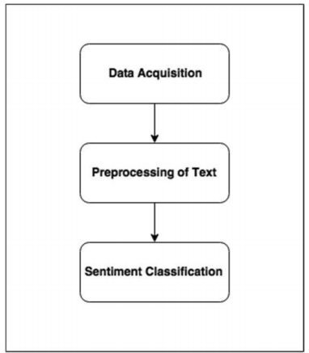
Sentiment Analysis Process
15

Slide 16
5.1.1 Data Acquisition
Using Twitter’s REST API to acquire tweet data in the JSON data format through “tweepy” library defined on Python itself.
The tweets obtained certain to topics such as politics, economics, tourism and marketing.

Slide 17
5.1.2 Preprocessing of Text
Targets:
To reduce noise in data
To reduce the dimension of the data
To perform suitable selection of features
17
Notes:
1 rectify the redundancies
2 concise
3 eliminate the ambiguous data

Slide 18
5.1.2 Preprocessing of Text
Techniques:
Remove all punctuations, symbols and numbers
Remove stopwords (the, is, at, etc)
Remove all URLs, hashtags(#), targets(@)
Stemming words (finding their root form)
Lowercasing all words
18

Slide 19
5.1.3 Sentiment Classification
NLP refers to computer systems that process human language in terms of its meaning.
NLP understands that several words make a phrase, several phrases make a sentence and, ultimately, sentences convey ideas.
19
Notes:
Anger Consolation Forgiveness Generous Nostalgic

Slide 20
Limitations of NLP :
Sarcasm a well known Australian trait, is very difficult to detect using NLP as is social media acronyms (e.g. OMG, BFF, BTW, ASAP etc) .
Same words having contracting meaning according to use (eg. “Sick”, ” Cool”).
20

Slide 21
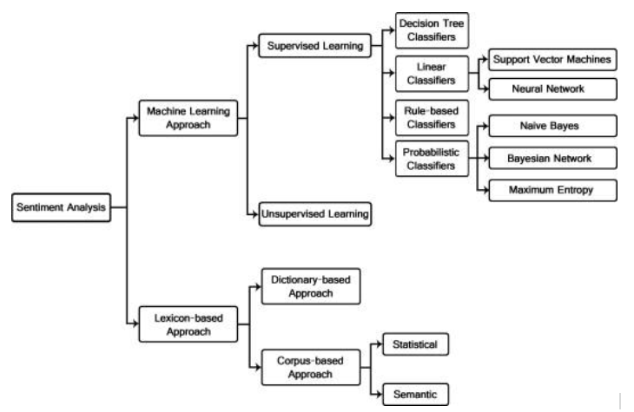
Sentiment Analysis Work Flow
21

Slide 22
5.2 Machine Learning Approach
Here we train the classifier with a set of example.
We gather a dataset with relevant examples for positive, neutral, and negative cases, extract these features from the examples.
Train the algorithm based on these examples.
22

Slide 23
5.3 Supervised Learning
A training dataset will be used to build the model
A testing dataset will be used to evaluate the model’s labelling predictions
23

Slide 24
5.3 Supervised Learning
Training is done on the dataset’s documents (tweets) that contain labels.
Usually the documents are manually labelled by a supervisor.
Several machine learning techniques such as Support Vector Machines (SVM) and Naive Bayes (NB) can classify text for sentiment analysis.
We have proposed to use the Support Vector Machine for our project.
24

Slide 25
6.
Resources Required for the project
Hardware/Software Requirements...

Slide 26
Twitter Metrics: insights about tweets volume metrics (tweets, retweets over time etc.)
Natural Language Processing (NLP): to extract linguistic information from textual contents, useful for further investigations.
API availability: accessibility via API.
Data Sets: Using inbuilt datasets from "tweepy" library defined in Python.
Data analysis: based on geolocation (e.g., geographic clustering).
Real-time analysis: the capability of the system to perform Twitter data analysis on a real-time basis.
Full faceted search: in order to have further views of data analyzed on tweets collection it is mandatory to do the exploitation of full faceted search.
26

Slide 27
7.
Expected Outcomes of the Project
The desired outcome !!!

Slide 28
No machine learning algorithm can be 100% accurate. Due to the complexity of natural languages, sentiment analysis algorithms are ~80% accurate.
Each tweet will be classified as either
positive, negative or neutral
Sentences with both positive and negative opinions are put through Binary Sentiment Analysis
Keyword spotting could be used to spot words with an obvious sentiment attached to them.
28

Slide 29
References of the Project
All resources of the Project...

Slide 30
1) “Harvesting Opinions in Twitter for Sentiment Analysis”
Juan Guevara13, Joana Costa12, Jorge Arroba34, Catarina Silva
2162315@my.ipleiria.pt,catarina, joana.costa@ipleiria.pt, jarroba@uce.edu.ec
2) “Sentiment Classification System of Twitter Data for US Airline Service Analysis”
Ankita Rane, Dr. Anand Kumar ankitarane24@gmail.com, Electricalakumar@dubai.bits-pilani.ac.in
3) “Twitter Vigilance:a Multi-User platform for Cross-Domain Twitter DataAnalytics, NLPand Sentiment Analysis”
Daniele Cenni, Paolo Nesi, Gianni Pantaleo, Imad Zaza
http://www.disit.org,http://www.disit.dinfo.unifi.it paolo.nesi@unifi.it,daniele.cenni@unifi.it
30

Slide 31

Thank
You :-)

