Slide 1
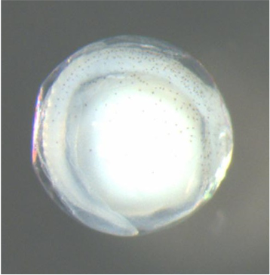
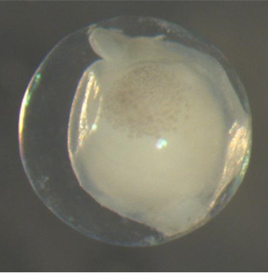
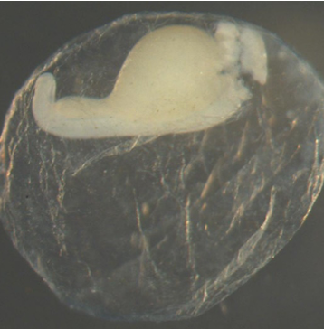
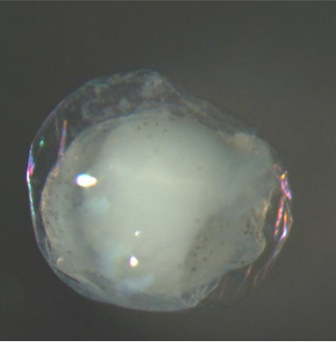
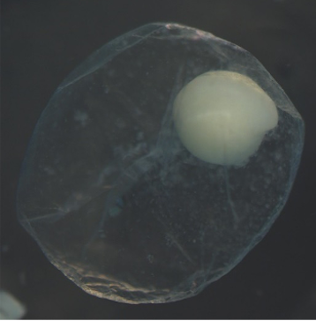

Slide 2
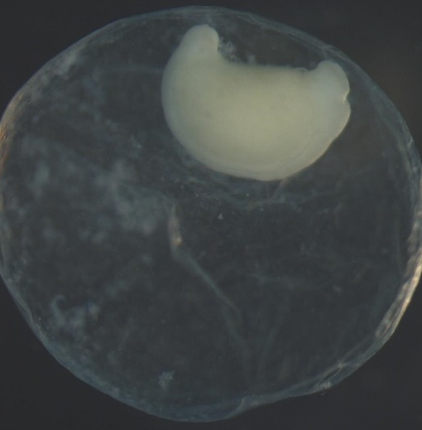
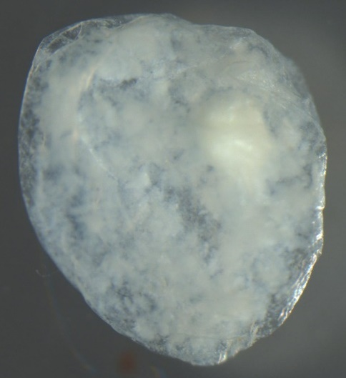
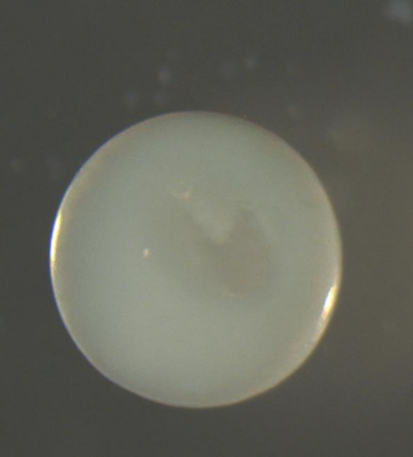
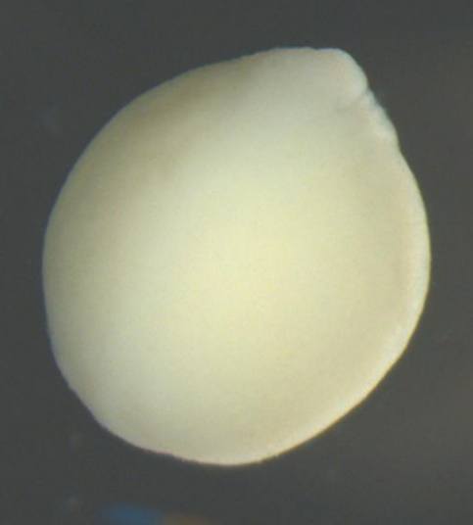

Slide 4
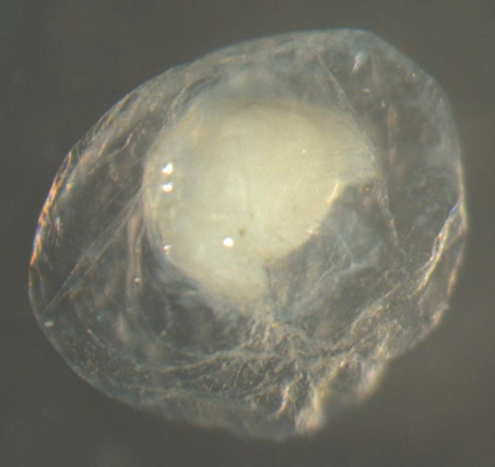

Slide 5





Provide Egg Characteristics
Use the ‘Data Input’ page to upload a spreadsheet containing characteristics of eggs to obtain predictions
Get Predictions
Use the the ‘Predictions’ page to apply the random forest models to predict the genus, family, and species taxonomies.
?
Download Predictions
Use the ‘Downloads’ page to download a spreadsheet with the egg characteristics and corresponding predictions.

Slide 6
Columns in Template
Fill in all variables (egg_ID and 13 egg characteristics)
See the help page for detailed definitions of the egg characteristics (includes example photos)
There is no maximum to the number of observations that may be included but at least one egg observations is required
Template Formatting Helpers
Select a cell with a variable name to see required formats, units, or accepted levels
Cells of categorical variables contains drop down options
Errors or warnings will appear if a values is not formatted correctly
Additional Variables
It is okay to include additional variables in the uploaded spreadsheet
Additional variables will be excluded from the processed data used for prediction but included in final downloadable spreadsheet

