Slide 1
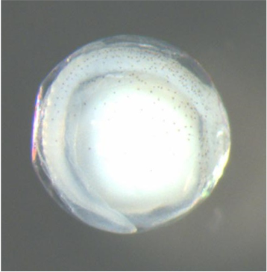
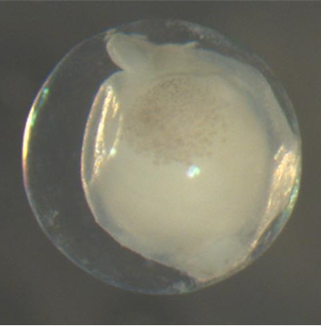
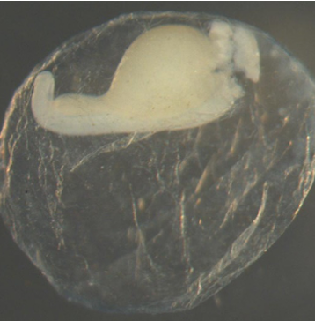
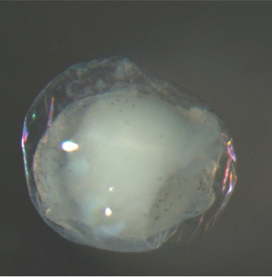
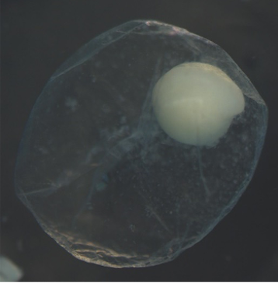

Slide 2





Provide Egg Characteristics
Use the ‘Data Input’ page to upload a spreadsheet containing characteristics of eggs to obtain predictions
Get Predictions
Use the the ‘Predictions’ page to apply the random forest models to predict the genus, family, and species taxonomies.
?
Download Predictions
Use the ‘Downloads’ page to download a spreadsheet with the egg characteristics and corresponding predictions.

