Slide 1
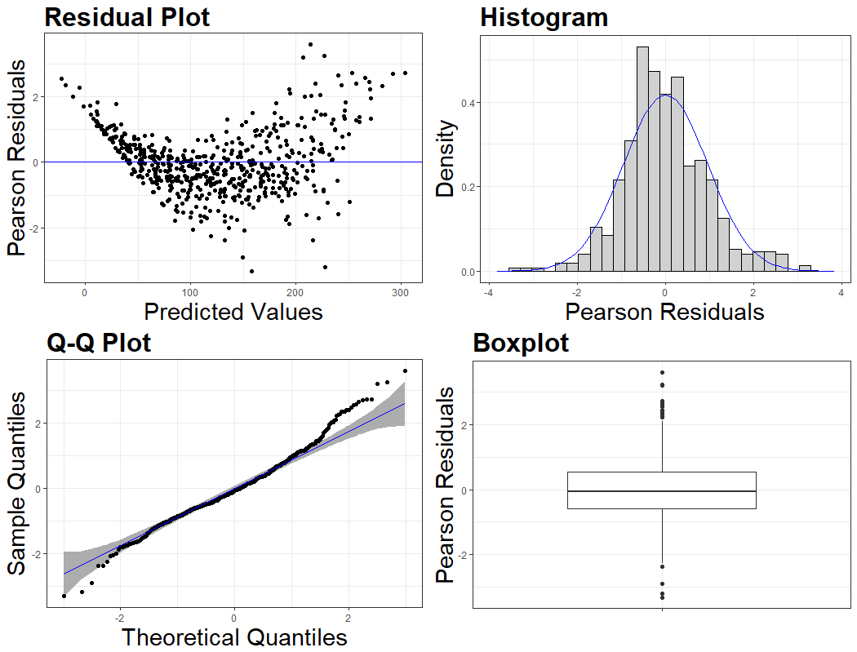
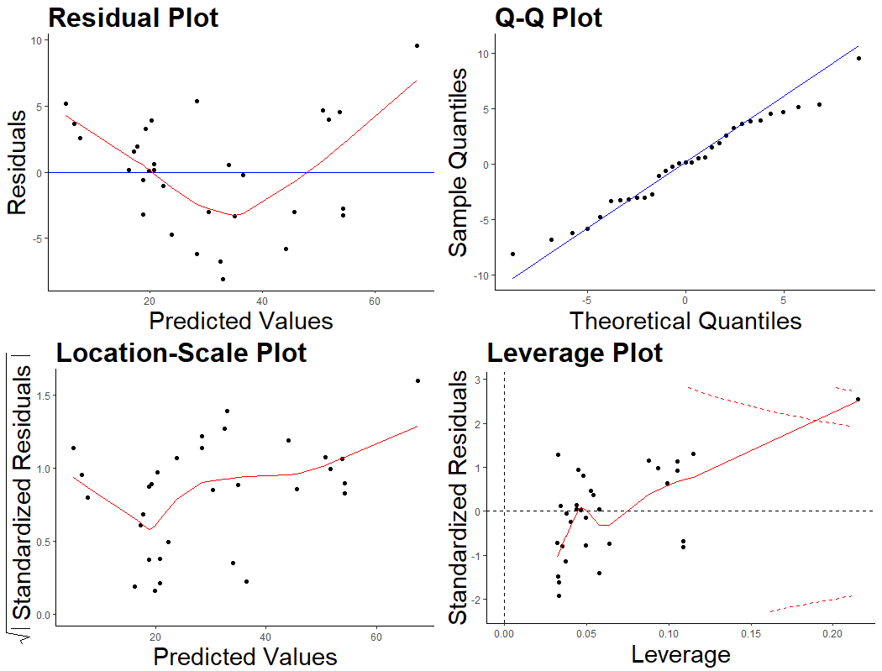
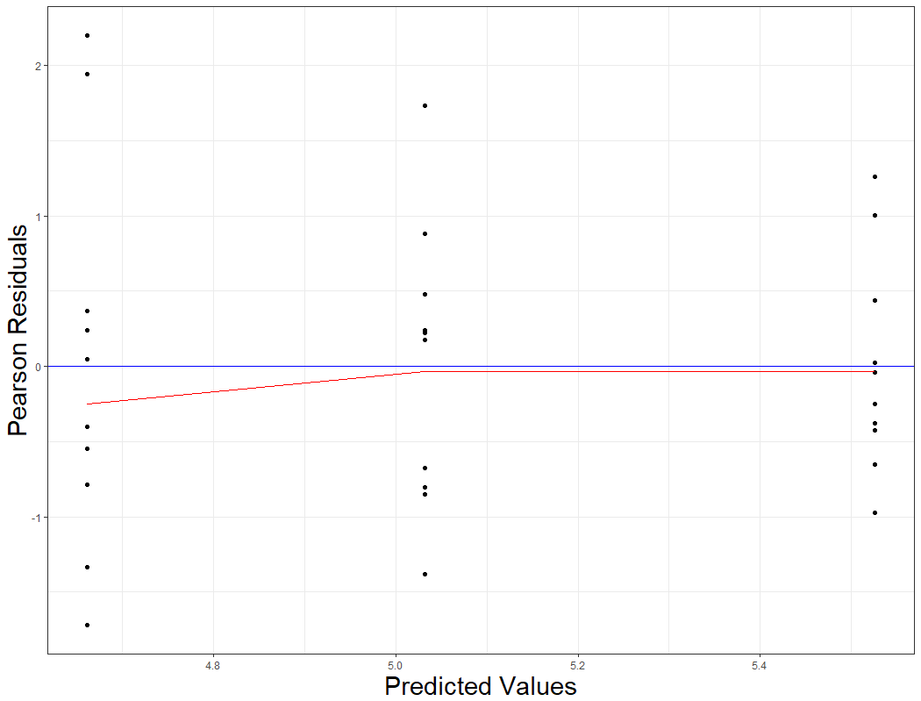
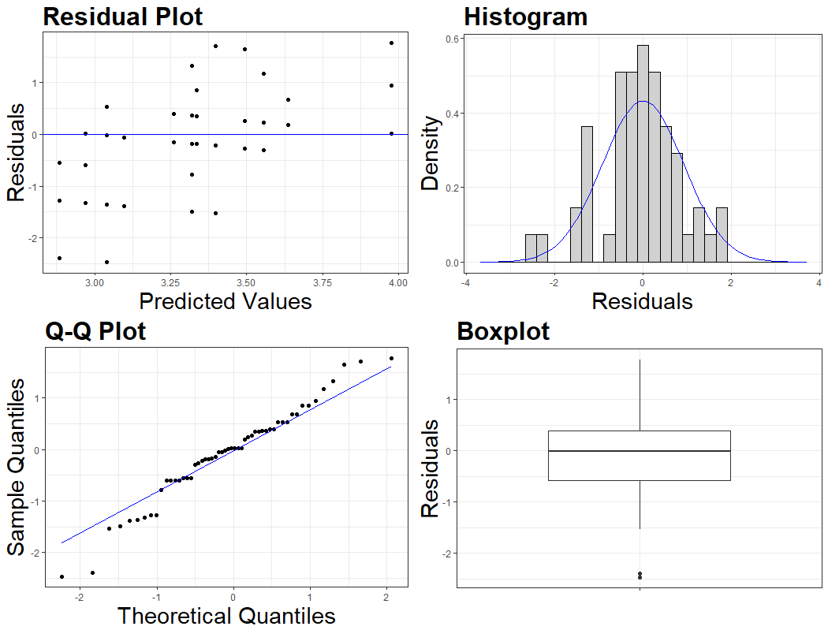
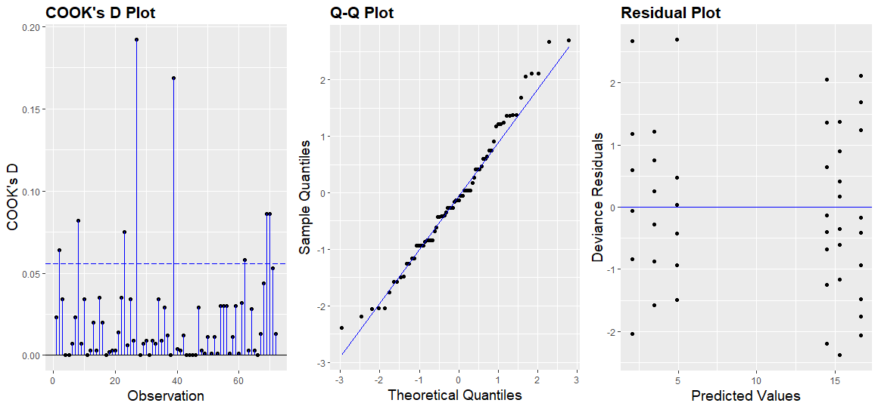
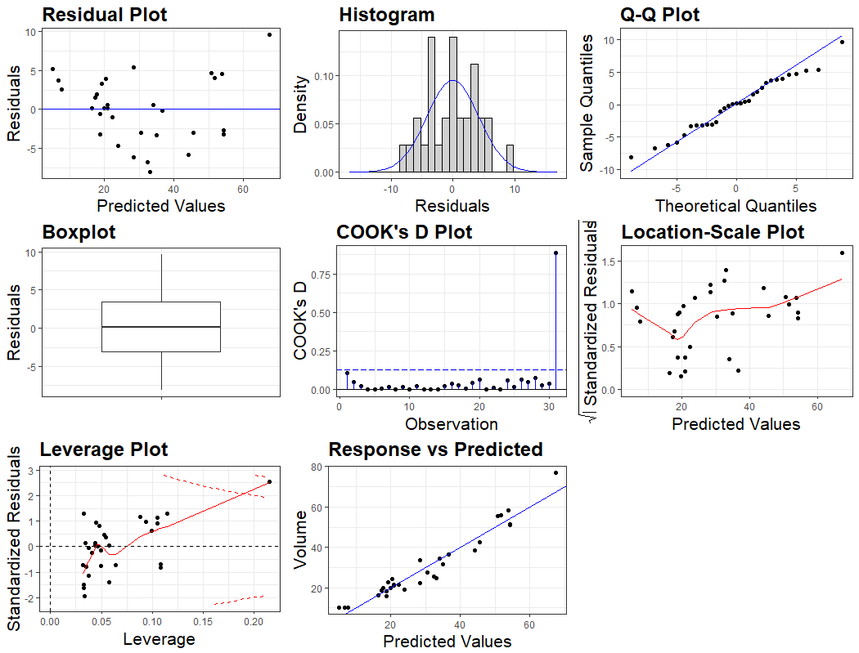
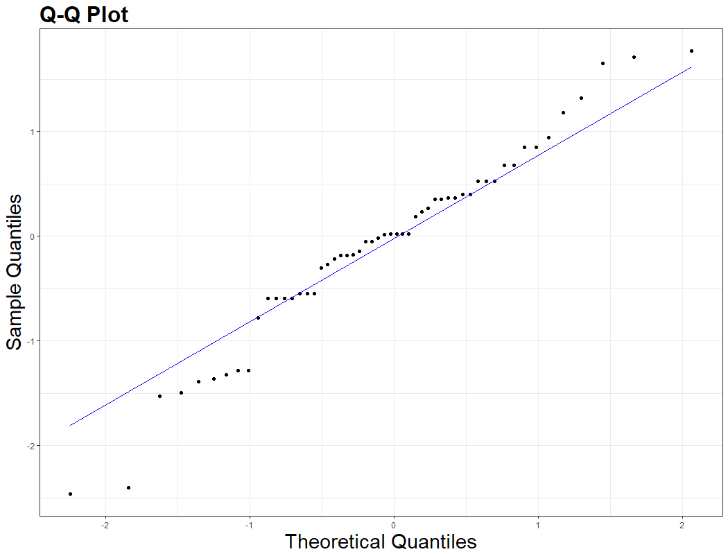
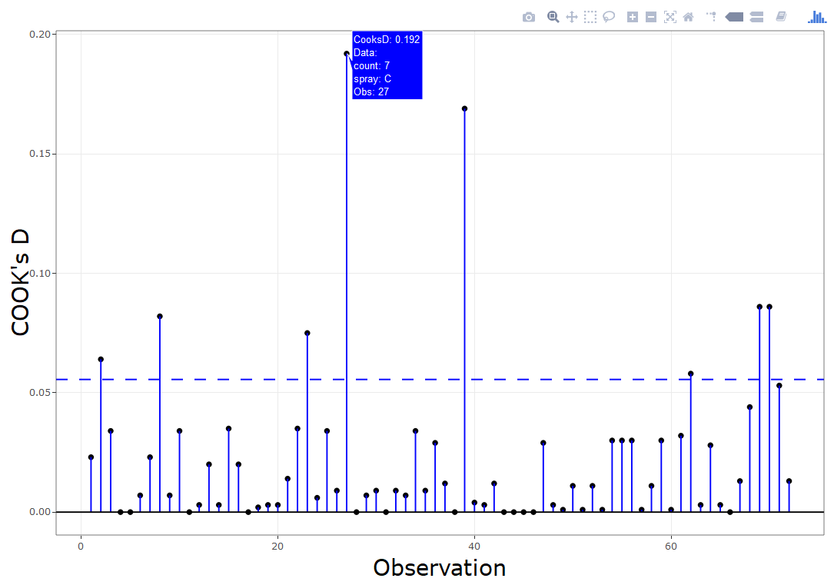
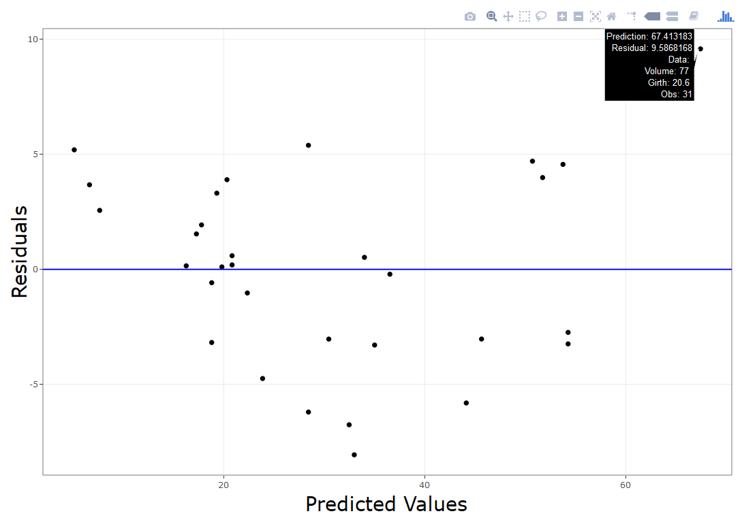
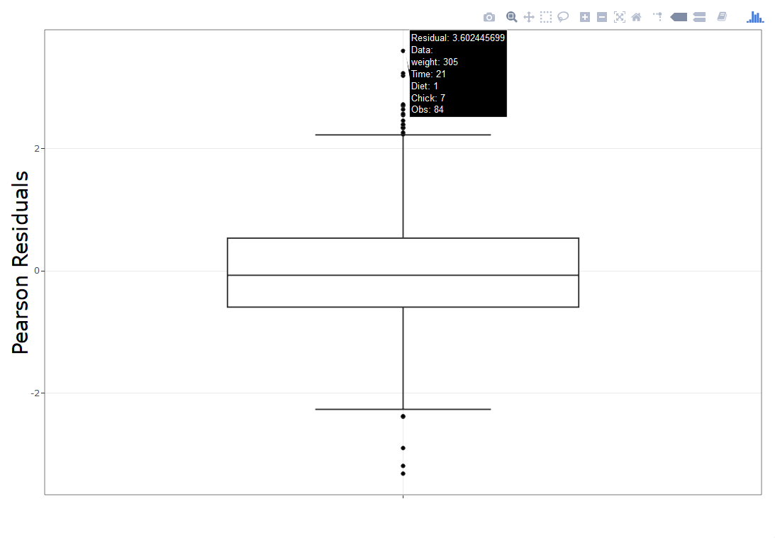

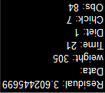
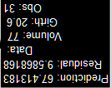
Statistics Department
Kansas State University Conference on Applied Statistics in Agriculture
May 8, 2018
Katherine Goode and Kathleen Rey$^{\text{†}}$
Introducing ggResidpanel: An R Package for Easy Visualization of Residuals
Introduction and Purpose
resid_panel: This function is designed to receive a model object and produce a panel of plots to analyze residuals and model assumptions from a variety of viewpoints.
resid_auxpanel: This function is designed to directly receive the residuals which enables the user to assess a wider variety of models.
As consultants on a wide variety of projects across many majors, a common oversight we encounter is a failure to examine the residuals. We were inspired by the residual panel in SAS to create an R package that easily provides users with a similar panel of plots for ‘lm’, ‘glm’, ‘lmer’, and ‘glmer’ models using ggplot2. An auxiliary function was also included to receive and plot residuals from any model type. Further capabilities include interactive plots for identifying the data associated with outliers and influential points.
resid_panel(model, qqbands = TRUE)
resid_panel(model, plots = "R", smoother = TRUE, theme = “classic")
resid_panel(model, type = "pearson", plots = "resid", title.opt = FALSE, smoother = TRUE, axis.text.size = 12)
resid_auxpanel(resid(model, type = "deviance"), fitted(model))
Plots Available
"boxplot": A boxplot of residuals
"cookd": A plot of Cook's D values versus observation numbers
"hist": A histogram of residuals (optional number of bins)
"ls": A location-scale plot of residuals
"qq": A normal quantile plot of residuals (optional confidence bands)
"lev": A plot of leverage values versus residuals
"resid": A plot of residuals versus predicted values (optional smoother)
"yvp": A plot of observed response values versus predicted values
Figure 1: The default panel inspired by SAS
Figure 2: A panel that presents the base R plots
Figure 3: A single plot with a variety of format options
Figure 9: Allows the user to directly input the residuals while producing the same panel as ‘resid_panel’
resid_panel(model, plots = c("cookd", "qq", "resid"),
ind.ncol = 3, theme = “grey”)
resid_panel(model, plots = “all”)
resid_auxpanel(resid(model, type = "deviance"), fitted(model),
plots = “qq”)
Residual Types (* denotes default)
raw*, Pearson, standardized“
raw, Pearson, deviance*, standardized Pearson, standardized deviance
raw, Pearson*
raw, deviance*, Pearson
lm
lmer
glm
glmer
Figure 4: The user can choose which plots to display in a panel
Figure 10: Individual plot selected with ‘resid_auxpanel’
Figure 5: A panel with all available plots
Format Options
resid_interact: This function is designed to connect the data to the plot in an interactive way using ‘plotly’.
Future Work
Text size
Theme
Title option
Plot scaling
resid_interact(model, plot = "cookd“)
resid_interact(model, plot = “resid")
resid_interact(model, plot = “boxplot")
Add a function that accepts multiple models to compare the residuals
Create a grid of interactive plots
Incorporate an extended panel similar to SAS that includes model summary statistics
Integrate an option for a “theme object” to allow users to further adjust the formatting using all capabilities available in ggplot2
Include an option for standardized residuals with ‘lmer’ and ‘glmer’ models
Write a vignette with more detailed instructions on how to use the package and specifications of how residuals are computed
Figure 6: An interactive Cook’s D plot
Figure 7: An interactive residual plot
Figure 8: An interactive boxplot
Acknowledgements: Iowa State University AES Consulting Group and Dr. Heike Hoffman
† Authors listed in alphabetical order

