Slide 1
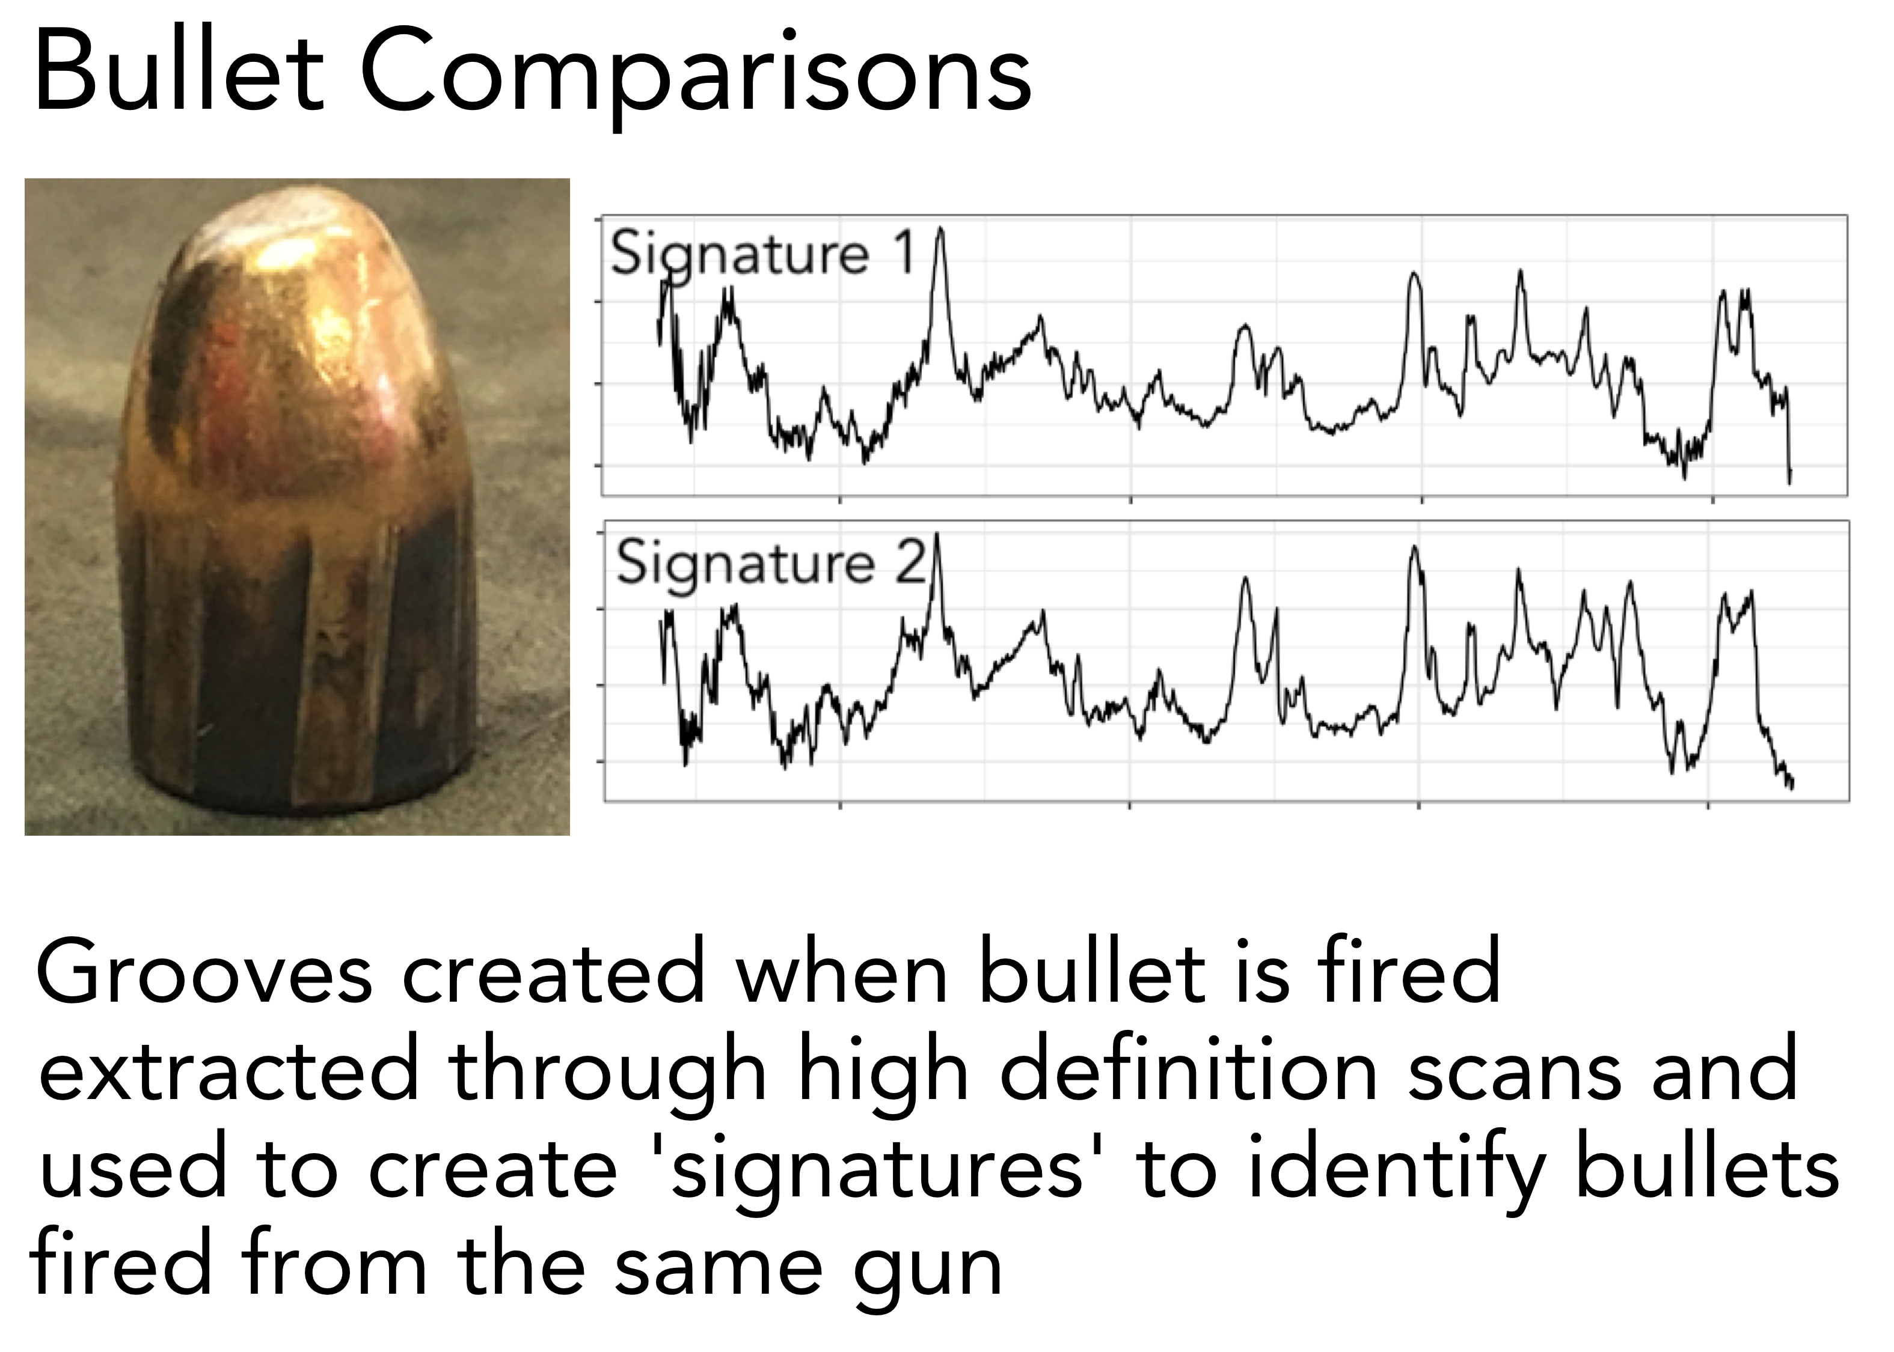
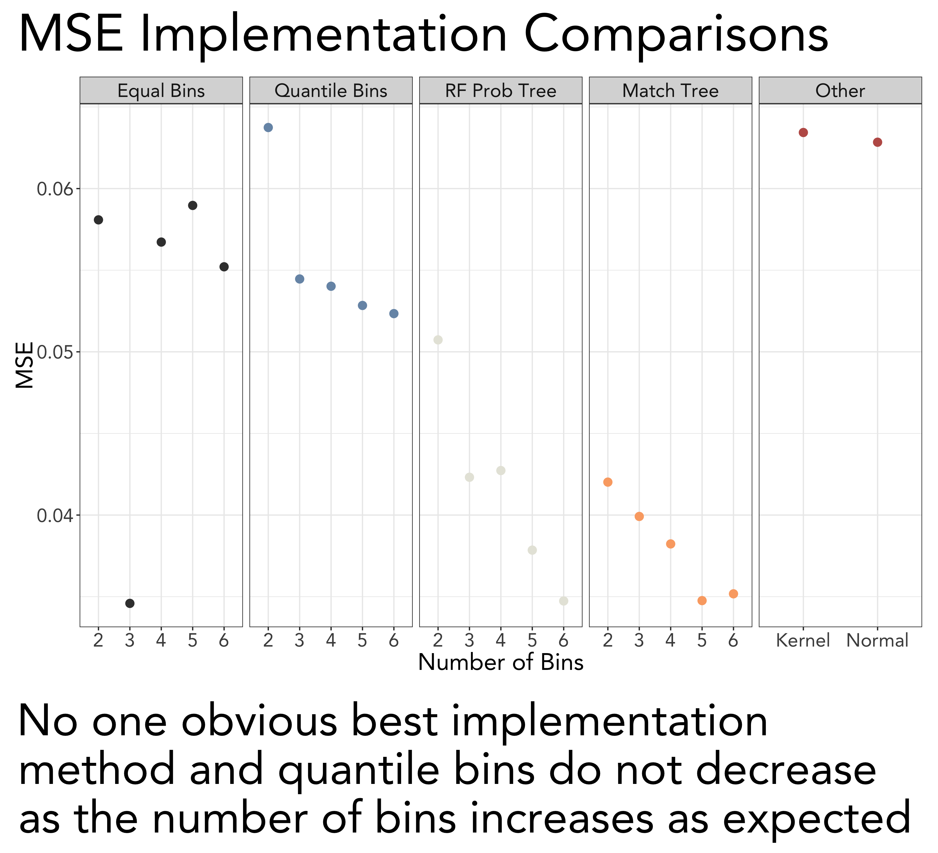
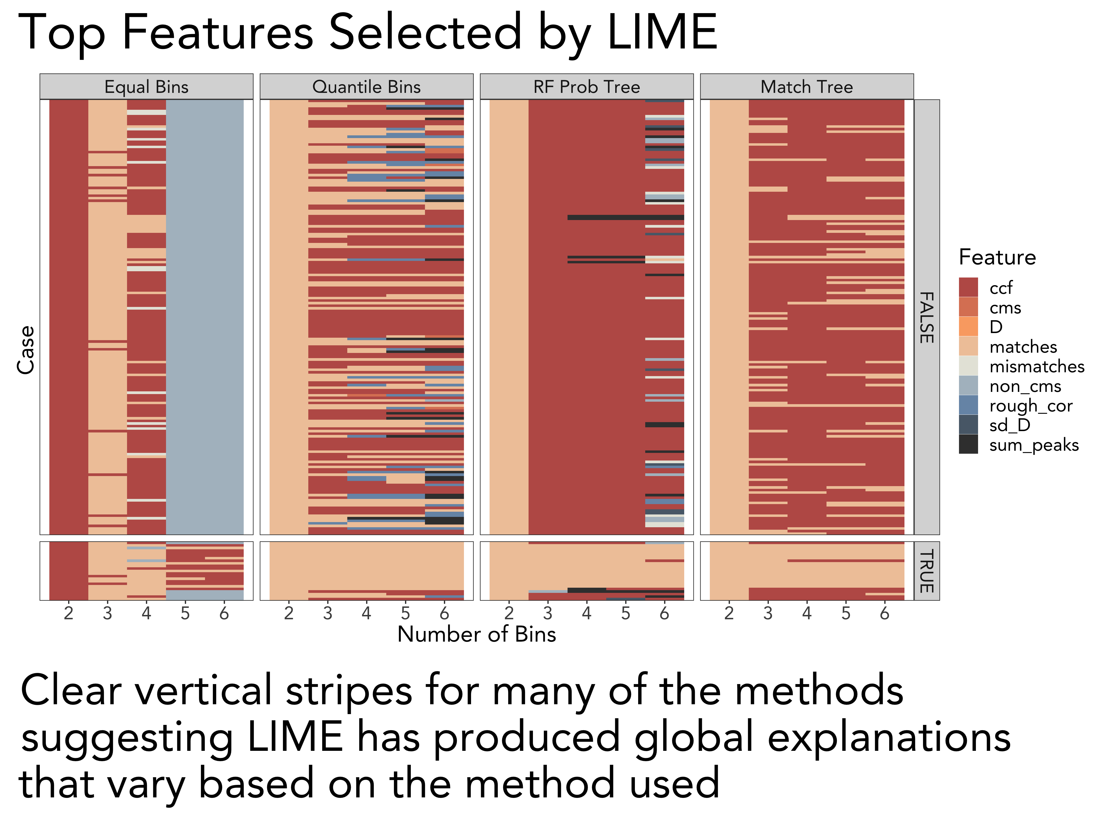
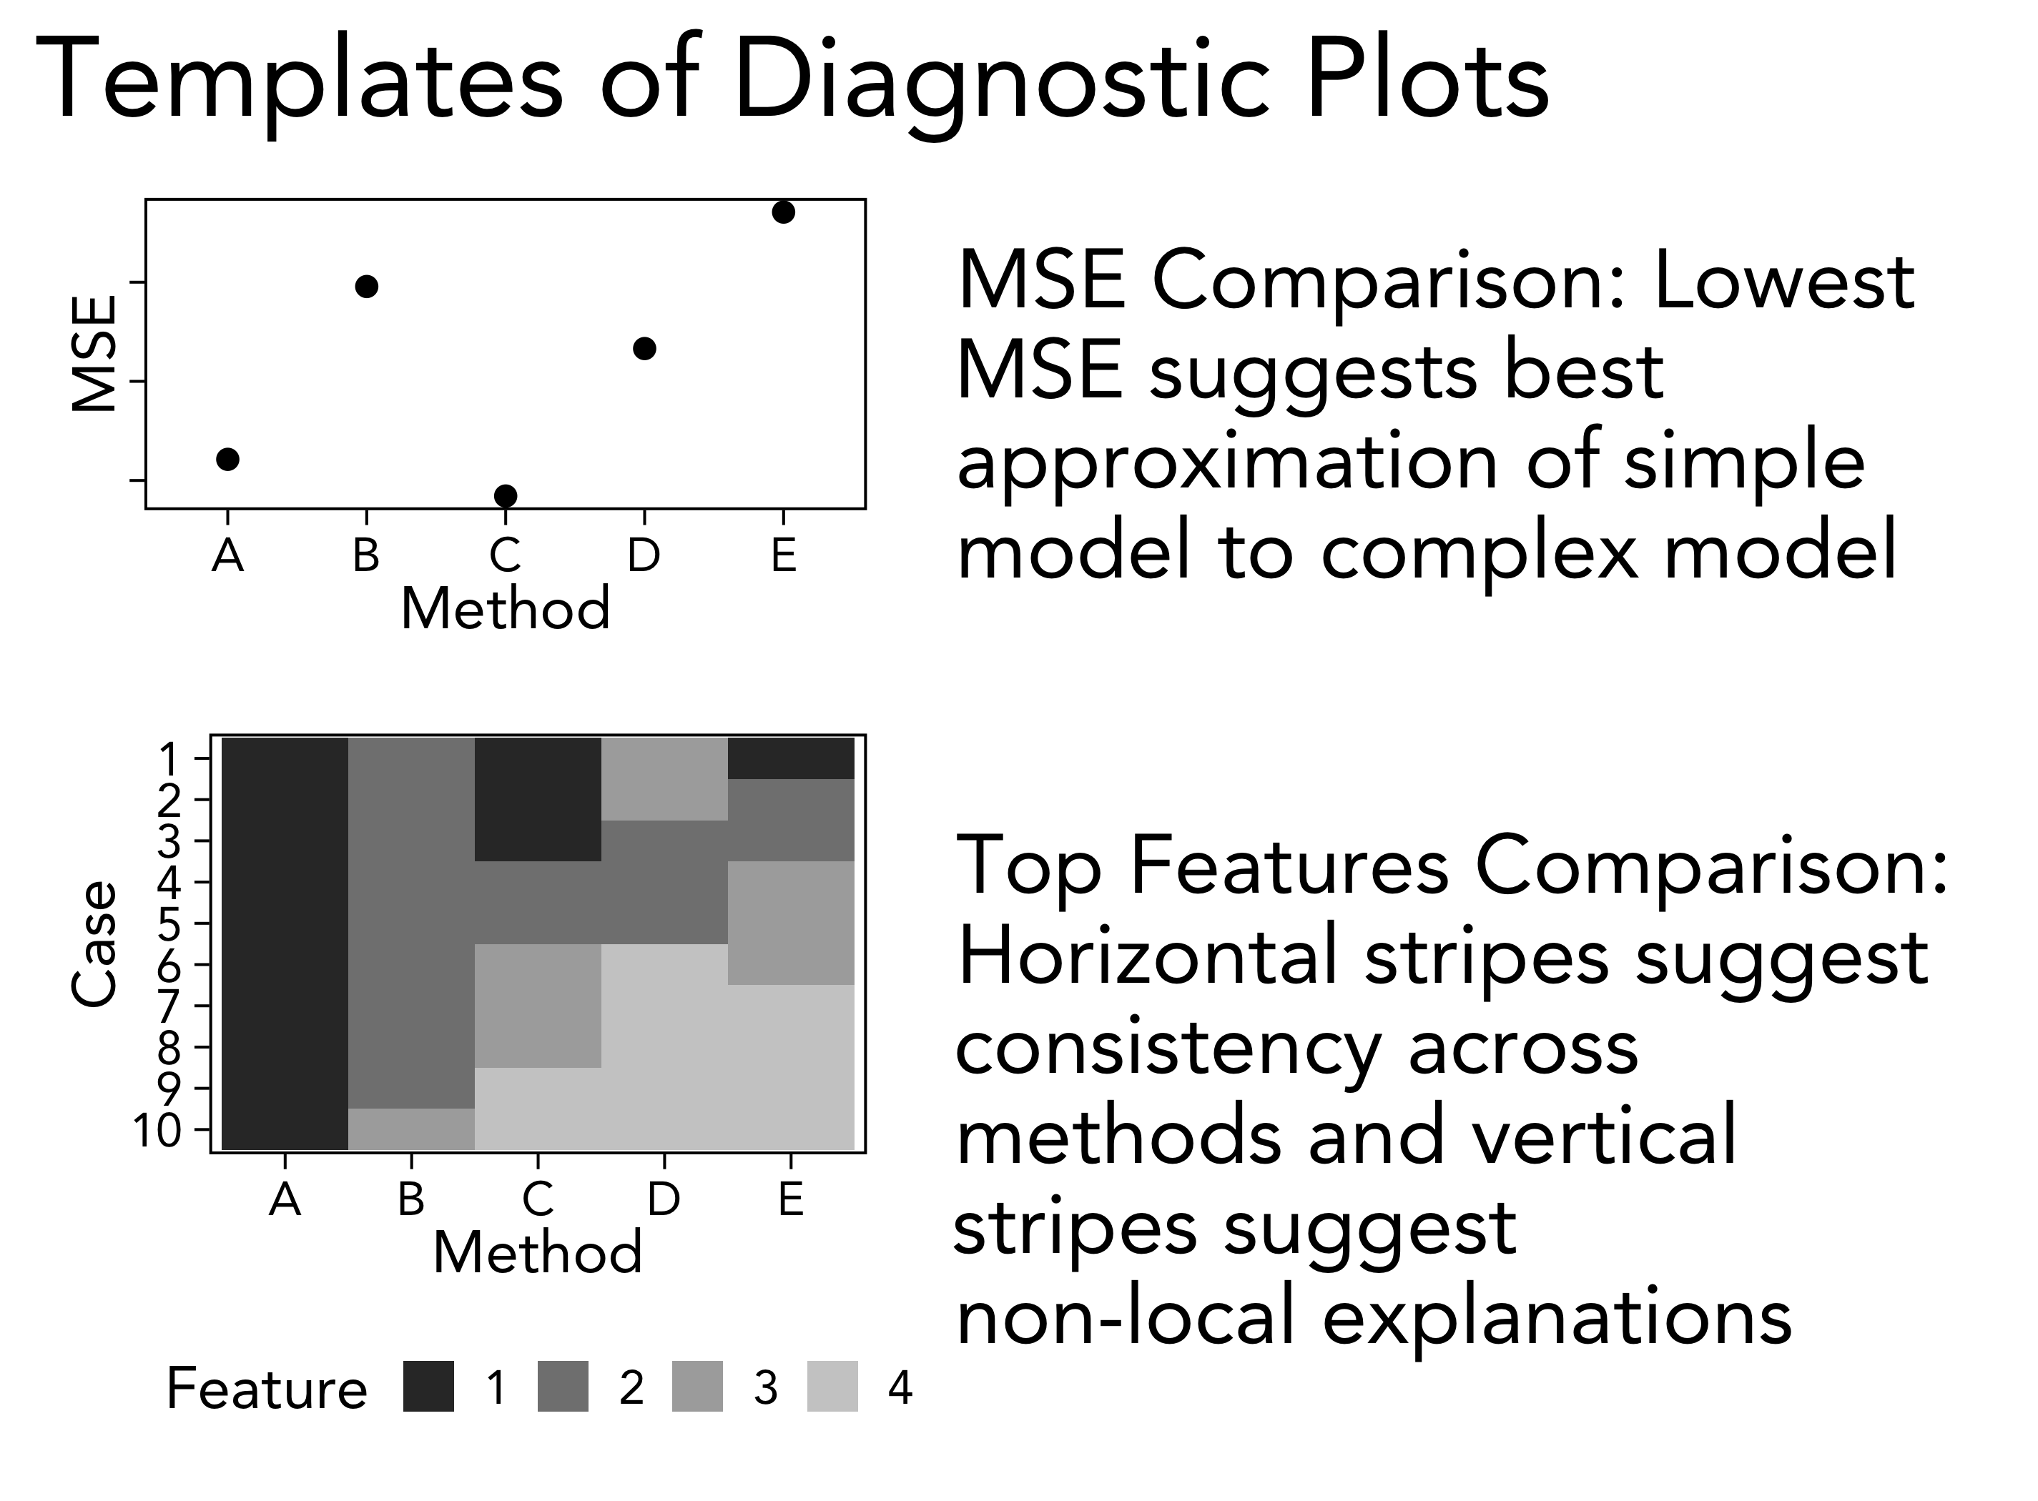
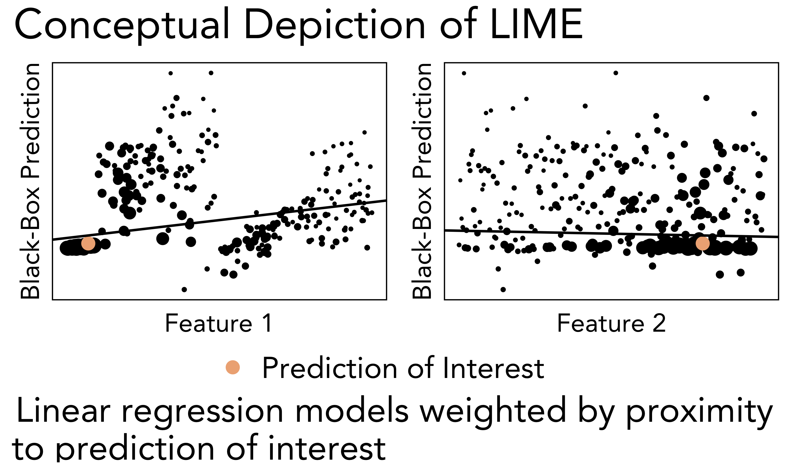
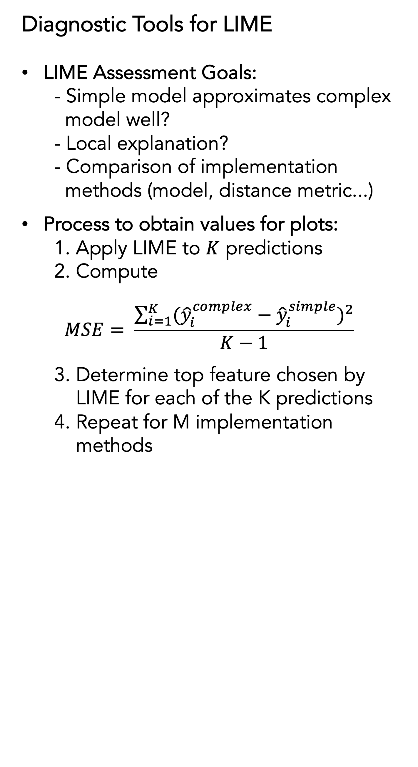
Visual Diagnostics of a Model Explainer: Tools for the Assessment of LIME Explanations from Random Forests
Iowa State University Department of Statistics
Katherine Goode and Dr. Heike Hofmann
Overview
Difficult to interpret “black-box” models
LIME provides “explanations” for black-box model predictions
Want to assess LIME explanations
Developed diagnostic visualization tools
Applied tools to a random forest model fit to a bullet matching dataset
Diagnostic Tools for LIME
LIME Assessment Goals:
- Simple model approximates complex
model well?
- Local explanation?
- Comparison of implementation
methods (model, distance metric...)
Process to obtain values for plots:
1. Apply LIME to $K$ predictions
2. Compute
$$MSE= \frac{\sum_{i=1}^{K}{{({\hat{y}}_{i}^{complex}−{\hat{y}}_{i}^{simple})}^{2}}}{K−1}$$
3. Determine top feature chosen by
LIME for each of the K predictions
4. Repeat for M implementation
methods
Bullet Matching Example
Data: Markings on bullets used to predict whether two bullets were fired from the same gun using a random forest model (Hare, Hofmann, and Carriquiry 2017)
Methods: Applied LIME in R to all observations in testing dataset using several LIME implementation methods
Background on LIME (Ribeiro et al. 2017)
LIME: Local Interpretable Model-Agnostic Explanations
Concept: Approximate relationship between black-box predictions and features near a prediction of interest using an “explainer” model (a “simple” and interpretable model)
Interpret explainer to select key features
Discussion
Important to diagnose LIME explanations to see if dependent on implementation methods and if local assumption is met
How to choose an implementation method?
References
Hare, E., Hofmann, H., and Carriquiry, A. (2017), “Automatic matching of bullet land impressions,” The Annals of Applied Statistics, 11, 2332–2356. https://doi.org/10.1214/17-aoas1080 .
Pedersen, Thomas Lin and Benesty, Michaël (2018). lime: Local Interpretable Model-Agnostic Explanations. R package version 0.4.1. https://github.com/thomasp85/lime
Ribeiro, M., Singh, S., and Guestrin, C. (2016), “‘Why Should I Trust You?’: Explaining the Predictions of Any Classifier,” 1135–1144. https://doi.org/10.1145/2939672.2939778 .

