Slide 1
complaint-router
Lab 2: data pipeline, versioning, baseline and MLflow
KSE MLOps · Lab 2 · Zakhar Staryk · github.com/goodfrog33/kse-mlops-complaint-router · tag lab-2
39
0.638 vs 0.384
0.0000
monthly batches through Airflow
macro-F1, model vs rule
reproduce difference

Slide 2
At a glance
Data versioned
Pipeline
117,000 complaints, 39 months, DVC
MinIO remote + public read-only mirror
Airflow 3.3.1, six tasks, one month per run
Reruns leave identical rows
Quality gate
Model and lineage
Fails on purpose (fault injection)
Fails for real: 2025-12 → 2026-06
TF-IDF 0.638 vs keyword rule 0.384
MLflow v2 @champion, reproduced exactly

Slide 3
Raw data is versioned with DVC
Sample | 39 monthly CSVs × 3,000 complaints (66 MB)
Drawn by | hash of complaint_id: uniform, byte-identical reruns
Data version | 0319edfe2ad83a39d4d8241602a462f8
Remotes | MinIO s3://dvc · public HTTP mirror
Pull | make data · make data-public
Checksum | 0bba9005abf7d408af110f7a192fc13a
39 CSV files
data/raw/ccdb_sample/
.dvc file in Git
hash 0319edfe…
MinIO remote
make data
Public mirror
make data-public

Slide 4
One Airflow run per month, never the clock
extract
validate
transform
load
build_features
quality_check
Batch
Schedule (@monthly)
Concurrency
data_interval_start
CronDataIntervalTimetable
6 months at once: 39 in 113 s
raw.complaints
dwh.complaints
features.complaint_features
as published, text columns
typed, mapped, PII-masked
feature_version, data_version
PostgreSQL warehouse

Slide 5
Rerunning a month leaves identical rows
Run 1 · 2024-06 | rows
raw.complaints | 3000
dwh.complaints | 3000
features | 1013
checks passed | 5 / 5
Run 2 · 2024-06 | rows
raw.complaints | 3000
dwh.complaints | 3000
features | 1013
checks passed | 5 / 5
Content hash, before and after
e15aa30f…
IDENTICAL
md5 of every feature row of the month
Why: every load deletes the month, then inserts it, in one transaction
delete from <table> where batch_month = %s; copy <table> from stdin

Slide 6
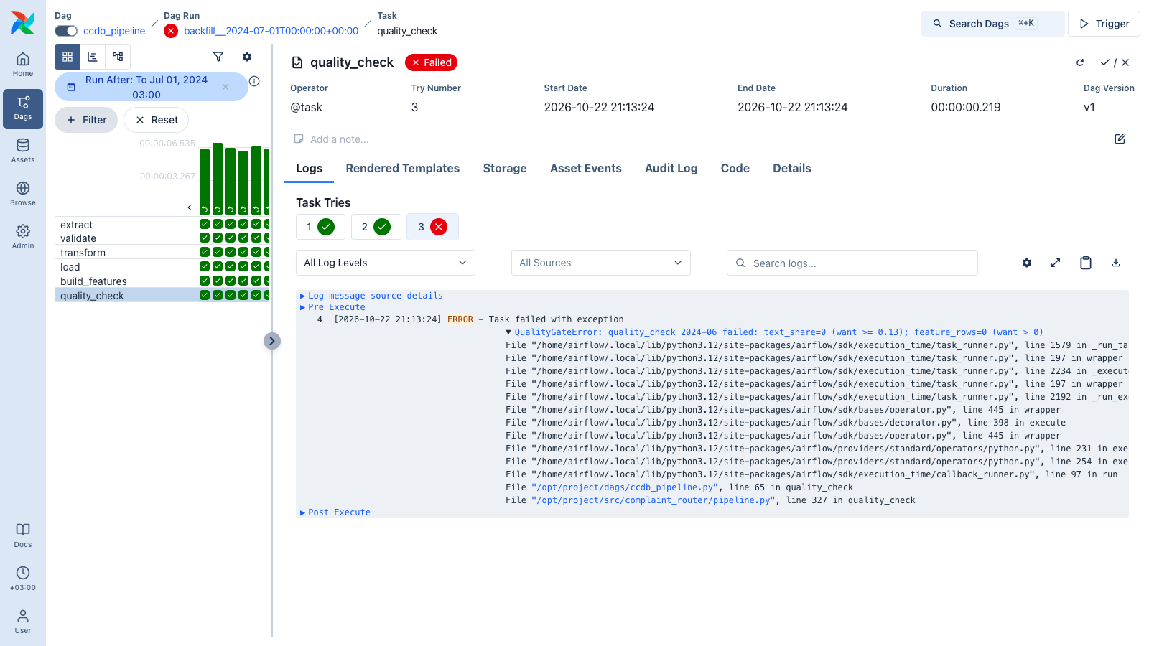
The quality gate fails when it should
On purpose: FAULT=null_narratives
text_share=0 (want >= 0.13); feature_rows=0 (want > 0)

Slide 7
Every feature has a serving-time source
Feature | Training | Serving
text | dwh narrative, clean_text_expr | request, clean_text (tested equal)
submitted_via | CFPB field | request; missing → unknown
state | CFPB field | request; missing → unknown
company | normalized name | dropped: sources differ
Feast: point-in-time join
Complaint on 2024-07-15; feature rows at 07-01 and 08-01
Company | Got | Later
Ally Financial | 3 | 5
American Express | 6 | 8
Affirm | 4 | 3
EARLIER ROW EVERY TIME
make feast-demo

Slide 8
The model beats the rule on every split
Backtest month | Model | Rule
2025-07 | 0.652 | 0.374
2025-08 | 0.682 | 0.377
2025-09 | 0.716 | 0.405
mean ± std | 0.684 ± 0.026 | 0.385 ± 0.014
Random split: 0.591
No inflation on this uniform 0.5% sample; time split kept because it matches use

Slide 9
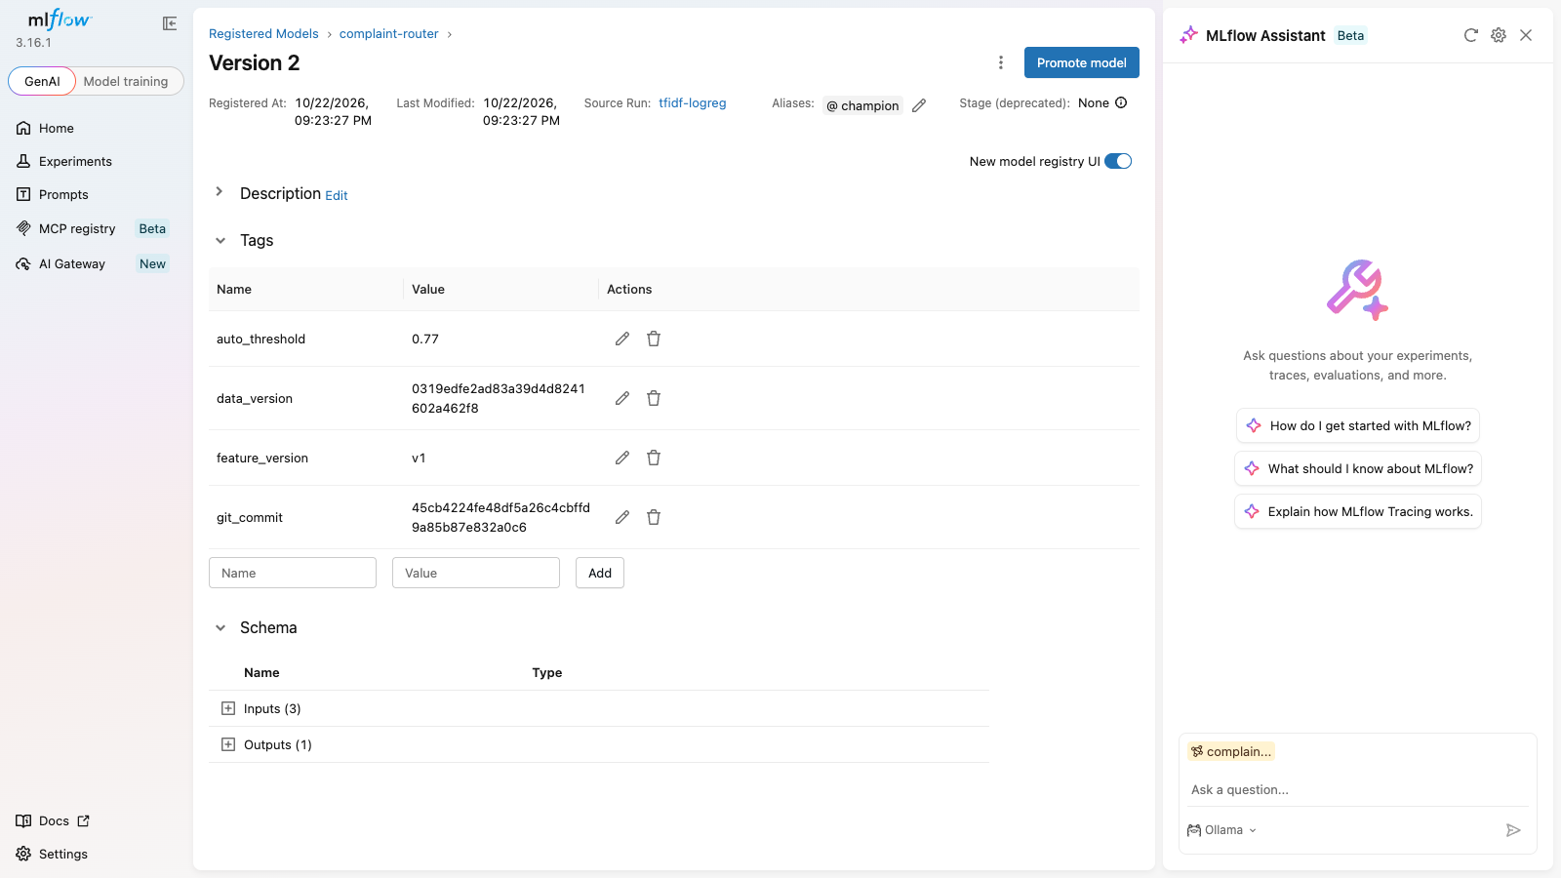
Every run carries its data version and commit
Server
MLflow 3.16.1 · Postgres backend · MinIO artifacts
Registered
complaint-router v2 · @champion
Lineage tags
data_version · git_commit
Rule baselines, backtest folds and the random-split check are logged with the same tags.

Slide 10
One command reproduces the champion
1. Read tags from registry
2. git worktree at commit
3. dvc pull + hash check
4. Rebuild features, retrain
$ make reproduce
version 2: commit 45cb4224fe, data 0319edfe…, test_macro_f1 0.6378
registered 0.6378 reproduced 0.6378 |diff| 0.0000 tolerance 0.005 -> OK
0.0000
0.005
difference on the same platform
tolerance: BLAS and thread differences

Slide 11
Lab 2 rows of the maturity scorecard
Property | Evidence
Data versioned | make data-public restores 39 files, checksum 0bba9005…
Pipeline idempotent | 2024-06 twice: 3000 / 3000 / 1013, same hash
Quality gate present | fault fails quality_check; 2025-12 → 2026-06 fail for real
Experiments tracked | every run: params, metrics, data_version, git_commit
Model registered with lineage | v2 @champion; make reproduce → diff 0.0000
Run it
make setup
make up
make data-seed
make data
make backfill
make train
make reproduce
CI: lint, unit and pipeline tests

