Slide 1
Dragonfly Hardware Architecture Presentation
Audio Parameters
VYn_ps13201 V1.0

Slide 2
Dragonfly Electrical features(1/2)
Audio outputs Able to drive:
  8 Ohms integrated amplifier for Hands free function ->Dynamic :3.65Vpp min differentially
  32 Ohms inner speaker -> Receiving function
  stereo outputs for 16 Ohms stereo headphones
  Multiplexing of audio mono and stereo data sources from IOM2, I2S and
  analogue Auxiliary inputs (ANL/ANR)
Two microphone inputs (differential) and stereo auxiliary inputs
(single ended) :
  integrated amplifier allowed a direct microphone connection
  Auxiliary stereo input for external application (FM radio…)->avoid using of additional amplifiers
  2 integrated supply able to bias one microphone each
Integrated audio accessories recognition system:
  Able to detect up to 5 accessories without dedicated lines (RECO1 RECO2 on SYSOL2)
  Based on 4 recognition resistor values: 1200, 820, 560 and 330 ohms set on AUXMIC line

Slide 3
Dragonfly Electrical features(2/2)
6 analogues and Digital gains :
  3 for the downlink direction (RXVOL,RXPGA,EARGAIN-HFRGAIN)
    Digital:RXVOL,RXPGA from +12 dB to –36.1dB (20*log(value/64) , value from 1 to 255)
    Analogue:EARGAIN from +8 to –40 dB and HFRGAIN from +14 to –34 dB (4dB steps)
  2 for the uplink direction (TXPGA,TXGAIN)
    Digital: TXPGA from +12 dB to –36.1dB (20*log(value/64) , value from 1 to 255)
    Analogue: TX gain 35dB, 20dB and 7dB (for MIC and AUXMIC inputs)
  1 for side Tone path (SidePGA) from –60.2 dB to +5.4 dB

Slide 4
Dragonfly Digital Processing features (speech)
Acoustic Echo Cancellation and noise suppression DENS
  cancel echo perceived by the far end speaker
  reduce the environmental noise on the uplink direction-> increase far end speaker quality perception
Compression on the downlink direction AC:
  increase low level signals
Burst reduction BR :
  reduce 216.7 Hz Harmonics level on the uplink direction
Digital equalisation for:
  acoustic frequency response compensation (development purpose) AULS
  User equaliser feature (Bass+, treble+…..) AUMMI
High pass filter
  Filter to be compliant to GSM mask in Tx and Rx direction

Slide 5
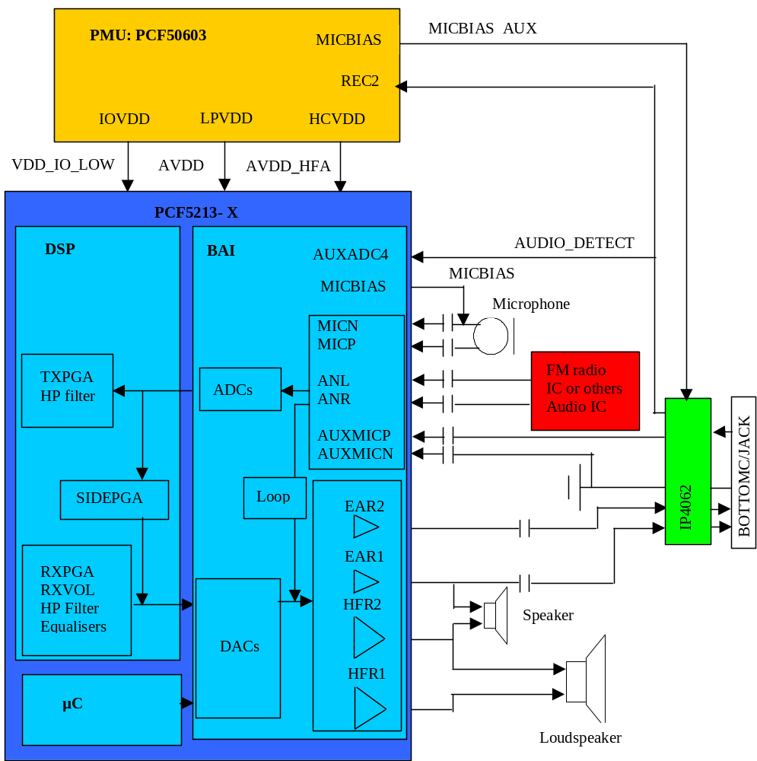
Dragonfly Bloc Diagram

Slide 6
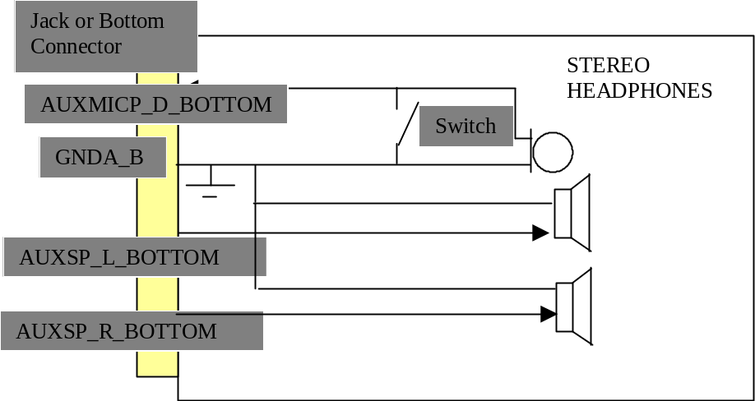
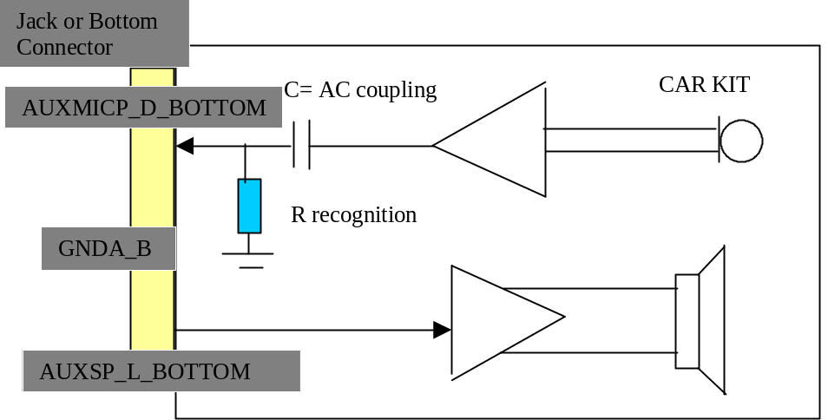
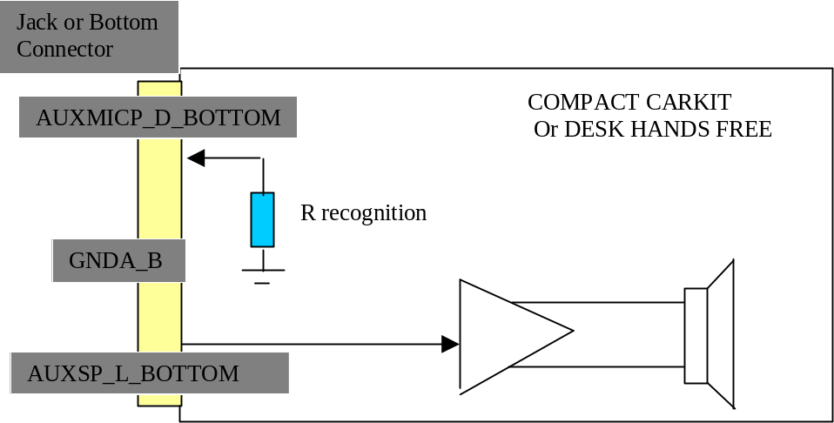
Dragonfly Audio accessories settings
Microphone consumption need to be between 100 and 500 µA

Slide 7
GSM Terminal
BaseBand and Audio Interface
Built in microphone for handset and hand free mode (can be also any other output and Auxmic input)
Mono ADC, 8kHz
IOM2one slot both directions
Mono DAC, 8kHz
Built in loudspeaker 8Ohm
for handset and hands free mode
ANL
ANR
FM
Receiver
Stereo DAC
DSP
A
D
I
F
Left
Headset
SIOY
A
F
E
Right
IOM2
EAR1
EAR2
Stereo ADC
AUXMICP
SC
IIS
Left
IIS
HFR1
HFR2
Right
MICP
MICN

Slide 8
Integrated MP3 Player
BaseBand and Audio Interface
Audio data via IIS,
Sampling rates
48 kHz, 44.1 kHz, 32 kHz,
24 kHz, 22.05 kHz, 16 kHz,
12 kHz, 11.025 kHz, 8 kHz
Stereo DAC
Output to headset(can be also any other output)
ANL
ANR
FM
Receiver
Stereo DAC
DSP
A
D
I
F
Left
Headset
SIOY
A
F
E
Right
IOM2
EAR1
EAR2
Stereo ADC
AUXMICP
SC
Left
IIS
IIS
HFR1
HFR2
Right
MICP
MICN

Slide 9
FM Reception (analog loop)
BaseBand and Audio Interface
Analog stereo audio data from FM receiver
(only ANL ANR can be used as inputs in this mode)
Analog loop via audio front end AFE
Stereo output to headset(or any other output)
ANL
ANR
FM
Receiver
Stereo DAC
DSP
A
D
I
F
Left
Headset
SIOY
A
F
E
Right
IOM2
EAR1
EAR2
Stereo ADC
AUXMICP
SC
IIS
Left
IIS
HFR1
HFR2
Right
MICP
MICN

Slide 10
Cordless Headset via Bluetooth
BaseBand and Audio Interface
Headset
8 kHz data from DSP to BT via IOM2
8 kHz data from BT via IOM2 to DSP
Bluetooth
PCF87752
+ UAA3559 (BGB101)
Bluetooth
ANL
ANR
FM
Receiver
Stereo DAC
DSP
A
D
I
F
Left
Headset
SIOY
A
F
E
Right
IOM2
EAR1
EAR2
Stereo ADC
AUXMICP
SC
IIS
IIS
Left
HFR1
HFR2
Right
MICP
MICN

Slide 11
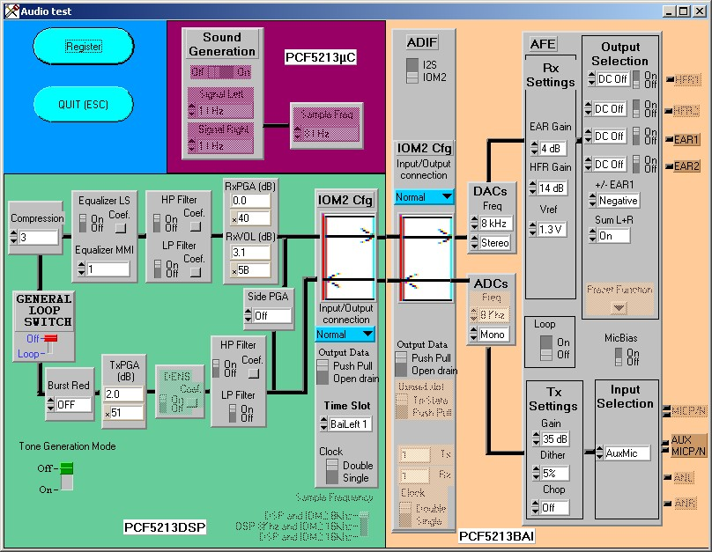
Dragonfly Test and Auto Test software
Audio loop window

Slide 12
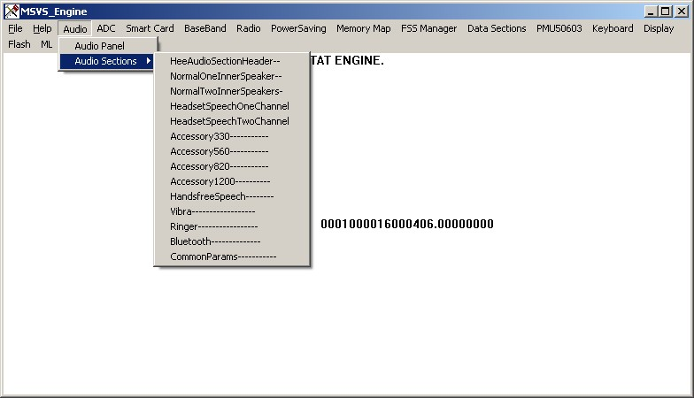
Dragonfly Test and Auto Test software
Audio data section: audio modes

Slide 13
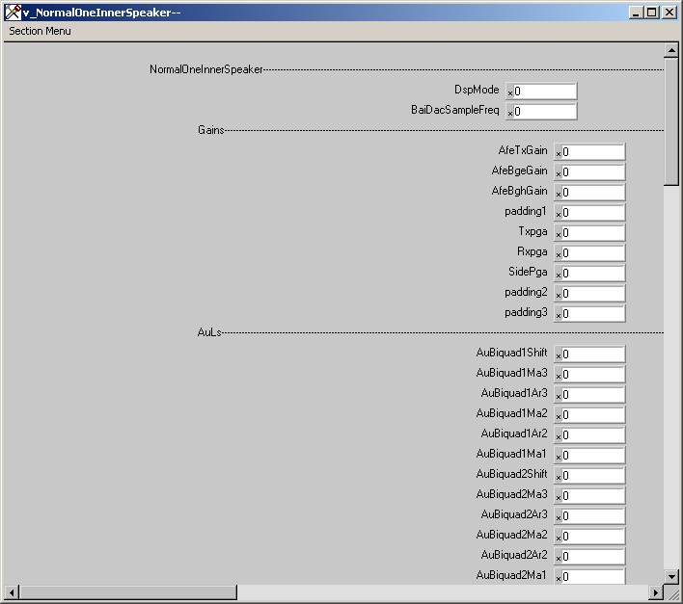
Dragonfly Test and Auto Test software
Audio data section: parameters per mode

Slide 14
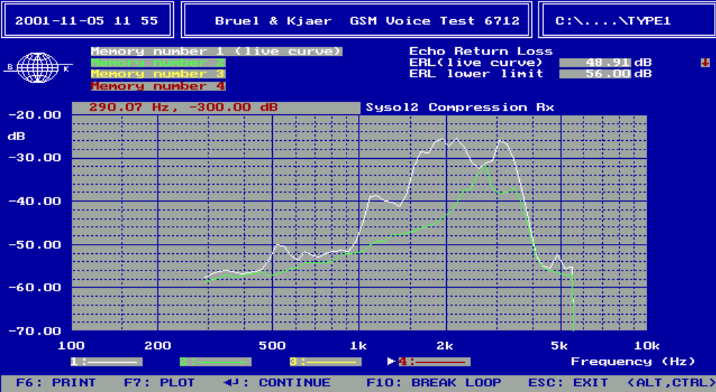
Dragonfly ALGORITHM:
Acoustic Echo cancellation (DENS)
AEC Off (white)-> ERL= 48.7 dB
AEC On (green)-> ERL=58.7 dB

Slide 15
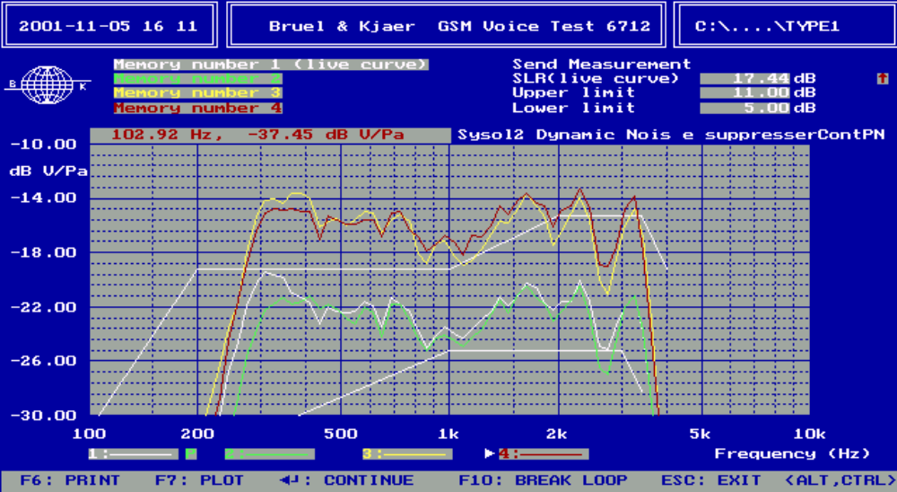
Dragonfly ALGORITHM:
Dynamic Noise Suppression (DENS)
Reduce the continuous noise signal up to 6 dB
input level :- 4.7dBPa SLR=11.1 dB
input level :-10dBPa SLR=11.3 dB
input level :-20dBPa SLR=18.2 dB
input level :-30dBPa SLR=17.4 dB

Slide 16
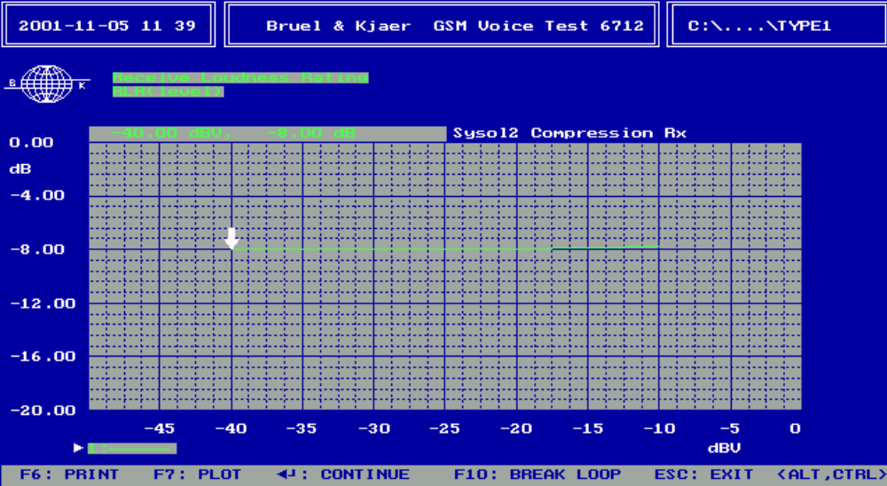
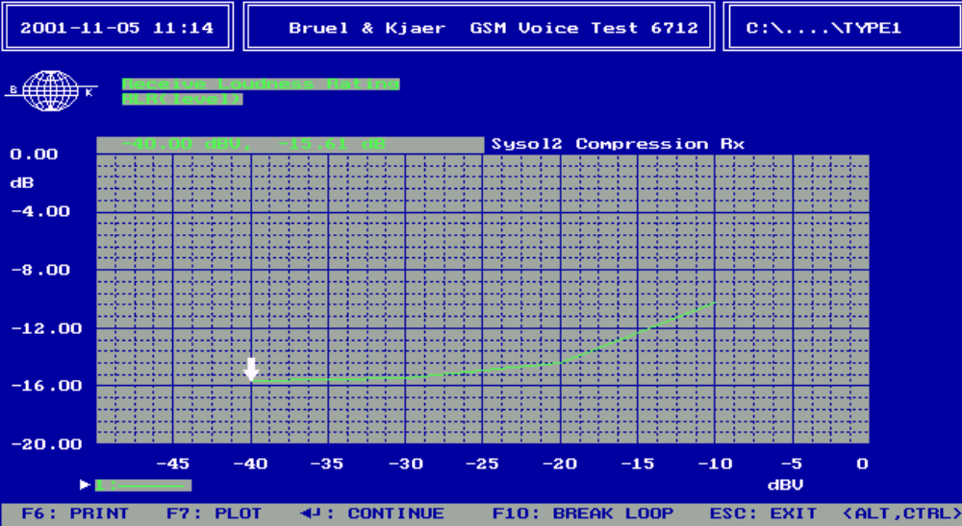
Dragonfly ALGORITHM:
Compression in the downlink direction (1/2)
Without compression RLR constant
With compression RLR depend on the input level

Slide 17
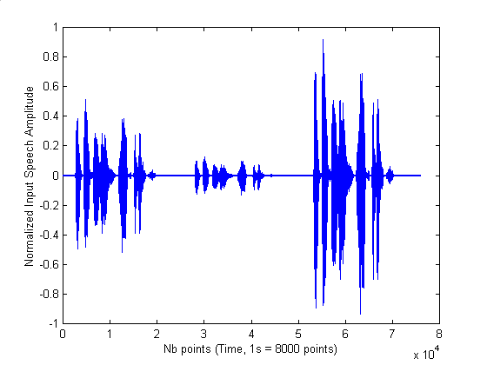
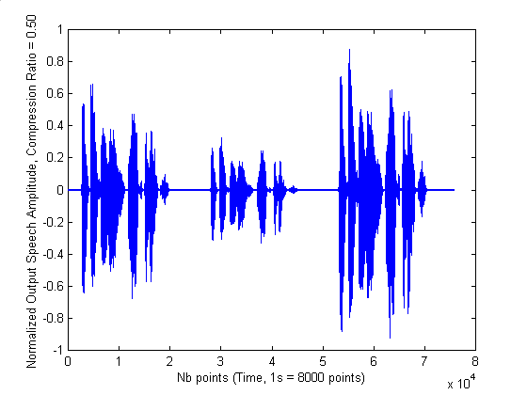
Dragonfly ALGORITHM:
Compression in the downlink direction (2/2)
Before compression
After compression
Compression is usually used on highest user volume levels
5 compression rates supported: 0.85 0.75 0.6 0.55 and 0.33 + OFF position

Slide 18
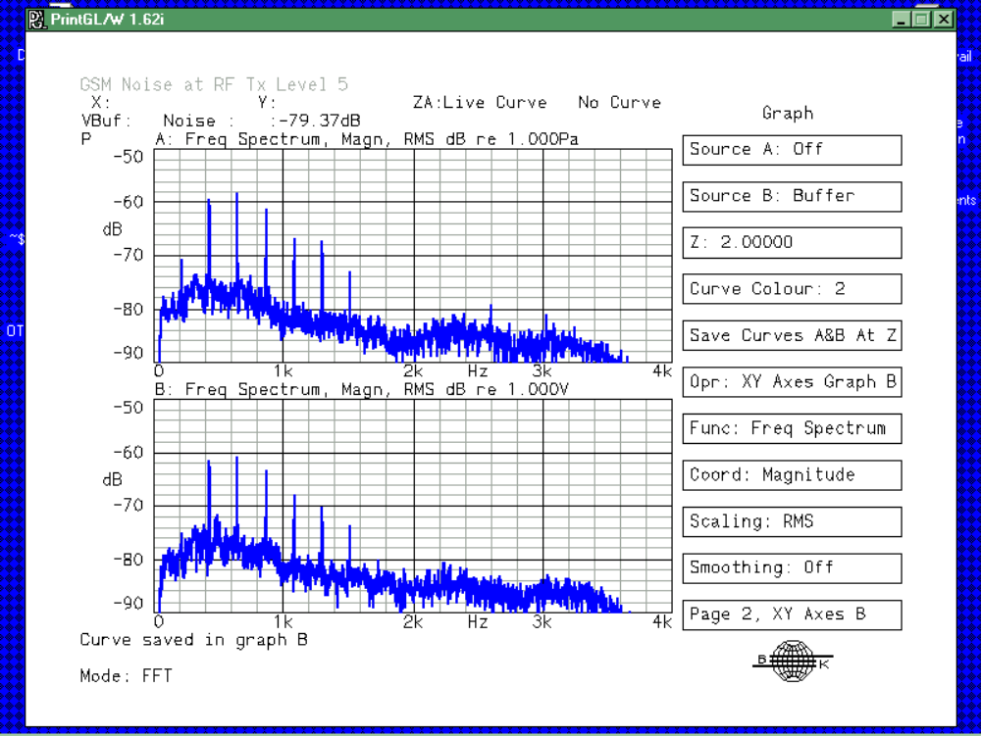
Dragonfly ALGORITHM:
Burst Reduction on uplink direction
BR Off ->H3=- 58 dBV
BR On ->H3= -61 dBV
3 reduction levels:
  -3 dB (BR=1)
  -5 dB (BR=2)
  -7 dB (BR=3)

Slide 19
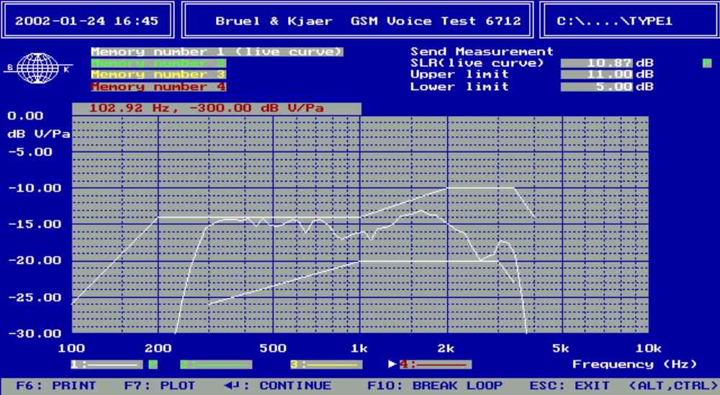
Dragonfly ALGORITHM:
Burst Reduction effect on Sending frequency response

Slide 20
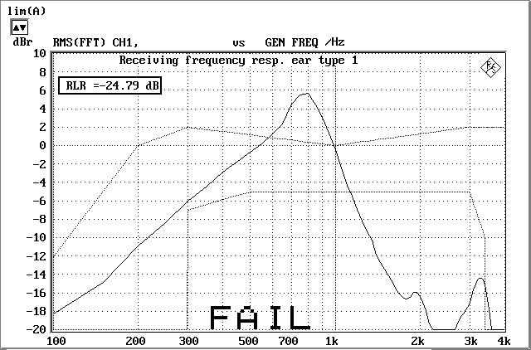
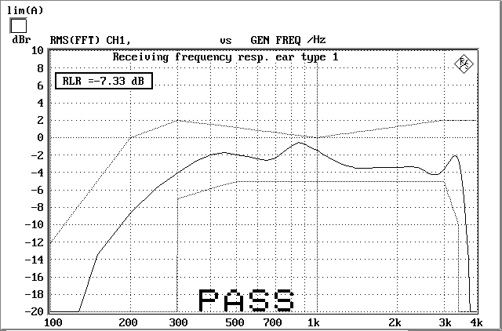
Dragonfly ALGORITHM:
Equaliser for acoustic compensation (AULS)
Acoustic without processing
Acoustic + Digital equaliser
Parameters of the filter tuneable
For each mode with TAT software

Slide 21
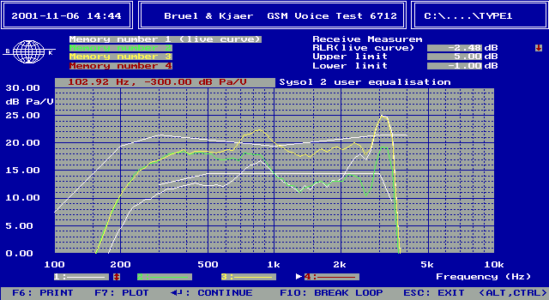
Dragonfly ALGORITHM:
User Equaliser (AUMMI)
Flat frequency response -> Yellow curve
Bass + -> green curve
Treble + -> white curve

Slide 22
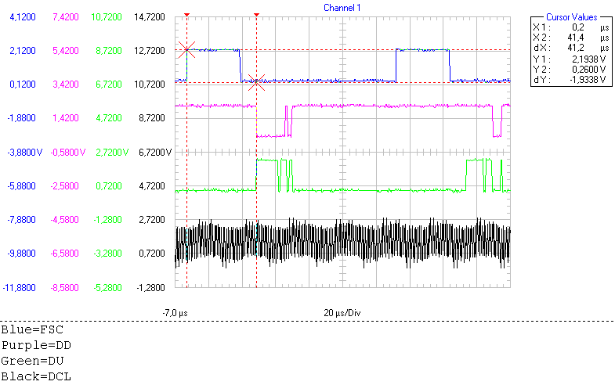
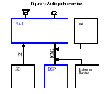
Dragonfly
SIOY bus (IOM2 like)
Data transfer from DSP to DAI
Double clock mode
DCL clock 1.536 MHz
FSC synchro 8 kHz
6 slot available:
  Slot 0 external USER (BT for ex)
  Slot1 BAI
  Slot 2 DAI interface
  Slot 3 external USER 16KHz (2nd slot)
  Slot 4 BAI 16 KHz (2nd slot)
  Slot 5 DAI interface 16 KHz (2nd slot)

Slide 23
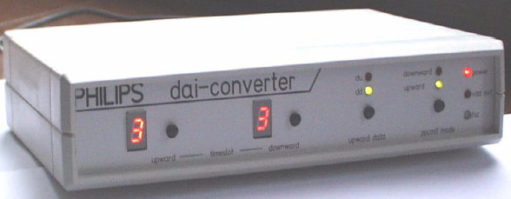
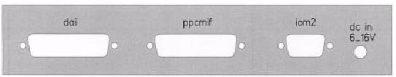
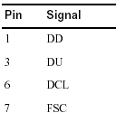

Dragonfly DAI interface :
DAI interface is used during audio test approval. The DAI path activation is set after the test bench layer 3 message sending

Slide 24
Dragonfly few PCB design rules
The tracks between the analogue input/output and microphone/speaker have to be shield with specific grounds.
The track resistance from the hands free outputs and the loudspeaker shouldn’t represent a significant impedance compare with the loudspeaker one.
The microphone speaker and loudspeaker tracks have to be set differentially.
The test point have to be include in the microphone and speaker footprint
Protection component have to be set as close as possible to the microphone and the BAI inputs.
Microphone lines have to set far from signal such as VBAT, backlight …
Baseband part have to be shielded

Slide 25
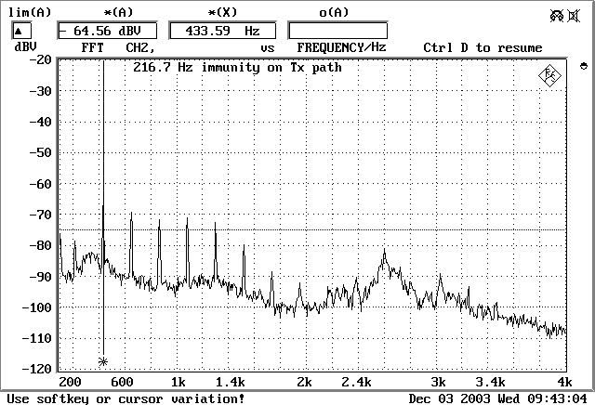
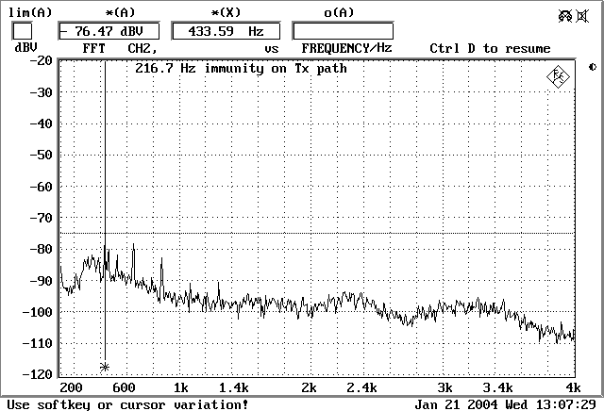
Dragonfly Protection IC’s
Integrated discrete ESD protection+ audio lines immunity:
IP4048: normal audio
IP4062: Auxiliary audio and SIM
IP4058:USB
IP5020: audio normal and auxiliary integration and protection
Normal microphone path, No protections
idem With IP4048+IP4062+IP5020

