Slide 1
Wideband Speech Coding for CDMA2000® Systems
Sassan Ahmadi, Milan Jelinek†, Redwan Salami‡, S. Craig Greer
Nokia Inc. USA
†University of Sherbrooke, Canada
‡VoiceAge Corporation, Canada

Slide 2
Outline
Overview of the 3GPP2 standardization process
Overview of VMR-WB architecture
Overview of the VMR-WB performance
Applications of VMR-WB

Slide 3
Overview of the 3GPP2 Standardization Process (1)
The variable-rate multimode wideband (VMR-WB) speech codec is the new cdma2000® wideband speech coding standard.
The standardization process in the 3rd Generation Partnership Project 2 (3GPP2) was initiated by Nokia in January 2002.
After comprehensive review and revision of the high-level requirements and the test plan, the selection phase started in November 2002.
Five candidate codecs including one from Nokia/VoiceAge participated in the competition.

Slide 4
Overview of the 3GPP2 Standardization Process (2)
Nokia/VoiceAge candidate is based on 3GPP/adaptive multi-rate wideband (AMR-WB) speech coding standard.
It is further interoperable with AMR-WB (ITU-T/G.722.2) in one of the operational modes.
Based on a stringent test plan, comprehensive statistical analyses that included global and condition-by-condition comparisons between each candidate codec and the references as well as between candidate codecs were performed to select the cdma2000® wideband speech codec.
AMR-WB was used as the reference codec.
Nokia/VoiceAge VMR-WB was selected as the winner in April 2003, outperforming other candidates with a large margin.

Slide 5
Overview of VMR-WB architecture (1)
Summary of the quality and average data rates of the existing modes of VMR-WB
Operating Rate-Set | Mode | Average Data Rate | Quality Reference
CDMA2000® rate-set II Radio Configuration 4(reverse link)/5 (forward link) | 0 | 9.14 kbps Same as TIA/EIA/IS-733 | No worse than 3GPP/AMR-WB @ 14.25 kbps under all conditions
 | 1 | 7.70 kbps Same as the average of TIA/EIA/IS-733 and TIA/EIA/IS-127 | No worse than 3GPP/AMR-WB @ 12.65 kbps under all conditions
 | 2 | 6.25 kbps Same as TIA/EIA/IS-127 | No worse than 3GPP/AMR-WB @ 8.85 kbps under all conditions
 | 3 | 9.49 kbps Not more than 12% of the ADR of TIA/EIA/IS-733 | No worse than 3GPP/AMR-WB @ 12.65 kbps under all conditions

Slide 6
Overview of VMR-WB architecture (2)
Although VMR-WB is based on AMR-WB core technology, new designs and certain improvements resulted in superior performance relative to AMR-WB
  Improved noise suppression
  New coding types optimized for voiced and unvoiced classes
  Signal modification
  Speech classification and rate determination
  Improved open-loop pitch search
  Novel post-processing technique for periodicity enhancement in the lower frequency band
  Improved frame error concealment mechanisms
  Other improvements

Slide 7
Overview of VMR-WB architecture (3)
Speech
Pre-processing
Spectral Analysis
VAD Noise Reduction
LP Analysis
Open-Loop Pitch Analysis
Noise Estimation
Rate Selection
Signal Modification
Modified Speech
Speech
Speech
CNG
Sub-Frame Loop
HR Voiced
- Compute ACB
Gain
- Compute FCB
- Compute FCB
Gain
- Synthesis
HR Unvoiced
QR Unvoiced
- Compute FCB
- Compute FCB
Gain
- Synthesis
Full Rates
General Purpose Half Rates
- Compute ACB
- Compute ACB Gain
- Compute FCB
- Compute FCB Gain
- Synthesis
FER Protection
Output Bit-Stream

Slide 8
Overview of VMR-WB architecture (4)
Input Bit-Stream
No
Frame Erasure
Yes
Decode classification
Decode LP filter
LP filter estimation
Noise/Silence
Active speech
CNG excitation
Noise synthesis
CELP Sub-Frame Loop
Excitation decoding
Speech synthesis
Synthesis speech scaling
Excitation estimation
Speech synthesis
Post-Processing
Noise/Silence
Active speech
High Frequency Generation
Output Speech

Slide 9
Overview of the VMR-WB performance (1)
Note that interoperability with AMR-WB was an optional feature during the selection phase
CDMA2000® Wideband Speech Codec Test Conditions
Clean Conditions | Nominal Audio Input Level, -22 dB
 | Low Audio Input Level, -35 dB
 | High Audio Input Level, -15 dB
 | Clear Channel Self-Tandem
Channel Burst Error Conditions | Clear Channel
 | 1% FER Forward + 1% Dim-and-Burst Signaling
 | 3% FER Forward + 1% Dim-and-Burst Signaling
 | 6% FER Forward + 1% Dim-and-Burst Signaling
Combined Background Noise and Channel Burst Error Conditions | Car noise @ 10dB SNR
 | Car noise @ 20dB SNR+2% FER+2% Packet-level signaling
 | Street noise @ 15dB SNR
 | Office noise @ 20dB SNR+2% FER+2% Packet-level signaling

Slide 10
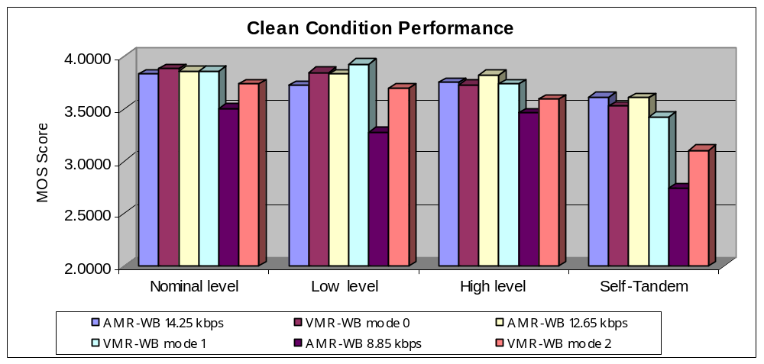
Overview of the VMR-WB performance (2)

Slide 11
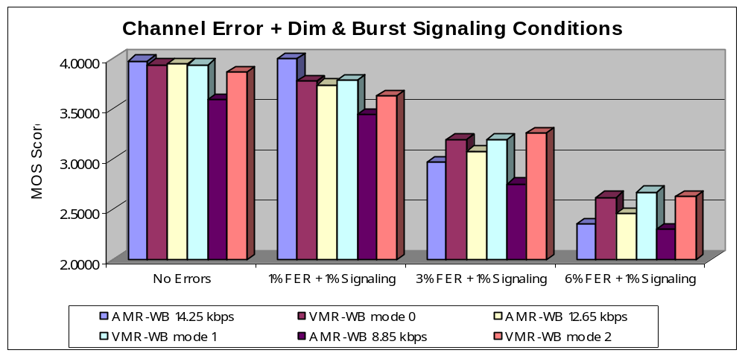
Overview of the VMR-WB performance (3)

Slide 12
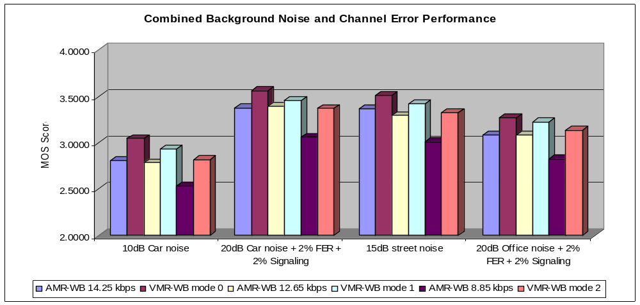
Overview of the VMR-WB performance (4)

Slide 13
Applications of VMR-WB
Modes of the cdma2000® wideband speech codec | Applications
Rate-set II modes 0, 1, and 2 | Packet-Switched VoIP, TFO, or TrFO Mobile-to-Mobile calls within CDMA2000® networks, Multimedia Streaming, and Instant Messaging between CDMA2000® terminals, Multimedia content generation, Internet applications
Rate-set II mode 3 [3GPP/AMR-WB (ITU-T/G.722.2) interoperable mode] | Packet-Switched VoIP Mobile-to-Mobile Calls, Multimedia content exchange between GSM/WCDMA and CDMA2000® terminals, Multimedia content generation for both CDMA2000® and GSM/WCDMA networks and terminals, Internet applications

