Slide 1


VMR-WB – Operation of the 3GPP2 Wideband Speech Coding Standard
M. Jelinek†, R. Salami‡ and S. Ahmadi*
†University of Sherbrooke, Canada
‡VoiceAge Corporation, Canada
*Nokia Inc., USA

Slide 2
Outline
VMR-WB key features
Background
VMR-WB rate selection
AMR-WB ↔ VMR-WB interoperation
Performance

Slide 3
VMR-WB Key Features
Variable-Rate Multi-Mode Wideband Speech Codec
New 3GPP2 WB speech coding standard for 3G applications
Near face-to-face communication speech quality

Slide 4
VMR-WB Key Features
Variable-Rate Multi-Mode Wideband Speech Codec
New 3GPP2 WB speech coding standard for 3G applications
Near face-to-face communication speech quality
Source and network controlled operation (4 modes)

Slide 5
VMR-WB Key Features
Variable-Rate Multi-Mode Wideband Speech Codec
New 3GPP2 WB speech coding standard for 3G applications
Near face-to-face communication speech quality
Source and network controlled operation (4 modes)
3GPP/ITU AMR-WB interoperable in mode 3

Slide 6
VMR-WB Key Features
Variable-Rate Multi-Mode Wideband Speech Codec
New 3GPP2 WB speech coding standard for 3G applications
Near face-to-face communication speech quality
Source and network controlled operation (4 modes)
3GPP/ITU AMR-WB interoperable in mode 3
Compliant with CDMA2000 rate set 2

Slide 7
VMR-WB Key Features
Variable-Rate Multi-Mode Wideband Speech Codec
New 3GPP2 WB speech coding standard for 3G applications
Near face-to-face communication speech quality
Source and network controlled operation (4 modes)
3GPP/ITU AMR-WB interoperable in mode 3
Compliant with CDMA2000 rate set 2
WB (50-7000 HZ) and NB (200-3400 Hz) input/output

Slide 8
VMR-WB Key Features
Variable-Rate Multi-Mode Wideband Speech Codec
New 3GPP2 WB speech coding standard for 3G applications
Near face-to-face communication speech quality
Source and network controlled operation (4 modes)
3GPP/ITU AMR-WB interoperable in mode 3
Compliant with CDMA2000 rate set 2
WB (50-7000 HZ) and NB (200-3400 Hz) input/output
20 ms frames

Slide 9
VMR-WB Key Features
Variable-Rate Multi-Mode Wideband Speech Codec
New 3GPP2 WB speech coding standard for 3G applications
Near face-to-face communication speech quality
Source and network controlled operation (4 modes)
3GPP/ITU AMR-WB interoperable in mode 3
Compliant with CDMA2000 rate set 2
WB (50-7000 HZ) and NB (200-3400 Hz) input/output
20 ms frames
Noise reduction with adjustable maximum reduction

Slide 10

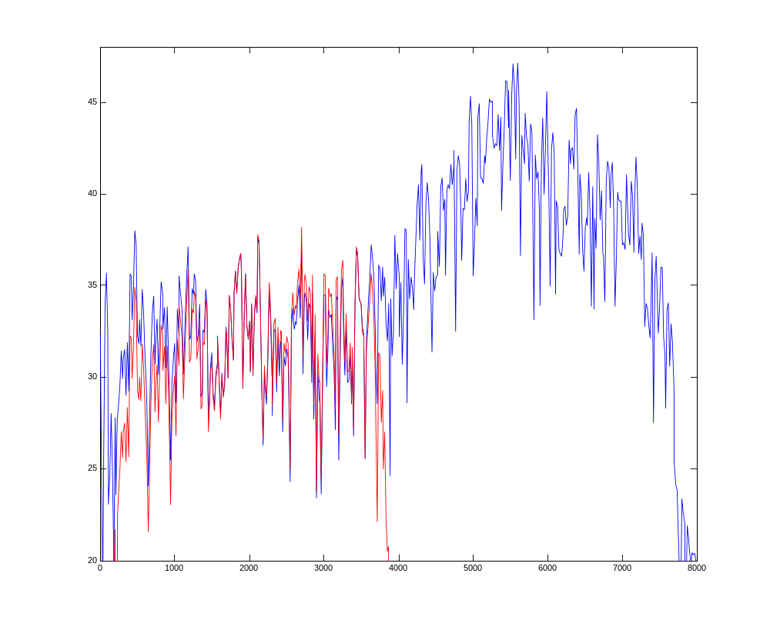
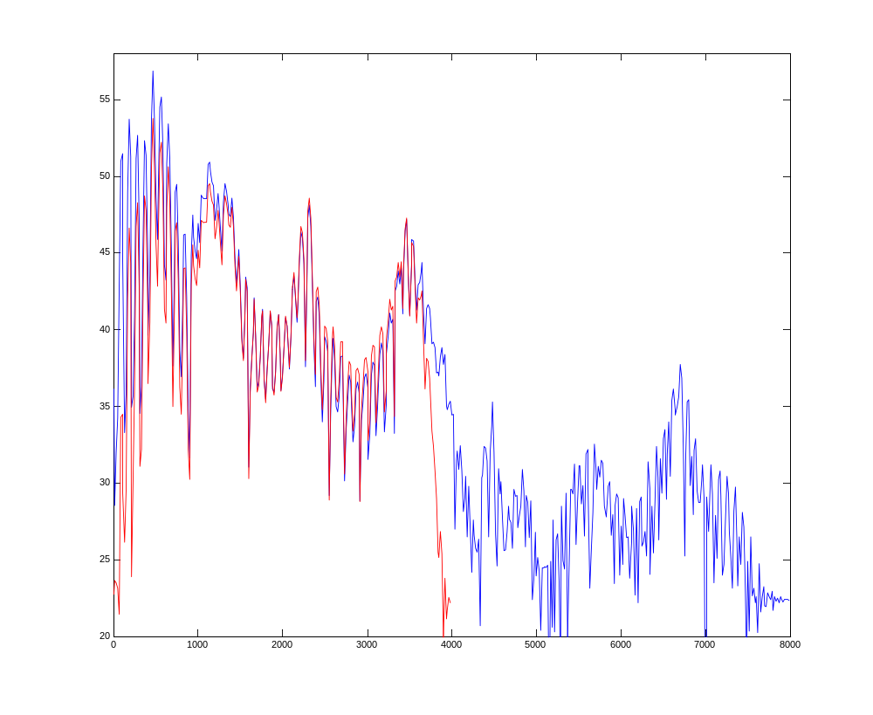
Background (1)
Wideband vs. “telephony” speech signal
Unvoiced spectrum, male speaker
Voiced spectrum, male speaker

Slide 11
Background (2)
Wideband speech coding standardizations:
AMR-WB (Adaptive Multirate Wideband)
  Standardisation: ETSI/3GPP (Europe, Asia, northern Africa)
  Selected: December 2000
  Applications: GSM, 3G WCDMA

Slide 12
Background (2)
Wideband speech coding standardizations:
AMR-WB (Adaptive Multirate Wideband)
  Standardisation: ETSI/3GPP (Europe, Asia, northern Africa)
  Selected: December 2000
  Applications: GSM, 3G WCDMA
Recommendation G.722.2
  Standardization: ITU-T (worldwide)
  Selected: July 2001
  Applications: wideband telephony, teleconferencing, voice over IP, internet applications, …

Slide 13
Background (2)
Wideband speech coding standardizations:
AMR-WB (Adaptive Multirate Wideband)
  Standardisation: ETSI/3GPP (Europe, Asia, northern Africa)
  Selected: December 2000
  Applications: GSM, 3G WCDMA
Recommendation G.722.2
  Standardization: ITU-T (worldwide)
  Selected: July 2001
  Applications: wideband telephony, teleconferencing, voice over IP, internet applications, …
VMR-WB
  Standardizations: TIA/3GPP2 (North America, Asia)
  Selected: April 2003
  Applications: 3G CDMA2000

Slide 14
Background (3)
AMR-WB rate adaptation to prevailing radio channel conditions
AMR-WB bitrates:
Mode 0 - 6.60 kb/s
Mode 1 - 8.85 kb/s
Mode 2 - 12.65 kb/s
Mode 3 - 14.25 kb/s
Mode 4 - 15.85 kb/s
Mode 5 - 18.25 kb/s
Mode 6 - 19.85 kb/s
Mode 7 - 23.05 kb/s
Mode 8 - 23.85 kb/s

Slide 15
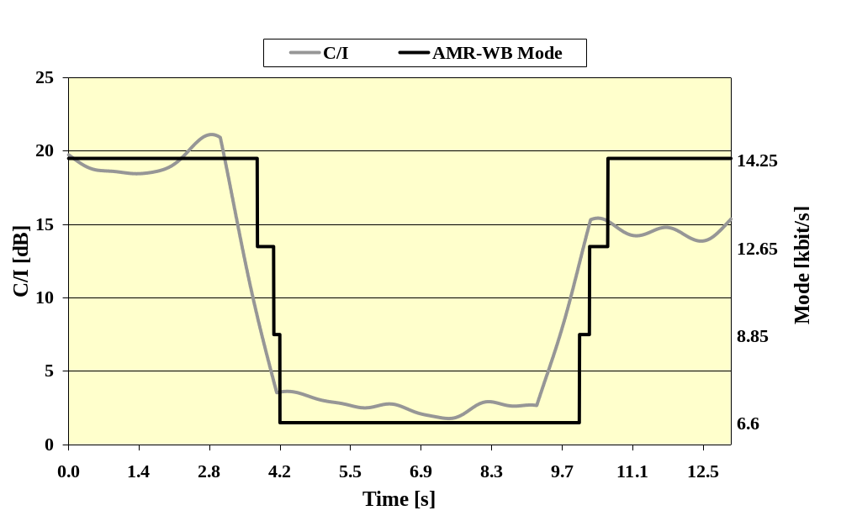
Background (3)
AMR-WB rate adaptation to prevailing radio channel conditions
AMR-WB bitrates:
Mode 0 - 6.60 kb/s
Mode 1 - 8.85 kb/s
Mode 2 - 12.65 kb/s
Mode 3 - 14.25 kb/s
Mode 4 - 15.85 kb/s
Mode 5 - 18.25 kb/s
Mode 6 - 19.85 kb/s
Mode 7 - 23.05 kb/s
Mode 8 - 23.85 kb/s
Example of AMR-WB mode adaptation in GSM Full Rate channel

Slide 16
VMR-WB rate selection (1)
Variable bitrate codec
The average bitrate (ABR) is controlled by
  System: defining operating mode, i.e. the target ABR

Slide 17
VMR-WB rate selection (1)
Variable bitrate codec
The average bitrate (ABR) is controlled by
  System: defining operating mode, i.e. the target ABR
  Source: the actual bitrate is chosen based on the information content in every speech frame

Slide 18
VMR-WB rate selection (1)
Variable bitrate codec
The average bitrate (ABR) is controlled by
  System: defining operating mode, i.e. the target ABR
  Source: the actual bitrate is chosen based on the information content in every speech frame
Building blocks:
(CDMA2000 allowed bitrates)
FR: 13.3 kb/s
HR: 6.2 kb/s
QR: 2.7 kb/s
ER: 1.0 kb/s

Slide 19
VMR-WB rate selection (1)
Variable bitrate codec
The average bitrate (ABR) is controlled by
  System: defining operating mode, i.e. the target ABR
  Source: the actual bitrate is chosen based on the information content in every speech frame
VMR-WB ABRs:
Building blocks:
(CDMA2000 allowed bitrates)
FR: 13.3 kb/s
HR: 6.2 kb/s
QR: 2.7 kb/s
ER: 1.0 kb/s
 | Active speech kbit/s | 40% Speech Activity kbit/s
Mode 3 | 13.3 | 6.1
Mode 0 | 12.8 | 5.7
Mode 1 | 10.5 | 4.8
Mode 2 | 8.1 | 3.8

Slide 20
VMR-WB rate selection (2)
1. Voice Activity?
Hierarchical Signal Classification
Operating on Frame-level
No
CNG Encoding or DTX (ER)
Yes
Unvoiced Speech Optimized HR or QR Encoding
2. Unvoiced Frame?
Yes
No
Voiced Speech Optimized HR Encoding
3. Voiced Frame?
Yes
No
4. Low Energy?
Yes
Generic HR Encoding
CNG – Comfort noise generation
DTX – Discontinuous transmission
No
Generic FR Encoding

Slide 21
VMR-WB rate selection (3)
1. Voice Activity Detection (VAD)
Speech
Spectral Analysis
Parameters
Voice Activity?
= f(SNR)
Noise Estimation Down
Noise Reduction
VAD decision
De-noised Speech
LP Analysis
Pitch Tracking, Voicing f_{c}
Voice Activity?
≠ f(SNR)
Update
Noise Estimation Up
No

Slide 22
1. Voice Activity?
Hierarchical Signal Classification
Operating on Frame-level
No
CNG Encoding or DTX
Yes
Unvoiced Speech Optimized HR or QR Encoding
2. Unvoiced Frame?
Yes
No
Voiced Speech Optimized HR Encoding
3. Voiced Frame?
Yes
No
4. Low Energy?
Yes
Generic HR Encoding
CNG – Comfort noise generation
DTX – Discontinuous transmission
No
Generic FR Encoding

Slide 23
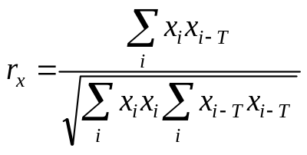
VMR-WB rate selection (4)
2. Unvoiced Frame Decision
Based on the following parameters:
T – open-loop pitch period estimate
x_{i} – perceptually weighted input signal
Normalized correlation

Slide 24
VMR-WB rate selection (4)
2. Unvoiced Frame Decision
Based on the following parameters:
T – open-loop pitch period estimate
x_{i} – perceptually weighted input signal
Normalized correlation
Spectral tilt

Slide 25
Unvoiced spectrum, male speaker
Voiced spectrum, male speaker

Slide 26
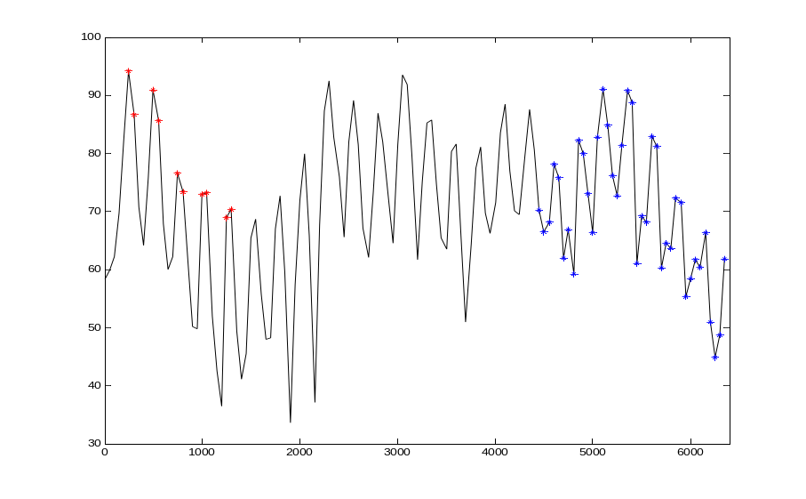
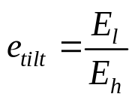
VMR-WB rate selection (4)
2. Unvoiced Frame Decision
Based on the following parameters:
T – open-loop pitch period estimate
x_{i} – perceptually weighted input signal
Normalized correlation
Spectral tilt
E_{h} – average energy of last 2 critical bands.
E_{l} – average energy of pitch-synchronous bins in the first 10 critical bands

Slide 27
VMR-WB rate selection (4)
2. Unvoiced Frame Decision
Based on the following parameters:
T – open-loop pitch period estimate
x_{i} – perceptually weighted input signal
Normalized correlation
Spectral tilt
E_{h} – average energy of last 2 critical bands.
E_{l} – average energy of pitch-synchronous bins in the first 10 critical bands
Relative frame energy with respect to long-term average

Slide 28
VMR-WB rate selection (4)
2. Unvoiced Frame Decision
Based on the following parameters:
T – open-loop pitch period estimate
x_{i} – perceptually weighted input signal
Normalized correlation
Spectral tilt
E_{h} – average energy of last 2 critical bands.
E_{l} – average energy of pitch-synchronous bins in the first 10 critical bands
Relative frame energy with respect to long-term average
Energy variation within a frame

Slide 29
1. Voice Activity?
Hierarchical Signal Classification
Operating on Frame-level
No
CNG Encoding or DTX
Yes
Unvoiced Speech Optimized HR or QR Encoding
2. Unvoiced Frame?
Yes
No
Voiced Speech Optimized HR Encoding
3. Voiced Frame?
Yes
No
4. Low Energy?
Yes
Generic HR Encoding
CNG – Comfort noise generation
DTX – Discontinuous transmission
No
Generic FR Encoding

Slide 30
VMR-WB rate selection (5)
3. Voiced Frame Decision / Signal Modification
Voiced decision is an inherent part of original Signal Modification Algorithm
i.e. frame is coded as voiced if all constraints of the modification are satisfied

Slide 31
VMR-WB rate selection (5)
3. Voiced Frame Decision / Signal Modification
Voiced decision is an inherent part of original Signal Modification Algorithm
i.e. frame is coded as voiced if all constraints of the modification are satisfied
Signal modification features:
pitch-period synchronous

Slide 32
VMR-WB rate selection (5)
3. Voiced Frame Decision / Signal Modification
Voiced decision is an inherent part of original Signal Modification Algorithm
i.e. frame is coded as voiced if all constraints of the modification are satisfied
Signal modification features:
pitch-period synchronous
Pitch period evolution is piecewise linear (constant at frame end)
to avoid pitch period oscillations

Slide 33
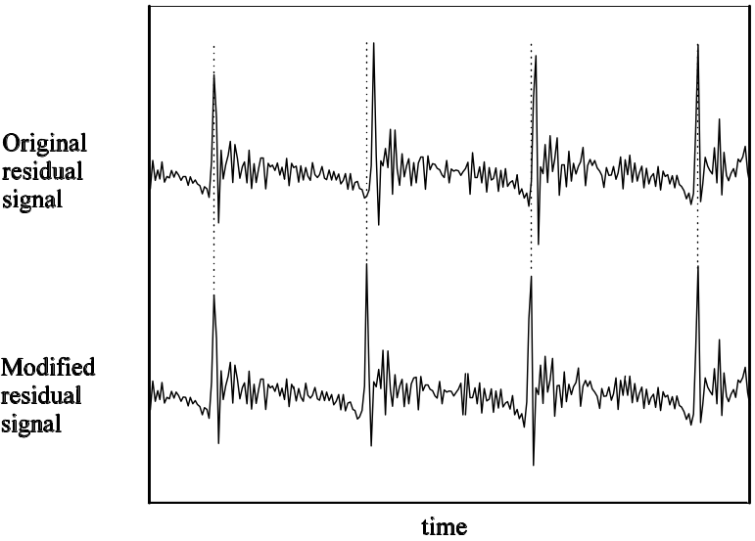
VMR-WB rate selection (5)
3. Voiced Frame Decision / Signal Modification
Voiced decision is an inherent part of original Signal Modification Algorithm
i.e. frame is coded as voiced if all constraints of the modification are satisfied
Signal modification features:
pitch-period synchronous
Pitch period evolution is piecewise linear (constant at frame end)
to avoid pitch period oscillations
Modified input is synchronous with original input at frame end

Slide 34
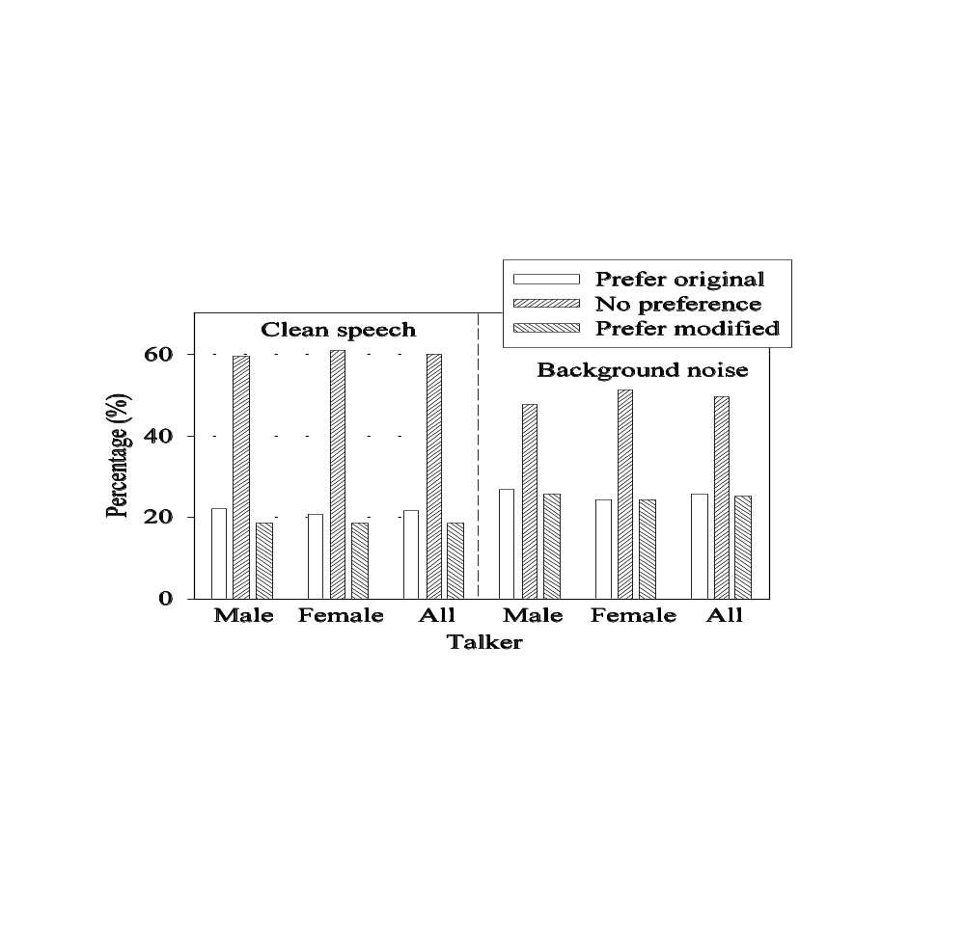
VMR-WB rate selection (5)
3. Voiced Frame Decision / Signal Modification
Voiced decision is an inherent part of original Signal Modification Algorithm
i.e. frame is coded as voiced if all constraints of the modification are satisfied
Signal modification features:
pitch-period synchronous
Pitch period evolution is piecewise linear (constant at frame end)
to avoid pitch period oscillations
Modified input is synchronous with original input at frame end

Slide 35
VMR-WB rate selection (2)
1. Voice Activity?
Hierarchical Signal Classification
Operating on Frame-level
No
CNG Encoding or DTX
Yes
Unvoiced Speech Optimized HR or QR Encoding
2. Unvoiced Frame?
Yes
No
Voiced Speech Optimized HR Encoding
3. Voiced Frame?
Yes
No
4. Low Energy?
Yes
Generic HR Encoding
CNG – Comfort noise generation
DTX – Discontinuous transmission
No
Generic FR Encoding

Slide 36
VMR-WB rate selection (6)
4. Low Energy Decision
Purpose:
Avoid encoding unclassified frames with low perceptual importance at Full Rate

Slide 37

VMR-WB rate selection (6)
4. Low Energy Decision
Purpose:
Avoid encoding unclassified frames with low perceptual importance at Full Rate
Condition:
E_{t} – sum of critical band energies for current frame, in dB
E_{f} – long-term mean of E_{t} for active speech

Slide 38
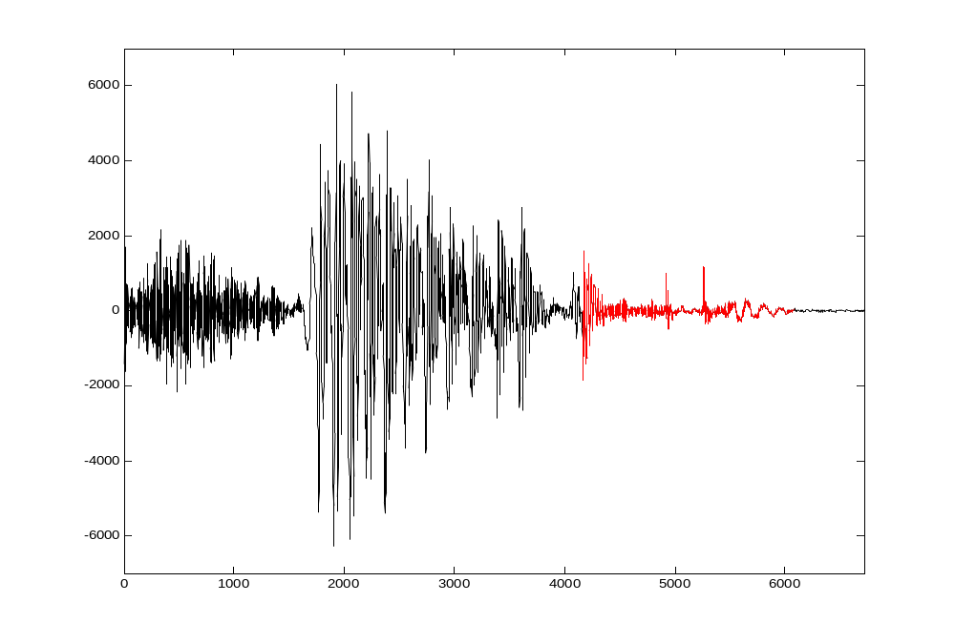
VMR-WB rate selection (6)
4. Low Energy Decision
Purpose:
Avoid encoding unclassified frames with low perceptual importance at Full Rate
Condition:
E_{t} – sum of critical band energies for current frame, in dB
E_{f} – long-term mean of E_{t} for active speech
Example:
Typical example of a low-energy frame encoded with Generic HR in mode 2

Slide 39
VMR-WB rate selection (7)
System-Controlled Operation
4 Operational Modes
  Mode 3: Interoperable with modes 0, 1, 2 of AMR-WB
  Modes 0, 1, 2 chosen depending on network capacity and the desired quality of service
Transparent Memoryless Mode Switching

Slide 40
VMR-WB rate selection (7)
System-Controlled Operation
4 Operational Modes
  Mode 3: Interoperable with modes 0, 1, 2 of AMR-WB
  Modes 0, 1, 2 chosen depending on network capacity and the desired quality of service
Transparent Memoryless Mode Switching
Usage of different coding techniques during active speech:
Coding Type
Mode 0
Mode 1
Mode 2
Mode 3
Generic FR
93.4 %
60.4 %
34.1 %
-
Interoperable FR
-
-
-
100.0 %
Generic HR
-
7.1 %
13.1 %
-
Voiced HR
-
13.0 %
33.2 %
-
Unvoiced HR
6.6 %
19.5 %
5.6 %
-
Unvoiced QR
-
-
14.0 %
-

Slide 41
AMR-WB ↔ VMR-WB interoperation (1)
Problems:
  DTX transmission of AMR-WB vs. continuous transmission of VMR-WB

Slide 42
AMR-WB ↔ VMR-WB interoperation (1)
Problems:
  DTX transmission of AMR-WB vs. continuous transmission of VMR-WB
  Different bitstream sizes

Slide 43
AMR-WB ↔ VMR-WB interoperation (1)
Problems:
  DTX transmission of AMR-WB vs. continuous transmission of VMR-WB
  Different bitstream sizes
  AMR-WB DTX hangover too long for 3GPP2 systems

Slide 44
AMR-WB ↔ VMR-WB interoperation (1)
Problems:
  DTX transmission of AMR-WB vs. continuous transmission of VMR-WB
  Different bitstream sizes
  AMR-WB DTX hangover too long for 3GPP2 systems
  In-band signalling of 3GPP2 systems

Slide 45
AMR-WB ↔ VMR-WB interoperation (2)
AMR-WB → VMR-WB link
System interface
CNG-update
frame
CNG QR frame
No-data frame
Void ER frame
AMR-WB encoder
VMR-WB decoder
VAD = 0
12.65 kb/s frame
Interoperable FR
Maximum HR
request
Interoperable HR
In case of maximum HR request, ACELP innovation indices ares discarded at the gateway and regenerated randomly at the decoder

Slide 46
AMR-WB ↔ VMR-WB interoperation (3)
VMR-WB → AMR-WB link
System interface
CNG-update
frame
CNG QR frame
ER frame
No-data frame
VMR-WB encoder
AMR-WB decoder
Interoperable FR
12.65 kb/s frame
Interoperable HR
Generate innovation
In case of Interoperable HR frame, ACELP innovation indices are generated at the gateway so that the bitstream is transparent for AMR-WB decoder

Slide 47
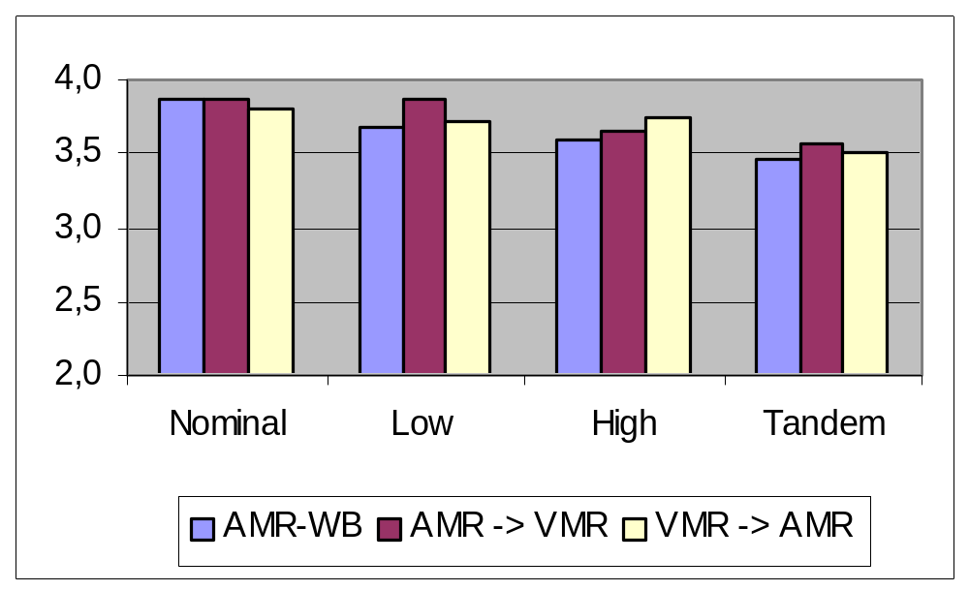
AMR-WB ↔ VMR-WB interoperation (4)
Performance of the interoperable links

Slide 48
Performance
Performance on WB speech:
  Selection test:
  modes 0, 1 & 2 evaluted in 3 experiments.
  VMR-WB outperformed all other candidates in all experiments, for all 3 modes

Slide 49

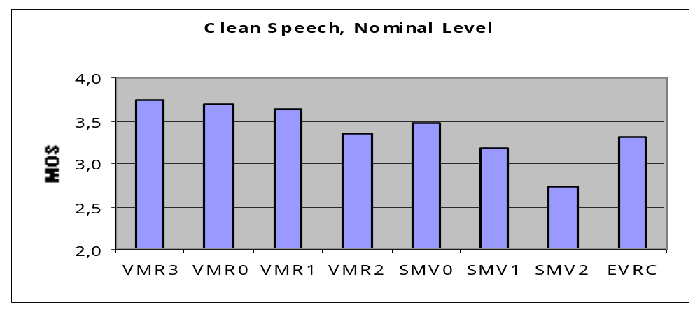
Performance
Performance on WB speech:
  Selection test:
  modes 0, 1 & 2 evaluted in 3 experiments.
  VMR-WB outperformed all other candidates in all experiments, for all 3 modes
Performance on NB speech:

