Slide 1
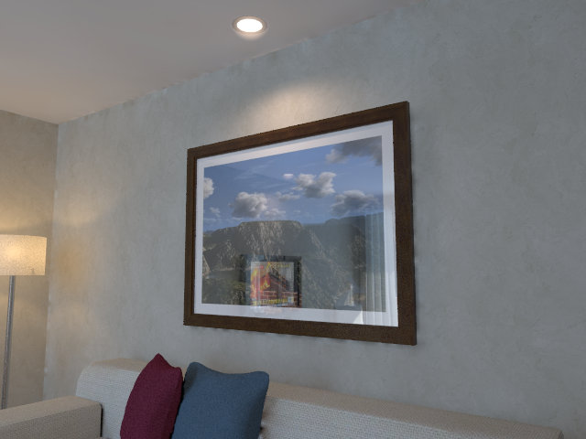

p’
p
Target image
Source image

Slide 2
p’
p
Target image
Source image

