Slide 1
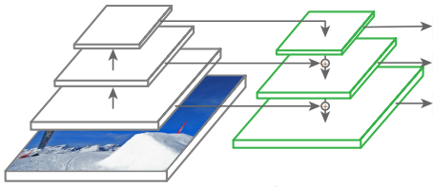
Backbone network
: Feature map 추출
Detection Head
: 검출 결과 출력
Darknet-53
Feature Pyramid
Network
`
Detection
(Large scale)
class
subnet
Class Probability
(Person, Car, ...)
Detection
(Medium scale)
box
subnet
Bounding Box
(XYHW)
Detection
(Small scale)
objectness
subnet
Objectness
(O)
입력이미지

Slide 2
Backbone network
: Feature map 추출
Detection Head
: 검출 결과 출력
Darknet-53
Feature Pyramid
Network
`
Detection
(Large scale)
Bounding Box (XYWH)
Detection
(Medium scale)
Objectness(O)
5+K
Detection
(Small scale)
Class Probability (P1,…,PK)
입력 이미지

Slide 3
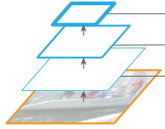
Feat. Large
Output Block
H/32 x W/32
x 3*(5+K)
Conv 1x1
Upsample 2x
Feat. Medium
Concat
Output Block
H/16 x W/16
x 3*(5+K)
Conv 1x1
Upsample 2x
Feat. Small
Concat
Output Block
H/8 x W/8
x 3*(5+K)
Conv 1x1
Conv 3x3
Conv 1x1
Conv 3x3
Conv 1x1
Conv 3x3
Conv 1x1

Slide 4
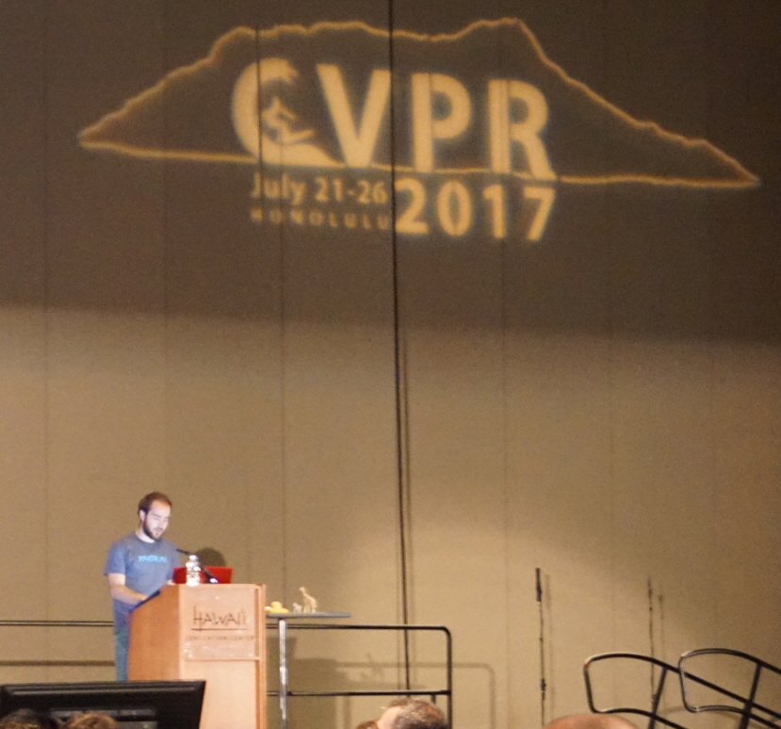
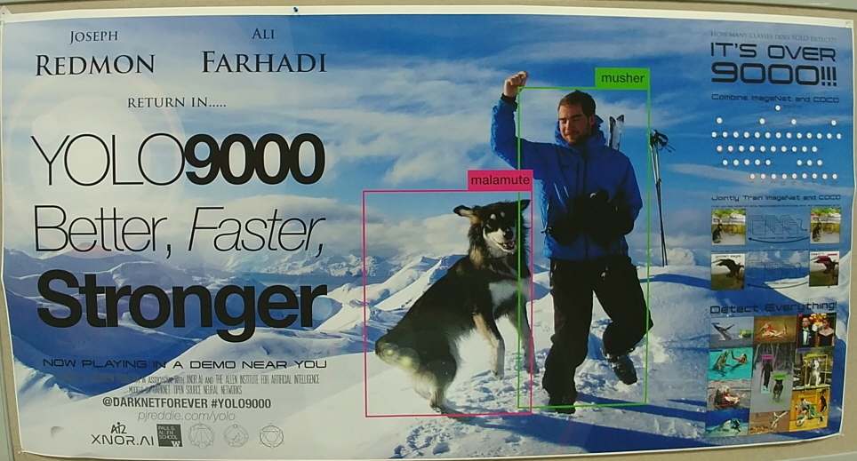

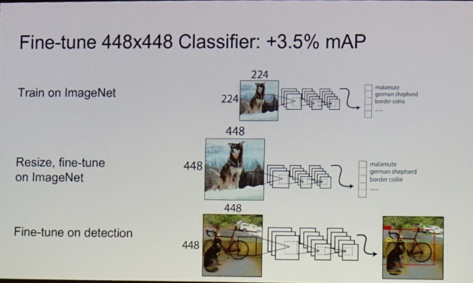

Slide 6
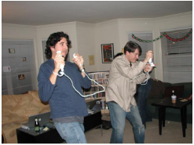
feature_m

Slide 7
Crop offset
Resize
Crop
to
target
ratio
Target resolution

Slide 8
feature map
bboxes
(batch, Hx, Wx, A)
yxhw
(4)
ctgr
index
(1)
GT
yxhw(4)
objectness(1)
category index(1)
(batch, Hx, Wx, A)
yxhw
(4)
ctgr
index
(1)
obj.
(1)
ctgr
prob.
(1)
score
(1)
Pred
yxhw(4)
objectness(1)
category prob.(4)

