Slide 1
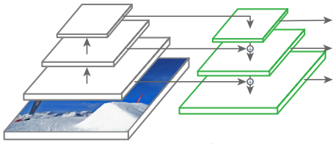
Backbone network
: Feature map 추출
Detection Head
: 검출 결과 출력
Darknet-53
Feature Pyramid
Network
`
Detection
(Large scale)
class
subnet
Class Probability
(Person, Car, ...)
Detection
(Medium scale)
box
subnet
Bounding Box
(XYHW)
Detection
(Small scale)
objectness
subnet
Objectness
(O)
입력이미지

Slide 2
Backbone network
: Feature map 추출
Detection Head
: 검출 결과 출력
Darknet-53
Feature Pyramid
Network
`
Detection
(Large scale)
Bounding Box (XYWH)
Detection
(Medium scale)
Objectness(O)
5+K
Detection
(Small scale)
Class Probability (P1,…,PK)
입력 이미지

Slide 3
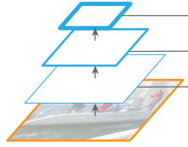
Feat. Large
Output Block
H/32 x W/32
x 3*(5+K)
Conv 1x1
Upsample 2x
Feat. Medium
Concat
Output Block
H/16 x W/16
x 3*(5+K)
Conv 1x1
Upsample 2x
Feat. Small
Concat
Output Block
H/8 x W/8
x 3*(5+K)
Conv 1x1
Conv 3x3
Conv 1x1
Conv 3x3
Conv 1x1
Conv 3x3
Conv 1x1

Slide 4
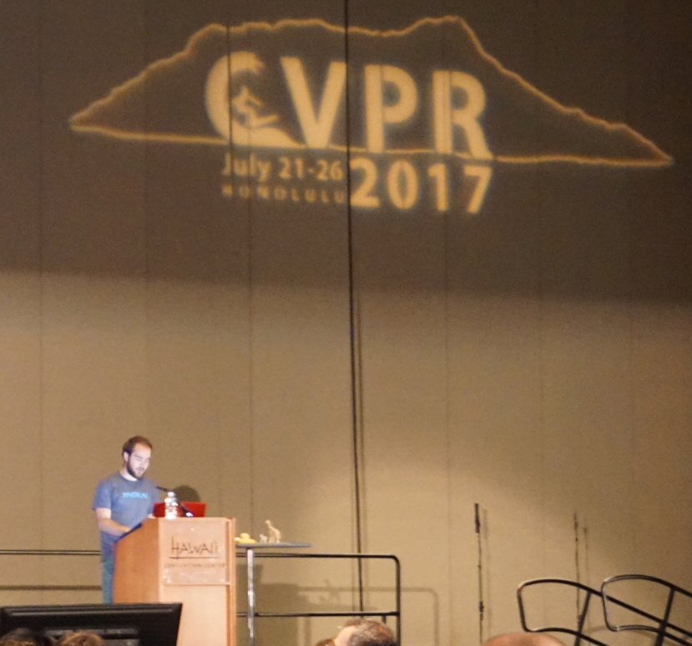
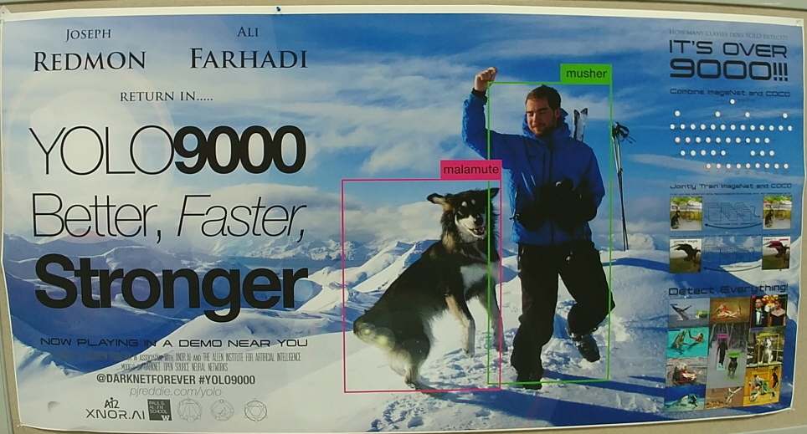

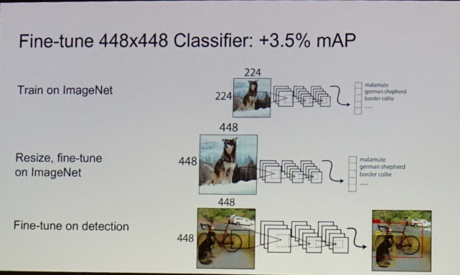

Slide 6
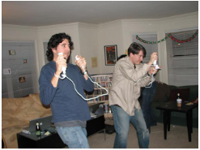
feature_m

Slide 7
Crop offset
Resize
Crop
to
target
ratio
Target resolution

