Slide 1


Slide 2
54% of Filipino adults agreed that:
“People are afraid that robbers might break into their houses."
A. Merenez, ABS-CBN News, online article, June 2018 (data sourced from SWS survey)

Slide 3
2018 NCR Statistics on Crime Incidents: January – May
BLOTTERED VICTIM REPORTS (NOT NECESSARILY CONVICTED SUSPECTS)
PNP, Directorate for Investigation and Detective management, Crime research Analysis center, Jan – May 2018
http://www.pnp.gov.ph/images/transparency_seal/2018/crimestats/Crime-Stat-Jan-May-2018.pdf

Slide 4
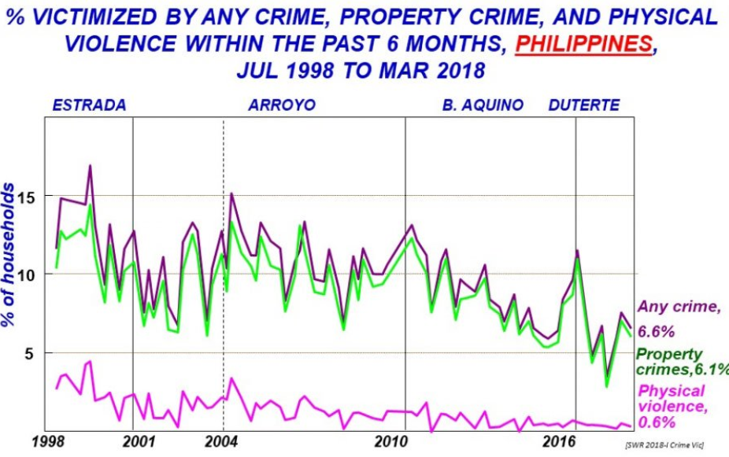
SWS Survey question:
Within the past 6 months, have you, and/or any member of your family, been a victim of these crimes ?
SWS, 1st Qtr. 2018 Social Weather Report, National Survey, March 2018

Slide 5


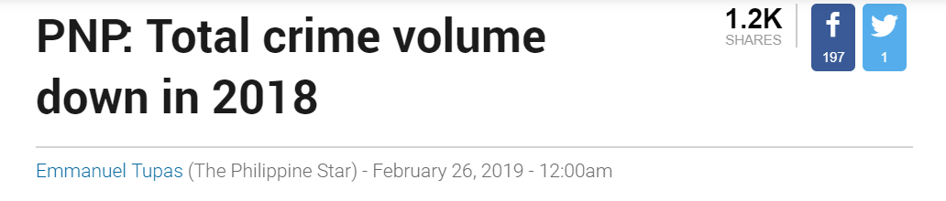
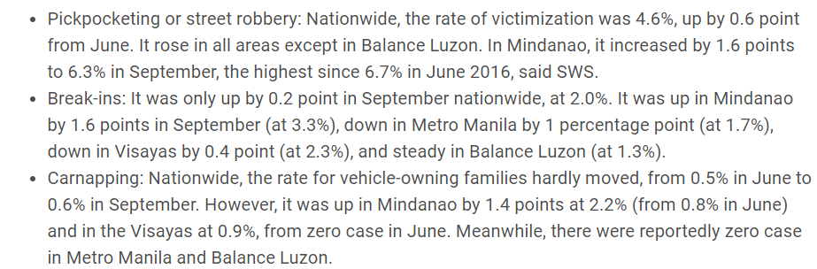
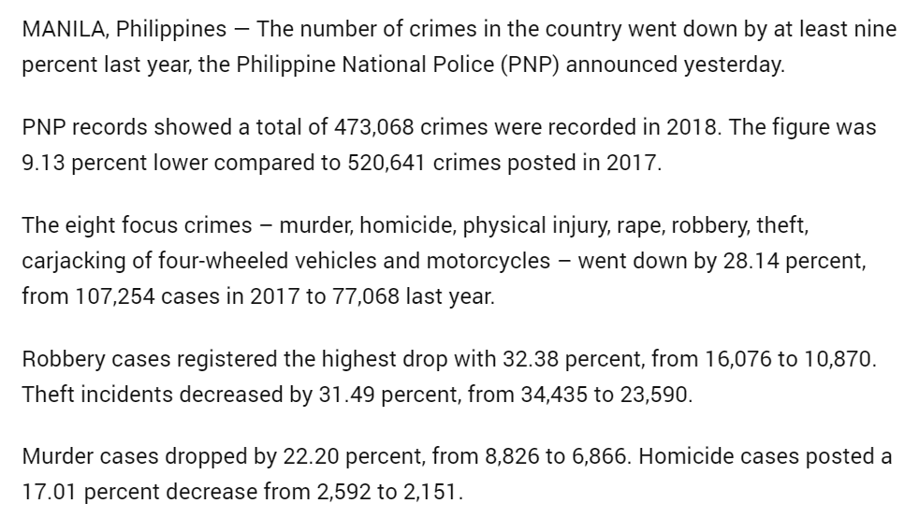
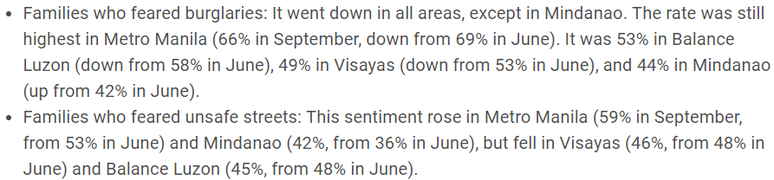
PNP Data and Reports
Surveyed Sentiments
3rd Qtr. Social Weather Survey
https://www.rappler.com/nation/217973-filipino-families-victim-common-crimes-sws-survey-september-2018
https://www.philstar.com/nation/2019/02/26/1896714/pnp-total-crime-volume-down-2018

Slide 6
PNP Data and Reports
Surveyed Sentiments
3rd Qtr. Social Weather Survey

Slide 7
PNP Data and Reports
Surveyed Sentiments
3rd Qtr. Social Weather Survey

Slide 8
WHERE IS THE DISCONNECT?
PNP Data and Reports
Surveyed Sentiments
3rd Qtr. Social Weather Survey

Slide 9
“ Victimization by common crimes reported in SWS surveys is much higher than the number of crimes
actually reported to the police “
- Social Weather Survey

Slide 10
Time and time again …
Police visibility results in lower estimates of subjective risks of victimization
F. W. Winkel, Reducing Fear Of Crime Through Police Visibility: A Field Experiment, December 1986

Slide 11

Time and time again …
Police visibility results in lower estimates of subjective risks of victimization
F. W. Winkel, Reducing Fear Of Crime Through Police Visibility: A Field Experiment, December 1986
Current PNP Operations :
A S S U M P T I O N S
Preventive patrolling route are statically scheduled
Police resource deployment is on-demand

Slide 12
OBJECTIVES :
1
Infer on crime based on probability distribution of:
location, month, week of month, day of week, time of day
2
Recommend police patrolling schedule, route, and police resource deployment via Decision Analysis of inference

Slide 13
APPROACH :
Handle uncertainty !
We are uncertain where and/or when a crime will happen
Each crime record provides information
But we are never fully certain
How are we going to handle uncertainty in a principled way ?

Slide 14
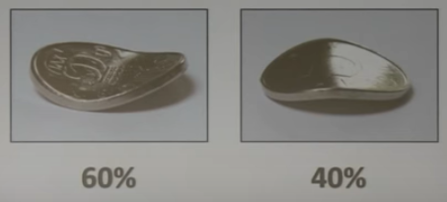
PROBABILITIES, PROBABILITIES,
PROBABILITIES …
Limit of infinite number of trials
Quantification of uncertainty

Slide 15
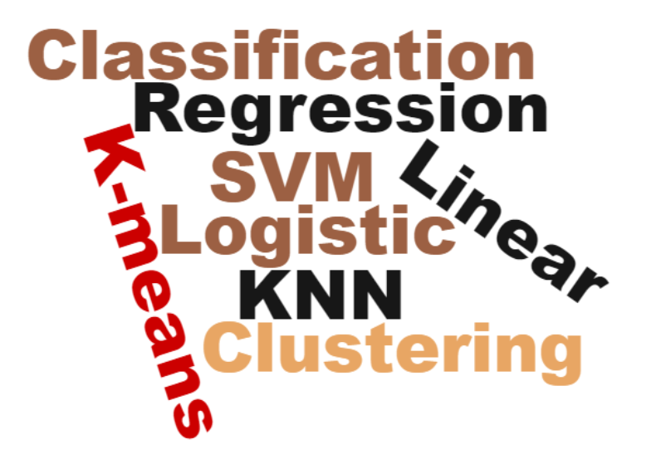
Traditional Machine Learning
Data
Predictions

Slide 16
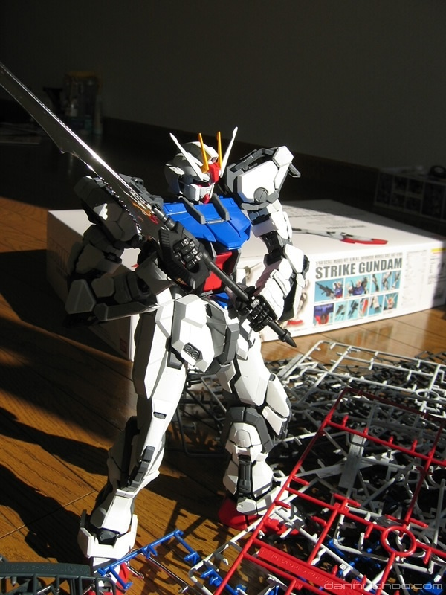

Black box
Machine learning
Probabilistic
programming
Opaque inference
Constrained models
Handles Uncertainty?
Clear inference
Extreme flexibility
Full Uncertainty

Slide 17
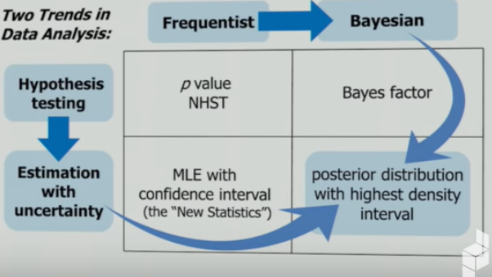
Null Hypothesis Significance Testing
Maximum Likelihood Estimate

Slide 18
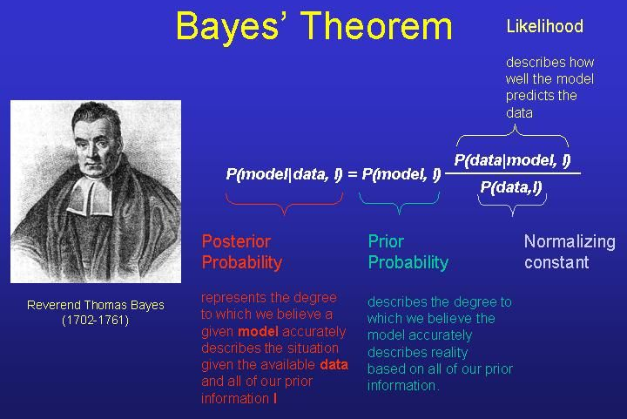

Slide 19
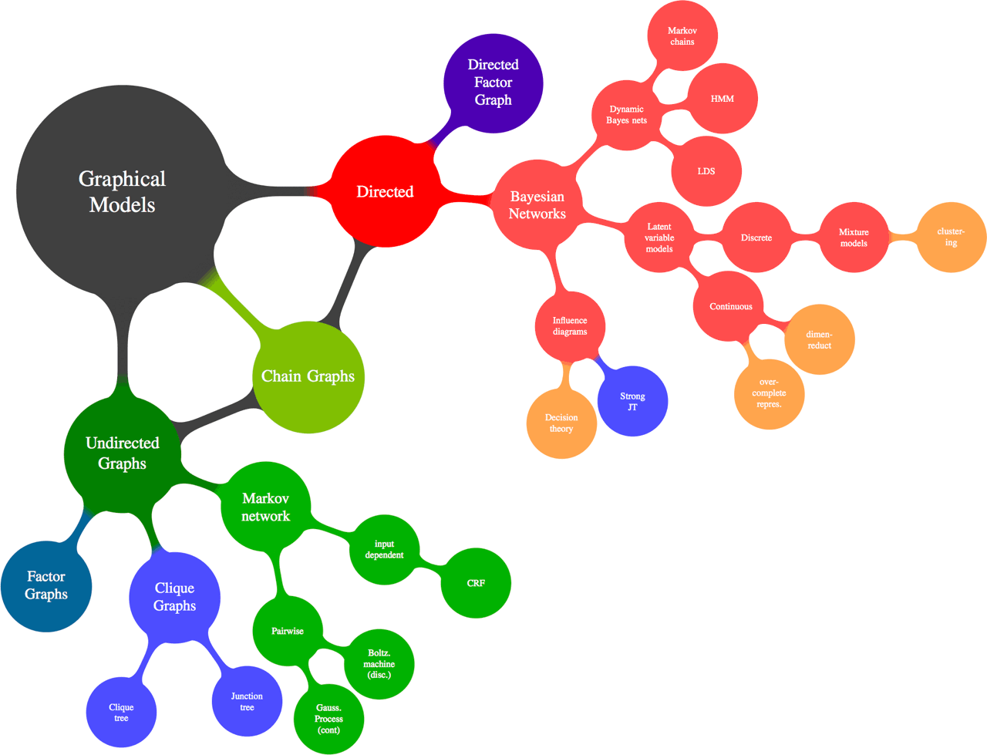

Slide 21
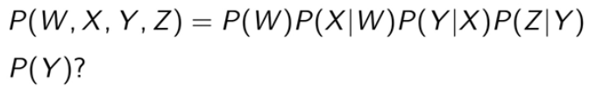
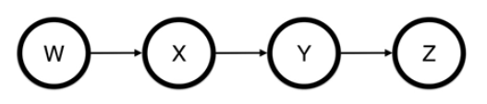
EXAMPLE : Making Inference
Variable Elimination
Marginal Probability of ‘Y’ ?

Slide 22
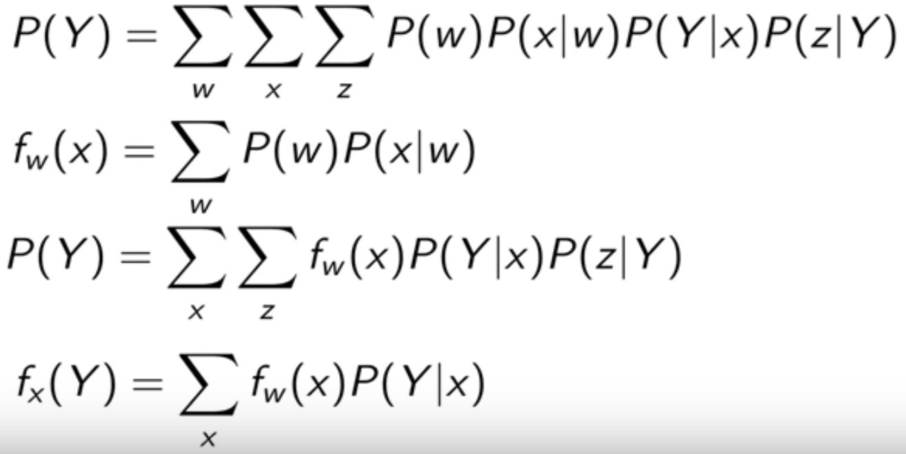
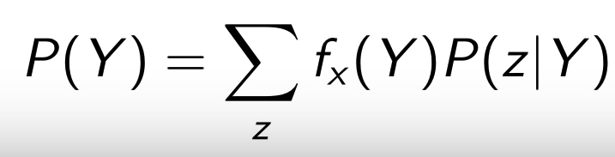
EXAMPLE : Making Inference
Variable Elimination
Marginal Probability of ‘Y’

Slide 23
DATASET
Crimes_in_Manila
Crimes against Property within Manila with Conviction
date
week_of_month
month
day_of_week
time_of_crime
time_range
crime_location
crime_type
property_loss
victim_gender
victim_occupation
victim_age
victim_civilstatus
suspect_count
suspect_weapon
suspect_gender
suspect_age
suspect_address

Slide 24
PROOF OF CONCEPT
Probabilistic Graph Model : Bayesian Network
M = Month
M_{w} = Week of Month
W_{d} = Day of Week
D_{t} = Time of Day
C_{l} = Crime location
C_{p} = Crime
M
W_{d}
C_{l}
C_{p}
M_{w}
D_{t}
P(M, M_{w} ,W_{d} ,D_{t} ,C_{l} ,C_{p}) = P(M) P(M_{w}) P(W_{d} | M,M_{w}) P(D_{t}) P(C_{l} | D_{t} ,W_{d}) P(C_{p} | C_{l})

Slide 25
VARIABLE ELIMINATION
e ε {M, M_{w} ,W_{d} ,D_{t} ,C_{l} ,C_{p}}
P(${\text{e}}_{x}$) = ${{{{{\text{Σ}}_{e_{x1}}^{n}\text{Σ}}_{e_{x2}}^{n}\text{Σ}}_{e_{x3}}^{n}\text{Σ}}_{e_{x4}}^{n}\text{Σ}}_{e_{x5}}^{n}$P(M, M_{w} ,W_{d} ,D_{t} ,C_{l} ,C_{p})
P(${\text{e}}_{x}$ | ${\text{e}}_{xn}$ ) ⧜ ${{{{\text{Σ}}_{e_{x1}}^{n}\text{Σ}}_{e_{x2}}^{n}\text{Σ}}_{e_{x3}}^{n}\text{Σ}}_{e_{x4}}^{n}$ P(M, M_{w} ,W_{d} ,D_{t} ,C_{l} ,C_{p})

Slide 26

DEMO
https://bit.ly/2YvSxyQ

Slide 27
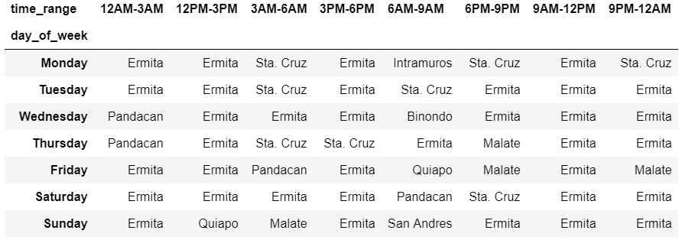
INFERENCE RESULT SUMMARY
Most likelihood of robbery & theft incident on a location given time weekly pattern
See paper for details: https://github.com/goodguynic/probabilistic_graphical_model/blob/master/Event_of_Crime_against_Property_prediction_using_PGM.pdf

Slide 28
