Slide 1
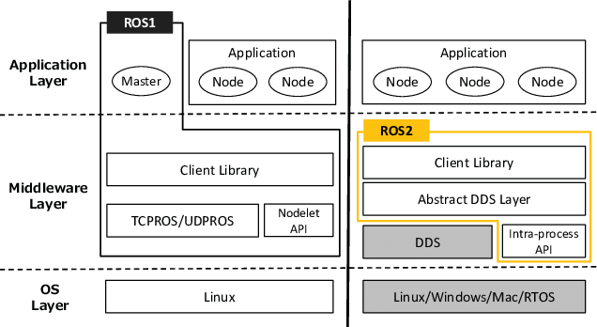
ROS 1 vs. ROS 2
OpenDDS
Adaptor
OpenDDS
Adaptor
OpenDDS
Adaptor
OpenDDS

Slide 2
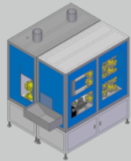
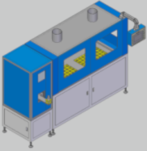
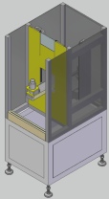
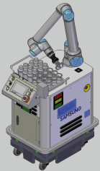
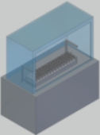
Node 분석
기기 | 반출입기 | 분석기 | Stocker | 폐기설비 | MOMA
Services | Status Check | Status Check | Status Check | Status Check | Status Check Location
Actions | Report | Analysis | Report | Disposal | Get ReadBottle Move Put
Target Object | Bottle | Bottle | Bottle | Bottle | Bottle
IDL 종류 | 기존 IDL 목록 확인 필요 | 기존 IDL 목록 확인 필요 | 기존 IDL 목록 확인 필요 | 기존 IDL 목록 확인 필요 | 기존 IDL 목록 확인 필요
Adaptor to DDS | DDS Adaptor 설치방법 확인 필요

Slide 3
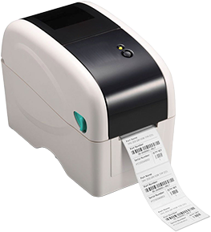
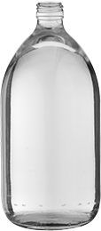
MOMA Paths
발생여부 확인 필요
Path_AD
폐기설비(Disposal)
분석기(Analyzer)
Path_DE
Tag Generator
Path_AS Path_SA
발생여부 확인 필요
Path_SD Path_DS
MOMA
Path_ES
Path_SE
Bottle
반출입기 (End Point)
Stocker

Slide 4
Moving Paths
기기 | 반출입기 | 분석기 | Stocker | 폐기설비
Bottle
Bottle
Bottle
(1)
(2)
(3)
(4)
(6)
(5)
(1)
(2)
(3)
(5)
(4)
(1)
(2)
(3)
(5)
(4)

Slide 5
Moving Paths
기기 | 반출입기 | 분석기 | Stocker | 폐기설비
Bottle
Bottle
(1)
(2)
(3)
(1)
(2)
(4)
(3)

Slide 6
Simplified Architecture
Dispatcher
DB Server
Monitor
ROS 2
DDS
Nodes
반출입기
분석기
Stocker
폐기설비
MOMA
기기별 Adaptor와 IDL 목록 확인

Slide 7
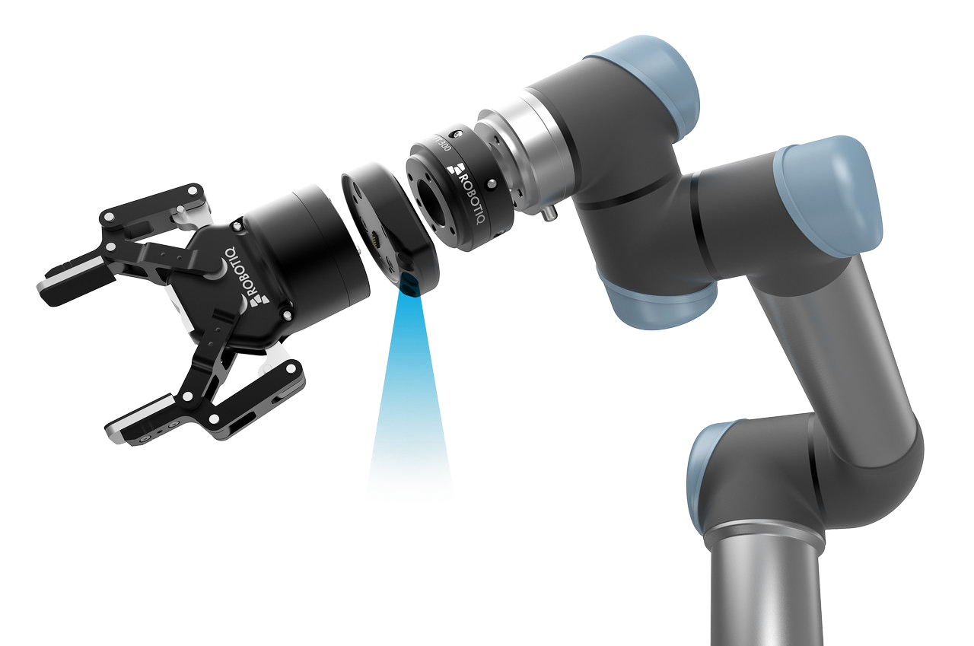
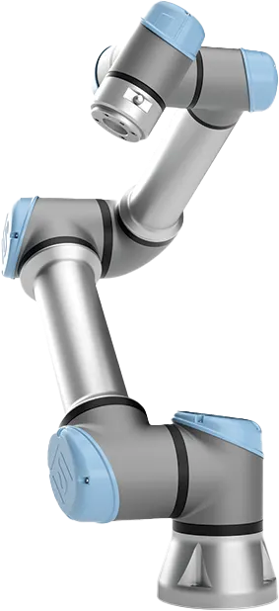
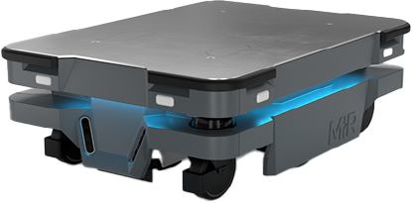
Mobile Manipulator (MoMa) / Mobile Cobot / Mobot
UR(Universal Robots 제품들은 PolyScope를 사용하고 있으며, 이는 ROS2를 부분 지원하고 있음. ➔ ROS2와 DDS 지원 여부 및 범위를 확인해야 함.
PolyScope는 Python기반의 UR Script를 사용함.
Gripper와 Camera의 제조사와 UR 호환성을 확인해야 함. ➔ UR과 통신 및 제어에 대한 확인이 필요함.
Mir, UR Cobot, Gripper, Camera를 각각 다른 Node로 제어할 것인지, 아니면 하나의 Node로 제어할 것인지 확인해야 함.
각각 다른 Node로 제어한다면, 각 Node의 ROS2 지원여부를 확인해야 함.
Gripper
Camera
UR Cobot
MiR
※ UR에는 Gripper와 Camera 제품이 없으나, 삼익 THK에는 있음 따라서, 호환성 및 제어에 대한 확인이 필요함.

Slide 8
PolyScope 자료
YouTube 강의: RTDE Universal Robot Tutorials RTDE(Real-Time Data Exchange)
Universal Robots RTDE C++ Interface: https://sdurobotics.gitlab.io/ur_rtde/
PolyScope 5: UR Cobot에 내장된 표준 소프트웨어 (https://www.universal-robots.com/products/polyscope-5/)
PolyScope X: 차세대 버전의 PolyScope SDK제공
URScript: PolyScope 내에서 사용할 수 있는 간단한 형태의 프로그래밍 언어 Sample in Git ➔ https://github.com/topics/urscript C++, Python 지원
URCap & SDK

Slide 9
Integration of PolyScope and ROS2
Unfortunately, there isn't a straightforward way to directly integrate PolyScope, the robot programming software for Universal Robots, with ROS2. PolyScope uses its own scripting language (URScript) for robot control, while ROS2 relies on message passing and a different development environment.
However, there are a few approaches you can consider depending on your specific goals:
External Control Interface: Universal Robots offers an "External Control" interface that allows external programs to communicate with the robot. You could potentially develop a ROS2 node that interacts with this interface to send commands or receive data from the robot [1]. This approach requires some development effort and understanding of both ROS2 and the External Control interface.
ROS Driver for Universal Robots: The ur_robot_driver package provides a ROS driver for Universal Robots within ROS2. This driver allows you to control the robot's motion using ROS topics and services. While it won't directly integrate with PolyScope, you could use it to develop ROS2 nodes that interact with the robot independently [2].
Third-Party Tools: There might be third-party tools or libraries that bridge the gap between ROS2 and PolyScope. However, due to the different programming paradigms, finding a readily available solution might be challenging. It's worth searching online for specific tools or projects related to "ROS2 PolyScope Integration".
Here are some additional resources that might be helpful:
Universal Robots PolyScope X SDK Documentation: https://forum.universal-robots.com/t/ci-cd-pipeline-with-polyscope-externalcontrol/29660 (This documentation mentions potential ROS2 backend contributions, but details might be limited)
CI/CD pipeline with polyscope/externalcontrol - ROS - Universal Robots Forum: https://forum.universal-robots.com/t/ci-cd-pipeline-with-polyscope-externalcontrol/29660 (This forum discussion mentions a project related to ROS2 and PolyScope integration, though specifics might not be available)
Remember, the best approach depends on your specific needs and technical expertise. If you're new to ROS2 or robot programming, it might be easier to start with the ROS driver for Universal Robots within ROS2.

Slide 10
Nav2 – Navigation Stack
Nav2 stands for Navigation 2. It's an open-source framework used to control the movement of robots in various environments. Here are some key points about Nav2:
Successor to ROS Navigation Stack: It's considered a more advanced and robust version of the older ROS Navigation Stack [3].
Moving Robots Around: Nav2 helps robots navigate safely and efficiently from one point to another while completing tasks. It can handle complex environments and different types of robots [3].
More Than Point A to B: In addition to moving between points, it can also be used for tasks like following objects [3].
Modular Design: Nav2 is built with a modular design, meaning it's made up of independent components that can be easily customized for different needs [2].
Uses Behavior Trees: These trees help create intelligent navigation behaviors by orchestrating various modular parts [2].
Open-Source and Production-Ready: Nav2 is freely available and considered reliable enough for real-world robotics applications [3].

Slide 11
Nav2 – Navigation Stack
Nav2 builds on ROS 2 (Robot Operating System 2) to provide a framework for robot navigation. Here's a breakdown of how it works within ROS 2:
Components and Communication:
Nodes: Nav2 is built on independent ROS 2 nodes that communicate with each other using message passing [1]. These nodes handle specific tasks like localization, planning, and controlling the robot.
Topics and Services: Nodes exchange information through ROS 2 topics (data streams) and services (remote procedure calls) [1]. This allows for a flexible and modular architecture.
Navigation Process:
Localization: A localization node (e.g., using LiDAR or odometry) determines the robot's current position in the environment [2]. This data is published on a ROS 2 topic.
Costmap Creation: A costmap node creates a map representing the environment's obstacles and free spaces. It considers sensor data and the robot's footprint [2]. This costmap is also published on a topic.
Path Planning: A planning node (e.g., using algorithms like A*) receives the costmap and a goal location. It then calculates a collision-free path for the robot to reach the goal [2]. The planned path is published on another topic.
Robot Control: A controller node subscribes to the planned path topic. It translates the path into motor commands and sends them to the robot's base controller, making it move along the path [2].
Additional Features:
Behavior Trees: Nav2 can utilize behavior trees to sequence and orchestrate these individual tasks. This allows for complex navigation behaviors like obstacle avoidance or following objects [2].
Plugins: The modular design allows for adding custom plugins for specific sensors, actuators, or planning algorithms [1].
Benefits of ROS 2:
Improved Performance: ROS 2 offers better performance and scalability compared to ROS 1, making it suitable for complex robots and environments [1].
Decentralized Communication: ROS 2 nodes can discover each other dynamically, simplifying setup for multi-robot systems [1].
For a deeper understanding, you can search for resources like "ROS2 Nav2 Tutorial" or "Nav2 ROS2 Crash Course". These resources often include video tutorials that visually demonstrate how Nav2 works within ROS 2.
Path 제어를 할 것인가?
PolyScope으로 사전 설정이 가능한가?

Slide 12
고정 Node
고정 Nodes
반출입기
분석기
Stocker
폐기설비
ROS2의 Node로서의 통신방식 확인 필요 - ROS2가 아닌 단순 통신으로 Event 보고 및 Service 통신이 가능한가? - 통신 방식은?
고정 Node에 대한 제어 - 반출입기에 반출입 Event에 대해 개폐 등의 제어가 필요한가? - 분석기와 폐기설비의 개폐 및 가동시작을 제어할 필요가 있는가?
DDS와의 연결방식 - DDS 연결을 위한 모듈의 개발 담당은? (삼익? 유비샘?) - SDK 등의 지원 여부 확인이 필요

Slide 13
MoMa
MoMa는 크게 MiR, Cobot, Camera, Gripper 등으로 구성됨
제어의 범위 및 제어모듈의 위치 - Dispatcher가 개발 구성품을 제어할 것인가? - MoMa의 구성원간의 통신 및 제어는 독립적인가?
Mir에 대한 제어 - 이동Path의 결정을 MiR에서 하는가? - 만약 Path를 Dispatcher나 다른 모듈에서 결정한다면, 이에 대한 대응방안은? (Nav2 사용여부, 등) - Map 작성은?
UR Cobot의 제어 - PolyScript로 별도 개발(or 설정) - 담당자는? - DDS기반의 Dispatcher와의 통신을 위한 모듈개발은?
Cobot과 Camera, Gripper의 통신 및 제어는 어디에서 총괄하는가? - PolyScope로 UR Cobot에 내장? - Dispatcher에서 제어?
Gripper
Camera
UR Cobot
MiR

