Slide 1
Engagement Manager Onsite Presentation Amy Corner Erwin

Slide 2
Engagement manager role
Be a continuous point of contact for the customer throughout the implementation, live, and renewal phases.
Work with the client to define their requirements, develop the best solution, and build the solution using Clarabridge Analytics.
Understand the client’s data and what business decisions will be made using Clarabridge insights.
Manage the implementation of the Clarabridge product – develop a project plan and work closely with the business and technical consultants to complete it. Manage staffing and status reporting.
Represent the client’s interests to the Clarabridge product team to continually improve the software.
Use implementation knowledge gained to add to Clarabridge best practices.
Stay on top of client industry trends and best practices and continue to expand the client’s use of Clarabridge through new offerings and encouragement to use current offerings to their maximum capabilities.

Slide 3
A few notes about this data analysis
Tools
Python
Pandas = library used for data manipulation and analysis
Matplotlib = plotting library
NLTK (Natural Language Toolkit) = suite of libraries and programs for symbolic and statistical natural language processing
Process
Loaded spreadsheet into a pandas dataframe.
Pandas functions to group, summarize, and filter the data.
Matplotlib to produce pie, bar, and histogram plots.
NLTK to tokenize review text into words and sentences for analysis.
Additional categorical analysis of text.
github.com/goodmorningdata/cb

Slide 4
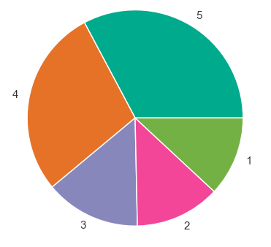
Data set overview
Your Clarabridge implementation is listening to online reviews and provided a file of 973 online customer reviews, each with a review rating (1-5) and a calculated review sentiment (strongly negative – strongly positive).
Data organized into:
6 age groups
8 brands
7 cities
6 regions
5 loyalty levels
male/female
business/leisure
Goal: use data to improve customers experience and reviews.
Average rating = 3.57

Slide 5
Data analysis methodology
Identify key highlights and pain points from all reviews by analyzing the review text of positive and negative reviews using key words and categorization to identify what needs work and where you should stay the course.
Drill down into customer categories to determine which groups of people and geographic regions need specific attention.
Identify pain points important to these key groups.

Slide 6
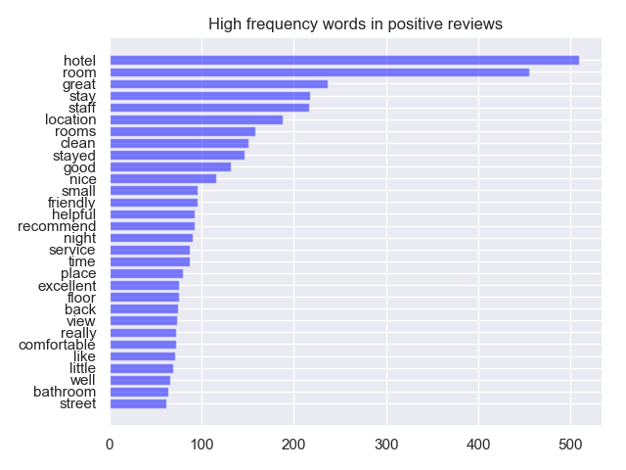
Overall highlights
room/rooms
good
nice
great
staff
clean
friendly
helpful
service
comfortable
bathroom
Positive reviews are those with a rating of 4 or 5 and a Sentence Sentiment of “Positive” or “Strongly positive”.
There are 320 positive reviews – 33% of the total.

Slide 7
Overall highlights
Facility
room/rooms (86%), great (48%), clean (45%), good (33%), bathroom (22%), comfortable (21%)
Service
staff (59%), helpful (30%), friendly (29%), nice (28%), service (23%)
What do the reviews say?
The rooms are very clean and bright, bed is very comfortable with so many pillows.
The entire staff, from the bellman to housekeeping were warm and welcoming, not pretentious!
The staff are very accommodating and courteous.
The room was perfectly clean.

Slide 8
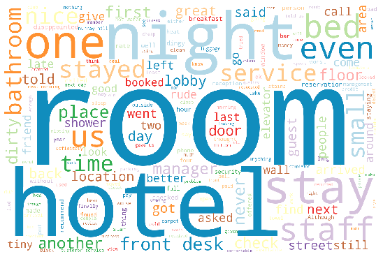
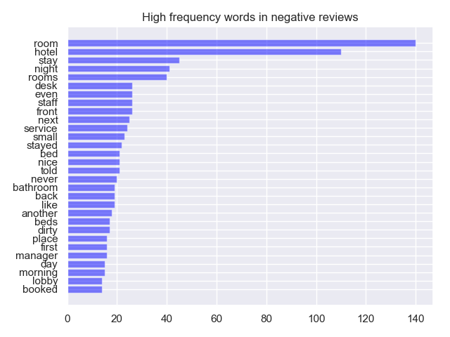
Overall pain points
rooms
desk
staff
service
bed/beds
bathroom
dirty
manager
booked
Negative reviews are those with a rating of 1 or 2 and a Sentence Sentiment of “Negative” or “Strongly negative”.
There are 69 negative reviews – 7% of the total.

Slide 9
Overall pain points
High frequency words tell us that guests complaints are focused on the facilities (room, bed, bathroom, dirty), and with customer service (staff, service, manager).
More in-depth categorical analysis tells us the major pain points:
Rooms that are not clean and/or have insects
Room condition that needs updating
Room condition that needs repair (plumbing/heat)
Room size too small
Staff unresponsive to requests/complaints or is perceived as rude
Perception that cost of room does not match value received
Elevator/street/hallway noise
Reservation problems – room or rate not available or not available on time

Slide 10
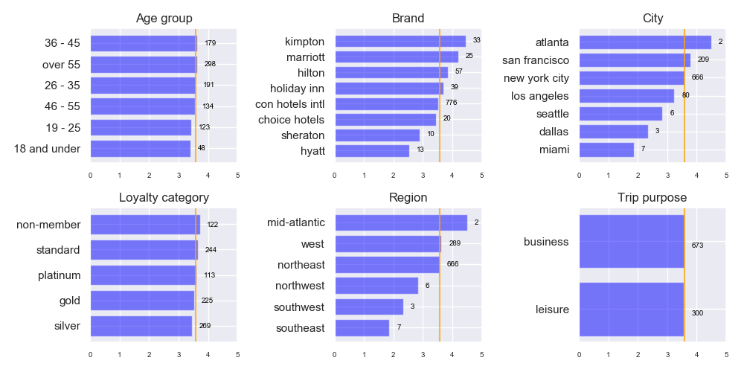
Where are the negative reviews coming from?

Slide 11
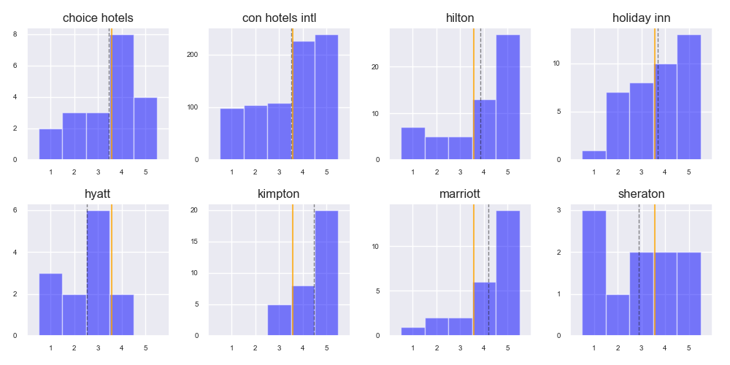
Brand insights
Total reviews 776
Total negative 56
Cleanliness 32% Size 23%
Condition 63% Staff 63%
Noise 18% Value 29%
Reservation 18%
Consolidated Hotels International

Slide 12
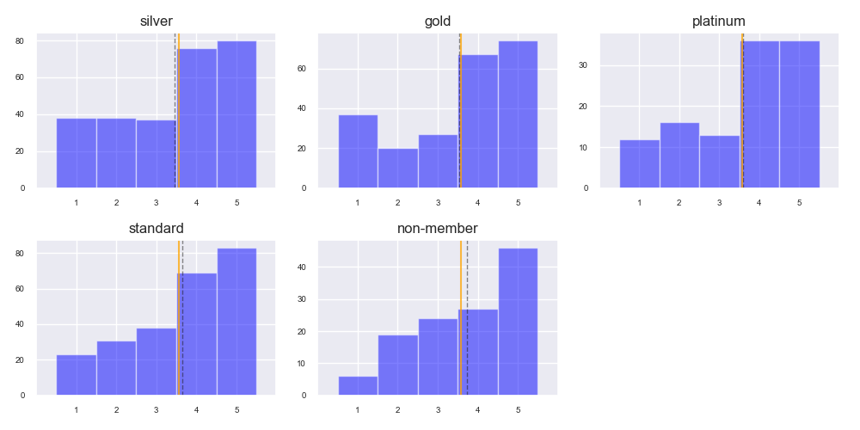
Loyalty level insights
Total reviews 269
Total negative 25
Condition 52%
Cleanliness 40%
Noise 24%
Reservation 8%
Size 20%
Staff 60%
Value 36%
_{Silver}
Total reviews 225
Total negative 15
Condition 93%
Cleanliness 27%
Noise 13%
Reservation 27%
Size 27%
Staff 73%
Value 40%
_{Gold}
Total reviews 113
Total negative 7
Condition 57%
Cleanliness 14%
Noise 0%
Reservation 14%
Size 14%
Staff 57%
Value 29%
_{Platinum}

Slide 13
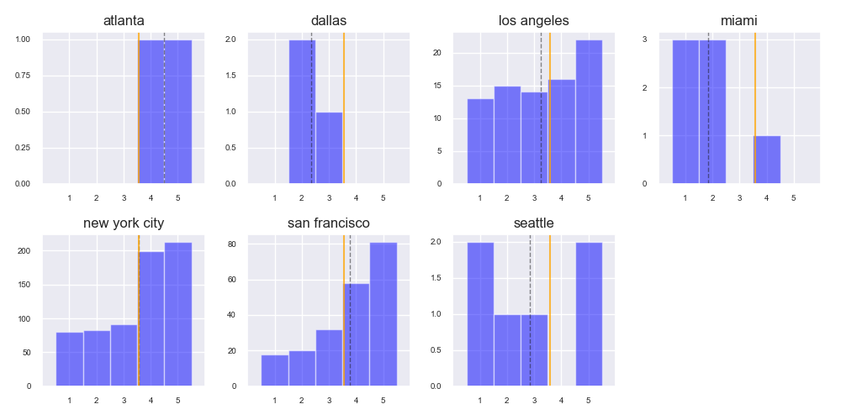
City insights
Total reviews 80
Total negative 11
Cleanliness 36% Size 27%
Condition 64% Staff 36%
Noise 18% Value 9%
Reservation 9%
Consolidated Hotels International

Slide 14
Now what?
We have identified:
Overall highlights and pain points
Customer segments with greatest impact on lowering average review rating
Specific pain points of those customer segments
We need to:
Gather additional data
Deliver the insights to those who can eliminate the pain
Set improvement goals
Measure progress

Slide 15
Clarabridge recommendations
Online reviews
Add more sources to collect review data from all channels – Facebook, Yelp, etc.
Touchpoints
Post-booking customer satisfaction surveys
On-site surveys
Reach out to loyalty members
Categorization
7 categories currently identified
Further refine using Clarabridge pre-built industry models and AI
Deliver the data
Share data across all departments
Clarabridge department-specific dashboards
Goal tracking

Slide 16
Clarabridge implementation plan
Set goals and objectives
Gather requirements – how will Clarabridge help you reach your goals?
Develop implementation plan
Customization of industry models/categorization
Identify feedback sources to integrate to capture additional data
Identify additional touchpoints to implement
Plan department dashboards
Work the plan
Measure progress against goals through Clarabridge and see an uptick in online review ratings.

Slide 17
Thank you!

Slide 18
Onsite Presentation Objective
Evaluate the candidate’s experience and strategy approach in Customer Experience Management (CEM/CX) and data analysis
Evaluate the candidate’s presentation skills in a business environment
Instructions
Create a 30 min presentation where you highlight how the Clarabridge Solution will help define/grow the hotel’s business actions based on Clarabridge CX Insights
Use the attached data to give the hotel team some sample insights based on the data they have provided. Focus your insights on extracting value from the text data to create compelling insights.
Assume this hotel brand is using Clarabridge to listen feedback from online reviews
Clarabridge personnel in the room will play the roles of the CX team, Operations group and/or Exec team at this hotel group, which owns the multiple brands you’ll see in the data

Slide 19
Proposed Agenda
Key topics to include
Introduction (3 Min)
Briefly describe your role as the Clarabridge Engagement Manager
Business Use Cases and Impact/ROI (25 minutes)
Describe actionable Insights from your data analysis
High level Project Plan for a Clarabridge Implementation (2 minutes)

Slide 20
Presentation Recommendations
Get a good understanding about the Engagement Manger role as it relates to the Clarabridge offering
When analyzing the data you will be using for your insights, make sure you leverage both the structured data with the text feedback
Include visualizations on how you could leverage the qualitative data (open text) with the quantitative data (metrics, attributes) to create more powerful analytics.
Focus on customer segmentation
Determine the highest spending guests
Determine Hotel Brand(s) and/or Location(s) with highest share of Voice of Customer (VOC)
Focus on pain points / highlights impacting guest satisfaction in the comments
Key drivers of (dis)satisfaction like key pain points / high points for hotel guests and their impact on guest scores or sentiment
Provide a strong argument for your insights and/or a powerful use case for what you are finding within the data.
Use the data to tell a story with clear insights, key takeaways
Be prepared to address your methodology for finding insights in the data
Why you chose to segment customers in the manner you did and/or why you focused on one group over another.
How do you go about creating these touchpoints (i.e. check in, room experience, hotel location)
Illustrate the Initial Project Plan and Vision for the Customer’s long term adoption plan using the Clarabridge solution

