Slide 1
TIP MULTIPURPOSE COOPERATIVE
Toshiba Information Equipment (Phils.), Inc.
04.12.2023

Slide 2
04: Summary of COOP WEBSITE
2nd -prio
MEMBERS
Online registration
Member & Non-member
Member Profile
Share History
Payments (with Option: G-cash or salary deduction)
Terms of Deduction
View Payment History
PM
Chat room (for checking if needed)
Cash Loans
Appliance loan
View my Dividend
Account closure
Product → per Vendor account + Dummy Account for Bazaar
Coop e-learning
User payment summary
Online ordering (add to cart)
ADMIN
Member Profile
Member Share summary report
Need download to excel
Account receivable
Payment summary
Chat room (for checking if needed)
PM ( for member and Admin)
Summary of Member PM concern
Loans summary
Manage Loan (admit for editing)
Dividend
Account closure summary
Product → per Vendor account + Dummy Account for Bazaar
Coop e-learning
POS REPORT – one week transaction
POS Sales
Note: Need to download excel report –separate date & without time
Inventory – vendor & COOP
Cash in/out * -cash flow management
Loan Ledger (GPL) →*
Vendor Summary of Total sales – Need excel report for principal & COOP rebate per vendor code
Summary of list of purchased
Who’s online
3rd -prio
1st -prio
VENDOR
POS
Summary of Total sales – Need excel report for principal & COOP rebate
Vendor uploading of list of product with price
Need admin approval
Notes:
Target : To establish new WEBSITE for TIPMC
Objectives : All cooperative transaction may apply

Slide 3
Notes
Membership approval → need education team approval
User Application → Need to select member or non-member
Access level
Sample: 0- viewer only, 1-non- member , 2 –member , 3- Admin , 4-BOD
Note: Active – order served, Inactive – order not serve , for order –add to cart
Pending: how to acknowledge the order by the costumer → need to swipe ID upon receiving
Note: WFH style – (member can add to cart even no physical store – Vendor will deliver to COOP office
Payment : Cash – coding 123456789, Coop – employee #, Gcash – CP#

Slide 4
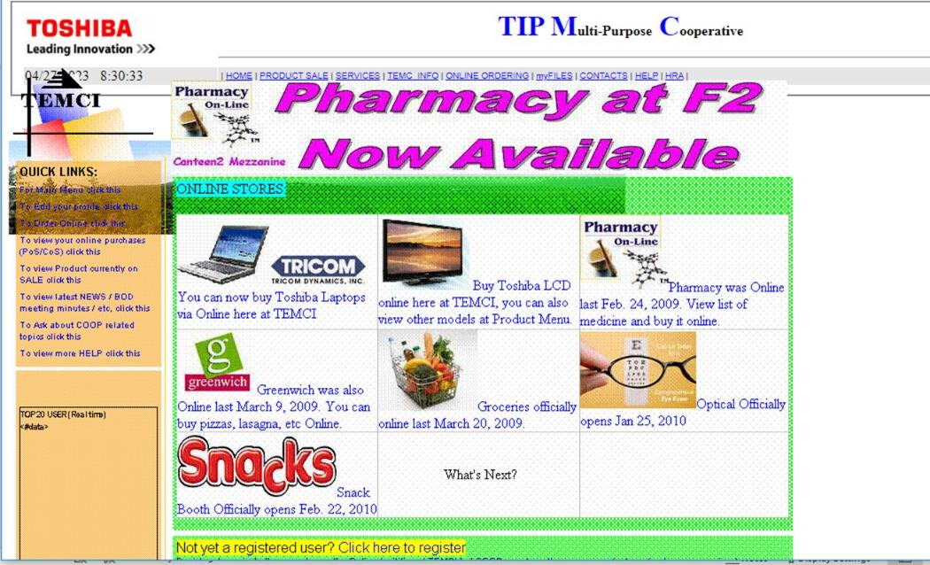

Slide 5
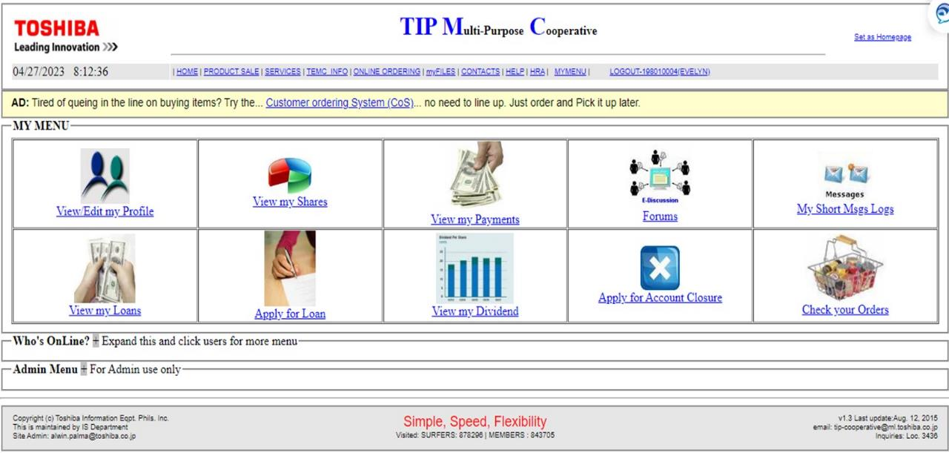
1
2
3
4
5
6
7
8
9
10

Slide 6
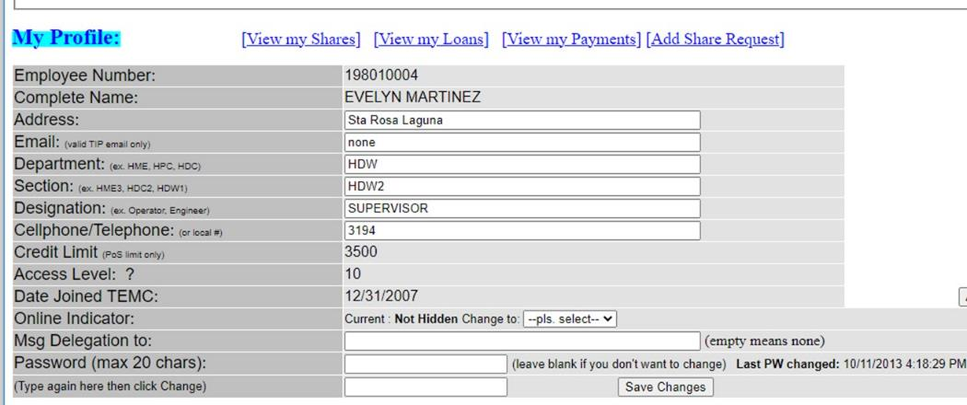
1
1. View/Edit my profile

Slide 7
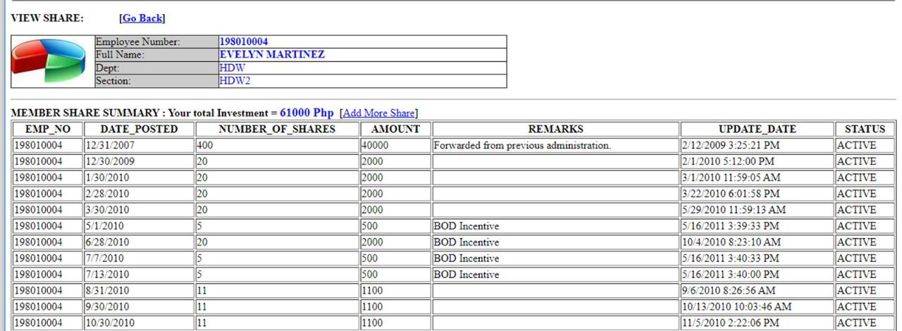

Slide 8
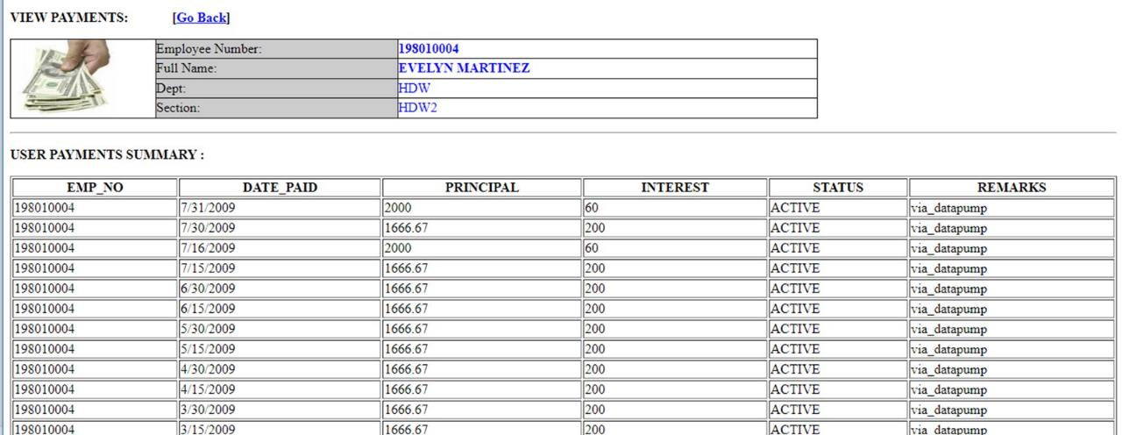
View my Payment

Slide 9
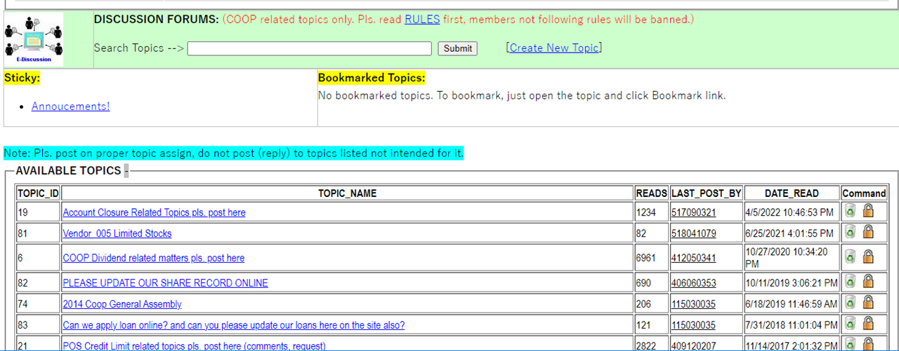
FORUM

Slide 10
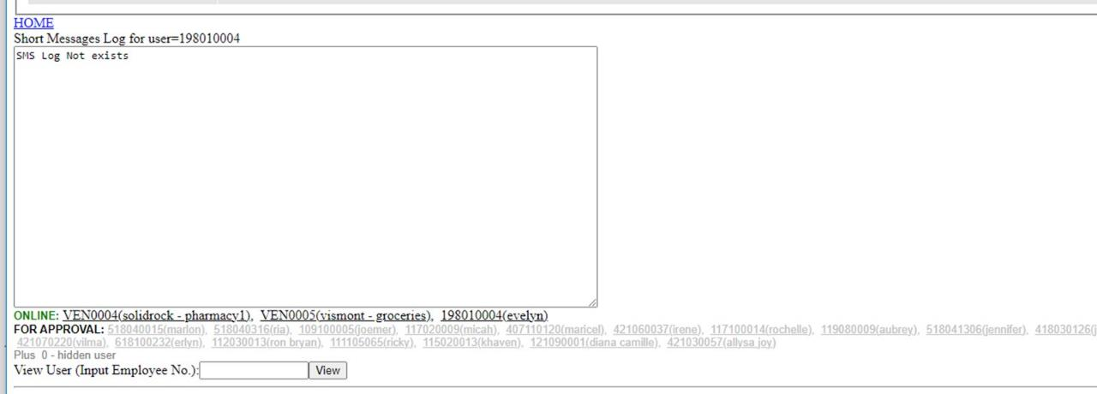

Slide 11
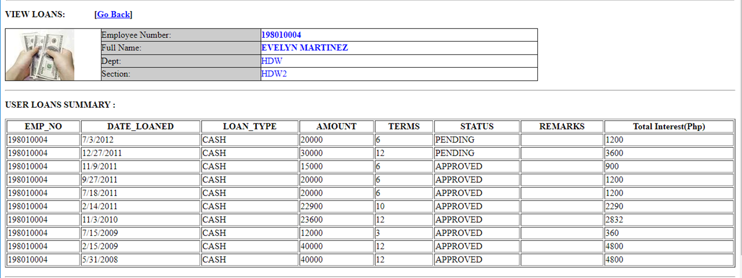
View my loan

Slide 12
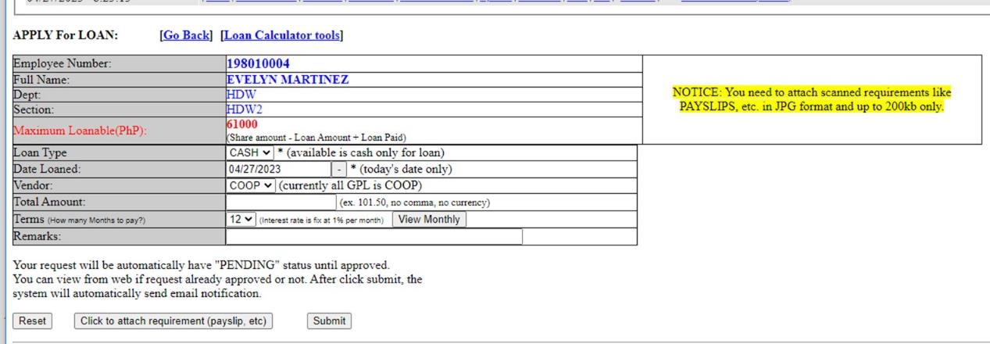
Apply for Loan

Slide 13
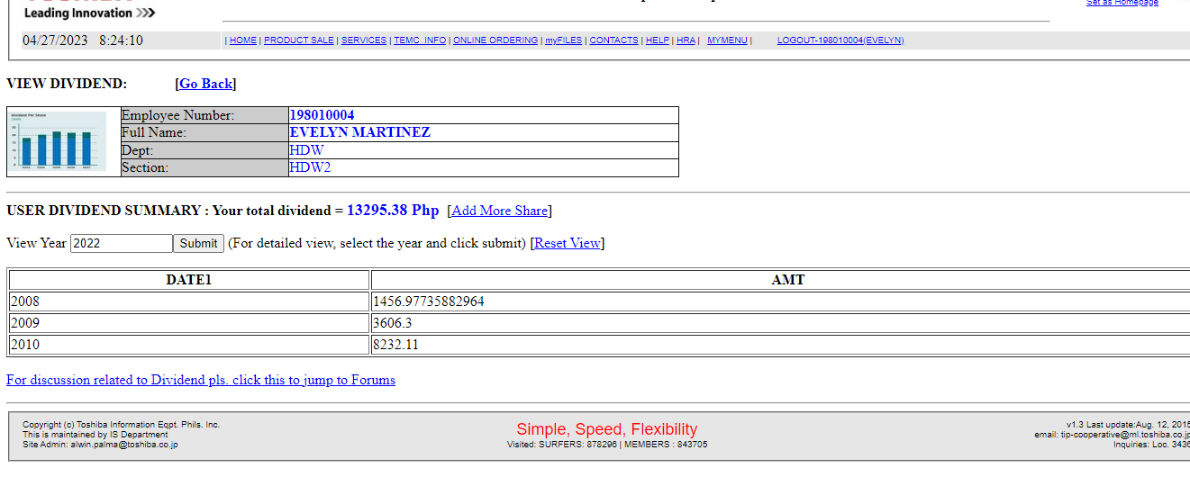
View Dividend

Slide 14
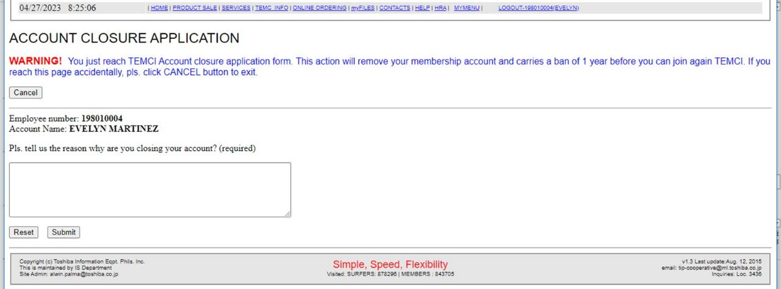

Slide 15
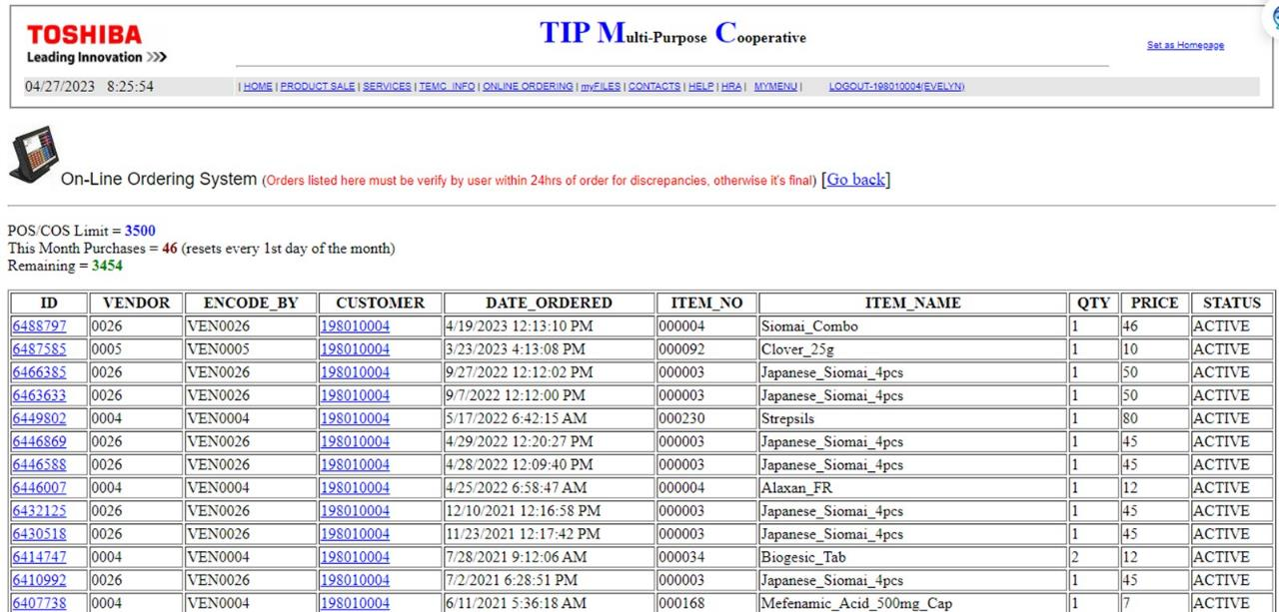

Slide 16
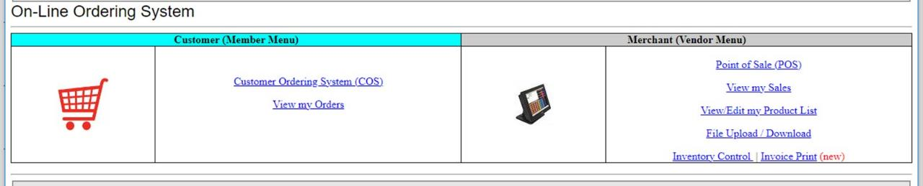
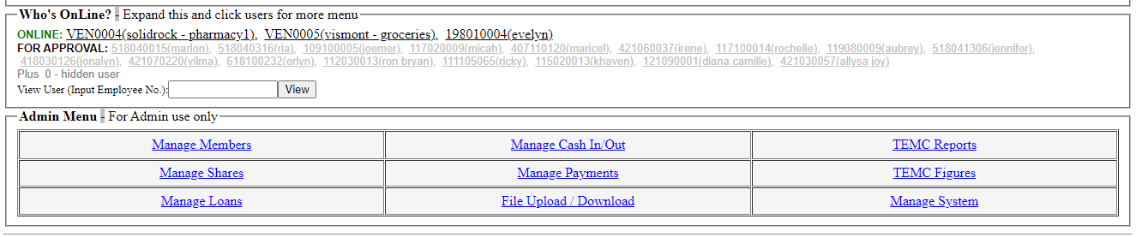

Slide 17
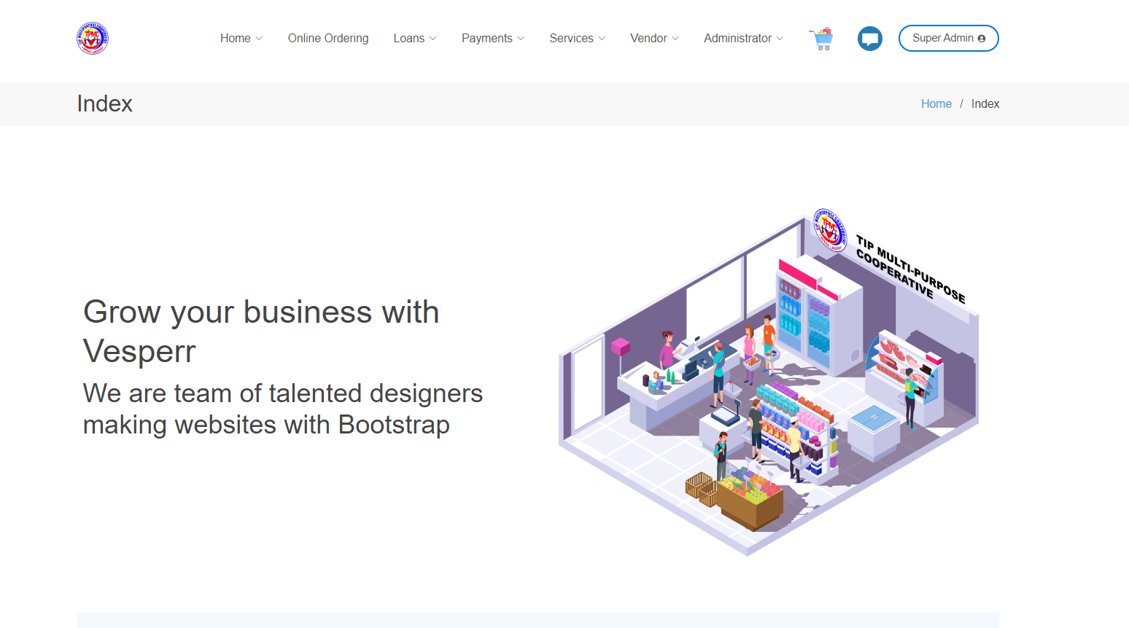

Slide 18
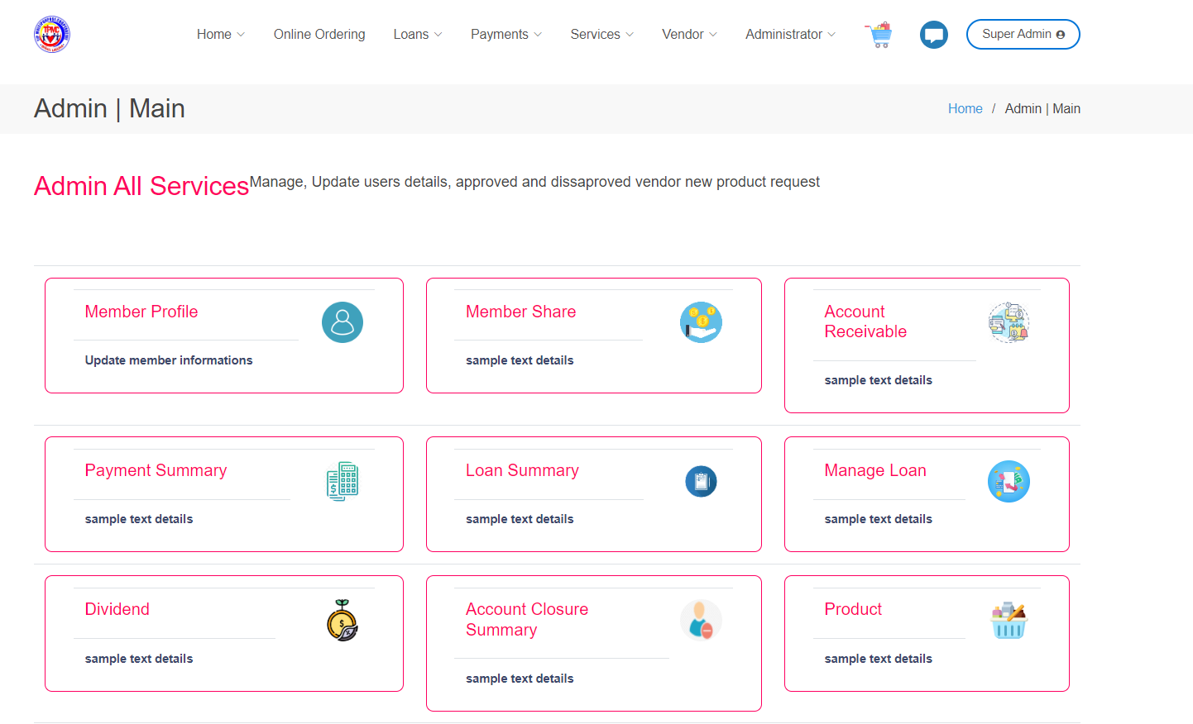

Slide 19
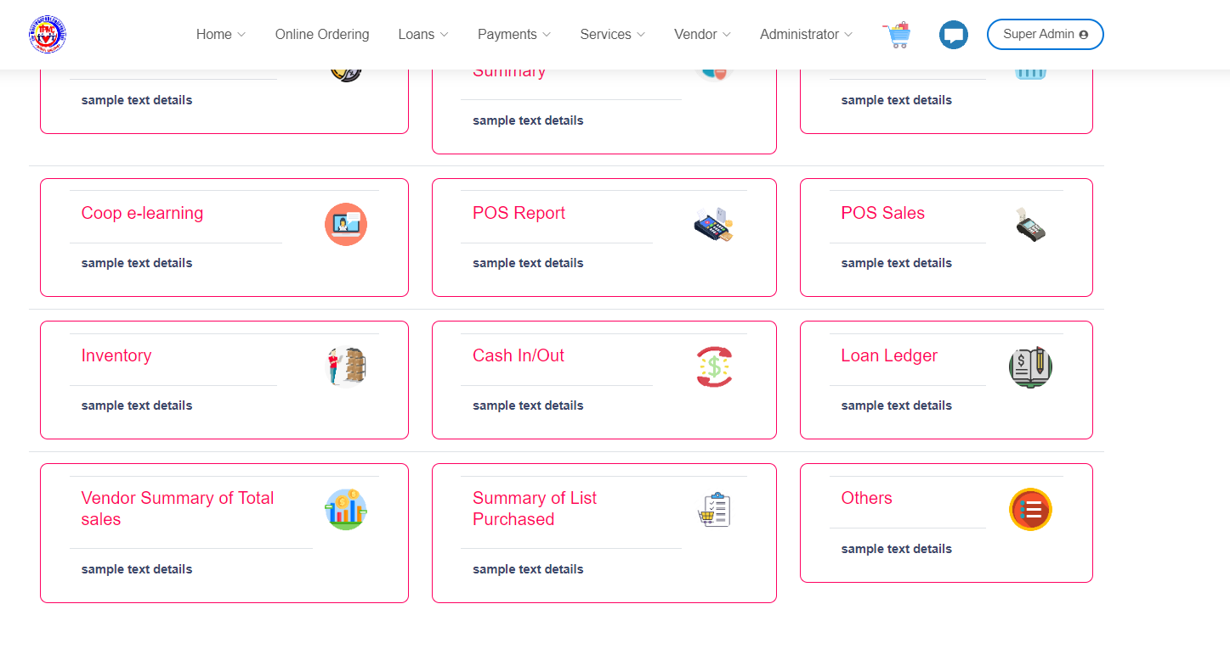

Slide 20
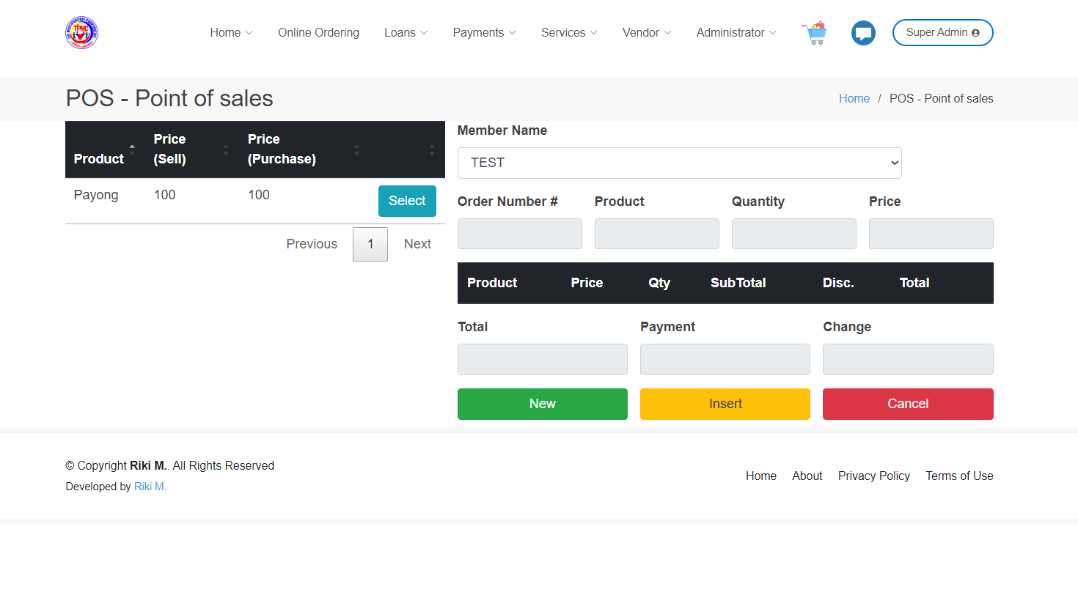
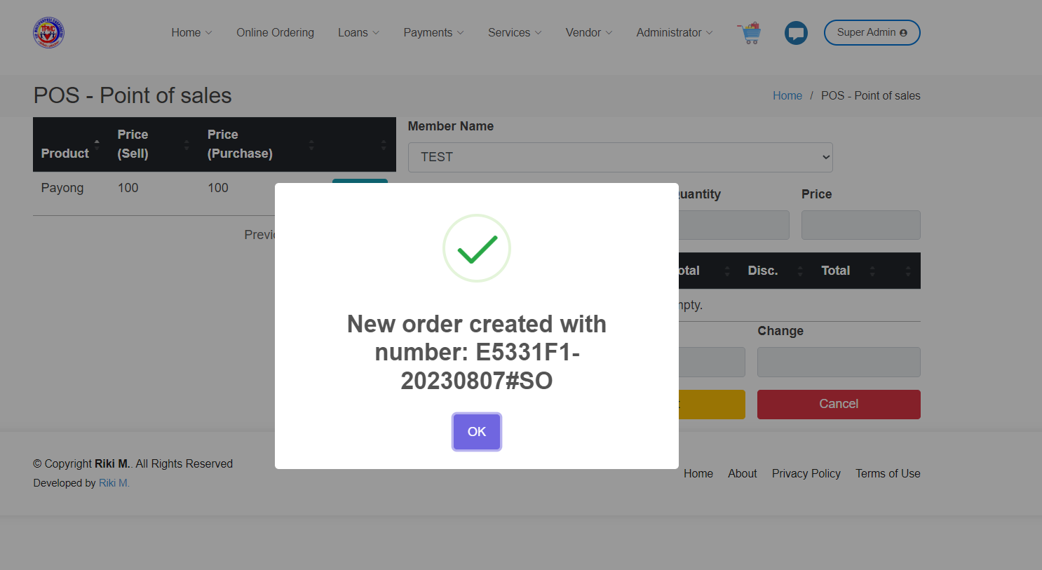
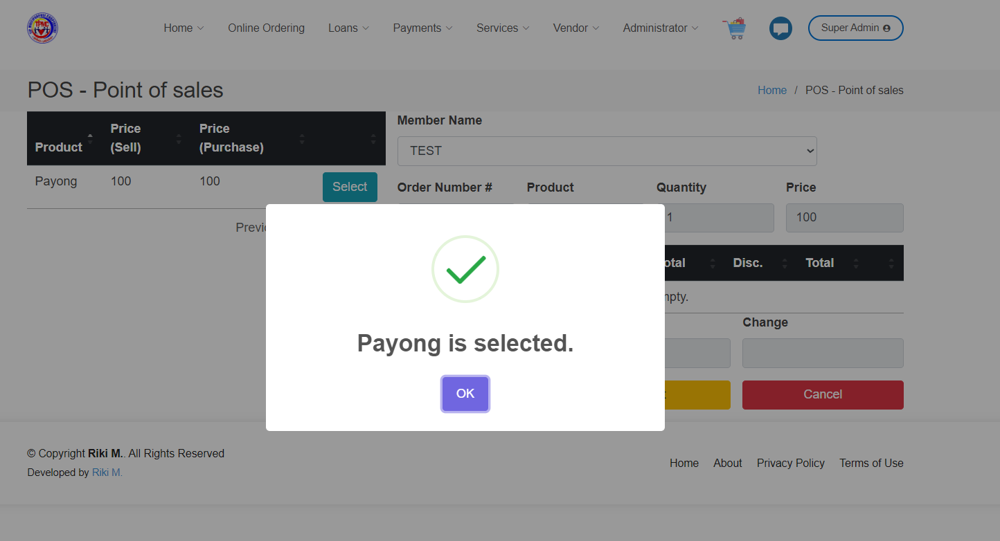
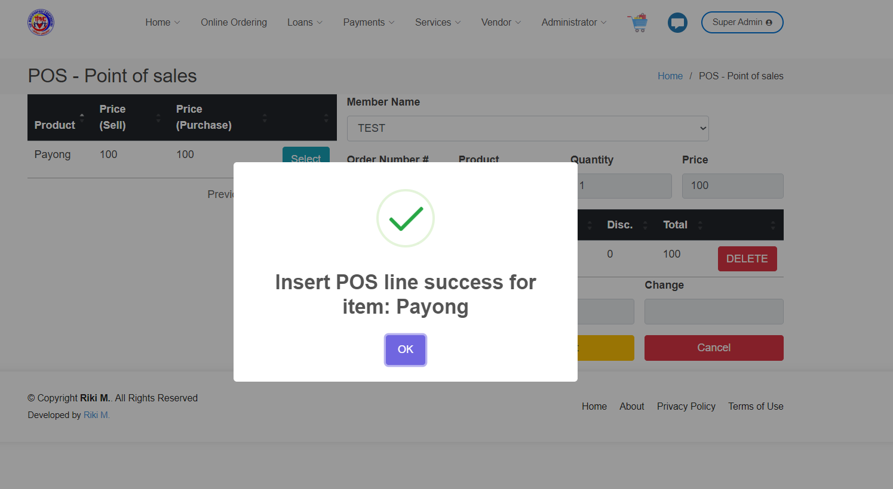

Slide 21
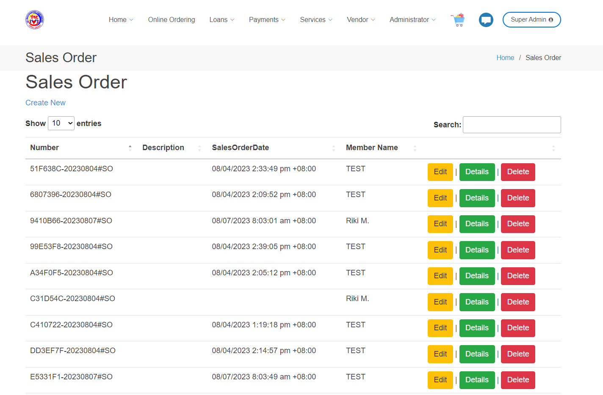
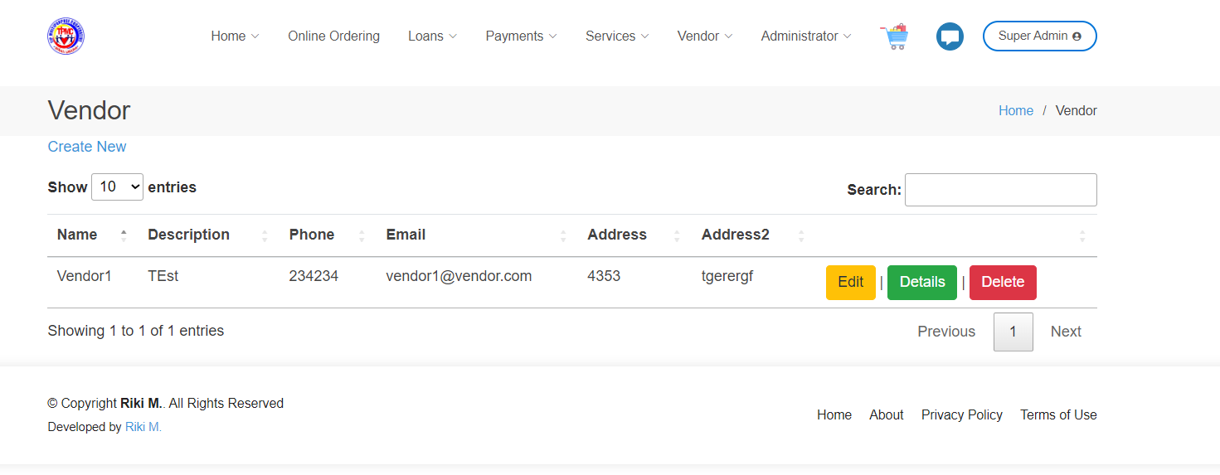
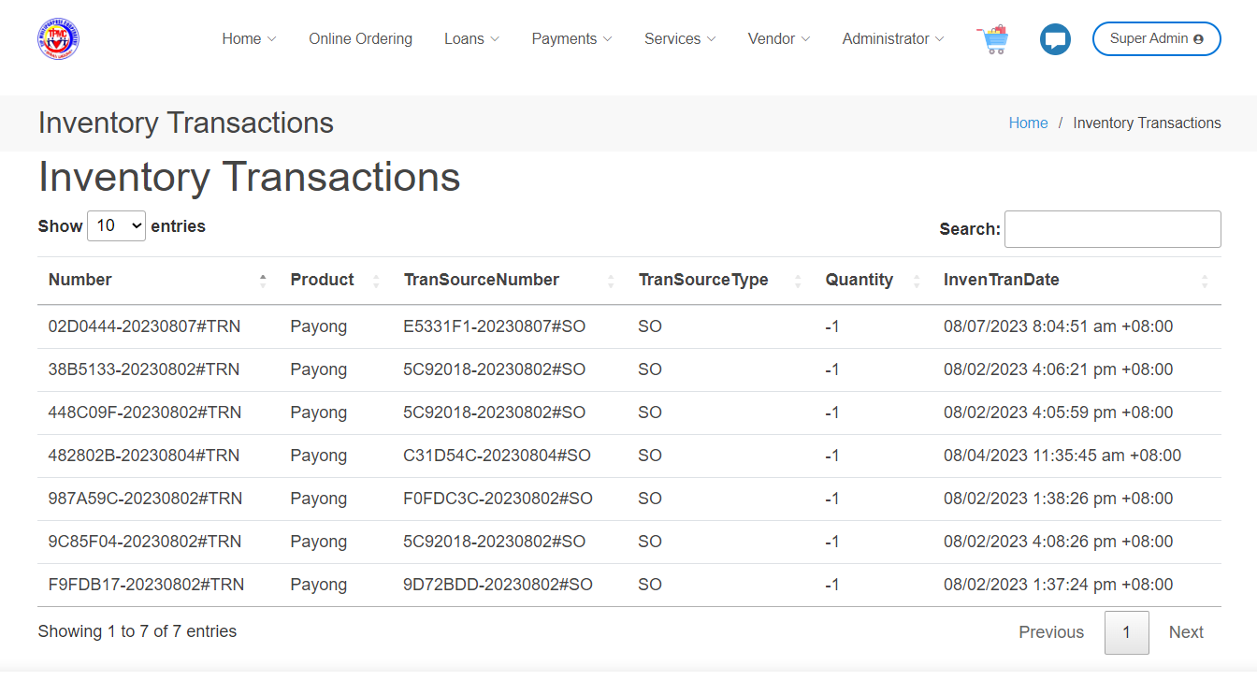
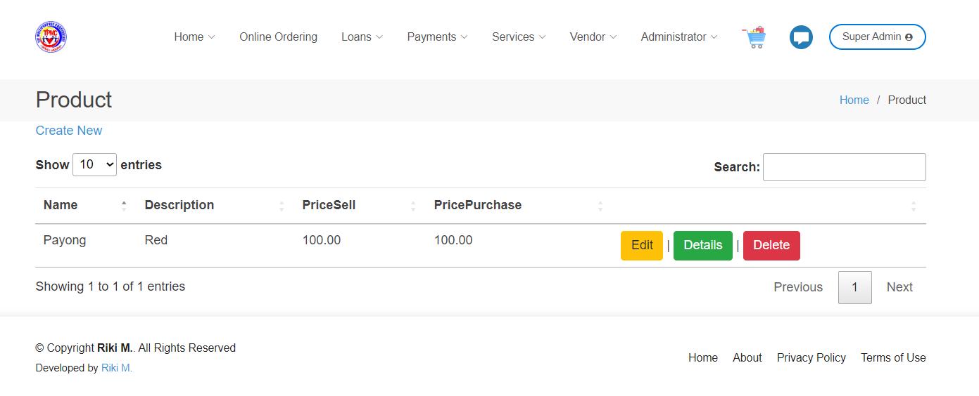

Slide 22
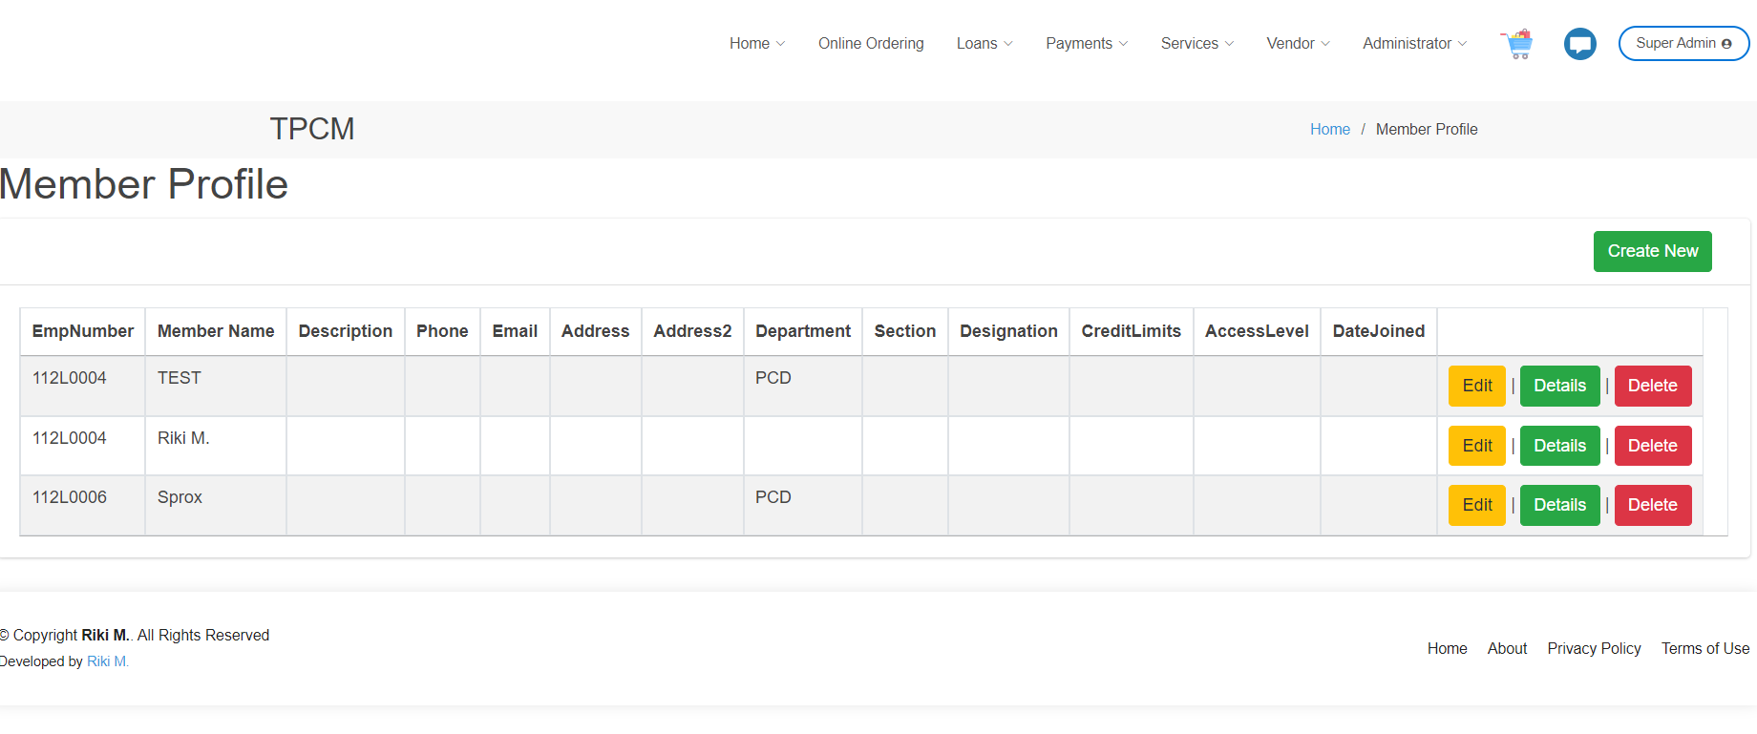
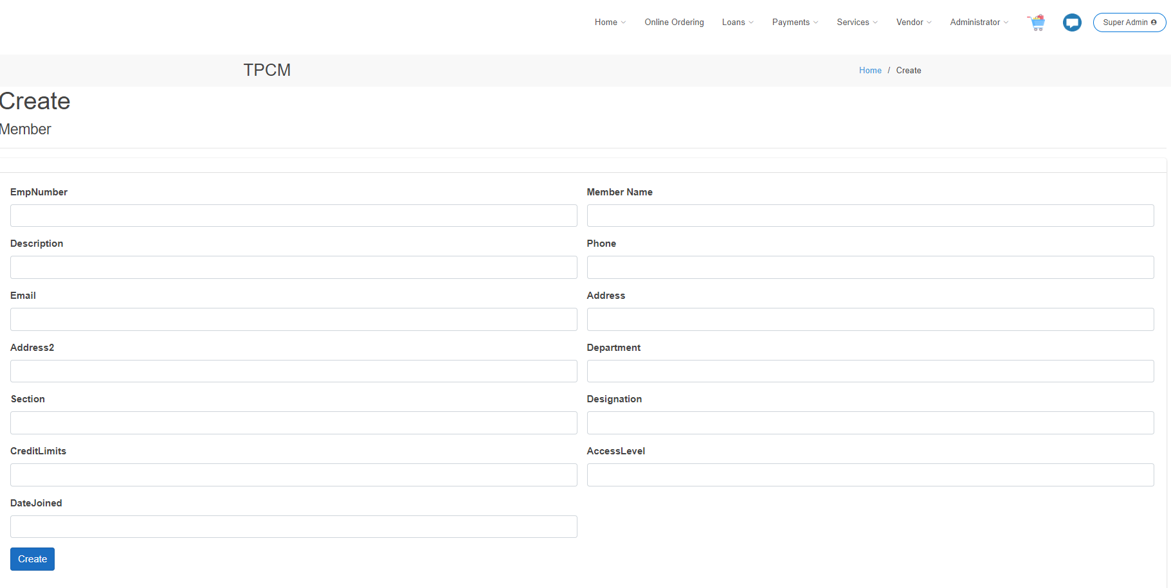

Slide 23
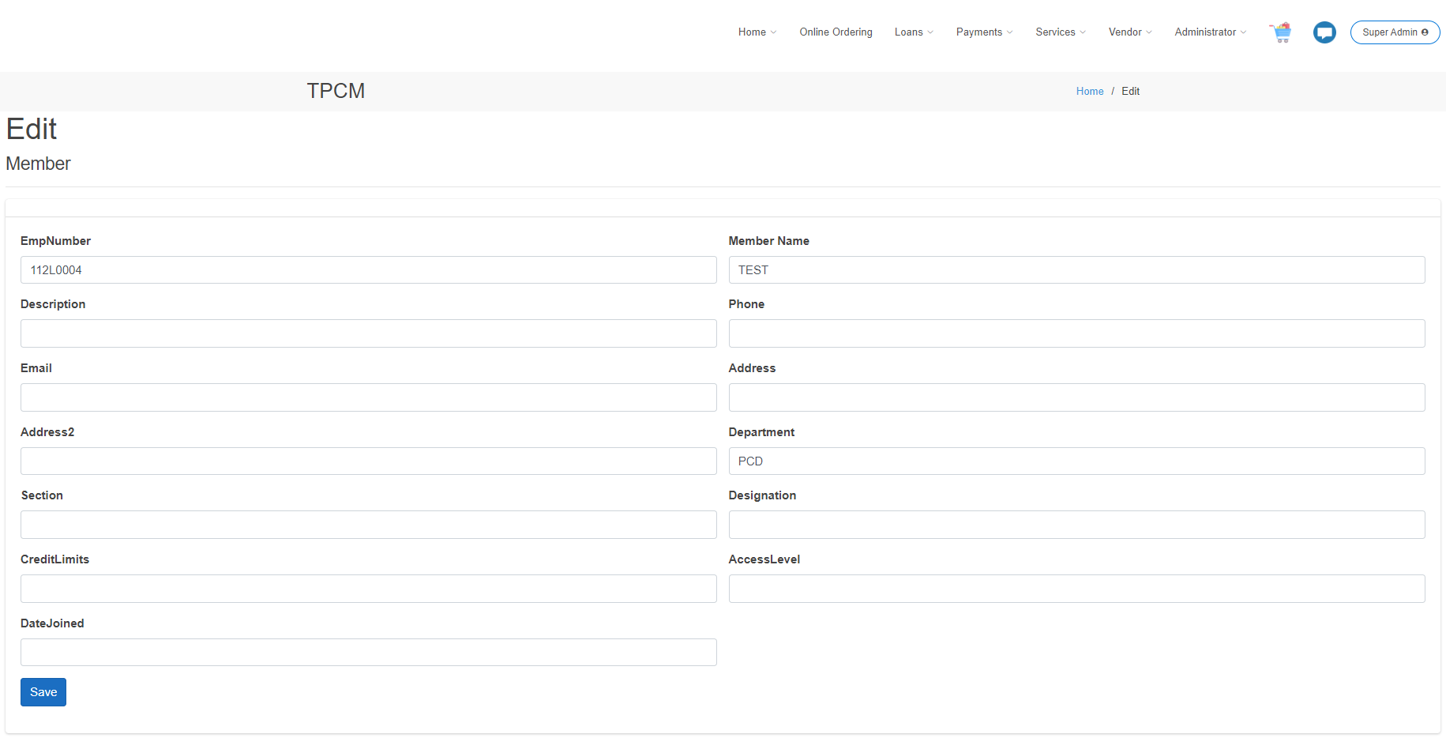
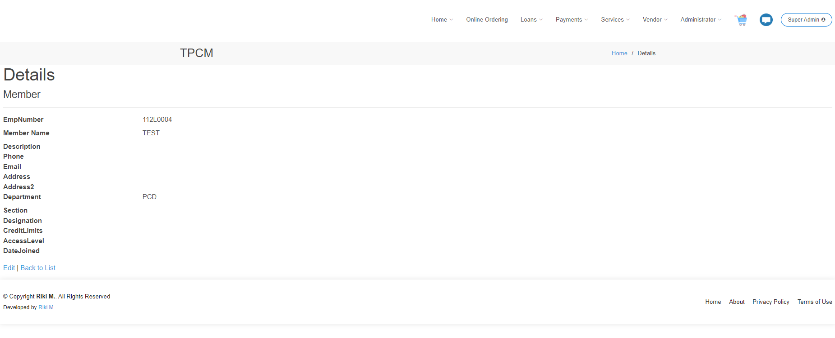

Slide 26
THANK YOU

