Slide 1
On-Street Parking
Transparent Wireless Systems, LLC
Version 3.1

Slide 2
Start Parking

Slide 3
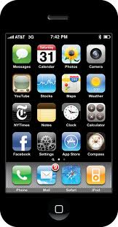
Street Parking Screens: Start Parking
Screen 0
TWS
User launches parking app (TWS)

Slide 4





Street Parking Screens: Start Parking
Screen 1
Street Parking.
Garage Parking.
Direct Payment
Scan ID
Profile
Setting
User launches Street Parking app

Slide 5

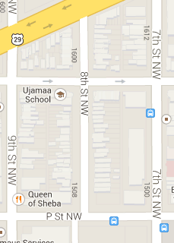
Street Parking Screens: Start Parking
BLE Tag inside car
Screen 2
BLE Beacon
Vehicle: VA ABCD123
Discovered location
Correct location indicated by user
Accept Location
User location and vehicle ID detected automatically
5

Slide 6
Street Parking Screens: Start Parking
Screen 3
Vehicle: VA ABCD123
Rate $ 0.25/hr
Max Time 2 hrs
Continue
Cancel
Parking rate/restrictions displayed

Slide 7

Street Parking Screens: Between Start and End
Screen 4
Vehicle: VA ABCD123
Parking Session
Started: 2/4/13 9:35 AM
Auto-renewal: 5 min period
Current Charge: $0.25
End Parking
Done. Session screen displayed remotely at all times

Slide 8
End Parking

Slide 9
Street Parking Screens: End Parking
Screen 0
TWS
User launches parking app (TWS)

Slide 10
Street Parking Screens: End Parking
Screen 1
Street Parking.
Garage Parking.
Direct Payment
Scan ID
Profile
Setting
User launches Street Parking app

Slide 11
Street Parking Screens: End Parking
Screen 2
Vehicle: VA ABCD123
Parking Session
Started: 2/4/13 9:35 AM
Ending: 2/4/2013 10:50 AM
Current Charge: $2.00
End Parking
Active session screen

Slide 12
Street Parking Screens: End Parking
Screen 3
Vehicle: VA ABCD123
Parking Session
Started: 2/4/13 9:35 AM
Ended: 2/4/2013 10:35 AM
Charge: $2.00
Thank you for using TWS
Save Receipt
Final session screen

