Slide 1

Garage Parking using Paper Tickets
Transparent Wireless Systems, LLC
Version 3.1
Proprietary & Confidential to Transparent Wireless Systems, LLC

Slide 2
Start Parking
Proprietary & Confidential to Transparent Wireless Systems, LLC

Slide 3
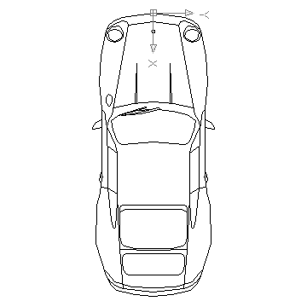
Garage Parking: Start Parking
TWS Parking Application Server
Garage Server
Wired Internet
Paper Ticket Reader
Paper Ticket
Lift-arm Barrier
Wireless Internet
Handset
Proprietary & Confidential to Transparent Wireless Systems, LLC

Slide 4

Garage Parking: Start Parking
User drives up to entrance gate
Bluetooth LE Proximity Beacon at Garage Gate sensed by wireless device inside vehicle
Phone reads & remembers Garage/Gate ID
Proprietary & Confidential to Transparent Wireless Systems, LLC

Slide 5
Garage Parking: Start Parking
Option 1: Automatic estimation of ticket issuance time
Paper Ticket
Lift-arm Barrier
Entrance Access Gate
Radiation Pattern of BT LE Beacon
Paper Ticket Dispenser
BT LE Beacon
Paper Ticket Dispensing Switch
Phone remembers time when BLE signal is maximum.
This time is the user’s estimated time of ticket issuance
Proprietary & Confidential to Transparent Wireless Systems, LLC

Slide 6
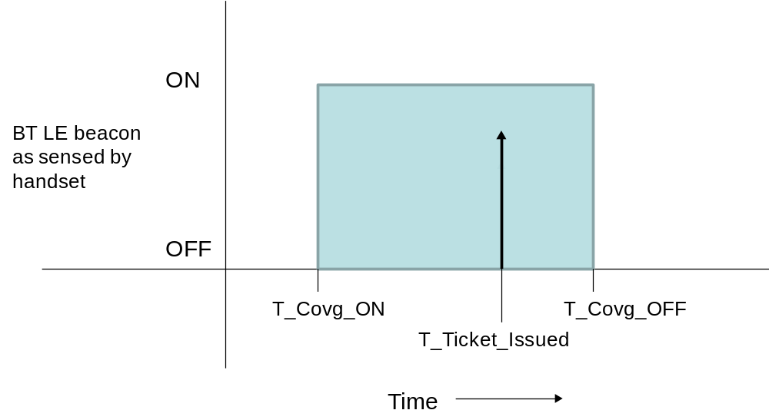
Proprietary & Confidential to Transparent Wireless Systems, LLC

Slide 7

User takes paper ticket from ticket dispenser in the usual
Proprietary & Confidential to Transparent Wireless Systems, LLC

Slide 8

Garage Parking: Start Parking
Proprietary & Confidential to Transparent Wireless Systems, LLC

Slide 9
Garage Parking: Start Parking
Proprietary & Confidential to Transparent Wireless Systems, LLC

Slide 10
Garage Parking: Start Parking
Proprietary & Confidential to Transparent Wireless Systems, LLC

Slide 11
Garage Parking: Start Parking
Prompted by
  Car going out of BLE coverage as it enters the garage
Handset sends a message to Parking Application Server to start a session.
  Message contains
    User ID (proxy: Session ID)
    Garage/Gate IDs
    Estimated time of ticket issuance
Above info is forwarded by Parking Application Server to Garage Server with request to initiate a session
Proprietary & Confidential to Transparent Wireless Systems, LLC

Slide 12
Garage Parking: Start Parking
Parking Application Server and Garage Server exchange messages
Ticket held by user is identified by Garage Server on the basis of Estimated Time of Ticket Issuance
  Ticket ID and Session ID are linked
Ticket is cleared for exit by Garage Server
Garage Server notifies the Parking Application Server that ticket has been cleared for exit
Parking Application Server sends “Accepted” message back to Handset.
  This tells the user that his payment method has been accepted by the garage
Proprietary & Confidential to Transparent Wireless Systems, LLC

Slide 13
End Parking
Proprietary & Confidential to Transparent Wireless Systems, LLC

Slide 14
Garage Parking: End Parking
Handset Screen 0
TWS
Other App.
Other App.
Other App.
Other App.
Other App.
User returns to car and launches TWS app
Proprietary & Confidential to Transparent Wireless Systems, LLC

Slide 15
Garage Parking: Start Parking
Handset Screen 1
Street Parking.
Garage Parking.
Direct Pmt.
Scan ID
Profile
Settings
User launches Garage Parking app
Proprietary & Confidential to Transparent Wireless Systems, LLC

Slide 16
Garage Parking: End Parking
Handset Screen 2
TWS
Garage N
230 N St. NW
Washington DC
Parking Session Status
Started: 2/4/2013 9:35 AM
Present Time: 6:09 PM
Status: Open
Current Charge: $22.50
Accepted
Active Session Screen displayed
Proprietary & Confidential to Transparent Wireless Systems, LLC

Slide 17
Garage Parking: End Parking
The active session screen, including the Accepted message and current charges, are displayed.
  Accepted message is the user’s assurance that the gate will open
User drives to exit gate and inserts ticket into ticket reader.
Ticket is recognized by Garage Server as cleared for exit.
Garage Server opens gate.
Proprietary & Confidential to Transparent Wireless Systems, LLC

Slide 18
Garage Parking: End Parking
Proprietary & Confidential to Transparent Wireless Systems, LLC

Slide 19
Garage Parking: End Parking
Proprietary & Confidential to Transparent Wireless Systems, LLC

Slide 20
Garage Parking: End Parking
Proprietary & Confidential to Transparent Wireless Systems, LLC

Slide 21
Garage Parking: End Parking
Garage Server determines final charge based on user’s time of exit
Garage server sends Invoice to Parking Application Server
Parking Application Server sends Receipt to Handset
Proprietary & Confidential to Transparent Wireless Systems, LLC

Slide 22
Garage Parking: End Parking
Handset Screen 3
TWS
Garage N
230 N St. NW
Washington DC
Parking Session Status
Started: 2/4/2013 9:35 AM
Ended: 2/4/2013 6:15 PM
Charge: $24.00
Store Receipt
Final Receipt Screen
Proprietary & Confidential to Transparent Wireless Systems, LLC

Slide 23

Exit Transactions for Gated Garage using paper ticket
Parking
Time
User
Handset
Gate Infrastructure
Application
Garage Server
Server
Cellular data link
Local Garage Infrastructure
User opens Garage Parking App (HS Screen 1)
. Active Session Screen is displayed (HS Screen 2).
User verifies that Accepted msg is displayed in Active Session Screen and submits ticket to ticket reader
Ticket ID
Garage Server recognizes ticket as Authorized to Exit.
Garage Server opens gate
Garage Server sends Invoice to Parking Application Server
Open Gate
User leaves
Display Receipt (HS Screen 3)
Invoice (Msg_ID, Session Details, Charge)
Proprietary and Confidential to Transparent Wireless Systems, LLC

