Slide 1

Targeted Enforcement for On-Street Parking
Transparent Wireless Systems, LLC
Version 3.1
Proprietary & Confidential to Transparent Wireless Systems, LLC

Slide 2
Enforcement Officer’s Terminal Screens
Washington DC
5th St. NW
6th St. NW
D St. NW
E St. NW
Targeted Enforcement Area (Area selected by Enforcement Officer for checking)
Enforcement Officer location
Vehicle Locations
Enforcement Officer selects a geographic area to survey
Proprietary & Confidential to Transparent Wireless Systems, LLC

Slide 3
Enforcement Officer’s Terminal Screens
Washington DC
Vehicle with expired parking status
5th St. NW
6th St. NW
D St. NW
Vehicle with un-expired parking status
E St. NW
Enforcement Officer location
Check Vehicle IDs
Enforcement Officer visits red icons and confirms their ID using wireless validation (RFID or Bluetooth LE)
Proprietary & Confidential to Transparent Wireless Systems, LLC

Slide 4

Enforcement Officer’s Terminal Screens
Issue Ticket
Parking Status: Expired
Lic. Plate VA XYZ1234
Start Time 13:30
End Time 15:30
Present Time 16:00
Overage 0:30
Location 6th & D St. NW, Wash DC
Vehicle Locations
Proprietary & Confidential to Transparent Wireless Systems, LLC

Slide 5

Enforcement Officer’s Terminal Screens
Parking Status:
Unexpired
Lic. Plate VA ABCD123
Start Time 13:30
End Time 15:30
Present Time 14:00
Time Left 1:30
Location 6th & E St. NW, Wash DC
Vehicle Locations
Proprietary & Confidential to Transparent Wireless Systems, LLC

Slide 6
Enforcement Officer’s Terminal Screens
Detected Vehicles:
Lic. Plate VA XYZ1234
Lic. Plate VA ABCD123
Vehicle Locations
Proprietary & Confidential to Transparent Wireless Systems, LLC

Slide 7
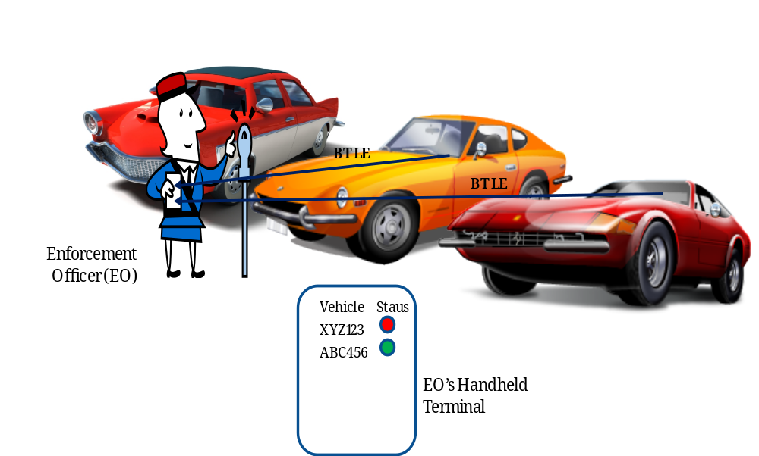
Walk-around Validation using BLE
Proprietary & Confidential to Transparent Wireless Systems, LLC

