Slide 1

Introduction to

Slide 2
Agenda

Slide 3
Git is hip
Source:
Developer Survey Results 2018
Website: Stackoverflow.com

Slide 4
Git is hip
Source:
Developer Survey Results 2018
Website: Stackoverflow.com

Slide 5
Schwierigkeiten beim Umgang mit Git

Slide 6
Why Version Control System?
With a version control system you
revert selected files back to a previous state
revert the entire project back to a previous state
compare changes over time
see who last modified something
if you screw things up or lose files
You can recover
On a cost of a little overhead
Not only Source Code
For every kind of data

Slide 7

Local Version Control System
Easiest way
Copy files in a different directory
Error prone
Easy to delete or modify the backup files
More advanced
Having a local database
Most popular is RCS
Created in the 80's
Keeps patches to the original file

Slide 8
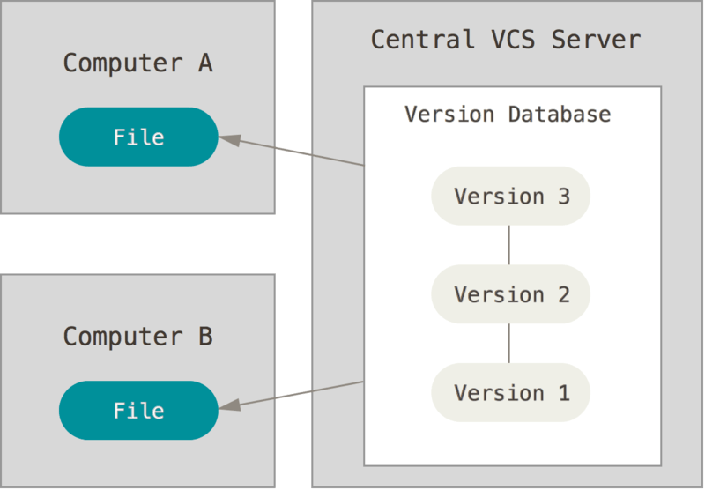


Centralized Version Control System
Answer to the question: How can I collaborate with other developer(s) on a different system?
A server-client system
Single Point-Of-Failure
Database on the server
Depends heavily on network
CVS
Concurrent Versions System

Slide 9
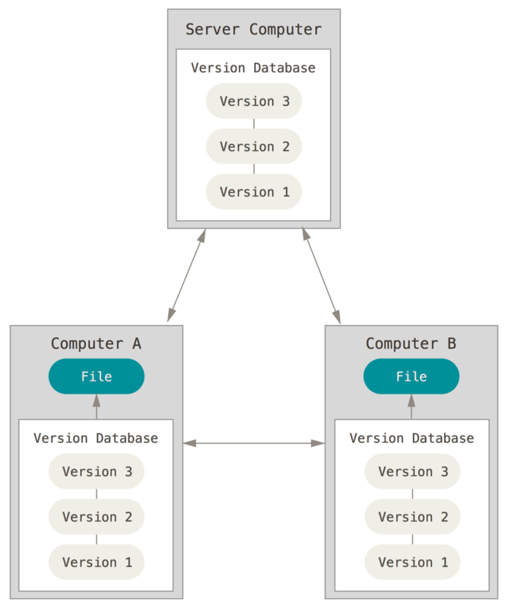


Distributed Version Control Systems
Every time the database is cloned
Every client has the whole database
Including the whole history

Slide 10
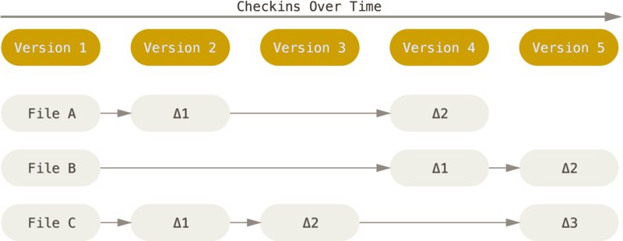
How do VCS save data? delta-based version control
CVS
Concurrent Versions System

Slide 11
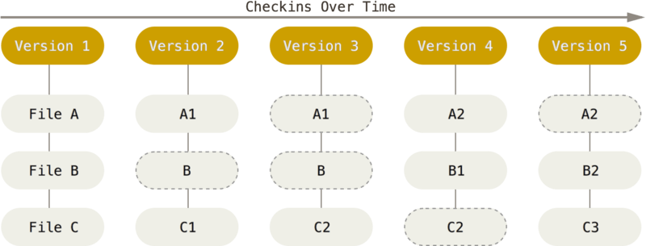
How does Git save data? snapshot-based version control

Slide 12
Nearly everything is local

Slide 13
Git has Integrity

Slide 14
Nachteile von Git

Slide 15
Drei-Schritte-Plan zum Umstieg

Slide 16
Quellen

