Slide 1
00
选择题
01
打印图形
CONTENT
02
递归
03
穷举

Slide 2
1
PART ONE
打印图形
数列通项
找规律

Slide 3
打印图形
Always believe that something wonderful is about to happen.
数列通项
找规律

Slide 4
打印图形 Level 1
Always believe that something wonderful is about to happen.
输入一个整数n，输出一个由“*”围成的腰长为n的空心等腰三角形
样例输入
4
样例输出
*
* *
* *
*******

Slide 5
打印图形 Level 1
Always believe that something wonderful is about to happen.
n = 4
 | Spaces
1 | 3
2 | 2
3 | 1
4 | 0
Spaces
1
3
5
 | 1 | 2 | 3 | 4 | 5 | 6 | 7 | 8
1 |  |  |  | * | \n
2 |  |  | * |  | * | \n
3 |  | * |  |  |  | * | \n
4 | * | * | * | * | * | * | * | \n
n-1
2n-1
i
n-i
2i-3

Slide 6
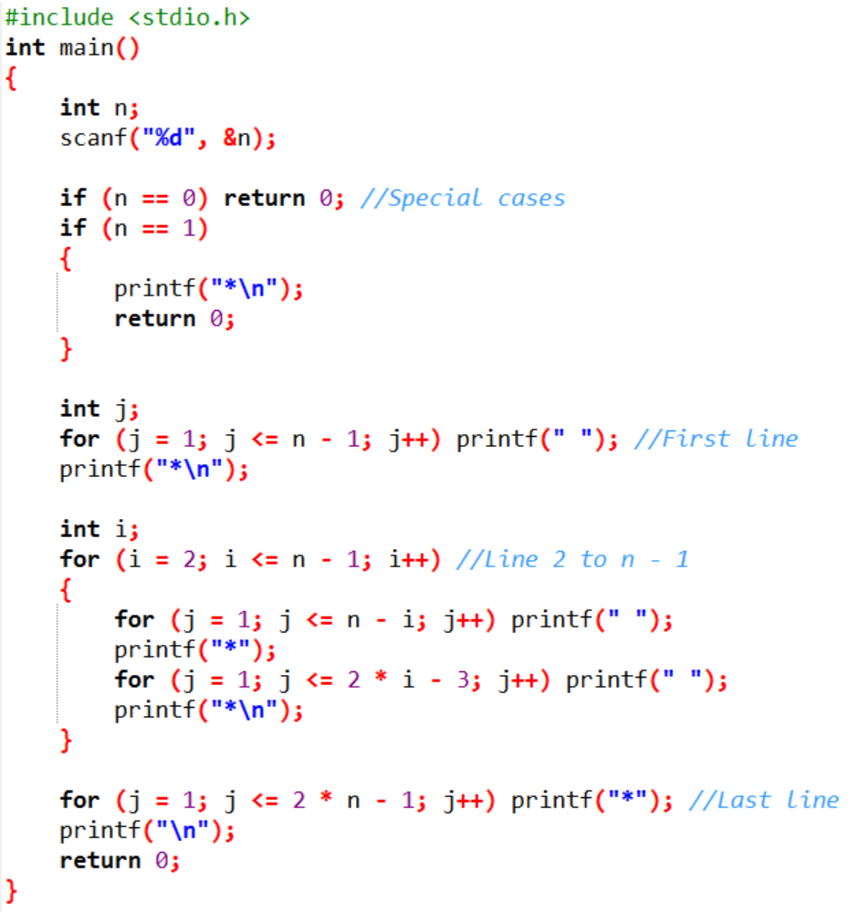
打印图形 Level 1
Always believe that something wonderful is about to happen.

Slide 7
打印图形 Level 2
Always believe that something wonderful is about to happen.
输入一个整数n，输出一个由“*”围成边长为n的空心字符菱形
样例输入
4
样例输出
*
* *
* *
* *
* *
* *
*

Slide 8
打印图形 Level 2
Always believe that something wonderful is about to happen.
 | 1 | 2 | 3 | 4 | 5 | 6 | 7 | 8
1 |  |  |  | * | \n
2 |  |  | * |  | * | \n
3 |  | * |  |  |  | * | \n
4 | * |  |  |  |  |  | * | \n
5 |  | * |  |  |  | * | \n
6 |  |  | * |  | * | \n
7 |  |  |  | * | \n

Slide 9
打印图形 Level 3
Always believe that something wonderful is about to happen.
输入一个整数n和一个大写字母，
输出一个腰长为n的字母空心等腰三角形，字母按序依次递增，但保证不会超过Z
样例输入
4 B
样例输出
B
C C
D D
EDCBCDE

Slide 10
打印图形 Level 3
Always believe that something wonderful is about to happen.
n = 4 c = B
 | 1 | 2 | 3 | 4 | 5 | 6 | 7 | 8
1 |  |  |  | B | \n
2 |  |  | C |  | C | \n
3 |  | D |  |  |  | D | \n
4 | E | D | C | B | C | D | E | \n
 | Letter
1 | B
2 | C
3 | D
4 | E
ASCII
c + 0
c + 1
c + 2
c + 3
i
c + i - 1
 | 1 | 2 | 3 | 4
 | E | D | C | B
 | c+3 | c+2 | c+1 | c+0
j
c+n-j

Slide 11
打印图形 Level 4
Always believe that something wonderful is about to happen.
输入一个整数n和一个大写字母，
输出一个腰长为n的字母空心等腰三角形，字母按序依次递增，但保证不会超过Z
样例输入
4 B
样例输出
E
D F
C G
BCDEFGH

Slide 12
打印图形 Level 4
Always believe that something wonderful is about to happen.
n = 4 c = B
 | 1 | 2 | 3 | 4 | 5 | 6 | 7 | 8
1 |  |  |  | E | \n
2 |  |  | D |  | F | \n
3 |  | C |  |  |  | G | \n
4 | B | C | D | E | F | G | H | \n
1 | E
2 | D
3 | C
4 | B
c + 3
c + 2
c + 1
c + 0
E
F
G
H
c+2+1
c+2+2
c+2+3
c+2+4
i
c+i-1
c+n-2+i
 | 1 | 2 | 3 | 4
 | B | C | D | E
 | c+0 | c+1 | c+2 | c+3
j
c+j-1

Slide 13
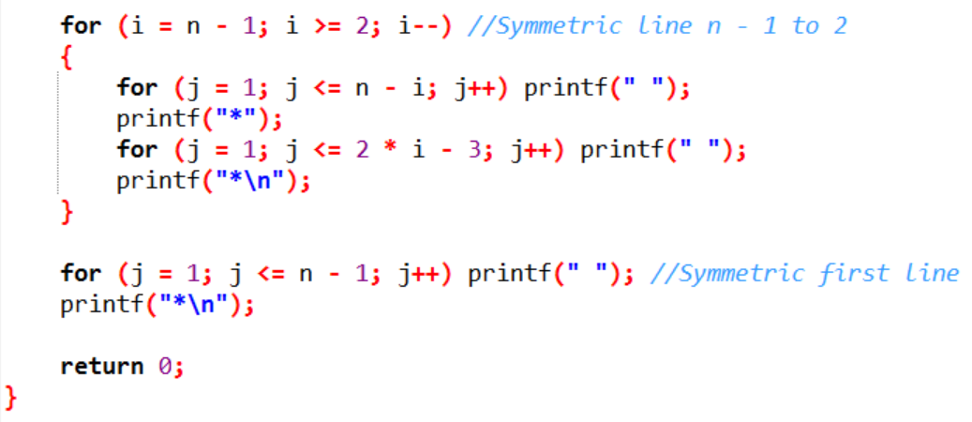
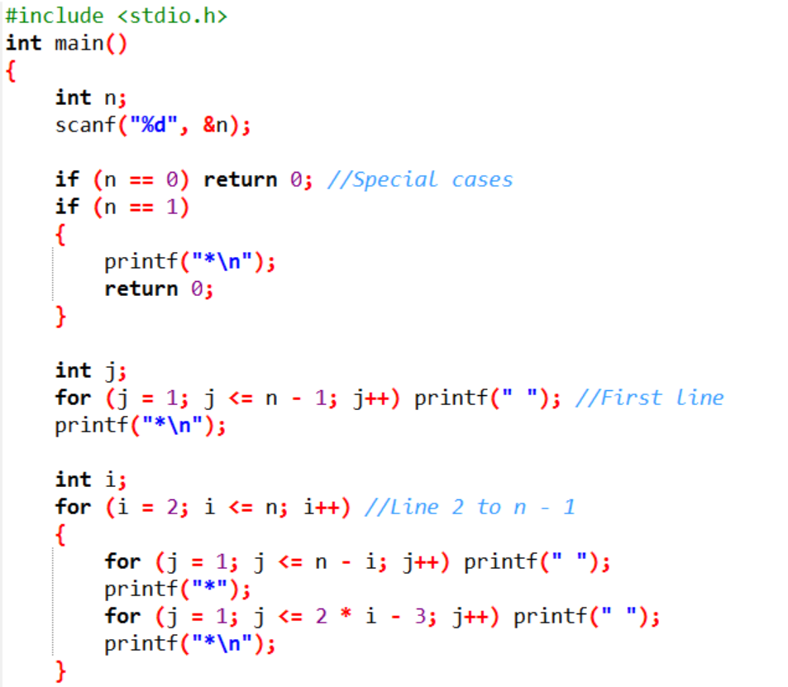
打印图形 Level 2
Always believe that something wonderful is about to happen.

Slide 14
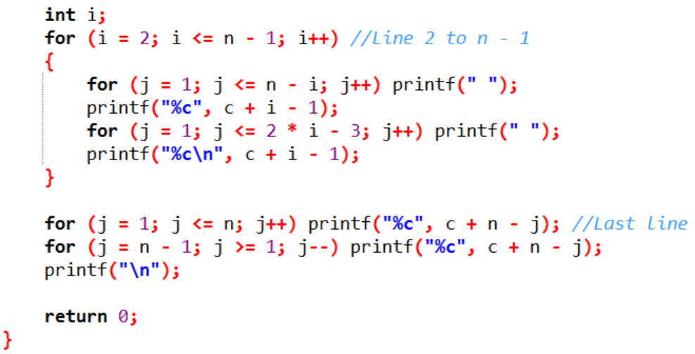
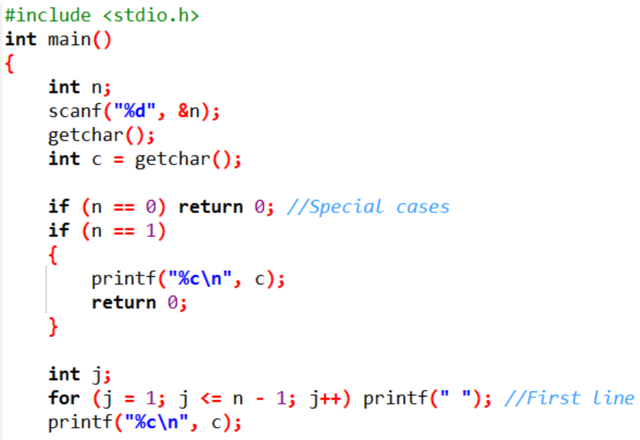
打印图形 Level 3
Always believe that something wonderful is about to happen.

Slide 15
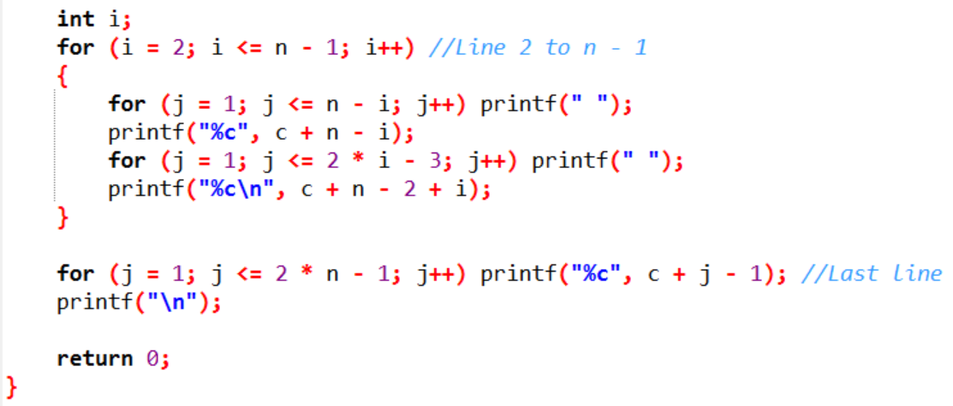
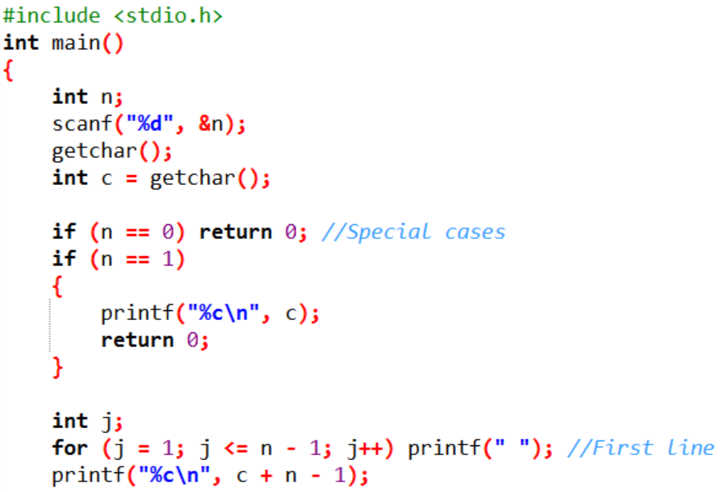
打印图形 Level 4
Always believe that something wonderful is about to happen.

Slide 16
打印图形
Always believe that something wonderful is about to happen.
数列通项
找规律

Slide 17
2
PART TWO
递归
数学规律
给函数实际意义
数列

Slide 18
递归
Always believe that something wonderful is about to happen.
数列递推式
分段函数

Slide 19
递归
Always believe that something wonderful is about to happen.
数列通项
数列求和
阶乘
Fibonacci
最大公约数gcd
函数表达式…

Slide 20
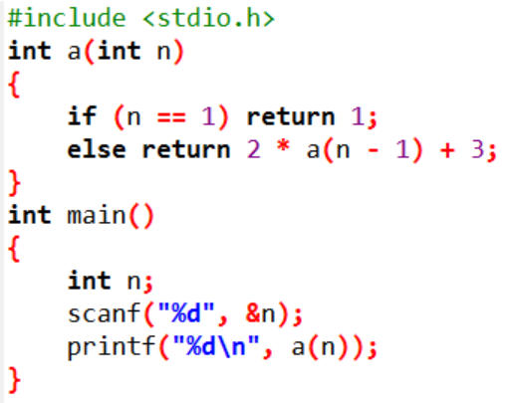
递归
Always believe that something wonderful is about to happen.
已知数列a(n)的递推公式为
a(n)=2*a(n-1)+3, a(1)=1
输入一个整数n
输出数列的第n项a(n)
a(n) = 2*a(n-1)+3 n>1
1 n=1

Slide 21
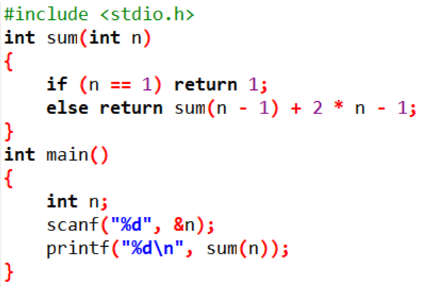
递归
Always believe that something wonderful is about to happen.
已知奇数列a(n)=2n-1
要求用递归方法求前n项和S(n)
输入一个整数n
输出前n项和S(n)
sum(n) = sum(n-1)+2*n-1 n>1
1 n=1

Slide 22
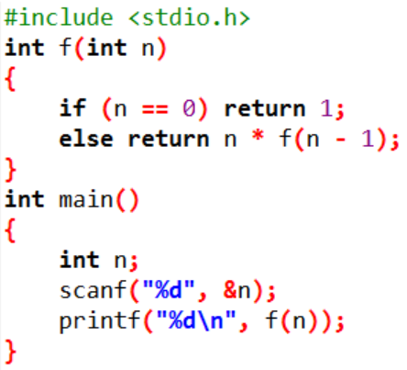
递归
Always believe that something wonderful is about to happen.
输入 n
输出 n!
f(n) = n*f(n-1) n>0
1 n=0

Slide 23
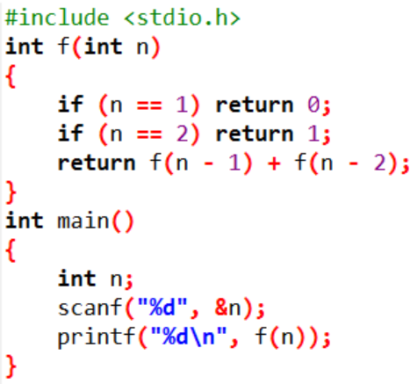
递归
Always believe that something wonderful is about to happen.
Fibonacci数列,第一项为0，第二项为1，以后每项都为其前两项之和
输入 n
输出 Fibonacci数列的第n项
f(n) = f(n-1) + f(n-2) n>2
1 n=2
0 n=1

Slide 24
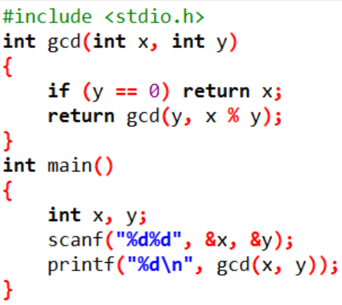
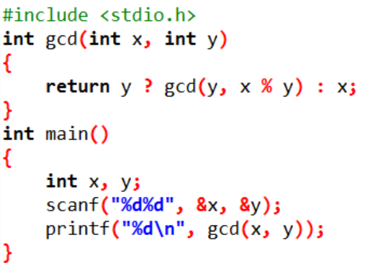
递归
Always believe that something wonderful is about to happen.
最大公约数gcd
(greatest common divisor)
输入两个正整数 x，y
输出x和y的最大公约数
gcd(x, y) = gcd(y, x % y) y != 0
x y == 0

Slide 25
递归
Always believe that something wonderful is about to happen.
上楼梯，一次可以上一级或两级，求上n级台阶的方法数
输入: 一个正整数n
输出: 走n阶阶台阶的方法数
第n阶 ← 第n-1阶 or 第n-2阶
f(n) = 1 n=1
2 n=2
f(n-1) + f(n-2) n>2

Slide 26
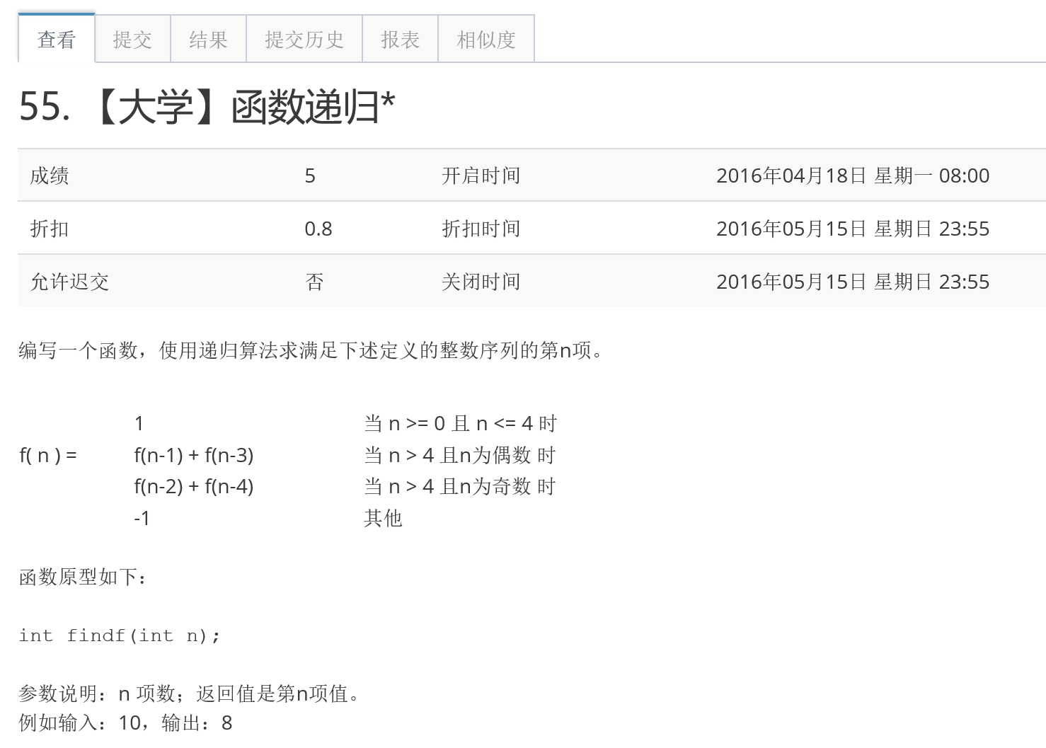
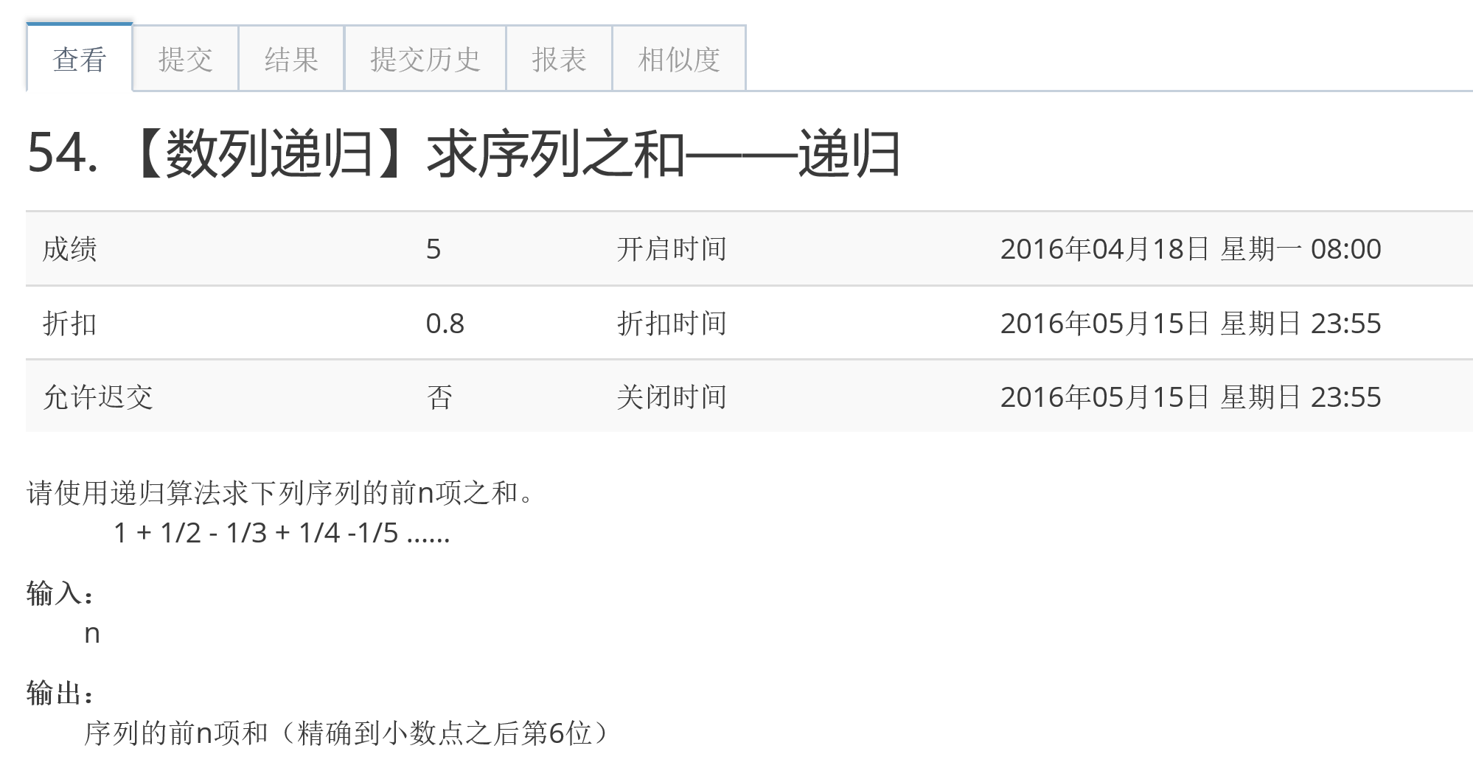
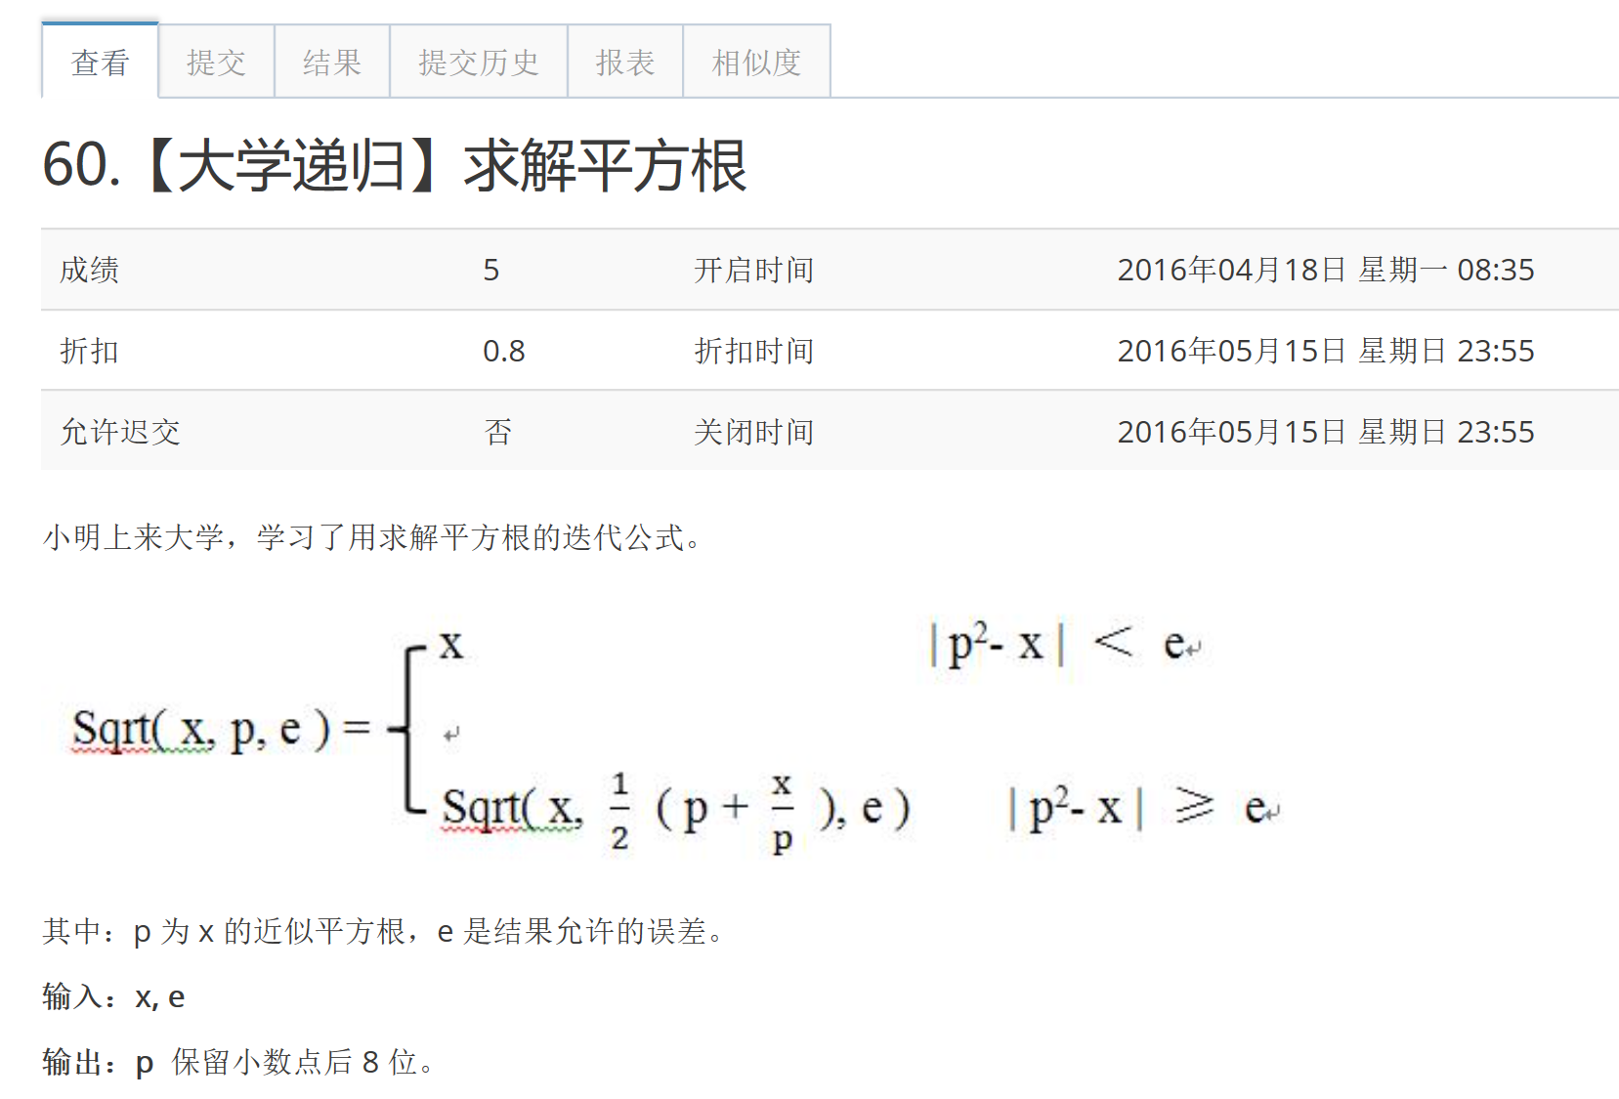
递归
Always believe that something wonderful is about to happen.

Slide 27
递归
Always believe that something wonderful is about to happen.
数列递推式
分段函数

Slide 28
3
PART THREE
穷举

Slide 29
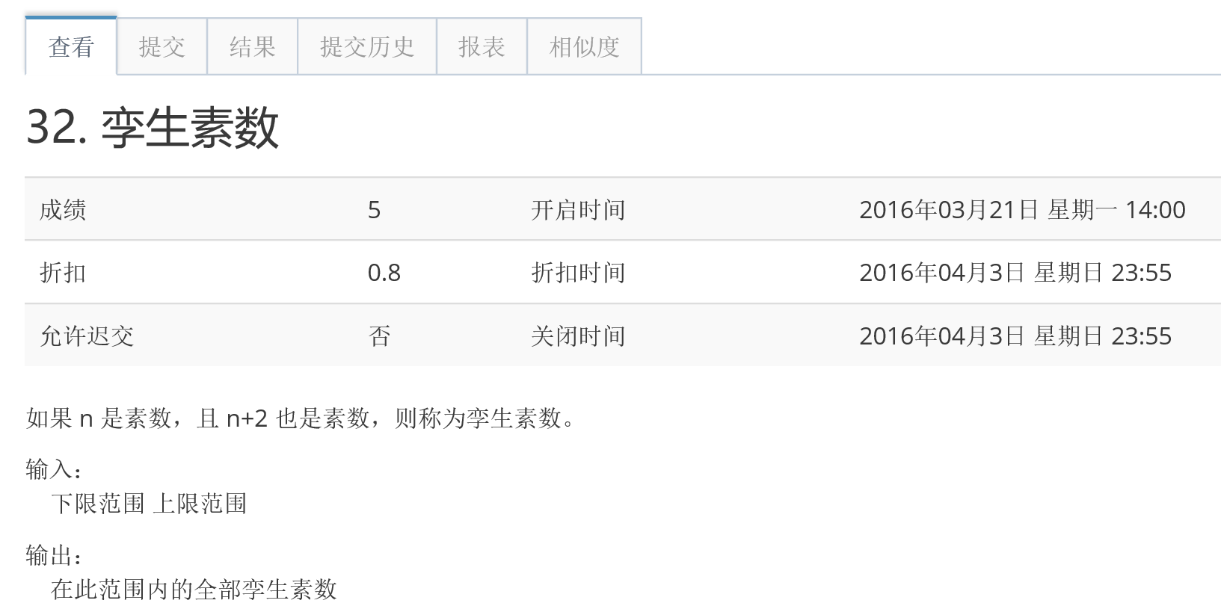
素数Prime
Always believe that something wonderful is about to happen.

Slide 30
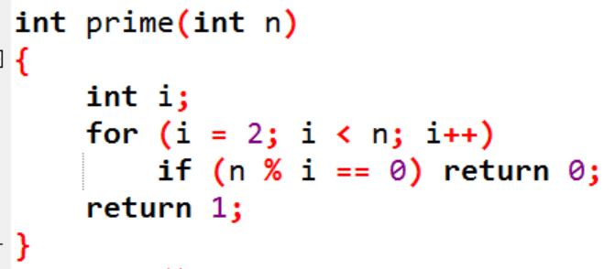
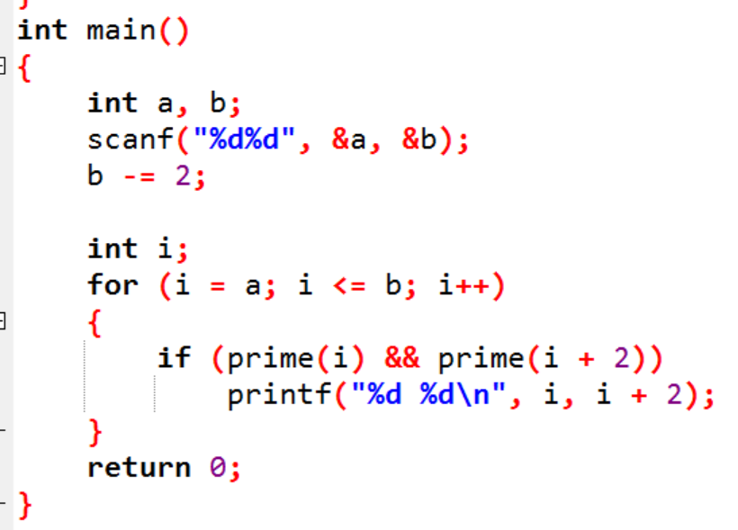
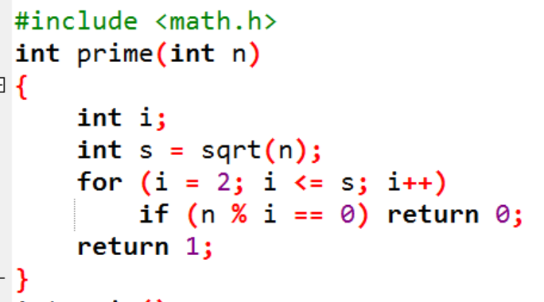
素数Prime
Always believe that something wonderful is about to happen.
素数Prime: 除1和它本身外没有其他约数

Slide 31
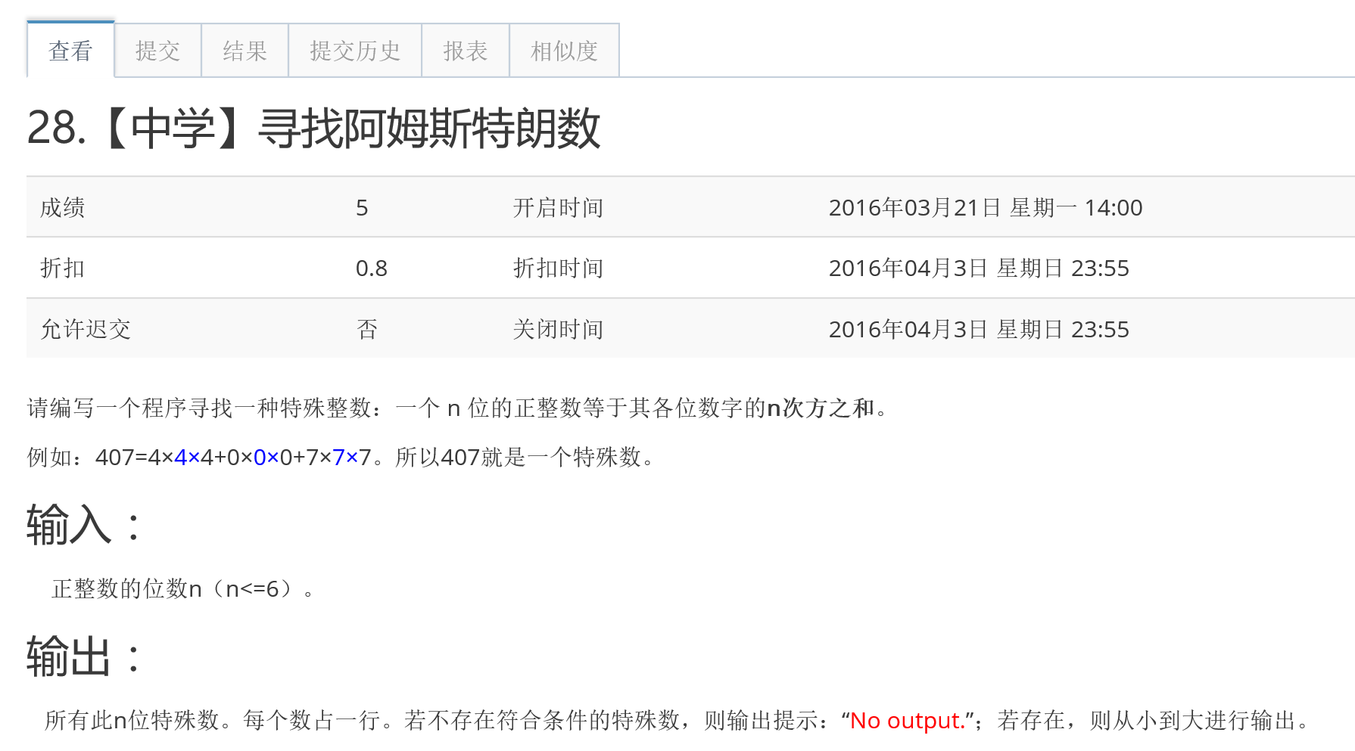
分离数字
Always believe that something wonderful is about to happen.

Slide 32
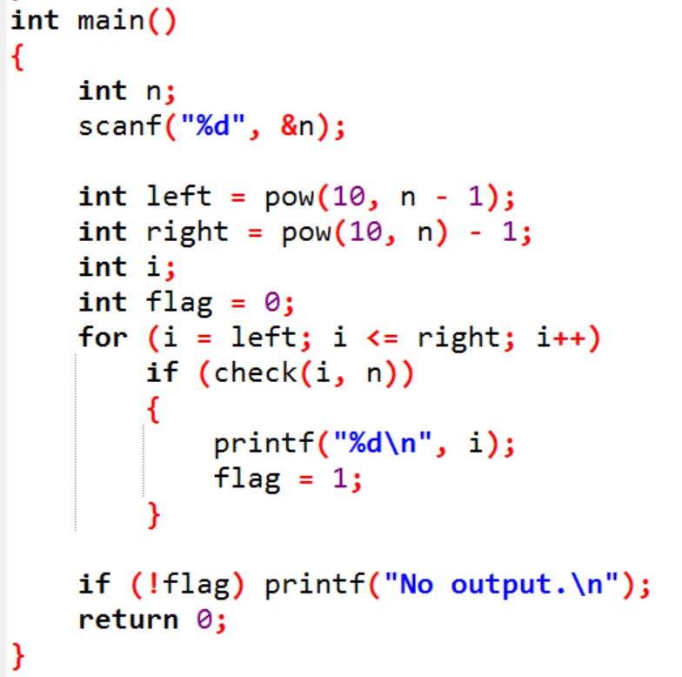
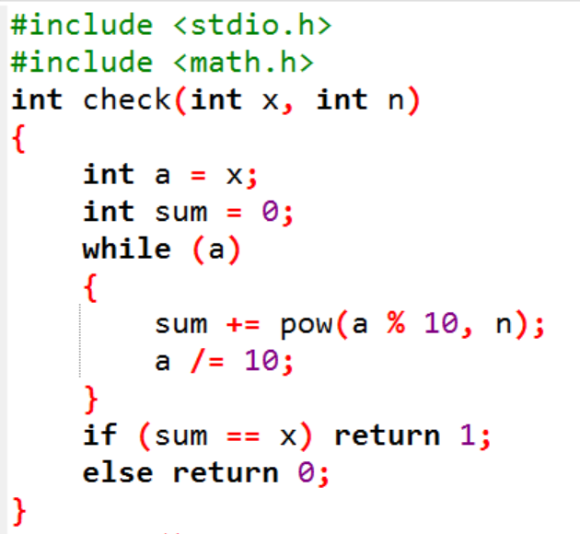
分离数字
Always believe that something wonderful is about to happen.

Slide 33
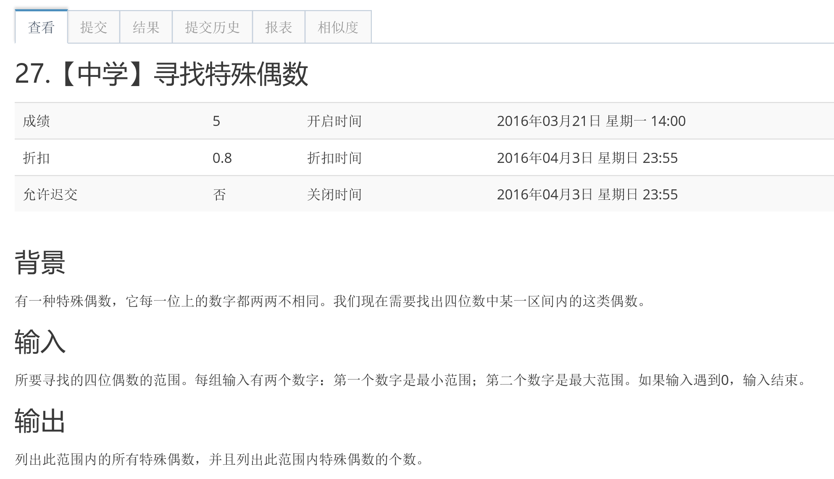
分离数字
Always believe that something wonderful is about to happen.

Slide 34
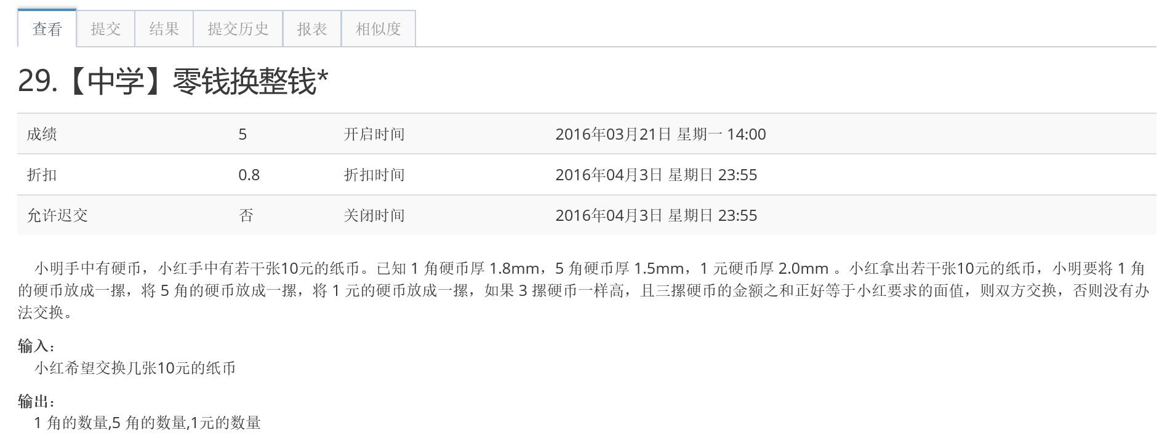
零钱换整钱
Always believe that something wonderful is about to happen.

Slide 35
排序
Always believe that something wonderful is about to happen.
选择排序(Selection sort)
冒泡排序(Bubble sort)
插入排序(Insertion sort)

Slide 36
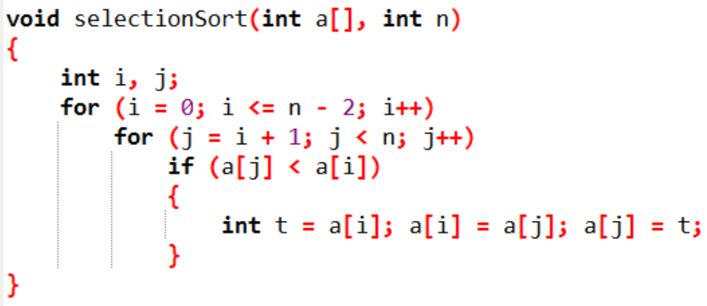

选择排序
Always believe that something wonderful is about to happen.
i的含义:
要排序的位置

Slide 37
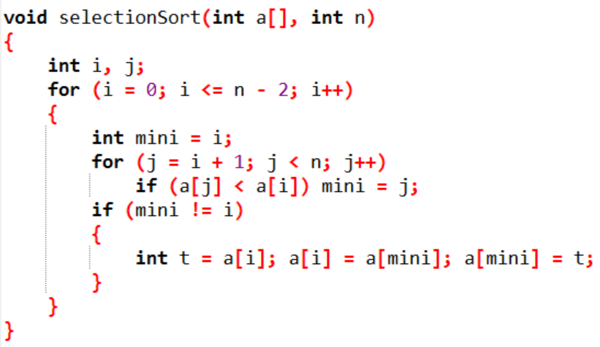
选择排序
Always believe that something wonderful is about to happen.

Slide 38
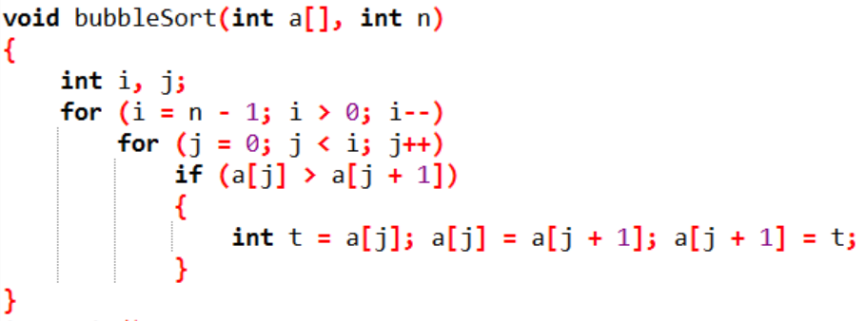
冒泡排序
Always believe that something wonderful is about to happen.
i的含义:
要排序的位置

Slide 39
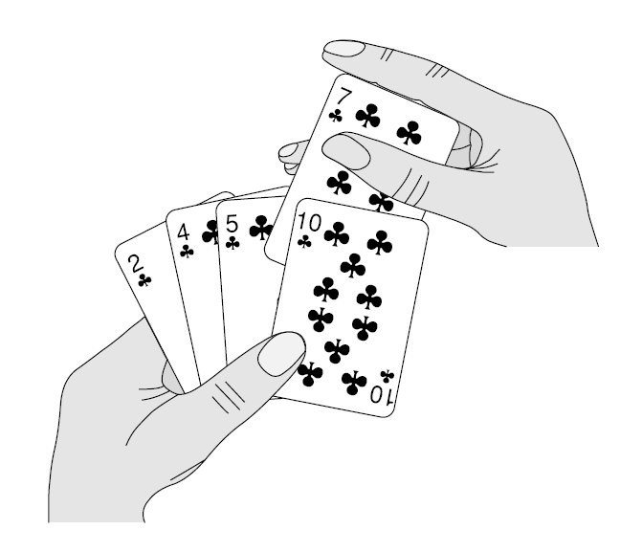
插入排序
Always believe that something wonderful is about to happen.

Slide 40
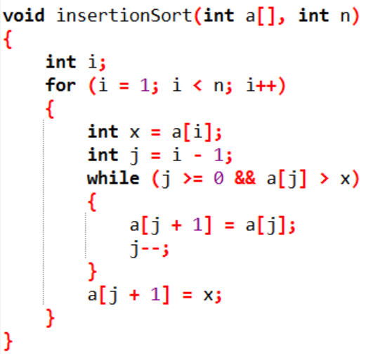
插入排序
Always believe that something wonderful is about to happen.
i的含义:
要排序的元素a[i]

Slide 41
Summary
Always believe that something wonderful is about to happen.
01
打印图形——数列找规律
Q&A
02
递归——分段函数
03
穷举——判素数、分离数字

Slide 42
THANKS FOR YOUR WATCHING
Copyright CFhM_R 2010-2016，
Powered by BITNP2016,
All Rights Reserved.

Slide 43

祝大家取得好成绩！

Slide 44




王元玮
徐恒达
wing.yuanwei@gmail.com
740879411
Rogggger
dadamrxx@gmail.com
799881985
DaDaMr_X
扫码关注网络开拓者公众号
获取本次串讲PPT及其他资源
还有更多精彩等着你！
欢迎关注第一天主讲人唐回峰的CSDN博客：http://blog.csdn.net/cfhm_r
同步发布《C语言从入门到懵逼》系列

