Slide 1
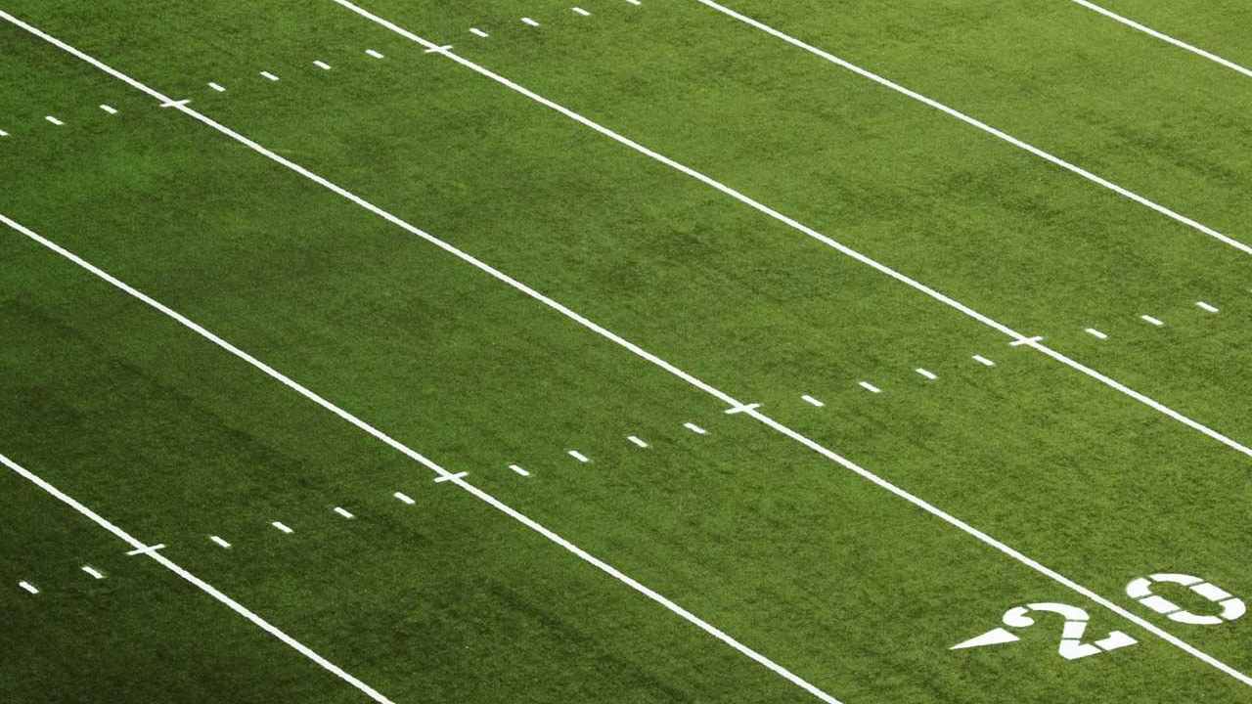
THE WISDOM OF NFL CROWDS
ROB MURRAY-RUST
OCTOBER 2018

Slide 2
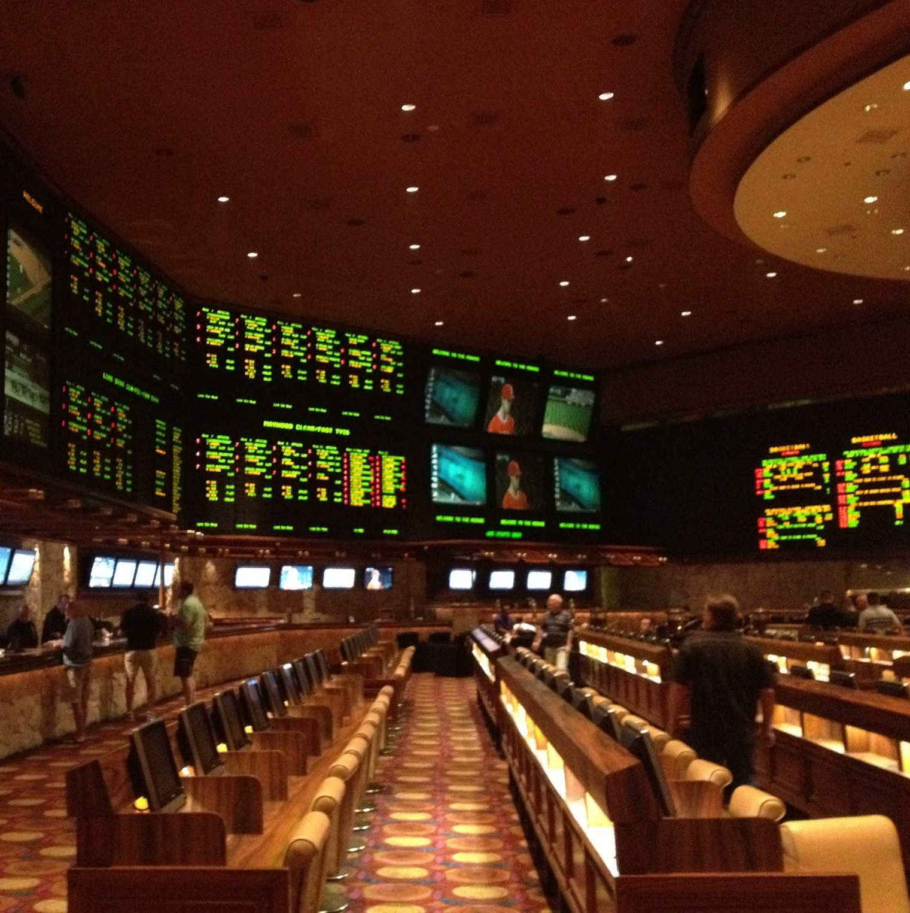
WE WANT TO BEAT
THESE
GUYS

Slide 3
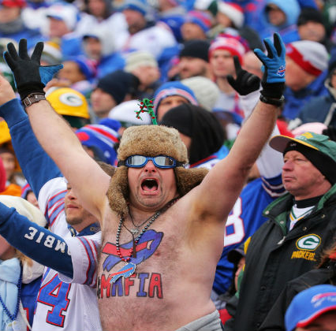
THIS GUY
WILL
HELP

Slide 4
BUT FIRST, SOME LINGO

Slide 5
BUT FIRST, SOME LINGO
AGAINST THE SPREAD
Covering the margin by which one team is favored.
Team A -6.5
Team B +6.5

Slide 6
BUT FIRST, SOME LINGO
AGAINST THE SPREAD
Covering the margin by which one team is favored.
Team A -6.5
Team B +6.5
MONEY LINE
Winning the game outright.
Team A -280 bet 280 to win 100
Team B +240 bet 100 to win 240

Slide 7
BUT FIRST, SOME LINGO
AGAINST THE SPREAD
Covering the margin by which one team is favored.
Team A -6.5
Team B +6.5
MONEY LINE
Winning the game outright.
Team A -280 bet 280 to win 100
Team B +240 bet 100 to win 240
JUICE
What costs you in the long run. Most bets are -110, so a winning percentage of 52.4% is needed to break even.
This is why Vegas always wins and can build castles in the desert.

Slide 8
WHAT’S THE THEORY?
1
How can we use the general public to improve our ability to pick games?

Slide 9
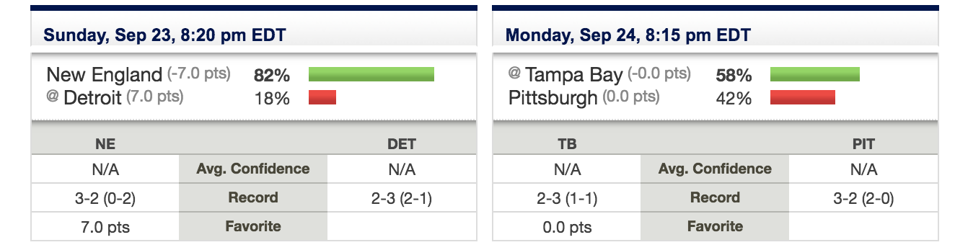
PICK ‘EM POOL

Slide 10


DATA SOURCES
2009 to 2017 seasons

Slide 11
IS THE THEORY CORRECT?
2
Do teams chosen by 80% of the public fail to cover to spread?

Slide 12
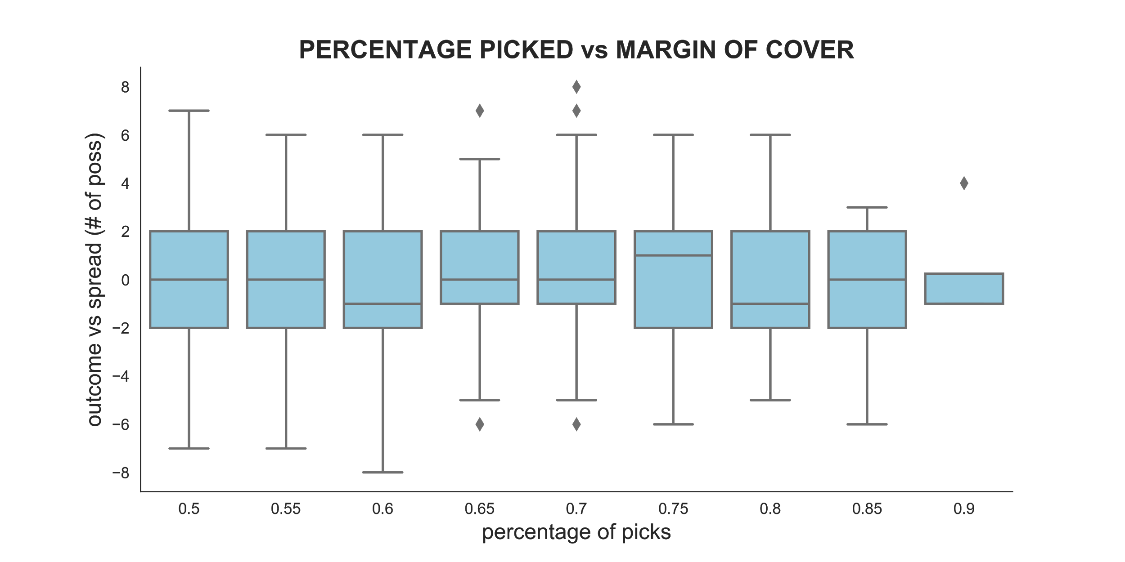

Slide 13
PERCENT PICKED | BETS | PUSHES | WINNERS | LOSERS | PCT | ROE
50% -55% | 418 | 9 | 198 | 211 | 47% | (8.2%)
55% -60% | 444 | 13 | 214 | 217 | 48% | (5.6%)
60% -65% | 423 | 12 | 200 | 211 | 47% | (7.6%)
65% -70% | 410 | 24 | 204 | 182 | 50% | 0.9%
70% -75% | 328 | 11 | 145 | 172 | 44% | (13.5%)
75% -80% | 266 | 8 | 131 | 127 | 49% | (3.3%)
80% -85% | 135 | 4 | 75 | 56 | 56% | 9.9%
85% -90% | 15 | 1 | 7 | 7 | 47% | (4.7%)
90% -95% | 2 | 0 | 1 | 1 | 50% | (5.0%)

Slide 14
PERCENT PICKED | BETS | PUSHES | WINNERS | LOSERS | PCT | ROE
50% -55% | 418 | 9 | 198 | 211 | 47% | (8.2%)
55% -60% | 444 | 13 | 214 | 217 | 48% | (5.6%)
60% -65% | 423 | 12 | 200 | 211 | 47% | (7.6%)
65% -70% | 410 | 24 | 204 | 182 | 50% | 0.9%
70% -75% | 328 | 11 | 145 | 172 | 44% | (13.5%)
75% -80% | 266 | 8 | 131 | 127 | 49% | (3.3%)
80% -85% | 135 | 4 | 75 | 56 | 56% | 9.9%
85% -90% | 15 | 1 | 7 | 7 | 47% | (4.7%)
90% -95% | 2 | 0 | 1 | 1 | 50% | (5.0%)

Slide 15
YES
THE PUBLIC
IS WRONG
When 4 out of 5 can agree, that is.

Slide 16
BUT WHY?
3
We need more information!

Slide 17
FEATURES
STATISTICS (last 3 games)
Average yards +/-
< -100
-100 > 0 > 100
> 100
Average turnovers +/-
< -1
-1 >= 0 >= 1
> 100
STREAK (last 3 games)
Opening game
Won 1
Won 2
Won 3
Lost 1
Lost 2
Lost 3
QUINTILES
Games 1-4
Games 5-8
Games 9-12
Games 13-16
Playoffs
GAME CONDITIONS
Road
Divisional

Slide 18
FEATURE CORRELATION | ALL PICKS | 80-85% ONLY | DIFFERENCE
Road Team | 0.50 | 0.78 | 0.28
Opponent avg turnover margin < -1 | 0.23 | 0.38 | 0.15
Team avg turnover margin > 1 | 0.24 | 0.37 | 0.14
Opponent yards margin < -100 | 0.10 | 0.24 | 0.14
Team yards margin > 100 | 0.10 | 0.17 | 0.07
Quintile #1 | 0.24 | 0.33 | 0.09
Opponent lost 2 in a row | 0.12 | 0.20 | 0.08
Opponent lost 3 in a row | 0.11 | 0.23 | 0.12

Slide 19
FILTERS | BETS | PUSHES | WINNERS | LOSERS | PCT | ROE
Road | 1214 | 0 | 599 | 615 | 49% | (6.4%)
Road, Turnovers | 100 | 0 | 57 | 43 | 57% | 9.7%
Turnovers | 200 | 0 | 105 | 95 | 52% | 0.2%
Road, Yards | 29 | 0 | 21 | 8 | 72% | 42.1%
Yards | 45 | 0 | 27 | 18 | 60% | 16.0%
Road, Dog lost 2+ | 334 | 0 | 177 | 157 | 53% | 1.3%
Dog lost 2+ | 669 | 0 | 351 | 318 | 52% | 0.2%
Road, Turnover, Yards | 3 | 0 | 3 | 0 | 100% | 100%
Turnover, Yards | 5 | 0 | 3 | 2 | 60% | 16%

Slide 20
FILTERS | BETS | PUSHES | WINNERS | LOSERS | PCT | ROE
Road | 1214 | 0 | 599 | 615 | 49% | (6.4%)
Road, Turnovers | 100 | 0 | 57 | 43 | 57% | 9.7%
Turnovers | 200 | 0 | 105 | 95 | 52% | 0.2%
Road, Yards | 29 | 0 | 21 | 8 | 72% | 42.1%
Yards | 45 | 0 | 27 | 18 | 60% | 16.0%
Road, Dog lost 2+ | 334 | 0 | 177 | 157 | 53% | 1.3%
Dog lost 2+ | 669 | 0 | 351 | 318 | 52% | 0.2%
Road, Turnover, Yards | 3 | 0 | 3 | 0 | 100% | 100%
Turnover, Yards | 5 | 0 | 3 | 2 | 60% | 16%

Slide 21
FILTERS | BETS | PUSHES | WINNERS | LOSERS | PCT | ROE
Road | 1214 | 0 | 599 | 615 | 49% | (6.4%)
Road, Turnovers | 100 | 0 | 57 | 43 | 57% | 9.7%
Turnovers | 200 | 0 | 105 | 95 | 52% | 0.2%
Road, Yards | 29 | 0 | 21 | 8 | 72% | 42.1%
Yards | 45 | 0 | 27 | 18 | 60% | 16.0%
Road, Dog lost 2+ | 334 | 0 | 177 | 157 | 53% | 1.3%
Dog lost 2+ | 669 | 0 | 351 | 318 | 52% | 0.2%
Road, Turnovers, Yards | 3 | 0 | 3 | 0 | 100% | 100%
Turnovers, Yards | 5 | 0 | 3 | 2 | 60% | 16%

Slide 22
29 bets @ $100/ea
72% win rate
$1,220 profit

Slide 23
SO WHAT’S THE LESSON?
4

Slide 24
HOME
COOKING
Home is where the heart is.
And the profit margin.

Slide 25
IGNORE
YOUR EYES
You want to pick teams
that have been
playing badly!

Slide 26
BE
SELECTIVE
29 bets in 9 years. Don’t get greedy!

Slide 27
CREDITS
Special thanks to all the people who made and released these awesome resources for free:
Presentation template by SlidesCarnival

