Slide 1

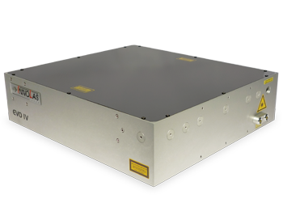
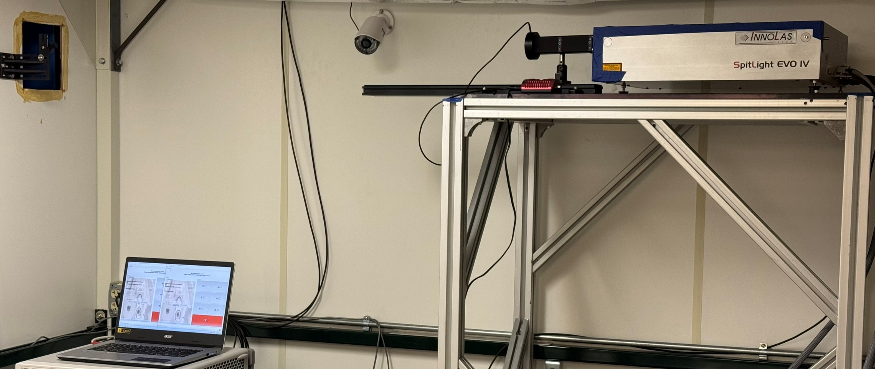
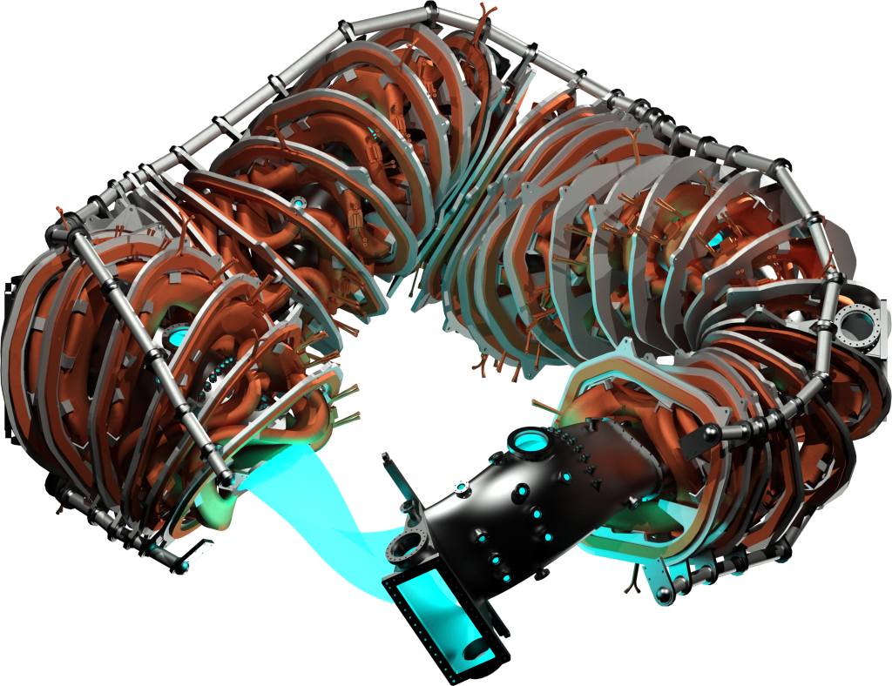
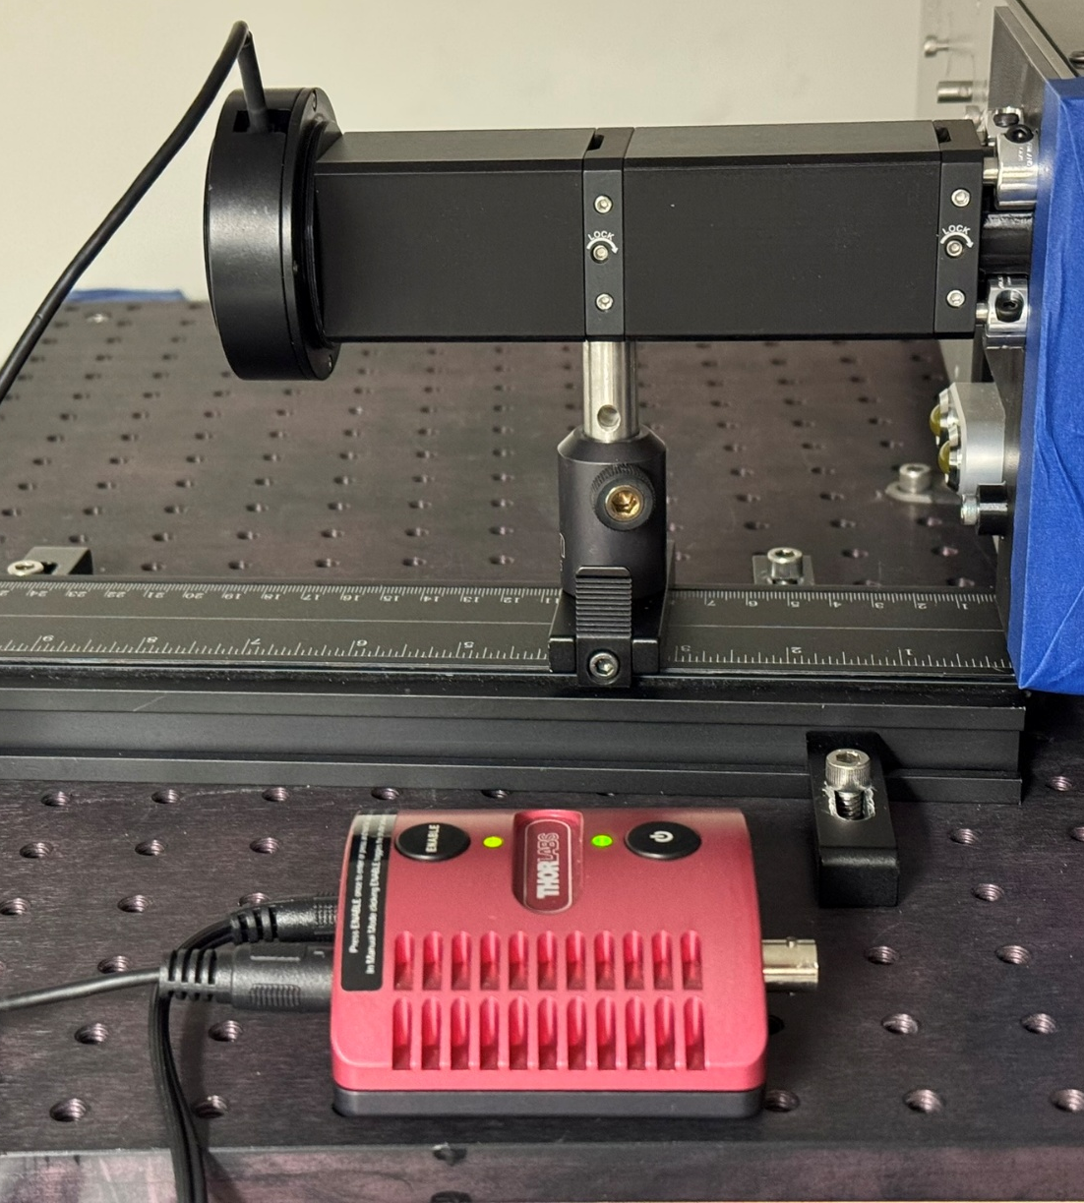
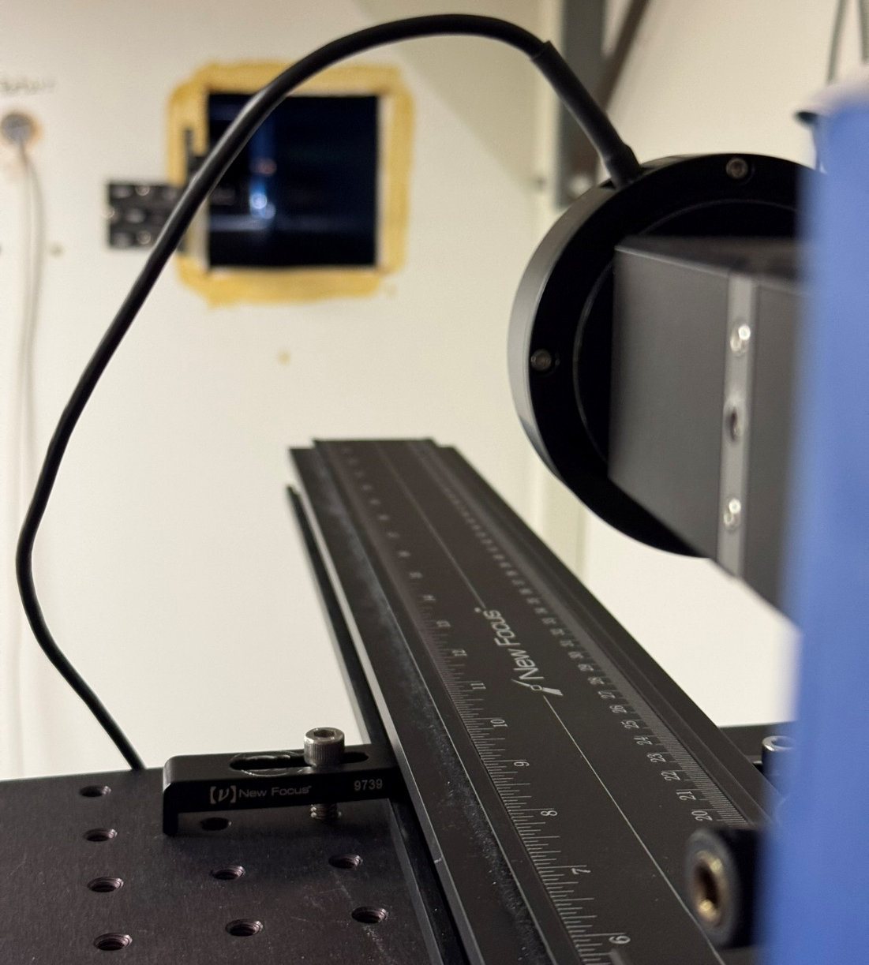
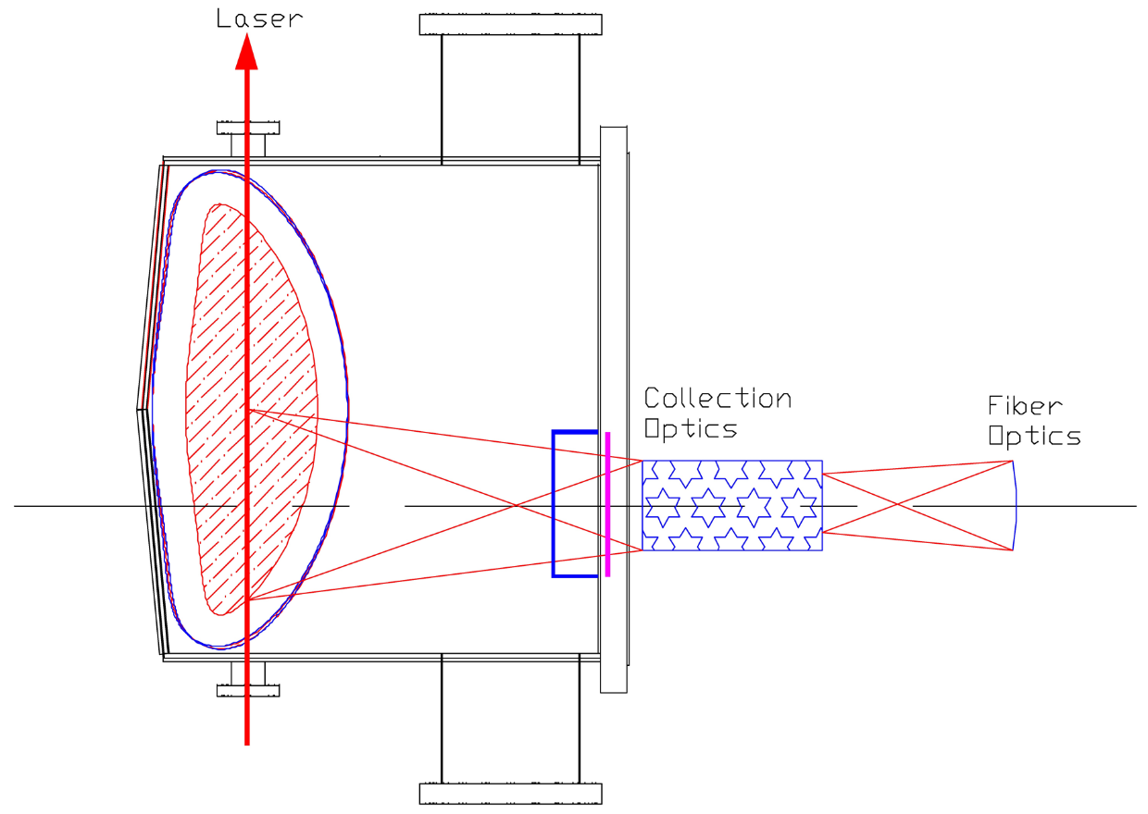
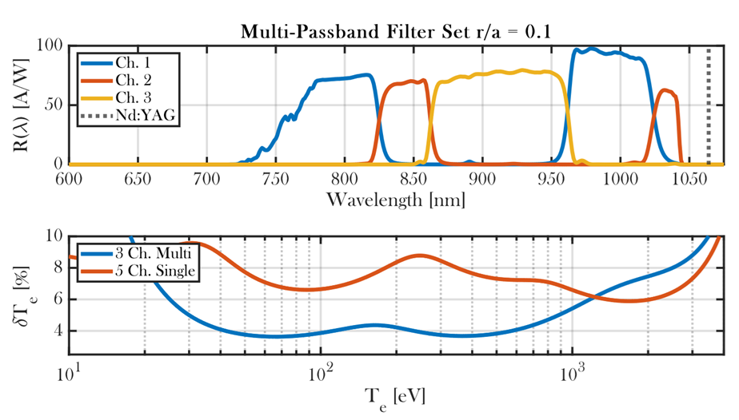
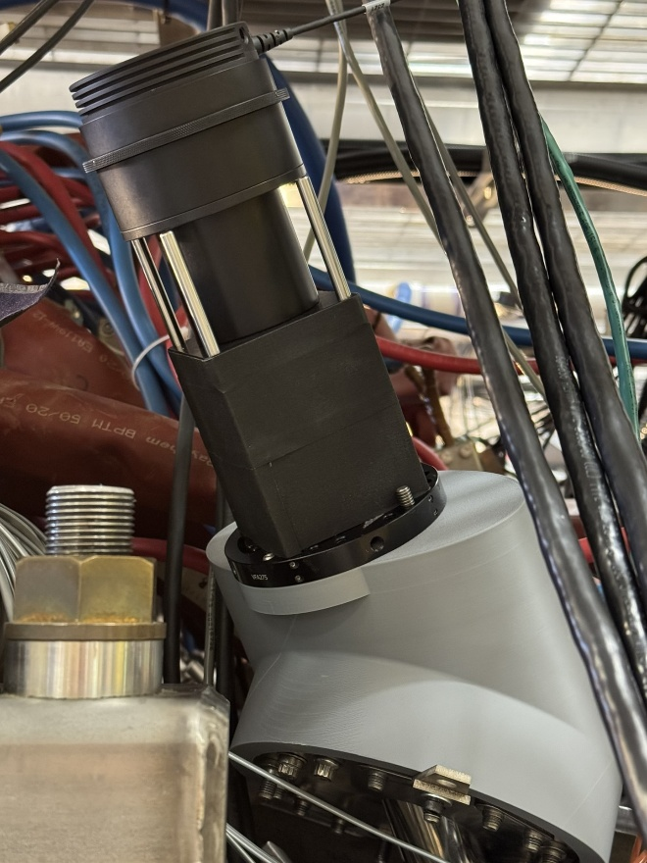
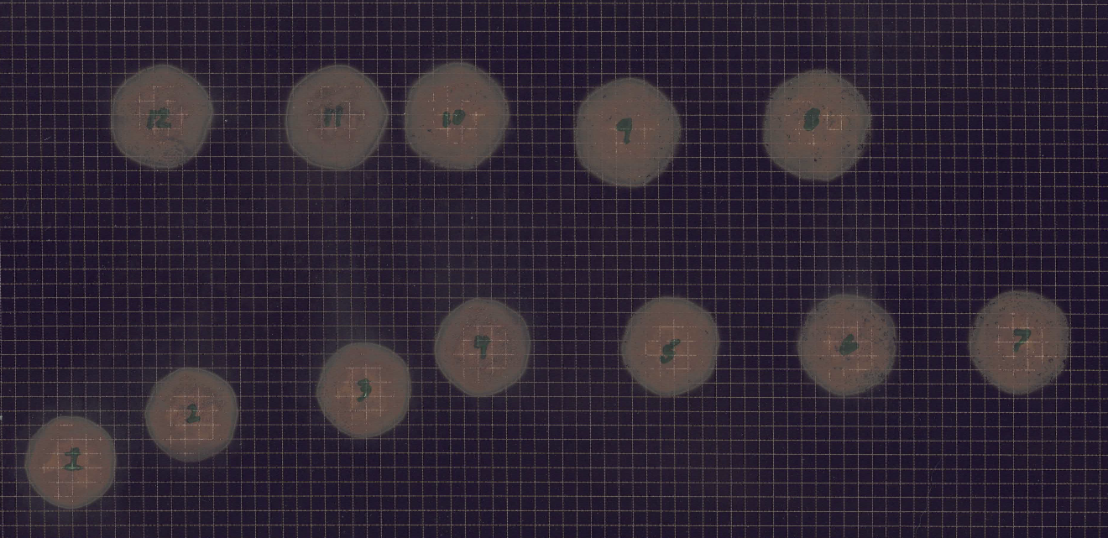
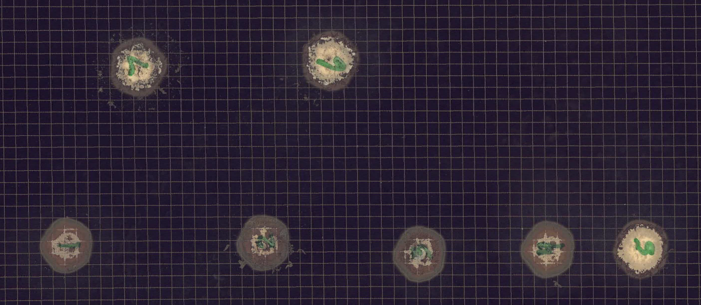
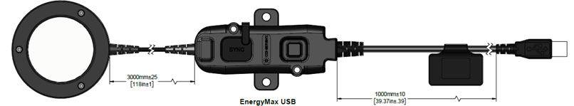



Commissioning a High-Repetition Rate, 1 Joule Nd:YAG Laser for the HSX Thomson Scattering System
W.R. Goodman¹, M.D. Nornberg¹, A. Wolfmeister¹, A.M. Wright¹, B. Geiger¹, and the HSX Team
¹HSX Plasma Laboratory, University of Wisconsin, Madison, Wisconsin, USA
Motivation
Laser Implementation & Results
Results
We report on the installation and commissioning of a major TS upgrade at the HSX stellarator, centered on a new Nd:YAG laser capable of burst operation of 80 consecutive 1 J, 10 ns pulses at 400 Hz. A 2 kHz mode supports up to 10 pulses per burst, limited by thermal loading. The upgrade includes integrating the laser with HSX beam-delivery optics and shot-to-shot pulse-energy monitoring to verify stability. To accommodate the increased data rate, a high-speed digitizer (3.2 GSa/s) and low-noise preamplifiers, providing an ~8.6 dB improvement in signal-to-noise ratio over the legacy digitizer chain [1,2]. In the near term, increasing the time resolution of the TS system will enable the study of plasma breakdown effects, MHD effects, impurity injection behavior, and time-resolved density profile adjustments.
InnoLas Laser System
SpitLight DPSS EVO IV Nd:YAG ~1 Joule, 1064 nm, 8 ns pulse 100 Hz continuous operation 80 pulses @ 400 Hz, 4 x 10 pulses @ 2 kHz Cold-rod operation standard
Laser Mounting
The EVO IV was mounted on an optical table ~1 m above the main TS optical table, eliminating at least two optical elements required for a beam periscope. Shown are a $λ/4$-waveplate (QWP), a $λ/2$-waveplate (HWP), and an interlocking beam shutter on the EVO IV exit.
Beam Energy
Beam energies were measured with a Coherent J-50MB-YAG-1528 energy sensor (100 Hz / 400 Hz) or a Coherent J-50MT-10KHZ energy sensor (2 kHz). The SpitLight IV is capable of continuous operation of 100 Hz. 100 Hz operation has a short warm-up period of ~300 pulses before leveling off at maximum energy output. Burst mode operation is enabled for up to 80 pulses at 400 Hz or four sets of ten pulses at 2 kHz. Burst mode operation does not have the initial warm-up period and does not have the same thermal lensing losses seen in 100 Hz operation.
Beam Polarization
Referring to the image of the HSX TS beam dump, a ~6” Brewster window is used as the beam exit. The Brewster window is installed so that p-polarized light is aligned with the magnetic axis, ${\overline{B}}_{ax}$, which aids in polarization alignment. The one mirror that the HSX TS beam interacts with is at a non-45-degree angle, introducing ellipticity into the beam polarization. Polarization is corrected by adjusting a QWP and HWP in the beam path with the goal of maximizing measured energy through the Brewster window.
Final settings: $λ/2$ waveplate @ 82° and $λ/4$ waveplate @ 18°.
Uncorrected beam $θ=\text{82°}$and phase shift $δ={7π}/{64}$
Energy Through Vessel
Warm-rod vs. Cold-rod Operation
When a diode-pumped solid-state laser operates with cold rods the thermal lens effect within the gain medium is minimal, meaning the rod behaves closer to a flat optical element, which can result in a larger or poorly matched mode volume. As the rods warm under sustained pumping, a roughly parabolic radial temperature gradient develops due to waste heat, creating a positive thermal lens that effectively shortens the cavity's equivalent focal length. A well-designed resonator is typically optimized for this steady-state thermal lens, so warm-rod operation yields a stable, well-defined mode, predictable beam divergence, and consistent output power. For example, for 100 Hz continuous operation, the InnoLas laser system incorporates a warm-up period before the laser functions at the factory design point.
Cold-rod measurements
Warm-rod measurements Arduino GIGA R1 needed to run warm-rod code.
An InnoLas SpitLight DPSS EVO IV has been incorporated into daily operations on the HSX Thomson scattering system. Mean beam energy through vessel = $852 [mJ]$, or $89.7\%$ of initial $950 [mJ]$ laser output.
Thomson Scattering on HSX
The HSX Stellarator
Major radius: 1.20 m Average minor radius: 0.12 m Plasma volume: 0.44 m³ Field periods: 4 Number of main coils: 48 Number of auxiliary coils: 48
HSX TS System
10 spatial channels [1] 1.6*20 mm scattering area 0.01 ≤ T_{e} ≤ 4 keV 0.5 ≤ n_{e} ≤ 10 [10¹⁸ m⁻³ ] 78.4 MHz detection BW 3.2 GSa/s digitization
TSSM Filters[3]
Machine learning optimized dual-passband filter set. Reduces error and/or increases $T_{e}$ bandwidth by more efficiently using the collected photons from a Thomson scattering event.
Beam Path
Even with high-reflectivity mirrors, each interaction results in a fractional power loss. Laser was mounted in a manner that there is only one optic interaction along the beam path.
Beam Dump
A Coherent J-50MB-YAG-1528 Energy Monitor is used as a combination beam dump and shot-to-shot energy measurement system enabling individual energy measurements for each TS laser pulse.
Future Work
Commission 2 kHz burst mode for daily operation
Design an ultra-low reflection beam expander lens system to eliminate possible stray light and avoid damage to the Coherent EnergyMax-USB J-50MT-10KHZ Energy Sensor
Commission warm-rod mode for daily operation
Add control channels to the HSX control system, verify operational stability, reperform Raman alignment and calibration.
Info & Resources
For access to all data, materials, and MATLAB functions used to generate this presentation, including code to enable warm-rod operation on an InnoLas laser, please scan the QR code or go to https://github.com/goodystacks/htpd2026[4].
For more info on HSX, please visit https://hsx.wisc.edu/. For more info on the University of Wisconsin or the Nuclear Engineering & Engineering Physics department, visit engineering.wisc.edu/ departments/nuclear-engineering- engineering-physics/
Warm-up Period
References
[1] K. Zhai et al, Rev. Sci. Instrum., 75, 3900-3902 (2004)
[2] W.R. Goodman et al, Rev. Sci. Instrum., 94, 093507 (2024)
[3] W. R. Goodman, B. Geiger, Rev. Sci. Instrum., 95, 093507 (2024)
[4] W. R. Goodman, GitHub Repo, doi.org/10.5281/zenodo.20269598 (2026)
Acknowledgements
This work is supported by US DOE award DE-FG02-93ER54222
26th Topical Conference on High Temperature Plasma Diagnostics. June 7 – June 11, 2026. Cambridge, MA

