Slide 1
MVVM CODE

Slide 2
PROCCESS
VIEW MODEL 1
VIEW MODEL 2
VIEW MODEL 3
MODEL
Waiting few second
SERVICE

Slide 3
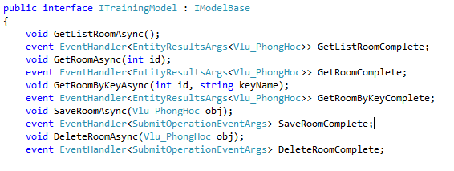
CODE MODEL - INTERFACE

Slide 4
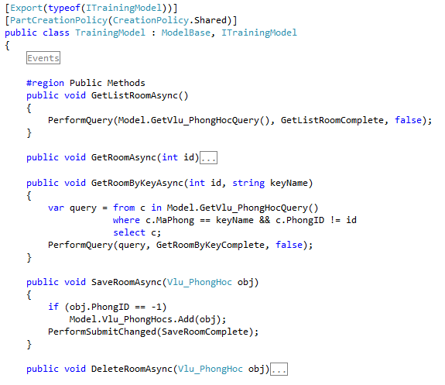
CODE MODEL - IMPLEMENT

Slide 5
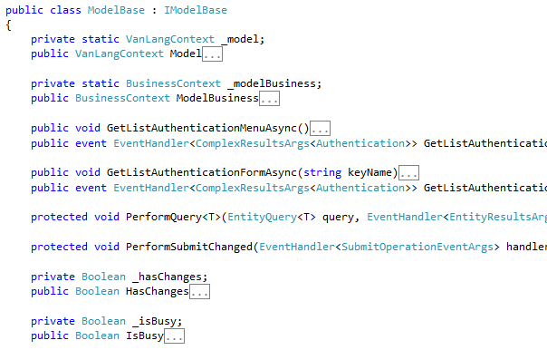
CODE MODEL – MODEL BASE

Slide 6
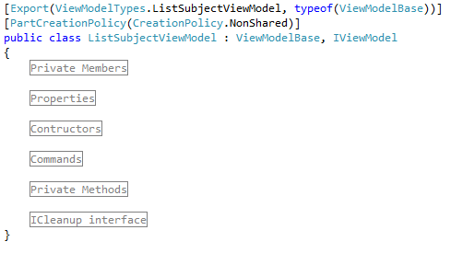
CODE VIEWMODEL

Slide 7
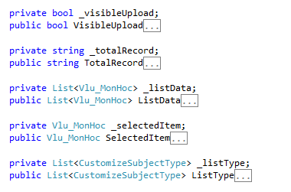
CODE VIEWMODEL - REGISTER

Slide 8
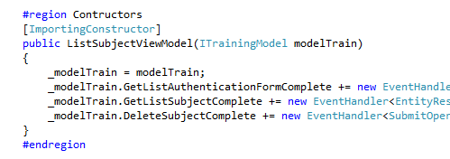
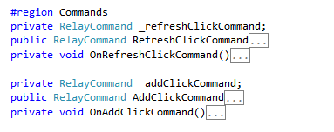

CODE VIEWMODEL - REGISTER

Slide 9
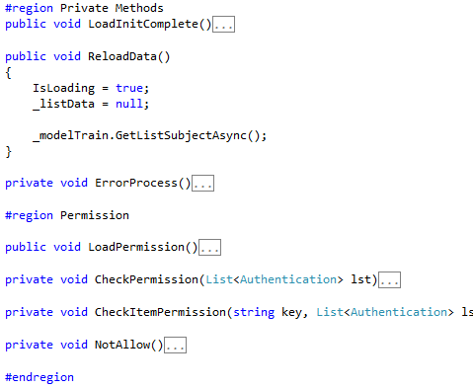
CODE VIEWMODEL - PROCCESS

Slide 10
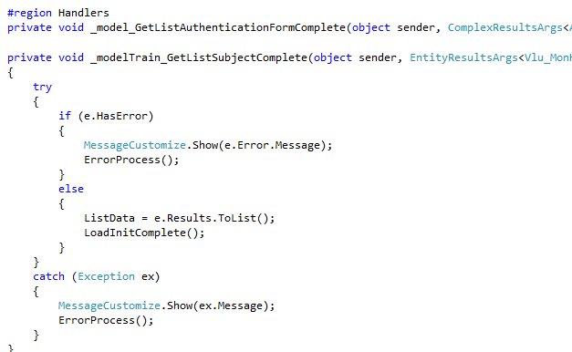
CODE VIEWMODEL - PROCCESS

Slide 11
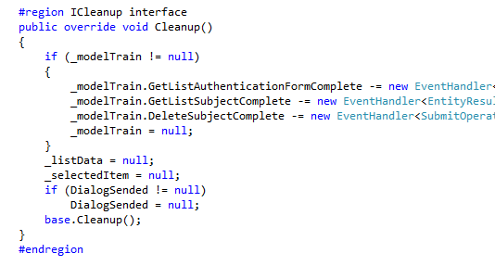
CODE VIEWMODEL - CLEANUP

Slide 12
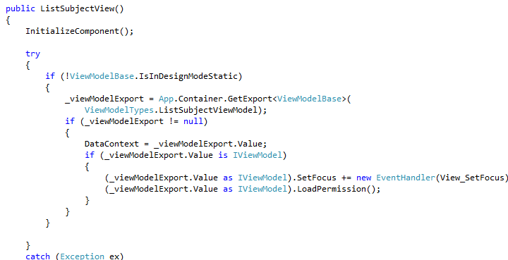
CODE VIEW

Slide 13
CODE RULE
Private member has prefix “_”: private IModelTraining _modelTraining; private int _currentPage;
Public member and Methods: public void ReLoadData(){ … } public MonHoc ItemEdit { get; set; }

Slide 14
CODEL BUSSINESS SERVICE

