Slide 1
OPENING OF
FA’s ENGLISH CLUB
By: Cuong Nguyen
Last update: Feb 2011
Duration: 30 minutes

Slide 2
Content
Objectives
Club Structure
Activities
Schedule
Budget
Confidential
Page <number>

Slide 3
Objectives
Improve English skills, currently focus on Listening and Speaking
Use English in daily tasks
Correct mistakes or misuses
Teamwork is highly recommended
Build up ready-to-use knowledge base
“English is fun and everyone loves it!”
Confidential
Page <number>

Slide 4
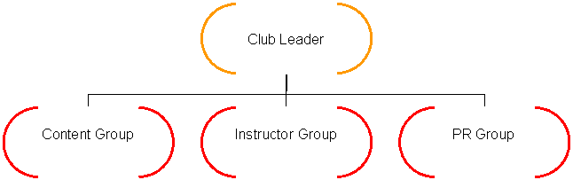
Club Structure
Confidential
Page <number>

Slide 5
Club Structure
Club Leader: Takes main responsibility for all activities of the club, can act as an instructor in some important meeting
Content Group: Composes and designs all materials needed for the club activities
Instructor Group: Speaks and instructs member to follow activities’ context in all meetings
PR Group: Announces new activities, builds up image for English Club, brings it close to people
Confidential
Page <number>

Slide 6
Activities
Watch Videos
Learn Through Music & Lyrics
Articles Reading Comprehension
Topic Discussion
Roles Play Speaking
Games
Learn Vocabulary & Grammar
Sample TOEIC Tests
Confidential
Page <number>

Slide 7
Activities – Sample 1
Microsoft Surface - The Possibilities
Confidential
Page <number>

Slide 8
Activities – Sample 2
Need You Now - Lady Antebellum
Confidential
Page <number>

Slide 9
Activities - Note
All members have to use English when they participate into those activities
Confidential
Page <number>

Slide 10
Schedule
Time: Every Tuesday and Thursday, 45 minutes for each meeting (13h30 to 14h15)
Place: Available rooms
Confidential
Page <number>

Slide 11
Budget
Participants are not required to contribute money for the club.
A fund would be raised to spend for activities in the club.
Confidential
Page <number>

