Slide 1


ABCD
Evaluation Report
Powered by Bulk AiBCD
1

Slide 2
ABCD Evaluation Report
Report Details
REQUESTED FOR:
COMPLETED ON:
BRAND_NAME
COMPLETION_DATE
# OF CREATIVES TESTED:
MARKETING OBJECTIVE:
VIDEO_COUNT
MARKETING_OBJECTIVE
Proprietary & Confidential
Creative Works.
2

Slide 3
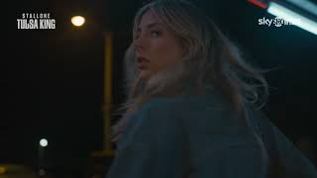
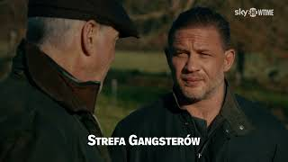
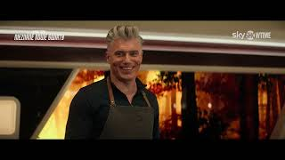
Results Summary
VIDEO_TITLE_1
ADHERENCE_CATEGORY_1
VIDEO_TITLE_2
ADHERENCE_CATEGORY_2
ADHERENCE_CATEGORY_3
VIDEO_TITLE_3

Slide 4
Detailed Results
Evaluated Guidelines
Asset ASSET_NUMBER of VIDEO_COUNT
● (A) Tight Framing
● (A) Voice
● (A) Direct to Camera
● (A) Supers
● (B) Close-ups (Product)
● (B) Product Extreme close up
● (C) People Using Product
● (C) Casual Language
● (C) Humor
● (C) Character-Driven
● (D) Call to Action (Audio)
● (D) Special Offer (Speech)
ASSET NAME
ASSET_NAME
ASSET LINK
ASSET_LINK
ASSET RESULT
ADHERENCE_PERC Adherence (ADHERENCE_X/ADHERENCE_Y)
ADHERENCE_CATEGORY
Proprietary & Confidential

Slide 5
Detailed Results
Evaluated Guidelines
Asset ASSET_NUMBER of VIDEO_COUNT
● (A) Starting Strong
● (B) Brand Visual (3+ Times)
● (C) Product Context
● (A) Quick Pacing
● (B) Brand Logo (Large)
● (C) Clear Messaging
● (A) Quick Pacing (First 5s)
● (B) Brand Mention (Speech)
● (C) Single Message
● (A) Tight Framing
○ (B) Brand Mention (Speech) (See & Say)
● (C) Casual Language
● (A) Tight Framing (First 5s)
○ (B) Brand Mention (Speech) (Last 5s)
● (C) Expression of Benefit
● (A) Sound On
○ (B) Brand Mention (Speech) (First 5s)
● (C) Competitive Claim
● (A) Music
○ (B) Brand Mention (Speech) (See & Say) (First 5s)
○ (C) Visualization of Benefit
● (A) Sound Effects
● (C) Emotions
● (A) Voice
● (B) Brand Mnemonic
● (C) Humor
● (A) Voice-Over
● (B) Multiple Brand Elements
● (C) Delight
● (A) Dialogue (1-Person)
● (B) Product Visual
● (D) Call-to-Action (Text)
● (A) Dialogue (2+ People)
● (B) Product Visual (First 5s)
○ (D) Call-to-Action (Speech)
○ (A) Direct to Camera
● (B) Product Visual (Last 5s)
● (D) Relevant Call-to-Action
● (A) Supers
○ (B) Product Visual (Close-up)
○ (D) Purchase Incentive (Limited Time/Quantities)
○ (A) Supers with Audio
○ (B) Product Visual (Extreme Close-up)
○ (A) Supers with Audio (Augmented)
● (B) Product Mention (Speech or Text)
○ (D) Special Offer (Text)
○ (A) Supers with Audio (See & Say)
○ (B) Product Mention (Speech)
○ (D) Special Offer (Speech)
ASSET NAME
○ (A) Large Supers
○ (B) Product Mention (Speech) (First 5s)
● (D) Price (Text)
ASSET_NAME
○ (A) Bright Visuals
○ (B) Product Mention (Speech) (Last 5s)
○ (D) Price (Speech)
○ (A) High Contrast Visuals
● (B) Product Mention (Text)
○ (D) Power of Free (Text)
○ (A) Shorts Production Style (User Generated)
● (B) Product Focus
○ (D) Power of Free (Speech)
ASSET LINK
○ (A) Short Form Video Adaptation_high
● (C) Presence of People
● (D) Path to Purchase
ASSET_LINK
○ (A) Vertical Format
● (C) Presence of People (First 5s)
○ (D) Search Bar
● (B) Brand Visual (Overlaid)
● (C) Presence of People (Close-up)
● (B) Brand Visual (Last 5s)
● (C) Visible Face (First 5s)
● (B) Brand Visual
● (C) Product Interaction
ASSET RESULT
● (B) Brand Visual (First 5s)
● (C) Emoji Usage
ADHERENCE_PERC Adherence (ADHERENCE_X/ADHERENCE_Y)
○ (B) Brand Visual (In-situation)
● (C) Direct to Camera Character Talk
ADHERENCE_CATEGORY
○ (B) Brand Secondary Element
● (C) Uses Influencer/Creator
○ (B) Secondary Product Context
Proprietary & Confidential

Slide 6
Missing Features Analysis
Features That Should Be Present But Weren't Detected
Asset ASSET_NUMBER of VIDEO_COUNT: ASSET_NAME
⚠️ Total Missing Features Found MISSING_FEATURES_COUNT
Objective: MARKETING_OBJECTIVE | Score: ADHERENCE_PERC | Status: ADHERENCE_CATEGORY
• MISSING_FEATURE_1
→ RECOM_1
• MISSING_FEATURE_2
→ RECOM_2
• MISSING_FEATURE_3
→ RECOM_3
• MISSING_FEATURE_4
→ RECOM_4

Slide 7
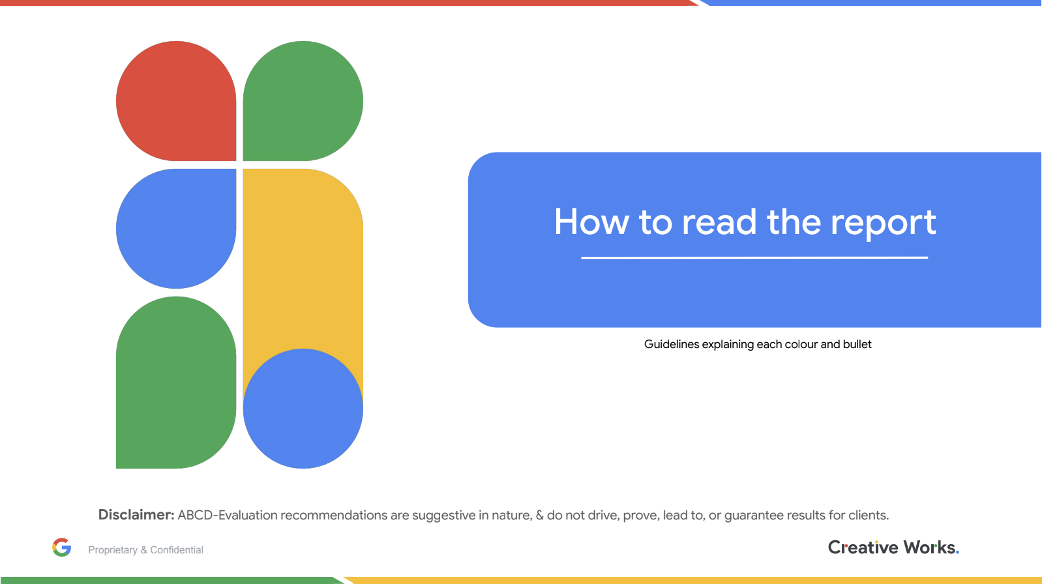

Slide 8
