Slide 1

Stick Diagrams and floorplanning
James E. Stine, Jr.
Edward Joullian Endowed Chair in Engineering
Oklahoma State University
Electrical and Computer Engineering Department
Stillwater, OK 74078 USA
james.stine@okstate.edu

Slide 2
Artwork
“Let’s crack open the crayons!!”
[Crayola]

Slide 3
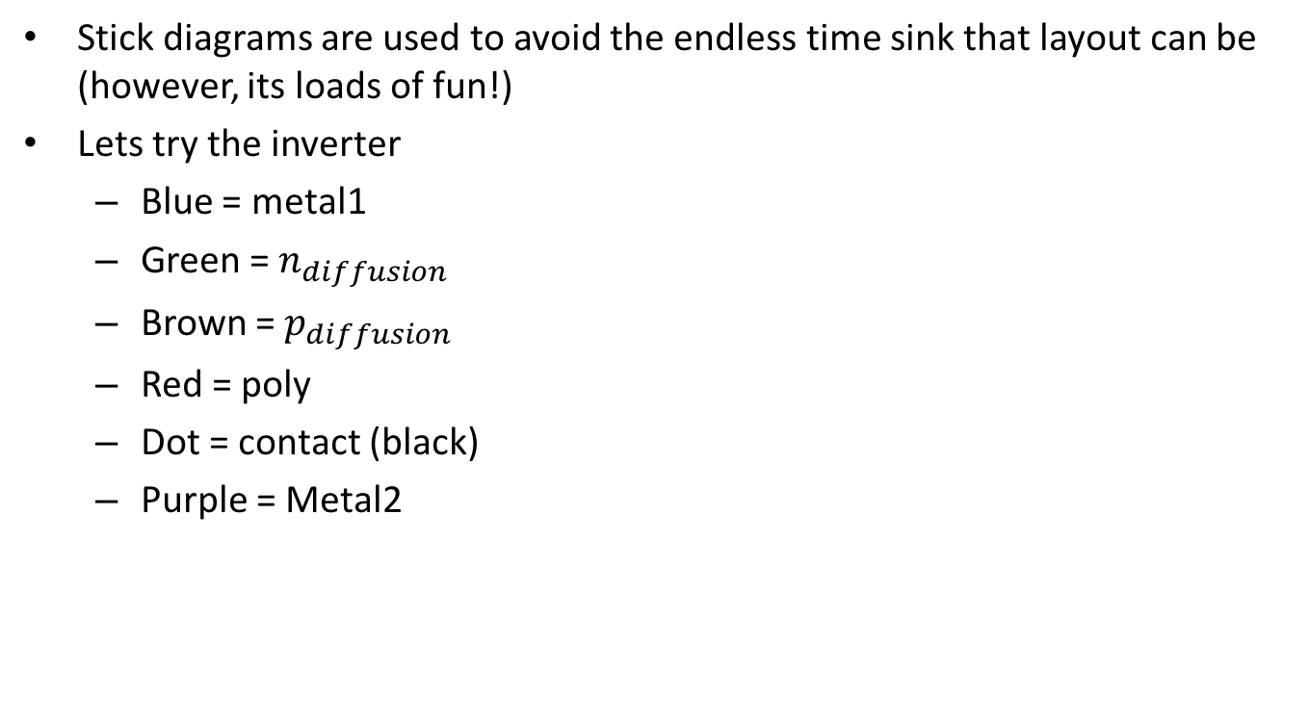
Stick Diagrams
Stick diagrams are used to avoid the endless time sink that layout can be (however, its loads of fun!)
Lets try the inverter
Blue = metal1
Green = $n_{diffusion}$
Brown = $p_{diffusion}$
Red = poly
Dot = contact (black)
Purple = Metal2

Slide 4
Static CMOS Inverter
A | Y
0 | 1
1 | 0

Slide 5
CMOS Fabrication
CMOS transistors are fabricated on silicon wafer
Lithography process similar to printing press
On each step, different materials are deposited or etched
Easiest to understand by viewing both top and cross-section of wafer in a simplified manufacturing process
To get this to be fabricated you need some way of putting layers into a Computer-Aided Design (CAD) tool.
This tool is called a layout editor (magic is our layout editor).
Layout editors are 2D realizations of 3D structures.

Slide 6
Inverter Cross-section
Typically use p-type substrate for nMOS transistor
Requires n-well for body of pMOS transistors
Several alternatives: SOI, twin-tub, etc.
[Weste, Harris]

Slide 7
Well and Substrate Taps
Substrate must be tied to GND and n-well to V_{DD}
Metal to lightly-doped semiconductor forms poor connection called Shottky Diode
Use heavily doped well and substrate contacts / taps
[Weste, Harris]

Slide 8
Inverter Mask Set
Transistors and wires are defined by masks
Cross-section taken along dashed line
[Weste, Harris]

Slide 9
Detailed Mask Views
Six masks
n-well
Polysilicon
n+ diffusion
p+ diffusion
Contact
Metal
[Weste, Harris]

Slide 10
Gate Layout
Layout can be very time consuming : its an art!!!!!!
Design gates to fit together nicely
Build a library of standard cells
Standard cell design methodology
V_{DD} and GND should abut (standard height)
Adjacent gates should satisfy design rules
nMOS at bottom and pMOS at top
All gates include well and substrate contacts
What?

Slide 11
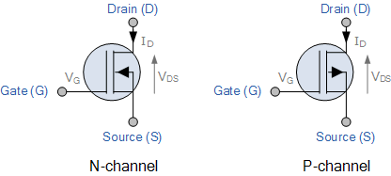
Revisiting Good’ol Kirchoff!
Remember Kirchoff’s Voltage Law
All loops around a loop are 0!
Even though we don’t understand the basic operation of MOSFETs yet, let’s look at the symbol we will use!
This is just a property of making sure that voltage always gets measured according to a certain level.
Make sure the Voltage has no fluctuation.

Slide 12
MOSFET : 4 terminals!!!
MOS devices have 4 terminals!
We will learn the operation well, I assure you.
But, for our design assume the following even though we have been drawing the two as 3 terminals
Let’s try it!!!

Slide 13
Inverter Gate

Slide 14
2 input nand : NAND2

Slide 15
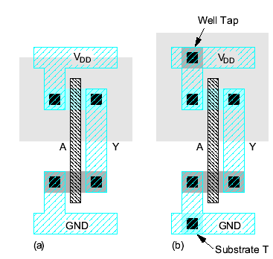
Example: Inverter

Slide 16
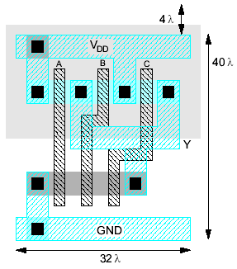
Example: NAND3
Horizontal N-diffusion and p-diffusion strips
Vertical polysilicon gates
Metal1 V_{DD} rail at top
Metal1 GND rail at bottom
32 λ by 40 λ

Slide 17
Stick Diagrams
Stick diagrams help plan layout quickly
Need not be to scale
Draw with color pencils or crayons or dry-erase markers

Slide 18
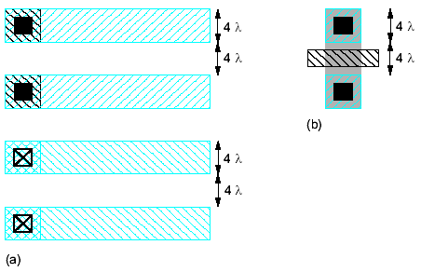
Wiring Tracks
A wiring track is the space required for a wire
4 λ width, 4 λ spacing from neighbor = 8 λ pitch
Transistors also consume one wiring track

Slide 19
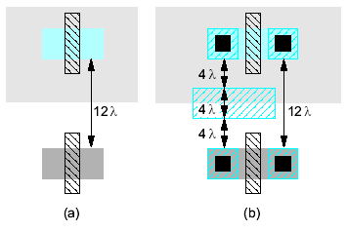
Well spacing
Wells must surround transistors by 6 λ
Implies 12 λ between opposite transistor flavors
Leaves room for one wire track

Slide 20
Area Estimation : Rule of 8
Estimate area by counting wiring tracks
Multiply by 8 to express in λ

Slide 21
More complicated Example : NOR3

Slide 22
Substrate Contact Census
So, how many substrate contacts should I use?
In this class, we will adopt the methodology that 1 substrate contact per transistor.
Some companies may change this depending on test results.
Companies will usually hire talented visual engineers that are called layout engineers.
These individuals are like gold for a company in that they can make the difference between success and failure.
They are highly coveted positions.

