Slide 1


FABS, Design rules and the art of layout
Oklahoma State University
Electrical and Computer Engineering Department
Stillwater, OK 74078 USA
james.stine@okstate.edu

Slide 2
Tools and their Use!
Scripts?
What is a script and why should I use them?
A script is a set of instructions that enables a user to repeat a set of actions, usually with a keystroke, program, or button.
Program, Process and how to get elements to interact?
The environment!!!
Let’s take a look-see before we begin!!!!

Slide 3
Processes and Resources
An application consists of one or more processes, a set of resources and state
Processes
Resources
File F₀
Process P₀
File F₁
Process P₁
...
...
File F_{M}
Process P_{N}
memory R_{i}
...
CPU
display R_{j}
Operating System
other
CPU
DRAM
DISKS
NET
other
other

Slide 4
Traditional OS (UNIX) Model
execution
environment
application
libraries
user
kernel
System call interface
File subsystem
IPC
Other
Resources
Process
control
subsystem
scheduler
memory
hardware

Slide 5
Shell Overview
What is a Shell?
UNIX shells provide a "command line" interface which allows the user to enter commands which are translated by the shell into something the kernel can comprehend and then is sent off to the kernel for it to act upon.
The user can pick their shell (just like the applications, desktop manger, window manager, etc. on a UNIX system).
OSU Shells
We have decided to give everyone the Turbo C shell, because it’s the most popular for our work in this class and what is used in industry.
Shells available on GL include:
tcsh - Turbo C Shell
csh - C Shell
ksh - Korn Shell
bash - Bourne Again Shell
sh - Shell

Slide 6
Environment Variables
Think of the shell as any other program that you write. Your program maintains information about its current state. Since the shell's main job is to act as a liaison between the kernel and the user, it maintains information about the computing environment. The environment variables hold this information.
All Operating Systems have environmental variables!!!
Most UNIX systems provide a command setenv that will allow you to see all of these variables that the shell is maintaining.
Windows : type “set” in a command prompt.
All things work for a reason – learn them, love them, enjoy them!

Slide 7
Example Environment Variables
HOME - your home directory.
USER and LOGNAME - your login ID.
HOSTNAME - the name of the host computer.
PWD - the current working directory.
LD_LIBRARY_PATH – location of your (dynamic) libraries.
PATH - a list of directories in which to look for executable commands.

Slide 8
Introducing tcsh
Currently, the default shell on OSU’s system is tcsh.
tcsh is short for Turbo C SHell.
The .cshrc file – sometimes .tcshrc.
tcsh looks for a configuration file at startup time called "~/.cshrc"
I recommend backing up a copy of your account configuration files before modifying them (such as "cp .cshrc .cshrc.bak").
Changes to your configuration file do not effect the system immediately after you save the file.
Any time you open a terminal it invokes your .cshrc file, therefore, any change could easily be invoked by opening a new terminal.
Right mouse button → terminal
Why do we want to want to use the configuration files?
I currently use an alias to help me with my scripts!
Its easy to use and call!

Slide 9
Schematic, yes, Layout, no
Okay…we can build any gate using CMOS pairs
Remember that gates are complementary and inverting!
Gates are classified usually according to their logic:
INV
NAND
NOR
AND
OR
OAI (Or-And-Invert)
AOI (And-Or-Invert)
Also, sometimes the number of inputs is included in naming convention
AOI221
NAND2

Slide 10
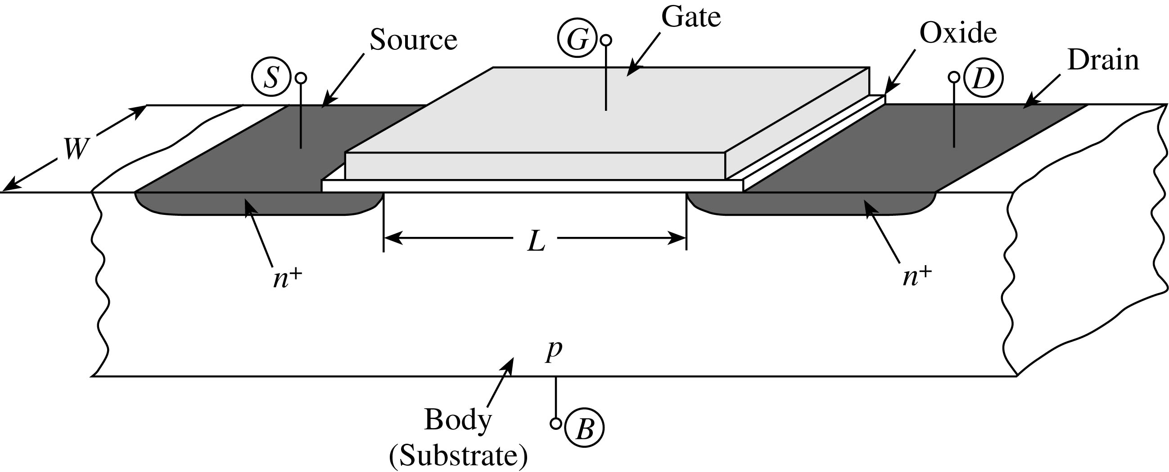
Typical Processes
A process is a sequence of steps required to engineer a chip.
Some important CMOS processes are p-well and n-well.
The SCN3ME_SUBM ON 0.5um
sometimes called 0.6um because its drawn and measured values are different!
0.5um is the minimum length for this technology, SCN3ME_SUBM.
The _SUBM indicates we are using submicron rules, which is a subset of MOSIS SCMOS rules.
http://www.mosis.com
All transistors will have this minimal length to guarantee its operability.
FIGURE 1.30 Simplified structure of an n-channel MOS transistor.
[Tsividis, McAndrew]

Slide 11
Design Rules
Who needs them?
There are practical limits on the resolution to which we can manufacture Silicon chips.
These have to do with equipment precision, mask alignment, lateral diffusion, etc.
In order to achieve reasonable yield, a layout must not violate these limits.
In order to shield the IC designer from the complexities of the fabrication process, process engineers specify simple design rules

Slide 12
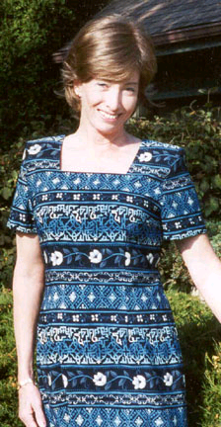
Lynn Conway
Before 1999, Lynn Conway was
already well respected for her many accomplishments:
VLSI work at Xerox PARC
DARPA / Strategic Defense Initiative
Her work at IBM included the invention of a fundamental component of today’s modern superscalar computers.
She taught one of the first VLSI courses at MIT.
Carver Mead at CalTech taught one, I believe, as well.
They were both instrumental in creating lambda-based rules among many other enhancements.
Thank you Lynn Conway and Carver Mead!
40+ Years since VLSI was first taught!

Slide 13
General Lambda Layout Layers
Many more varieties of processes are possible.
New processes are constantly being developed.
Some terminology:
Pitch: dimension in the metal to describe interdimensions. Pitch is used to mean the cell dimension perpendicular to the stacking direction.
Floorplan: high level organization of design blocks.
Ripper: A connector from a line to a bus.
Instance: the actually symbol instance.
Design Rules: A set of permissible geometries and geometric constraints (a recipe)
Include minimum width, minimum separations, and minimum overlaps.
Usually, basic unit of length is λ .
For a 2 µm process, λ = 1 µ m

Slide 14
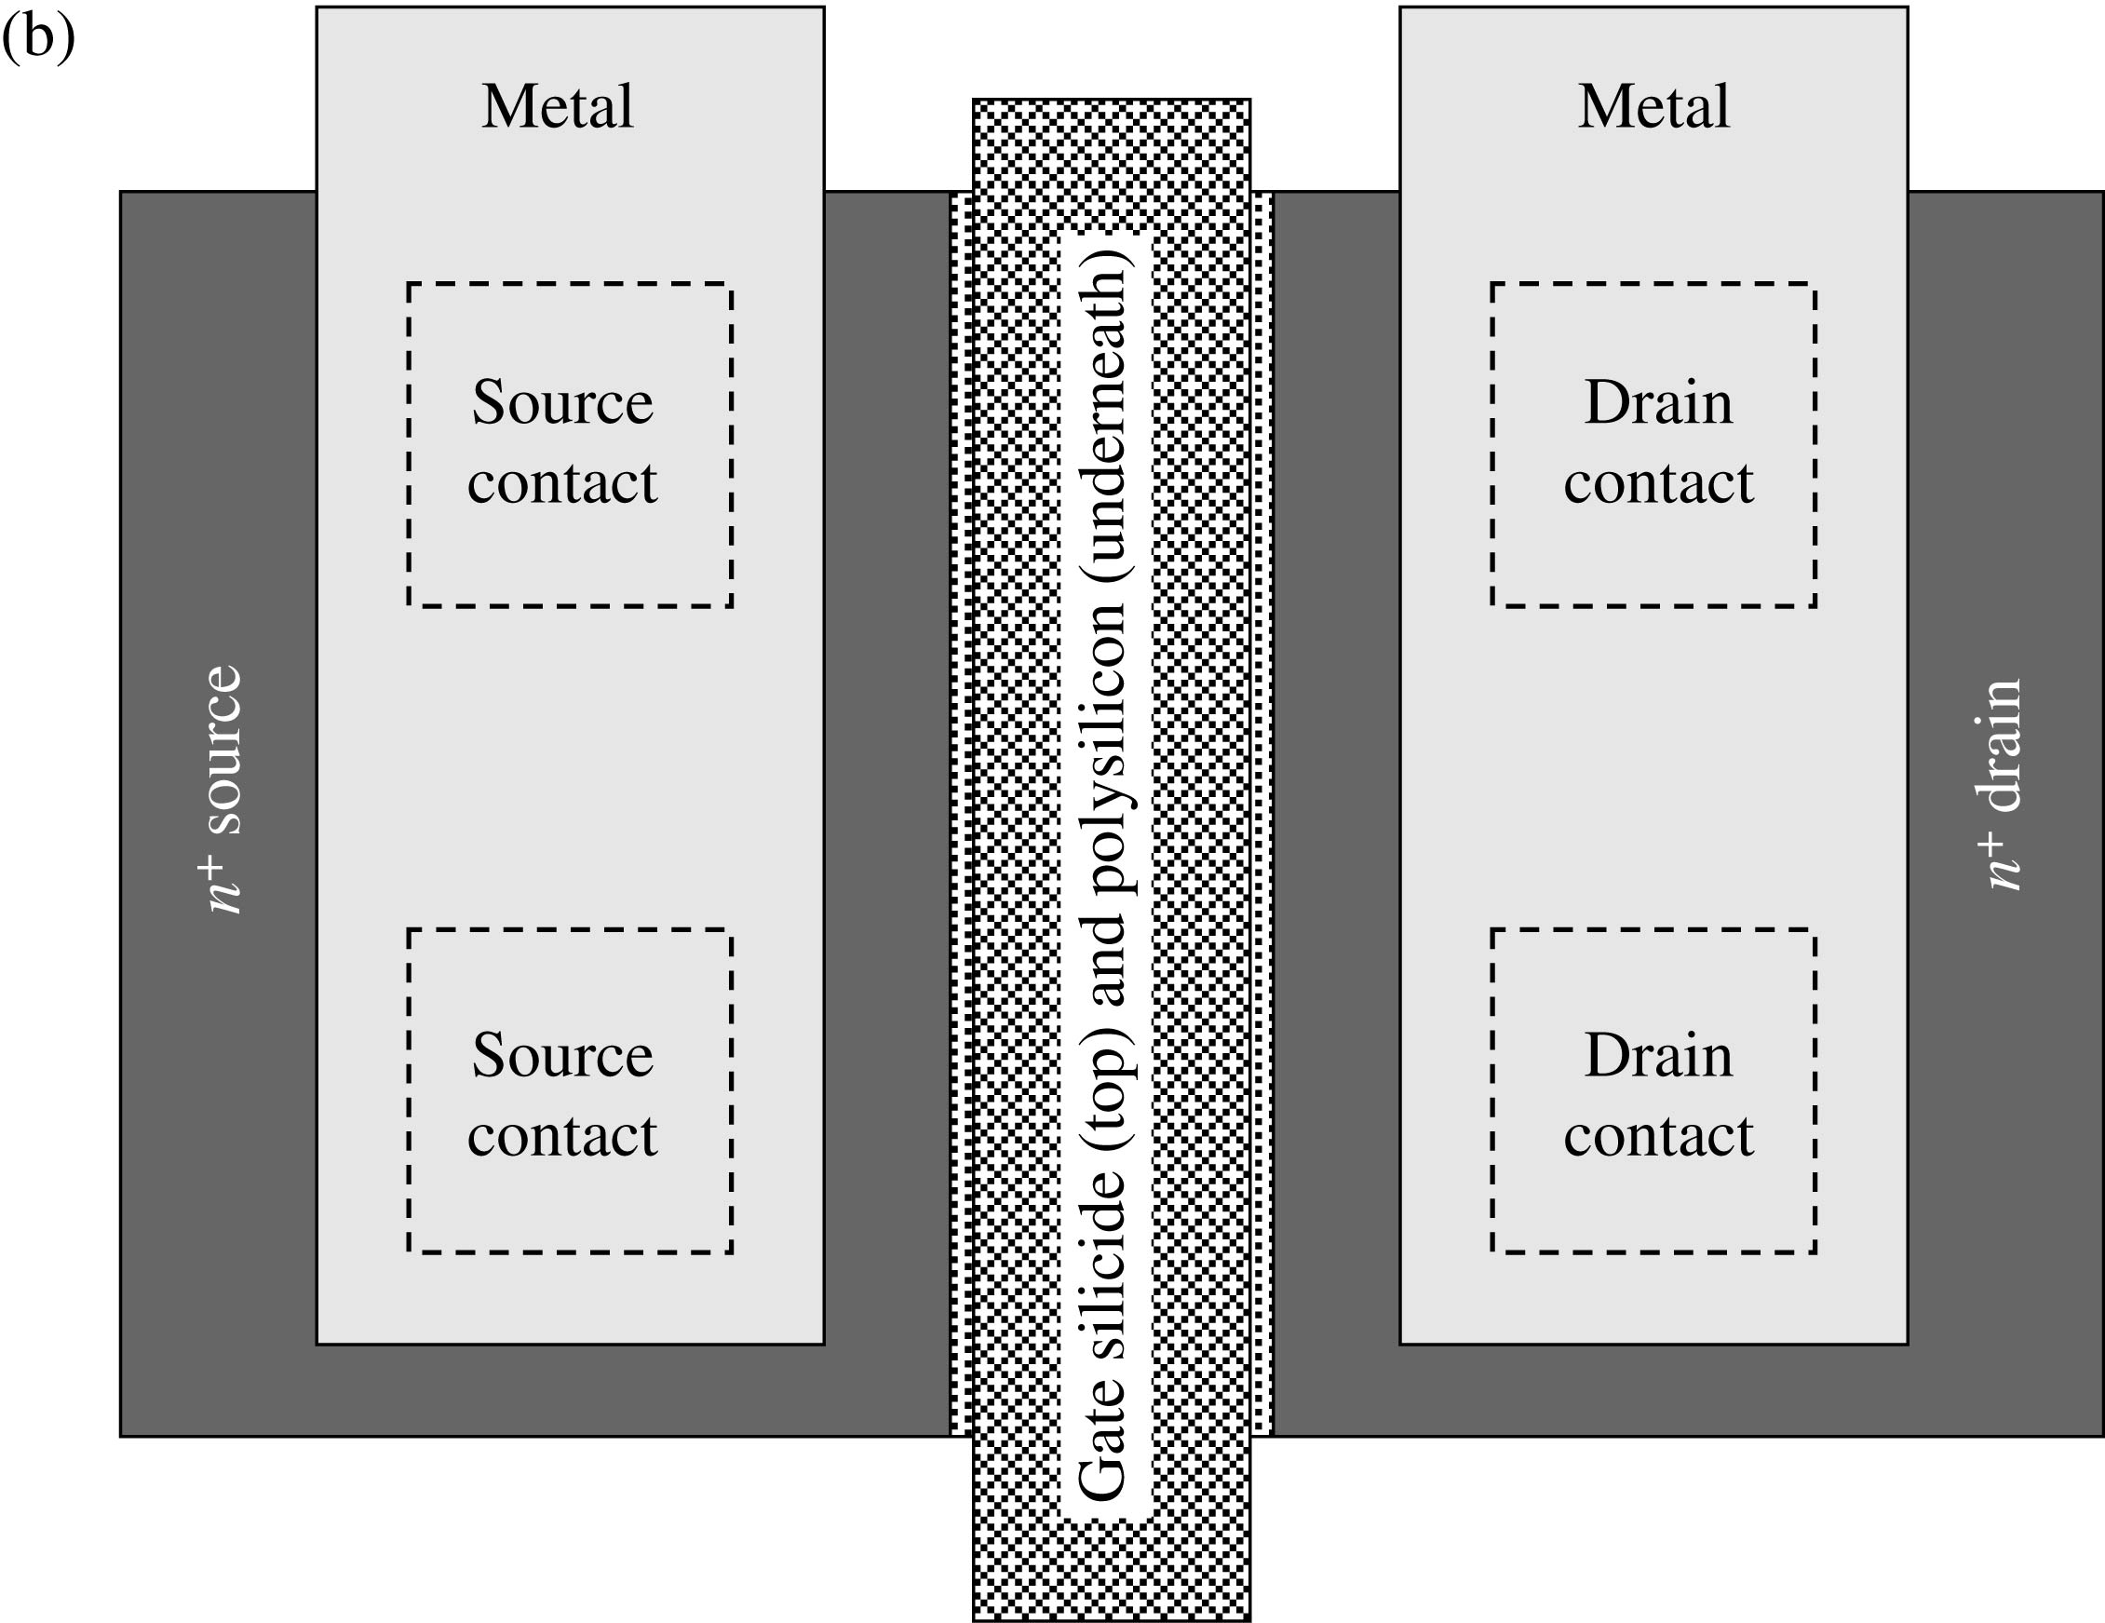
Layout Design Rules
Layout design rules describe device dimensions and how close different and like layers can be brought to close proximity without creating shorts.
The lambda based design rules made popular by Mead and Conway are based on the single parameter λ and permit for ease of scaling.
Industry used micron as a unit of measure and this makes scaling difficult since not all dimensions do not scale uniformly.
Lambda (λ) is generally half of the minimum drawn transistor channel length.
The channel length describes the distance between the inside edges of the source and drain (what’s defined by process/technology).
It is set by the minimum poly width (what engineers control).
We are begin to refer to the gate channel length in nanometers (nm) whereas for technologies 0.18 μm and above we used the micron.
W
What is our Lambda (λ)?
[Tsividis, McAndrew]
L
FIGURE 1.38 A device drawing showing realistic relative dimensions for the various features; (b) top view.

Slide 15

Art?
What is it?
What are we doing?
What are you doing?
[Usborne]

Slide 16
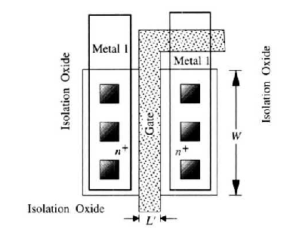

Basic Principle
The basic principle is the polysilicon across the diffusion area.
This forms a transistor for every crossing path!
typically drawn as “red”
Typically drawn as “blue”
How many gates?
Overhang???????
metal1 is the first layer of metal!
[Uyemora]

Slide 17

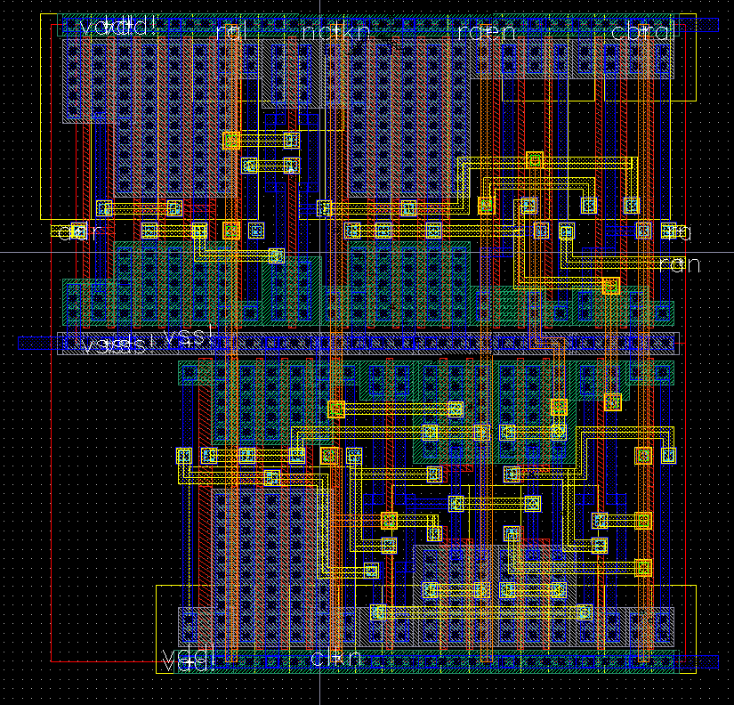
How many?
[http://www.eecg.toronto.edu/~roman/teaching/1388/2004/finalProj/2004_ECE1388_FP_www/256kb_SDRAM/]

Slide 18
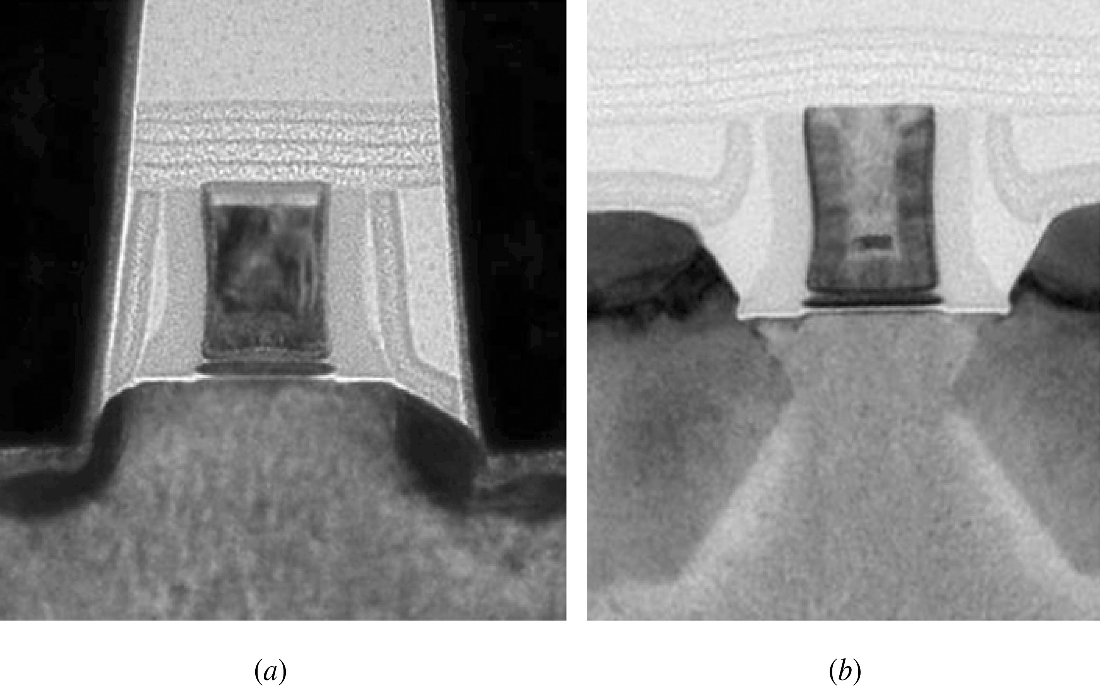
SiO₂ : sometimes called passivation
FIGURE 1.40 SEM images of (a) an nMOS and (b) a pMOS transistor in Intel’s 45-nm technology. Copyright © 2008 by IEEE, Courtesy of Intel Corporation.

Slide 19
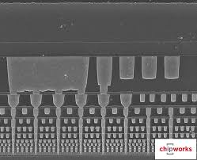
Interconnect (Metal Layers)
metal
SiO₂
transistor
[semimd.com]

Slide 20
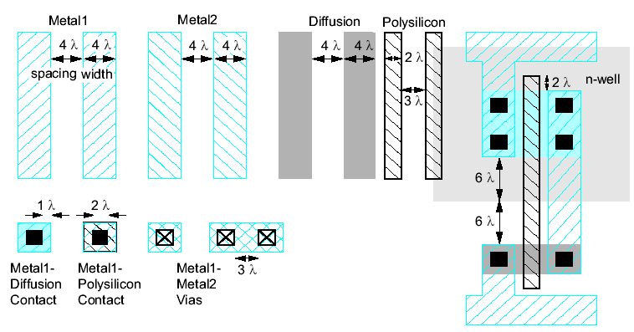
Simplified Design Rules
Conservative rules to get you started
Lambda ($λ$) rules in this class – Intel and AMD use “vendor” rules!

Slide 21
Vendor vs. SCMOS
SCMOS wastes extra space for drawing the transistor.
Area is money, so fabrication facilities resorted to creating rules based on distance and not grids!
Grids are still used to help keep connections together.
It also helps with contacting two transistors together.
Vendor rules use absolute distances to draw transistors.
Very hard to do in a reasonable amount of time without some practice.
Almost all current technologies use vendor or manufacturer rules.
SCMOS rules use grids based on lambda
This is our preferred method for this class.
Both methods are based on same principle of using design rules.

Slide 22
Overview of Physical Verification
What is Physical Verification (PV)?
General PV topics
Design Rule Check (DRC)
Logical Versus Schematic (LVS)
Verification Algorithms
Flat and Hierarchical (different file structures)
Approaches
DRC
Place and Route, Flat and Hierarchical
LVS (some places can fire you if you forget!)
Place and Route, Flat and Hierarchical
Electronic Design Automation (EDA) Tools
Notes:
Physical Verification
It is the last verification step performed on the design before it is sent to be manufactured. In this step the physical design (layout) from the place and route (Gate level) design as well as custom (Transistor level) design are put together and verified against the manufacturing process rules and the netlist at a transistor level.
The objective is to verify if the:
design can be manufactured correctly and meet the required yield and reliability goals (DRC)
layout of the design matches the netlist representation (LVS)
Impact
With the shrink in technology the transistor count in the designs is growing exponentially and the process rules are getting more complicated. This translates into a drastic increase in data volume and intricate checks. Therefore the product time to market could be drastically impacted by the long runtimes, analysis and repair of the PV problems identified.
The lecture concentrates on:
DRC and LVS general concepts and contrasting the implications of flat and hierarchical approaches.

Slide 23
What is Design Rule Checking?
Can DRC Checkers use “the cloud”?
Verification that layout geometry is legal
obeys set of design rules
minimum widths and spacings
extensions, overlaps
circuit-dependent rules
Goal
verify that all rules are met
highlight places that rules fail and why
use minimum CPU time, memory
integrated DRC + layout editor
use existing data structures
check incrementally
A
S_{min} = 3 if V_{AB} < 2.5V,
S_{min} = 4 otherwise
B

Slide 24
Design Rule Checks (DRCs)
Goals:
Manufacturability
Yield
Analysis Inputs:
Foundry
Rules
Design data
Mask data, Layer information
Typical checks performed:
For Manufacturing
Width, Spacing, Minimum Area, Enclosed Area, Overhang, etc.
For Yield (repeating every working chip)
Antenna, Electromigration, Latch-up, Electrostatic Discharge, Density
Rules Deck
Design
(Layout)
DRC
Violations Markers
Violations Report

Slide 25
Design Rule Waivers
Well tested special structures
Memory macros
Special permissions with the cost of reduced yield
Antenna rules
Density rules
EM rules
Many Intellectual Property (IP) vendors who supply silicon or instances (instantiations) of IP that they have worked out with the fabrication facility of “fab” with certain errors that have waivers.
That is, they are allowable, but they may or may not decrease yield.
Design Rules are for making sure yield is maintained and that the chip becomes what it is supposed to.
Notes:
Design Rule Waivers:
Special DRC rules which apply to certain designs with strict area limitations. These rules fail normal design rules constraints, however, are so well tested that they are accepted by the foundry. I.e. Ram cells

Slide 26
Whew!
Boy, that was tough!
Seems like an enormous work load for any user!
Let’s make it easier!!!!
Boy, this will be a common trait – if you can make it better and easier, do it!
Design Rule Check or DRC
Let the computer check it for you!
The question is how to get your system to enter a layout!

Slide 27
Magic : the layout editor!
Magic was a tool created by John Ousterhout who was previously known for inventing a language called Tcl/Tk (pronounced Tickle)
John now runs Sun Microsystems or has so for the last couple of years.
This tool was invented for easy layout and is built on Tcl/Tk
Its further refined by a friend of mine, Tim Edwards
http://www.opencircuitdesign.com
Magic is simple to learn:
Source startup script!
Type “magic”

Slide 28
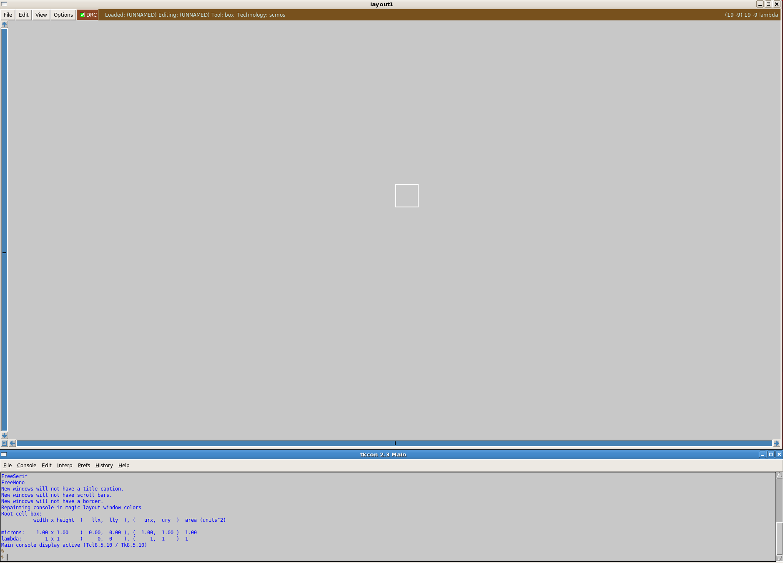
Magic Environment
Magic environment has two windows : the text and graphical window.
I like to have my text and window windows separated and visible, because you only see graphics in the graphics window and you only see text in the text window – confusing?
Let me show you an example!

Slide 29
Mouse
The mouse draws a box!
If you don’t have a box, type “tool box”, but it should run by default
Buttons:
Left Button → lower left hand part of box
Right Button → upper right hand part of box

Slide 30
Menus
All menus are invoked with the GUI or by typing the command
Its best to always use the command
Magic uses the : to prefix the command.
Example:
:paint ndiff
:paint poly
:paint metal1
:paint m1

Slide 31
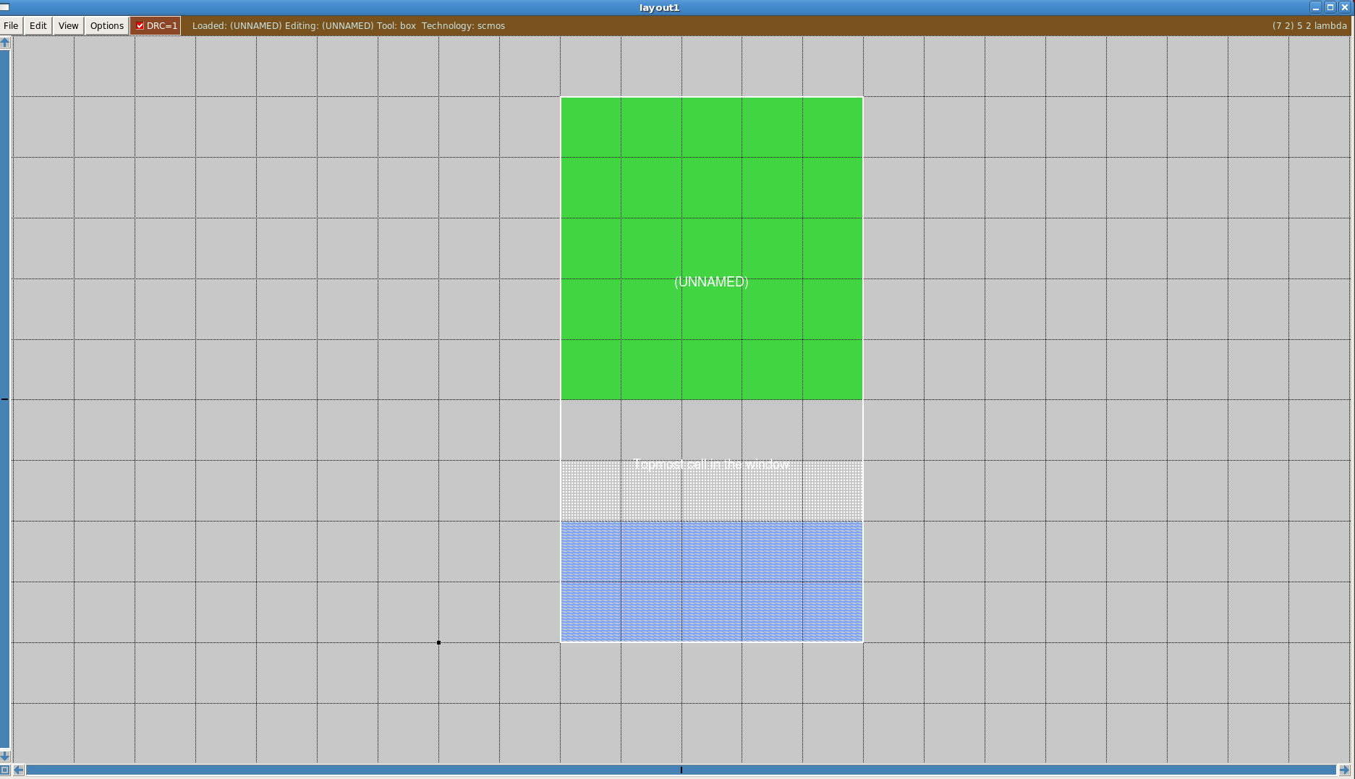
DRC : Design Rules Check
DRC or design rules check is used to tell if there are errors with the SCMOS rules.
In our case SUBM_SCMOS
There are two types:
Interactive : tells error based on drawing
Batch-based : you have to run a command to show the errors (by far, the most common)
Luckily Magic uses interactive DRC which is supppperrr cool!
White dots indicate error!

Slide 32
Grids
Since each grid is a lambda, its important to keep the grids at 1 when starting at.
They should default to 1, but you can change by typing: “grid 1”

Slide 33
Saving
Saving is a trouble maker
In the past, the old magic tool used to kill everything and it did this often
However, I believe the current version does have some backup features.
But, get in a good habit of keeping backups
Since files tend to copy old files, its important to keep the filename different
Example
:save james
:save awesome
:load james

Slide 34
Hierarchy
As stated earlier, everything is a hierarchy
However, its good to get in the habit of saving files into the hierarchy.
For example, I will typically work on an inverter in one directory.
Then, make an other directory for the hierarchy above it and work there.
Then, copy files from the lower level hierarchy into the other.
Saving files is highly recommended!!!!!!!
Some students in the past would run scripts to save files periodically
To use a hierarchy, type “:getcell inv” where inv is the lower level cell.
You will see a box to represent the hierarchy
To view it, type “x”
To un-view it, type “Shift x”

Slide 35
Moving
One of the coolest features of Magic is the ability to move blocks.
This can be done with the select key and the movement keys.
To select layout, highlight a box and type “a”
To move a block, use QWER
Q = left
W = down
E = up
R = right
Use interactive DRC to help make sure things are DRC free ☺!

Slide 36
Editing
Some magic commands are not cool!
For example, editing and resizing blocks is hard.
Its advisable to find what methodology works best for you.
Here are some strategies:
Deleting cells and starting over
Saving files and editing Magic file manually (Magic is saved as a text file).
This is extremely useful for text placement of pins
Opening up last saved file and starting again

