Slide 1
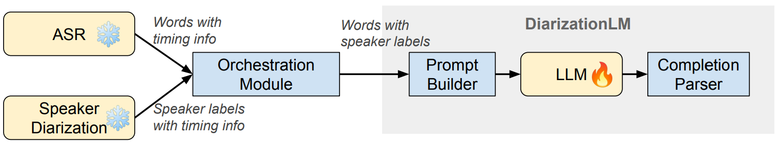
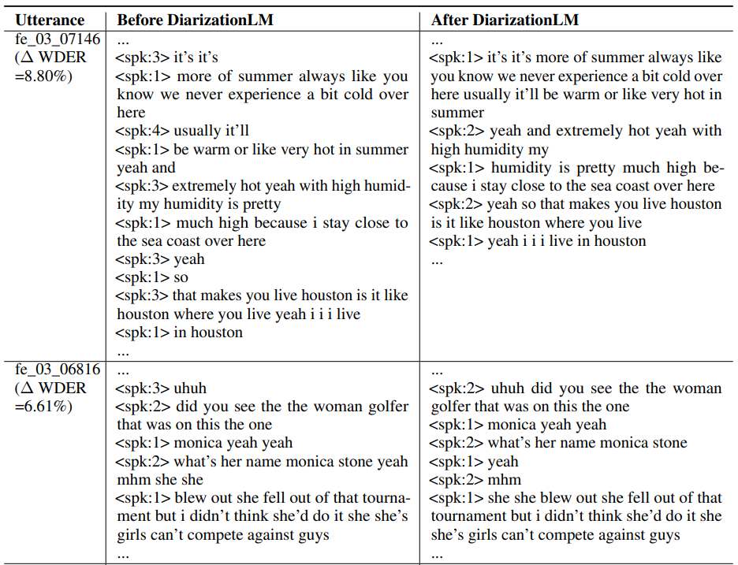
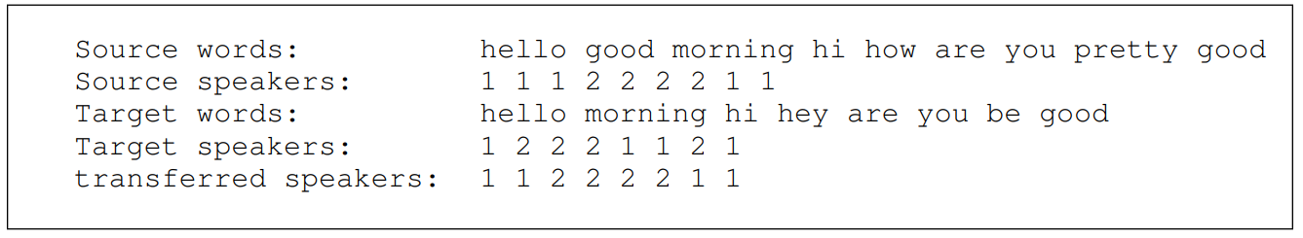
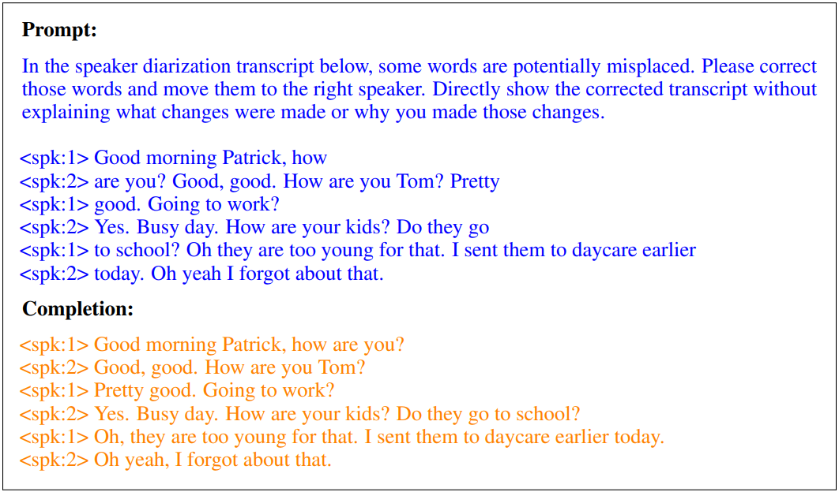
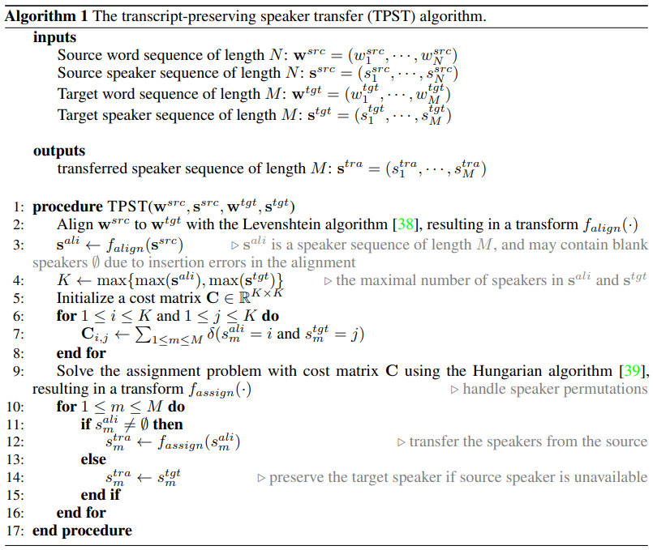
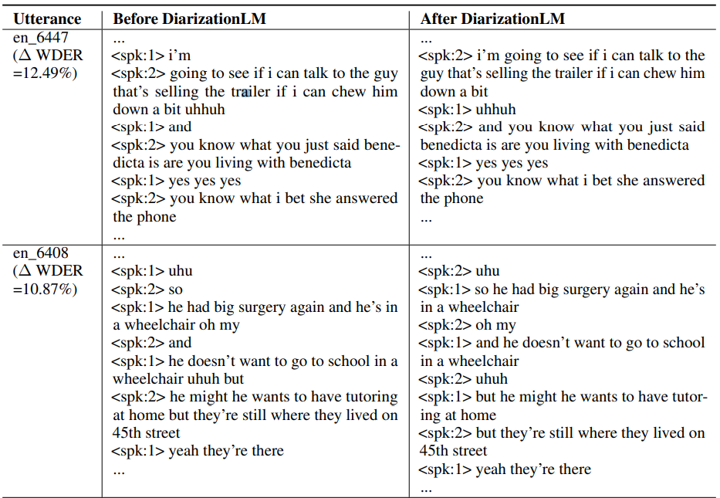
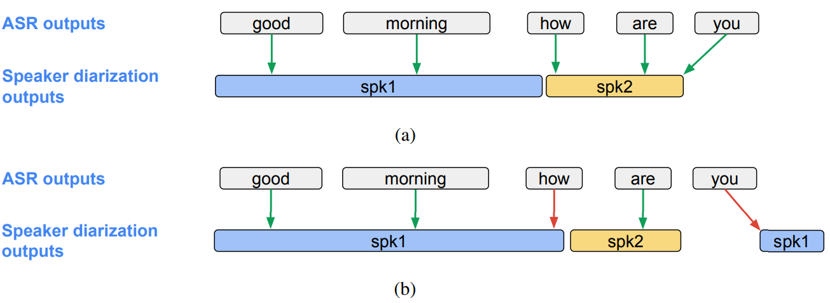

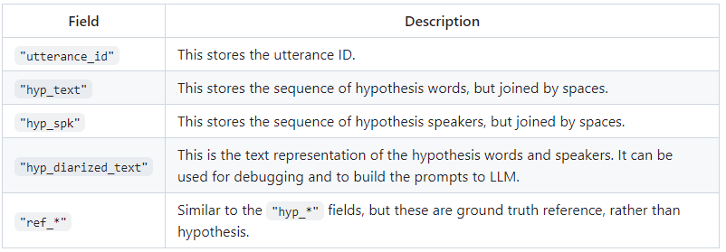
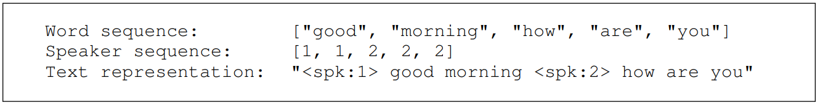

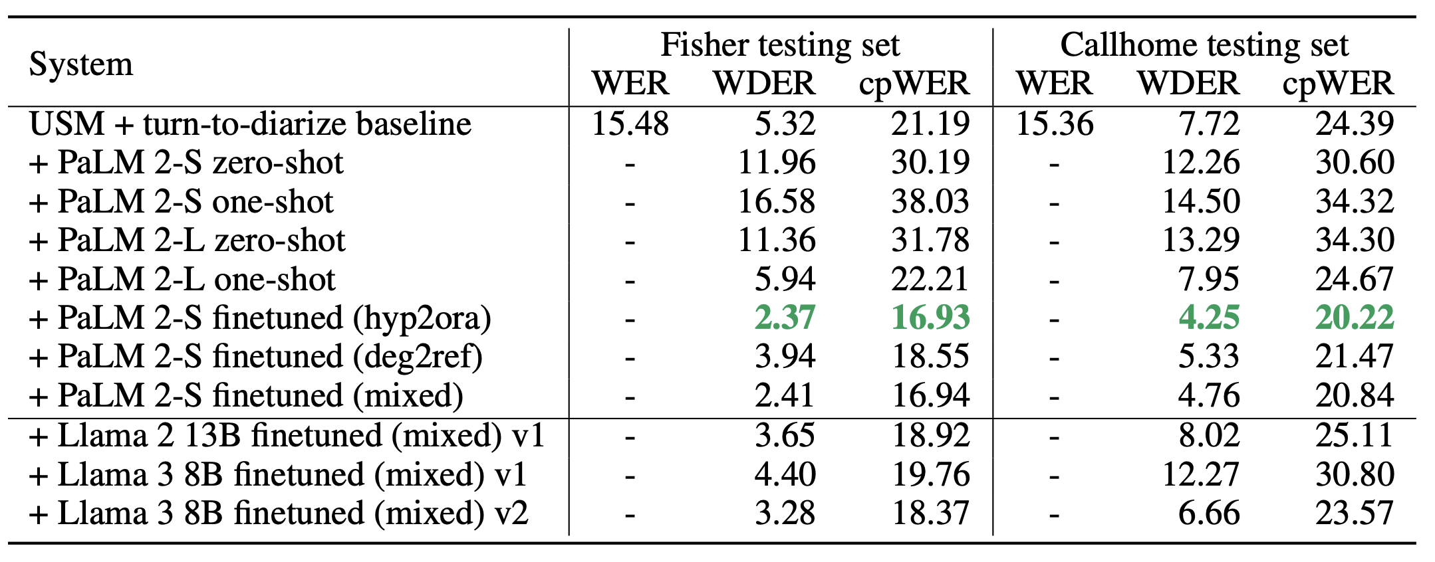
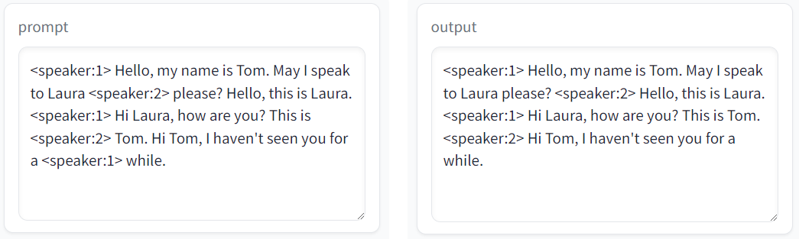
Patterns of successful corrections
Different parts of sentence incorrectly attributed to the same speaker
Short speaker turns due to disfluency
Speaker turns due to interruptions
Overview
Transcript-preserving spk transfer
DiarizationLM is a post-processing framework for ASR + speaker diarization systems.
Works with any off-the-shelf ASR models and diarization algorithms.
As a correction model, reduces Word Diarization Error Rates by >40% rel.
We also discovered other diarization capabilities of LLM: autofilling speaker names, autofilling speaker roles, or replacing the orchestration module.
LLM input & output should have the same text, and only different speakers
We need TPST in both prompt builder and completion parser
TPST(src_word, src_spk, tgt_word, tgt_spk) -> trans_spk
Fig. A motivating example where LLM can easily correct speaker diarization errors on the word level, even with a zero shot instruction.
Source of word diarization errors
Python library
3 flavors of data processing:
Flavor 1: hypothesis-to-oracle (hyp2ora)
Prompt: hypothesis word+ hypothesis speaker
Completion: hypothesis word + oracle speaker
Flavor 2: degraded-to-reference (deg2ref)
Prompt: reference word + degraded speaker
Completion: reference word + reference speaker
Flavor 3: mixed
https://github.com/google/speaker-id/tree/master/DiarizationLM
Install the library:
pip install diarizationlm
Prepare data in json format:
Fig. Orchestration between ASR and diarization results. (a) Correct output; (b) Incorrect output due to bad word-vs-speak timestamps.
Errors may come from any individual module, e.g. VAD, ASR, segmentation, speaker embedding, clustering, etc.
Errors may also come from the orchestration between these modules.
Different components are trained with different datasets, algorithms, models, etc. Thus their timestamps may not match.
Experiment results
Datasets:
Training: 11527 utterances from Fisher
Testing: 172 utterance from Fisher + 20 utterances from Callhome English
Metrics:
Word Error Rate (WER)
Word Diarization Error Rate (WDER)
Concatenated minimum-permutation Word Error Rate (cpWER)
Baseline system:
ASR: Google Universal Speech Model (USM)
Speaker diarization: Turn-to-diarize + multi-stage clustering (unknown number of speakers)
LLMs experimented:
PaLM 2-S & PaLM 2-L: 0-shot, 1-shot, finetuning with 3 flavors
Llama 2 & Llama 3: LoRA fintuning with mixed flavor
Convert between word/spk sequences and pure text:
create_diarized_text() - sequences to text
extract_text_and_spk() - text to sequences
Transcript-preserving speaker transfer (TPST):
def transcript_preserving_speaker_transfer(
src_text: str, src_spk: str,
tgt_text: str, tgt_spk: str) -> str
Compute metrics:
python3 compute_metrics_on_json.py \
--input=testdata/example_data.json \
--output=/tmp/example_metrics.json
Finetune llama model with unsloth:
cd unsloth && python3 1_finetune.py
Play with demo:
https://huggingface.co/spaces/diarizers-community/DiarizationLM-GGUF
System description
Prompt builder:
Converts word and speaker sequences to a text representation
Segment the sequences recursively to fit the LLM input length limit
Completion parser:
Truncate undesired LLM output
Extract word and speaker sequences from text completion
Concatenate sequences of all segments from same utterance
Transfer speakers to original word sequence

