Slide 1
OpenID Foundation Workshop
Monday, November 14, 2022
Notes:
Welcome everyone, I am Gail Hodges, Executive Director of the Open ID Foundation, and joining me is Anoop Saxena, one of the Co-Chairs of the FAPI WG. I’ll be providing an overview of the Foundation’s strategy, and Anoop will offer a deep dive into one of our leading standards, FAPI, and the global open banking and open data and open health movement FAPI is helping to enable.

Slide 2
Welcome
Gail Hodges – OpenID Foundation Executive Director

Slide 3
Note Well Statement
NOTICE: An OpenID IPR contribution agreement is not mandatory in order to participate in this workshop. If participants provide feedback, they (on behalf of themselves and any organization they represent) are deemed to agree that: Attendee gives the OIDF the right to use their feedback and comments. Attendee grants to the OpenID Foundation a perpetual, irrevocable, non-exclusive, royalty-free, worldwide license, with the right to directly and indirectly sublicense, to use, copy, license, publish, and distribute and exploit the Feedback in any way, and to prepare derivative works that are based on or incorporate all or part of the Feedback for the purpose of developing and promoting OpenID Foundation specifications and enabling the implementation of the same. Also, by giving Feedback, attendee warrants that they have rights to provide this feedback. Please note that feedback is not treated as confidential and that OpenID Foundation is not required to incorporate feedback into any version of an OIDF specification.

Slide 4

Thank you!

Slide 5
New News
Welcome Open Banking Brazil to OIDF Board
FAPI 2.0 – Big Milestones:
Implementor’s Draft 2.0 (45 day review, vote, move to Final)
Stuttgart University formal Security Analysis delivered (Australian Gov/OIDF)
ETSI Liaison Signed
ISO Publicly Available Specification – PAS Application Submitted
Whitepaper Collaborators: AAMVA, Better Identity Coalition, EPIC, Kantara, OIX, SIA/OSIA.
Imminent Open Banking launches - Open Insurance Brazil, Saudi Open Banking
1650+ Implementations Certified
Kim Cameron Award formalized
Notes:
Open Banking Brazil joining the Board representing Central Bank of Brazil, and wider community. Recognize their movement to Ecosystem wide certification of OP and RP.
New members, MasterCard, WorkDay to the community.
Open Insurance in Brazil targeting certification with OIDF by end of this year
ETSI Liaison now in place, highlight OpenID Connect for VC family of specifications. Appetite in EU to use this spec for
Saudi Monetary Authority (SAMA) selected FAPI as their security profile, and OIDF Certification, moving towards launch in the days and weeksahead

Slide 6
2022 Key Initiatives
Sustain & Refine
Mature & Partner
Invest
Refine Approach
New Opportunities
IoT*
Emerging Trends (e.g. blockchain, Web3, Metaverse, fraud)
Standards Due Process
Nurture next generation of thought leaders & diverse views**
Policy Charter?
OpenID Connect
FAPI*
Certification Program
OpenID Connect for Identity Assurance
MODRNA
Shared Signals & Events
FastFed
GAIN POC / MOU
OpenID Connect for VC*
Government Engagement*
Marketing
iGov*
Federation Spec
Health*
Privacy* (Whitepaper Gov Issued Digital credentials)
End Developer Support
10
10
Comments/ Support: director@oidf.org
*7 new Whitepapers in 2022
**Kim Cameron Awards for 2022 for EIC & Identiverse
Notes:
Italian Gov selected iGov profile to support their electronic ID program. Updating the iGovprofilewill allos creation of a conformance profile for testing, and the ID is to point all relying parties in Italy to OIDF for cerfification, as one of the steps to join the Italian eID federation. One of the areas of work is to close the gap since PKCE was mdae available in IETF, so iGovis out of date.
The Italian Gov for EID has also selected the Federation Spec, as has the GAIN POC. So some good activity there as well.
The Health Whitepaper published by Deb Bucci in July is being updated, we are working on refining the recommendations with the partner organizations like HL7, CAIRIN alliance, IHE, ONC, and others so we can move that paper to final. Are sense is that work on consent is happening in both identity and health domains, and we would all benefit from closing those gaps. If anyone or their org is deeply invested in health, please reach out to me or deb at director@oidf.net.
Certification team is partnering with the Brazil government and Saudi Government to support their open banking implementations. Continue to engage other open banking and open data leaders in government and in the private sector to explore the fit to support their programs. One piece of new news, is that we now have the option of 3rd party licensing, giving government even more domestic sovereignty and control of their implementations while allowing them to leverage OIDF standards and certification tests that are proven, secure, and interoperable.
Emerging trends we have been monitoring all year. FTX bankruptcy last year has shaken the markets. This afternoon I will tee up the question to the Board if there is more we can do to help this complex and dynamic community in their efforts to create safe spaces. Really an open question…? Do we need to formalize analysis of the identity related problems they are facing, and is there more we can do to help close those gaps?
Next Generation of Thought Leaders, three winners of our stipends for young members of the community to attend conferences and support their travel. Exec Committee agreed to fund another $10k going forward, and Don is leading the effort to secure ongoing funding.
Policy charter next steps, group to define…

Slide 7
Whitepaper Progress
Gail
Q1 ‘22
Q2
Q3
Q4
Q1 ‘23
Q2
Open Banking, Open Data & FAPI (Final)
OIDC for VC (#1)
OIDC for VC (Final)
Health (#1)
(Final)
Open Banking, Open Data Crossing Borders? (#1)
(Final)
Gov Digital IDs + Privacy (#1)
(Final)
Government (#1)
(Final)
IoT (#1)
(Final)

Slide 8
Agenda
TIME (PT) | PRESENTATION | PRESENTER(S)
12:30-12:35 | Welcome | Gail Hodges – OIDF
12:35-1:00 | OIDF Privacy Whitepaper Listening Session: “Help Design a Scalable Future for Personal Privacy” | Heather Flanagan – Spherical Cow Consulting
1:00-1:25 | OIDF Government Whitepaper Listening Session “Citizen-Centric Identity Systems” | Elizabeth Garber – Whitepaper Co-Author
1:25-1:50 | OIDF IoT Whitepaper Listening Session: “IoT & Identity: First Thoughts on a Blueprint for How People and Things can Interoperate” | Andre Priebe – iC Consult
1:50-2:00 | Break
2:00-2:25 | A Review of the Global Assured Identity Network (GAIN): One Year On | Elizabeth Garber – Co-Chair GAIN Proof of Concept
2:25-2:40 | OpenWallet Foundation Listening Session | Juliana Cafik – Microsoft & Dr. Torsten Lodderstedt – yes.com
2:40-2:50 | Connect WG Update | Michael Jones – Microsoft
2:50-3:00 | FAPI WG Update | Nat Sakimura – OIDF
3:00-3:10 | eKYC & IDA WG Update | Dr. Torsten Lodderstedt – yes.com
3:10-3:20 | Shared Signals & Events WG Update | Tim Cappalli – Microsoft
3:20-3:30 | MODRNA WG Update | Bjorn Hjelm – Verizon Wireless
3:30-3:50 | OpenID for Verifiable Credentials (OpenID4VC) Update | Kristina Yasuda – Microsoft & Dr. Torsten Lodderstedt – yes.com
3:50-4:00 | Wrap Up and Open Q&A
Thought Leadership
WG Status

Slide 9
OIDF Privacy Whitepaper Listening Session: “Help Design a Scalable Future for Personal Privacy”
Heather Flanagan, Spherical Cow Consulting

Slide 10

Purpose of this White Paper
To engage and inspire a community of thought leaders to develop a path forward for government-issued and associated derived credentials. We aim to help close the policy and protocol gaps that exist between today’s disparate solutions and services and the vision of a privacy-preserving, globally viable privacy landscape.
Photo by reza jahangir on Unsplash

Slide 11
Outlining Our Thoughts
Intro / Scope
Terminology
Getting there from here
current landscape
promise(s) offered by digital transformation
Gaps and risks
where the guardrails need to be installed
‘Gotcha’s’ and failures of prior policies
Scaling to the future - policy + technology
Roadmap for developers and implementers
Roadmap for technical policy and standards authors
Roadmap for policymakers
Roadmap for private sector participants

Slide 12
Introduction
Scope & Terminology

Slide 13
Let’s Be Clear
In Scope
Out of Scope
Government-issued credentials
Third-party / derived credentials (based on government-issued credentials)
…
Third-party / derived credentials (NOT based on government-issued credentials)
Self-asserted credentials
Privacy challenges beyond those that touch on government-issued and associated derived credentials
…
Notes:
The gov’t credentials are in process, will be scaling up, and the privacy implications are going to be keenly felt by gov’t stakeholders because as they issue these, they are caught up in the privacy debate (e.g., CCPA and its impact on California-generated credentials). In scope - things nominally designed as public good; out of scope - things not designed for public good.

Slide 14
Terms Needing Definition
Government-issued credential
Derived credential
Mobile credential
Issuer
Holder
Verifier
…
We don’t necessarily need to invent new definitions; we should point to existing standards where at all possible!
Notes:
We will come back to this at the end of the session; don’t want to bog down in this slide

Slide 15
Getting There From Here
Current Landscape & Digital Transformation

Slide 16
Current Landscape
Discussions on:
Biometrics
Access to government source records
The state of government-provisioned and associated derived credentials
Policy efforts (GDPR, CCPA, etc)
…
Discussions on
user control of data
data minimization
relying party accountability
extensibility to other domains
optional audit log of transactions and ability to assert rights (CCPA, GDPR)
…
Notes:
key issues in this space; name them. Detailed discussion can happen later.

Slide 17
Digital Transformation
Desired Outcomes
user control of data
data minimization
relying party accountability
extensibility to other domains
optional audit log of transactions and ability to assert rights (CCPA, GDPR)
…

Slide 18
Gaps and Risks
Guardrails & Lessons Learned

Slide 19
Learning from the Past
Discussions/Examples of what hasn’t worked
Where no legal protection is offered (but should be)
Where legal protection is offered but has no viable enforcement mechanism(s)
Going too far (e.g., security, law enforcement capabilities)

Slide 20
Protections in the Right Places
Highlighting the need for policy protections
Highlighting the need for technical protections
Highlighting where these can overlap
Assessment criteria?
Where are the practical differences between what governments are achieving vs what they'd like to achieve?

Slide 21
Plans and Roadmaps

Slide 22
Roadmaps
Who will benefit from having roadmaps/next steps offered in this white paper?
Specification/Standards Architects?
Civil Society?
Private Sector?
…
Notes:
Note: This was originally “specification developers.” I don’t actually understand the difference between spec developers and policy/standards authors. Perhaps this should be something more towards developers and implementers?

Slide 23
OIDF Government Whitepaper Listening Session: “Citizen-Centric Identity Systems”
Elizabeth Garber – Whitepaper Co-Author

Slide 24
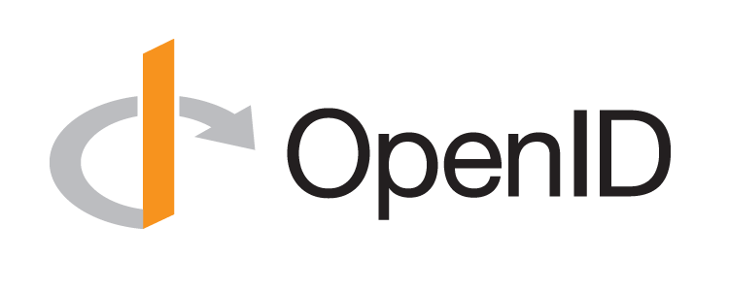
Goals of the Government Whitepaper
Educate and engage government stakeholders & wider community in order to:
Inform government stakeholders on the current landscape, challenges & risks
Role of standards (including OIDF standards) to enable Digital ID ecosystems, achieve goals
Incorporate the needs of citizens and their government in the OIDF’s strategic direction

Slide 25
For Discussion Today
Purpose of Government
Nature of Identity
Government Roles in Digital ID
Government Concerns
The Role of OIDF Standards
Discussion

Slide 26
Identity underpins governments’ core purpose
Business Resilience
Government is seeking to ensure the wellbeing of citizens, underpinned by sustainable growth and resilience.
Cyber
Resilience
Economic Resilience
Societal Resilience
Human
Resilience
Political Resilience

Slide 27
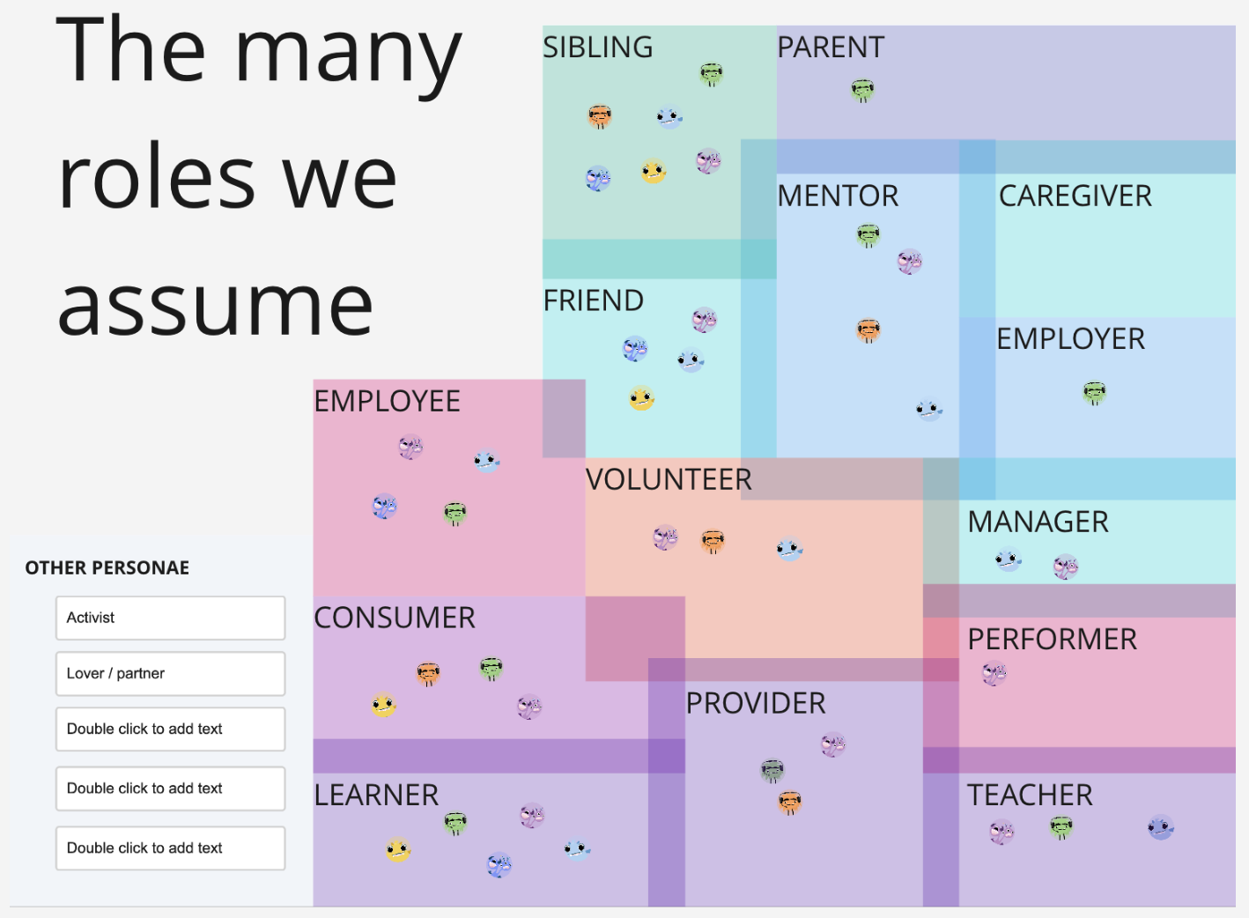
The Nature of Identity
Different aspects of our identities are salient in different contexts; we have rights over when/how to assert them
While our identity data is personal and, in many senses “ours”, we share limited rights to that data with issuers (e.g. the government or the university)
GDPR and similar legislation in other jurisdictions provides a baseline for this paper’s assumptions about privacy and PII
IN REAL LIFE (IRL) ROLES – Mozilla Festival 2022, The Context of You – The Many Facets of Your Digital Identity via Identity Flashmob

Slide 28







Government role & concerns in ID ecosystems
multiple roles between and within government functions
Credential Issuer
Verifier or RP
Regulator
Binding to a unique human
How to recognize them when they return
Data security, scalability, resiliency
AuthZ decisions
Access to credentials
AuthN & consent across contexts
Data security, scalability, resiliency
Citizen rights & safety
Ethics & accountability
Adoption
Promotes growth
Data security, scalability, resilience
Concerns

Slide 29


OpenID Standards offer tools to government
They are proven tools that can be used to provide
Security (FAPI profile)
Interoperability
Scalability (broad global adoption)
Simplification
User privacy and data protection
They work together with other standards as part of any user journey:
e.g.
FIDO standards for authentication
W3C standards for verifiable credential formats
ISO Standard for digital drivers licenses

Slide 30
OIDF Standards* applicable to Government Needs
Slide originally produced for discussion around EU Digital Wallet Requirements
OIDC Core & Discovery Authorization protocol that orchestrates authentication and consent | Financial-grade API security profile Specific configurations to mitigate security risks in OIDC | OpenID for Identity Assurance Data structure to standardize communication of evidence and assurance | OpenID for Verifiable Presentations Extension that enables transportation of Verifiable Credentials
SIOP v2 Standardises Self-Issued OpenID (Wallet) key exchange and authentication | OpenID for Credential Issuance Extension that standardises Issuance of Verifiable Credentials | OpenID for Authority Extension that adds ability to present on-behalf-of information | Shared Signals Standardised Privacy-protected, secure webhooks for communicating risks and events
Advanced syntax for Claims Extension that enables much richer data minimization | OIDC Dynamic Client Registration Specification that allows clients to register their meta-data including credentials and privacy notice and TOS locations for user protection. | OpenID Connect Federation Specification to enable multiple ecosystem parties to establish technical trust
* More details are found on https://openid.net/developers/specs/

Slide 31
Discuss!
What do our assumptions about the nature of government suggest? Whom do we leave out?
Are there other government goals to be accounted for in this whitepaper?
Are there roles for the government that we are not considering?
Are there government concerns/issues that we are not considering?
Are there OIDF technical standards that we have not considered? Important standards that work in partnership?
What else should we be asking?

Slide 32
IoT & Identity
Andre Priebe, CTO @ iC Consult Group GmbH

Slide 33
2022 Key Initiatives
Sustain & Refine
Mature & Partner
Invest
Refine Approach
New Opportunities
IoT*
Emerging Trends (e.g. blockchain, Web3, Metaverse, fraud)
Standards Due Process
Nurture next generation of thought leaders & diverse views**
Policy Charter?
OpenID Connect
FAPI*
Certification Program
OpenID Connect for Identity Assurance
MODRNA
Shared Signals & Events
FastFed
GAIN POC / MOU
OpenID Connect for VC*
Government Engagement*
Marketing
iGov*
Federation Spec
Health*
Privacy* (Whitepaper Gov Issued Digital credentials)
End Developer Support
10
10
*7 new Whitepapers in 2022
Notes:
Italian Gov selected iGov profile to support their electronic ID program. Updating the iGovprofilewill allos creation of a conformance profile for testing, and the ID is to point all relying parties in Italy to OIDF for cerfification, as one of the steps to join the Italian eID federation. One of the areas of work is to close the gap since PKCE was mdae available in IETF, so iGovis out of date.
The Italian Gov for EID has also selected the Federation Spec, as has the GAIN POC. So some good activity there as well.
The Health Whitepaper published by Deb Bucci in July is being updated, we are working on refining the recommendations with the partner organizations like HL7, CAIRIN alliance, IHE, ONC, and others so we can move that paper to final. Are sense is that work on consent is happening in both identity and health domains, and we would all benefit from closing those gaps. If anyone or their org is deeply invested in health, please reach out to me or deb at director@oidf.net.
Certification team is partnering with the Brazil government and Saudi Government to support their open banking implementations. Continue to engage other open banking and open data leaders in government and in the private sector to explore the fit to support their programs. One piece of new news, is that we now have the option of 3rd party licensing, giving government even more domestic sovereignty and control of their implementations while allowing them to leverage OIDF standards and certification tests that are proven, secure, and interoperable.
Emerging trends we have been monitoring all year. FTX bankruptcy last year has shaken the markets. This afternoon I will tee up the question to the Board if there is more we can do to help this complex and dynamic community in their efforts to create safe spaces. Really an open question…? Do we need to formalize analysis of the identity related problems they are facing, and is there more we can do to help close those gaps?
Next Generation of Thought Leaders, three winners of our stipends for young members of the community to attend conferences and support their travel. Exec Committee agreed to fund another $10k going forward, and Don is leading the effort to secure ongoing funding.
Policy charter next steps, group to define…

Slide 34
Problem Statement
“Internet of Things” is the broad area of connected devices beyond smartphones and notebooks – which are more constrained.
Large number of different standards and protocols are out there – the relevance for a particular use case is often unclear. Many vendors/manufactures therefore implementing proprietary solutions – this effects usability, costs, privacy, and security aspects.
A lot of innovations around physical products are related to digital services – the demand for seamless integration and convenient interaction between “Things” and “People” is increasing.

Slide 35
Whitepaper - Approach
Dilligence and Interviews
1st Editor‘s Draft
Gather Feedback
With thought leaders
Industry experts
Listening sessions
Getting co-authors and contributors involved
Request for Comments
Feedback from ecosystem stakeholders and government officials
Conform feedback
Publish 2nd Editor‘s Draft
Final Editor's Draft
Nov./Dec. 2022
Jan.
2023
Feb./Mar.
2023
Apr.
2023

Slide 36
Ecosystem
Device Focus
Device (general purpose)
MQTT
FIDO (FDO)
WoT
Device (sector specific)
CSA (Matter/Zigbee)
OAuth
Appli-cation
And many others…
OpenID
FIDO
(FIDO2)
SCIM
None
SAML
User authentication
Identity Focus
None
Device-only
Identity focused
Notes:
Explanation to the axis and dedicated values
Clarification: CCC, FIDO in general,…

Slide 37
Ecosystem
Device Focus
MQTT
FIDO (FDO)
?
Device (general purpose)
WoT
Device (sector specific)
CSA (Matter/Zigbee)
OAuth
Appli-cation
And many others…
OpenID
FIDO
(FIDO2)
SCIM
None
SAML
User authentication
Identity Focus
None
Device-only
Identity focused
Notes:
Explanation to the axis and dedicated values
Clarification: CCC, FIDO in general,…

Slide 38
Scope of the Whitepaper
Devices
In scope: Constrained devices connected to the internet or a private network
Not in scope: Specific bus systems (e.g. CAN-Bus, KNX,…)
Not in scope: Anything more fine grained than a “MAC-address (e.g. chips. Microcontrollers, …)
Organizations
In scope: Contributing to Identity AND/OR IoT topics (e.g. by specifications like OIDC) with current and planned activities
Use Cases
In scope: General-purpose and abstract
Not in scope: completely sector specific
Notes:
Trust between different components on a board, manipulation of components on a board, side-channel attacks etc.
TRUST for a system might be very important, but we need to have a break point or abstraction layer to be able to make progress and not losing in a very challenging area, which nobody can overview at all

Slide 39
IoT Use Cases
Administrative
Manage (CRUD)
Claim
Delegation
Consent
Runtime
Access, AuthN, AuthZ
Session Mgt.
Acting on-behalf-of
Read/Explore
Trust
...
...

Slide 40
Abstract Entity Relationship
Device
Application / Service
*User
(Owner, Co-user, Organization)
**Maintainer
(Organization)
* utilizes the device
** maintains the device – might be the user in B2B scenarios

Slide 41
Abstract Entity Relationship
Identity Provider
Device
Application / Service
Identity Provider
Identities
Sessions
Privileges
Trust
…
*User
(Owner, Co-user, Organization)
**Maintainer
(Organization)
* utilizes the device
** maintains the device – might be the user in B2B scenarios

Slide 42
Abstract Entity Relationship
Identity Provider
Identities
Sessions
Privileges
Trust
…
Identity Provider
Device
Application / Service
Foreign
Services
Foreign Services
Calls the Device (on behalf of the user)
Is triggered by the Device (on behalf of the user)
*User
(Owner, Co-user, Organization)
**Maintainer
(Organization)
* utilizes the device
** maintains the device – might be the user in B2B scenarios

Slide 43
Input and first thoughts by interviewees,…
We need “OAuth 2.0 for Native Apps” but for IoT
OAuth 2.0 Device Az Grant should be an OIDC Flow – Devices need ID Tokens and OpenID Certifications
Ability to manage relations between Identities and Devices in a SCIM-style
OIDC Userinfo-Endpoint including Device relations (e.g. ownership) and a “Device”-Endpoint
An entity for devices in addition to “Client-ID” and “Subject”
…
Notes:
Feedback from Mercedes, Miele, Siemens

Slide 44
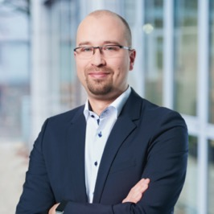

Andre Priebe
andre.priebe@ic-consult.com
+49 172 1425576
iC Consult | sales@ic-consult.com | www.ic-consult.com
Plano – Atlanta – Toronto – New York – London – Barcelona – Zurich – Munich – Vienna – Sofia – Nanjing

Slide 45
10 minute break
Visit: openid.net

Slide 46
A Review of the Global Assured Identity Network (GAIN): One Year On
Elizabeth Garber – Co-Chair GAIN Proof of Concept

Slide 47
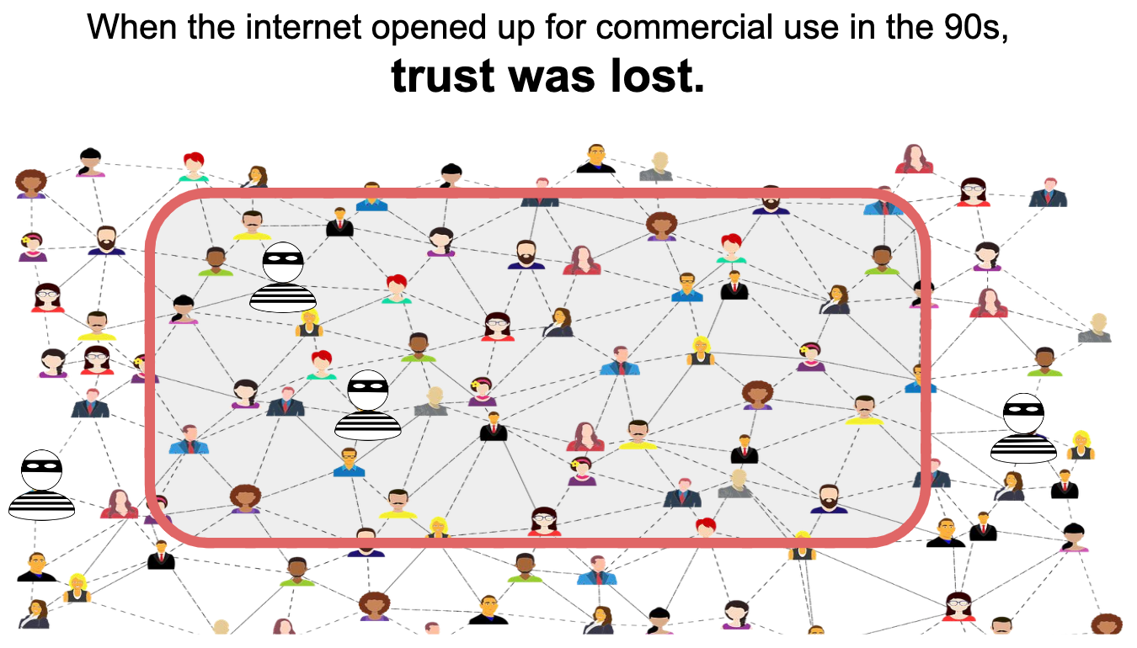
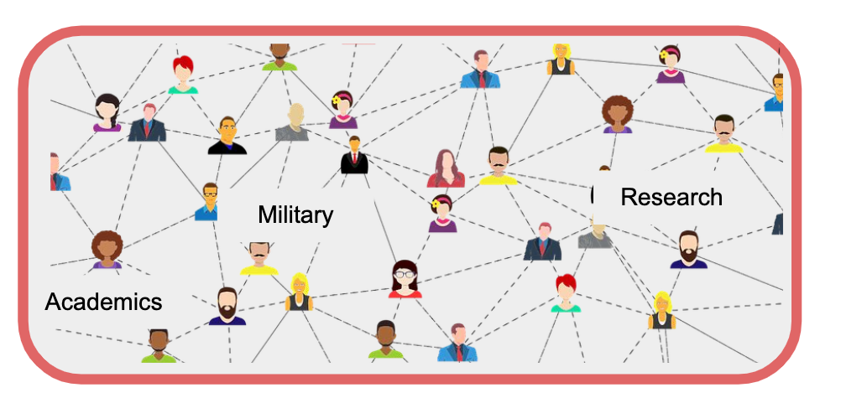
GAIN emerged from something you know
In the beginning, there was trust on the internet
But as it opened up,
trust was lost.

Slide 48
GAIN emerged from something you know
Weaponized Anonymity for Some…
Financial Crime is up to 5% of GDP (2Tn USD)
Misinformation
… Lack of Control for the Rest
Pervasive Tracking
Identity Theft

Slide 49
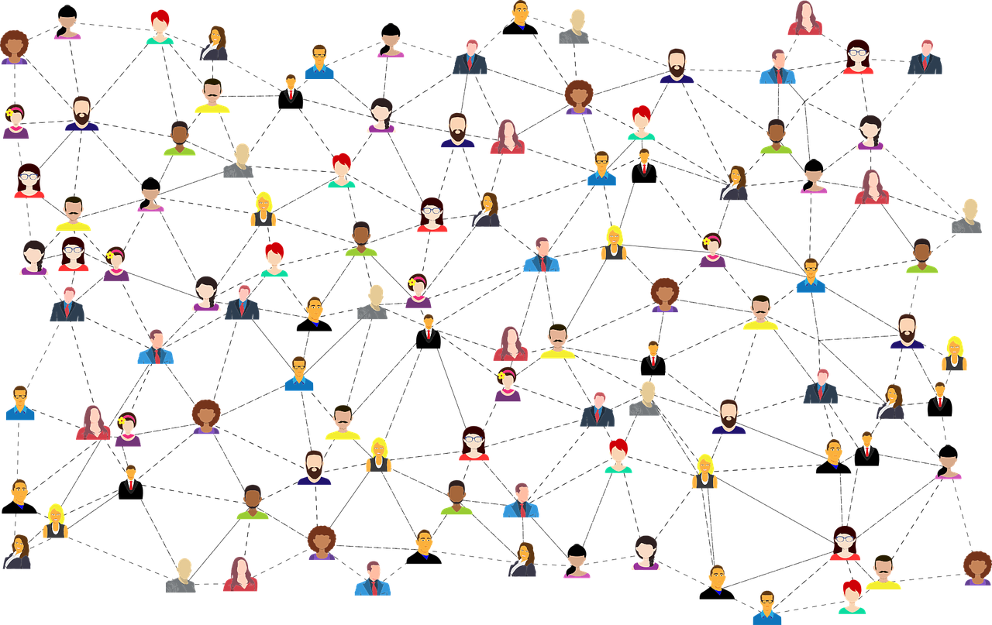
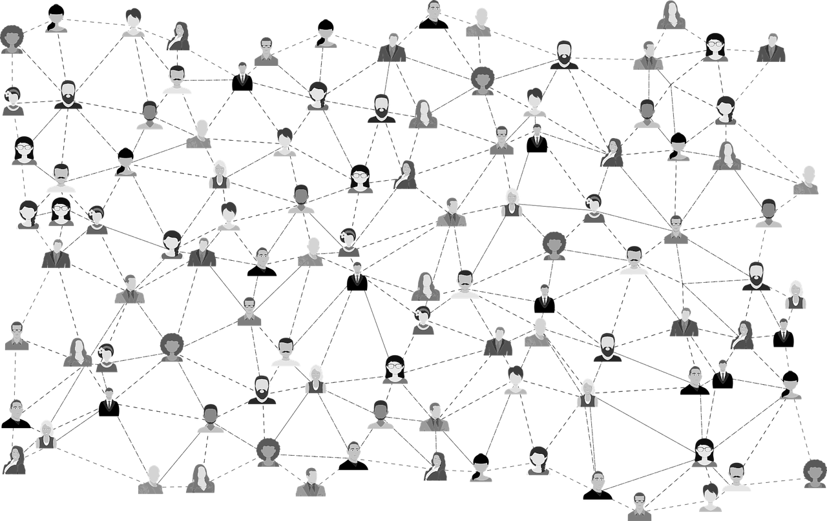
GAIN is a shared vision
An interoperable system that bridges islands of trust
Trusted Network
Trusted Network
Interoperability
Notes:
Trust layers already exist on the internet. The GAIN vision is that we connect them. That we create a globally interoperable network of networks that leverages the high trust data that exists in trust networks and trusted institutions today - and also interoperates with the emerging decentralized solutions, SSI and wallet providers etc.

Slide 50
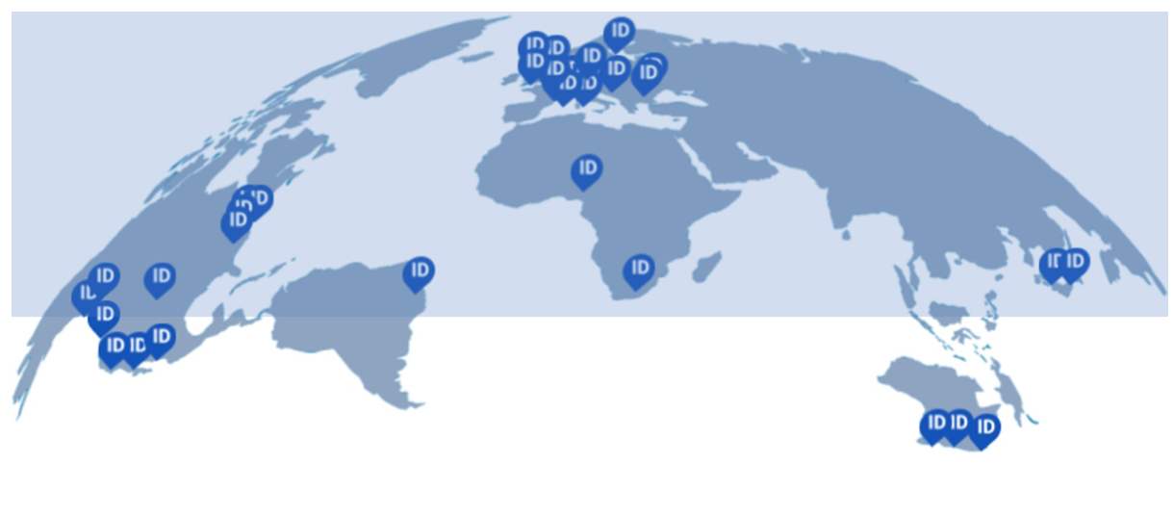
It became a whitepaper
GAIN Digital Trust
150+ Authors
no logo, pro bono, open source
Notes:
As everything must, GAIN became a white paper.
We had technologists, lawyers, leaders in existing federated identity networks. SSI and thought leaders in decentralized identity. Wallet creators. Identity information providers. Verifiers and business leaders who see the value in the network.
We did not agree on everything – even the paper’s target audience. But we shared that vision for global interoperability and it’s potential to

Slide 51
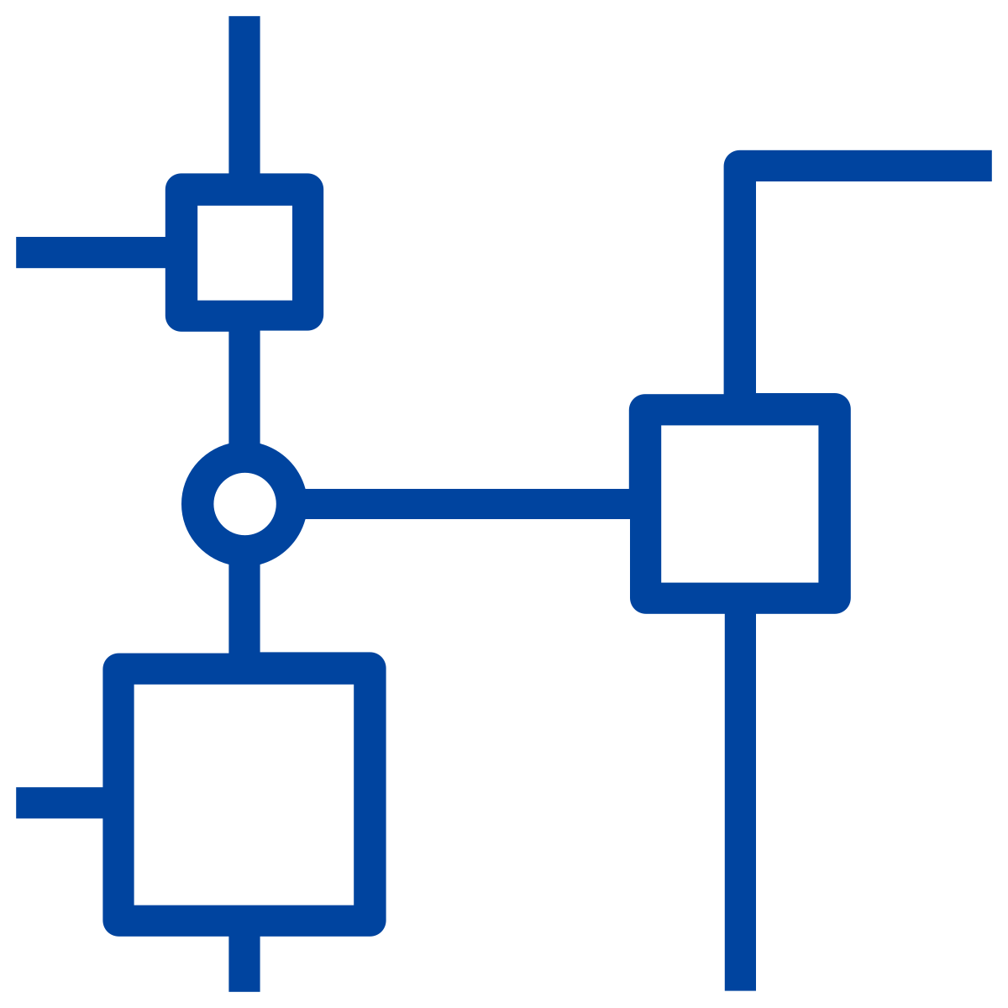
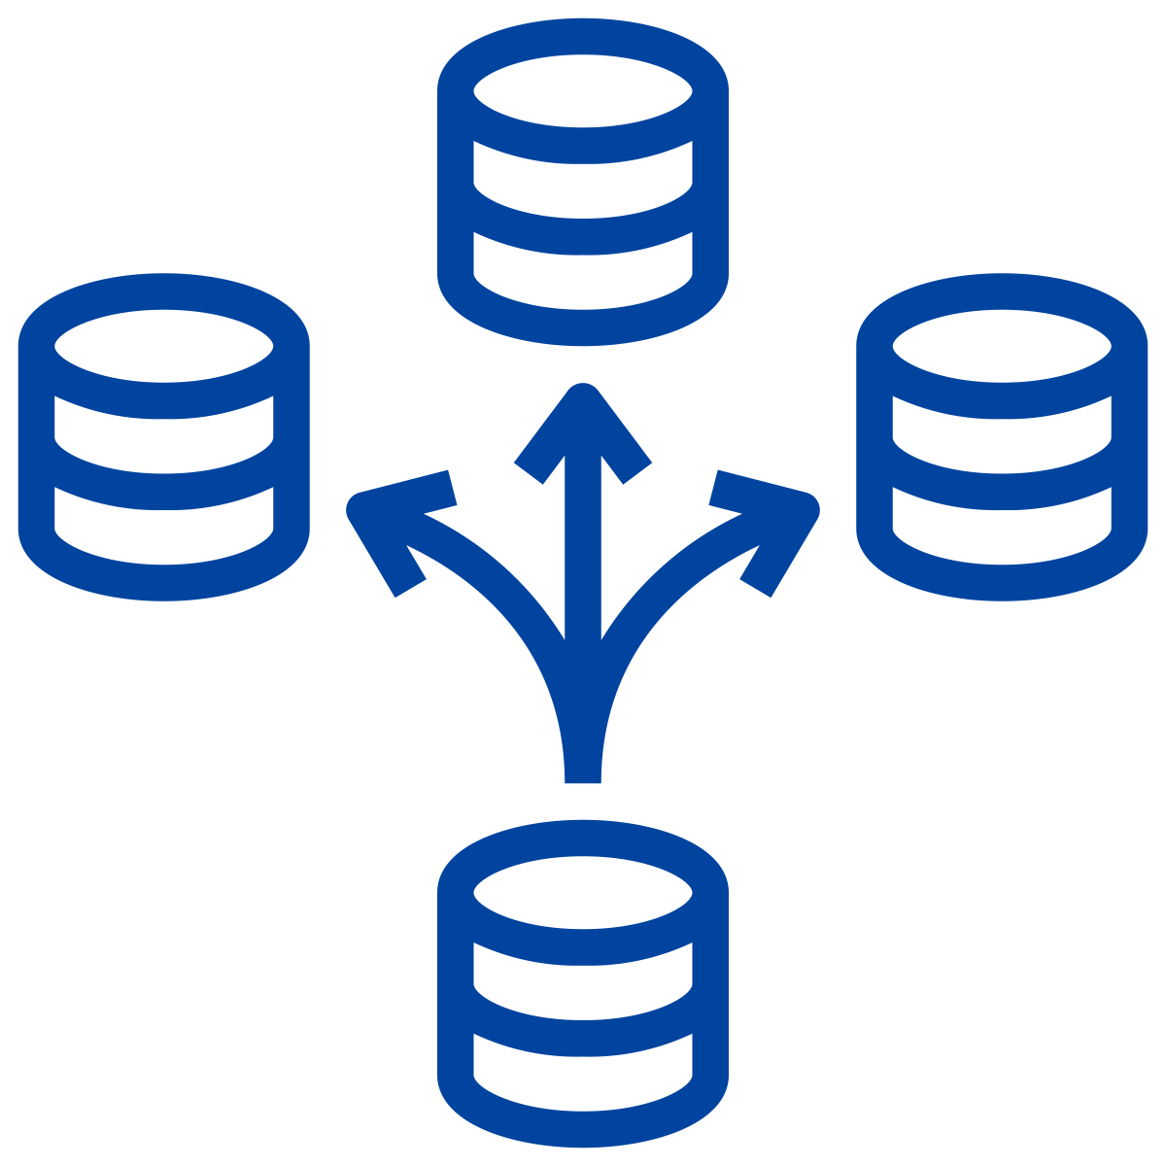


GAIN’s principles are lofty and pragmatic
Global
Interoperability
Technology
Agnostic
Open
Standards
Internet
Scale
“Build on what’s been built”
Notes:
reach is key success factor in identity
solving the identity challenge on a global level requires a global solution
building from scratch is very hard
leveraging local solutions into a global network is the pragmatic solution
We had technologists, lawyers, leaders in existing federated identity networks. SSI and thought leaders in decentralized identity. Wallet creators. Identity information providers. Verifiers and business leaders who see the value in the network.
We did not agree on everything – even the paper’s target audience. But we shared that vision for global interoperability and it’s potential to

Slide 52

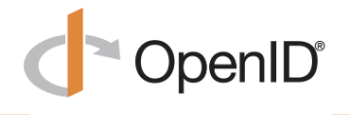
How to build the Global Assured Identity Network
Interoperability
Trusted Network
Trusted Network
Prove goodwill through collaboration
Prove governance is viable
Prove it is technically viable
Trusted Network
Notes:
So how do you deliver GAIN? How do you actually create networks of networks, and overcome this intractable problem of identity on the internet?
There a three key steps. (1) Prove it is technically viable (2) Prove governance is viable (3) Prove goodwill to get it done.

Slide 53
Goodwill: non-profit & community engagement
You’re Invited!
Standards for electronic signatures
Standards for legal entities LEIs & vLEIs
Cloud
Signature Consortium
Global Legal Entity Identifier Foundation
Institute of Internat’l Finance
Secure Identity Alliance / OSIA
Engagement of the Financial Services community
*Under Discussion* Standards for Government Foundational Layer Interoperability
GAIN
MOU
Rules and governance, Digital Trust frameworks
30 Participants
Open Identity Exchange
OpenID Foundation
Identity standards &
GAIN POC Community Group
30 Members & Non-Members Involved
Notes:
Five non-profits agreed to the GAIN vision and signed the MOU. That means the Board of Directors of each entity agreed the the GAIN vision and approach was a worthy investment of its organizations time. They are showing their Goodwill to support GAIN.
Open Identity Exchange…which is leading on the rules, governance and trust frameworks conversations
Institute of International Finance is engaging the financial community, which comprises 500 banks globally
Cloud Signature Consortium, leading on standards for electronic signatures.
Global Legal Entity Identifier Foundation, leading on legal entity identifiers
OpenID Foundation, leading in identity standards and hosting the GAIN technical proof of concept.
Together, these non-profits offer the “safe-spaces” for collaboration and helping realize the vision of GAIN. We are also in active conversations with other non-profits with a contribution to make. So maybe next time we’ll have even more colorful peacock feathers to add to our image, Nick.

Slide 54
OIDF and OIX groups complement each other
+ OIDF
openid4ida profile
+ OIDF
Network of Network
trust
+TOIP (?)
+ DIF (?)
Alpha POC
Connecting IDPs and RPs
Uses OIDC for Identity Assurance
Diverse architectures (including federated and SSI)
Multiple geographies
Minimal claims set
Identity assurance attestation
SSI protocols
+ CSC
Extended Attributes
Add 3rd Party Services
Additional Participants
More use cases
Richer identity schema
Extended claims set
Legal Entity linked identities
Mapping across Frameworks
Guide to Trust Framework
+GLEIF
+OIX
+OIX
Notes:
We see non-profits and standard-setting bodies continuing to guide the GAIN vision – though we invite others to participate

Slide 55
How to build the Global Assured Identity Network
Interoperability
Trusted Network
Trusted Network
Prove goodwill through collaboration
Prove governance is viable
Prove it is technically viable
Trusted Network
Notes:
So how do you deliver GAIN? How do you actually create networks of networks, and overcome this intractable problem of identity on the internet?
There a three key steps. (1) Prove it is technically viable (2) Prove governance is viable (3) Prove goodwill to get it done.

Slide 56
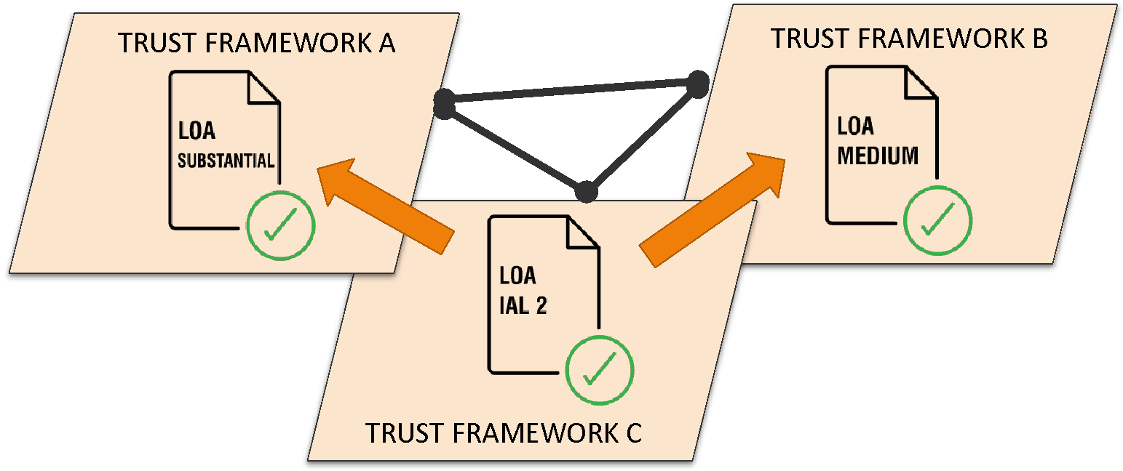
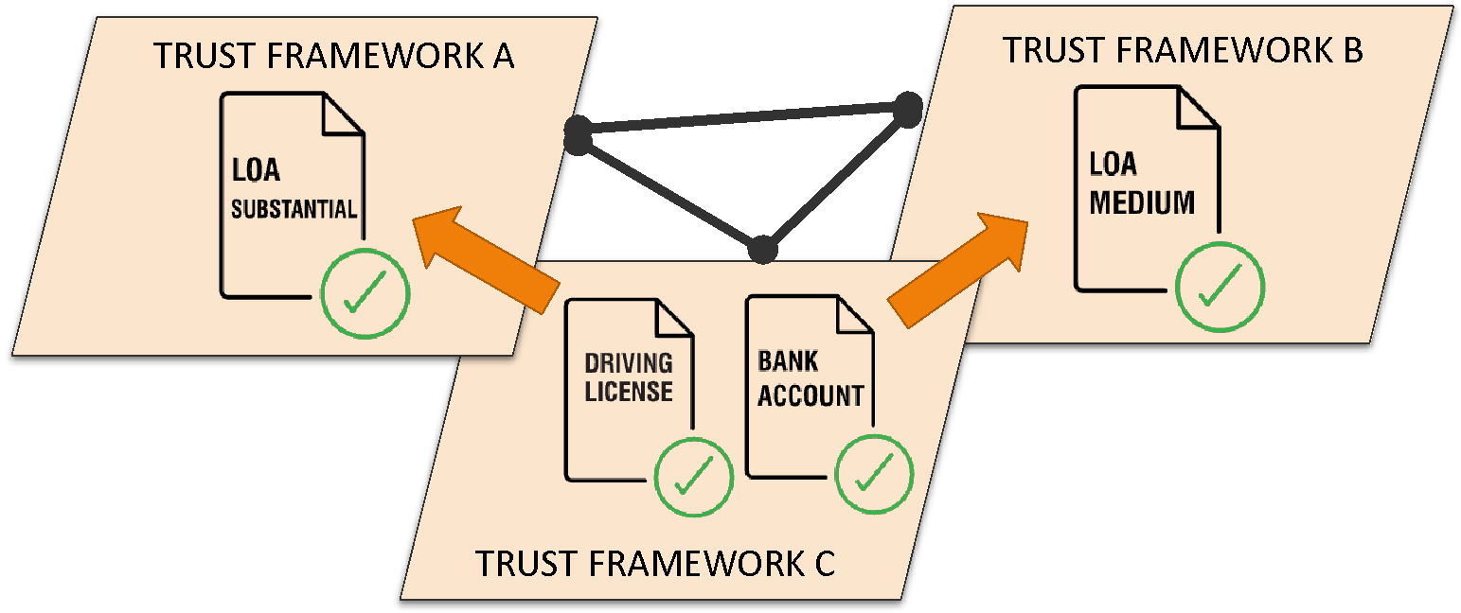
Prove Governance is viable
Are Levels of Assurance the “Currency of Identity”?
Or must we trade at the Digitized Credential level?
Notes:
Communication of Identity Trust from framework to framework. What is the ‘currency of identity’ when this happens? Levels of Assurance, that are defined differently by each framework? Or is it perhaps the proofs, or credentials, that underlie those levels of assurance: passports, bank accounts, driving licences. Here, Bank IDs are a key credential, as they all have a global “financial grade” level of assurance due to AML regulation.
56

Slide 57
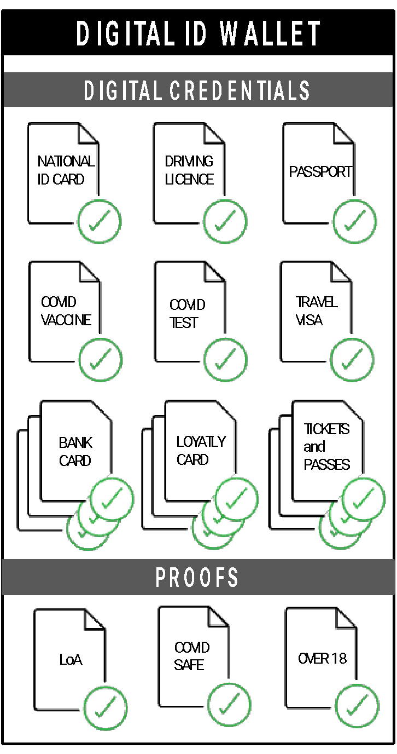
Interoperability models under exploration
TRUST FRAMEWORK A
TRUST FRAMEWORK A
TRUST FRAMEWORK C
TRUST FRAMEWORK B
TRUST FRAMEWORK B
TRUST FRAMEWORK D
We accept each others IDs
To support all of these models, we need a
Policy Characteristics Model
We all accept each others IDs
TRUST FRAMEWORK A
TRUST FRAMEWORK C
TRUST FRAMEWORK A
TRUST FRAMEWORK C
INTEROPERABILITY FRAMEWORK
TRUST FRAMEWORK B
TRUST FRAMEWORK D
We all accept each others IDs because they are benchmarked to an Interoperability Framework
TRUST FRAMEWORK B
TRUST FRAMEWORK D
My wallet meets the rules for different trust frameworks

Slide 58
Policy Model
FRAMEWORK POLICY CHARACTERISTICS MODEL
CREDENTIALS
ID ASSURANCE
FRAUD
DATA MANAGEMENT
LIABILITY
DATA SCHEMA
Etc.
Trusted Network
Trusted Network
METADATA
Interoperability
Trusted Network

Slide 59





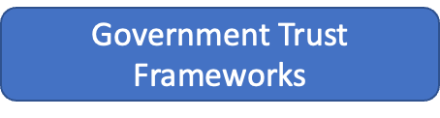

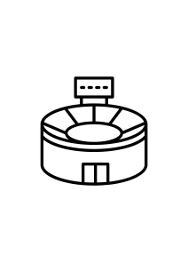
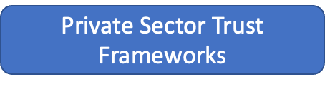





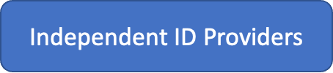
Who will achieve interoperability?
Notes:
Who is gain trying to help? Well, end users obviously. But also Identity providers of all kinds, whether part of a trust framework or not. Along this those who benefit from instant trust in a user: relying parties from all sectors. If you are either of these - join us to make this a reality.
59

Slide 60
How to build the Global Assured Identity Network
Interoperability
Trusted Network
Trusted Network
Prove goodwill through collaboration
Prove governance is viable
Prove it is technically viable
Trusted Network
Notes:
So how do you deliver GAIN? How do you actually create networks of networks, and overcome this intractable problem of identity on the internet?
There a three key steps. (1) Prove it is technically viable (2) Prove governance is viable (3) Prove goodwill to get it done.

Slide 61

OIDF GAIN POC - proving technical viability
POC Goals
Participants know how to implement in a live environment.
Participants want to take it to the next level.
GAIN can be built on existing networks
Cross jurisdiction interoperability
5 Hypotheses
Different architectures
Variety of APIs
Relying Party access
Notes:
The GAIN POC Community Group has already demonstrated that GAIN is technically viable. Their ultimate goal is to ensure participants know how to technically implement in a live environment, and are collectively motivated by the end to take it into production.
The POC is proving out 5 hypotheses. That GAIN can be built on existing networks, and to date, four different identity services have already been proven to interoperate. We imagine there may be thousands of networks in the future, but proving 4 can interoperate is already a huge step as you know.
Second, we wanted to prove cross jurisdiction interoperability, and we have indeed proven this across multiple jurisdictions aided by conformance tests for OpenID for Identity Assurance.
Third, in just the first 4 implementations we proved this works for a SSI based solution, distributed identity solution, and a centralized solution.
We have also made progress on proving out interoperability for a variety of APIs and Relying Parties, but we have more work to do this year to prove this out. We want to to scale trusts management by validating the parties participating and building out the discovery mechanism across all parties, and working on the interoperability with W3C DIF, ToIP, GLEIF and CSC.
Ultimately, we will also need to overlay operational considerations like how to enable single, simple contracts for relying parties.
GAIN can be built on top of existing networks and solutions
IIPs from different jurisdictions can input to GAIN
The network can support different IIP architectural approaches (federated, SSI, etc.) and different interoperable interfaces to RPs (OIDC, DIDCom, WACI, etc.)
IIPs can offer a variety of APIs – built to serve different purposes – into the network
RPs can access assured identity data from IIPs in a simple and trusted approach (single contract, single credential and a single technical specification)

Slide 62
H1: GAIN can be built on top of existing networks H2: Cross border participation
Data Plane: OpenID Connect 4 Identity Assurance Profile used to demo interoperable x-network exchange of identity data
4 IDPs and 2 RPs successfully demoed
1 RP extended the POC to deliver CSC standard signing
Integration of the following existing solutions:
BankID Sweden (SWE)
Dizme (IT)
German Banks (DE)
Planned:
mojeID (CZ)
SecureKey (CA)
KDDI
Authlete
Criipto
Meeco
Hello
FranceConnect
MOSIP
Relevant Specifications
This list is non-exhaustive and under development with the Community Group.
OpenID Connect Core
OpenID Connect for Identity Assurance 1.0. – 3rd Implementer’s Draft
Financial Grade API

Slide 63


Hypothesis 3: Different IIP approaches
OpenID Connect 4 Identity Assurance
BankID Sweden
one service for all bank customers
Relying Parties
Relying Parties
Relying Parties
large scale federation
German Banks
Credential to Claims
transformation
SSI Wallet
Dizme

Slide 64
Hypothesis 4 IIPs can offer a variety of APIs
Several extensions are being discussed in the group
Identity
(Implemented) OpenID Connect 4 Identity Assurance
SSI-specific:
OpenID Connect 4 SSI (?)
DIDComm (?)
Account Information & Payments
Electronic Signing
Actively seeking participants to explore these protocols within GAIN

Slide 65
Hypothesis 5 Simple RP Integration
Vision: “Register Once, become a client to all the IDPs”.
Trusted RP management to allow RP to access all IDPs with single credential
Trusted IDP management to allow RPs to find and select suitable IDPs
Approach
Collection of Requirements
Survey of design choices (DNS-based, OpenID Connect Federation, EU Trusted List, …)
Selection and setup of test network
Assumption: there can be multiple GAIN-based networks, such networks might be federated
Testing this now!

Slide 66
Hypothesis 5 Simple RP Integration
Use cases to evaluate hypothesis
Electronic Signing
Identification of Domain Registrants
Provisioning of SSI Credentials
Remote Staff Onboarding
Students Identification
User Account verification (e.g. Twitter)
Account Recovery
Age verification

Slide 67

Next 6 Months: Network-of-Networks
Trusted Network
Trusted Network
Digital ID Exchange:
The Data Plane
RP
IDP
OpenID 4 IDA
Discovery and trust:
The Control Plane
OpenID Federation
Current Focus
Trusted Network
The <untrusted> Internet

Slide 68
Network of networks - trust management principles
How does IDP in Network A trust RP from network B?
Minimize central infrastructure and governance, no central point of failure or control. No central decision making on what's allowed and what's not, no scheme can decide on behalf of the other scheme.
Minimize the effort for participants, minimally invasive structure
Encapsulate "local" in the local scheme (delegate translation to RPs vs schemes?). Could be a shared or entity service, an SDK or another solution. Compliance with local regulation is the scheme responsibility.
Autonomy of local networks is preserved.
Participant on-boarding, vetting and integration is to be done at a local scheme level (by scheme operator).
Trusted Network
Trusted Network
Trusted Network

Slide 69
GAIN POC Community Group (Status & Timeline)
Started Alpha PoC
Establish OIDF community group
Agree on goals and hypothesis to test
Demonstrate end2end scenarios in sandbox (federated and SSI)
Q3/2021
Q4/2021
Q1 2022
Q4 2022
Q1 2023
Successful conformance tests of the first group of IDPs
Connect Networks via standardized APIs and network functions

Slide 70
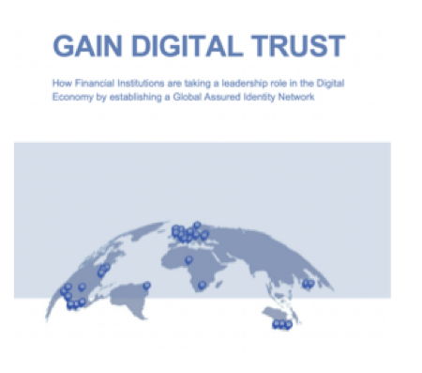
GAIN Paper: One Year On
Learning has continued since Sept 2021 and the market continues to shift
Relevant regulatory movements, e.g. continued evolution of eIDAS 2.0
Developments in gov-issued ID, e.g. ISO 18013-5 (mobile drivers’ licenses)
W3C recommendation on Decentralized Identifiers (DIDs)
Technical development & broader use of VCs - including GLEIF’s vLEI pilots using KERI
Two GAIN-specific working groups have refined the approach
OIDF’s GAIN Community group (Technical POC) focused on Network-of-Network protocols
OIX GAIN Working group focused on framework-framework interop
We are drafting a paper that includes the current thinking of those people and orgs now progressing the GAIN vision
Targeting a broader audience for interoperability (though still encouraging FI participation)
The current thinking & recommendations of the OIX and OIDF working groups
Defining GAIN as it relates to verifiable credentials and SSI

Slide 71

Open Wallet Foundation
Torsten Lodderstedt | CTO | yes.com
Juliana Cafik | Principal Standards Architect | Microsoft

Slide 72
Open Wallet Foundation
Introduction to the OWF;
OWF Umbrella Project Structure;
Proposed Requirements;
Shared Code Across Platforms;
OWF Project Lifecycle;
Foundations for Interoperability;
Associate Members;
Points of Discussion

Slide 73
Introduction to the OWF
The purpose of the Open Wallet Foundation is to support various open source, open data and/or other projects relating to, or supporting the development of, interoperable digital wallets, including infrastructure and support initiatives.
The concept behind the OWF is to create an open-source community that works together to blend different skill sets to build fundamental, standards-based technologies for multipurpose wallets.
Currently there are over 300 entities expressing interest in joining.

Slide 74
Umbrella Project Structure
Do-ocracy: Fundamental proposal for the OWF to do the projects that members are willing to contribute the resources necessary to complete a project;
Self-Organization: members self-organize “Code Projects” and associated working groups (where necessary) to propose a Code Project;
Members have expressed interest already to contribute resources for these initial building blocks/credential types (based on the EUDI wallet as reference point) - OWF Use Case Interest - Google Sheets:
Payment Tokenisation (EMV Payment Tokenisation Specification)
ISO mDL (ISO/IEC 18013-5:2021 - Mobile Driving Licence (mDL))
W3C Verifiable Credentials (W3C Verifiable Credentials Data Model v1.1)
Anonymous Credentials (AnonCreds Specification v1.0 Draft)
Code Project proposals will be required to follow (to be agreed) principles/requirements (e.g. security, privacy, interoperability), detail the requirements, the standards on which they are based, and what functions they plan to share with other projects
Code Projects will go through a defined lifecycle.

Slide 75
Proposed Requirements
REQ 1: Provision building blocks for multi-purpose wallets. Note: The current building blocks represent multiple purposes;
REQ 2: Enable access those building blocks with a single login and through a consistent UX;
REQ 3: Present different credentials from different building blocks in the course of the same transaction;
Assumption: REQ 1-3 lead to the following shared functions (common core):
- shared key management allowing to unlock the keys with for all credentials for a single login
- shared credential management allowing to unlock/decrypt the credentials with a single login
- shared protocol building blocks utilizing available credential building blocks to present credentials

Slide 76
Shared Code Across Platforms?
Do the proposed requirements necessitate that shared building blocks are shared across platforms (like iOS or Android or Cloud)?
Assumption: sharing required in wallet on a certain platform, not across platforms, as a certain user’s wallet will run on a certain platform and not several of them;
Decisions will be dependent on source code contributions;
The OWF provides an opportunity to join forces and share cost to make building wallets with a competitive user experience and access to platform services more affordable.
Shared Code
+ Cost efficient
New programming language?
Stability?
Platform abstractions required?
Potential upfront investment
Platform Native Code
+ Use of platform native programming languages (e.g. Swift / iOS & Kotlin / Android)
+ Use of platform capabilities
(e.g secure enclave, key chain & NFC)

Slide 77
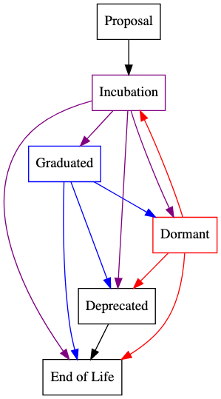
Umbrella Project Lifecycle
LF umbrella projects by definition are collaborations among multiple individual projects, some of them have developed processes (and in some cases tools) to facilitate this. For example, the Hyperledger Foundation’s Project Lifecycle process defines six stages in the completely lifecycle of a project as summarized in the diagram;
It is proposed that a similar six-stage process for OWF projects be defined, and in particular that we establish the combination of maturity, interoperability, security, privacy, and other requirements that a component project must meet to “graduate” and become part of the Open Wallet distribution.

Slide 78
Foundations for Interoperability
To support different member-proposed standard credential types the OWF must develop a common core that lays the foundation for interoperability and inclusivity;
To achieve whole product interoperability — the level required for OWF-based wallets to be accepted by governments and regulatory regimes around the world is high and will require the common core to solve for interop at four different layers:
Legal: Governance for the interoperability of credentials, systems and the management of identity and access rights across multiple applications and services to meet regulatory and security requirements;
Business: Alignment of business processes, responsibilities and expectations to achieve commonly agreed and mutually beneficial goals;
Semantic and syntactic: The ability of two or more systems to exchange data even if the interface and programming languages are different;
Protocol / Technical: The ability of different systems devices, applications or products to connect and communicate in a coordinated way without effort from the end user.

Slide 79
Associate Members
The experience and expertise of Non-Profit organizations can help guide the Open Wallet Foundation and can increase the opportunities for industry and Governments;
As Associate Members, they can participate in many areas including, but not limited to:
Trust Framework Awareness, Education and Adoption;
International Alignment and Cross Sector Interoperability;
Legal and Regulatory Compliance;
Technical Standards Conformance.

Slide 80
Points of Discussion
The Primary objective of the OWF is to produce code, and it must be high-quality, secure, privacy-preserving and standards-based;
The OWF is built on a group of interdisciplinary people who self-organize and collaborate to build code;
To move forward the OWF needs Code Projects with code contributions, resources, stated objectives and requirements.

Slide 81
OpenID Connect Working Group Update
Michael B. Jones - Identity Standards Architect at Microsoft

Slide 82
Working Group Updates Since Last Workshop – May 2022
The Logout specs are now Final
https://openid.net/2022/09/12/the-openid-connect-logout-specifications-are-now-final-specifications/
unmet_authentication_requirements becoming Final
Vote now at https://openid.net/foundation/members/polls/291!
prompt=create becoming Final
Vote tomorrow at https://openid.net/foundation/members/polls/296
Native SSO for Mobile Apps becoming Implementer’s Draft
Vote opens next week

Slide 83
Working Group Updates Since Last Workshop – May 2022
Continued progress on OpenID for Verifiable Credentials specs
VC Issuance and Presentation specs now based on OAuth 2.0
Working steadily towards Implementer’s Drafts
We created a page dedicated to the OpenID4VC specs
https://openid.net/openid4vc/
Continued progress on OpenID Connect Federation spec
In production deployment by Italian Government
Another round of interop testing being planned
We appreciate the great reviews that have come in
Incrementally working towards Final status

Slide 84
Working Group Updates Since Last Workshop – May 2022
Submitted ISO/IEC JTC 1 PAS Submitter Application
Will create ISO equivalents of Final OpenID Connect specs
Will enable governments to use OpenID Connect in procurements
Continued progress on Errata updates
Addressed 10 errata issues in the last few weeks
Another 22 to go
Errata updates need to be completed as input to PAS submission

Slide 85
Possible Topics at IIW This Week
Automatic Registration
The ability for a client to dynamically provide information about itself to the AS/OP, rather than performing pre-registration
OAuth WG attendees were receptive to idea at IETF last week
Working OpenID4VC PRs and Issues
Possibly decide which are critical to reach Implementer’s Drafts
Working OpenID Federation PRs and Issues
Currently 2 PRs and 11 open issues

Slide 86
Next Calls
Today’s Connect WG call cancelled in favor of this workshop
Do we want to hold Thursday’s calls?
7am European-friendly OpenID Connect WG call
8am SIOP Special Topic call

Slide 87
FAPI Working Group Update
Nat Sakimura, Co-chair, FAPI WG

Slide 88
Working Group Updates Since Last Workshop – May 2022
Since May, the WG has been preoccupied with finishing the formal security analysis and applying the learning from it to the specs. It is NOW COMPLETE as of the last week.
FAPI 2.0 Status on Formal security verification
Work Package (1) – Imminent Publication
FAPI 2.0 Security Profile & Attacker Model
Co-funded by Australian Data Standards Body (DSB) & OIDF
Performed by U. Stuttgart
Brazil: Re-certification started
SAMA: Adoption of FAPI 1 with transition plans to FAPI 2
Japan: Minna Bank announced the availability of FAPI API to MoneyForward
Pertinent issues fixed and was sent to the 2nd Implementer’s draft.
Expected to be final in 2023 spring.

Slide 89
Working Group Issues to be Addressed
Work Package (2) – Imminent Contract
FAPI 2.0 Message Signing, FAPI –Client Initiated Backchannel Authentication, Dynamic Client Registration
To be funded by Australian DSB
Work Package (3)
FAPI Grant Management, Security Event Token, SSE, OIDC for Identity Assurance
Co-funding welcome
FAPI 2 SP: Certification: 7
Grant Management: 5
Implementation & Deployment Advice: 13
FAPI – CIBA: 6
HTTP Signing: 2
Errata for FAPI 1
FAPI 1 AP: 11
FAPI 1 BL: 4
Others: 14

Slide 90

New shiny tools in FAPI 2
Pushed Authorization Requests (PAR) Replace bespoke solutions like external resources with references in scope/claims, custom authorization request parameters, … → Simplified development through vendor support (expected) → Minimize data in front-channel to improve security
Rich Authorization Requests (RAR) Enables fine-grained and complex consents.
Grant Management API Enables support for 1) consent state synchronization 2)consent revocation 3) concurrent consents 4) dashboards
OAuth Security Best Current Practice RFC Latest OAuth security recommendations.
Notes:
New tools in FAPI 2
Pushed Authorization request (PAR) RFC 9126 - enables resources references in scope/claims & Custom authorization request parameters
Rich Authorization Request - Enables fine-grained & Complex consents
Grant Management - enables state synchronization , life cycle management along with dashboard.
Best Security practices from OAUTH security recommendation

Slide 91
Could Global Open Data be next?
Private API ecosystems
Cross industry ecosystems
Open banking ecosystems (classic)
Cross jurisdiction ecosystems
Notes:
So what next in Open Data? - Cross Jurisdiction ecosystem ( GAIN and GAIN2 - POC)
Global Assured Identity Network

Slide 92

Working Group Opportunities

Slide 93
Potential use cases
How can this be achieved?
Account information
Payment initiation
Payee confirmation
Identity
Re-use as much as possible
Global trust management?
New and simplified, limited functionality APIs?
No new payment rails?
Notes:
Potential use cases
Account information, Payment initiation, Payee confirmation and Identity
Standardizing data sets - Ex: Checking account in US vs Current account in Europe
Global trust management.
More work is happening here where OpenID is providing an forum for like minded folks to do POC

Slide 94
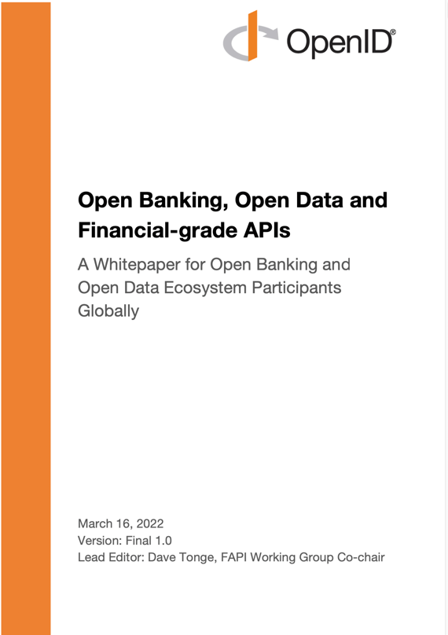
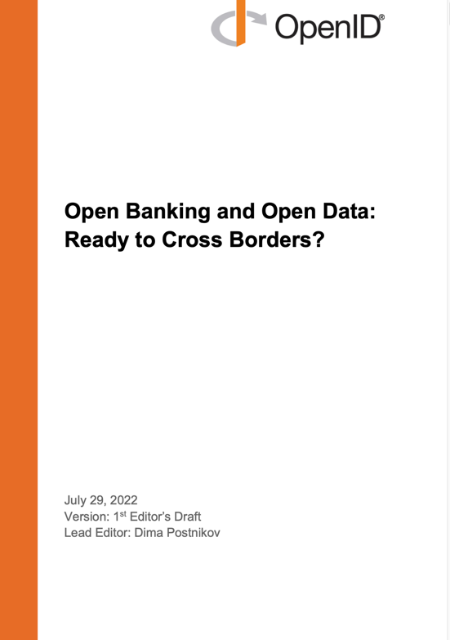
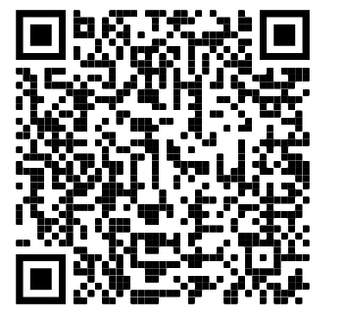
FAPI Whitepapers
Notes:
This concludes my presentation and More details are provided in these white paper … With that let me invite Gail to close.

Slide 95
eKYC & IDA Working Group Update
Dr. Torsten Lodderstedt, yes.com

Slide 96
Working Group Updates Since Last Workshop – May 2022
Heavy focus on getting OpenID Connect for Identity Assurance draft to Final
Almost exclusively editorial improvements
Implementers’ draft 4 review was successful

Slide 97
Working Group Issues to be Addressed
Get “OIDC4IDA” through final review
How to support “Pending verification” case – will be dealt with after OIDC4IDA ‘Final’
Solve problems in the “Advanced Syntax for Claims” draft with Selective Abort and Omit
Add use cases and specific examples to “OpenID Connect for Authority Draft”

Slide 98
Working Group Opportunities
ASC and OIDC4Authority put forward as useful for OECD work on “Digital Safety by Design for Children”
Potential Implementers guide on implementing OIDC4IDA in conjunction with SSE Framework
Support implementers of OIDC4IDA Final

Slide 99
What the WG Hopes to Accomplish at IIW This Week
Let everyone know that we are almost finished with OIDC4IDA and that there will be no more normative changes
Communicate our next focus areas
Advanced Syntax for Claims draft to Implementers Draft
OpenID Connect for Authority draft to Implementers Draft
Solve “Pending Verification” case

Slide 100
Shared Signals and Events Working Group Update
Tim Cappalli - Microsoft

Slide 101

Working Group Updates Since Last Workshop – May 2022
Name Changes
SSE >> SSF
Shared Signals and Events WG (SSE WG) >> Shared Signals Framework WG (SSF WG)
Shared Signals and Events Framework Specification >> Shared Signals Framework Specification

Slide 102

Working Group Updates Since Last Workshop – May 2022
Participation
Uberether
Workday
Strata Identity
Easy Dynamics
Appgate

Slide 103
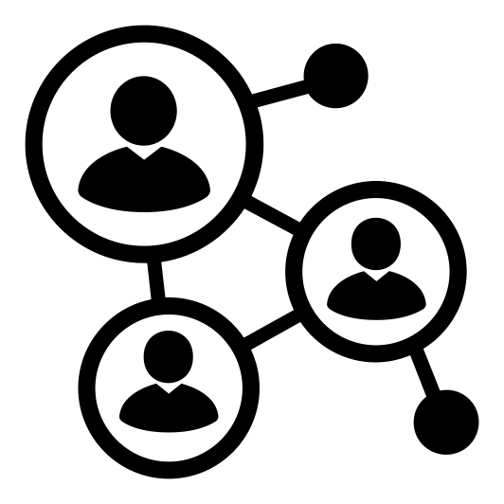
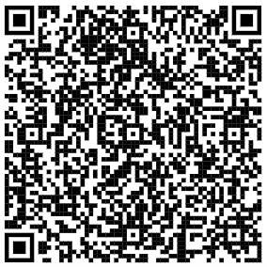
Working Group Updates Since Last Workshop – May 2022
Industry Work
Identity Defined Security Alliance Webinar
MITRE Workshop
CISA Engagements

Slide 104
Working Group Updates Since Last Workshop – May 2022
Participation
Uberether
Workday
Strata Identity
Easy Dynamics
Appgate

Slide 105
Working Group Issues to be Addressed
Registries
Stream IDs
Adoption

Slide 106
Working Group Opportunities
Collaboration with SCIM WG
Continued collaboration with CISA on Zero Trust
Reference implementations
Developer resources
Large SaaS vendor evangelization

Slide 107
MODRNA Working Group Update
Bjorn Hjelm – Verizon Wireless, OIDF Vice-Chairman and MODRNA WG Co-chair

Slide 108
Purpose
Support GSMA technical development of Mobile Connect and similar industry and standards development.
Enable Mobile Network Operators (MNOs) to become Identity Providers.
Developing (1) a profile of and (2) an extension to OpenID Connect for use by MNOs providing identity services.

Slide 109













Participants and Contributors

Slide 110
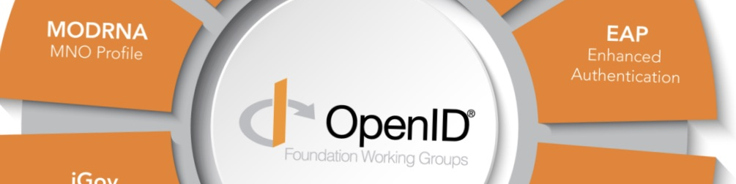
Working Group Status
Continuing to work on advancing working group drafts to Implementer’s Draft status and support discussions across working groups (such as CIBA use cases).
Active engagement in outreach activities and serve as a forum for MNO engagement in the identity services ecosystem.
Specification Status
Final Publication status:
CIBA Core
Implementer’s Draft status.
Authentication Profile
Account Porting
User Questioning API
Working Drafts status:
MODRNA CIBA Profile
Discovery Profile
Registration Profile

Slide 111

MODRNA WG Collaborations and Outreach

Slide 112

Evolution of Mobile Connect architecture, functionality and identity services.
RCS (Rich Communications Services) services and MaaP support for OpenID Connect.
Configuration of device-based services with embedded SIM (ODSA, C-V2X) leveraging OpenID Connect.

Slide 113

3GPP Mission Critical Services
3GPP (Third Generation Partnership Project) Mission Critical (MC) services support PSA (Public Safety Agencies) and other critical communications.
Identity management is part of MC system security architecture and OpenID Connect MCX Profile defined for user authentication.
Development of SEAL (Service Enabler Architecture Layer) to support vertical applications (such as V2X) services is based on MC architecture.
Identity management is a common capability supporting mission critical and other vertical applications.

Slide 114

European Telecommunications Standards Institute (ETSI)
ETSI supports the development and testing of global technical standards for ICT-enabled systems, applications and services.
Structure includes Technical Committees and industry specification groups.
Member of 3GPP and OneM2M partnerships.
Technical work covering multiple areas of digital communications and infrastructure.
Liaison agreement with ETSI completed initial focus on ETSI TC ESI (Electronic Signatures and Infrastructure).

Slide 115
OpenID 4 Verifiable Credentials Update
Kristina Yasuda, Microsoft
Dr. Torsten Lodderstedt, yes.com

Slide 116
What is it?
Issuer
(Website)
Holder
(Digital Wallet)
Can be hosted locally on the user’s device, have cloud components, or be entirely hosted in the cloud
Verifier
(Website)
Issue Credentials
Present
Credentials
OpenID for Verifiable Credential Issuance (Issuance of verifiable credentials)
OpenID for Verifiable Presentations (Presentation of verifiable credentials)
Self-Issued OP v2 (authentication using identifiers not namespaced to a third-party identity provider)

Slide 117
Working Group Updates Since Last Workshop – May 2022
Renamed from “OpenID Connect 4 SSI” to “OpenID 4 Verifiable Credentials”
Positioning it as “new kind of OpenID”
Conducted comprehensive security threat analysis
Conformance Test (1st revision)

Slide 118
OpenID for Verifiable Credential Issuance
Pre-authorized code flow
Changed base protocol to OAuth 2.0
Improved Credential type identification (flexible yet format native)
Added issuer/credential metadata
Batch credential issuance
Enabled protocol for high level security credential issuance
{
"format": "jwt_vc_json",
"types": [
"VerifiableCredential",
"UniversityDegreeCredential"
],
"CredentialSubject": {
"given_name": {},
"last_name": {},
"degree": {}
}
...
}
{
"format": "mso_mdoc",
"doctype": "org.iso.18013.5.1.mDL",
"claims": {
"org.iso.18013.5.1": {
"given_name": {},
"last_name": {},
"birth_date": {}
}
},
"...
}

Slide 119
OpenID 4 Verifiable Presentations
Changed base protocol to OAuth 2.0
Replaced “claims” parameter by following options:
scope (definition left to spec or deployment)
presentation definition (by value or by reference)
Started to move SIOP v2 pieces to make OpenID4VPs self-contained
cross device flow
client metadata

Slide 120




Other standards bodies & government activities
Incorporated OpenID4VCs into ISO drafts (18013-7/mDL & 23220-3&4/eID)
The European Blockchain Services Infrastructure (EBSI) adopted OpenID4VCs
EU eIDAS v2
Presented to EU eIDAS expert group
OpenID4VCs was added to short list
Established liaison with ETSi

Slide 121
Implementers
Finnish ID, CA DMV, Microsoft, Mattr, IDunion, walt.id & yes.com & BCDiploma (eSSIF-Lab), Talao.io, Workday, Ping Identity, Trinsic/Dentity (incl. Auth0 plugin), Convergence.Tech, Sphereon, Gimly, CAS Software AG, Verimi/Deutsche Telekom, …

Slide 122
Working Group Issues to be Addressed
More implementers feedback (preparing IDs for all spec)
Overall trust model and security considerations draft
Issuance: issuer metadata path & file content, issuer identification by DID, anonymous & externally managed clients
Presentation: offline support (BLE), enhance cross device flow (redirect)
Conformance Testing

Slide 123
Working Group Opportunities
ISO adoption
Adoption by EU for eIDAS
Implementation in OWF context

Slide 124
What the WG Hopes to Accomplish at IIW This Week
Gathering implementers feedback
Education on progress and feature set of OpenID 4 VCs

Slide 125
Joint us, Learn More: Openid.net
Contact us: director@oidf.org
Thank you.

