Slide 1
CURRO HOLDINGS LTD
2012 Results
26 February 2013

Slide 2

CURRO PRESENTS….
80 @ 20

Slide 3
MARKET POTENTIAL
Predominant private school market
Other potential private school market

Slide 4
SOUTH AFRICAN SCHOOL STATISTICS
 | 2006 | 2012/13 | CAGR | 2020 | CAGR
Nr of learners (‘000)
Curro | 910 | 20 840 | 68% | 80 000 | 17%
% of total | 0.01% | 0.17% |  | 0.8%
Public ('000) | 11 942 | 11 924 | 0%
Private ('000) | 352 | 504 | 6%
% of total | 2.9% | 4.1%
 | 12,294 | 12,428
Significant increase in private schools confirms the market potential.
+- 30 000 government schools of which +- 5 000 former Model C

Slide 5
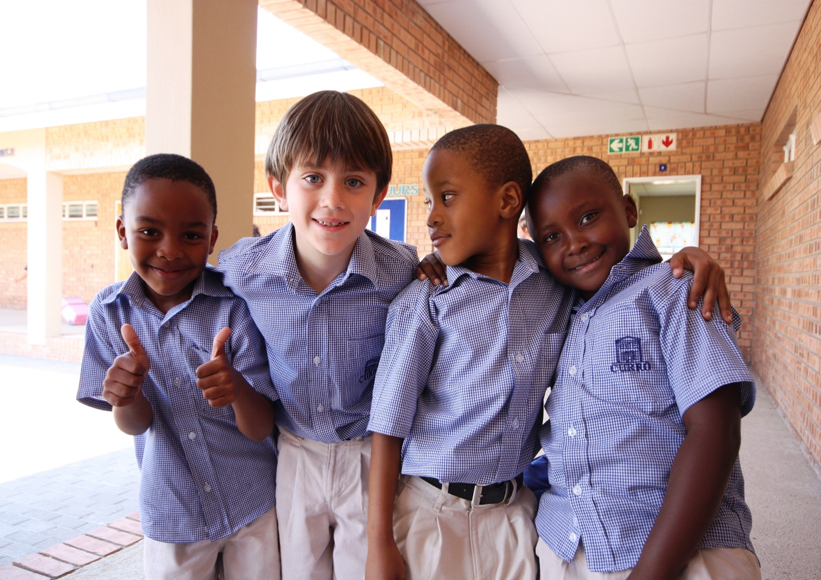
CURRO
provides private school education
From 3 months to grade 12

Slide 6
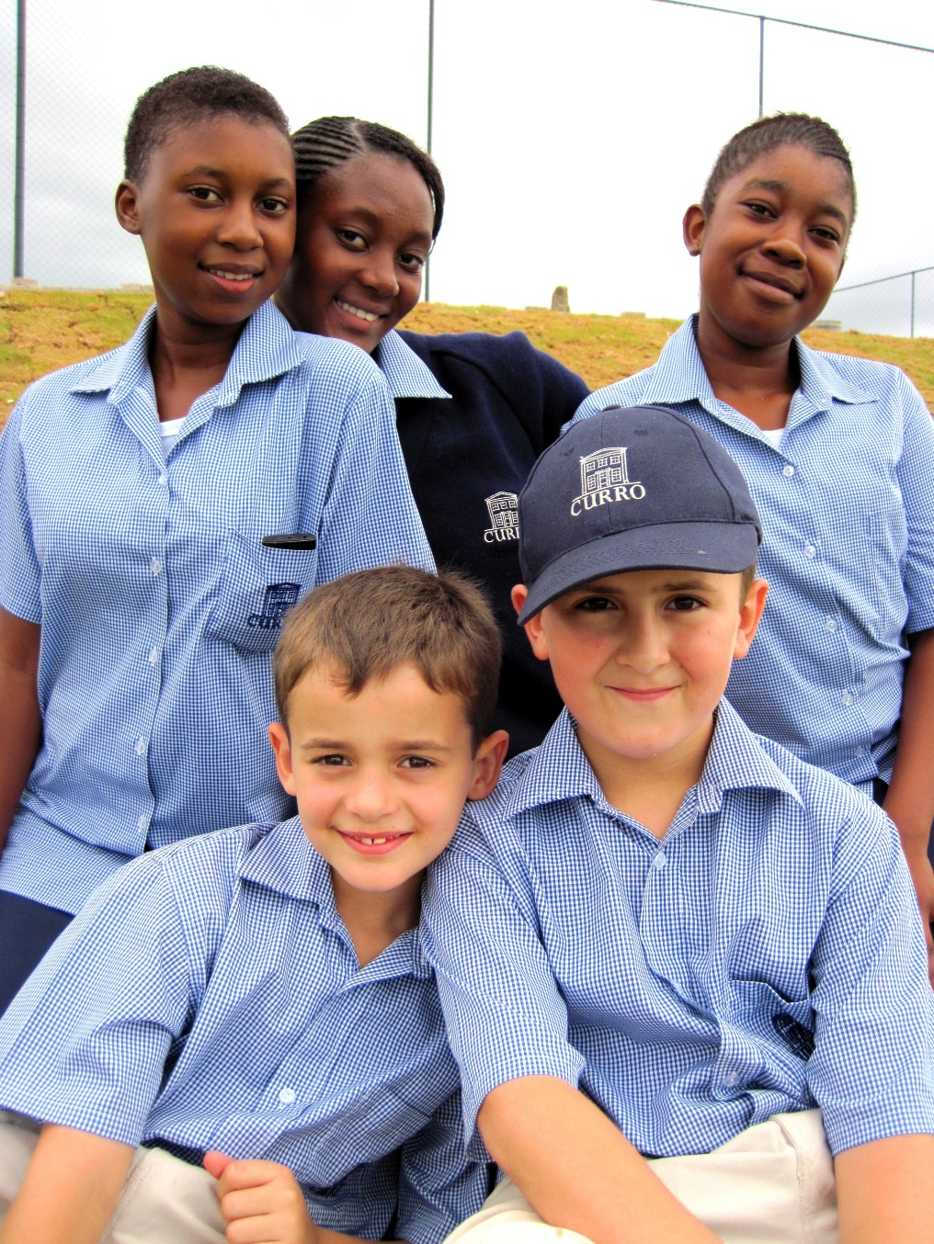
SUPPORT SERVICES
Aftercare
Bus services
Clothing and attire
Teacher training

Slide 8
LEARNERS PER GRADE
Excludes Northern Academy

Slide 9





OUR BRANDS
 | R2500 – R4000 pm | Max 25 learners Academic, sport , culture Sufficient variety
 | R4500 – R6000 pm | Established campus Convenience Location Wide variety
 | R900 – R1500 pm | 35 – 70 per class Academic focus Support by class assistants Some extra mural
 | R2000 – R2500 pm | Full day care Convenience and safety Cognitive development programs
SELECT SCHOOLS
CURRO CASTLE

Slide 10
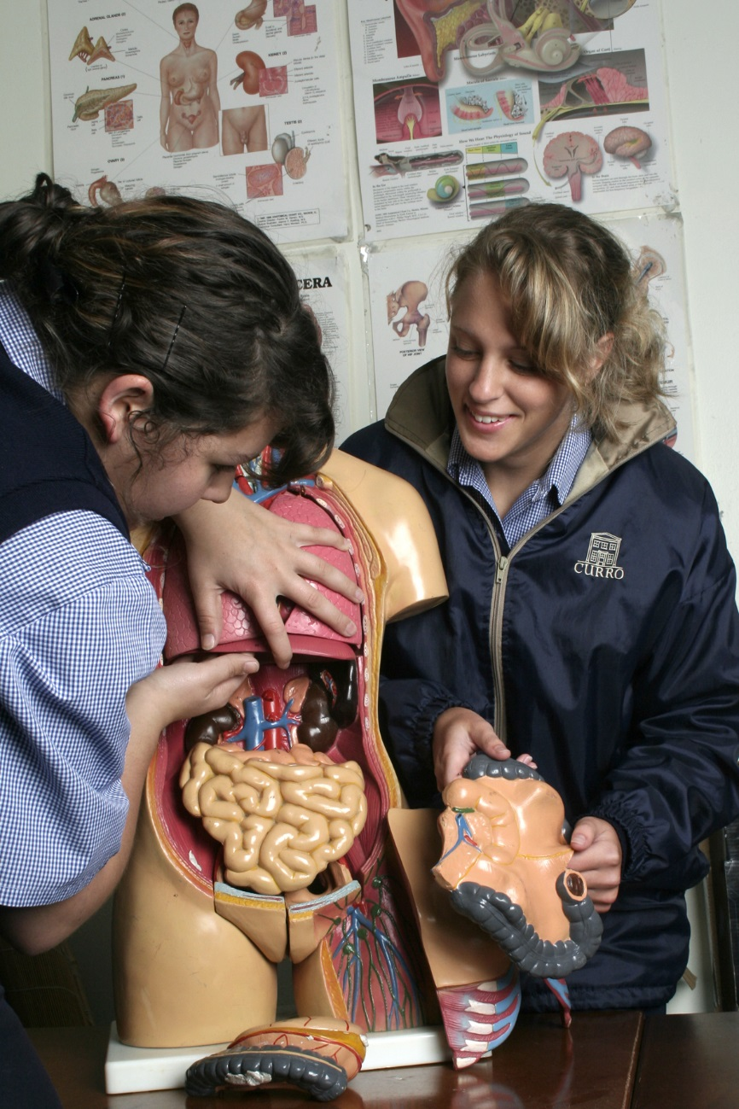
2012 ACADEMIC RESULTS AND QA
Select and Curro brands
358 candidates
99.4% pass rate
81% university exemption
Northern academy
346 candidates
99.4% pass rate
73% university exemption
Meridian
180 candidates
77% pass rate
14% university exemption
Government
72% pass rate
26% university exemption

Slide 11
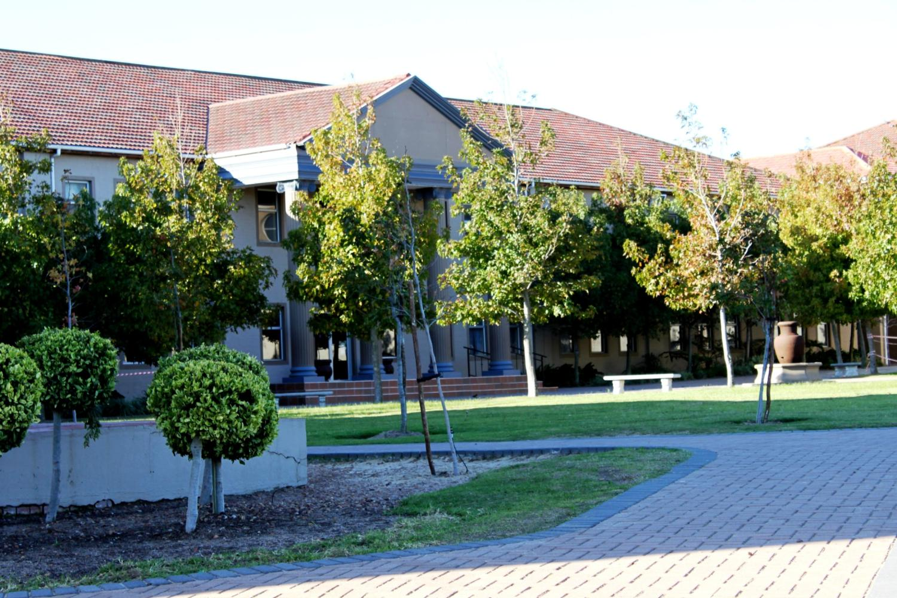
DURBANVILLE (WESTERN CAPE)

Slide 12
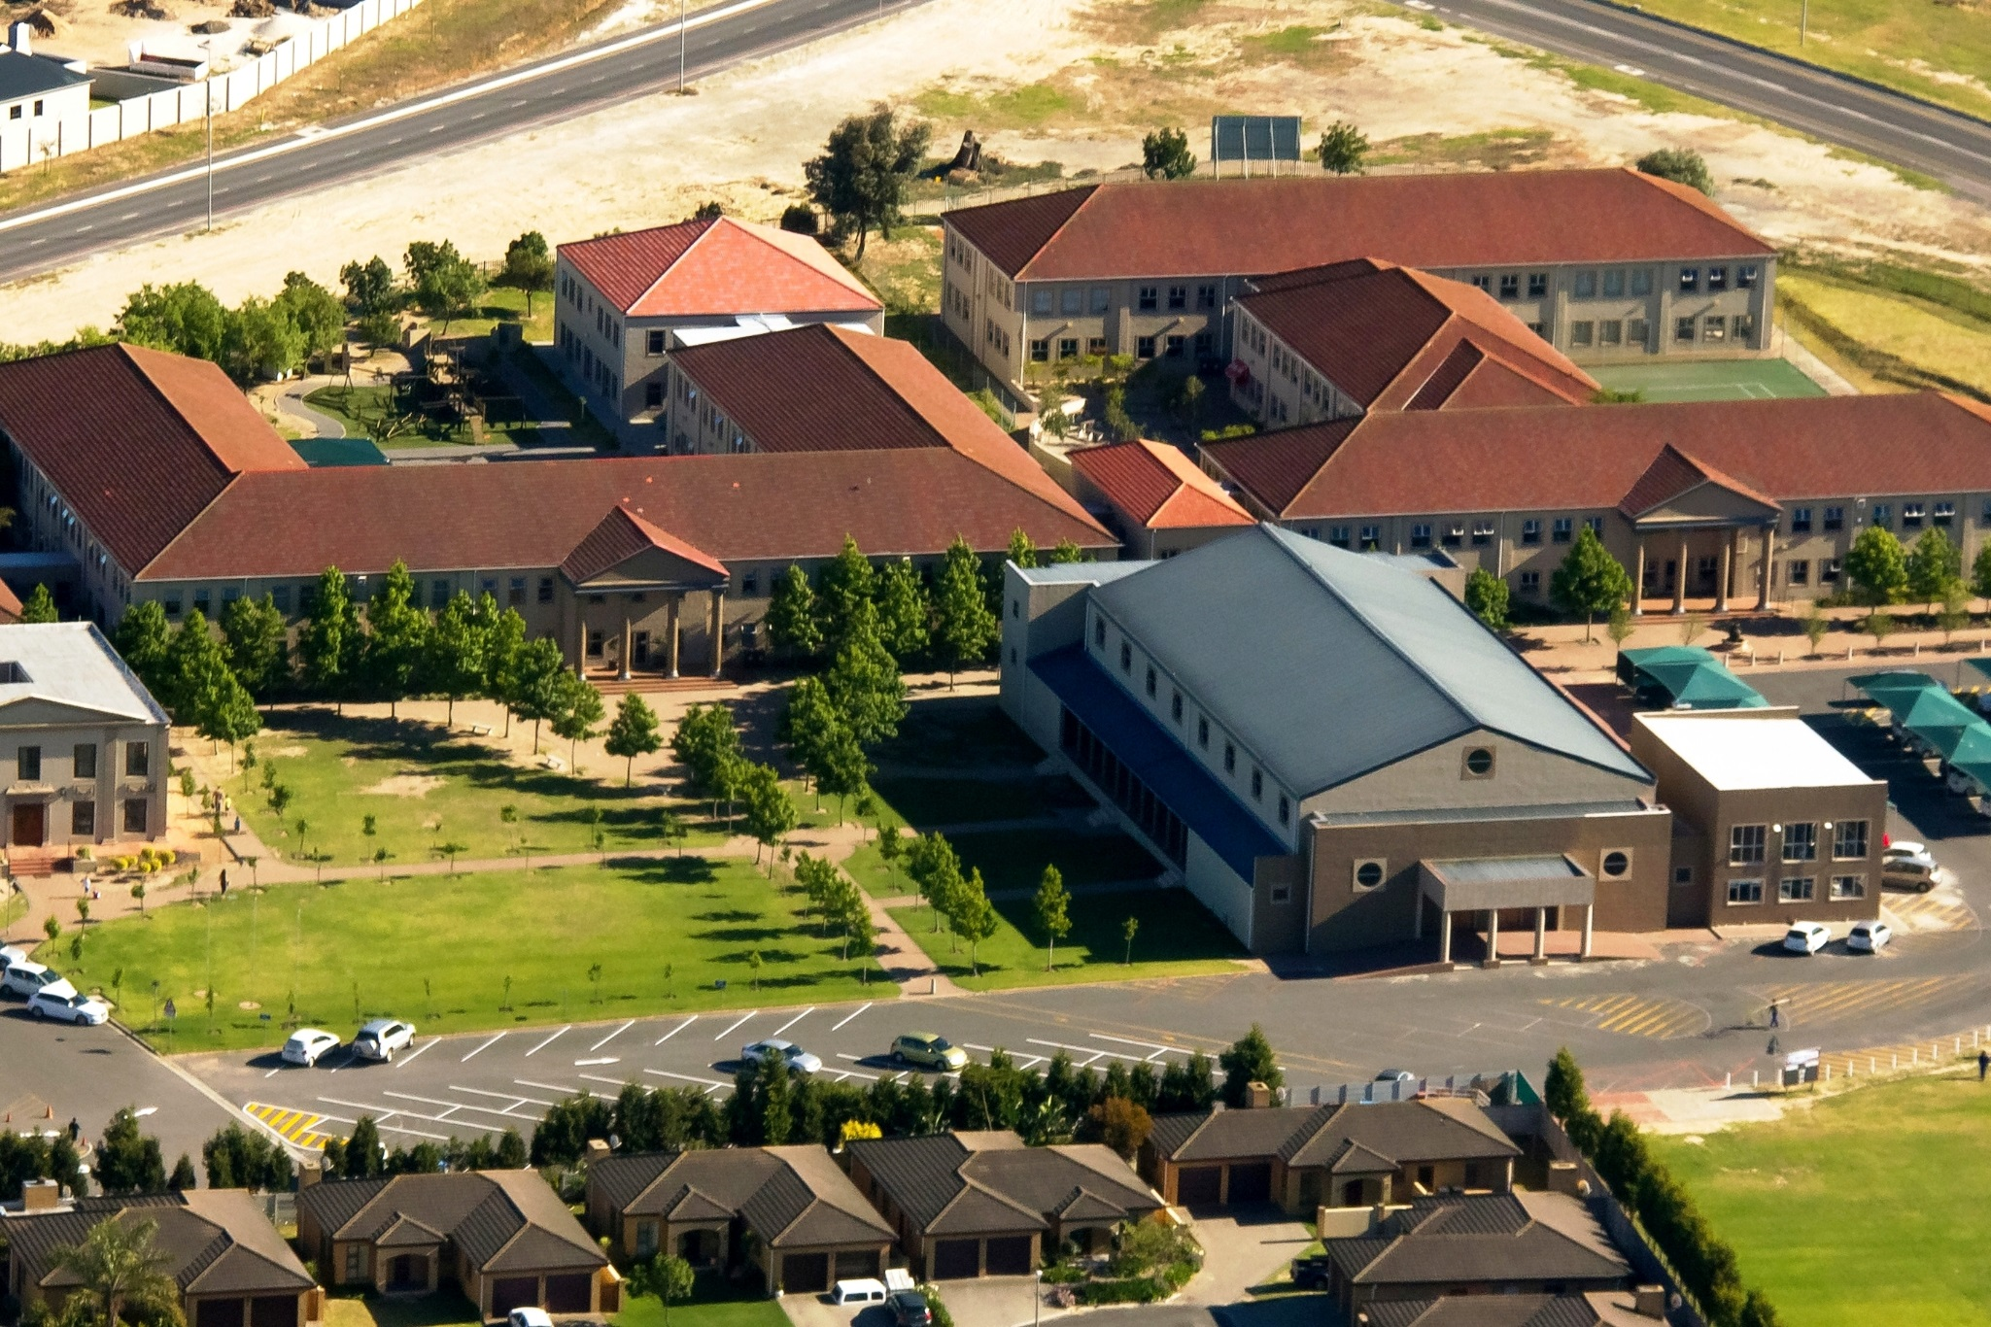
DURBANVILLE

