Slide 1




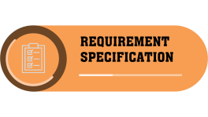

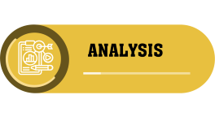

Slide 2
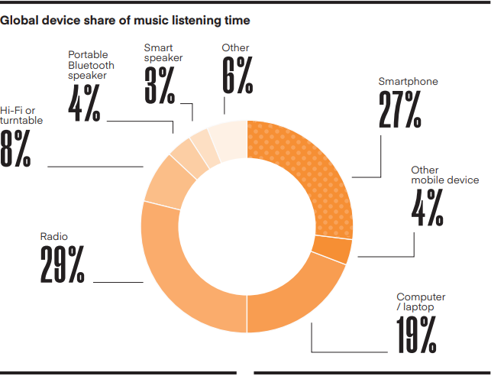




Slide 3





Slide 5


Slide 6
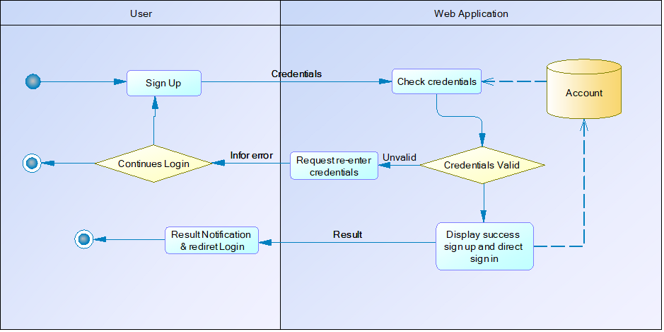
SIGN UP

Slide 7
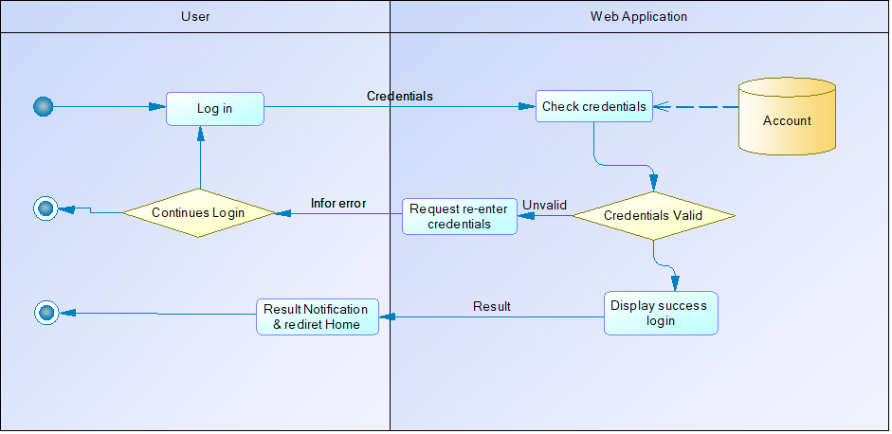
LOGIN

Slide 8
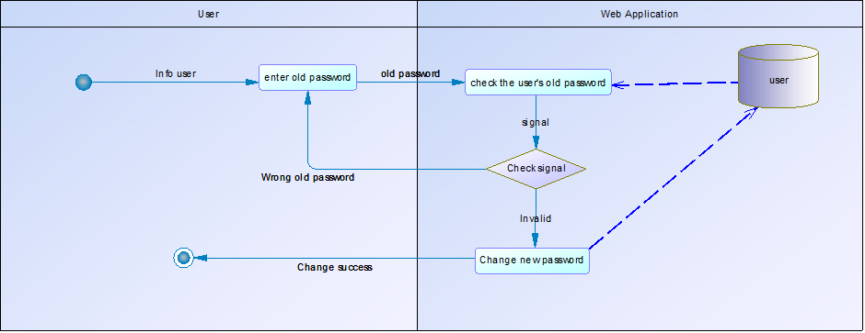
Change Passowrd

Slide 9
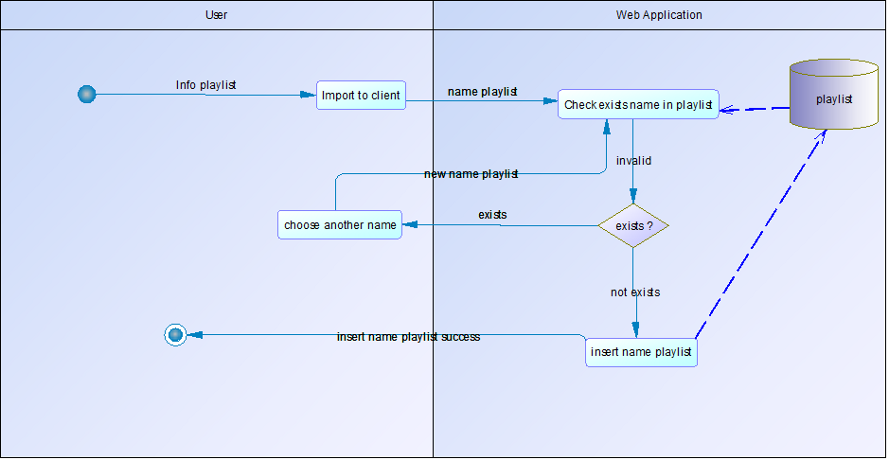
CREATE PLAYLIST

Slide 10
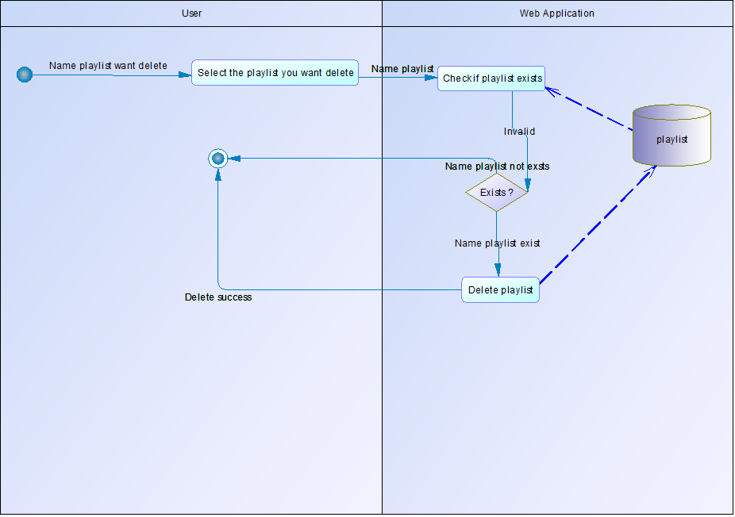
DELETE PLAYLIST

Slide 11
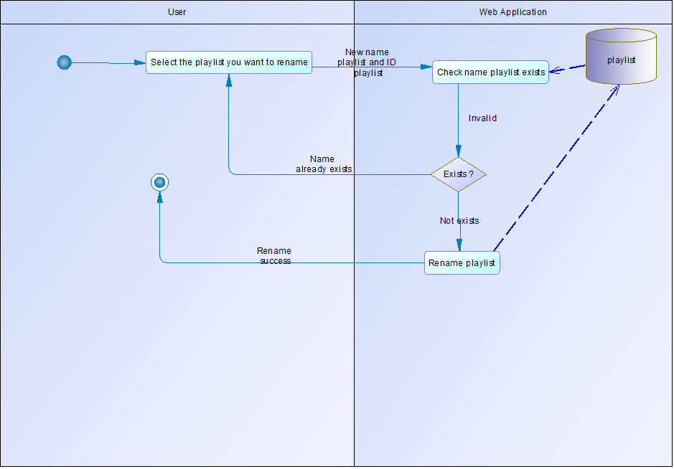
EDIT NAME PLAYLIST

Slide 12
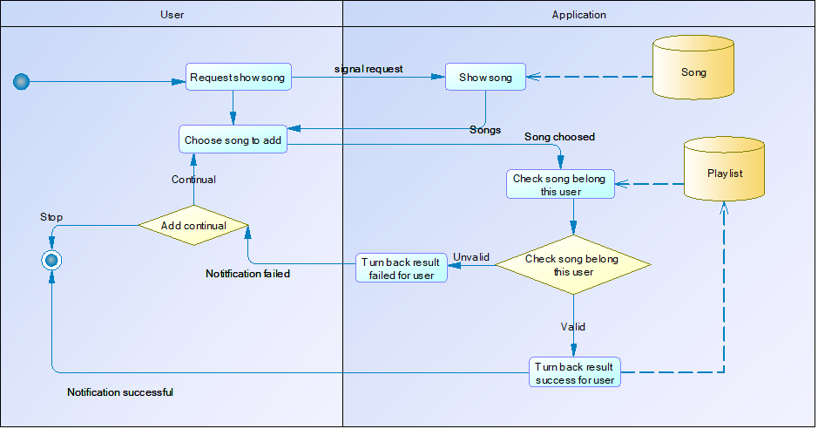
ADD SONG TO PLAYLIST

Slide 13
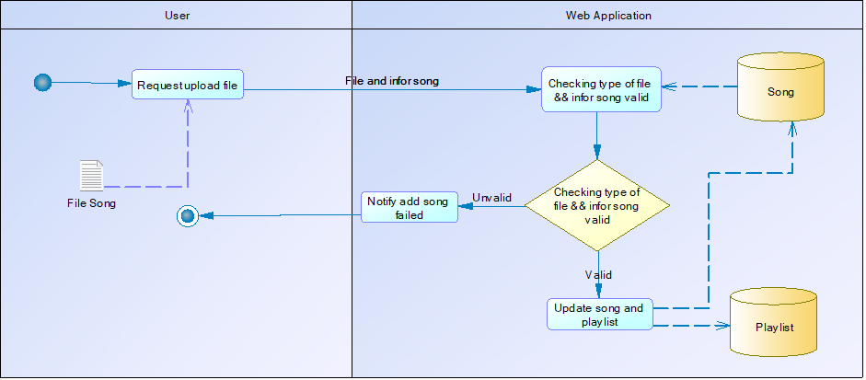
ADD SONG FROM DEVICE

Slide 14
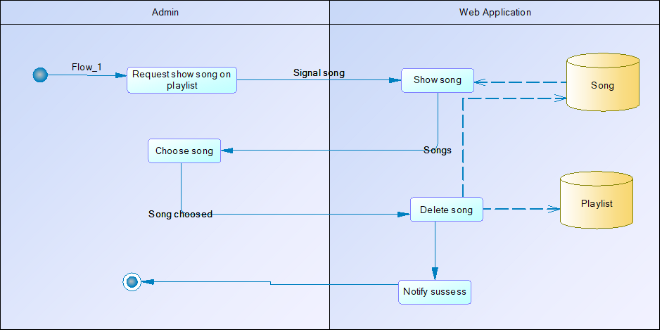
DELETE

Slide 15
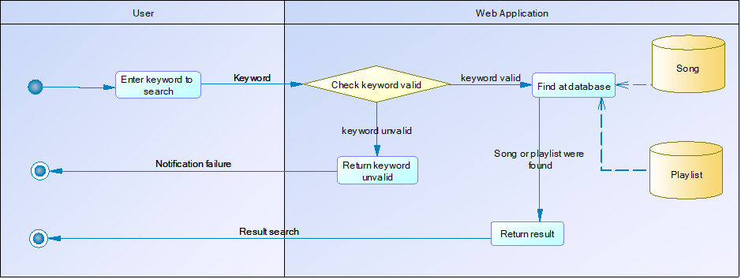
SEARCH

Slide 16

Entity Relationship Diagram

Slide 17
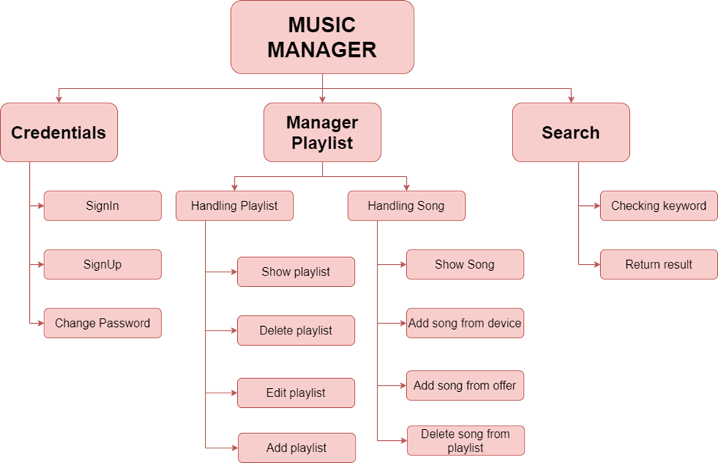
Business Function Diagrams

Slide 18

Data Flow Diagrams
Level 0

Slide 19
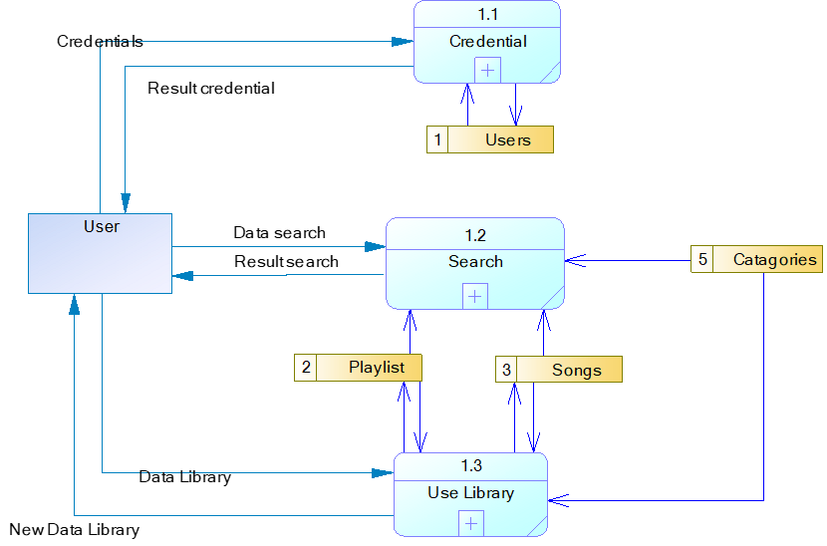
Data Flow Diagrams
Level 1

Slide 20
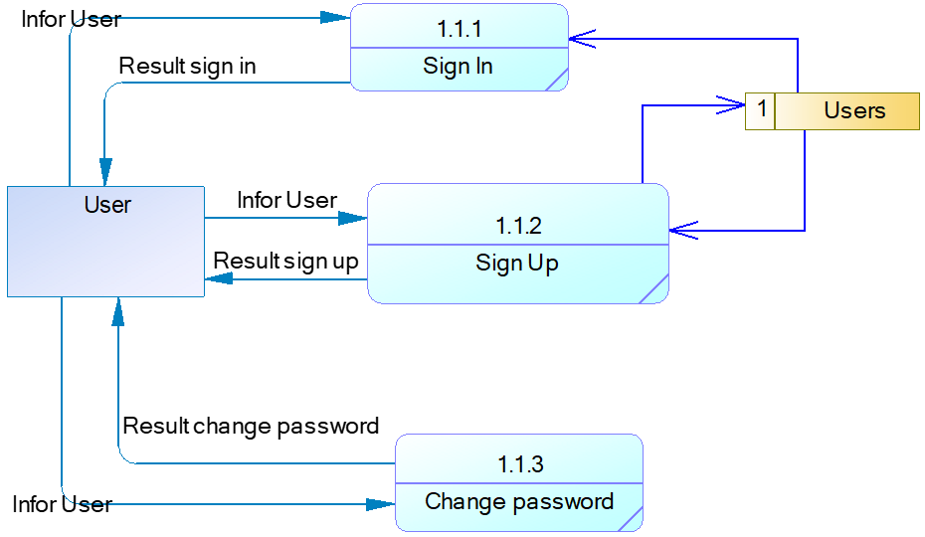
Data Flow Diagrams
Level 2

Slide 21
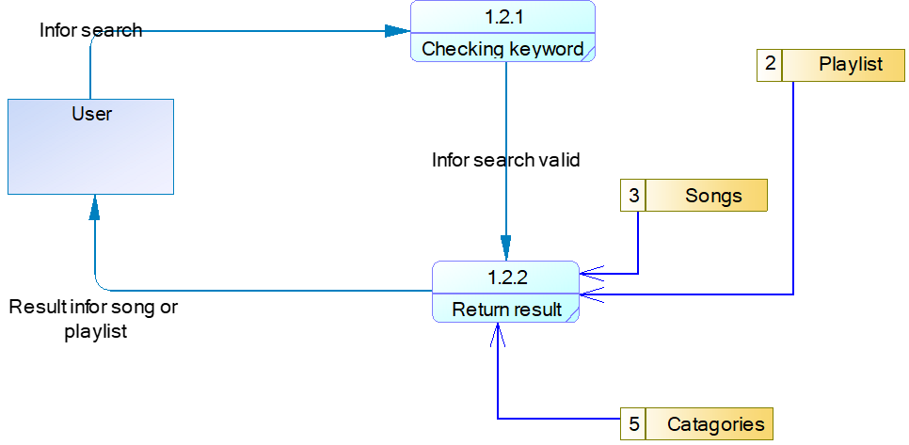
Data Flow Diagrams
Level 2

Slide 22
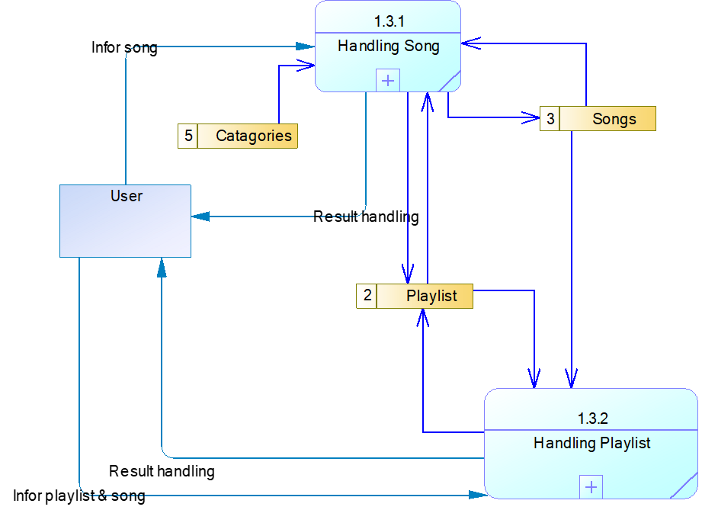
Data Flow Diagrams
Level 2

Slide 23
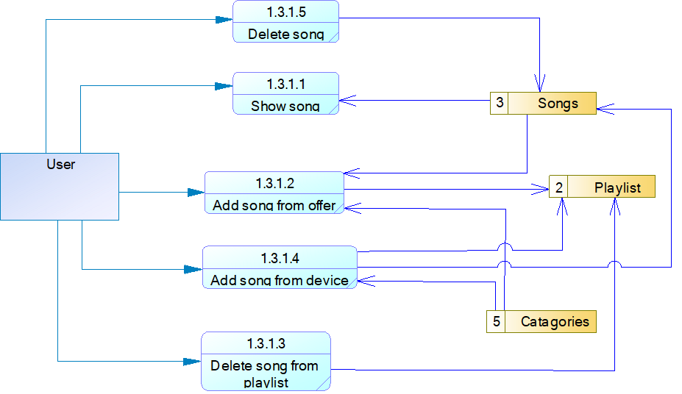
Data Flow Diagrams
Level 3

Slide 24
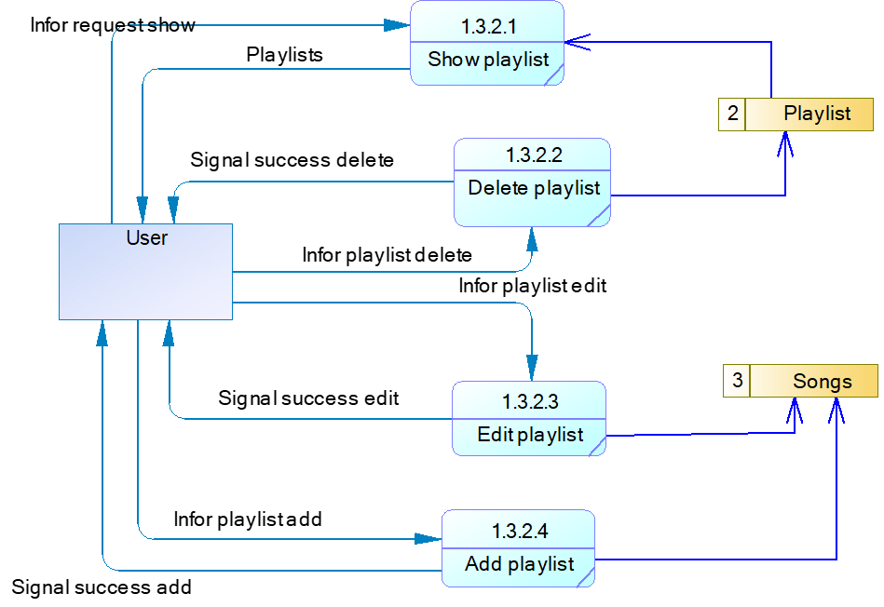
Data Flow Diagrams
Level 3

Slide 25


Slide 26
Business Physical Diagrams

Slide 27










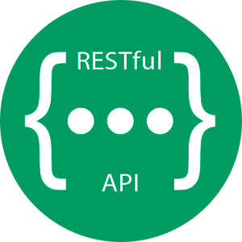



VIEW
USER
MODEL
CONTROLLER

Slide 29


Slide 31


