Slide 1

EDA Project – insights for Erin Robinson
EDA Project – King County real estate
Andreas Greif
October 2025

Slide 2


My Client : ERIN ROBINSON
Erin is from Seattle, 47 years old, married, has 2 kids and a cat, and she loves hiking in the mountains around Seattle.
Professional real estate investor, inherited money from her father
Likes to do socially responsible projects, where she can make a difference in the area by upgrading houses and the whole neighborhood
Looks for interesting houses in poor neighborhoods
Does buying & selling
Does not need much profits
I, Andreas, am a data consultant with deep insights in Kings County real estate and a shared love for hiking (we got to know each other in a hiking group).

Slide 3
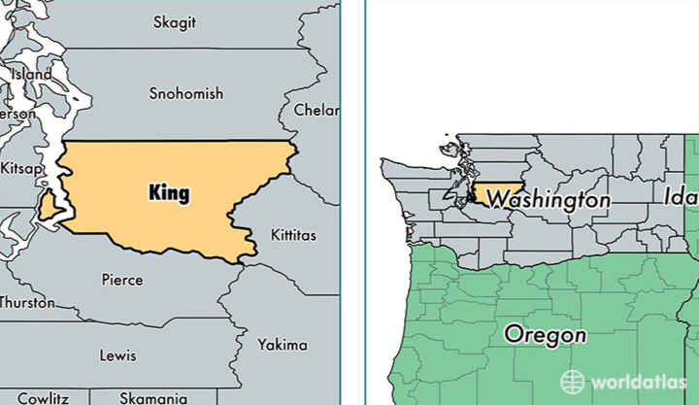
The used data
Some characteristics of the data
Data of house sales in King County, WA, USA
Time span from May 2014 – May 2015
about 21.500 houses in King County.
Restrictions based on Erin’s target market (poor neighborhoods)
Poor areas, defined by Erin : Lowest 10% of mean house prices in ZIP code
That means the mean price is just below 250.000 USD.
Questions from Erin that she wants some answers on :
Are the areas of my interest concentrated, or spread all over Kings county?
I would like to support areas that are picking up in popularity to give them a further boost. Are there areas in poorer neighborhood that grow more than the average in Kings county?
When are good times in the year to buy and sell a house?
When looking only at the price, do I maybe miss something and still buy (relatively) expensive?

Slide 4
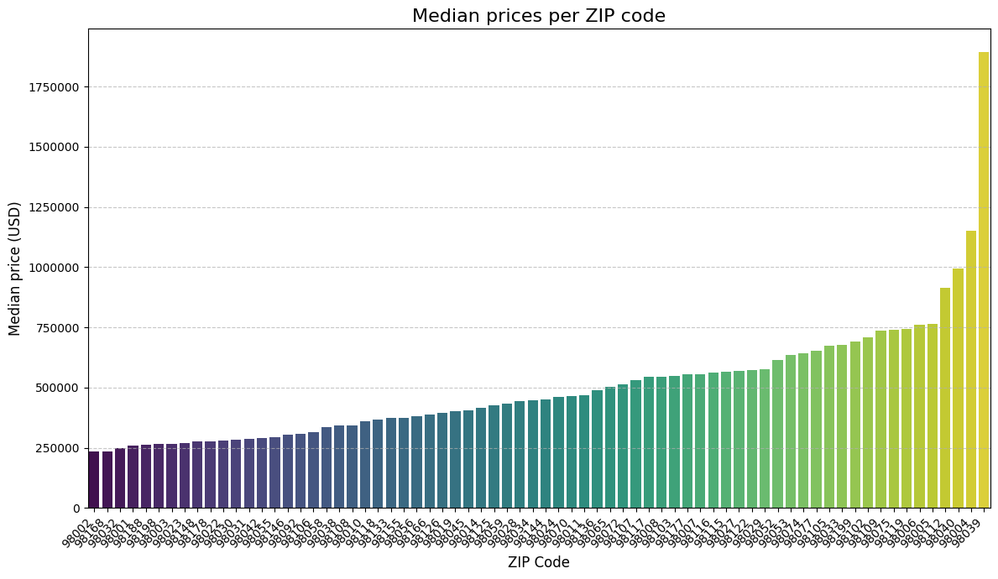
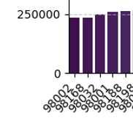
QUESTION 1 - Are the areas of my interest concentrated, or spread all over Kings county?
Hypothesis 1 : The lowest-priced houses (bottom 10%) in the entire region are concentrated in a few of all the ZIP codes, indicating highly localized investment zones.
Bottom 10 % of houses are in only 3 (< 5%) of all ZIP codes and highly localized (98002, 98168, 98032)
Erin wants to look into the 5 ZIP codes with the lowest mean prices to have more choice.
10 % of mean prices

Slide 5
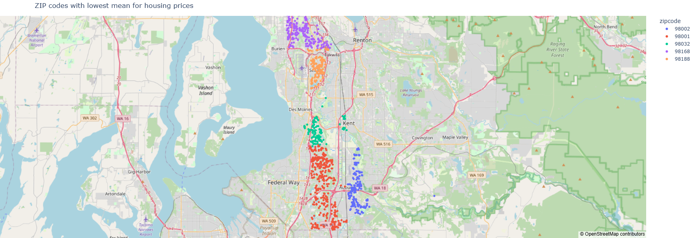
QUESTION 1 - Are the areas of my interest concentrated, or spread all over Kings county? Where are they?
These are the 5 ZIP Code areas that we are going to focus on in the upcoming analysis.
They are all more or less spread around Seattle airport or in the entry lane, where there could be quite some noise.
The red and blue areas (ZIP codes 98001 and 98002 are further away, hence should have less noise).

Slide 6
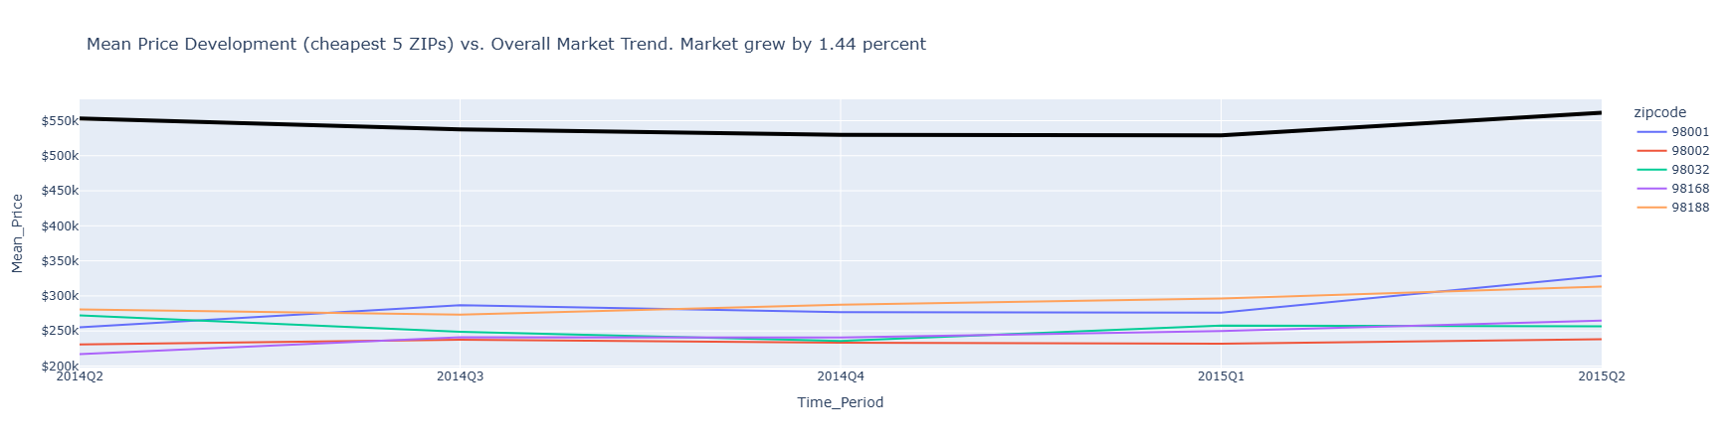
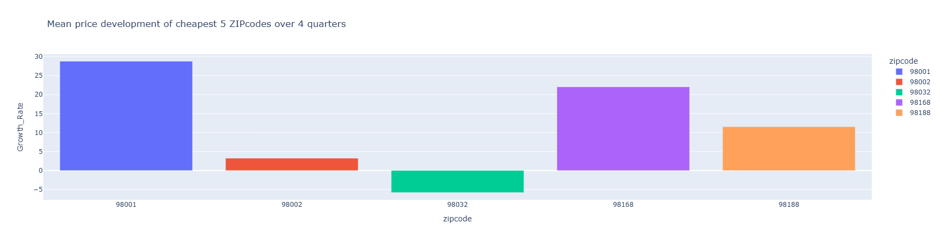
QUESTION 2 - Are there areas in poorer neighborhood that grow more than the average in Kings county?
Hypothesis 2 : The Price-per-SqFt growth rate year-over-year in the target neighborhoods will exceed the city average Price-per-SqFt growth rate over the next years based on the available history.
The overall market grew by 1,44% from May 2014 to May 2015.
Most of the poor ZIP codes did better, some much better (98001 with 28,8% and 98168 with 22,0% growth) → Hypothesis proven.
Furterh hint : 98166 shows the more stability in growth, 98001 volatility was higher

Slide 7
QUESTION 3 - When are good times in the year to buy and sell a house?
Hypothesis 3 : Summer time is a good time to buy since most people think about vacation. January seems to be good to sell, since people had time over Christmas to investigate the market.
ZIP Code | Low price | High price
Overall market | Q1 | Q2
98001 | Q1/2015 (after low in Q2/14) | Q2
98002 | Q1/2014 | Q3
98032 | Q4/2015 | Q1 (apart from high in Q2/14)
98168 | Q2/2014 | Q2/2015
98188 | Q3/2014 | Q2
Overall market has high in Q2 and a low in Q1.
Most poor ZIP codes act similarly, but with outliers
Hypothesis was wrong!
Recommendation for Erin : Buy in Q1, sell in Q2.

Slide 8
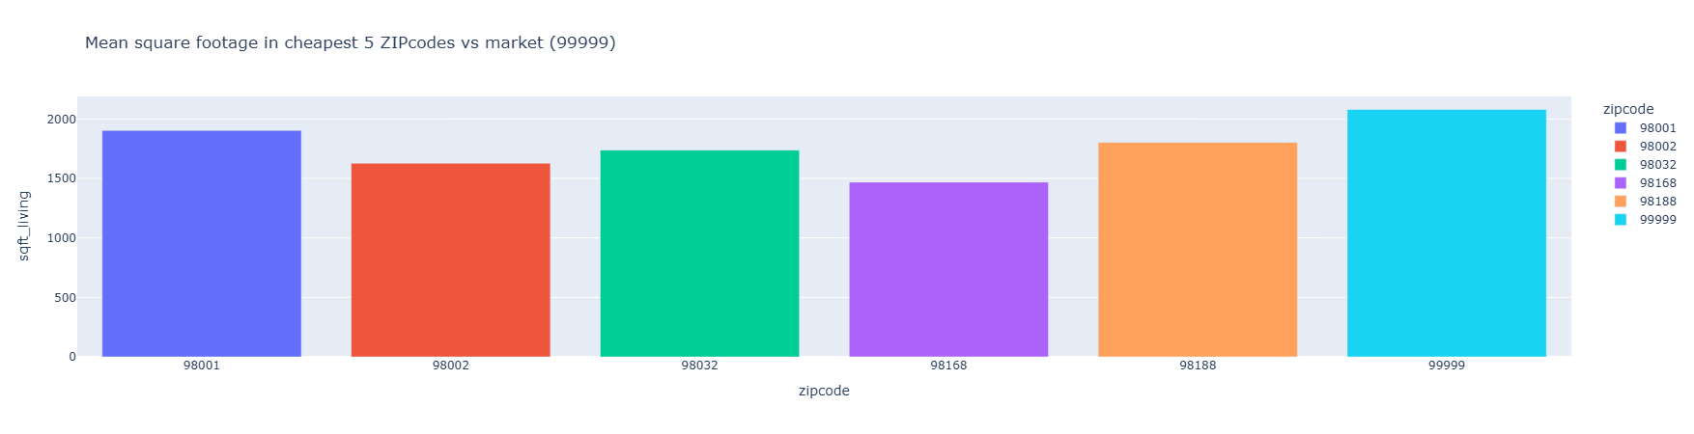
QUESTION 4 - When looking only at the price, do I maybe miss something and still buy (relatively) expensive?
Hypothesis 4 : The average House SqFt in target neighborhoods is significantly smaller than the city average, suggesting the low price is partially driven by unit size, not just location risk.
Hypothesis is right : Our Zip codes all have a lower mean square footage, making them only cheaper not by price/sqft, but by overall price.
→ So let‘s look at price/sqft !

Slide 9
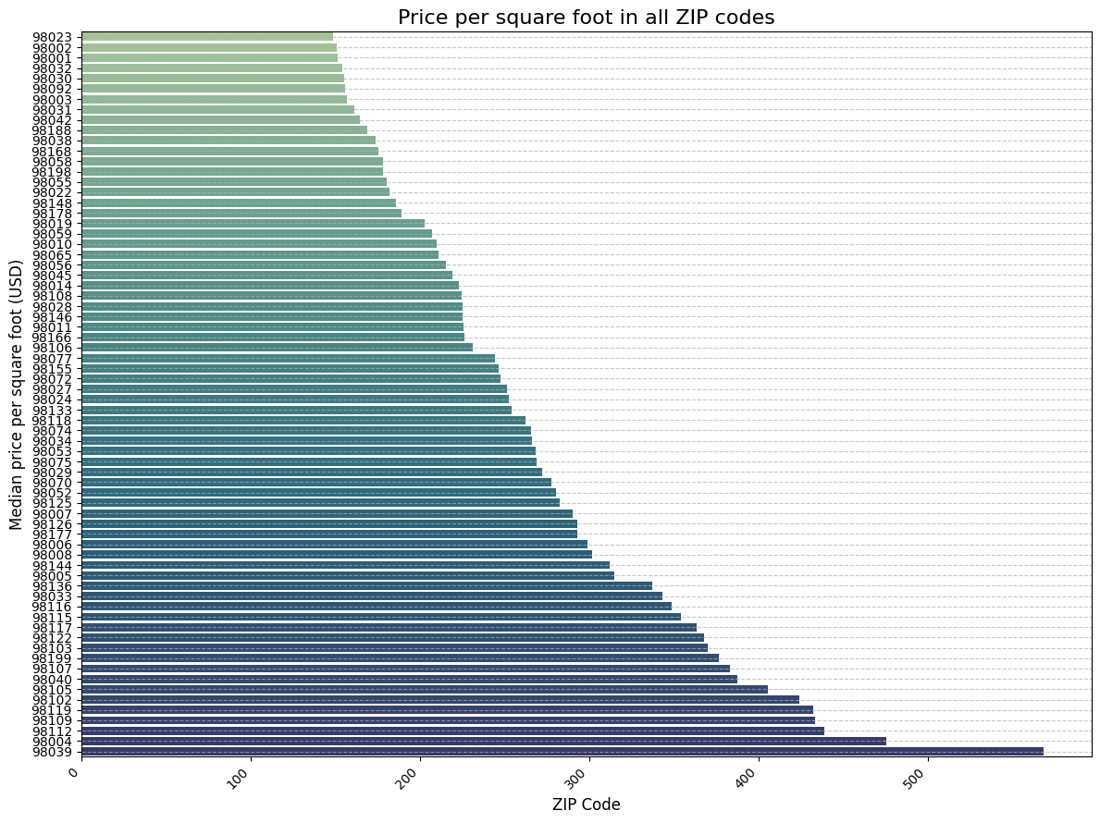
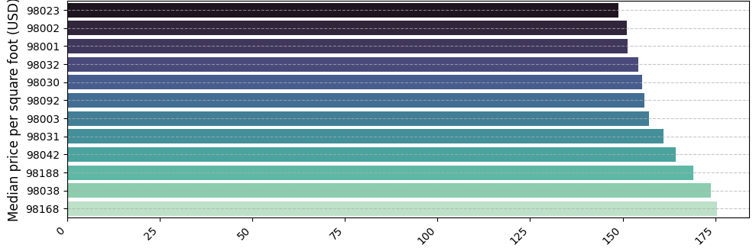
QUESTION 4 - When looking only at the price, do I maybe miss something and still buy (relatively) expensive?
Hypothesis 4 : The average House SqFt in target neighborhoods is significantly smaller than the city average, suggesting the low price is partially driven by unit size, not just location risk - So let’s look at price/sqft !
Our “cheapest” ZIP codes are in the list of the cheapest ones per sqare foot
98001, 98002, 98032 are within the 4 cheapest ZIP codes, whereas 98168 (one of the best growth value) is further down in the list.
This seems to confirm that Erin should go for 98001 as a first place to look for houses.

Slide 10
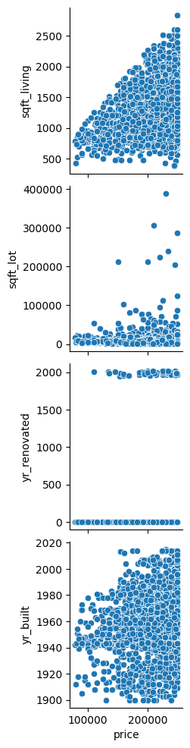
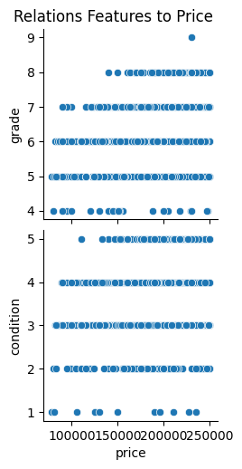
Conclusions and further advice
Conclusions and answers to her questions
„Poor“ neighborhods are in zipcodes 98002, 98168, 98032, 98001, 98188
98001 and 98168 have the best growth in mean price, 98168 being less volatile
When to do transactions : Do your buying in Q1 and your selling in Q2.
To get the best and cheapest market, look at 98001 first because of
Furthest off from Seattle airport (noise)
Best growth rate, and cheaper than 98168 in terms of price/sqft
Furher insights about what to look for (correlations from scatterplots)
Clear correlation of price to sqft, so look for bigger houses at same price
Correlation of lot size to price, quite some outliers (maybe interesting!)
No clear correlation of price to year renovated
Very few houses that are older and very cheap – seems that older houses do not loose much value just because of their age, are therfore quite stable in price.
High Grades from 7 on correlate to price. Look for values 7 and up.
High condition values correlate to price, so look for 4 and 5.

