Slide 1


Slide 2
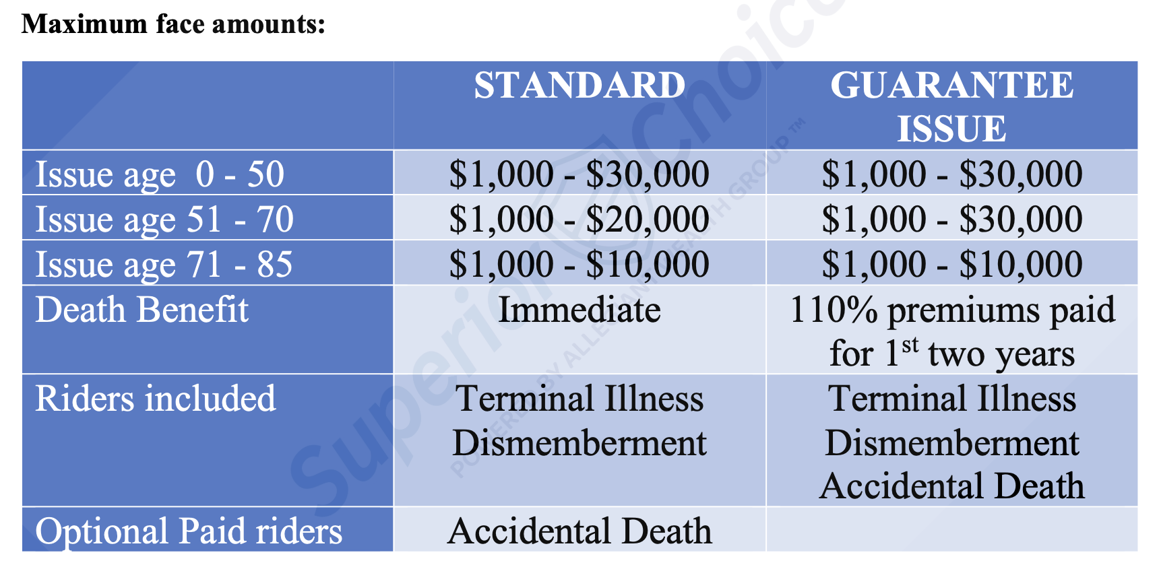

Slide 3
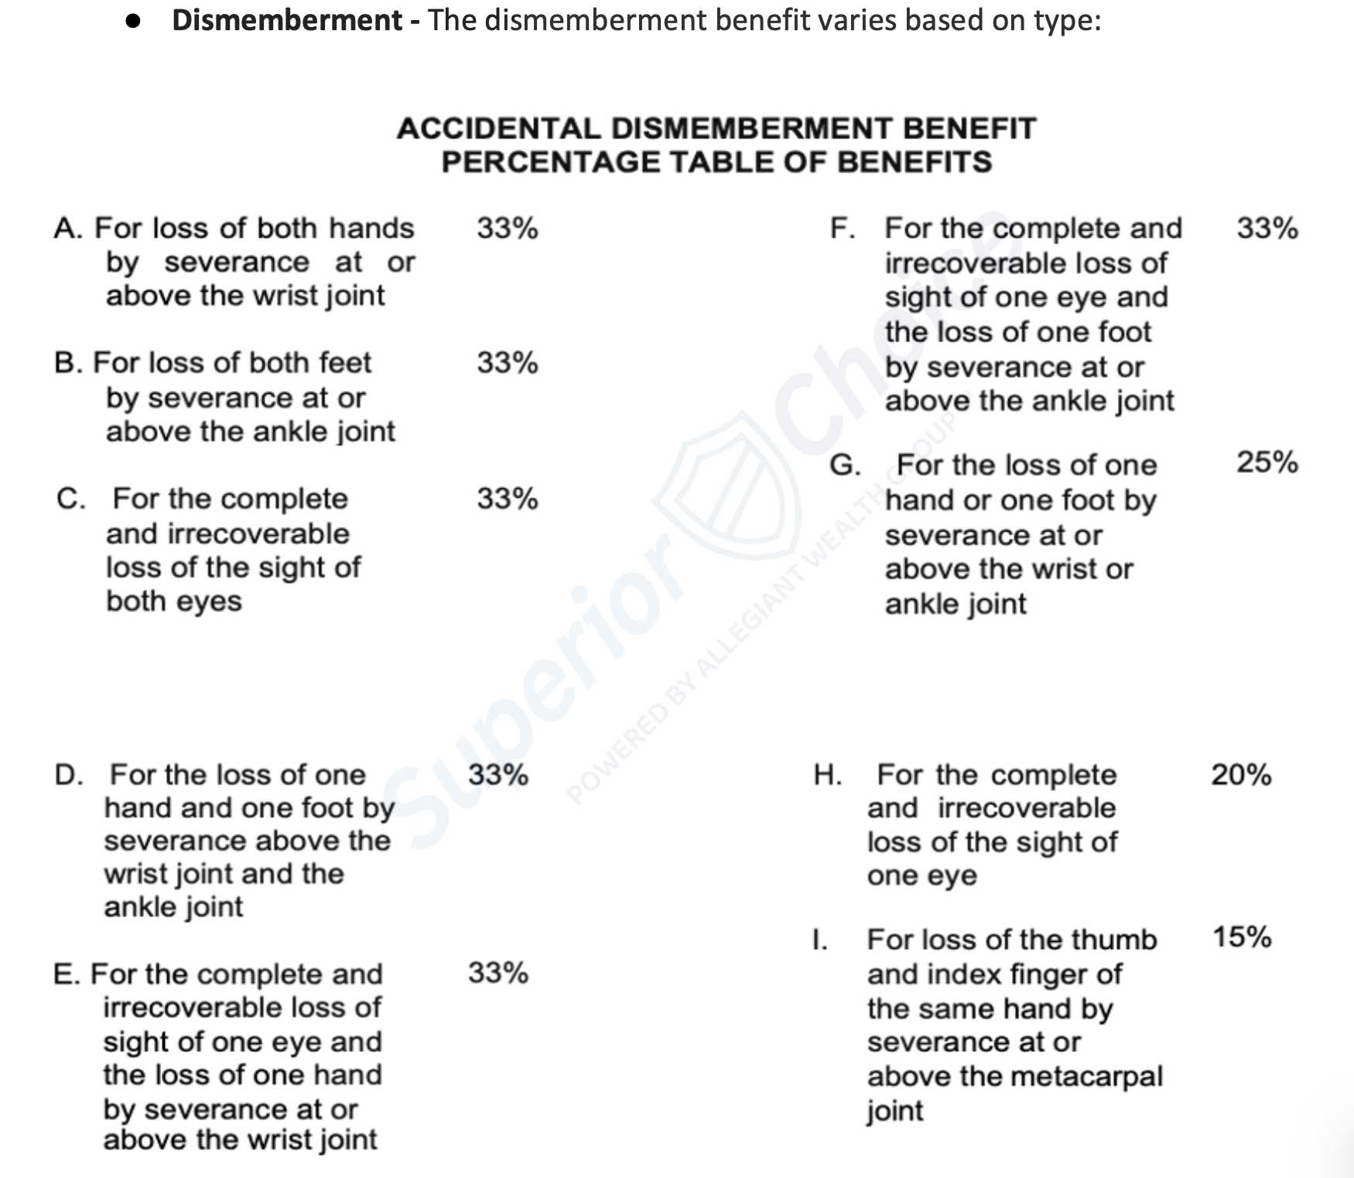
Additional Coverage
Terminal Illness Accelerated Death Benefit
Maximum accelerated benefit payment equals $15,000.
Accidental Death Benefit
Doubles the policy face amount.
Maximum benefit payment equals $30K.
Available ages 0 – 84.
Additional premium of $5 per month regardless of face amount.

Slide 4
Additional Coverage
Terminal Illness Accelerated Death Benefit
Maximum accelerated benefit payment equals $15,000.
Accidental Death Benefit
Doubles the policy face amount.
Maximum benefit payment equals $30K.
Available ages 0 – 84.
Additional premium of $5 per month regardless of face amount.

Slide 5
Additional Coverage
Terminal Illness Accelerated Death Benefit
Maximum accelerated benefit payment equals $15,000.
Accidental Death Benefit
Doubles the policy face amount.
Maximum benefit payment equals $30K.
Available ages 0 – 84.
Additional premium of $5 per month regardless of face amount.

Slide 6
● No Height/Weight requirement
● Issue age is age of LAST birthday
● No MIB or RX
● No tobacco usage question
● Physician information is recommended but is not required

Slide 7
● No Height/Weight requirement
● Issue age is age of LAST birthday
● No MIB or RX
● No tobacco usage question
● Physician information is recommended but is not required

Slide 8
● No Height/Weight requirement
● Issue age is age of LAST birthday
● No MIB or RX
● No tobacco usage question
● Physician information is recommended but is not required

Slide 9
● No Height/Weight requirement
● Issue age is age of LAST birthday
● No MIB or RX
● No tobacco usage question
● Physician information is recommended but is not required

Slide 10
● No Height/Weight requirement
● Issue age is age of LAST birthday
● No MIB or RX
● No tobacco usage question
● Physician information is recommended but is not required

Slide 11
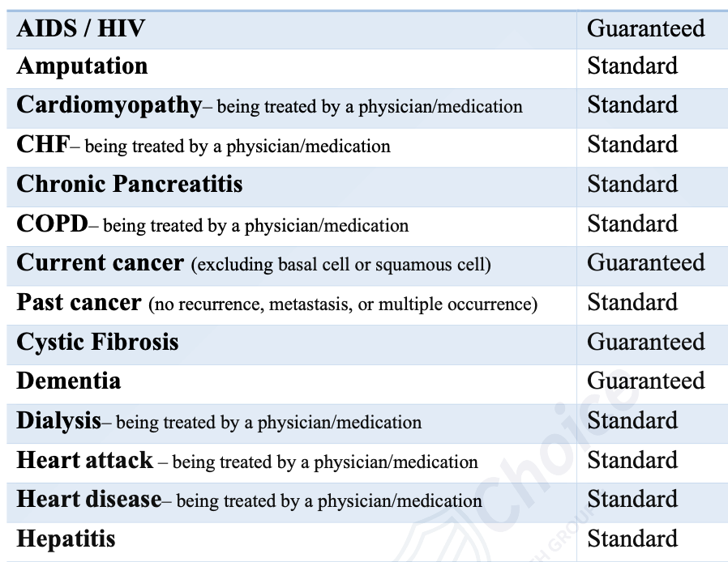

Slide 12
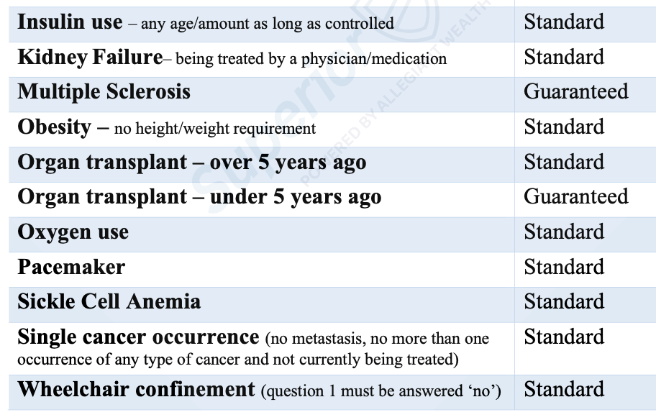

Slide 13
Health Questions:
8 health questions
Any health question answered ‘yes’ will result in the client qualifying only for the Guarantee Issue policy.
Standard approval if the client IS taking medication or being treated by a licensed member of the medical profession on many conditions.
If ‘YES’ to any health questions, you will be prompted to change the plan to the Guarantee Issue policy in step 1

Slide 14
Health Questions:
8 health questions
Any health question answered ‘yes’ will result in the client qualifying only for the Guarantee Issue policy.
Standard approval if the client IS taking medication or being treated by a licensed member of the medical profession on many conditions.
If ‘YES’ to any health questions, you will be prompted to change the plan to the Guarantee Issue policy in step 1

Slide 15
Health Questions:
8 health questions
Any health question answered ‘yes’ will result in the client qualifying only for the Guarantee Issue policy.
Standard approval if the client IS taking medication or being treated by a licensed member of the medical profession on many conditions.
If ‘YES’ to any health questions, you will be prompted to change the plan to the Guarantee Issue policy in step 1

Slide 16
Health Questions:
8 health questions
Any health question answered ‘yes’ will result in the client qualifying only for the Guarantee Issue policy.
Standard approval if the client IS taking medication or being treated by a licensed member of the medical profession on many conditions.
If ‘YES’ to any health questions, you will be prompted to change the plan to the Guarantee Issue policy in step 1

Slide 17
A.) Are you currently hospitalized, confined to a bed or nursing facility, residing in an assisted living facility, receiving hospice care, or do you have any physical or mental impairment for which you need or receive assistance or supervision in performing normal activities of daily living, unable to care for yourself, or terminally ill?
B.) Tested positive for exposure to the HIV infection or been diagnosed as having ARC or AIDS caused by the HIV infection or other sickness or condition derived from such infection.
C.) Have you been diagnosed by a licensed member of the medical profession with more than one occurrence of any cancer, a recurrence of any cancer, metastasis of any cancer, or currently being treated for cancer (excluding basal cell or squamous cell skin cancer)?

Slide 18
A.) Are you currently hospitalized, confined to a bed or nursing facility, residing in an assisted living facility, receiving hospice care, or do you have any physical or mental impairment for which you need or receive assistance or supervision in performing normal activities of daily living, unable to care for yourself, or terminally ill?
B.) Tested positive for exposure to the HIV infection or been diagnosed as having ARC or AIDS caused by the HIV infection or other sickness or condition derived from such infection.
C.) Have you been diagnosed by a licensed member of the medical profession with more than one occurrence of any cancer, a recurrence of any cancer, metastasis of any cancer, or currently being treated for cancer (excluding basal cell or squamous cell skin cancer)?

Slide 19
A.) Are you currently hospitalized, confined to a bed or nursing facility, residing in an assisted living facility, receiving hospice care, or do you have any physical or mental impairment for which you need or receive assistance or supervision in performing normal activities of daily living, unable to care for yourself, or terminally ill?
B.) Tested positive for exposure to the HIV infection or been diagnosed as having ARC or AIDS caused by the HIV infection or other sickness or condition derived from such infection.
C.) Have you been diagnosed by a licensed member of the medical profession with more than one occurrence of any cancer, a recurrence of any cancer, metastasis of any cancer, or currently being treated for cancer (excluding basal cell or squamous cell skin cancer)?

Slide 20
D.) In the past 10 years, have you been medically diagnosed, for which you have NOT been treated by a licensed member of the medical profession, or have NOT taken medication for the following: uncontrolled diabetes, uncontrolled high blood pressure, stroke/TIA, paralysis, Congestive Heart Failure, heart disease, cardiomyopathy, lung disease (including COPD (Chronic Obstructive Pulmonary Disease)/emphysema), liver cirrhosis or failure, kidney (renal) failure/insufficiency, or chronic/end-stage kidney disease (including dialysis)?
E.) Have you ever been medically diagnosed, treated by a licensed member of the medical profession, or taken medication for mental disorder, disorder of the brain or nervous system, Systemic Lupus (SLE), Alzheimer’s disease, dementia, brain disease, organic brain syndrome, Lou Gehrig’s disease (ALS), Huntington’s disease, Muscular Dystrophy, Cystic Fibrosis, Pulmonary Fibrosis, or Multiple Myeloma?

Slide 21
D.) In the past 10 years, have you been medically diagnosed, for which you have NOT been treated by a licensed member of the medical profession, or have NOT taken medication for the following: uncontrolled diabetes, uncontrolled high blood pressure, stroke/TIA, paralysis, Congestive Heart Failure, heart disease, cardiomyopathy, lung disease (including COPD (Chronic Obstructive Pulmonary Disease)/emphysema), liver cirrhosis or failure, kidney (renal) failure/insufficiency, or chronic/end-stage kidney disease (including dialysis)?
E.) Have you ever been medically diagnosed, treated by a licensed member of the medical profession, or taken medication for mental disorder, disorder of the brain or nervous system, Systemic Lupus (SLE), Alzheimer’s disease, dementia, brain disease, organic brain syndrome, Lou Gehrig’s disease (ALS), Huntington’s disease, Muscular Dystrophy, Cystic Fibrosis, Pulmonary Fibrosis, or Multiple Myeloma?

Slide 22
F.) In the past 2 years, have you been hospitalized 2 or more times, or have you been advised or recommended to have any tests, treatment, surgery, or hospitalization which has NOT been received or completed?
G.) Within the last 2 years, have you been treated for or been advised by a licensed medical professional to have treatment for alcohol, drug, opioid, or controlled substance abuse, plead guilty or been convicted of a felony or misdemeanor for any reason, or attempted suicide?
H.) Within the last 5 years have you been advised to by a licensed member of the medical profession to have an organ transplant?

Slide 23
F.) In the past 2 years, have you been hospitalized 2 or more times, or have you been advised or recommended to have any tests, treatment, surgery, or hospitalization which has NOT been received or completed?
G.) Within the last 2 years, have you been treated for or been advised by a licensed medical professional to have treatment for alcohol, drug, opioid, or controlled substance abuse, plead guilty or been convicted of a felony or misdemeanor for any reason, or attempted suicide?
H.) Within the last 5 years have you been advised to by a licensed member of the medical profession to have an organ transplant?

Slide 24
F.) In the past 2 years, have you been hospitalized 2 or more times, or have you been advised or recommended to have any tests, treatment, surgery, or hospitalization which has NOT been received or completed?
G.) Within the last 2 years, have you been treated for or been advised by a licensed medical professional to have treatment for alcohol, drug, opioid, or controlled substance abuse, plead guilty or been convicted of a felony or misdemeanor for any reason, or attempted suicide?
H.) Within the last 5 years have you been advised to by a licensed member of the medical profession to have an organ transplant?

Slide 25
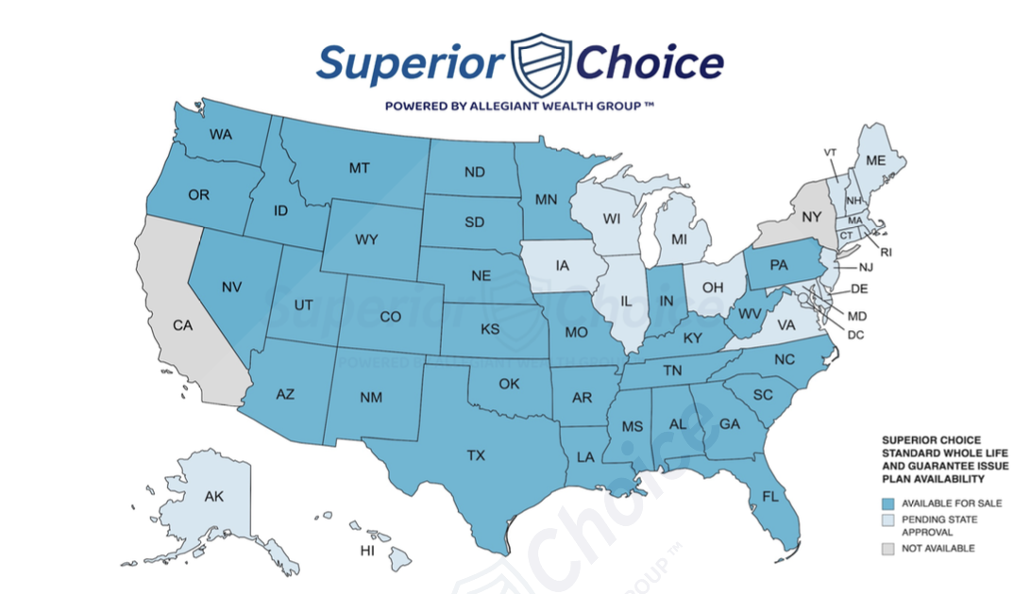
Check your agent portal for the current availability list

Slide 26
Application tips
Check you state appointments & availability BEFORE taking an application
Licenses & Appointments report on your agent portal dashboard
If the client does not have an email, use none@none.com
Do NOT use your agent email or the policy will go to underwriting
Beneficiary name, date of birth, relationship and percentage are required
0’s for social security number and none@none.com for email
TaxID number may be used if the client does not have a social security number

Slide 27
Application tips
Check you state appointments & availability BEFORE taking an application
Licenses & Appointments report on your agent portal dashboard
If the client does not have an email, use none@none.com
Do NOT use your agent email or the policy will go to underwriting
Beneficiary name, date of birth, relationship and percentage are required
0’s for social security number and none@none.com for email
TaxID number may be used if the client does not have a social security number

Slide 28
Application tips
Check you state appointments & availability BEFORE taking an application
Licenses & Appointments report on your agent portal dashboard
If the client does not have an email, use none@none.com
Do NOT use your agent email or the policy will go to underwriting
Beneficiary name, date of birth, relationship and percentage are required
0’s for social security number and none@none.com for email
TaxID number may be used if the client does not have a social security number

Slide 29
Application tips
Check you state appointments & availability BEFORE taking an application
Licenses & Appointments report on your agent portal dashboard
If the client does not have an email, use none@none.com
Do NOT use your agent email or the policy will go to underwriting
Beneficiary name, date of birth, relationship and percentage are required
0’s for social security number and none@none.com for email
TaxID number may be used if the client does not have a social security number

Slide 30
Application tips
Replacement form is included in the e-app
MUST have the replaced carrier name, policy number maybe be the clients social or 0’s if unavailable
If any health question is marked yes, must go back to step 1 to recalculate premium as the GI product and scroll through all steps
Step 7 – Remarks
Do NOT put information in this section. Should information be entered, the application will go to a manual underwriting process. If there is a concern about the policy, send via email to CICA at cps@citizensinc.com

Slide 31
Application tips
Replacement form is included in the e-app
MUST have the replaced carrier name, policy number maybe be the clients social or 0’s if unavailable
If any health question is marked yes, must go back to step 1 to recalculate premium as the GI product and scroll through all steps
Step 7 – Remarks
Do NOT put information in this section. Should information be entered, the application will go to a manual underwriting process. If there is a concern about the policy, send via email to CICA at cps@citizensinc.com

Slide 32
Application tips
Replacement form is included in the e-app
MUST have the replaced carrier name, policy number maybe be the clients social or 0’s if unavailable
If any health question is marked yes, must go back to step 1 to recalculate premium as the GI product and scroll through all steps
Step 7 – Remarks
Do NOT put information in this section. Should information be entered, the application will go to a manual underwriting process. If there is a concern about the policy, send via email to CICA at cps@citizensinc.com

Slide 33
Application tips
Premiums may be scheduled up to 28 days in advance
Hold dates for recurring payments may be the 1st – 28th of the month
Missed premiums can be collected from the agent portal at any time
Third party premium payors are allowed
Payments may be made via ACH, credit card, debit card & direct express
ONLY policies set to pay premiums on recurring ACH are advanced commissions

Slide 34
Application tips
Premiums may be scheduled up to 28 days in advance
Hold dates for recurring payments may be the 1st – 28th of the month
Missed premiums can be collected from the agent portal at any time
Third party premium payors are allowed
Payments may be made via ACH, credit card, debit card & direct express
ONLY policies set to pay premiums on recurring ACH are advanced commissions

Slide 35
Application tips
Premiums may be scheduled up to 28 days in advance
Hold dates for recurring payments may be the 1st – 28th of the month
Missed premiums can be collected from the agent portal at any time
Third party premium payors are allowed
Payments may be made via ACH, credit card, debit card & direct express
ONLY policies set to pay premiums on recurring ACH are advanced commissions

Slide 36
Tele-Sales / Call Center Sales
All CICA Life Superior Choice voice signatures MUST be on a recorded line.
Call recording must be uploaded within 24 hours of completing the application.
Do not need to trim the call recording, it can be the full presentation.
Call must include all client information, health questions, disclosures, HIPPA statement, replacement questions if applicable, and voice signature.
Recording ID requested on the application MUST be the insureds full telephone number followed by the date and must match the label of the upload.
(8502283234-12/01/23)

Slide 37
Tele-Sales / Call Center Sales
All CICA Life Superior Choice voice signatures MUST be on a recorded line.
Call recording must be uploaded within 24 hours of completing the application.
Do not need to trim the call recording, it can be the full presentation.
Call must include all client information, health questions, disclosures, HIPPA statement, replacement questions if applicable, and voice signature.
Recording ID requested on the application MUST be the insureds full telephone number followed by the date and must match the label of the upload.
(8502283234-12/01/23)

Slide 38
Tele-Sales / Call Center Sales
All CICA Life Superior Choice voice signatures MUST be on a recorded line.
Call recording must be uploaded within 24 hours of completing the application.
Do not need to trim the call recording, it can be the full presentation.
Call must include all client information, health questions, disclosures, HIPPA statement, replacement questions if applicable, and voice signature.
Recording ID requested on the application MUST be the insureds full telephone number followed by the date and must match the label of the upload.
(8502283234-12/01/23)

Slide 39
Tele-Sales / Call Center Sales
All CICA Life Superior Choice voice signatures MUST be on a recorded line.
Call recording must be uploaded within 24 hours of completing the application.
Do not need to trim the call recording, it can be the full presentation.
Call must include all client information, health questions, disclosures, HIPPA statement, replacement questions if applicable, and voice signature.
Recording ID requested on the application MUST be the insureds full telephone number followed by the date and must match the label of the upload.
(8502283234-12/01/23)

Slide 40
Tele-Sales / Call Center Sales
All CICA Life Superior Choice voice signatures MUST be on a recorded line.
Call recording must be uploaded within 24 hours of completing the application.
Do not need to trim the call recording, it can be the full presentation.
Call must include all client information, health questions, disclosures, HIPPA statement, replacement questions if applicable, and voice signature.
Recording ID requested on the application MUST be the insureds full telephone number followed by the date and must match the label of the upload.
(8502283234-12/01/23)

Slide 41
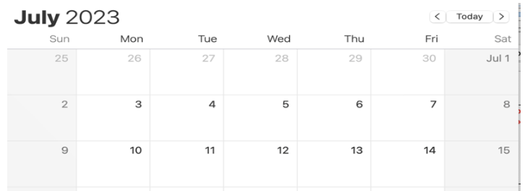
Commissions
Advances paid on recurring ACH, all others paid as-earned
Hold dates for recurring payments may be the 1st – 28th of the month
Six month advance with change backs debited from as-earned payments
Commissions are paid each Friday for business settled (1st premium payment is successful) between the previous Wednesday – Tuesday.
Policies with a first successful draft between 7/5 – 7/11 will be paid 7/14

Slide 42
CICA – Superior Choice Agent Portal
* Track pending lapses * Collect missed premiums
* View policy payment status * View key policy information
* Track personal and agency production
* Export all reports to easily view in your CRM
https://cicaamerica.citizensinc.com/

Slide 43
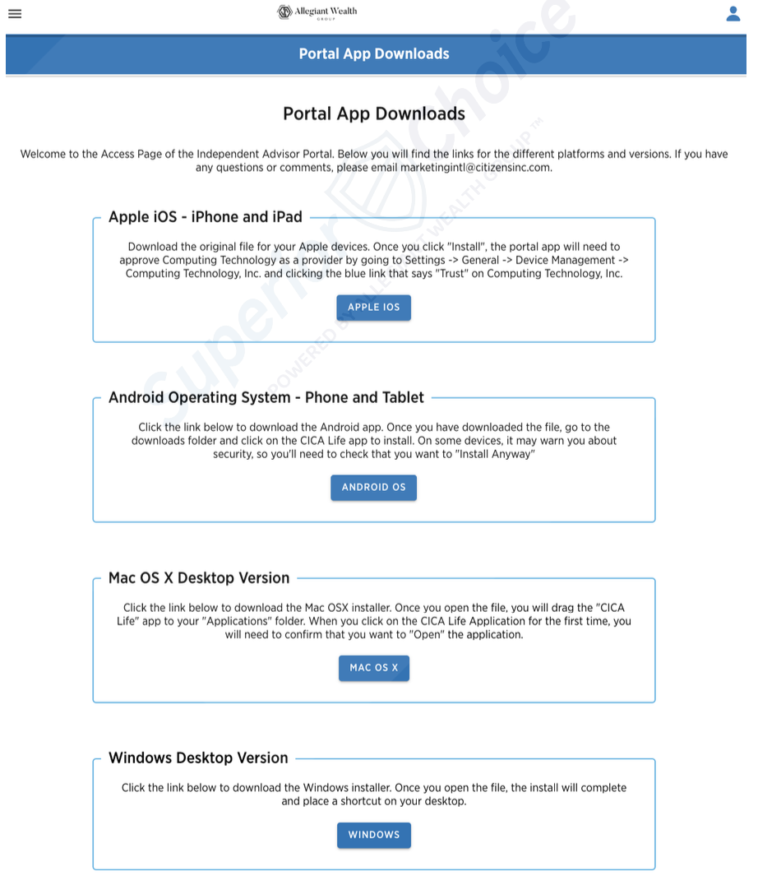
Download the mobile app!
The CICA mobile app is available for download on any mobile device, tablet, or desktop.
Download from your CICA agent portal.
The mobile apps ‘Offline Mode’ can be a great resource for agents working in remote areas with limited reception.

Slide 44
Superior Choice Agent support:
Team Email: cps@citizensinc.com
Team Phone: (737) 289-4670
Policy Holder Services Information:
Team Email: phs.usa@citizensinc.com
Team Phone: (877) 282-7127
New Business Department Information:
Team Email: nb@citizensinc.com
Team Phone: (737) 289-4670
Claims Department Information:
Team Email: claims@citizensinc.com
Team Phone: 737-530-0337 or ext 10151
Contracting, Appointments and Commission Department Information:
Team Email: cps@citizensinc.com
Team Phone: (737) 289-4670

