Slide 1
Advisory Board
Meeting
16 October 2012
@ British Library

Slide 2
Agenda:
11.00 Welcome & notes of last meeting
11.10 Budget Update
11.20 Platform update & development log
PDF update
12.10 Accessibility report
12.40 Content update
Call for Content & Adrian on BL
13.00 Lunch
13.30 OCR Project
14.00 MARC records Update
14.10 Evaluation Report
14.50 AOB and DONM

Slide 3
Welcome and Introductions / Attending
Joanna Ball, Research Liaison Manager, University of Sussex
Laurel Brake, Professor Emerita of Literature and Print Culture, Birkbeck, University of London
Justin Champion, Professor of the History of Early Modern Ideas Royal Holloway, University of London
Adrian Edwards, Lead Curator, Printed Historical Sources, The British Library
Gabriel Egan, Professor of Shakespeare Studies, De Montfort University(Chair)
Simon Elliot, Chair in the History of the Book, Deputy Director, Centre for Manuscript and Print Studies, School of Advanced Studies, University of London
Scott Gibbens, Service Representative, JISC Collections
Jonathan Gibson, Academic co-ordinator, HEA English Subject Centre, Royal Holloway, University of London
Jerome de Groot, Director of Research Training in the Arts, University of Manchester
Bonnie Latimer, Lecturer in Eighteenth-Century Literature, University of Plymouth (NEW!)
Notes:
In attendance:
Gabriel
Caren
Scott Gibbens
Laurel Brake
Simon Elliot
Chris Mounsey
Stam Hoove
Michael Popham
Jonathan Gibson
Paul Rayson
Liz McHugh
Amada Salter
Adrian Streete
Rachel Marshall (on behalf of Sam Tillet)
Erica Swain
Bonnie Latimer
Ceri Sullivan
Matt Steggle

Slide 4
Welcome and Introductions / Attending
Vic Lyte, Senior Manager, Mimas
Rachel Marshall, British Library
Elizabeth McHugh, Electronic Resources Manager, University of the Highlands and Islands
Caren Milloy, Head of Projects, JISC Collections
Chris Mounsey, Lecturer in English, University of Winchester
Michael Popham, Head of Digital Initiatives, Bodleian Digital Library Systems & Services, Bodleian Libraries, University of Oxford
Paul Rayson, Director of UCREL and Lecturer in Computer Science School of Computing and Communications, Lancaster University
Amanda Salter, Librarian, Faculty of Arts, Creative Industries and Education, University of the West of England (NEW!)
Matthew Steggle, Reader in English, Sheffield Hallam University
Adrian Streete, Senior Lecturer, School of English, Queen's University Belfast
Ceri Sullivan, Professor, School of English, Bangor University
Erica Swain, Subject Librarian - English, Communication & Philosophy / Religious Studies & Theology, Cardiff University

Slide 5
Apologies received
Simon Bell, Head of Partnerships and Licensing, The British Library
Giles Bergel, JPR Lyell Research Fellow in the History of the Book, Merton College, University of Oxford
Kelly Centrelli, PhD Candidate (English Literature), Royal Holloway, University of London (NEW!)
Godfried Croenen, Reader in French Historical Studies, University of Liverpool
John Gilmore, Associate Professor, Department of English and Comparative Literary Studies, University of Warwick (NEW!)
Stephen Gregg, Senior Lecturer in English, University of Bath
Catherine Grout Programme Director, e- Content, JISC
Tracey Hill, Head of Department of English & Cultural Studies, Bath Spa University
Andrew Murphey, Head of the School of English, University of St Andrews
Beth Palmer, Lecturer in English Literature, University of Surrey
Elizabeth Scott-Baumann, Lecturer in Early Modern English Literature, Wadham College, University of Oxford
Mark Townsey, Coordinator of Postgraduate Research, Lecturer in Modern British History, University of Liverpool
Samantha Tillet, Project and Service Manager, The British Library

Slide 6
Notes of the last meeting and matters arising
Members are invited to agree the notes of the last meeting as an accurate record
Main matters arising are agenda items today
Outstanding action include:
FE members
Documentation for students
Notes:
The notes were agreed as an accurate record.

Slide 7
Development Funding
Notes:
Caren updated members on the development costs and service fees.

Slide 8
Platform Update
Since our last meeting…
http://www.jischistoricbooks.ac.uk/
Stable URLs. These provide permanent URLs to navigate directly to individual pages within a book as well as to the results list for title or author.
Improvements to the page viewer:
Variable zoom (zoom controls 100-400%)
Thumbnails (so you can quickly identify which pages you want to view in more detail )
Next/previous book
Hide the top and side panels of the viewer.
PDF upgrade - Faster file generation, improved PDF image quality and OCR within the PDFs.
Web interface enabling librarians to download their institutions usage statistics.
Notes:
Scott Gibbens introduced the enhancements made since the last meeting.
The was some discussion around the enhancements:
It was noted the “full screen” display still did not seem to use the full screen and there was quite a lot of grey space around the edge of the pages
In full screen mode the drop down disappears very quickly as well which makes it difficult to type in page numbers etc.
Do users understand what the Text / HTML / Image items mean? Members agreed that some work needs to be done around the terminology
Members suggested adding in the level of zoom (i.e. 50%, 100% etc.)
Scott showed how the search within the book section works and members suggested that perhaps this is not as transparent as it could be to user.
The Help could really be improved and this may also support use of the content.
Tool tips could be improved
Could we have the possibility to remove the boxes for the metadata. Perhaps the page elements could be configurable by the user?

Slide 9
Platform Update
In the coming months… (Annex A)
PDF document shows upcoming development includes:
New sort options
Indication if full text is available or not
New actions to allow you to email records, download records to reference management software or save records to list
New MyBibliograpy: you can save results to your own bibliography. Once you have saved items they are saved here until you delete them.
Slightly further forward…
Autonomy licence renewal to allow unlimited indexing (limited only by computer hardware)
19th Century Collection from Oxford/Google partnership to be integrated
Notes:
Scott informed members of the enhancements that are coming - members will be asked to test the new enhancements and this testing is essential to male sure the system works as intended.
Members highlighted some issues:
- mark items and email and store is good
- facility to browse the content would be useful
- concern about the amount of bibliographic data that is being shown is limited – perhaps add the link back to the ETSC?
- concern over the email function of the PDF

Slide 10
Development Log
The development log has been updated..
(Annex B)
Following the last meeting the development log has been updated with items completed and those in progress.
All items we have received via email since the last meeting were repeats of items already on the list
A couple of items have not yet been investigated due to difficulties getting available expertise to analyse metadata provided
The few items that have not been progressed all relate to additional searching options
Notes:
Members noted the updated development log.

Slide 11
PDF Update
Some issues with the new PDF feature…. Members to discuss and advise….
The new PDF functionality is designed to provide a better quality PDF with smaller file size and includes OCR functionality
If you wish to download a book or pages from a book you enter the details and shortly after you get an email with a link to the PDF
This link is protected and you need to be either on campus or have access via Shibboleth (or open athens)
We have had some problems where the email has not been received in a acceptable timescale. This is either because
1. The file has failed to generate due to problems with the OCR
2. The file has failed to generate due to system issues
3. The file is very large and is taking a long time to process
In order to mitigate these problems we have authorise the following solutions: install an additional PDF server, an error email to be sent if the process fails and some programming is being investigated.
It has also been recommended that we restrict the download option to 250 pages. In some cases books or over 1000 pages have been downloaded at once.
Is the page restriction solution acceptable? Users can still go back in and request the next 250 pages if they wish
Notes:
Scott explained the new PDF functionality.
He explained there are some issues with the PDFs leading to delays.
There are a number of options the board were asked to consider:
- Can we cache the ones that are used more often? There is a storage issue associated with this.
- Does the my bibliography resolve this.
- Message to the user to say it may take a while?
It was a agreed to install a second PDF server review this to see what impact it has before proceeding with other solutions.
The Board agreed that the quality of the PDFs has improved with this new service.

Slide 12
Accessibility Report
Members are invited to discuss…. (Annex C)
Vic Lyte of Mimas will present the recent accessibility audit undertaken by Mimas on the JISC Historic Books platform.
Members are invited to discuss this report and its recommendations
Notes:
Vic Lyte (MIMAS) presented the accessibility report recently compiled by Mimas. Members agreed that this is a useful report and work should proceed to take forward the suggestions.
Members discussed the accessibility and join up with the OCR project – if the OCR project produced OCR that could be read by screen readers this would be extremely valuable to users. If you the OCR is good it reduced reliance on the user interface.
Members agreed that this is a very good point and will support the OCR proposal and it may perhaps help achieve funding.
Action: Mimas was asked to go through the accessibility report and assess what could be done short term, long term and any costs associated with the activity. If fixes could be easily implemented they should be.
Scott would recommend that we go through the report and assess what we can do.

Slide 13
Quick Recap!
Following the discussions…
What does this mean for the development budget?

Slide 14
Members are invited to discuss…. (Annex D)
Improving the OCR of ECCO, EEBO and the British Library content
Dan Burnstone will present the findings of the recent study to explore how JISC could become involved in Laura Mandell’s project.
Notes:
Dan provided an overview of the EMOP project: http://emop.tamu.edu/ and talked through the possibilities for JISC involvement which include implementing typewright on the BL content as a demonstrator first.
Q. Did the discussions with Laura surface anything to do with the value of OCR for accessibility?
No, not as such, the project is interested in the OCR element as much as the output
Members talked about their crowdsourcing experiences; there was an instant success when this task was broadcast says Laurel, but there is a tension between restricted access v open access that needs to be considered.
Q. How much of the text can you see?
A. On EMOP anyone can correct the text but you only see a snippet. TypeWright is intended to work like that – snippets only.
Simon Elliot talked of his experience with crowdsourcing and has to submit all the data for editorial control. This element is built into the grant and talks of an editorial process. The editorial process needs much more consideration if this OCR project is to work well.
Members discussed what the incentive would be for researchers to correct the OCR. Dan explained that a researcher who corrects a whole text can own that and publish it as a scholarly edition and this is an incentive. Further incentives may need to be considered to get the community to participate for small snippets. One member suggested that it is built into student courses – have to complete some crowdsourcing to understand the limitations of the OCR.
Members agreed that the proposal is very worthwhile and fits with the strategic aims of the board and the need to widen access.
Action: JISC to work with Laura Mandell to firm up the proposal and see how best to proceed.

Slide 15
UK HE & FE
Centralised Server & Editorial Board
18th Century Connect
Proquest / Cengage / British Library
JISC Historic Books
TypeWright software (expert editing)
Widget (quick edits)
TEI-A used to send the textual changes back and forth
Date & time stamped with versioning

Slide 16
Content Update
Members are invited to note….
JISC Collections Call for Content (Caren)
What is in the British Library collection? (Adrian)
Notes:
Caren provided a brief update on progress with the Call for Content.
Adrian provided an overview of the collection that forms the BL content in JHB.
65,000 books, 25 million pages
Images are full colour
Action: JISC to get the updated BL records

Slide 17
Providing UK HE and FE with MARC records for JHB
Caren Milloy and Rachel Marshall will provide a verbal update on discussions within the British Library to release the ESTC data under an open licence
Recommendation 3: JISC Collections should work with the British Library, ESTC North America, and other stakeholders to achieve the release of ESTC data under a license that explicitly allows re-use.
Notes:
Caren and Rachel provided a verbal update on the MARC records discussions. The British Library and the ESTC are discussing this and it is waiting for agreement by the various strategic groups.

Slide 18
Evaluating progress and success
Members are invited to discuss….. (Annex E)
Using the data that we have immediate access too:
Benchmarking usage of JHB against ProQuest / Cengage (bi-annual)
Benchmarking usage (annual)
Surveys by JISC Collections & Mimas (annual)
User testing – performance, accessibility (annual)
Feedback on lists / helpdesks / twitter (quarterly)
Notes:
Scott introduced the evaluation report proposal.

Slide 19
JISC Historic Book Usage 2011 – 2012 by collection
Notes:
Caren shared the latest usage data with the group.
BL = 80,648
ECCO = 101,816
EEBO = 474,763 views

Slide 21
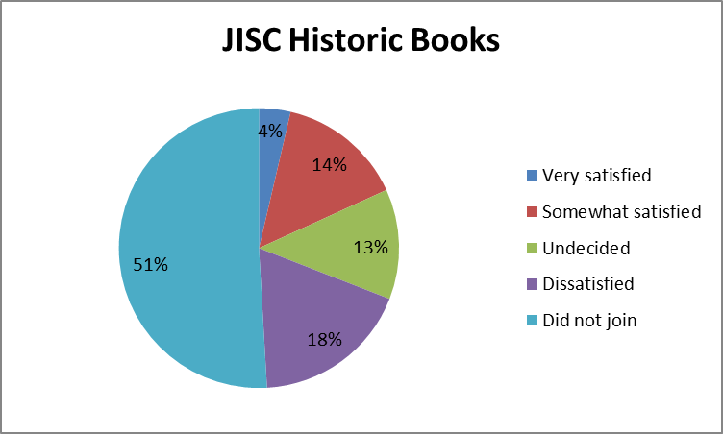
JISC Collections HE Annual Satisfaction Survey Responses for JISC Historic Book 2011 – 2012 year
Notes:
HE Satisfaction 2011: 55 responses

Slide 22
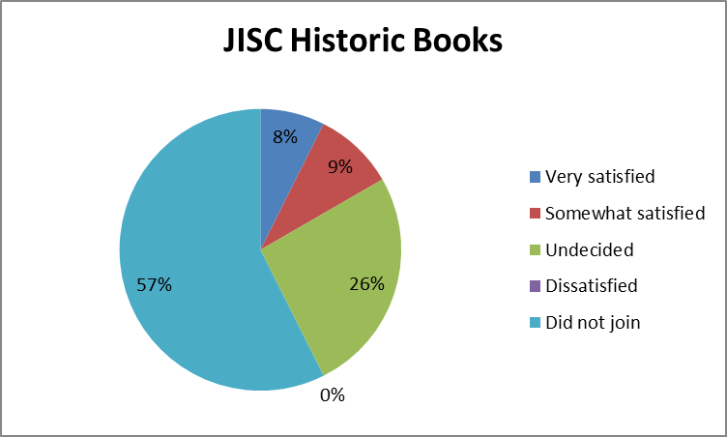
JISC Collections FE Annual Satisfaction Survey Responses for JISC Historic Book 2011 – 2012 year
Notes:
FE Satisfaction 2011: 54 responses.

Slide 23
Top 10 users of JISC Historic Book 2011 – 2012 year
The top 10 users accounted for 62% of all downloads
Institution Downloads
Queen's University Belfast 77798
University of Southampton 61183
University of St Andrews 47061
Newcastle University 42649
University of Wolverhampton 40399
Wellcome Trust 33834
Oxford Brookes University 31428
University of Strathclyde 26435
University of Stirling 24957
Aberystwyth University 24178
Notes:
Discussions are taking place with the Monitoring Unit to help analyse the data.
Also can hopefully include analysis of PDF downloads into the mix.

Slide 24
Date of next meeting and AOB
February 2013

