Slide 1

A MODULAR DETECTION AND COMPLETION FRAMEWORK FOR OCCLUDED VEHICLES IN AUTOMOTIVE LIDAR
Supervisor: Dr. Doan Nhat Quang
Presenter: Ngo Vi Viet Anh
ID: 24MSE13205
1
Notes:
★ TALK 0:15 — title, name, supervisor.

Slide 2
TABLE OF CONTENTS
I. Introduction
II. Proposed Methodology
III. Experimental Evaluation
IV. Conclusion & Future Work
2
Notes:
★ TALK 0:10 — four parts.

Slide 3
I. INTRODUCTION
3
Notes:
divider: click through

Slide 4
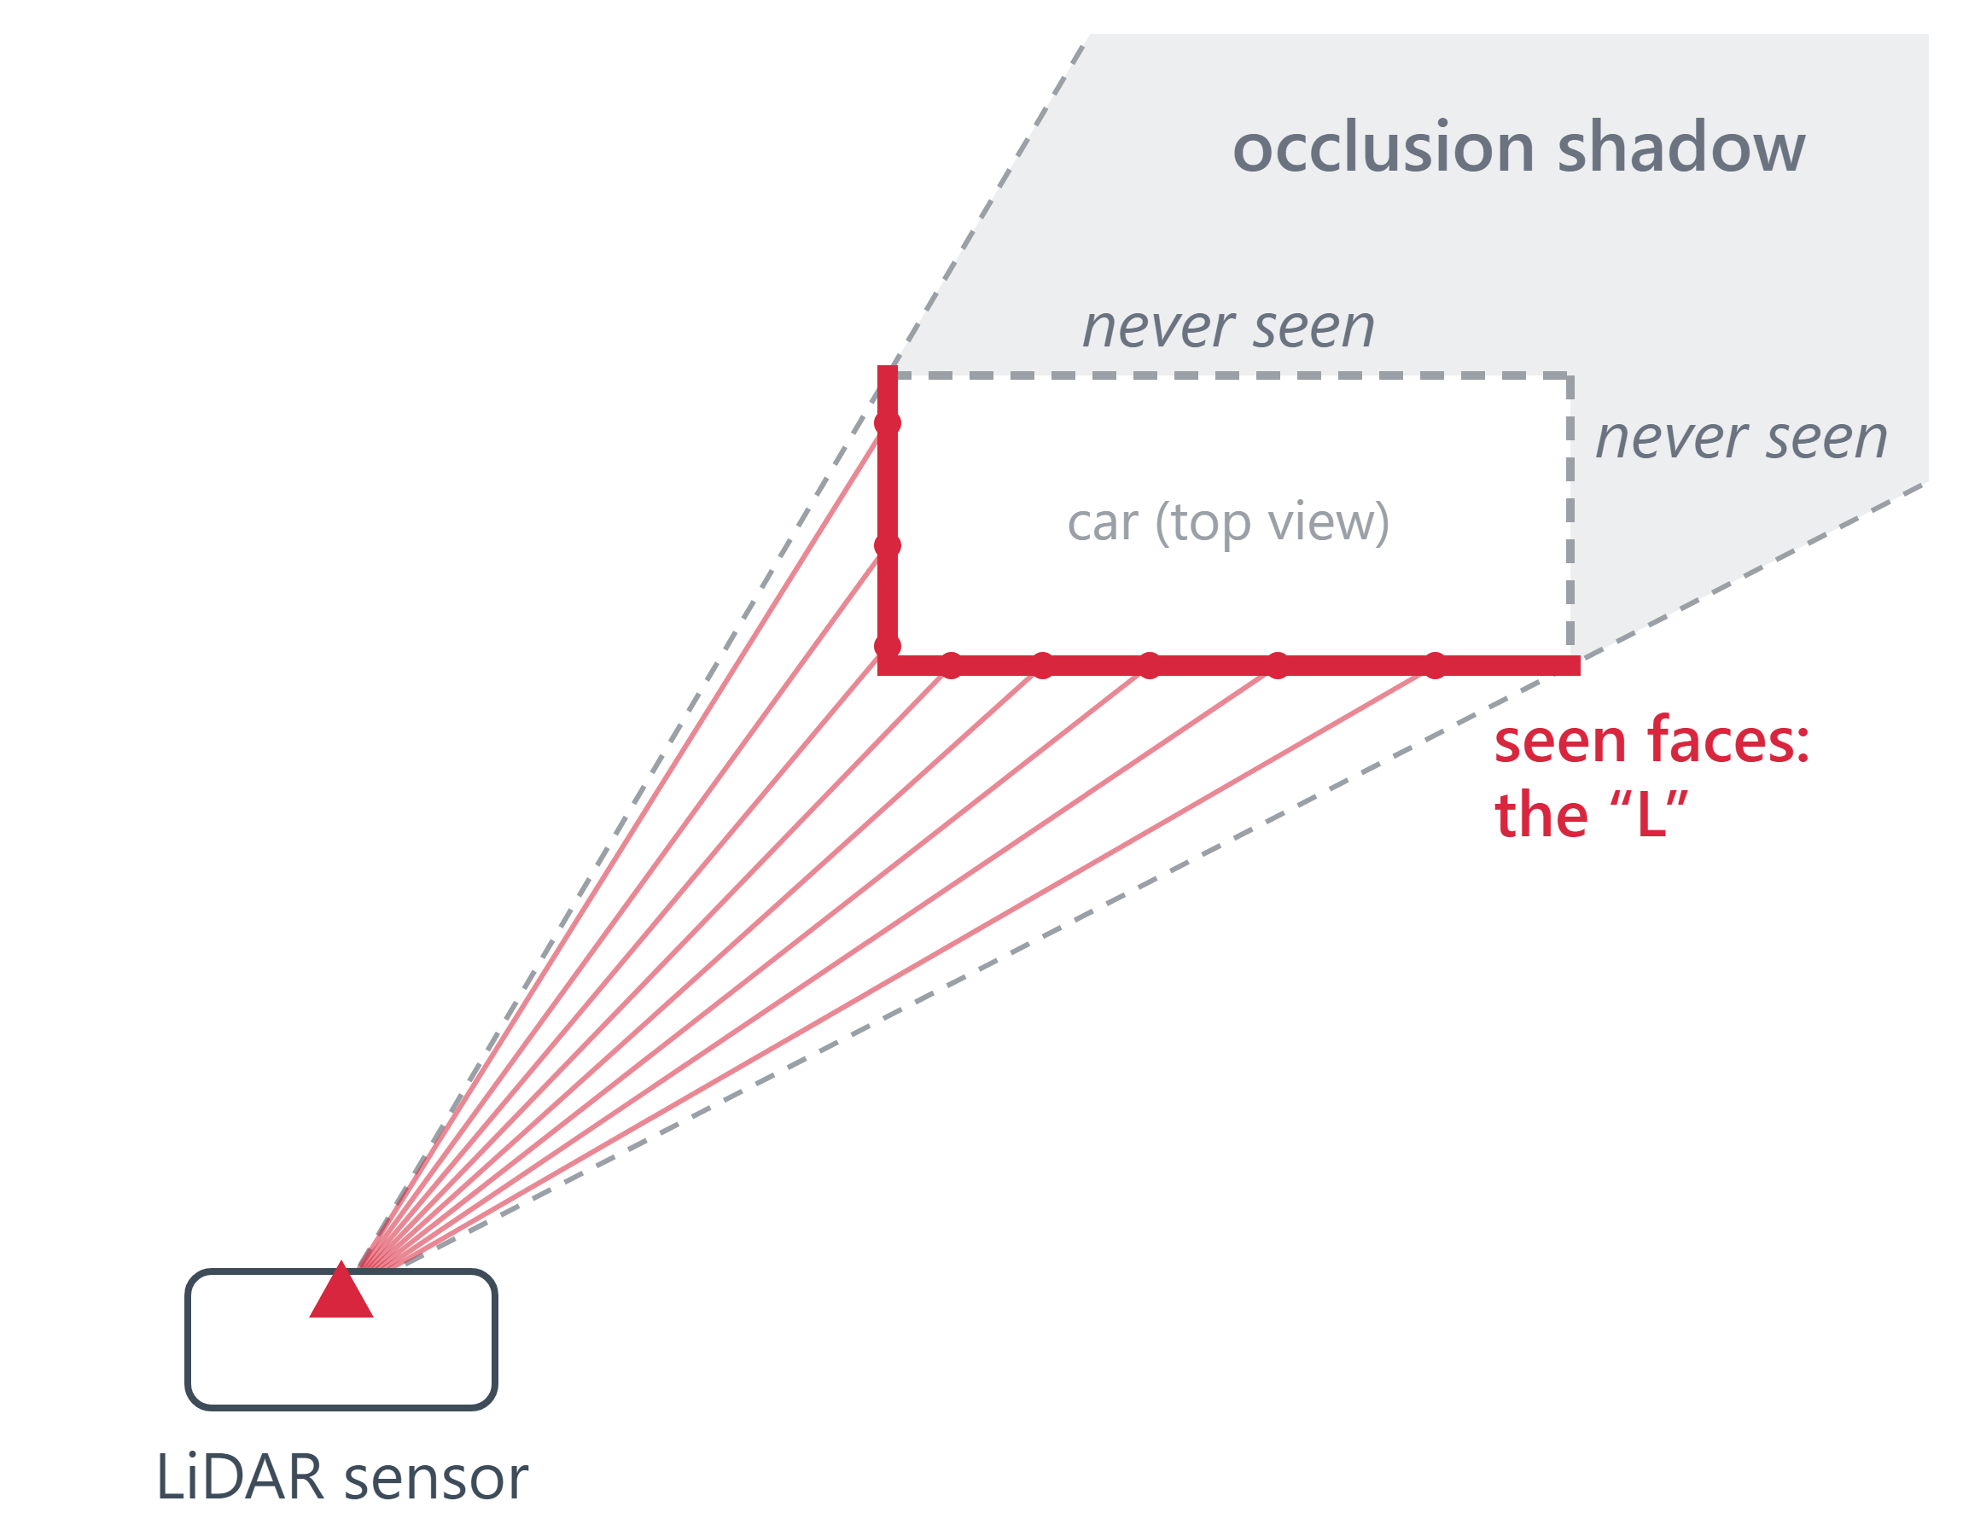
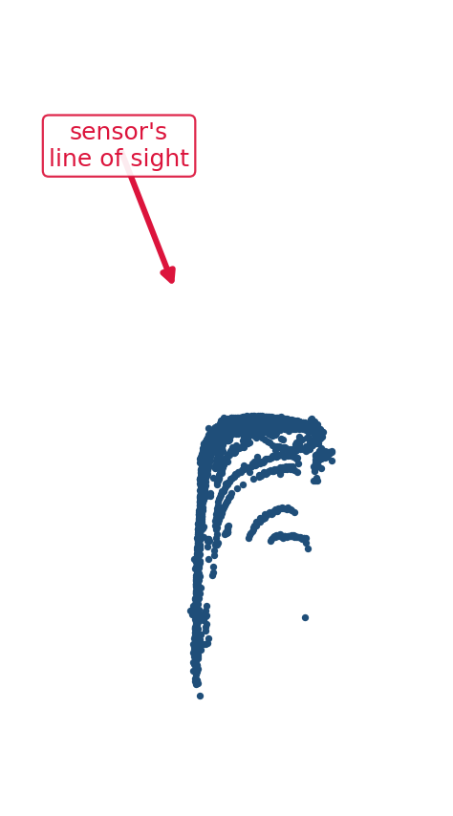
1.1 BACKGROUND
The laser only reaches the near side, so half of every car is missing.
Real car, 6 m away (Thesis Fig. 2.3)
I. INTRODUCTION
4
Notes:
★ TALK 1:00 — source: D1; fig:bg-lidar-scan (b); say the 3 point-cloud properties aloud (backup slide)

Slide 5
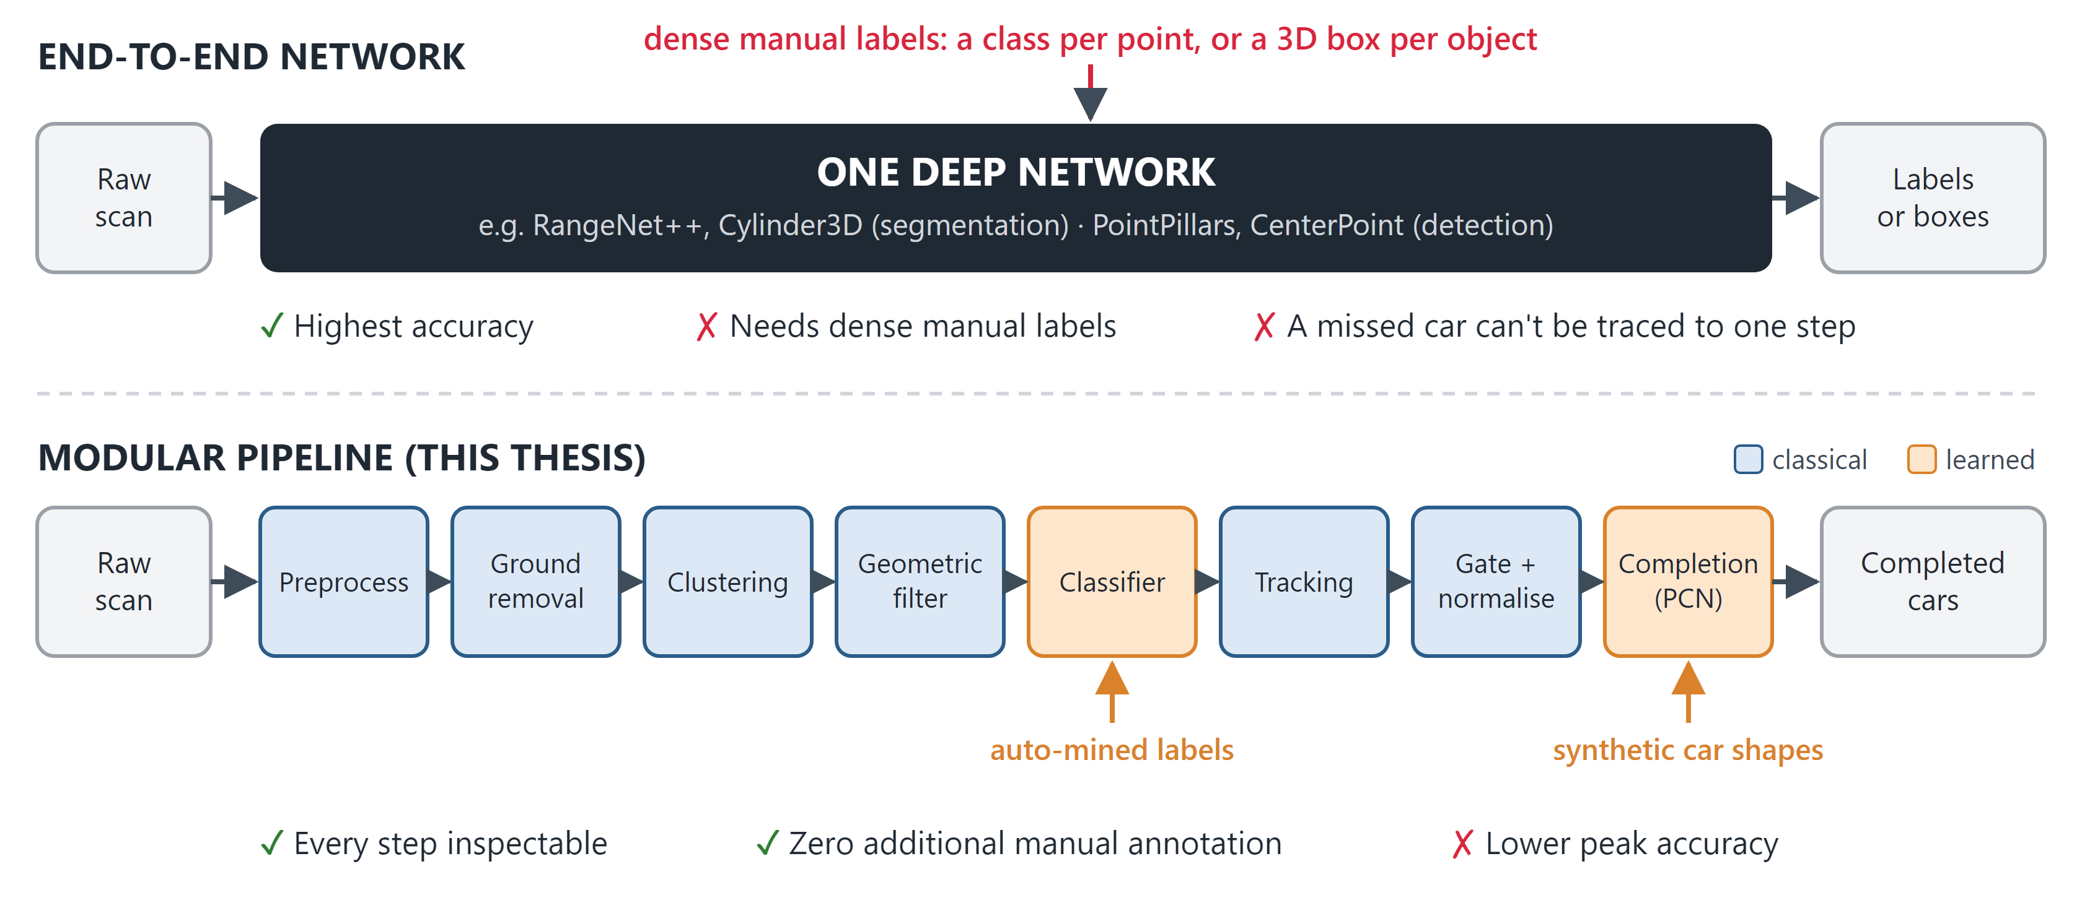
1.2 CURRENT APPROACHES
End-to-end networks are accurate but need dense labels and act as black boxes; we take the modular route.
I. INTRODUCTION
5
Notes:
★ TALK 1:00 — source: D2; ch1 §1.1 (examples); ch2 §2.2.2–2.2.3. If asked how we compare: different metrics (their all-class mIoU vs our car-only point F1), not one scale; see 1.3 / tab:positioning

Slide 6
1.3 LITERATURE REVIEW
Three lines of prior work, and what each leaves open.
Approach | Representative works | Strengths | Remaining challenges
End-to-end deep segmentation | RangeNet++, RandLA-Net, Cylinder3D; panoptic: Panoptic-PolarNet, DS-Net | Benchmark leaders (Cylinder3D 67.8 mIoU on the SemanticKITTI test set) | Need dense per-point (and per-instance) labels; a missed object can't be traced to one step
Classical geometric segmentation | RANSAC ground removal + DBSCAN / HDBSCAN clustering | No training data for segmentation; every stage inspectable | No notion of objectness: clustering splits cars, which costs recall
Object-level completion | PCN, PoinTr, SnowflakeNet, SeedFormer | Learns to map a partial view to a complete shape | Trained on synthetic CAD shapes (domain gap); Chamfer scoring needs a complete true shape that real LiDAR lacks
I. INTRODUCTION
6
Notes:
○ SUPPORT (skip in talk) — source: ch2 §2.2 (bg-deep, bg-classical, bg-completion); tab:positioning for the per-method table. No accuracy column on purpose: their mIoU / PQ over all classes and our car-only point F1 are different measurements (ch2 §positioning).

Slide 7
1.4 RESEARCH GAP
Accurate detectors need dense labels and are hard to inspect, and real-world completion has no ground truth to train or test against.
Dense labels
Accurate networks need a class per point or a box per object
Opacity
A missed car can't be traced to one step
No paired real data
No real occluded car comes with its full shape
No ground truth
Real completions can't be scored against a true shape
I. INTRODUCTION
7
Notes:
★ TALK 0:40 — source: ch1 §1.1–1.2

Slide 8
1.5 OBJECTIVES & CONTRIBUTIONS
Three objectives, two contributions.
Objectives
Contributions
1. Test whether a modular, geometry-first pipeline can detect vehicles as a transparent alternative to end-to-end networks.
2. Evaluate point cloud completion on real LiDAR, where no complete ground truth exists.
3. Test whether synthetic-only training and auto-mined supervision transfer to real LiDAR without new manual labels.
1. A modular detection and completion framework for occluded vehicles, inspectable and reproducible at every stage.
2. Zero additional manual annotation: classifier labels are mined automatically; the completion network trains only on synthetic shapes.
I. INTRODUCTION
8
Notes:
★ TALK 0:45 — source: ch1 §Objectives, §Contributions

Slide 9
II. PROPOSED METHODOLOGY
9
Notes:
divider: click through

Slide 10
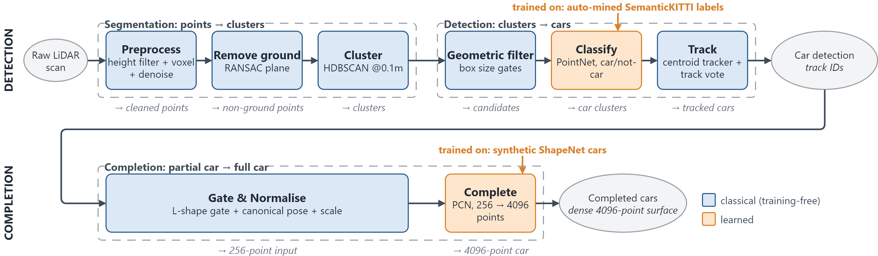
2.1 SYSTEM ARCHITECTURE
Eight steps from a raw scan to completed cars.
II. PROPOSED METHODOLOGY
10
Notes:
★ TALK 1:00 — source: D3; fig:architecture, fig:pipeline, fig:completion-pipeline

Slide 11
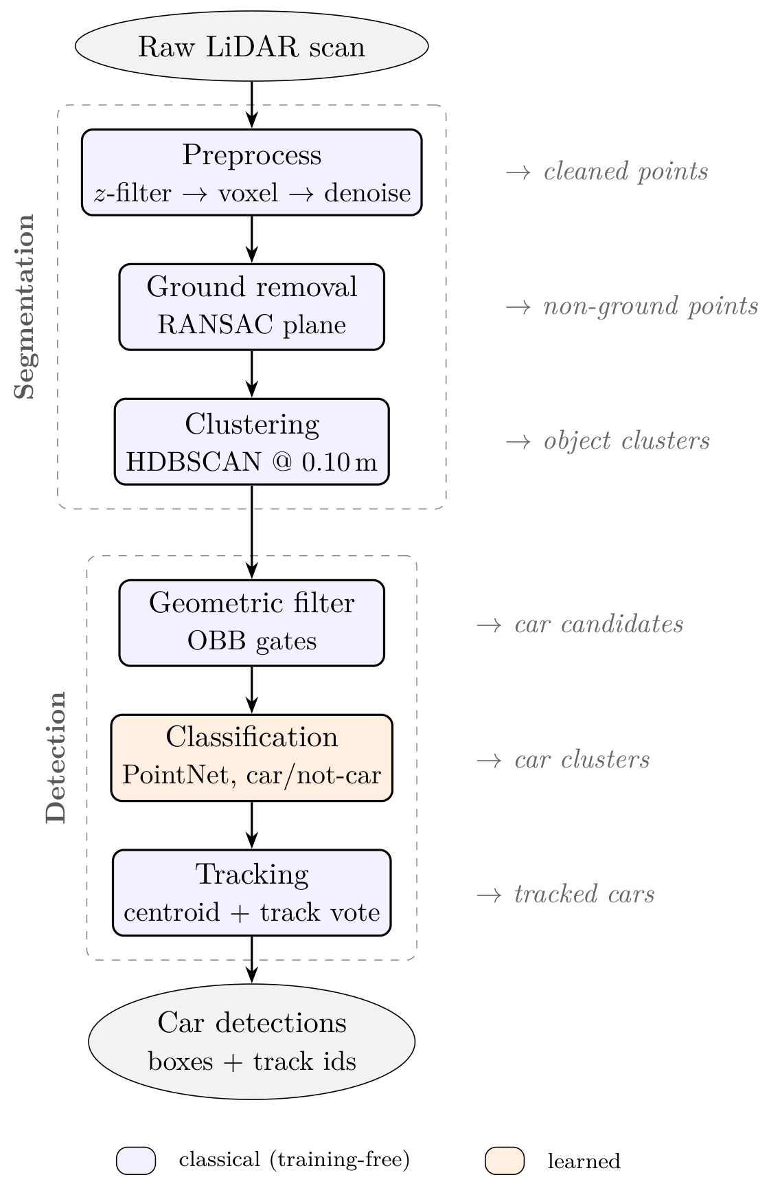
2.2 DETECTION PIPELINE
Six steps turn a raw scan into tracked cars.
II. PROPOSED METHODOLOGY
11
Notes:
○ SUPPORT (skip in talk) — source: ch3 §detection pipeline; fig:pipeline (crop: scripts/crop_thesis_figure.py 3.2 pipeline)

Slide 12
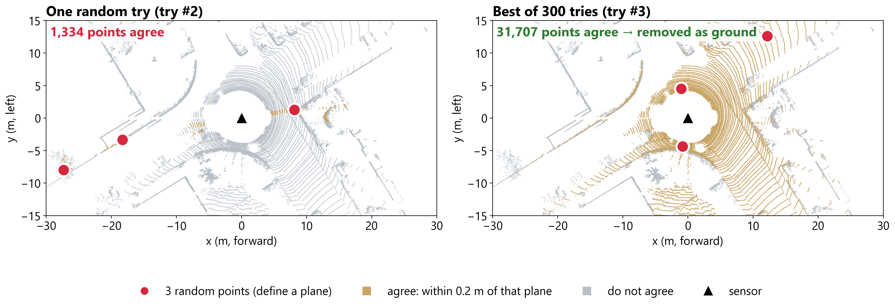
2.2.1 PREPROCESSING AND GROUND REMOVAL
Clean the scan, then remove the ground plane with RANSAC.
II. PROPOSED METHODOLOGY
12
Notes:
★ TALK 0:45 — source: D4 (seq 08 frame 2500, one-frame illustration: counts are NOT thesis results); ch2 §RANSAC; ch3 §preprocessing, §RANSAC.

Slide 13
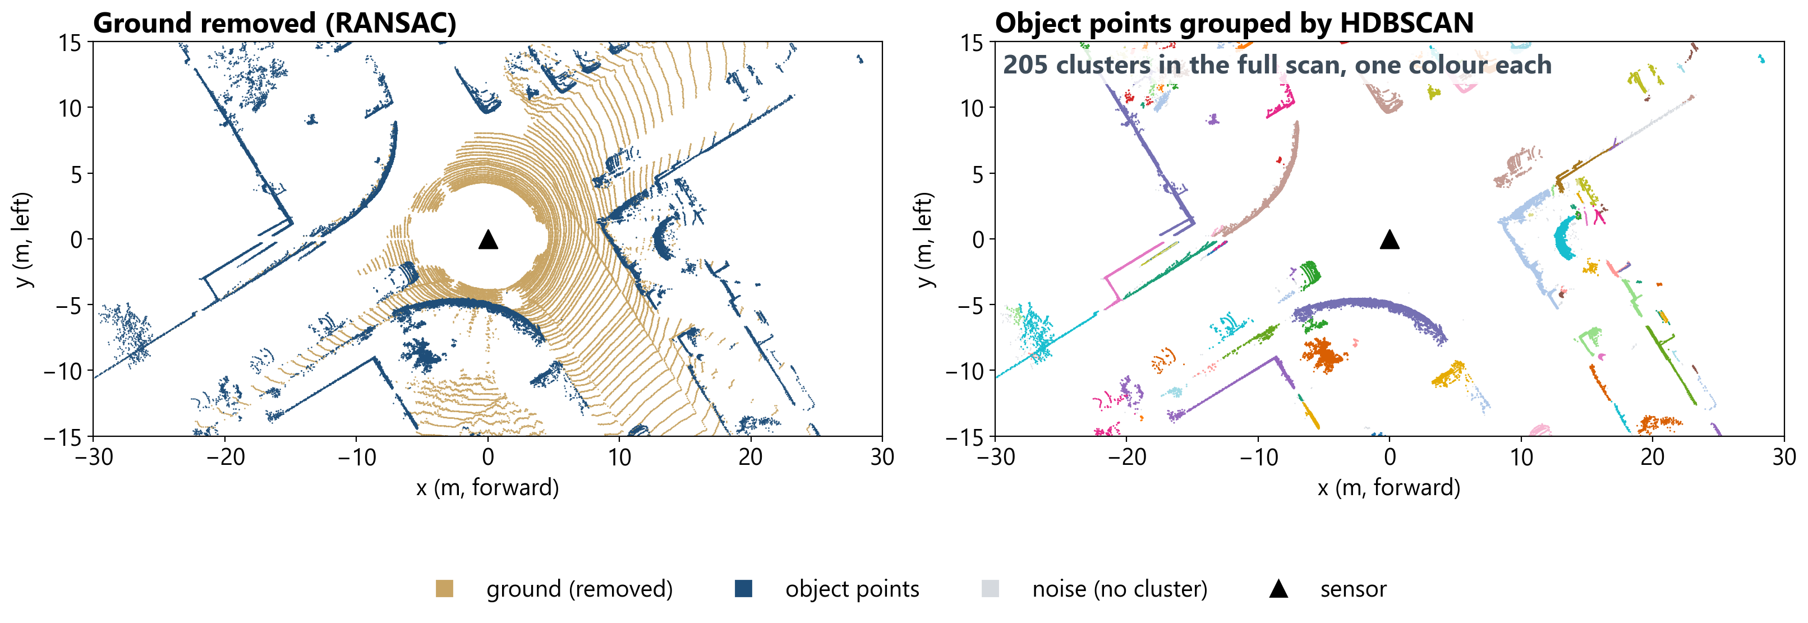
2.2.2 CLUSTERING (HDBSCAN)
HDBSCAN groups the remaining points into object candidates.
II. PROPOSED METHODOLOGY
13
Notes:
★ TALK 0:45 — source: D5 = same seq 08 frame 2500 as D4 (scripts/make_d5_clusters.py, pipeline's own preprocess, remove_ground, cluster_objects); one-frame illustration: the 205 clusters are NOT a thesis result. Concept: fig:clustering; fig:bg-pipeline-stages.

Slide 14
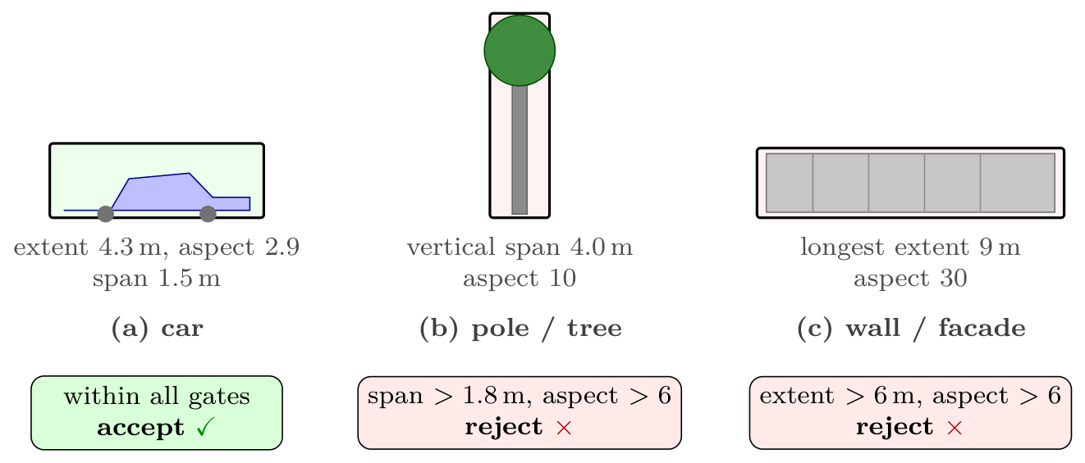
2.2.3 GEOMETRIC FILTER
Size and shape rules on each cluster's oriented box drop obvious non-cars.
Gate | Keep the cluster if
Points | ≥ 15
Box volume | 0.5–50 m³
Longest side | ≤ 6.0 m
Size floors | longest ≥ 0.5 m, middle ≥ 0.4 m
Centre height | ≤ 1.5 m above the ground plane
Vertical span | ≤ 1.8 m
Aspect ratio | longest / shortest ≤ 6.0
After this filter alone: precision 0.199, recall 0.773.
Loose by design: the classifier makes the fine decision.
II. PROPOSED METHODOLOGY
14
Notes:
○ SUPPORT (skip in talk) — source: fig:geo-filter (crop: scripts/crop_thesis_figure.py 3.4 geo_filter); gates = ch3 §Geometric Filtering; P 0.199 / R 0.773 = tab:ablation-stage geometric-only row. If asked which gates cost cars: 27,718 rejected clusters overlap a GT car, 73.9% by the minimum-volume and 12.7% by the minimum-points gate, i.e. small splinters of already-split cars (the thesis states this as an inference).

Slide 15
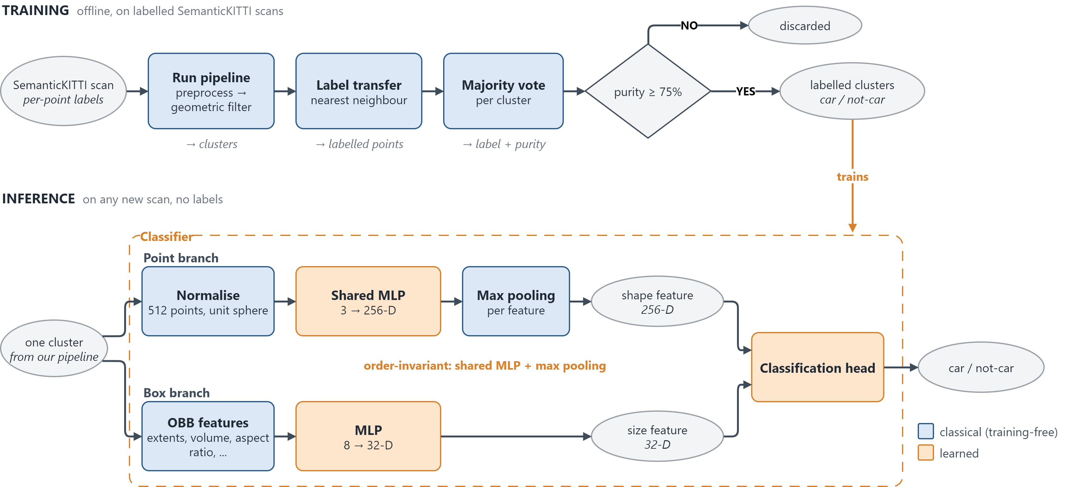
2.2.4 CAR / NOT-CAR CLASSIFIER
A small PointNet decides car or not-car, trained on labels mined automatically from SemanticKITTI.
II. PROPOSED METHODOLOGY
15
Notes:
★ TALK 1:00 — source: D6+D7 merged. Top lane (training) = ch3 §training data (mined, not hand labelled); bottom lane (inference) = fig:classifier, simplified. Story: the top lane is the answer key, looked up from SemanticKITTI labels; the classifier learns to give the same answer from the points alone, so on a new scan, with no labels, only the bottom lane runs. Say 'zero additional manual annotation', not 'annotation-free'. Counts: 420,333 training clusters (seq 00-07, 09, 10), 130,394 validation (seq 08), about 21% car / 79% not-car.

Slide 16
2.2.5 TRACKING AND TRACK FILTER
Detections are linked into tracks across frames; a track is kept only if at least half of its frames vote car.
[ D8 tracking timeline ]
II. PROPOSED METHODOLOGY
16
Notes:
★ TALK 0:30 — source: fig:tracker

Slide 17
2.3 COMPLETION PIPELINE
Each detected car is gated, normalised, given a length, and completed by PCN.
[ thesis fig:completion-pipeline (crop from main.pdf) ]
II. PROPOSED METHODOLOGY
17
Notes:
○ SUPPORT (skip in talk) — source: ch3 §object completion; fig:completion-pipeline

Slide 18
2.3.1 COMPLETION NETWORK (PCN)
The completion network trains only on synthetic cars and must work on real scans it has never seen.
[ D11 PCN training and inference ]
II. PROPOSED METHODOLOGY
18
Notes:
★ TALK 1:00 — source: fig:pcn

Slide 19
2.3.2 SYNTHETIC TRAINING PARTIALS
Training inputs are simulated LiDAR-style partial views of synthetic ShapeNet cars.
[ thesis fig:kitti-like-partial (fig61_partials PNG) ]
II. PROPOSED METHODOLOGY
19
Notes:
○ SUPPORT (skip in talk) — source: fig:kitti-like-partial

Slide 20
2.3.3 L-SHAPE GATE, NORMALISATION AND LENGTH
Each real cluster passes an L-shape gate, then is rotated and scaled into the network's training frame using an estimated car length.
[ thesis fig:lshape-gate (crop from main.pdf) ]
[ table: tab:completion-config ]
II. PROPOSED METHODOLOGY
20
Notes:
○ SUPPORT (skip in talk) — source: fig:lshape-gate, tab:completion-config

Slide 21
III. EXPERIMENTAL EVALUATION
3.1 DATASET AND PROTOCOL
21
Notes:
divider: click through

Slide 22
3.1.1 DATASETS
Real SemanticKITTI scans for detection; synthetic ShapeNet cars for completion.
 | SemanticKITTI | ShapeNetCore v2
Data | Real LiDAR scans | Synthetic CAD meshes
Role | Detection, mining, evaluation | Completion network training
Volume | 23,201 frames (11 sequences) | ~3,150 car models
Annotations used | Point-wise semantic + instance | None (synthetic partials)
Sensor | Velodyne HDL-64E
Beams | 64
Frame rate | 10 Hz
Horizontal resolution | ~0.09°
Max range | 120 m
Points per frame | ~100,000–120,000
Seq | 00 | 01 | 02 | 03 | 04 | 05 | 06 | 07 | 08 | 09 | 10
Frames | 4541 | 1101 | 4661 | 801 | 271 | 2761 | 1101 | 1101 | 4071 | 1591 | 1201
Classifier | train | train | train | train | train | train | train | train | val | train | train
Sequences 11–21 have no public labels, so no labelled sequence is left as a separate test set. For completion, every sequence is evaluation only: PCN trains on synthetic ShapeNet.
III. EXPERIMENTAL EVALUATION
22
Notes:
○ SUPPORT (skip in talk) — source: tab:dataset-roles, tab:sensor-spec, tab:dataset, verbatim. Seq 08 is the classifier's validation sequence, not a test set; LOSO (3.2.3) is the leakage control.

Slide 23
3.1.2 TARGET ELIGIBILITY AND GROUND TRUTH
A car is scored only if enough of its points survive preprocessing.
[ eligibility rule + example ]
III. EXPERIMENTAL EVALUATION
23
Notes:
○ SUPPORT (skip in talk) — source: ch4 §eligibility — ≥10 surviving points; 25.5% of annotated cars excluded; recall vs ALL annotated cars ≈ 0.55 (ch4, ch5) vs 0.732 eligible

Slide 24
3.2 EXPERIMENTAL SETUP
24
Notes:
divider: click through

Slide 25
3.2.1 BASELINES
Detection stages are compared by ablation, not against supervised detectors; completion is compared with the raw partial, a dense reference, and PoinTr.
[ table: tab:positioning (why no head-to-head) + completion references ]
III. EXPERIMENTAL EVALUATION
25
Notes:
○ SUPPORT (skip in talk) — source: ch4 §baselines; tab:positioning

Slide 26
3.2.2 METRICS
Detections are matched to real cars by point overlap (IoU); completions are scored by an independent car classifier.
[ detection metrics: IoU matching ]
[ completion metric: plausibility ]
III. EXPERIMENTAL EVALUATION
26
Notes:
★ TALK 0:30 — source: fig:bg-iou; ch4 §metrics; ch4 §plausibility

Slide 27
3.2.3 DATA SPLIT: LEAVE-ONE-SEQUENCE-OUT
Train on ten sequences, test on the eleventh, and repeat for every sequence.
[ LOSO diagram ]
III. EXPERIMENTAL EVALUATION
27
Notes:
○ SUPPORT (skip in talk) — source: ch4 §splits; tab:loso

Slide 28
3.3 DETECTION RESULTS
28
Notes:
divider: click through

Slide 29
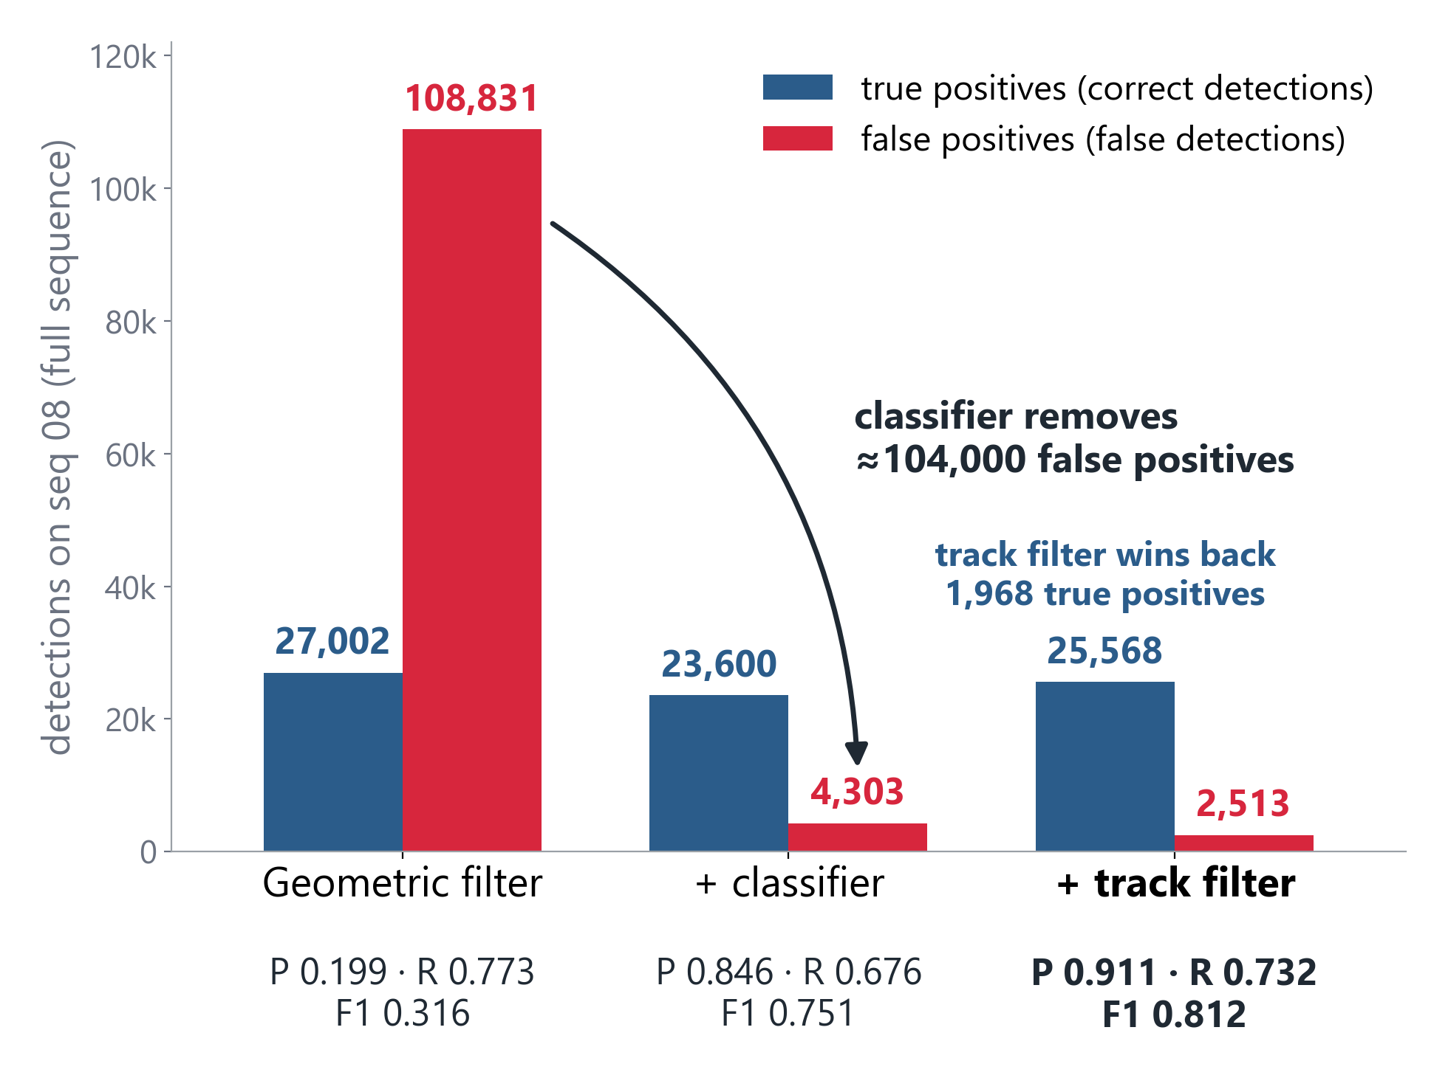
3.3.1 OVERALL DETECTION RESULTS
F1 0.812 on seq 08 (0.793 cross-validated), and each stage has a measurable job.
Detection results
 | Precision | Recall | F1
Seq 08 | 0.911 | 0.732 | 0.812
All 11 sequences | 0.888 | 0.717 | 0.793
All 11 sequences are cross-validated: each is scored by a classifier trained without it.
Within about 2 points of seq 08 on every metric.
III. EXPERIMENTAL EVALUATION
29
Notes:
★ TALK 1:00 — source: D9 = tab:ablation-stage, numbers verbatim (scripts/make_d9_funnel.py); table = tab:headline + tab:loso pooled row. Story, left to right: the geometric filter keeps most cars (recall 0.773) but 4 of 5 detections are false positives (precision 0.199); the classifier removes about 104,000 false positives (precision 0.846) and pays some recall (0.676); the track filter wins back 1,968 true positives and drops more false positives (0.911 / 0.732 / F1 0.812). Counts are per-frame matches over the sequence, not distinct cars. Table row 2 = tab:loso pooled (each fold's classifier never saw its test sequence). If asked whether we selected and report on seq 08: the seq-08 fold of LOSO (classifier blind to seq 08) gets 0.888 / 0.736 / 0.805, so selection bought about 2 precision points and no recall (tab:headline).

Slide 30
3.3.2 DETECTIONS ON A REAL FRAME
One seq-08 frame: found cars, false detections and missed cars.
[ thesis seq08_bev_detections.png ]
III. EXPERIMENTAL EVALUATION
30
Notes:
○ SUPPORT (skip in talk) — source: fig:bev-detections

Slide 31
3.3.3 WHAT LIMITS RECALL
Clustering splits cars into fragments; the classifier is not the limit.
[ D10 = thesis seq08_failure_zooms.png, frame-250 row (split car) ]
III. EXPERIMENTAL EVALUATION
31
Notes:
★ TALK 1:00 — source: tab:split, fig:failure-zooms

Slide 32
3.3.4 ACCURACY VS RANGE
Recall falls with distance as cars get sparser.
[ table: accuracy by distance ]
III. EXPERIMENTAL EVALUATION
32
Notes:
○ SUPPORT (skip in talk) — source: tab:distance

Slide 33
3.3.5 DETECTION RESULT ANALYSIS
What each detection stage contributes, and where it fails.
[ geometric filter ]
[ classifier ]
[ track filter ]
III. EXPERIMENTAL EVALUATION
33
Notes:
○ SUPPORT (skip in talk) — source: ch4 §result analysis

Slide 34
3.4 COMPLETION RESULTS
34
Notes:
divider: click through

Slide 35
3.4.1 JUDGING COMPLETION WITHOUT GROUND TRUTH
Distance metrics reward doing nothing, so an independent judge decides whether each output looks like a car.
[ D12 judge schematic ]
[ acceptance bar chart ]
III. EXPERIMENTAL EVALUATION
35
Notes:
★ TALK 1:30 — source: D12; tab:plausibility, fig:plausibility

Slide 36
3.4.2 COMPLETION EXAMPLES: RAW VS COMPLETED
The same real cars before and after completion.
[ thesis completion_shape_08.png ]
III. EXPERIMENTAL EVALUATION
36
Notes:
○ SUPPORT (skip in talk) — source: fig:completion-shape, fig:plausibility

Slide 37
3.4.3 SYNTHETIC FIDELITY
On held-out synthetic cars, the network reproduces the complete shape.
[ synthetic examples ]
[ CD and F-score ]
III. EXPERIMENTAL EVALUATION
37
Notes:
○ SUPPORT (skip in talk) — source: ch4 §synthetic fidelity

Slide 38
3.4.4 PLAUSIBILITY ROBUSTNESS
The plausibility gain holds on every sequence, for moving cars, and under a heading flip.
[ table: per-sequence plausibility ]
[ movers / flip / McNemar ]
III. EXPERIMENTAL EVALUATION
38
Notes:
○ SUPPORT (skip in talk) — source: tab:plausibility-seq; ch4 §plausibility

Slide 39
3.4.5 COMPLETION RESULT ANALYSIS
Where completion helps, and where it stays flat.
[ strengths ]
[ limitations ]
[ vs dense reference ]
III. EXPERIMENTAL EVALUATION
39
Notes:
○ SUPPORT (skip in talk) — source: ch4 §scope of the completion claim; ch5

Slide 40
3.5 RUNTIME EVALUATION
40
Notes:
divider: click through

Slide 41
3.5.1 RUNTIME BY STAGE
The pipeline runs offline; the classical CPU stages dominate the time per scan.
[ table: runtime per stage ]
III. EXPERIMENTAL EVALUATION
41
Notes:
○ SUPPORT (skip in talk) — source: tab:runtime

Slide 42
3.5.2 RUNTIME OPTIMISATION
Fewer RANSAC iterations and a coarser clustering voxel cut the time per scan by about a third.
[ before vs after optimisation ]
III. EXPERIMENTAL EVALUATION
42
Notes:
○ SUPPORT (skip in talk) — source: ch4 §runtime evaluation (921.3 → 623.5 ms)

Slide 43
3.6 ABLATION STUDY
43
Notes:
divider: click through

Slide 44
3.6.1 STAGE ABLATION
Adding one filtering stage at a time shows what each contributes.
Configuration | Precision | Recall | F1 | Mean IoU | TP / FP / FN
Geometric only | 0.199 | 0.773 | 0.316 | 0.907 | 27,002 / 108,831 / 7,920
+ classifier | 0.846 | 0.676 | 0.751 | 0.922 | 23,600 / 4,303 / 11,322
+ classifier, track filter | 0.911 | 0.732 | 0.812 | 0.913 | 25,568 / 2,513 / 9,354
The classifier is the precision step: false positives 108,831 → 4,303, at a recall cost.
The track filter wins recall back: true positives 23,600 → 25,568.
First two rows are per frame; the last row uses the offline track filter. Mean IoU is over matched detections only.
III. EXPERIMENTAL EVALUATION
44
Notes:
○ SUPPORT (skip in talk) — source: tab:ablation-stage, verbatim. Same numbers as the slide 29 chart, plus mean IoU and the raw counts. Counts are per-frame matches over the full sequence, not distinct cars.

Slide 45
3.6.2 CLUSTERING ALTERNATIVES AND RESOLUTION
No faster clusterer matches HDBSCAN's recall; a coarser resolution reduces fragmentation.
Clustering method (0.10 m grid, per frame, track filter off)
Clustering grid (seq 08, 34,057 cars)
Seq | Method | Precision | Recall | F1 | Time (ms)
00 | HDBSCAN | 0.972 | 0.731 | 0.835 | 306
00 | DBSCAN | 0.975 | 0.637 | 0.771 | 54
00 | Euclidean | 0.979 | 0.636 | 0.771 | 76
08 | HDBSCAN | 0.840 | 0.671 | 0.746 | 320
08 | DBSCAN | 0.870 | 0.565 | 0.685 | 57
08 | Euclidean | 0.869 | 0.576 | 0.693 | 75
 | 0.05 m | 0.10 m
Car in one cluster | 55.1% | 66.0%
Car split | 44.8% | 33.7%
Car merged | 0.2% (56) | 0.8% (284)
Clusters per split car | 4.7 | 3.0
Recall 0.710 → 0.732 (+756 true positives),
F1 0.798 → 0.812.
Precision within 0.03; HDBSCAN gains 9–11 recall points for about 6× DBSCAN's clustering time.
III. EXPERIMENTAL EVALUATION
45
Notes:
○ SUPPORT (skip in talk) — source: tab:clustering, tab:splitrate. Mean IoU column of tab:clustering left out. If asked 'why not an even coarser grid, e.g. 0.20 m?': merges grow as the grid coarsens (56 → 284), so we expect more fused cars; 0.20 m was NOT tested, say 'expect', not 'found'. If asked 'did you tune DBSCAN's radius?': yes, an epsilon sweep; the best fixed radius (Euclidean, 0.4 m) reaches F1 0.800 on seq 00, still below HDBSCAN's 0.835 (ch4 §clustering).

Slide 46
3.6.3 IOU-THRESHOLD SENSITIVITY
How the results change with the matching threshold.
[ table: IoU sensitivity ]
III. EXPERIMENTAL EVALUATION
46
Notes:
○ SUPPORT (skip in talk) — source: tab:iou-sensitivity

Slide 47
3.6.4 SYNTHETIC PRETRAINING
Synthetic pretraining adds nothing once enough real clusters are mined.
Classifier level (seq 08 validation clusters)
Cross-domain transfer (car-class F1)
Training recipe | Macro-F1
Real clusters only, from scratch (final) | 0.9285
Synthetic pretraining, then real | 0.9225
Trained on ↓ / tested on → | Synthetic | Real
Synthetic (Stage A) | 0.999 | 0.000
Real (Stage B) | 0.000 | 0.885
Within run-to-run noise. At pipeline level the two give identical F1 to three decimals.
A model from one domain finds no cars in the other: the gap is total and symmetric.
III. EXPERIMENTAL EVALUATION
47
Notes:
○ SUPPORT (skip in talk) — source: ch4 sec:ablation-stagea (macro-F1 0.9285 vs 0.9225; pipeline F1 identical to three decimals); tab:cross-domain. Don't mix the metrics: 0.9285 is macro-F1 (mean of car and not-car F1), 0.885 is car-class F1. Why keep it in the thesis: it changes the recipe, so it is reported as a negative result.

Slide 48
3.6.5 COMPLETION ABLATIONS
Input quality and normalisation matter more than the network: PoinTr improves synthetic Chamfer distance only from 0.161 to 0.153 m.
[ five ablations: normalisation · sim-to-real fine-tuning (negative) · L-shape gate · length · PCN vs PoinTr ]
III. EXPERIMENTAL EVALUATION
48
Notes:
○ SUPPORT (skip in talk) — source: ch4 §completion ablations (sec:abl-completion)

Slide 49
IV. CONCLUSION & FUTURE WORK
49
Notes:
divider: click through

Slide 50
4.1 RESEARCH SUMMARY
Four findings from a modular framework that needs zero additional manual annotation.
Detection on real LiDAR
F1 0.812 on seq 08; 0.793 cross-validated over all 11 sequences
Plausible completions
Independent judge's car acceptance: 0.253 raw → 0.785 completed
Clustering-bound recall
HDBSCAN splits 33.7% of cars; the classifier is not the limit
Redundant synthetic pretraining
Enough auto-mined real clusters make it unnecessary
IV. CONCLUSION & FUTURE WORK
50
Notes:
★ TALK 0:45 — source: ch5 §principal outcomes, §diagnostic findings, Final Remarks

Slide 51
4.2 LIMITATIONS
Four limits on what the results show.
Dense scenes only
Highway seq 01 recall 0.336 vs 0.758 on seq 00 (precision still 0.951)
Recall ceiling
0.773 before any learned stage
Plausibility only
Fidelity metrics do not corroborate the completion gain
Offline
623.5 ms per frame; real time is out of scope
IV. CONCLUSION & FUTURE WORK
51
Notes:
★ TALK 0:30 — source: ch5 §limitations (disc-architectural, disc-completion-scope, disc-eval-validity)

Slide 52
4.3 DISCUSSION & FUTURE WORK
Three next steps, each scoped by a finding.
Real-time variant
A native or GPU HDBSCAN implementation
Real-data fine-tuning
Close the synthetic-to-real gap for completion
Downstream detection
Test whether completed cars improve 3D detection
IV. CONCLUSION & FUTURE WORK
52
Notes:
★ TALK 0:30 — source: ch5 §future work

Slide 53
THANK YOU.
QUESTIONS ARE WELCOME.
53
Notes:
★ END — leave up during Q&A; jump to slides by number.

Slide 54
LIDAR POINT CLOUD PROPERTIES
A LiDAR scan is an unordered set of 3D points that gets sparser with range and sees each object from one side.
Unordered
No fixed order, unlike the pixels of an image
Sparser with range
Far objects get only a handful of points
One-sided
Each object is seen from one side only
BACKUP
54
Notes:
○ SUPPORT (skip in talk) — source: ch2 §LiDAR point cloud; tab:sensor-spec; S1 notes A1

Slide 55
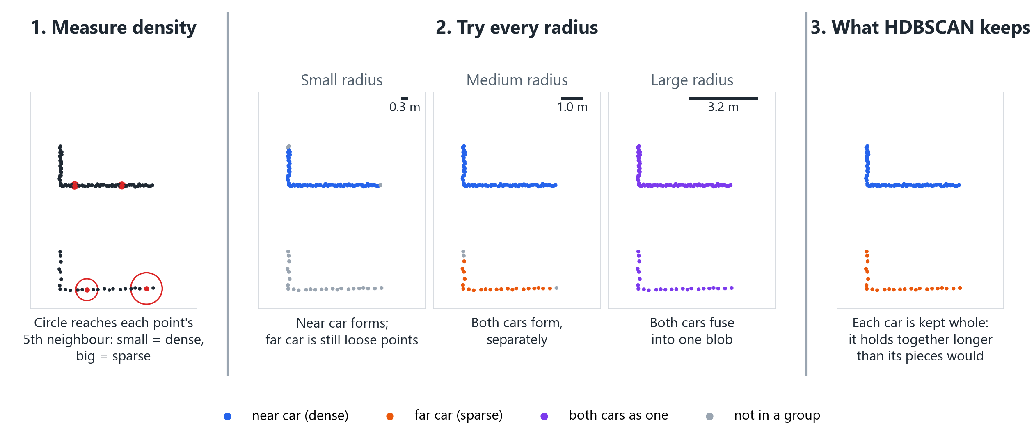
HOW HDBSCAN WORKS
It tries every radius at once, and keeps a group whole if it holds together longer than its pieces would.
BACKUP
55
Notes:
○ SUPPORT (skip in talk) — source: backup for 'how does HDBSCAN work?'. TOY 2D example (scripts/make_hdbscan_explainer.py), real hdbscan library with our settings (min_samples 5, min_cluster_size 10); NOT a thesis result. Say: (1) each point measures how crowded its neighbourhood is: the distance to its 5th nearest point (itself included); (2) HDBSCAN then looks at every radius at once: at a small radius only the dense near car forms, at a medium one both cars form, at a large one they fuse; (3) shrinking the radius, it keeps a group whole if it holds together longer than its pieces would. Each car is judged only against its own pieces, never against the other car, so the dense near car and the sparse far car both survive; a fixed-radius DBSCAN would have to pick one column. Toy numbers: near car 335.7 vs its pieces 19.2 -> whole; far car 24.1, no pieces -> kept (S2 notes A4). Precision if pressed: the 'radius' is the mutual reachability distance max(core a, core b, distance a-b), and 'longest' is stability, lifetime measured in 1/radius and summed over points; groups under 10 points are noise. ch2 §density-based clustering; S2 notes A4.

Slide 56
REPAIR STRATEGIES AND WHY THEY FAIL
[ Repair Strategies and Why They Fail ]
BACKUP
56
Notes:
○ SUPPORT (skip in talk) — source: backup

Slide 57
THE NORMALISATION BUG
[ The Normalisation Bug ]
BACKUP
57
Notes:
○ SUPPORT (skip in talk) — source: backup

Slide 58
IS THE JUDGE INDEPENDENT?
[ Is the Judge Independent? ]
BACKUP
58
Notes:
○ SUPPORT (skip in talk) — source: backup

Slide 59
FIDELITY METRICS: UCD AND UHD
[ Fidelity Metrics: UCD and UHD ]
BACKUP
59
Notes:
○ SUPPORT (skip in talk) — source: backup

Slide 60
WORKED EXAMPLE: IOU MATCHING
[ Worked Example: IoU Matching ]
BACKUP
60
Notes:
○ SUPPORT (skip in talk) — source: backup

Slide 61
PIPELINE CONFIGURATION
[ Pipeline Configuration ]
BACKUP
61
Notes:
○ SUPPORT (skip in talk) — source: backup

