Slide 1
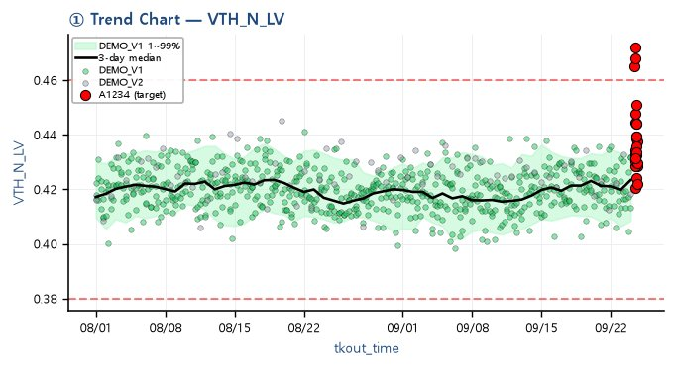
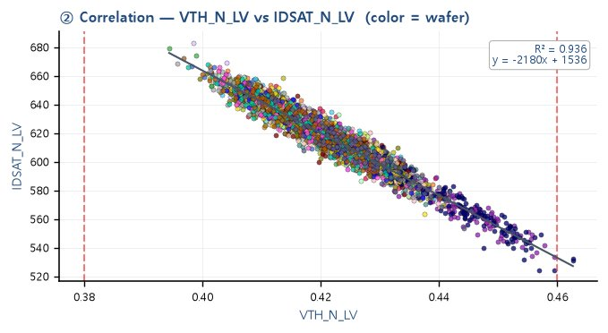
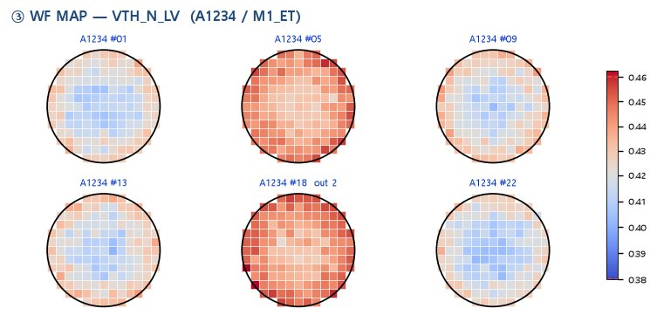
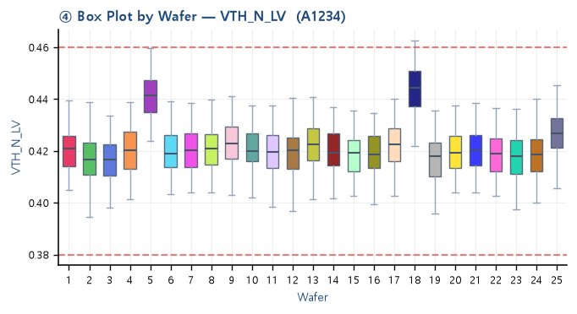
DEMO_V1 / A1234 / M1_ET — VTH_N_LV Summary (Demo)
※ Demo — dummy data. Spec line(red dashed) = 0.38 ~ 0.46. Wafer color / WF MAP colormap / box style = Auto Report theme.

