Slide 1

Summary Information
Selected cat1 value: ProductA Unique cat3 values: #1, #2, #3, #4, #5, #6, #7, #8, #9, #10 Generated on: 2024-03-04 00:33:27 Visit: http://abc.com

Slide 2
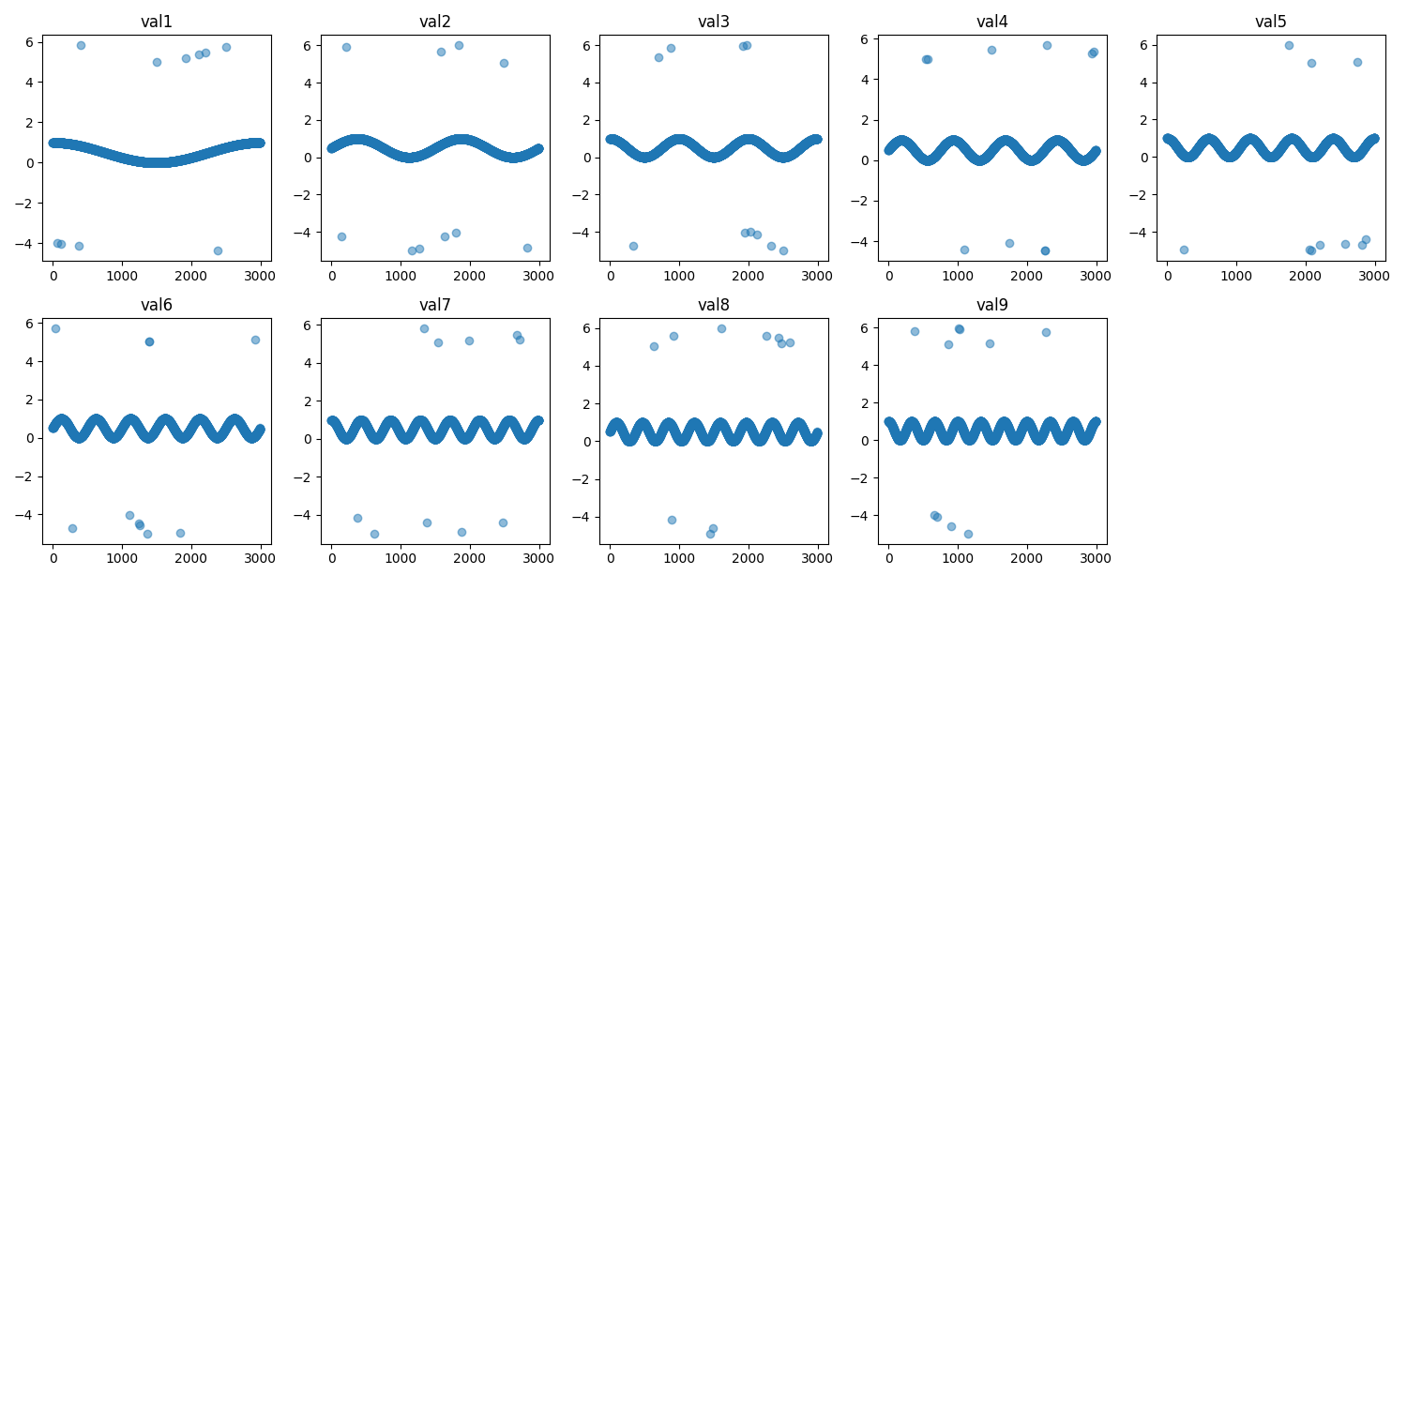

Slide 3
2nd chapter
Anomaly logic : pyod_mahalanobis distance Threshold : 150

Slide 4
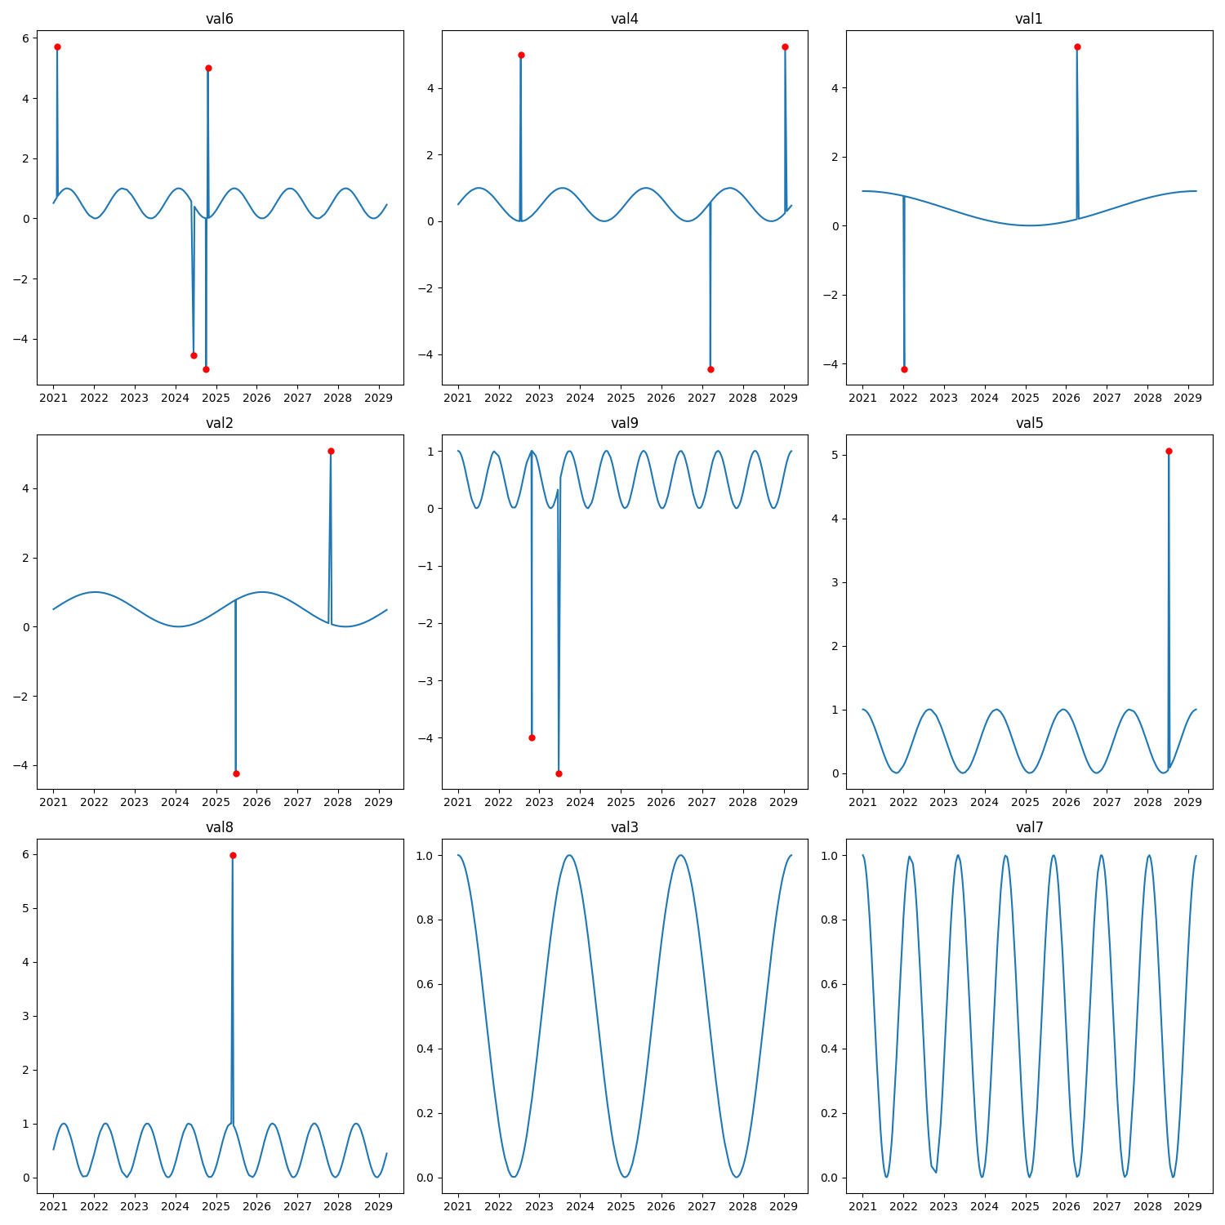

Slide 5
Anomaly Scores for Each Variable
Variable | Anomaly Count
val6 | 4
val4 | 3
val1 | 2
val2 | 2
val9 | 2
val5 | 1
val8 | 1
val3 | 0
val7 | 0

