Slide 1
Visualizing personal call records with Mobile Footprint
22.02.2017
Johannes Thon, Niels Hoppe, Tobias Ilte

Slide 2
Agenda
Goal
Related work
Overview
Features
Evaluation
Conclusion

Slide 3
1. Goal
Android application to visualize own location data and connection data history of call detail records
  Easy to use
  Visually appealing
  Should help to understand the dimension of data retention

Slide 4
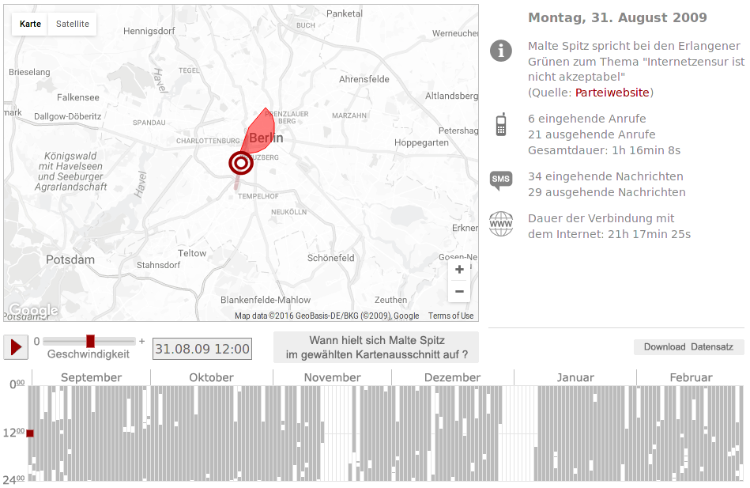
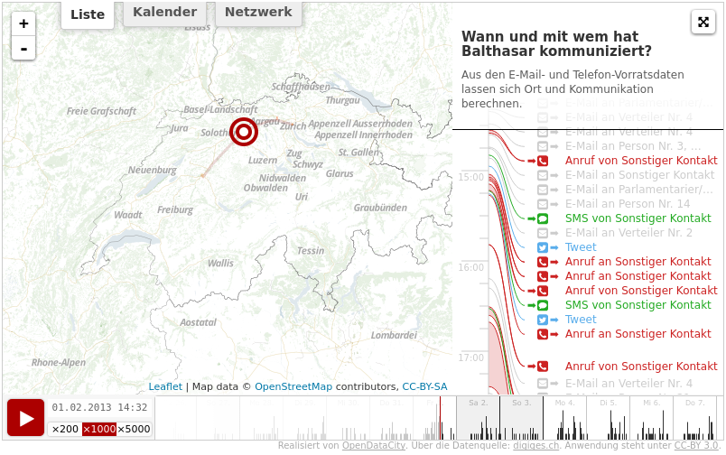
2. Related Work
Web services
  Malte Spitz, german green party politician
  Balthasar Glättli, politician in switzerland

Slide 5
3. Technologies
DataCollector (CellService)
Spatial database (SpatiaLite)
OpenStreetMap library (osmdroid)
Chart Library (MPAndroidChart)
Mozilla Location Service

Slide 6
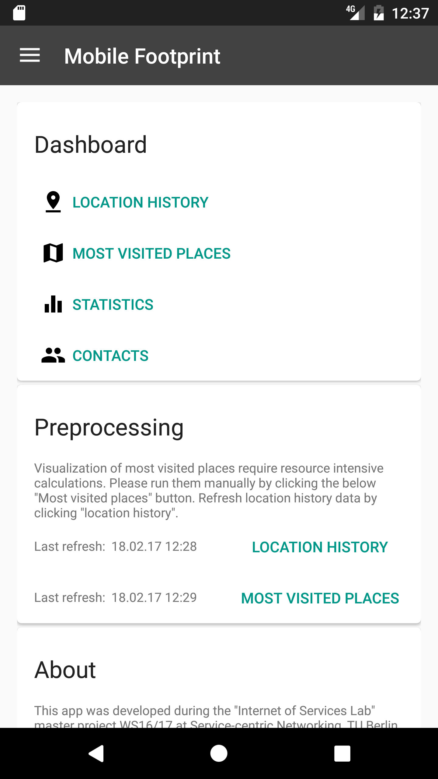
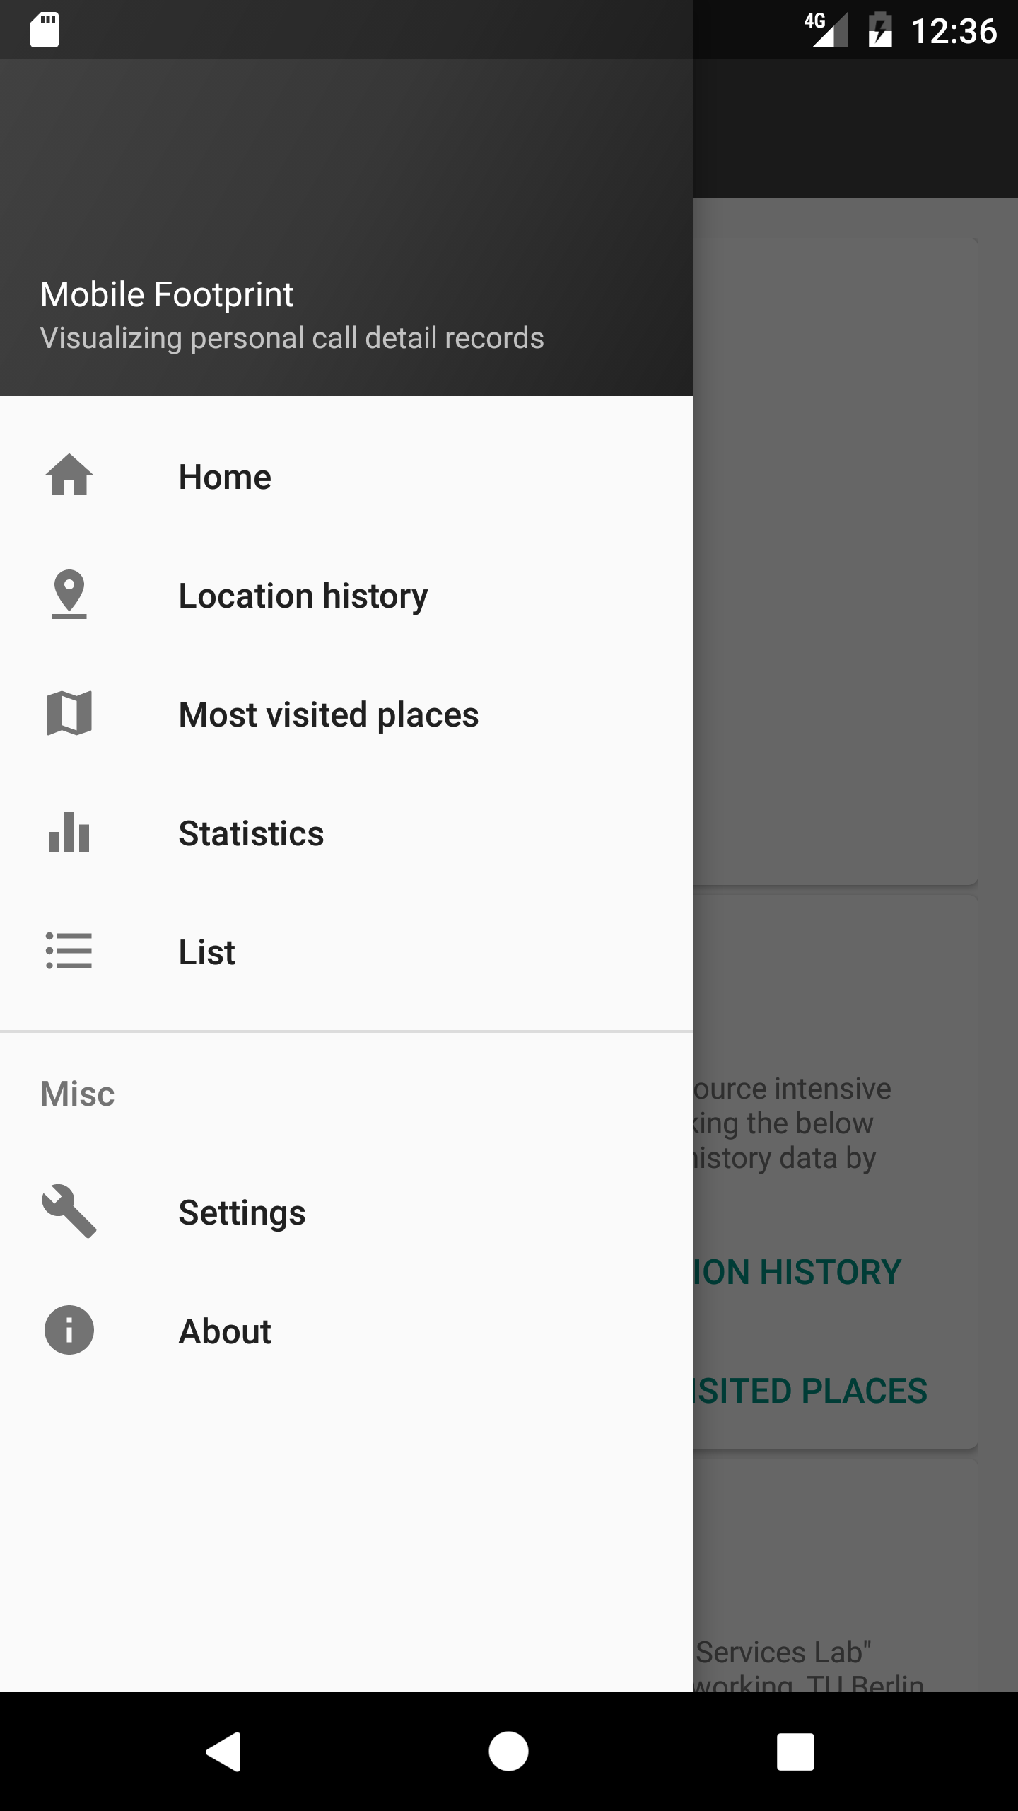
3. Overview – Mobile Footprint
Android Application (API 17-25)
Collecting metadata, estimation
of positions, Visualization
Main features:
→ Location history
→ Most visited places
→ Statistics

Slide 7
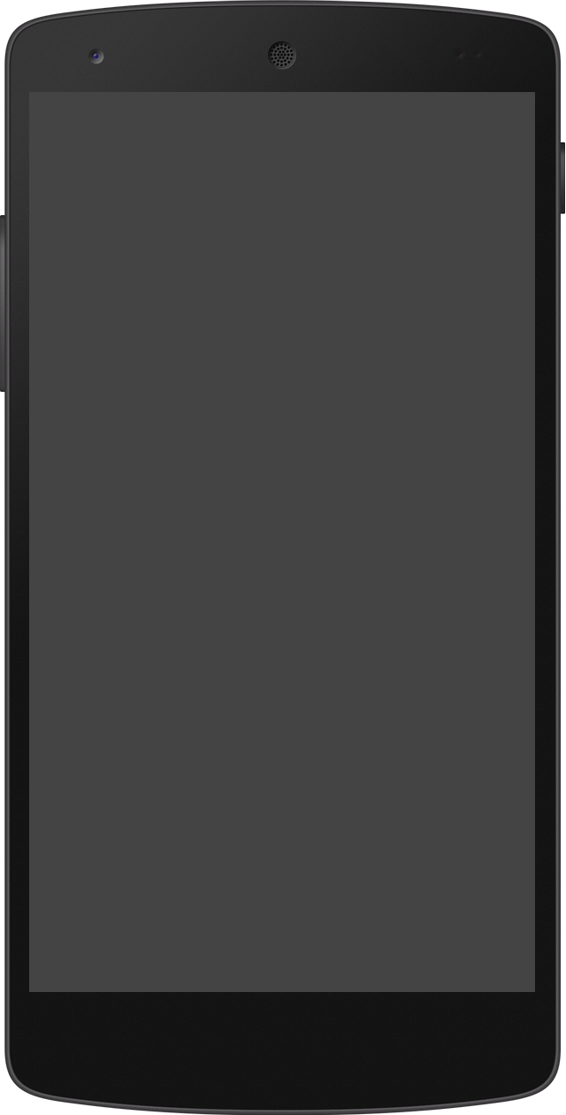
4. Features – Location history
Displays recorded events on a map
Filter by type and by time
Jump through events chronologically
Playback function

Slide 8
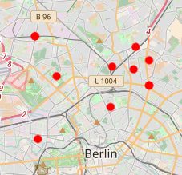
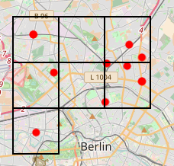
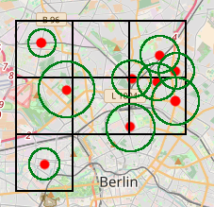
4. Features – Most visited places
Computation of the heat map:
1) Use GPS positions of MLS
2) Create tessellation over positions
3) Enrich positions with accuracy
4) Intersect with grid
polygons
5) Colorize heat map
(1)
(2)
(3,4)

Slide 9
4. Features – Most visited places
Preprocessing necessary
For last 4 weeks
Hexagonal tessellation
Saved to database

Slide 10
4. Features – Statistics
Day of week chart
Month (Histogram) chart
Month (Punchcart) chart
Contacts chart

Slide 11
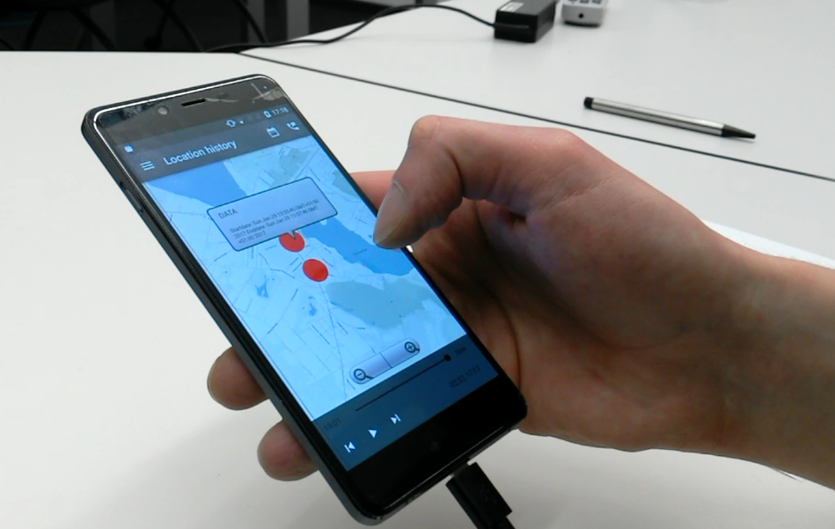
5. Evaluation
Qualitative evaluation
Think aloud test with 3 participants
Test device with test data
7 tasks
Audio+Video recording

Slide 12
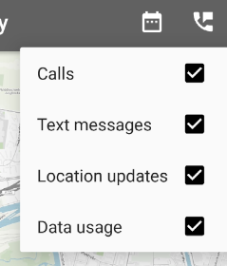
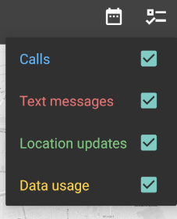
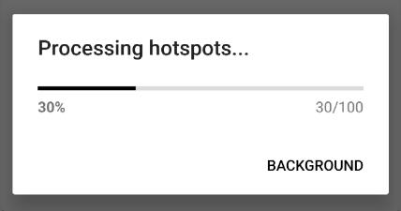
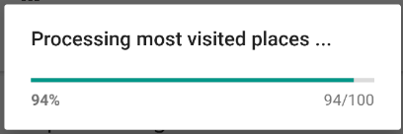
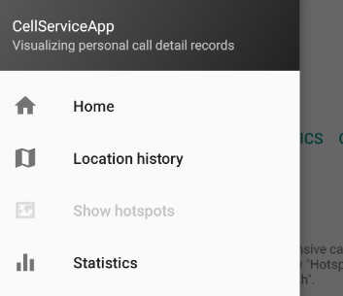
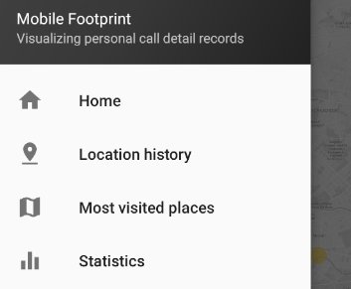
5. Evaluation - Results

Slide 13
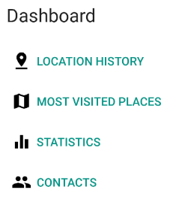
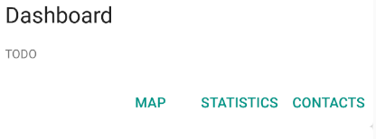
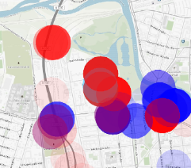
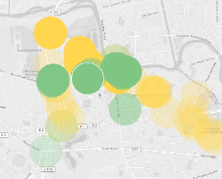


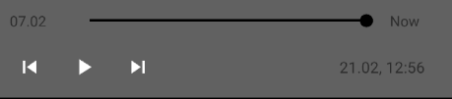
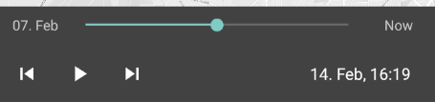
5. Evaluation - Results

Slide 14
6. Conclusion
Think aloud test was extremely helpful → Use it earlier and more often
Performant data structures matter
Variety of API levels introduces complexity
Native libraries may cause trouble

Slide 15
7. Further recommended work
SpatiaLite native library needs to be compiled for 64 bit architecture
Include cell size visualization in map
Enhance live processing of heat map
Add instruction tutorial

Slide 16
Fin
Any Questions?

Slide 17
References
Related work
  http://www.zeit.de/datenschutz/malte-spitz-data-retention
  https://www.digitale-gesellschaft.ch/dr.html
Most visited places tessellation sample
  https://www.gaia-gis.it/fossil/libspatialite/wiki?name=tesselations-4.0

Slide 18
Discussion
For discussion

