Slide 1


When you don’t know where to go….. there’s….
Kyle Ottmann and Michael Martinez

Slide 2
The Runder Mission
Runder is a company who believes its users deserve the best, most thorough information, and to get it faster than Bode Miller on the last turn. Together, with a vast database of ski and snowboarding runs and a simple, effective user-interactive website, we can ensure users are safely enjoying their time on the mountain. At Runder, we take the stress out of planning your winter trip so you can enjoy more time with your friends, family, or the person you just met on the chairlift.

Slide 3
The plan
Collect information from multiple ski and snowboard resorts
Ski Runs
Names, terrain, elevation, chairlifts, patrol shacks
Develop a user friendly website
Above all, save peoples lives on the mountain

Slide 4
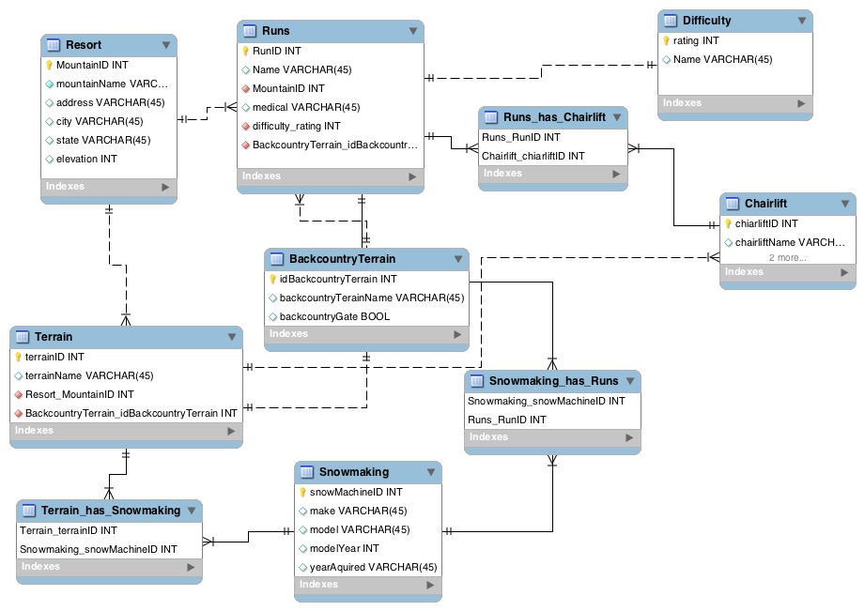
Where It Began

Slide 5
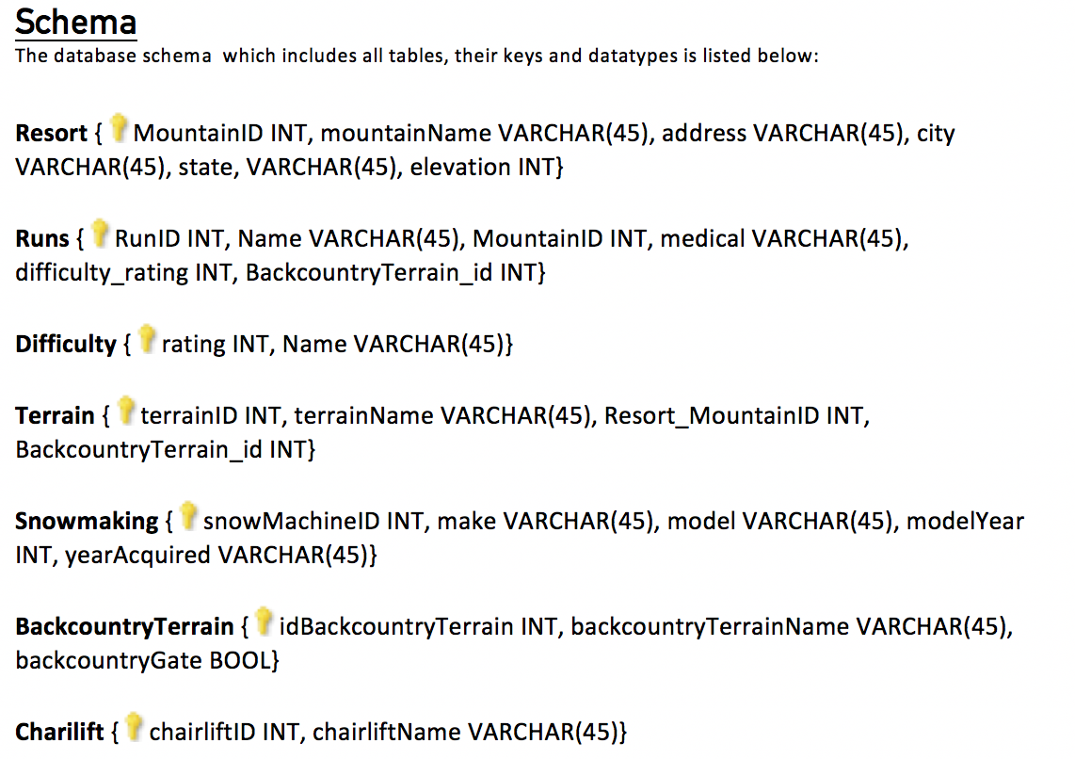
Schema

Slide 6
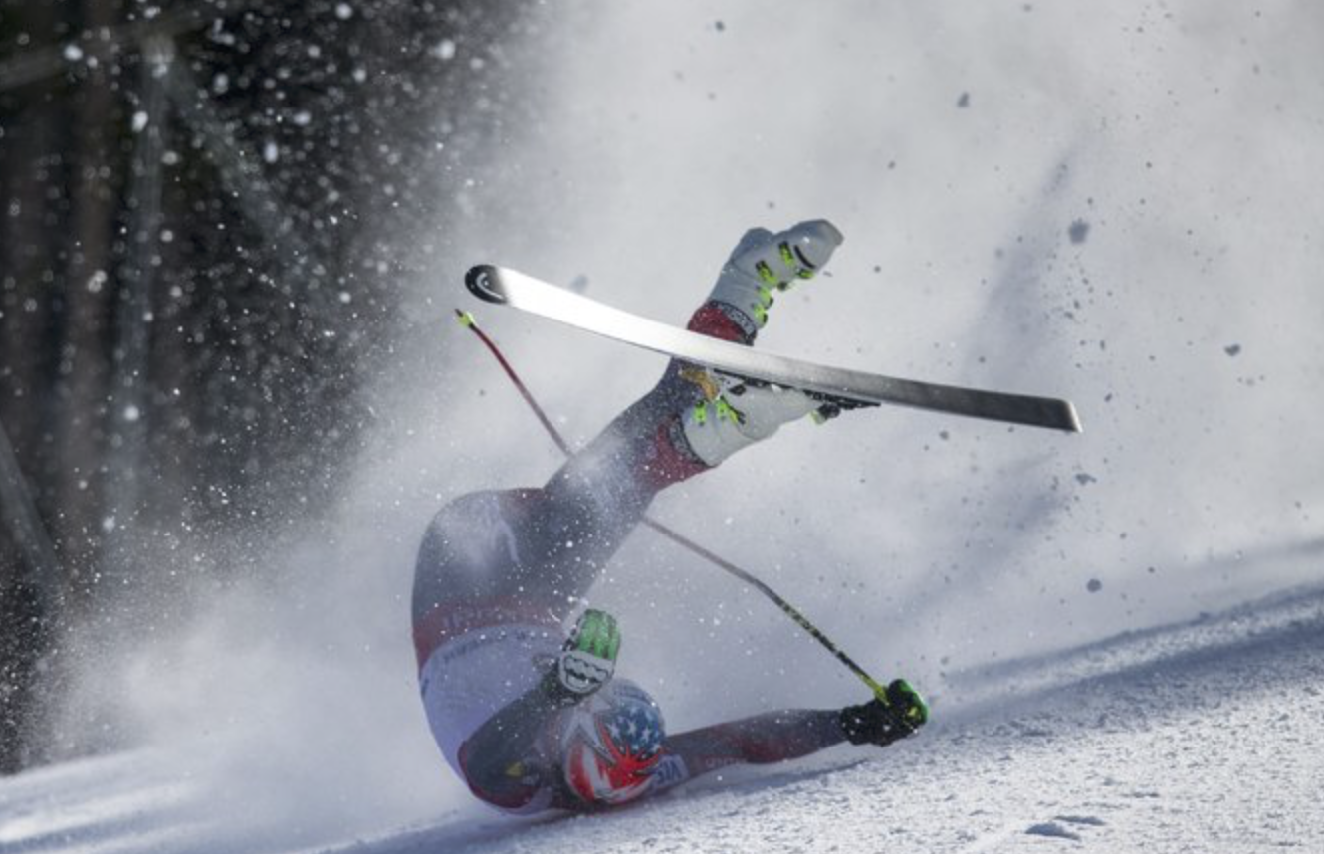
The Problems
Bode Miller fall

Slide 7
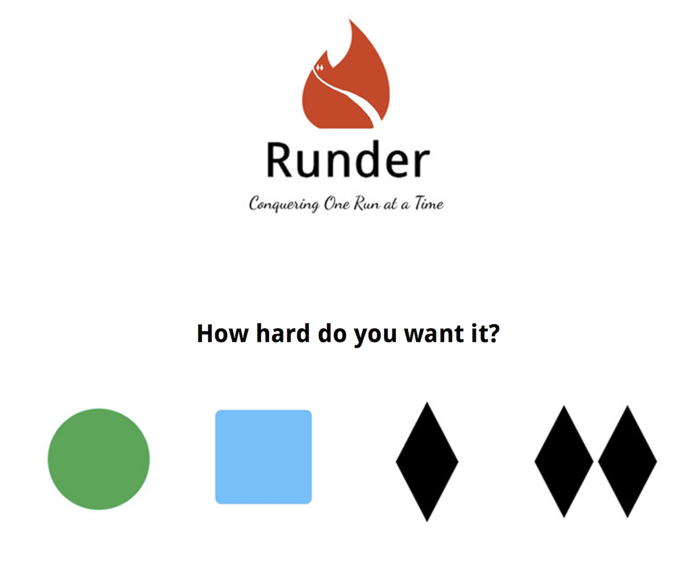
The website

