Slide 1

GoOSe Linux
Rebuilding Enterprise Linux
The 'Community' Way

Slide 2




Hello. My name is
Clint Savage
People online call me herlo
I participate online at the following places
I don't always blog, but when I do, I use http://sexysexypenguins.com

Slide 3
This presentation
Is Interactive!
Please ask questions.

Slide 4
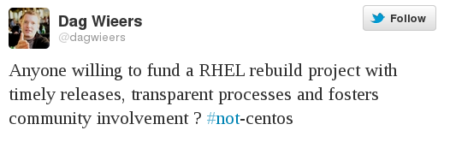
The Request
https://twitter.com/#!/dagwieers/status/57563280260087808

Slide 5
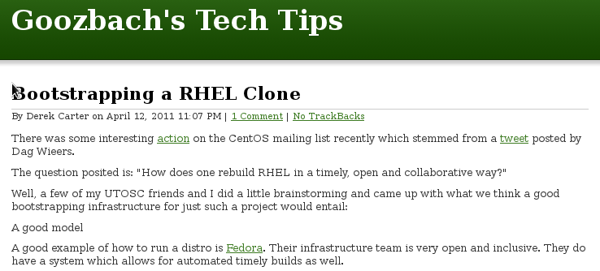
The Response
http://blog.friocorte.com/2011/04/bootstrapping-a-rhel-clone.html

Slide 6
The Result?
An 'Enterprise Linux' Rebuild Project
With a goal to grow the EL Rebuild ecosystem
The GoOSe Project
Focused on making rebuilds a 'transparent ' process

Slide 7
You need
Tools
and
Infrastructure
To rebuild an enterprise operating system

Slide 8



We stand on the shoulders of awesomeness!
http://github.com
http://python.org
https://fedorahosted.org/koji
Our Toolbelt
We have quite a bit of code too!
Written for the GoOSe Project
skein – manages imports and builds
grapple – git hook to automate koji
reposort – dependency ordering (alpha)
Forks from other projects
Python-github2
Python-github3 (soon)
supybot-gribble / meetbot
Notes:
Github hosts our git repos, over 2100 of them. They also host all of our issue tracking, and their API accounts for a good portion of our automation.
Koji is the server that builds our RPMS. So far, we've bootstrapped and built 3000+ packages with Koji.
Python is the powerhouse for the tools we write. Skein, written in python, requests repos, imports SRPMs and sends builds to the python powered koji.

Slide 9
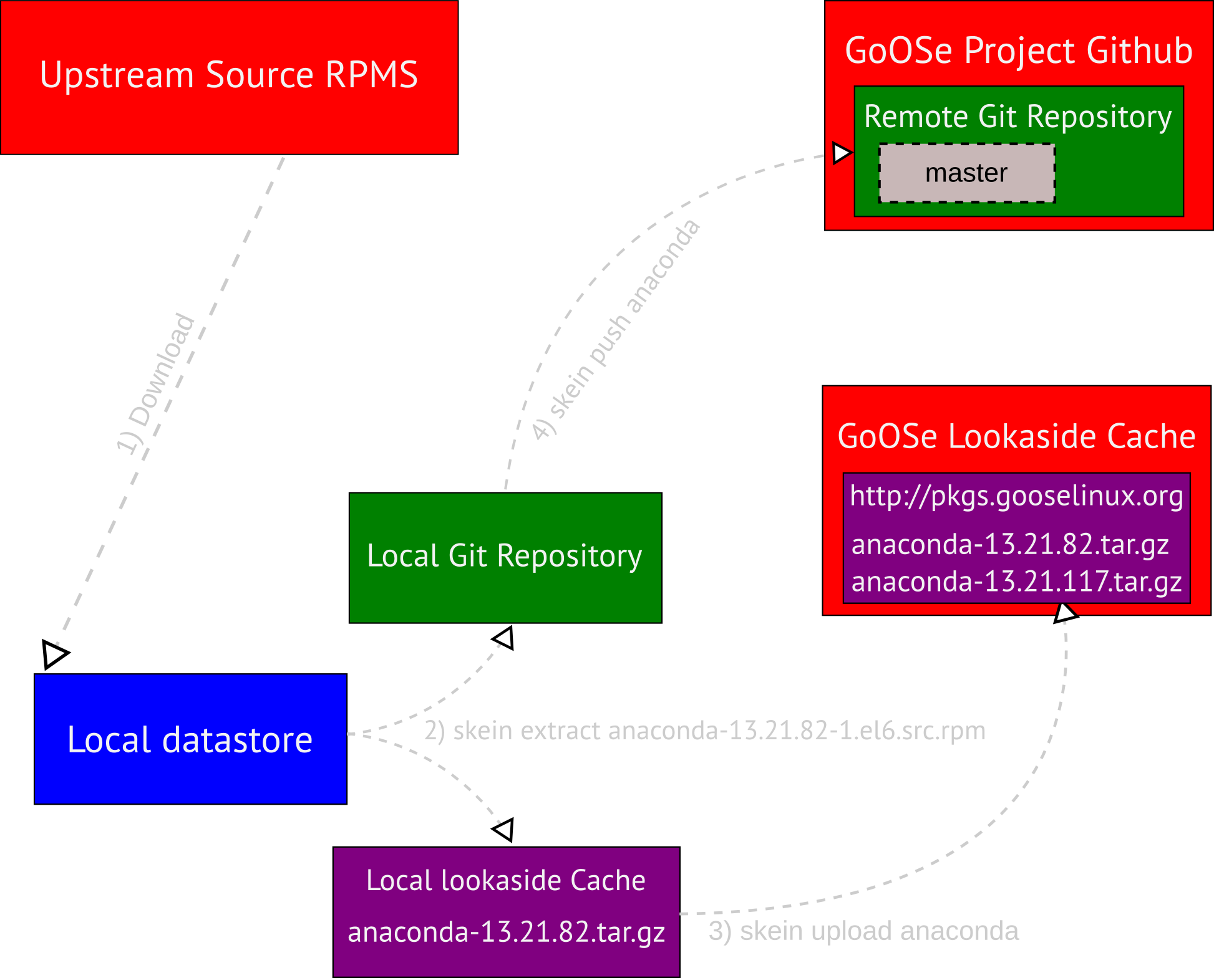
Building GoOSe Linux - Part I
Importing from Upstream

Slide 10
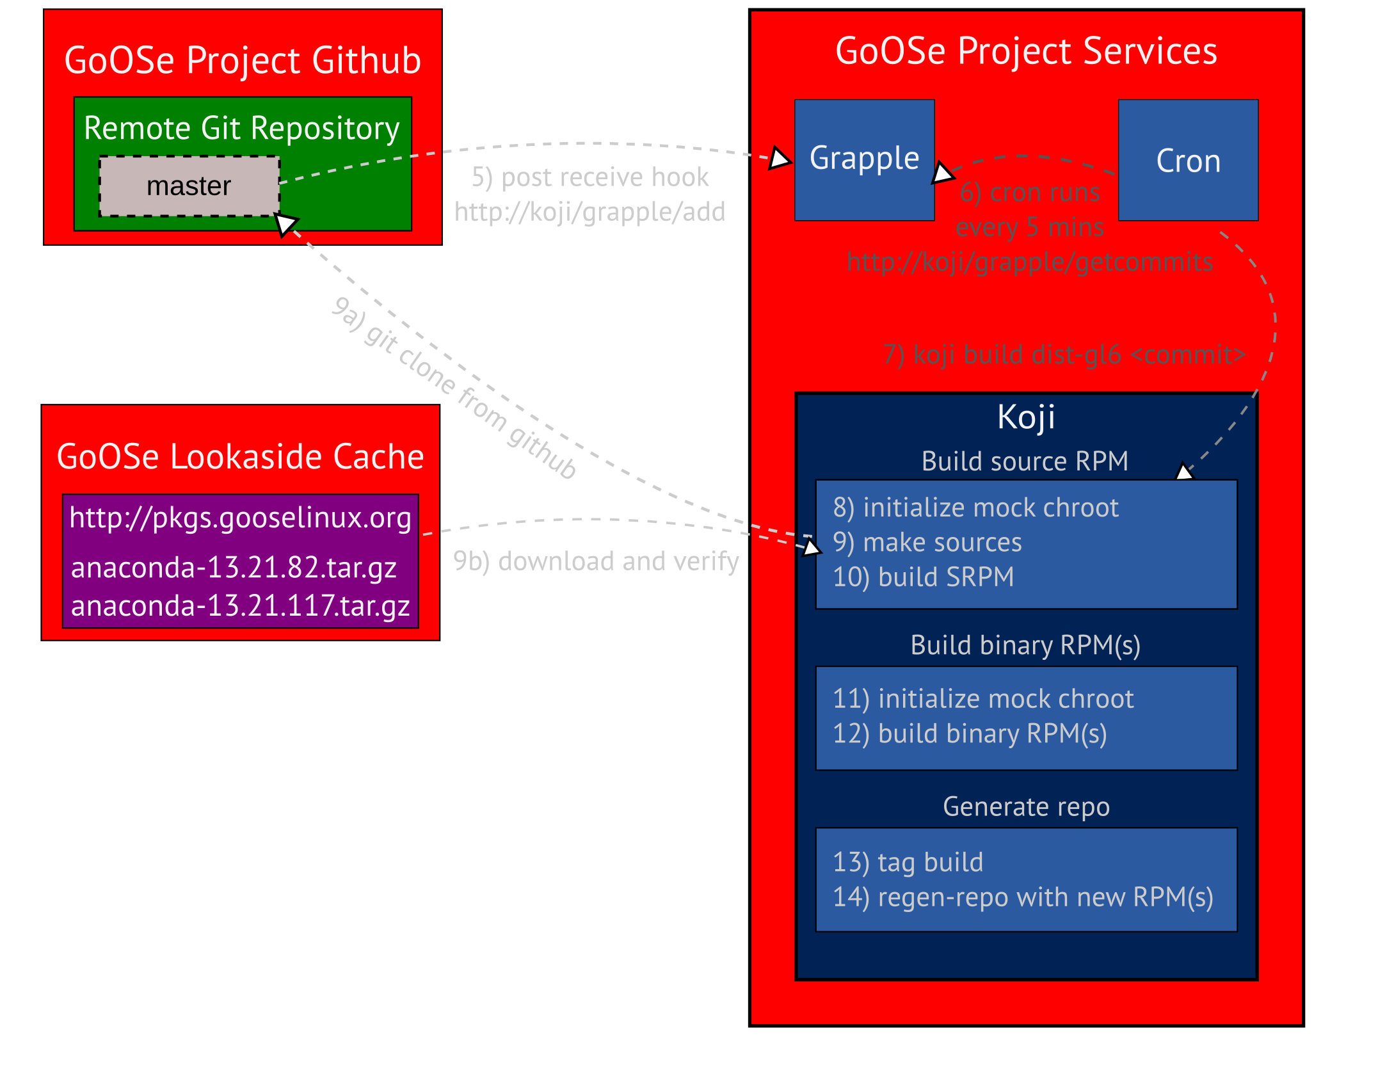
Building GoOSe Linux - Part II
How an RPM is built

Slide 11
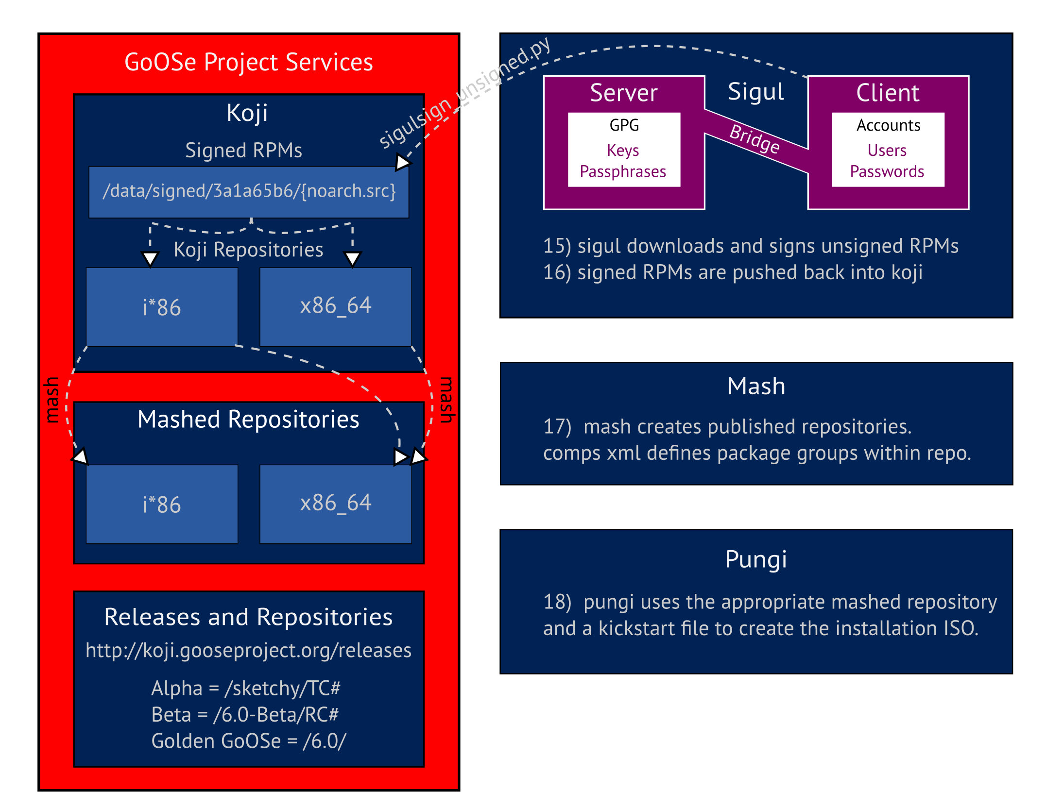
Building GoOSe Linux - Part III
GPG Signing, Repo Mashing, ISO Creation

Slide 12
Why are you building
The GoOSe Project?
Doesn't CentOS* already do this?
Is there really a need?
* - Ask Scientific Linux, ClearOS, Acendos.
They likely have thought this through as well.

Slide 13
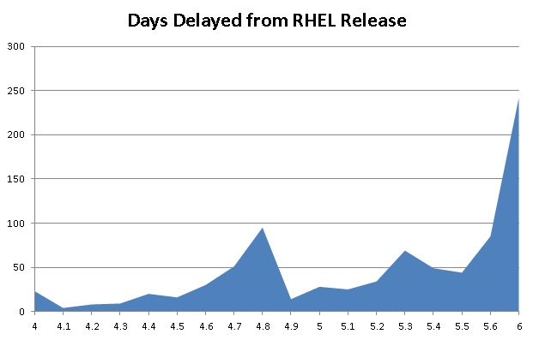
CentOS releases are becoming more time-consuming.
Image Credit: http://www.standalone-sysadmin.com/blog/2011/07/centos-6-great-but-for-how-long/

Slide 14
“No, no, you have it all wrong ! The C in CentOS means Closed ;-)”
-- Dag Wieers (Feb 16, 2011)
http://lists.centos.org/pipermail/centos-devel/2011-February/006644.html
What is going on here?
“CentOS is for the community ... it is not BUILT buy the community.” [sic]
-- Johnny Hughes (March 10, 2011)
http://lists.centos.org/pipermail/centos-devel/2011-March/007101.html

Slide 15
It is all about
The Community
A community of 'contributors'

Slide 16
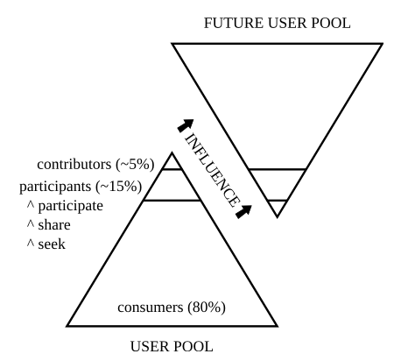
Contributors are the key
to successful communities
Image Credit: http://iquaid.org/2009/04/14/community-sets/

Slide 17
Mirroring of Upstream Sources
Collaboratively Creating Docs
Collaborating with other Enterprise Linux Rebuild projects
More Hands, Less Work
Makes it easier to do the hard stuff
Building QA Test Suites
Cross-project backups

Slide 18
How far have you gotten
One Year into the Project
Share your progress

Slide 19
Contributors
We currently have 16
Many are in #gooseproject every day
5 of which have made more than two commits
Much of our contribution has been in setup and configuration of toolsets like koji, mash, etc.

Slide 20
We have successfully built almost 2200
Most built without intervention, some were a lot more work
Packages
Patches to be sent upstream are tracked on github
Over 13000 rpms reside in our koji repository today

Slide 21
We have successfully performed 6 Alpha composes
Alpha ISOs are called 'sketchy'
ISOs
The latest (TC6) now has gpg signed RPMs
All ISOs are downloaded and tested

Slide 22
Fork the gooseproject/main repository
And send us a pull request!
Join the GoOSe Project
We need your help!

Slide 23
GoOSe 6.0 Beta is available today!
get.gooseproject.org
Download your copy now!

Slide 24
Thank you
for your attention!
web: http://gooseproject.org
email: herlo@gooseproject.org
project url: http://github.com/gooseproject irc.freendode.net: #gooseproject
Slides available @ http://speakerdeck.com/u/herlo/p/goose-linux-rebuilding-enterprise-linux

