Slide 1
CPAN 144 · GROUP PROJECT · PHASE 3
CinemaScope
A Next.js 14 movie discovery app — live TMDB data, optimized, and production-ready.
Humber College · Milton
Phase 3 of 3
Server-Side Scripting · Spring 2026
April 22, 2026

Slide 2
AGENDA
What we'll cover
01
Project Objective
What CinemaScope is and why we built it
02
Main Features
Core functionality across home, browse, details, watchlist
03
Architecture
Next.js App Router + TypeScript + TMDB
04
Performance
Code splitting, caching, images, debouncing
05
SEO & Metadata
Titles, Open Graph, and dynamic link previews
06
Challenges
What broke, and how we solved it
07
Live Demo
Walkthrough of the running application
CinemaScope — Phase 3
2 / 12

Slide 3
01 · PROJECT OBJECTIVE
Give users a fast, beautiful way to discover movies.
The goal
5
Turn the Phase 2 UI shell into a production-grade web app: real API data, fast loads, strong SEO, and a polished UX on every route.
Application routes
8
TMDB endpoints wired
What Phase 3 delivers
350ms
Live TMDB API integration (no more mock data)
Performance passes — bundle, images, caching, search
Route-level loading / error / 404 states
SEO metadata + dynamic Open Graph per movie
Search debounce
1hr
Catalog cache window
CinemaScope — Phase 3
3 / 12

Slide 4
02 · MAIN FEATURES
Five routes plus a mobile-first layout.
Home
Browse
Movie Details
Trending hero + Now Playing, Popular, Top Rated, Upcoming carousels.
Filter by genre, year, rating, and sort. Debounced live search.
Backdrop hero, synopsis, metadata, one-tap add-to-watchlist.
Watchlist
About
Responsive
Persisted via React Context + localStorage. Survives refresh.
Project summary, tech stack, Phase 3 additions.
Mobile-first layouts. Works cleanly from 375px to desktop.
CinemaScope — Phase 3
4 / 12

Slide 5
03 · ARCHITECTURE
Server-first with targeted client interactivity.
Browser
Next.js
Cache
TMDB
User navigates
or types a query
→
Server component
fetches TMDB
→
Fetch cache
1hr / 60s
→
REST v3 API
over HTTPS
Stack
Next.js 14
TypeScript
Tailwind
TMDB v3
App Router, RSC
Strict mode
Utility-first CSS
Movie data + images
Every interactive route is split: a server page.tsx owns metadata + data fetching; a page.client.tsx owns UI state. This pattern unlocks SEO without giving up React state.
CinemaScope — Phase 3
5 / 12

Slide 6
04 · PERFORMANCE OPTIMIZATIONS
Every box on the rubric — ticked.
Code splitting
next/image
next/dynamic on Hero + MovieCarousel shrinks initial JS on /
AVIF + WebP, remote pattern for image.tmdb.org, priority on Hero
Fetch caching
Debounced search
revalidate: 3600 for catalogs, 60 for search — Next.js built-in
350ms useDebounced hook prevents per-keystroke network calls
memo(MovieCard)
Parallel fetches
Grid + carousel skip re-renders when props are unchanged
Promise.all across 5 catalog endpoints on the home route
CinemaScope — Phase 3
6 / 12

Slide 7
05 · SEO & METADATA
Link previews that actually look like a product.
What we added
app/movies/[id]/page.tsx
Root metadata with title template %s | CinemaScope
openGraph tags (title, description, images, site name)
twitter card set to summary_large_image
Keywords, description, and canonical URL
generateMetadata on /movies/[id] — dynamic per title
export async function generateMetadata(
{ params }: { params: { id: string } }
) {
const movie = await getMovie(params.id);
return {
title: movie.title,
description: movie.overview,
openGraph: {
title: movie.title,
images: [tmdbImage(movie.backdrop_path)],
},
};
}
CinemaScope — Phase 3
7 / 12

Slide 8
06 · CHALLENGES & SOLUTIONS
Six things broke. Six lessons learned.
Challenge
Solution
Client components can't export metadata
Split every page: server page.tsx + client page.client.tsx
TMDB rate limits during fast typing
350ms debounce + 60s fetch cache on /search/movie
next/image blocked external CDN
images.remotePatterns for image.tmdb.org; AVIF + WebP on
Carousels shipped JS on every route
Converted Hero + MovieCarousel to next/dynamic
Hardcoded genre list drifted from API
FilterBar now fetches /genre/movie/list on mount
No UX for slow networks / 404s
Added loading.tsx, error.tsx, not-found.tsx per route
CinemaScope — Phase 3
8 / 12

Slide 9
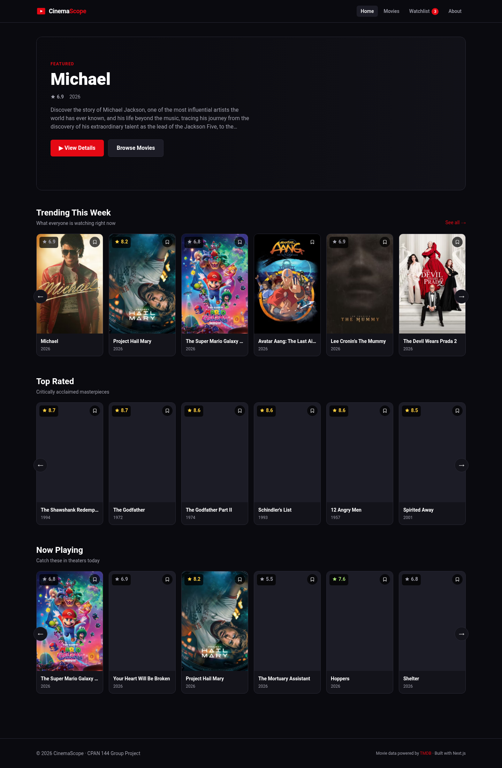
07 · DEMO · HOME
Trending hero + four live carousels.
What you're seeing
Hero loaded with priority for LCP
Four carousels, one Promise.all
Posters served as AVIF / WebP
Dynamic imports on the carousels
CinemaScope — Phase 3
9 / 12

Slide 10
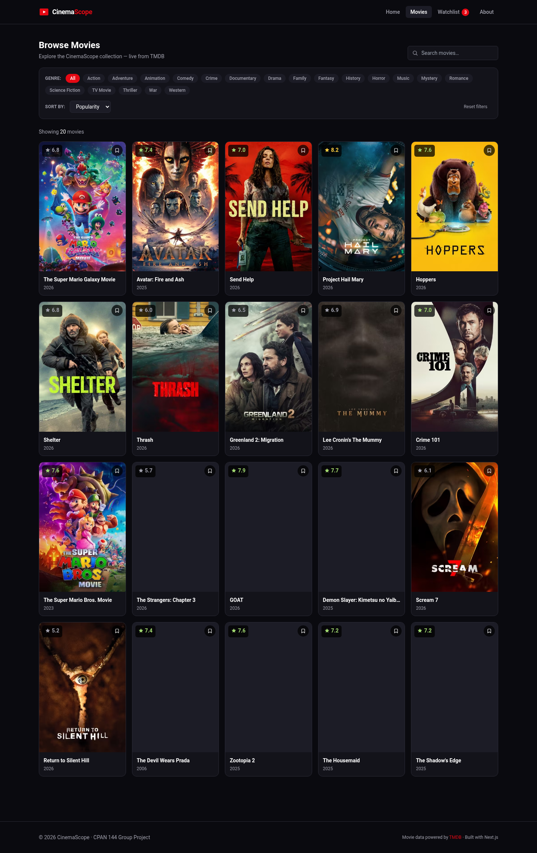
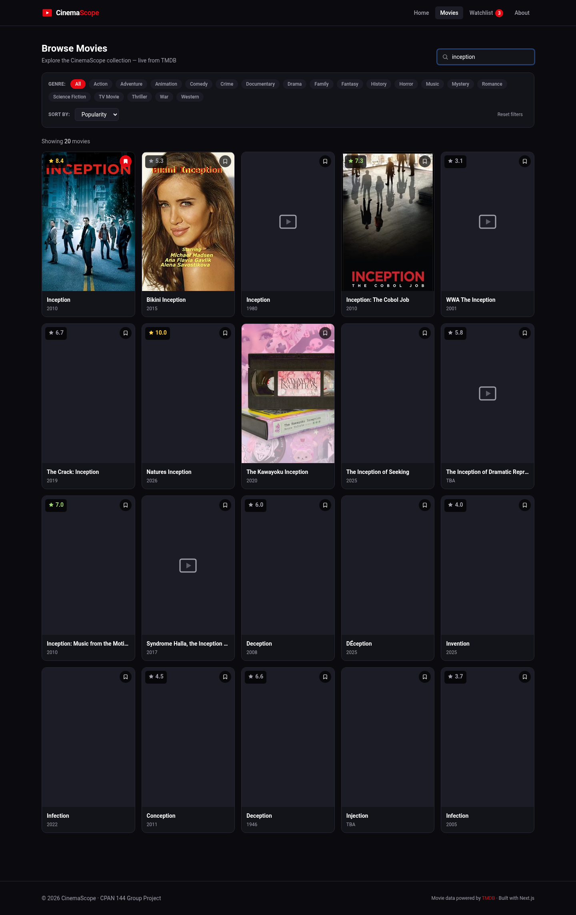
07 · DEMO · BROWSE & SEARCH
Filters and debounced search over live TMDB.
Browse with filters
Debounced live search
CinemaScope — Phase 3
10 / 12

Slide 11
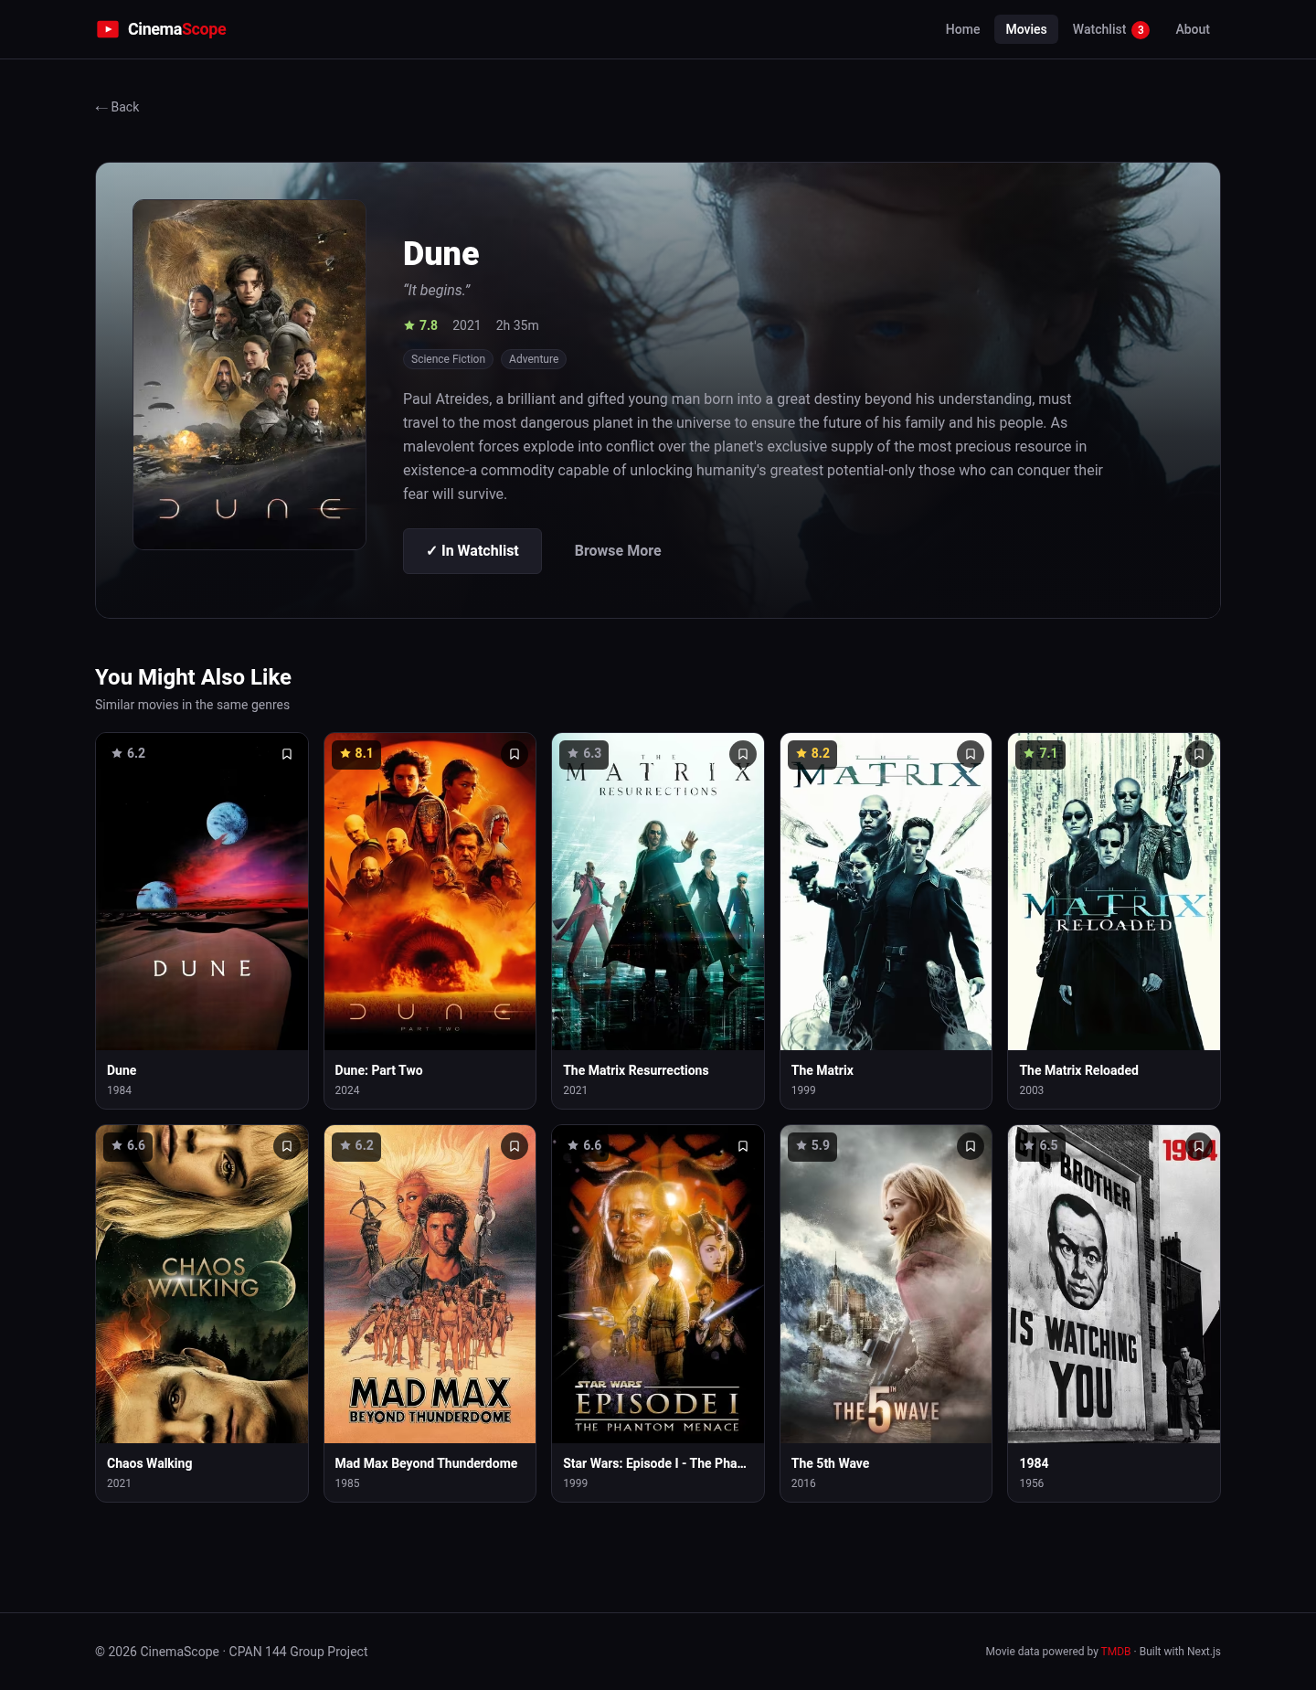
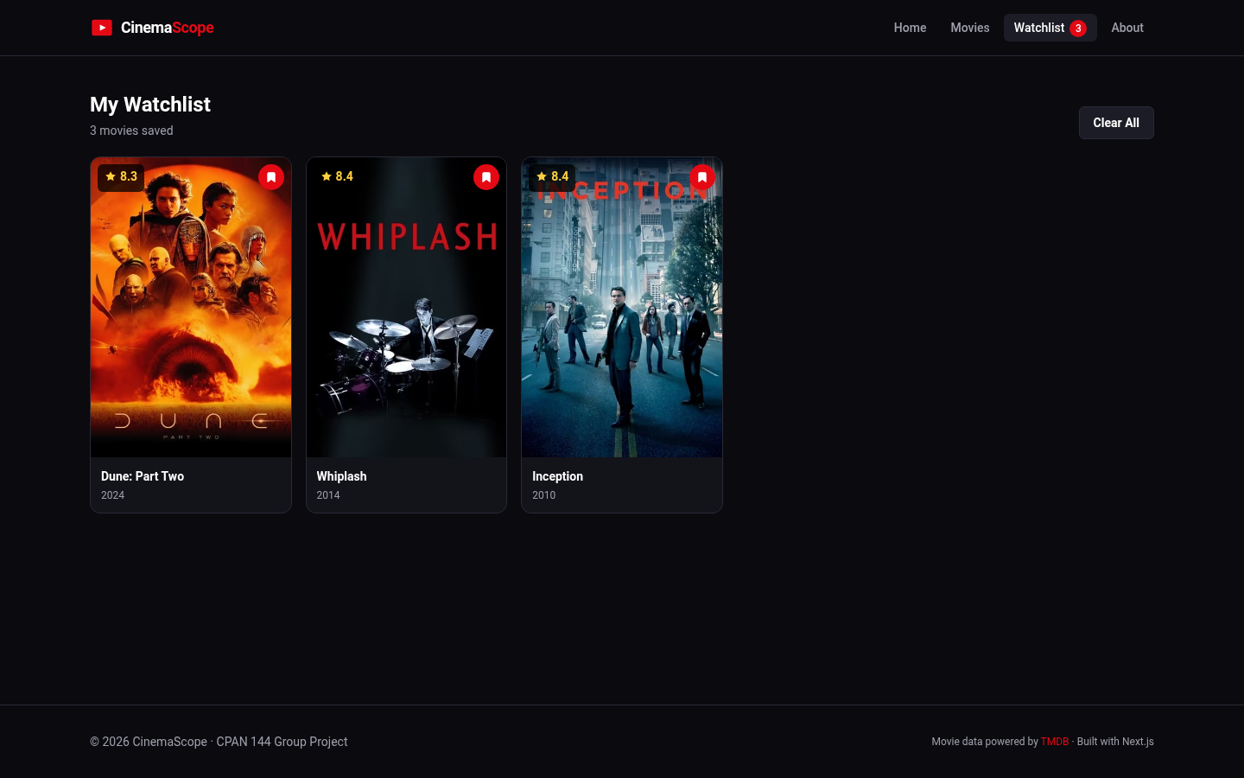
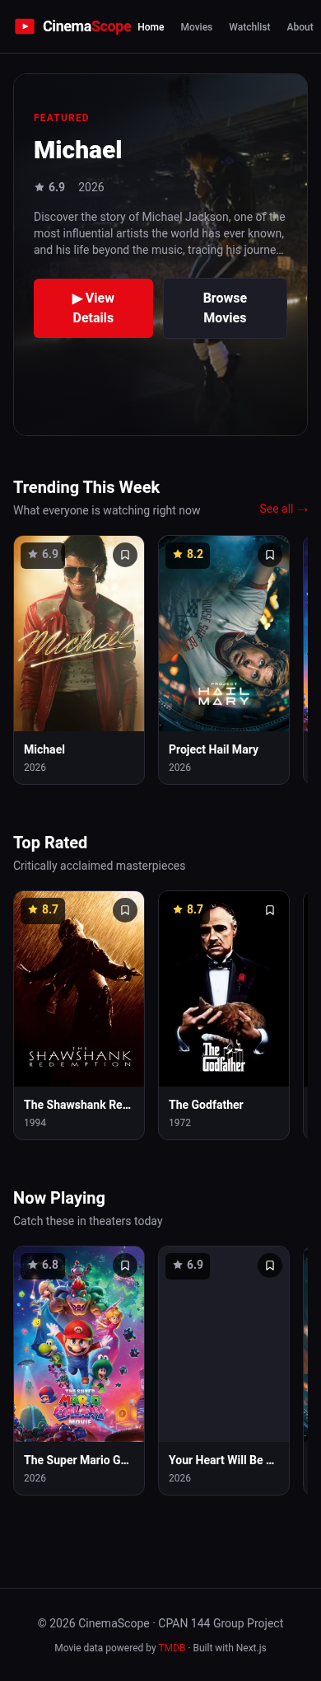
07 · DEMO · DETAILS, WATCHLIST, MOBILE
Polished routes across every screen size.
Movie details
Watchlist (persisted)
Mobile · 375px
CinemaScope — Phase 3
11 / 12

Slide 12
THANK YOU
Questions?
CinemaScope — Phase 3 · Humber College · CPAN 144
Repository
Data
github.com/goothey/cinemascope
themoviedb.org API v3

