Slide 1
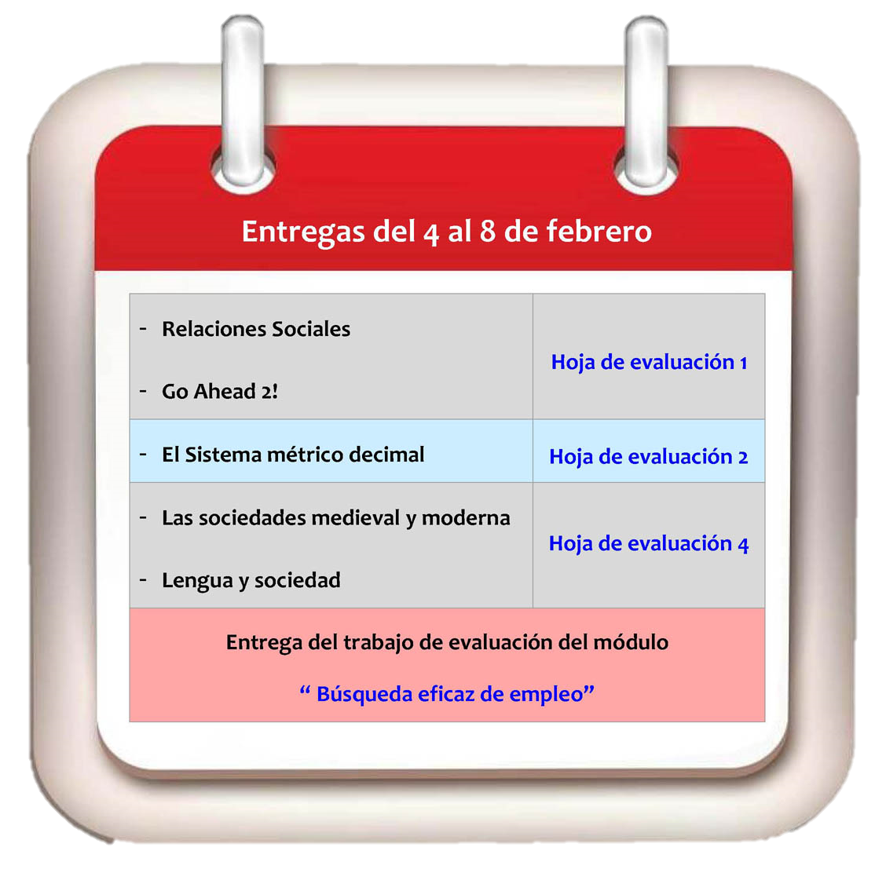
E
DU
NOW
Your courses
your control

Slide 2



Problem:
Users with many online courses who can’t keep up with:
Deadlines
Deliverables
Lecture Materials
Users who forget what courses they signed up for.
Users who are interested in free online courses but don’t know what is offered and where.

Slide 3


Market:
Services:
Coursera, Udacity, (3 million +)
HarvardX, MITx, EdX (650,000)
Khan Academy, Open Learning Initiative
MOOC.ca, DS106.org
Communities:
Peer 2 Peer University
Open Masters Program
Creative Commons

Slide 4
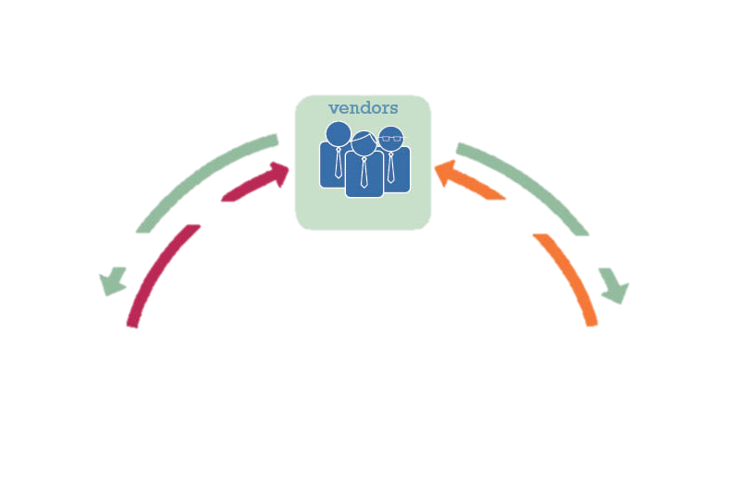


Solution:
Keep track of your signed up courses
Aggregate information from different sources:
Deadlines
Deliverables
Lecture Materials
Compile and share list of all MOOC and online learning communities and services.
Rank the most taken courses

Slide 5
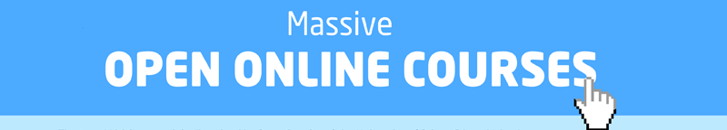
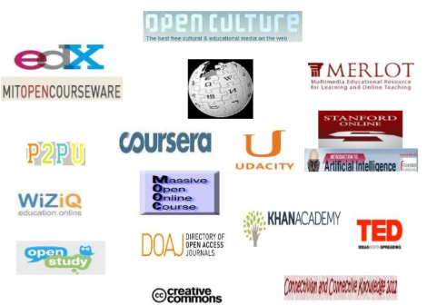

Business Model:
Partners main sources of revenue:
Certified Diplomas
Access to job placement
Employees or University Screening
Tutoring
Enterprise Training Programs
Sponsored Courses
Tuition Fee
Premium Content

Slide 6



Business Model:
Refereral Fee Model:
New customer fee
Premium content
Sponsored Courses
Subscription Model:
App purchase
Monthly payment
Ad Revenue:
Sponsors: Classes, Promoters
Complementary: Companies

