Slide 1

JalSetu
Backwater Cargo Exchange: shipment-first decisions for Kerala's inland waterways
IBM x Kerala Government Hackathon 2026
Challenge 7: Backwater Cargo Exchange | Team Vortex
Notes:
Introduce JalSetu: a decision engine for the Backwater Cargo Exchange challenge. One line: it tells a cargo owner whether to go by road, by water, or by a mix, explains why, and keeps a person in charge of every confirmation. Everything you will see is the running prototype, not mock-ups. TIMING: the full deck is 23 slides. For a 10-minute slot, present slides 1, 2, 4, 5, 6, 7, 8, 9, 15, 17, 20 and 23, and demo live in place of slides 11 to 14 and 18. For a 15-minute slot, add slides 3, 10, 11 to 14, 16, 18 and 21.

Slide 2



The problem
Shippers can't compare road, waterway and hybrid options for their shipment, so they default to road, leaving water transport (often cheaper and cleaner) and boat capacity under-used.
Who is affected: shippers, boat owners, warehouses and planners, plus the environment.
No visibility
No fair comparison
No safety net
Cargo owners and boat operators cannot see each other's needs, or how reliable boats are.
Cost, time, CO₂ and deadline are rarely weighed in one place.
Hazardous cargo and disruptions have no clear, checked options.
Example from the brief: a construction company moving building materials from Kochi to Alappuzha wants to compare road with waterway options. Source: Challenge 7 brief
Notes:
State the problem in one sentence, then who is affected. The premise comes from the Challenge 7 brief: goods mostly move by road although waterways are often cheaper and greener, because cargo owners and boat operators cannot see each other. The three cards are the gaps we chose to close: visibility, a fair comparison, and a safety net for hazardous cargo and disruptions. The last line quotes the brief's own example.

Slide 3
Why NW-3, and where next
Why we started with NW-3
Where next
It is where the brief's example lives: Kochi to Alappuzha runs on NW-3.
A defined national waterway: Kollam to Kottapuram, about 205 km, nine terminals.
One corridor modelled honestly beats many modelled thinly.
Four illustrative jetties: Kochi Thevara, Vaikom, Alappuzha, Kollam.
Same engine, more corridors: adding a waterway is mostly adding data.
Nearby: NW-8 (Alappuzha to Changanassery, 28 km) and NW-9 (Alappuzha to Kottayam to Athirampuzha, 38 km).
North: the Kovalam to Bekal West Coast Canal project (about 590 km) and the extension towards Kozhikode.
Beyond Kerala: other national waterways.
Figures from public sources (IWAI, Ministry of Ports, Shipping and Waterways, press). Verify with IWAI before relying on them. Jetty names and positions in the prototype are illustrative.
Notes:
Why NW-3: the brief's own example, Kochi to Alappuzha, sits on National Waterway 3, the West Coast Canal from Kollam to Kottapuram, about 205 km. We chose one well-defined corridor and modelled it honestly with four illustrative jetties rather than many corridors thinly. The engine reads its distances and rates from data files, so adding a waterway is mostly adding data. Next candidates: NW-8 and NW-9 around Alappuzha, the Kovalam to Bekal West Coast Canal project and a northern extension, and eventually other states. These come from public sources and should be verified with IWAI. Nothing beyond NW-3 is built.

Slide 4
How JalSetu differs
FOCAL
PANI
BlackBuck
JalSetu
IWAI
IWAI
Private
This project
Per its documented scope
Per its documented scope
Per its documented scope
What it does
Portal where cargo owners and logistics operators list cargo and vessel availability.
Navigation and asset information for national waterways, for voyage planning.
Road trucking marketplace: matches shippers with truckers.
Decides per shipment: road, water or hybrid, with a reason, hazard checks and re-plan.
How we relate
How we relate
How we relate
How we relate
We add a road vs water decision on top of listings.
Its data is what we would check our distances and depths against.
Road is the baseline we compare against.
An intelligence layer above existing platforms, not a replacement.
Descriptions from each platform's public documentation. JalSetu is not integrated with any of them yet.
Notes:
Be respectful and precise here. FOCAL, the Forum of Cargo-Owners and Logistics-Operators, is an IWAI portal where cargo owners and logistics operators list cargo and vessel availability. PANI, the Portal for Asset and Navigation Information, gives navigation and asset information on national waterways for voyage planning. BlackBuck is a private road-trucking marketplace. Per their documented scope, none of them is described as comparing road, water and hybrid options for one shipment with a reason. We do not say they lack anything; we say we add a decision layer above them. We have not integrated with any of them; that is future work.

Slide 5







Our approach: spec-driven development
We specified first, then let AI coding agents build to the spec. We used GitHub's Spec Kit workflow.
Constitution
Specify
Clarify
Plan
Tasks
Analyze
Implement
15 rules
what and why
edge cases
how
tests first
find gaps
AI agents build
Specs before code
A real constitution
AI builds to the spec
Six feature specs, each with a plan and a requirements checklist; task lists for the later four.
15 principles checked in review: the engine stays pure, the model never decides, people confirm.
IBM Bob and Claude Code wrote code against the specs. We reviewed it and ran the tests.
Notes:
Our approach is spec-driven development with Spec Kit. Instead of prompting an AI to write an app, we wrote a constitution first: 15 principles such as the decision engine must be pure code, a language model may never price or rank, and a person confirms every state change. Then each feature went through specify, clarify, plan, tasks, analyze and implement, with tests written before code. IBM Bob and Claude Code were the AI coding agents that implemented against those specs. Be precise if asked: the Spec Kit structure and workflow were followed for all six features; for the last two features we ran the steps by hand rather than through the Spec Kit command line. The AI agents wrote code, but the specs, tests and gates decided what counted as correct.

Slide 6

Built with IBM Bob
IBM's AI coding agent was our development partner, working from our specs rather than loose prompts.
How we worked with it
IBM Bob
Constitution and specs set the rules
1
AI coding agent | used throughout development
Task lists say what to build, tests first
2
✓
Code generation
✓
Spec writing
IBM Bob implements each task
3
✓
Task implementation
Tests and gates check it; we review and confirm
4
Claude Code supported later work. Per-file authorship is not tracked.
Notes:
This is our IBM story, told straight. IBM Bob, IBM's AI coding agent, was our development partner throughout the build: code generation, spec writing and task implementation, as listed in our disclosures. What made it work was the spec-driven setup: Bob worked from the constitution, the specs and the task lists, tests first, and the output was checked by tests and gates and reviewed by us before we confirmed it. Claude Code supported later features and the documentation. We do not track which tool wrote which file, and we say so. The product itself keeps AI out of the decision path; Bob accelerated the building, not the deciding.

Slide 7






Our solution: JalSetu
Post cargo
Compare
Match
Confirm
Monitor and re-plan
Weight, route, hazard class
Road vs hybrid, with a reason
Ranked sailings, exclusions explained
A person approves every booking
Simulated milestones; ranked options
No visibility: shared listings and matching. No comparison: road vs hybrid. No safety net: hazard gate and re-plan.
Shipper
Boat owner
Warehouse
Planner
Posts cargo, compares, books, tracks
Registers vessels, publishes sailings
Lists storage, sees utilisation
Sees corridor viability and disruptions
Notes:
Walk the five steps, then show how each answers one of the three gaps from the problem slide. Be careful with the last step: milestones are simulated, there is no live tracking, so we call it monitor and re-plan. Four role views because a marketplace needs all sides.

Slide 8
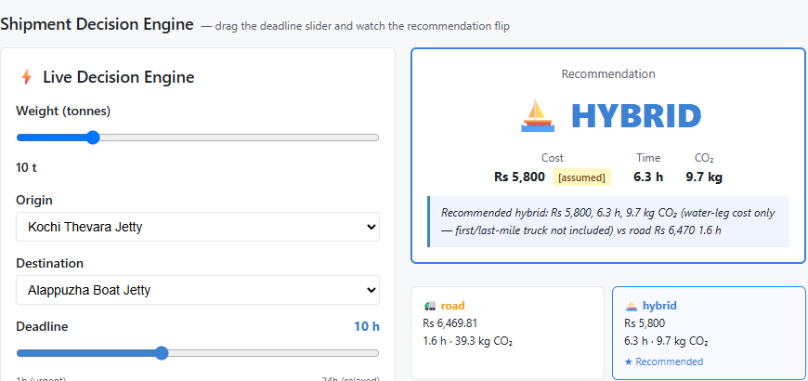
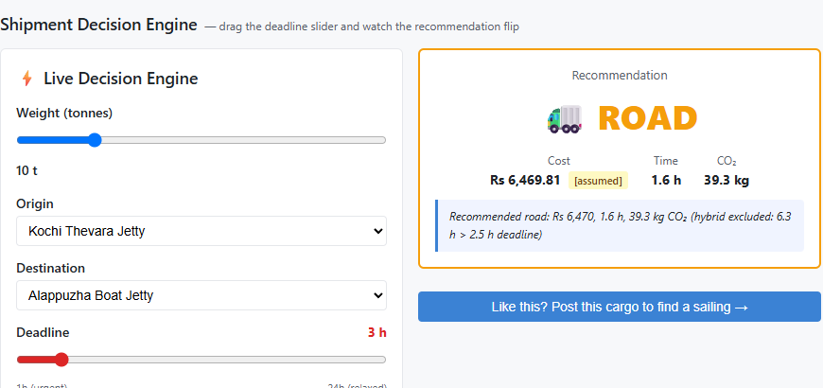
The deadline decides the mode
Hybrid cost: barge leg only. It excludes first and last-mile trucking; road is door to door.
10 h deadline → HYBRID
3 h deadline → ROAD
Rs 5,800 | 6.3 h | 9.7 kg CO₂
Rs 6,470 | 1.6 h | 39.3 kg CO₂
About 10% cheaper, 75% less CO₂ (barge leg)
Hybrid takes 6.3 h: too slow for 2.5 usable hours
Road for comparison: Rs 6,470, 1.6 h, 39.3 kg CO₂
Road wins when the deadline is tight
Notes:
This is the moment to demo live. Same shipment, same boats; drag the deadline from 10 hours to 3 and the recommendation flips from hybrid to road, with the reason in plain English. READ THE CAVEAT BAR OUT LOUD: the hybrid figure is the barge leg and jetty handling only. Road is door to door. So the roughly 10 percent cost saving and 75 percent CO2 saving are for the barge leg, not a door-to-door claim. All rates are assumed and tagged in the app. If asked, the next step is to add first and last mile trucking to the hybrid plan.

Slide 9
Major features
Decide
Match
Book safely
Road vs hybrid on cost, time, CO₂ and reliability, with a reason
Ranked sailings; excluded vessels shown with reasons
Two-step confirmation; hazard gate and compliance review
Re-plan
List and build trust
Store and plan
Disruption alternatives, ranked; nothing changes until you confirm
Vessel and sailing listings; on-time record with trip counts
Warehouse staging and utilisation; planner views
Notes:
The six headline capabilities. The next slides go through every function by role: shipper, boat owner, warehouse and planner, then the safety and trust functions that cut across them.

Slide 10

Built for the brief
Major features: the five suggested in Challenge 7, all built
Cargo posting
Weight, route, hazard class; validated
BUILT AND TESTED
Boat availability listing
Register by form or message; publish sailings
BUILT AND TESTED
Matching recommendations
Ranked sailings; exclusions explained
BUILT AND TESTED
Schedule planning
Sailing times; simulated milestone timeline
BUILT, MOCKED
Cost comparison
Road vs hybrid: cost, time, CO₂, reliability
BUILT AND TESTED
Notes:
The brief suggested five features. All five are in the prototype. Four are covered by automated tests; schedule planning is partly simulated because milestones are a demo control and there is no live tracking. These are the same status labels as our README.

Slide 11
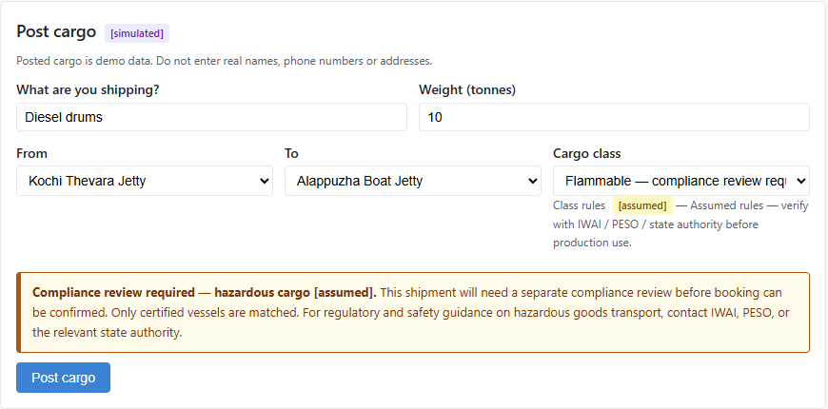
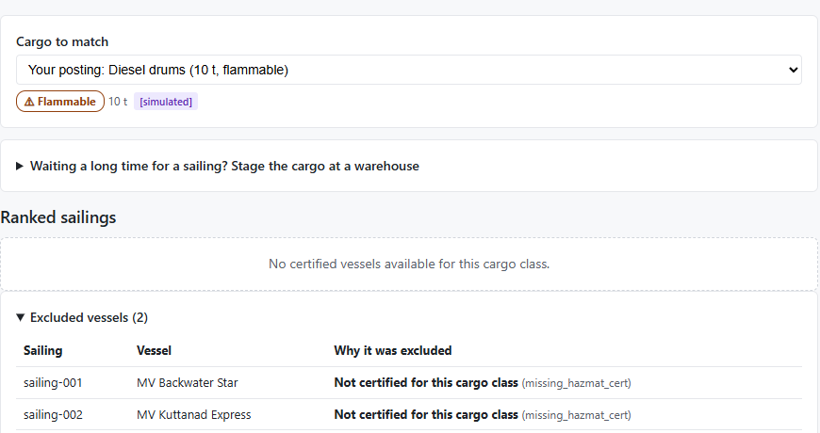
Functions: shipper
1
Compare options road vs hybrid, with a reason
2
Post cargo hazard class and warning banner
3
Matches ranked sailings; exclusions explained
4
Warehouse staging itemised plan for long waits
5
Confirm two-step booking; hazard review
6
My shipments timeline; mark delivered
7
Simulate disruption ranked alternatives, explicit confirm
8
Plain-language intake simulated chat; English only
Notes:
Everything a shipper can do, in the order of the journey. Compare options is the landing screen. Post cargo has the hazard class selector and shows a compliance banner for hazardous classes. Matches ranks sailings and lists excluded vessels with a reason. Staging is an optional warehouse plan when the wait is long. Confirm is the two-step booking, with a separate review for hazardous cargo. My shipments has the milestone timeline, which is simulated, plus mark delivered. Simulate disruption shows ranked alternatives and needs an explicit confirm. The plain-language chat is simulated and English only.

Slide 12
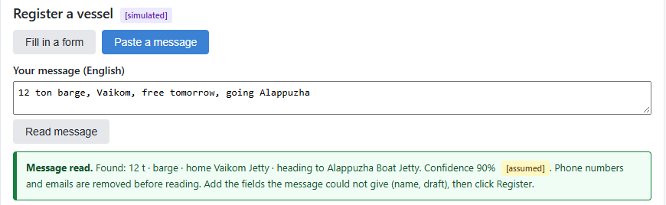
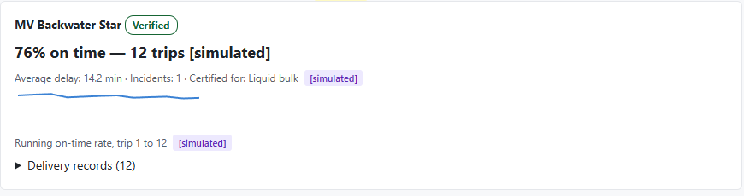
Functions: boat owner
1
Register a vessel form with per-field checks
2
Register from a message e.g. "12 ton barge, Vaikom..."
3
Publish sailings route, weekdays, time, price, capacity
4
Verification demo admin action (simulated)
5
Suspend / reinstate existing bookings stay untouched
6
On-time record rate always shown with trip count
7
Delivery history recorded when a shipment is delivered
Notes:
The boat owner side. Register by form or by pasting a short message; the pattern reader pulls out capacity, type and home jetty and shows what it found, but nothing is registered until the owner clicks Register. Publish recurring sailings with route, weekdays, time, price and capacity. Verification is a demo admin button; production would check the vessel registry. Suspending a vessel never alters confirmed bookings. The on-time record uses a fair starting assumption so new boats are not penalised, and always shows the number of trips. All history shown is simulated.

Slide 13
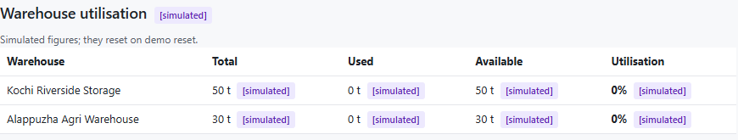
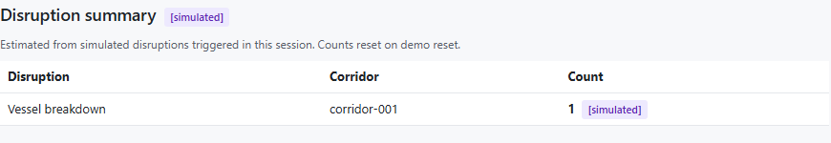
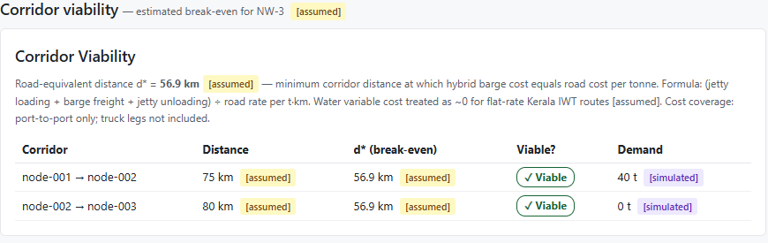
Functions: warehouse and planner
1
Register a warehouse capacity, costs, classes accepted
2
Utilisation capacity used and available
3
Staging plans storage cost, time and CO₂, itemised
4
Corridor viability break-even distance by corridor
5
Corridor map static NW-3 diagram, works offline
6
Disruption summary counts by type and corridor
Warehouse (1 to 3), planner (4 to 6)
Notes:
Warehouse owners register storage with capacity, handling and storage costs, and the cargo classes they accept, then see utilisation. Staging plans use those costs. Planners get corridor viability, which shows the break-even distance where a barge leg beats road per tonne, a static offline map, and a disruption summary by type and corridor. Warehouse data, disruption counts and demand figures are simulated and tagged so.

Slide 14
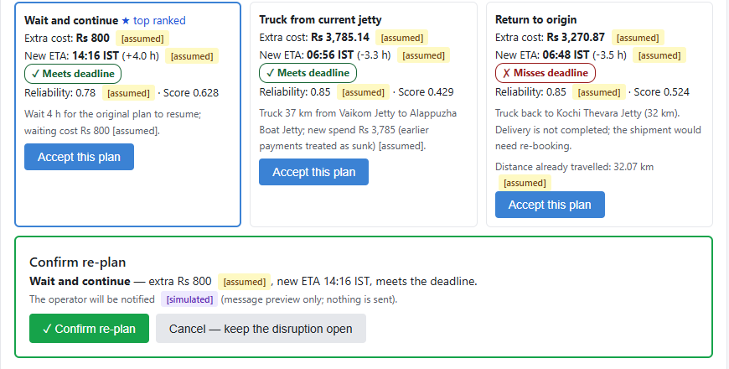
Functions: safety and trust
1
Hazard hard filter uncertified vessels excluded, reason named
2
Compliance review separate gate for bookings and re-plans
3
Human confirmation booking, re-plan and staging all need a click
4
Evidence tags [sourced], [assumed], [simulated] on every number
5
Input checks field-level errors; duplicate guard
6
Privacy scrub phones and emails removed before parsing
Every number says how far to trust it
7
What-if scenarios subsidy (off by default); perishable rules
[sourced]
[assumed]
[simulated]
8
Offline demo reset restores seed data in milliseconds
Backhaul and pooling: simple counts after booking.
Notes:
These functions cut across all roles. Hazardous cargo is filtered out of matching before any scoring, with a named reason. A separate compliance review is required before a hazardous booking or re-plan can be confirmed; in the demo the reviewer is a button. Every state change needs an explicit person click. Every number is tagged. Forms give field-level errors and guard against duplicates. Phone numbers and emails are removed before text reaches any parser. Subsidy is a what-if and is off by default. The demo resets to seed data in milliseconds, offline. Backhaul and pooling are only basic counts in the prototype; network-wide planning is future work.

Slide 15
Innovation 1: how decisions are made
AI may help here
Decisions happen here
Human in the loop
Forms and text
The reader
Decision engine
A person
Cargo, vessels, short messages
A simple pattern reader today. IBM Granite adapter: built, not run in this demo.
Pure Python. Reads its numbers from config. Explains itself.
Approves every booking and change
The language model never prices, ranks or recommends.
Zero LLM imports in the decision engine (checked by grep). The demo runs fully offline, with no API keys.
Deterministic
Auditable
Offline
Notes:
This slide is the how. Many AI logistics tools let a model make the call. We drew a hard line: a language model may only read text and turn it into fields. All pricing, ranking and compliance decisions are made by deterministic Python that reads its numbers from a configuration file, explains each decision, and can be audited. A person confirms every state change. State the IBM Granite status once and plainly: the Granite adapter is built but was not run in this demo; the demo uses a simple pattern reader and calls no model.

Slide 16
Innovation 2: what is new
The diagram showed how decisions are made. These are the five things that are new.
1
Explains itself in plain English
What the screen shows
Every recommendation has a reason anyone can check
Rs 5,800
2
Every number shows its evidence
[sourced], [assumed] or [simulated] on screen
[assumed]
3
Never auto-switch
76% on time, 12 trips
Disruption options wait for an explicit confirm
[simulated]
4
Fair to new boats
A fair starting score; trips shown beside the %
CO₂ factor 3.3x
5
Safety before convenience
[sourced]
Hazardous cargo hard-filtered, reasons named
Examples from the running app
Notes:
Five things we think are new here. One: every recommendation comes with a plain-English reason. Two: every number is tagged with how much we trust it, and a test keeps our documentation in step with the data. Three: the system never switches plans on its own; a disruption produces ranked options and waits. Four: new boats get a fair starting score, so a brand-new boat is not punished for having no history, and the trip count is always shown beside the percentage. Five: hazardous cargo is filtered before any scoring, with a named reason. The examples are real figures from the app.

Slide 17
Innovation 3: specs kept the AI honest
1
Tests first
Where AI sits
261 tests; engine functions are tested before they count as done
AI agents
2
Analyze before build
write the code
Caught a random id inside the engine, hardcoded weights, and a re-plan log that broke the read-only rule. All fixed.
Specs, tests, gates
Gates that can fail
check it
3
Checks: no LLM imports in the engine; docs must match the data
People
review and confirm
4
One source of truth
Every number lives in config with a tag; doc tables are generated from it
In the product, AI may only read text. The engine decides.
Notes:
This slide shows what the specification layer bought us. Tests came first. The analyze step compared the specs, plan and tasks against the constitution and found real defects before they reached the demo: a randomly generated id inside the supposedly deterministic engine, hardcoded fallback weights, and a re-plan event that would have changed a booking before the person confirmed. We fixed all of them. Gates can fail: a grep check that the engine has no language-model imports, and a test that fails if our documentation tables drift from the data. On the right, where AI sits: AI agents write code, specs and tests check it, people review and confirm. And in the product itself, AI may only read text; the engine decides.

Slide 18
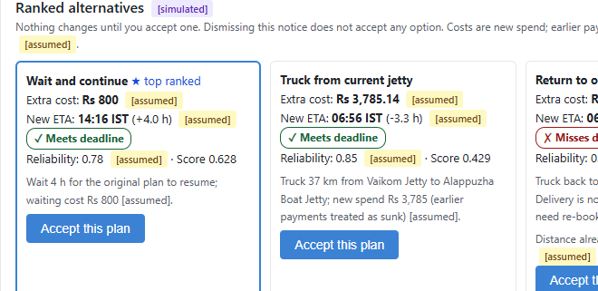
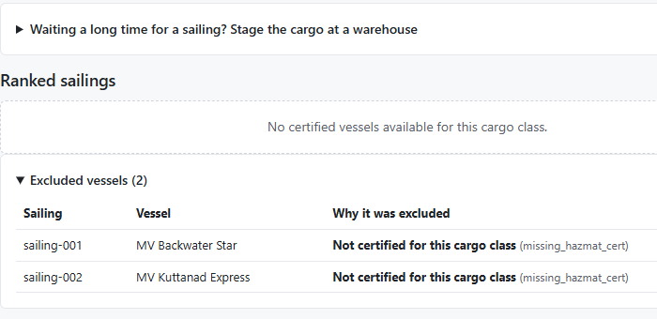
Prototype snapshot
Disruption, handled
Safety first
Ranked alternatives; nothing changes until you confirm
No certified vessel: every exclusion has a reason
Real captured screens of the running prototype. Disruptions, vessels and milestones are simulated.
Notes:
These are real screenshots from the running prototype, taken by script, not mock-ups, cropped to the part that matters. Left: a simulated vessel breakdown with ranked alternatives; nothing changes until the person confirms. Right: flammable cargo with no certified vessel, so the ranked list is empty and every exclusion is explained. Say clearly that the disruption, the vessels and the milestones are simulated.

Slide 19
Tech stack
Built with IBM Bob
Code generation
Spec writing
Task implementation
IBM's AI coding agent, our partner
Interface
What users see and click
API
Connects screens to logic
React 19, Vite 8
FastAPI, Pydantic v2, Uvicorn
Decision engine
Calculates, ranks, explains
Data
67 tagged constants; demo data
Pure Python, RapidFuzz, PyYAML
config.yaml, seed.json, in memory
AI (optional)
Adapter built, not run in this demo
Quality and tooling
Tests first; spec-driven workflow
IBM watsonx.ai Granite 13B chat
pytest (261 tests), Claude Code, Spec Kit
Notes:
A deliberately small product stack, each piece in plain words. React and Vite for what users see. FastAPI and Pydantic for the server. Plain Python for the decision engine so every result can be traced. Data lives in a YAML config and a JSON seed, in memory. The IBM watsonx.ai Granite adapter is built but was not run in this demo. The featured band is how we built it: IBM Bob, IBM's AI coding agent, was our development partner for code generation, spec writing and task implementation, with Claude Code supporting later work, all inside the Spec Kit workflow. Disclosed in full in our disclosures document; all libraries are open source and listed in ATTRIBUTIONS.md.

Slide 20
What is real today
261
0
67
0
tests passing
LLM calls in decisions
tagged constants
API keys needed
BUILT AND TESTED
BUILT, MOCKED
ROADMAP
Road vs hybrid decisions
Matching and hazard filter
Booking and re-plan gates
Vessel and reliability logic
Vessel verification
Milestones and disruptions
Notification previews
History and warehouses
Live vessel tracking
Real alerts and payments
Registry and rules checks
Live LLM parsing
Notes:
Honesty is a feature. Left: built and covered by automated tests. Middle: runs but simulated and tagged so on screen. Right: roadmap, not built, including live tracking and the live language-model adapter, which exists in code but has never been run. 261 tests pass, the decision engine contains no model calls, every configuration value carries a status tag (67), and the demo needs no API keys. These numbers match the README and the submission document.

Slide 21
Future scope: roadmap
NEXT
THEN
LATER
Make it real
Make it live
Make it grow
Verified tariffs and hazard rules from IWAI, PESO and state bodies
Real jetty network and routed road distances
Vessel registry checks
Live vessel positions (GPS, AIS)
WhatsApp and SMS alerts, in Malayalam too
Accounts, roles and a real database
More waterways beyond NW-3
Network-wide pooling and backhaul planning
Carbon reports for shippers (idea)
Biggest hurdle: getting cargo owners and boat operators to share real data.
Notes:
Our path from prototype to practical. Next: replace assumptions with verified data, such as tariffs, the real jetty network and hazard rules from the proper authorities, plus vessel registry checks. Then: go live with vessel positions, real alerts and proper accounts and a database. Later: more waterways, network-wide pooling and backhaul planning, and carbon reporting, which is an idea rather than a plan. The honest hurdle is data: a marketplace only works if cargo owners and boat operators are willing to share real data. This whole slide is roadmap; none of it is built.

Slide 22







Future scope: ideas worth building
Live tracking
More waterways
Depth and weather
Quotes, payments
GPS and AIS positions replace simulated milestones
NW-8, NW-9, northern Kerala, other states
Draft, tide and monsoon feeds into reliability
Operator rates, digital booking, payments
First and last mile
Real alerts
Smarter planning
Carbon reports
Book trucks to the jetty for true door-to-door cost
WhatsApp and SMS in English and Malayalam
Demand forecasts and network-wide load pooling
Shippers show emissions saved per shipment
None of these is needed for the prototype; they are chosen for impact. Roadmap only.
Notes:
Ideas we would build with more time, none required for the prototype. Live GPS and AIS tracking would replace our simulated milestones. More waterways extends the same engine with new data. Live depth and weather would make reliability real. Real operator quotes and payments turn it into a true marketplace. First and last-mile trucking would let us show true door-to-door cost, which directly fixes the caveat on our comparison slide. Real alerts in English and Malayalam, smarter planning with demand forecasts and network-wide pooling, and carbon reports for shippers complete the list.

Slide 23
Thank you
A recommendation you can explain, and a person who confirms it.
Team Vortex | IBM x Kerala Government Hackathon 2026 | Challenge 7
Repository: github.com/gop-i-krishnan/keralai-team-vortex (private)
Questions welcome. We will happily run the demo live.
Notes:
Close on the one-line pitch: a recommendation you can explain, and a person who confirms it. Offer to run the demo live. Have the honest answers ready: the saving is computed from assumed rates and covers the barge leg only; the demo uses no AI model and the Granite adapter was not run; tracking is simulated; and what we would verify first.

