Slide 1

Emotion Detection System for Psychiatric Patients
Team Members (E-12):
Gopa Pulastya (Backend Developer & QA) – AIE22116
Rishi Anirudh K (Scrum Master) - AIE22139
Mahithi Reddy (Computer Vision & ML Engineer) – AIE22178
Department of Computer Science & Engineering,
Amrita School of Engineering, Bengaluru

Slide 2
Project Overview
Objective: Non-invasive emotion detection for psychological care using real-time facial analysis.
Team Roles: Scrum Master, Computer Vision/ML Engineer, Backend Developer/QA.
Sprints:
Sprint 1: Feb 18–Mar 17, 2025 (Real-Time Foundation)
Sprint 2: Mar 18–May 05, 2025 (Model and Insights)
Product Owner: Dr. Madhusmitha
Internal Assessor: Dr. Neha
TEAM-E12

Slide 3
Software Engineering Principles
Lifecycle: Agile methodology with iterative sprints for flexibility.
Roles:
Scrum Master: Facilitated daily stand-ups, sprint planning.
Engineers: Specialized in vision, ML, backend, QA.
Quality: Modular design (MediaPipe integration), scalability (CNN training), maintainability (logging system).
Evidence: Delivered 7/8 story points in Sprint 1, comprehensive testing (Test Case ED_01).
TEAM-E12

Slide 4
Selection and Justification of SDLC Model
Choice: Agile with Scrum framework.
Justification:
Complexity: Iterative development for real-time detection, ML training.
Flexibility: Adapted to dataset limitations (2-day CNN training delay).
Customer Involvement: Bi-weekly therapist feedback for features like visualization.
Project Size: Small team suited for short sprints (20–34 days).
Implementation: Daily stand-ups, weekly code reviews, sprint retrospectives.
TEAM-E12

Slide 5
Requirements Engineering
Process: Stakeholder interviews (therapists, researchers), documented in SRS.
User Stories:
Sprint 1: Real-time detection, dataset preprocessing, performance logging.
Sprint 2: CNN training, MNIST evaluation, emotion trend visualization.
Clarity & Completeness: Detailed SRS (e.g., “As a Therapist, I want real-time emotion detection via webcam”).
Tools: MediaPipe for detection, Python for ML.
TEAM-E12

Slide 6
Software Design
Architecture: Modular system:
Real-time detection (MediaPipe, webcam).
ML pipeline (CNN, preprocessing).
Backend (logging, visualization).
Principles:
Modularity: Independent detection/training modules.
Scalability: MNIST evaluation for broader use.
Reusability: Reusable preprocessing pipeline.
Consistency: Aligned with SRS user stories (e.g., emotion overlay).
Design Patterns: Pipeline pattern for data processing.
TEAM-E12

Slide 7
System Architecture
Components: Webcam feed → MediaPipe → CNN → Visualization Dashboard.
Functionality: Supports real-time processing, longitudinal tracking.
TEAM-E12

Slide 8
Development and Maintenance
Implementation:
Sprint 1: Real-time detection, preprocessing pipeline, logging.
Sprint 2: CNN on 912 images, MNIST evaluation, trend dashboard.
Tools: Python, MediaPipe, TensorFlow, backend with encryption/anonymization.
Maintenance:
Bug fixes via QA (Test Case ED_01).
Planned GPU maintenance to avoid delays.
TEAM-E12

Slide 9
Results and Future Work
Achievements:
Sprint 1: Real-time detection, preprocessing, logging (7/8 points).
Sprint 2: CNN training, MNIST evaluation, visualization dashboard.
Future Work:
Sprint 3: Integrate FER-2013, add longitudinal tracking.
Enhance test automation, GPU maintenance.
Decisions: Approved deliveries, planned scalability.
TEAM-E12

Slide 10
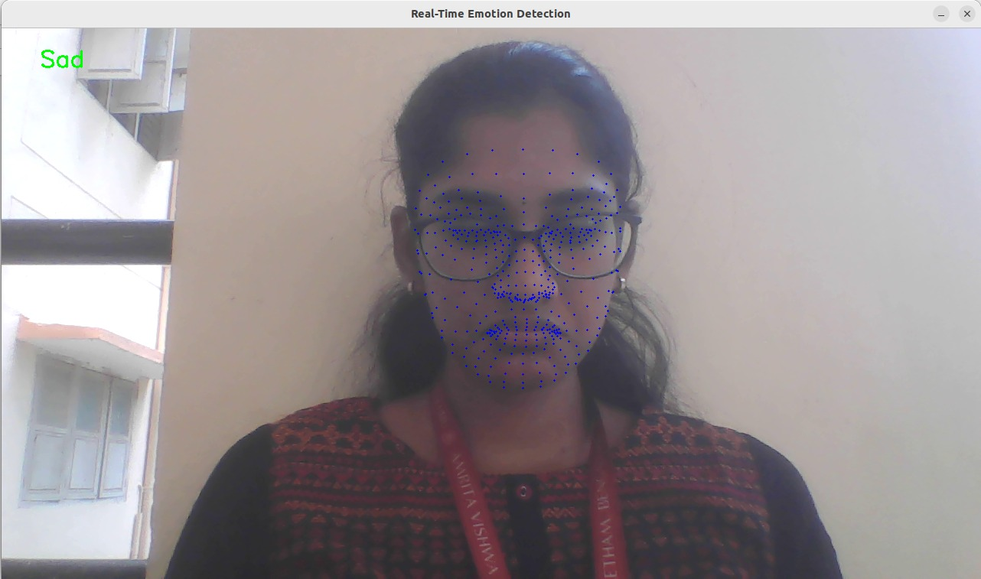
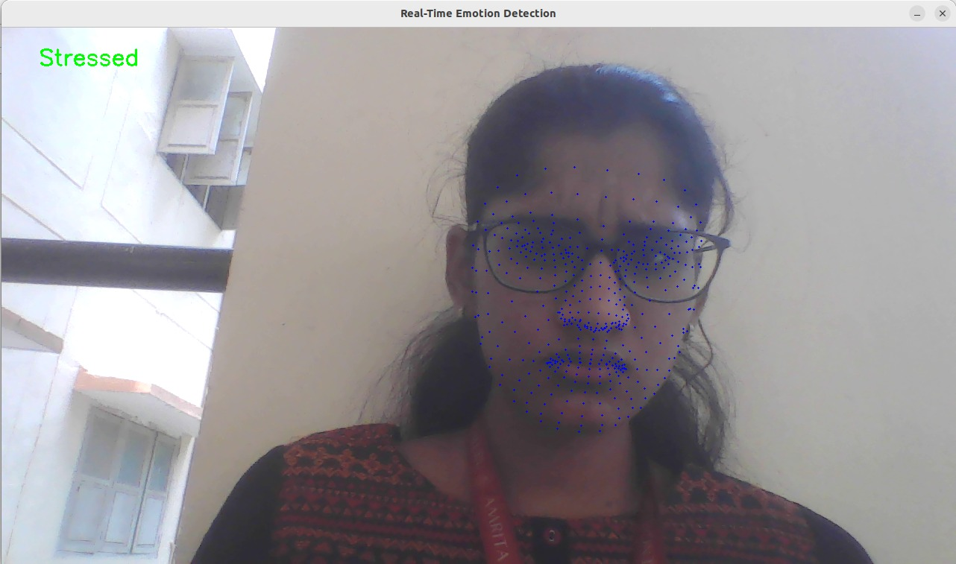
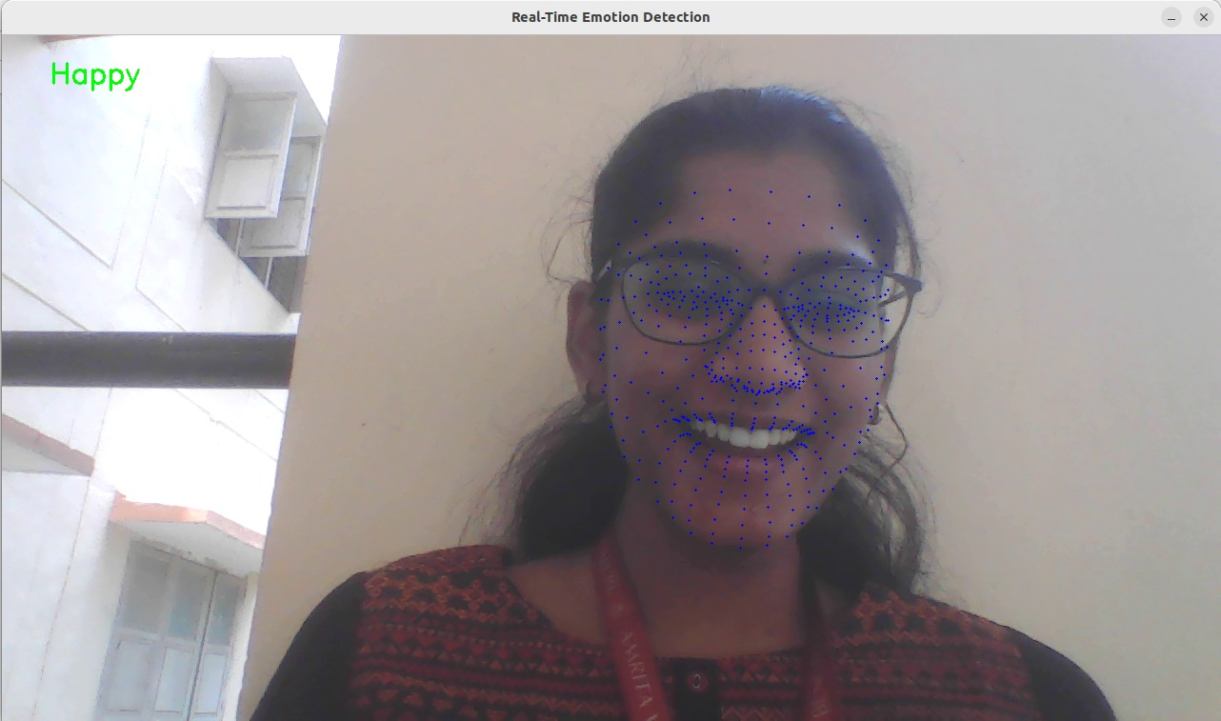
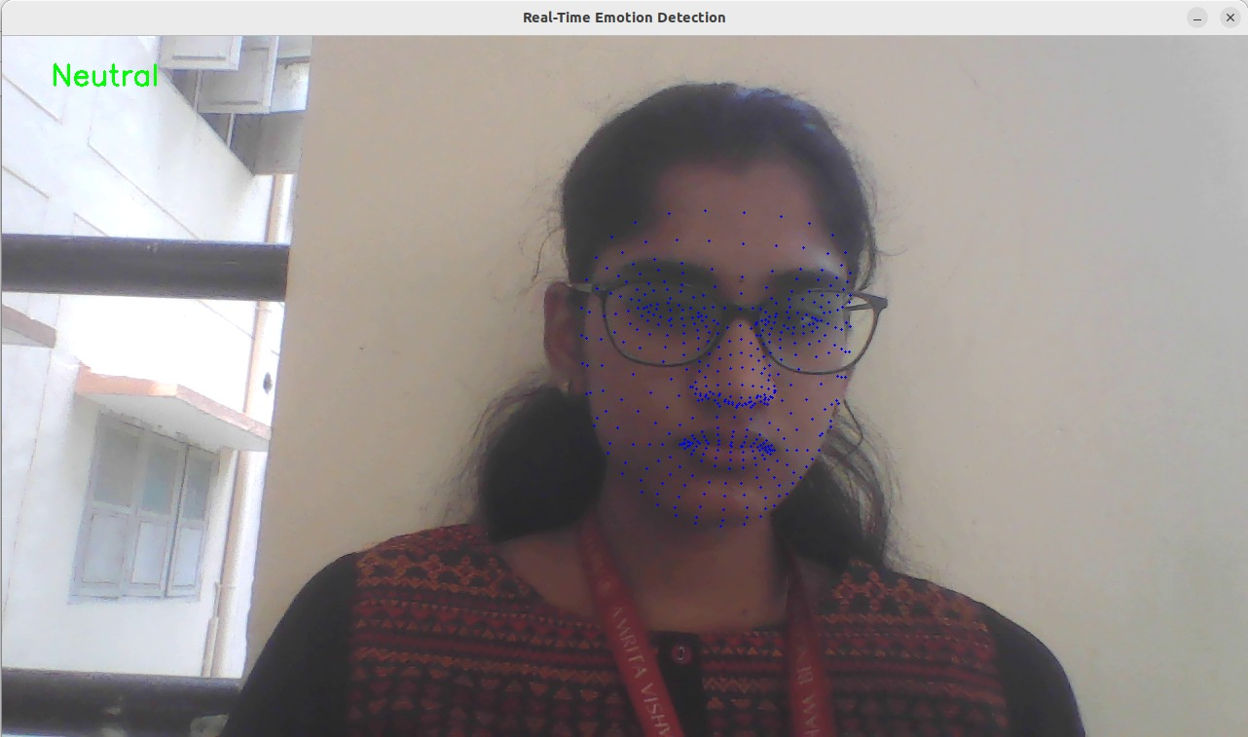
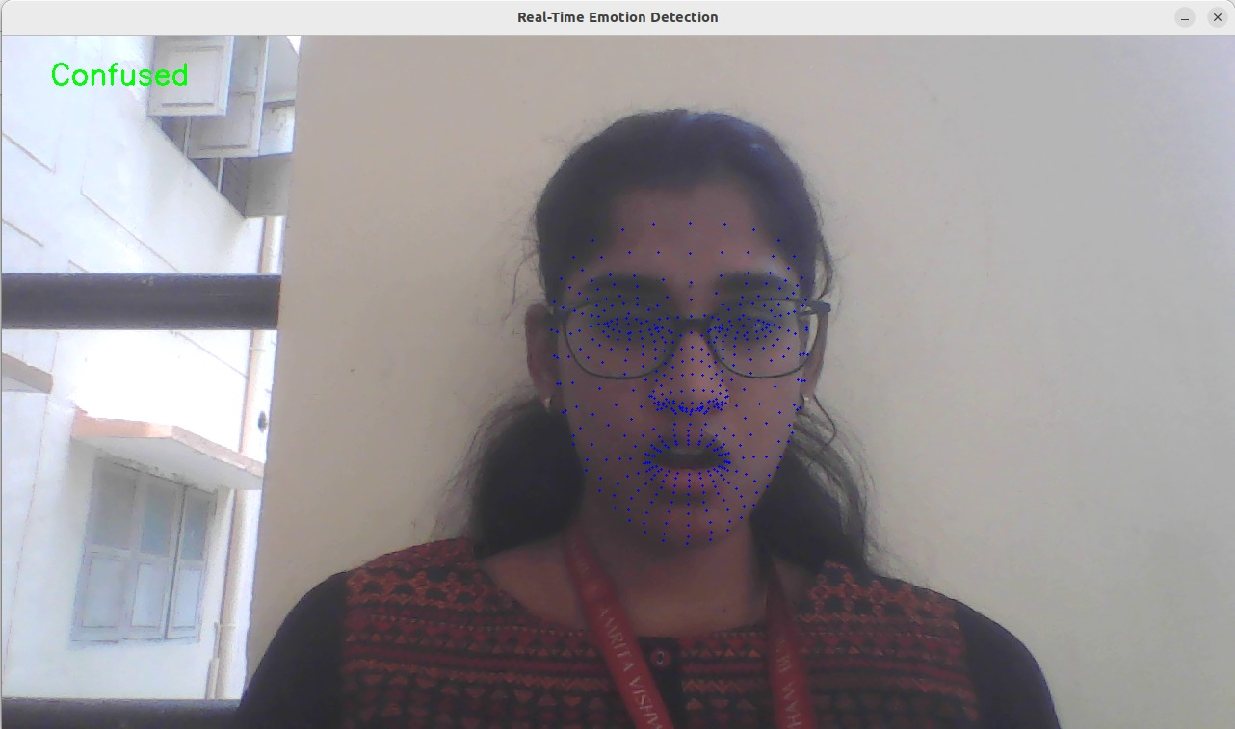
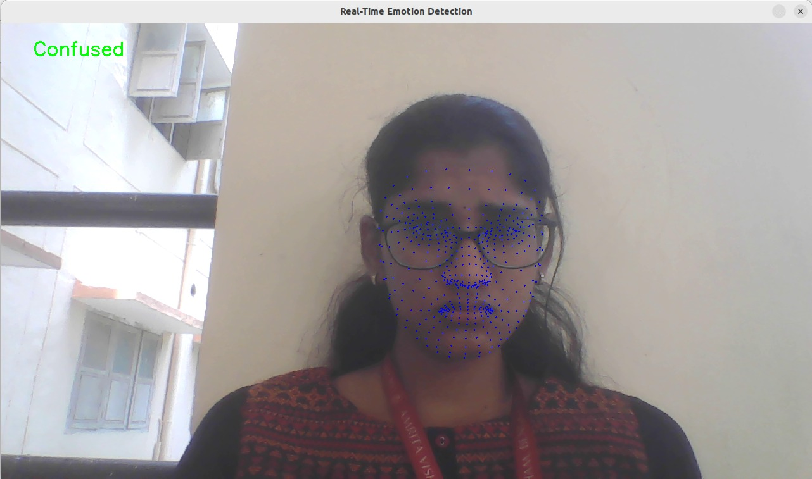
Results (Sprint 1)
TEAM-E12

Slide 11
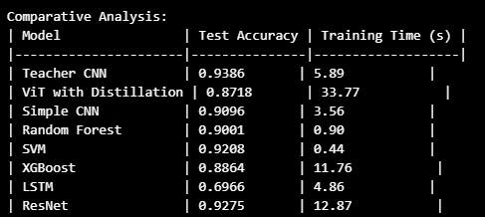
Results (Sprint 2)
TEAM-E12

Slide 12
THANK YOU

